Slide 1
Linux LVM
Ken Chen 2012/12/08

Slide 2
Terminology
Physical Volume (PV)
A physical disk can be divided into one or more physical volumes
Volume Group (VG)
An aggregate of PVs (PV can be from multiple physical disks)
Physical Extents (PE)
Each PV consists of a number of fixed-size physical extents
Logical Extents (LE)
Each LV consists of a number of fixed-size logical extents. The size of LE is always equals the size of PE, the default in LVM2 is 4 MB.
Partition
Something like physical disk

Slide 3
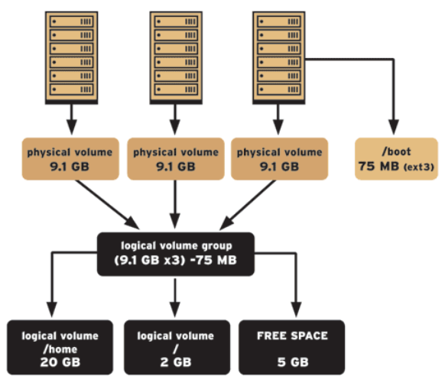
Volume Group
LVM internal organization

Slide 4
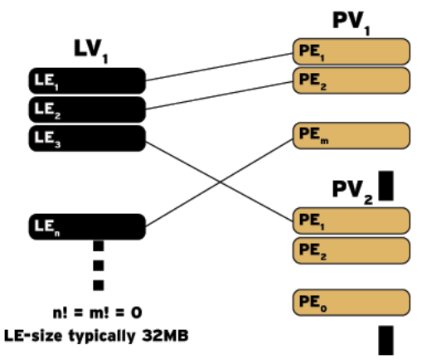
LE – PE mapping
Mapping logical extents to physical extents
The mapping can be constructed to achieve particular performance, scalability, or availability goals

Slide 5
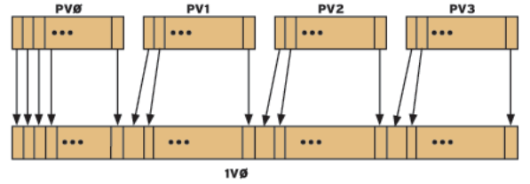
LV Linear mapping
Linear mapping
Multiple PVs are connected together to create a single large logical (For large capacity)

Slide 6
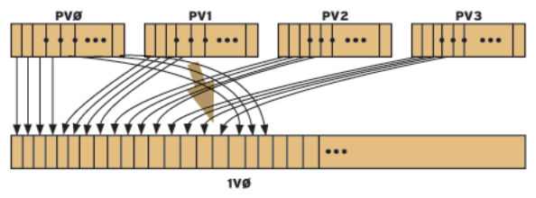
LV Striped mapping
Striped mapping
Stripes (groups of contiguous physical extents) from alternate PVs are mapped to a single LV which allows a single logical volume to nearly achieve the combined performance of two PVs (For high-bandwidth)

Slide 7
Basical Commands
pvcreate
Convert partitions/whole disk to Physical Volumes
Before converting, make sure that the partition has type 0x8E (LVM) by using fdisk command
Example: /usr/sbin/pvcreate /dev/hda
vgcreate
Aggregates multiple PVs to a Volume Group
Examples (128GB * 2 with 4MB PEs): vgcreate volume_group_one /dev/hda /dev/hdb
vgextend
Add additional PVs to the existing VG
Example: vgextend volume_group_one /dev/hdc

Slide 8
Basic Commands (Cont.)
vgreduce
Remove PV from VG. Note that any logical volumes using physical extents from PV /dev/hdc will be removed as well
Example: vgreduce volume_group_one /dev/hdc
lvcreate (linear mappings by default)
Create logical volume by using the free physical extents in the VG pool
Example: lvcreate -n logical_volume_one --size 255G volume_group_one or vgdisplay volume_group_one | grep "Total PE“ => Total PE 65536 lvcreate -n logical_volume_one -l 65536 volume_group_one
To create a 1500MB linear LV named logical_volume_one and its block device special file /dev/volume_group_one/logical_volume_one lvcreate -L1500 -n logical_volume_one volume_group_one

Slide 9
Basic Commands (Cont.)
lvcreate (linear mappings by default)
Create striped mapping with two stripes and stripe size of 4 KB lvcreate -i2 -I4 --size 255G -n logical_volume_one_striped volume_group_one
creates a striped LV named logical_volume_one that is striped across two PVs (/dev/had and /dev/hdb) with stripe size 4 KB and 128 GB in size lvcreate -i2 -I4 -L128G -n logical_volume_one_striped volume_group_one /dev/hda /dev/hdb
lvremove
Remove LV from VG umount /dev/volume_group_one/logical_volume_one lvremove /dev/volume_group_one/logical_volume_one
Note

Slide 10
Basic Commands (Cont.)
File directory tree
/dev/<volume_group_name>/<logical_volume_name>
lvextend
Extend LV
Example: lvextend -L120G /dev/myvg/homevol # extend to 120G lvextend -L+10G /dev/myvg/homevol # extend 10G
ext2online (ext2resize offline)
Extend the file system to explore the additional LV space
Example: ext2online /dev/myvg/homevol #extend the ext3 file system to completely fill the LV
Notes:
lvscan
lvdisplay

