Slide 1
How SSL Works
Ken Chen 2014/03/28

Slide 2
The files
.csr
Certificate Sign Request. Contains “vendor public key” + “vendor information (org, state, expiry date etc)”.
.pem
Privacy Enhanced Email. A container format that may include just the public certificate, or may include an entire certificate chain including public key, private key, and root certificates. For, eg, Apache /etc/ssl/certs
X.509 certificate defined using ASN.1, encoded by using ASN.1 DER
.key
PEM formatted file containing just the private key of a specific certificate. For eg, Apache /etc/ssl/private, the rights of this dir is important
Notes:
Send to Certificate Authority (CA) for signing. CA

Slide 3
The files (cont.)
.pkcs12, .pfx, .p12
Public Key Cryptography Standards by RSA, enhanced by Microsoft. It is passworded container format that contains both public and private certificate pairs. Unlike pem, it is fully encrypted.
.der
Distinguished Encoding Rules (Binary), a way to encode ASN.1 syntax
.cert, .cer
A .pem formatted file with a different extension
.crl
A certificate revocation list
Notes:
openssl can break .pkcs12 file into .key and .pem files
openssl can convert .der to .perm

Slide 4
Digital Signature
Asymmetric cryptography
Public/private key pair. Receiver publish the public key and owns the private key
Sender
Receiver
Public key
Private key
Clear content
Encrypted Content
Encrypted Content
Clear content
Risk: what if somebody change the the “clear content” in the first place ?

Slide 5
Digital Signature
Asymmetric cryptography
Message Digests makes sure the integrity of the message
Sender
Receiver
Public key
Private key
Clear content
Encrypted Content
Encrypted Content
Clear content
Hash func
Hash func
Digest
Digest
Digest2
Problem: how can “Digest” be safely transferred to receiver ?

Slide 6
Digital Signature
Asymmetric cryptography
Use sender’s private key to encrypt Digest to form a digital signature
Sender
Receiver
Public key
Private key
be
Clear content
Encrypted Content
Encrypted Content
Clear content
Hash func
Hash
Sender’s
Sender’s
Public key
Private key
Digest
Encrypted Digest
Encrypted Digest
Digest
Digest2
Problem: how Sender verifies if the public key is part of key-pair of the receiver and not an intruder’s. How Receiver verifies the message signature really is signed by the private key that belongs to Sender

Slide 7
Certificates
Certificate Information
Distinguished Name Information
Subject | Distinguished Name, Public Key
Issuer | Distinguished Name, Signature | CA
Period of Validity | Not Before Date, Not After Date
Administrative Information | Version, Serial Number
Extended Information | Basic Constraints, Netscape Flags etc
DN Field | Abbrev. | Description | Example
Common Name | CN | Name being certified | CN=Joe Average
Organization or Company | O | Name is associated with this organization | O=Snake Oil, Ltd.
Organizational Unit | OU | Name is associated with this organization unit, such as a department | OU=Research Institute
City/Locality | L | Name is located in this City | L=Snake City
State/Province | ST | Name is located in this State/Province | ST=Desert
Country | C | Name is located in this Country (ISO code) | C=XZ

Slide 8
Certificates
Certificate Authority
Browsers are preconfigured to trust well-known certificate authorities
Which means well-known CA certificates are installed in browsers
Self-signed certificate
The issuer of the certificate is the same as the subject
Notes:
openssl can break .pkcs12 file into .key and .pem files
openssl can convert .der to .perm

Slide 9
SSL
Secure Sockets Layer protocol
Digital signature for integrity
Encryption for privacy
Support a range of choices for specific algorithms used for cryptography, digests and signatures. Choices are negotiated between client and server when establishing a protocol session
TLS is based on SSL V3.0
Notes:
openssl can break .pkcs12 file into .key and .pem files
openssl can convert .der to .perm

Slide 10
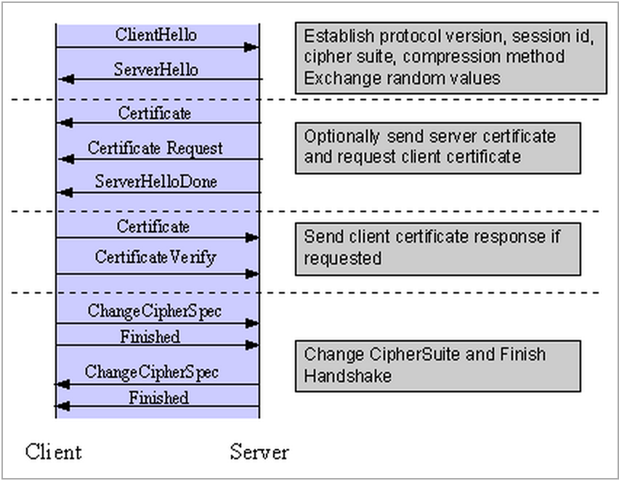
SSL
Establishing a session
Simplified SSL Handshake Sequence

Slide 11
SSL
Elements of handshake sequence
Negotiate the Cipher Suite to be used during data transfer
Key Exchange Method
Cipher for Data Transfer
Message Digest for creating the Message Authentication Code (MAC)
Establish and share a session key between client and server
Optionally authenticate the server to the client
Optionally authenticate the client to the server

Slide 12
SSL
Key Exchange Method
defines how the shared secret symmetric cryptography key used for application data transfer will be agreed upon by client and server
SSL 2.0, RSA key exchange only
SSL 3.0, RSA key exchange with certificate used, Diffie-Hellman key exchange without certificates
One variable in the choice of key exchange methods is digital signatures -- whether or not to use them, and if so, what kind of signatures to use

Slide 13
SSL
Cipher for Data Transfer
SSL uses conventional symmetric cryptography.
9 choices of how to encrypt
No encryption
Stream Ciphers
RC4 with 40-bit keys
RC4 with 128-bit keys
CBC Block Ciphers
RC2 with 40 bit key
DES with 40 bit key
DES with 56 bit key
Triple-DES with 168 bit key
Idea (128 bit key)
Fortezza (96 bit key)
Notes:
"CBC" refers to Cipher Block Chaining, which means that a portion of the previously encrypted cipher text is used in the encryption of the current block. "DES" refers to the Data Encryption Standard [AC96, ch12], which has a number of variants (including DES40 and 3DES_EDE). "Idea" is currently one of the best and cryptographically strongest algorithms available, and "RC2" is a proprietary algorithm from RSA DSI [AC96, ch13].

Slide 14
SSL
Digest Function
No digest (Null choice)
MD5, a 128-bit hash
Secure Hash Algorithm (SHA-1), a 160-bit hash
The message digest is used to create a Message Authentication Code (MAC) which is encrypted with the message to verify integrity and to protect against replay attacks.

Slide 15
SSL
Handshake Sequence Protocol
The SSL Handshake Protocol for performing the client and server SSL session establishment.
The SSL Change Cipher Spec Protocol for actually establishing agreement on the Cipher Suite for the session.
The SSL Alert Protocol for conveying SSL error messages between client and server.
These protocols + application protocol data are encapsulated in SSL Record Protocol
Notes:
The message digest is used to create a Message Authentication Code (MAC) which is encrypted with the message to verify integrity and to protect against replay attacks.

Slide 16
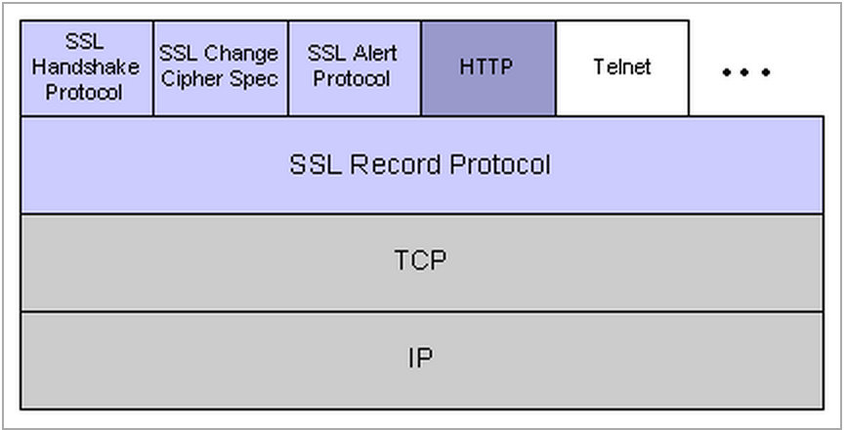
SSL
SSL Record Protocol

Slide 17
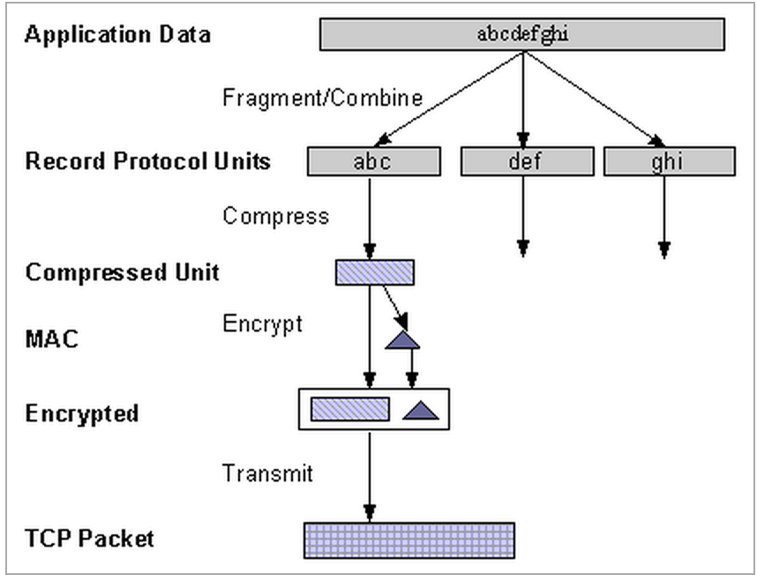
SSL
Data Transfer
Attach Message Digest

Slide 18
Self-signed certificate
Self-signed cert for Apache (openssl)
Generate a private key openssl genrsa -des3 -out private_key.pem 2048
Generate a CSR (Certificate Signing Request and the “Common Name” – host domain name is important) openssl req -new -key private_key.pem -out cert.csr
Remove passphrase from private key openssl rsa -in private_key.perm -out key.pem
Generating a self-signed certificate openssl x509 -req -days 365 -in cert.csr -signkey key.perm -out ss.crt
Install the private key and certificate cp ss.crt key.pem /usr/local/apache/conf/
Config SSL enabled virtual hosts and restart Apache SSLEngine/SSLCertificateFile/SSLCertificateKeyFile
Notes:
Create self sign certificate in one line
openssl req -x509 -newkey rsa:2048 -keyout key.pem -out cert.pem -days 365

