Slide 1
Intro to Data Warehousing and Business Intelligence (aka DW/BI)
CIS 355 ∙ Dr. Joseph Clark

Slide 2
Objectives
Introduce DW/BI
Introduce star schemas
Talk about DW/BI architectures
Discuss the Guthy-Renker case

Slide 3
Operational and Informational database Systems
Operational system – a system that is used to run a business in real time, based on current data; also called a system of record
Also called “transaction processing”
Informational system – a system designed to support decision making based on historical point-in-time and prediction data for complex queries or data-mining applications
Also called “analytical processing”

Slide 4
Why separate Operational and Informational Systems?
As mentioned last time, certain optimizations, such as the use of indexes, have a performance trade-off:
Indexes make SELECT queries much faster, but
Indexes make INSERT, UPDATE, DELETE queries much slower.
Relational databases are consistent. They enforce this consistency by locking the database while each transaction is processing.
Therefore if you are running a query that takes ten minutes to process, the entire business will be on hold waiting for access to the database.
Analysts and managers interested in “the big picture” have a wider scope of concerns than any particular front-line worker.
Therefore, it makes sense to create systems for data analysis that are broader in scope than transactional systems, physically separate so they don’t slow down the business, and optimized for SELECT queries.

Slide 5
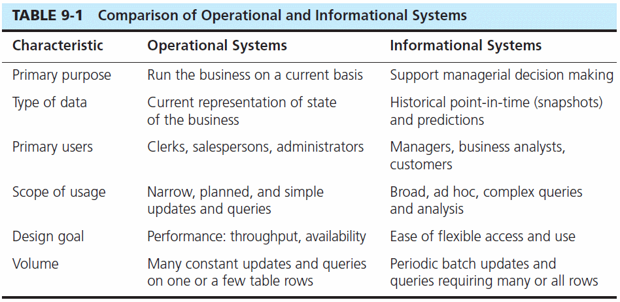

Slide 6
Different data usage needs
In Operational or Transactional Systems
Most queries are INSERT, UPDATE, or DELETE
Most queries do repetitive actions on one row at a time – taking orders, processing payments, shipping packages, etc.
Data is in the form of “states” and discrete “events”:
Example of state data: X has $100 in his account
Example of event data: X deposited $25 at time T
In Informational or Analytical Systems
Most queries start with SELECT and may involve many JOINs.
Most queries process many, many rows at once, but may focus on one column at a time (such as dollar sales or units sold).
Data is usually aggregated (summed) and needs to be “sliced and diced” by all kinds of dimensions.
Example: Sales of Product X in Store Y in month Z: …
Transforming the data is the art and science of data warehousing!

Slide 7
What’s Dw/bi?
A Data Warehouse may be defined as “a subject-oriented, integrated, time-variant, non-updatable collection of data used in support of management decision-making processes”
Subject-oriented: e.g. customers, patients, students, products
Integrated: consistent naming conventions, formats, encoding structures; from multiple data sources
Time-variant: can study trends and changes
Non-updatable: read-only, periodically refreshed
Business Intelligence may be defined as “a broad category of applications, technologies, and process for gathering, storing accessing and analyzing data to help business users make better decisions”
Kimball’s “restaurant” metaphor (pp.23-26) may be helpful here: data warehousing (including ETL) is “the kitchen” where data is prepared, while business intelligence is “the dining room” or presentation area where data products and services are provided to users.

Slide 8
Key points about dw/bi
DW/BI is not an IT initiative, it’s a business initiative and must be led by business.
What was the difference between Guthy-Renker’s first and second BI projects?
Kimball’s “publishing house” metaphor (pp.5-6) suggests:
First you need to understand the readers (BI users).
Then you produce high quality content (information, analytics) that suits their needs.
And you need to sustain and justify continuation of the intiative.

Slide 9
Dimensional modeling
Data models for DW/BI are “dimensional” models.
They are not “normalized to 3NF” like the transactional databases you would use in building an operational system like a website.
Instead, the data model is a “star schema” consisting of fact tables and dimension tables.
Dimensional models address two objectives:
Data is understandable to business users (so they can use it without depending on IT).
Queries are as fast as possible.
But, dimensional models can result in gigantic databases.

Slide 10
Star schema
Each “star” consists of one fact table and a number of dimension tables.
Fact Table
The “facts” are numbers, almost always quantitative, and typically they are numbers that can be summarized (added up or averaged) along any dimension. Sales in dollars, sales in units, number of complaints, miles driven, etc. are examples of typical facts.
In addition to one or more facts, a fact table has usually several foreign keys relating it to dimension tables.
Dimension Tables
The “dimensions” are descriptive context. They are the source of virtually all constraints and the labels on reports. You can think of them as “by” words: if the business might want to know sales by product line, by store, or by date, then product line, store, and date are all dimensions.
Each dimension table may have more than one attribute, each of which could be used to “slice and dice” the facts. This is not 3NF because that would result in too many tables. Simplicity and speed are gained by keeping them together.

Slide 11
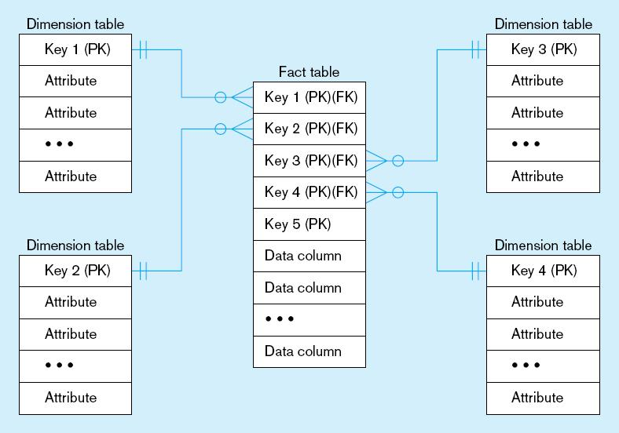
Figure 9-9 Components of a star schema
Fact tables contain factual or quantitative data
1:N relationship between dimension tables and fact tables
Dimension tables are denormalized to maximize performance
Dimension tables contain descriptions about the subjects of the business
Excellent for ad-hoc queries, but bad for online transaction processing

Slide 12
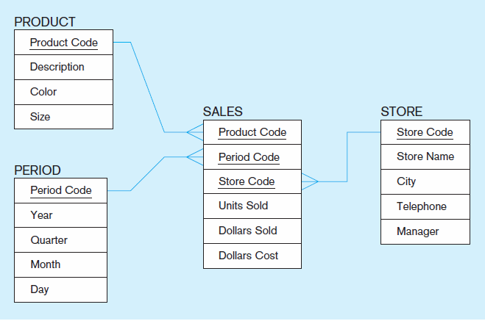
Figure 9-10 Star schema example
Fact table provides statistics for sales broken down by product, period and store dimensions
Benefits:
SIMPLICITY:
Understandable to business users.
PERFORMANCE:
Joins are very simple and predictable; it’s easy for DBMS to process queries.

Slide 13
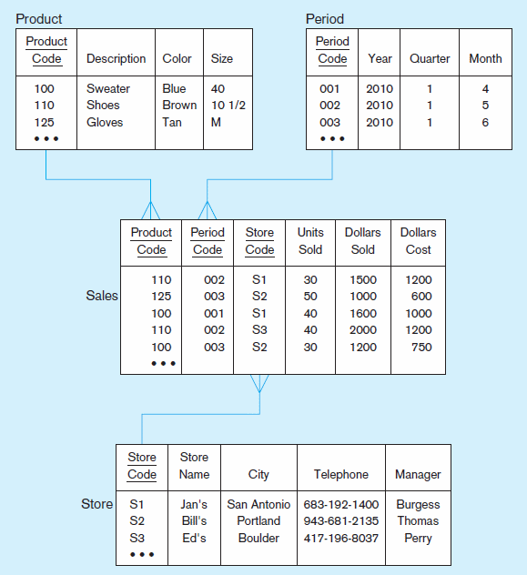
Figure 9-11 Star schema with sample data

Slide 14
DW/BI architectures
Kimball’s architecture calls for independent fact tables with conformed dimensions.
This means that the “date” dimension or “employee” dimension built for one star schema is compatible with the same dimension in another star schema.
This enables Agile development: you can build star schemas one at a time and re-use dimensions in future schemas.
The Corporate Information Factory (Bill Inmon, Claudia Imhoff, and others) architecture calls for the creation of a normalized Enterprise Data Warehouse (EDW) from which star schemas are derived.
This may have advantages for data governance and data quality, at the expense of agility.

Slide 15
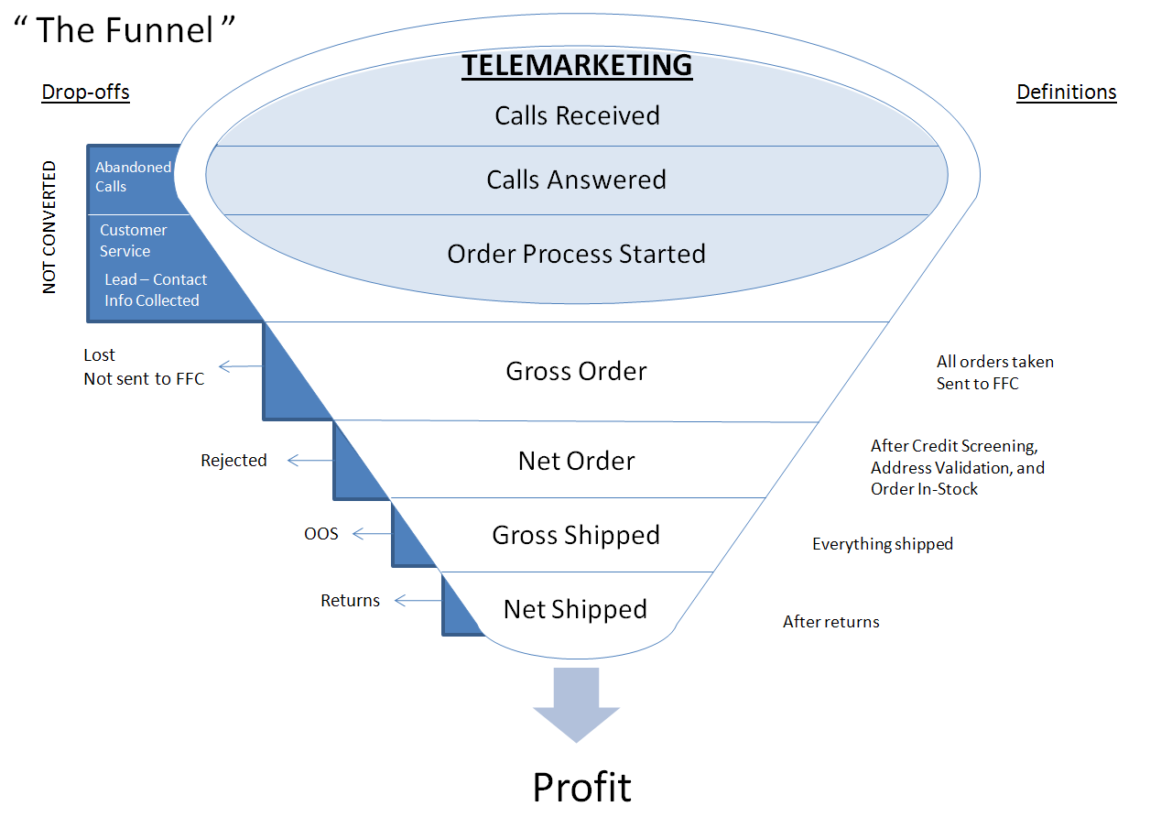
Guthy-Renker Case
You have to know the business model!
The “funnel” metaphor is a source of important measures to the business.
Note that we are taking a “business process” view which cuts across what are probably lots of independent transactional systems.

Slide 16
Key performance indicators
“Pain Points” are a good source of action items and information about priorities

Slide 17
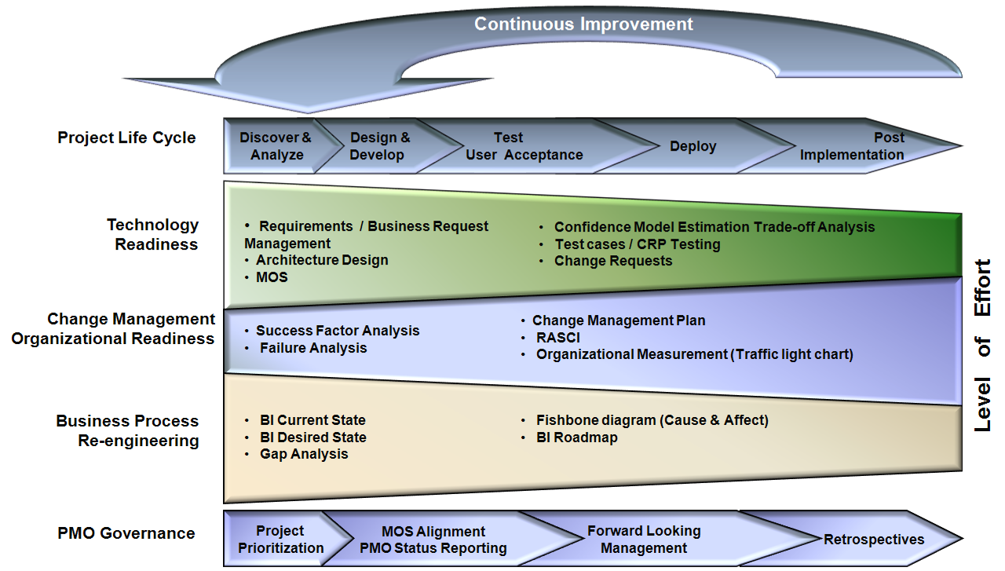
DW/BI governance
DW/BI projects benefit from governance and organizational change management.
Part of the benefit is shared responsibility – taking the heat off the IT department and getting the users to share the credit/blame.

Slide 18
Evolution of dw/bi capability via 3 kpis
Cost Per Order
Simple division
Adding dimensions allows you to slice and dice more deeply
Customer Lifetime Value
Now you need to be able to link all events back to the customer
Return on Promotional Investment
Now all customers (and CLV) need to be traced back to the advertisement that brought them in

Slide 19
discussion
What else struck you as interesting about this case?

