Slide 1
Data Warehouse Appliance
By: Alex Neumann

Slide 2
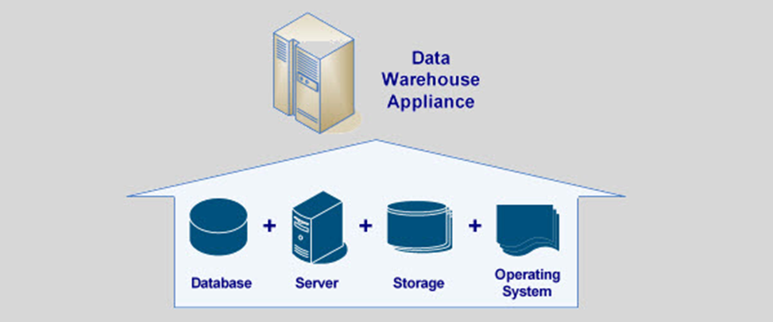
What are Data Warehouse Appliances?
Packaged, integrated platforms of hardware and software, designed to perform specified functions/workloads
They include:
Hardware
Software
DBMS (Database management system)
Storage
Server

Slide 3
Types of Data Warehouse Appliance
Complete Data Warehouse Appliance
Includes: hardware, software, database, operating system, server and storage
Examples: Oracle Exadata, SAP HANA, IBM DB2
Partial Data Warehouse Appliance
Known as “software appliances”
Specialize in Database management systems which easily integrate with other hardware
Examples: Kognitio, Aster Data (now part of Teradata)
General Data Appliance
Focus on providing software which compliments existing data warehouse environment in an organization

Slide 4
Characteristics of DWA
Foster Hinshaw, founder of Netezza (now part of IBM)
Workload optimized – optimized to deliver excellent performance for large reads, long table scans and complex queries
Extreme Scalability – designed to scale and perform well on large data sets
Highly Reliable – not susceptible to a single point of failure, hardware and software is optimized to function together
Simplicity of Operation – simple to install, setup, configure and tune

Slide 5

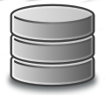

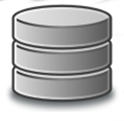
Where do they fit in the Data Pipeline?
“Black Box”
Visualization
Source System
ETL
BI applications
Source System
Data Warehouse Appliance
Business Reporting

Slide 6
Hadoop and Hadoop Distributions
Some appliance vendors use Hadoop as part of their platform, but it is not required
Data Warehouse Appliances usually operate as a “Black Box”
Provides very limited access, to the internal workings of the appliance once it has been correctly tuned, configured and deployed by the vendor
Why a “Black Box”?
Not all software is open-source
Big Data appliance vendors such as IBM, Oracle and SAP use proprietary technology
Allows for easy setup, maintenance and simple operation

Slide 7
Common Appliance Technologies
Apache Spark
MapReduce
Hive
Massively Parallel processing (MPP)

Slide 8
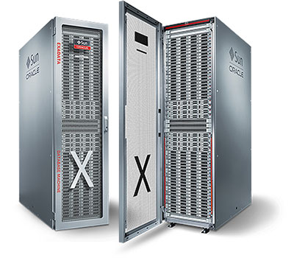

What do they look like?
Oracle Exadata

Slide 9
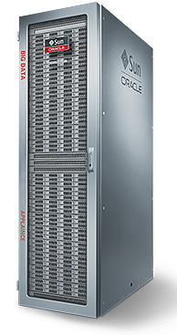
Oracle Big Data Appliance
18 Oracle’s Sun x86 servers
288 CPU cores, 864 TB disk storage
InfiniBand
Integrates:
Hadoop
Oracle NoSQL database
Oracle loader for Hadoop
Cloudera Impala
Oracle Linux
Oracle Java
Oracle R distribution

Slide 10
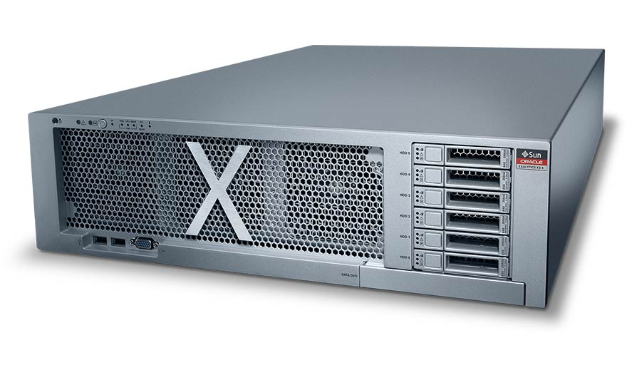
Oracle Exalytics
“best-in-class hardware, market leading business intelligence software and in-memory database technology”-Oracle
Specifications
4 TB of RAM
6.4 TB of PCIe Flash memory
9.6 TB of disk capacity
128 CPU cores

Slide 11
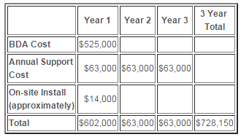
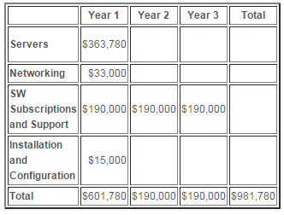
Appliance vs Do-it-yourself
Oracle Big Data Appliance
Do-It-Yourself
HP + Cloudera
$728,150
$981,780
*SW = Software subscription for
Cloudera Enterprise

Slide 12
Which option is better? Depends.
Money - Buying any data appliance has a big upfront investment
Small to medium sized companies cannot always afford upfront costs
Time – appliances will be up-and-running very quickly compared to DIY projects
Support / Maintenance –
Appliance – you have one dedicated vendor offering you support
DIY – hardware vendor, OS vendor, Hadoop vendor, encryption/security vendor, database vendor

Slide 13
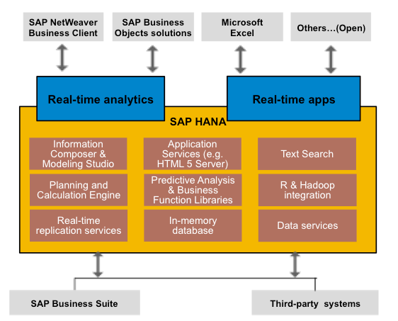
SAP HANA (High-Performance Analytic Appliance)
ERP, CRM, SRM & SCM

Slide 14
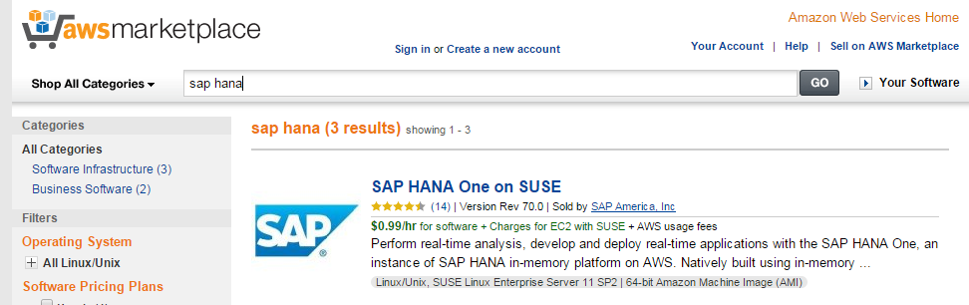
On-Premise or Cloud
Many appliances are available for on-premise deployment, in the cloud or a hybrid solution

Slide 15
Columnar Database
NOT the same as the NoSQL Column-store technology we saw in Martin Fowler’s NoSQL video, but similar
Still relational (but not row-oriented) and has a schema
Becoming more popular for conducting analytics on Big Data
Mainly used for OLAP (Online Analytical Processing) - requires only some of the columns, not the entire record
Typically not used for OLTP – reads/writes require entire row of data, not just a few columns

Slide 16
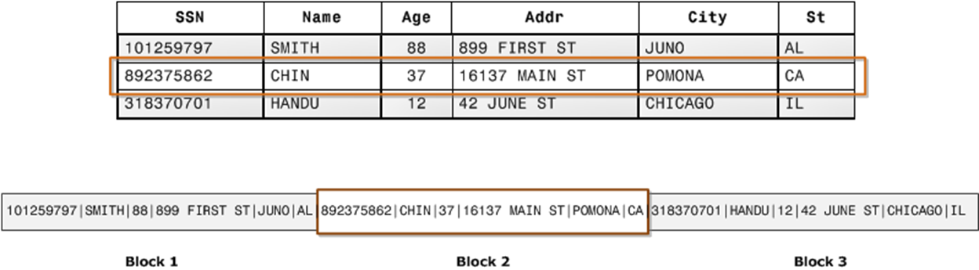
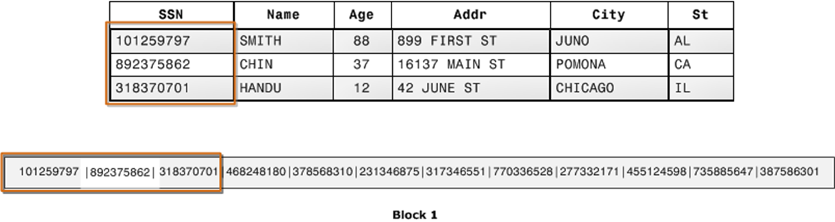
Column vs Row-Oriented
SSN
SSN
SSN
SSN
SSN
SSN

Slide 17
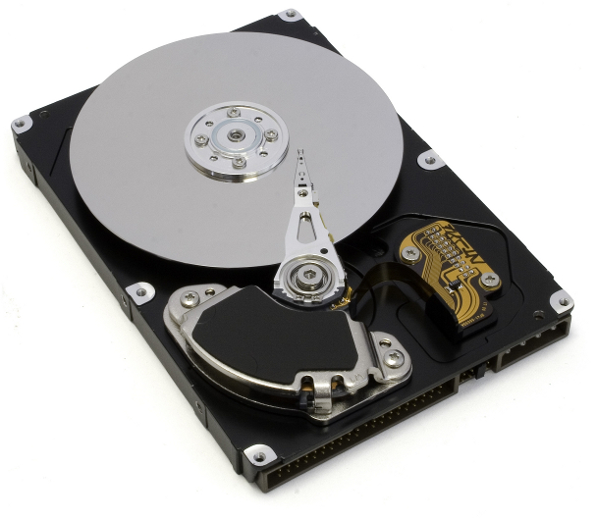
Why are Reads much faster?

Slide 18
Benefits of Columnar Databases
Faster query performance when aggregating many rows for only a few columns
Data Compression - each column block has uniform data which allows for size compression
Increases the speed in which data is read into memory
Allows for real-time analytic capabilities

Slide 19
Oracle Exadata Video
https://www.youtube.com/watch?v=ZHlFDgci9Fc

Slide 20
Any Questions?

