Slide 1
Apache Spark
Chris Frame and Schuyler Mortimer

Slide 2
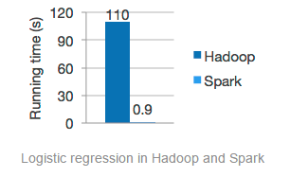
Apache Spark
Short explanation: a faster MapReduce with more capabilities
“It has been used to sort 100 TB of data 3X faster than Hadoop MapReduce on 1/10th of the machines”

Slide 3
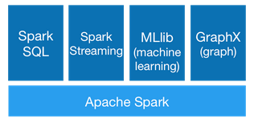
Extra Capabilities
Write applications in: Scala, Java, or Python
Can read from any Hadoop data source
Reads from sources other than Hadoop
Real time data manipulation

Slide 4
Why is Spark faster?
Memory
Able to run in memory
Greatly reduces the required amounts of writes and reads to disk
Uses different architecture to distribute work
Allocates hardware resources better than MapReduce

Slide 5
Demo / Tutorials
Tweets Demo: https://www.youtube.com/watch?v=FjhRkfAuU7I#t=35m20s
Apache Tutorials: https://spark.apache.org/documentation.html

Slide 6

Questions?

