Slide 1
The Great Debate: R vs. Python
Presented by Manoj Panikkar TEAM VELOCITY
“Speeding ahead of the rest”

Slide 2
Pros and CONS of R
Created for statistical analysis
Extend functions with add-on packages
Integrates with other languages (C++, Java, etc.) and tools (SPSS, Matlab, Stata, etc.)
Programmable!
Different learning curve – not like other programming languages!
Everything is under a command line (minimal GUI)
Documentation hard-to-understand
Can’t create .exe files

Slide 3
Pros and Cons of Python
Easy syntax, easy-to-learn
Plenty of documentation
Extend functions by importing Python modules
Used for other purposes – efficiency of one programming language across different applications
No focus on data (jack of all trades, master of none)
Less sophisticated graphing capabilities
Community support not data-driven nor statistically focused

Slide 4
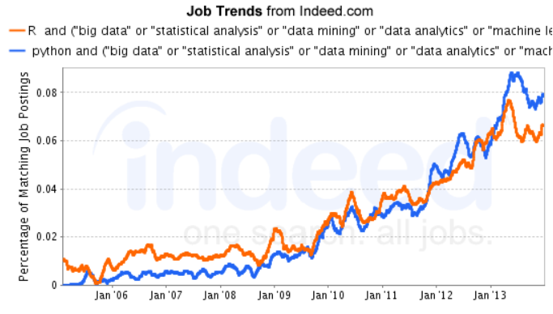
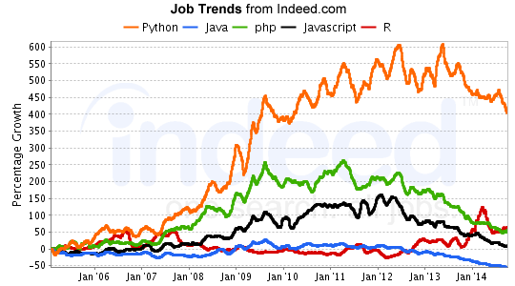
Industry Trends
Data Analytics
Overall

Slide 5


Verdict
Both Python and R have their own strengths and weaknesses
Use the tool you know best
Use the tool that can get your work done
R usually used for more complex statistical analysis
Python usually used for data manipulation and simple statistics
“The more tools you have at your disposal, the more effectively you can do the job at hand” –Kaggle user

Slide 6
The “Rpy2” Package – Best of both Worlds?
Allows you to issue R commands from Python
Focuses on providing a simple interface to R from Python
“from rpy2.robjects import r” after installing the package

Slide 7
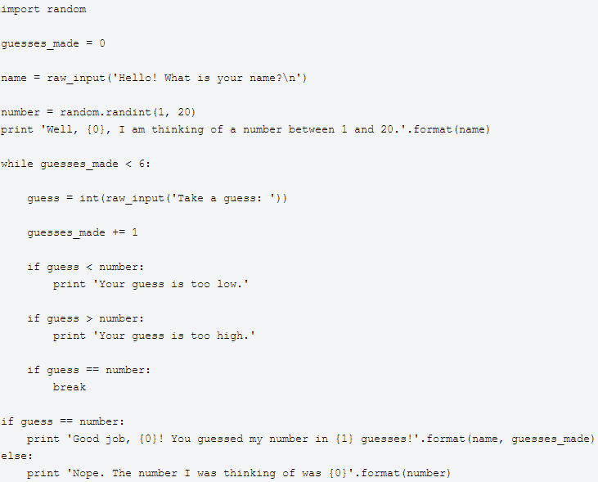
Sample CODE - Python

Slide 8
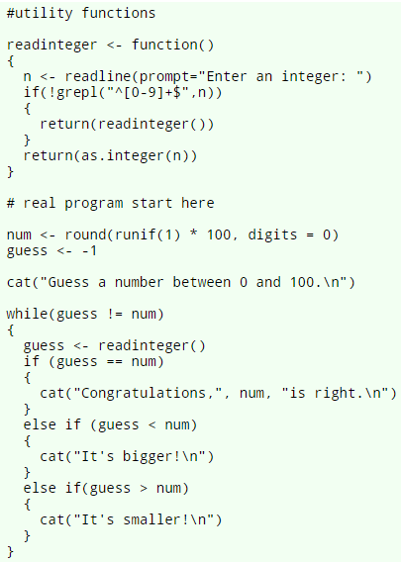
SAMPLE CODE - R

Slide 9
In-Class DEMO
Tutorial From: http://www.theswarmlab.com/r-vs-python-round-1/

Slide 10

QUESTIONS?

