Slide 1
Retail Sales Case Study (part 1)
CIS 355 ∙ Dr. Joseph Clark ReF: Kimball Ch. 3

Slide 2
Plan for two weeks
We’ll develop a complete DW/BI application for the “Retail Sales” case.
9/29: requirements, facts, dimensions
10/1: creating data tables
10/6: data transformation / ETL
10/8: business intelligence app

Slide 3
Dimensional design process
Select the Business Process
Declare the Grain
Identify the Dimensions
Identify the Facts
At each stage, consider the data available in the source systems, but also focus on the business requirements. Prioritizing projects requires understanding the business value as well as the feasibility.

Slide 4
Select the business process
A business process is “a low-level activity performed by an organization, such as taking orders, invoicing, receiving payments, handling service calls, registering students, performing a medical procedure, or processing claims.”
Often expressed as an action verb.
Processes generate or capture key performance metrics.
Usually have an “input” and an “output”.
Business owners may not be able to specify which business process they’re interested in:
They may think in terms of organizational departments: finance, accounting, marketing, etc.
Or they may point to “strategic initiatives” at a too-high level
A business process is a “project-sized unit of work” for a data warehousing team.

Slide 5
Declare the grain
The grain of a fact table is the level of detail of its data.
Kimball encourages use of “atomic” grain – the finest possible granularity. This enables lots of dimensionality and lots of “slicing” of the data for analysis.
Aggregate data can be derived from atomic data but not the other way around.
Nowadays, the cost of storage isn’t a huge limiting factor.
Grain will be different for the three types of fact tables: transaction, periodic snapshot, and accumulating snapshot
More on that later…

Slide 6
Identify the dimensions
Dimensions are the “who, what, when, where” of the data. How do business users describe the data? How do they want to slice and aggregate it?
Look for “by” words – if users want to see “sales by product category” then product category is a meaningful dimension.
Dimensions must be compatible with the grain – atomic data has the greatest dimensionality.

Slide 7
Identify the facts
Facts are performance measures from the business process. What can we measure about the process? What are its performance metrics?
Facts must be compatible with the grain:
Avoid facts incompatible with the grain, like “year-to-date” (YTD) measures. Those cause mistakes when aggregated.
Typical facts are numeric and additive, meaning they can be summed, averaged, and compared at any level of aggregation.
Derived facts (e.g. sales quantity x unit price = sales dollar amount) can be stored in a fact table rather than calculated on the fly for every query.

Slide 8
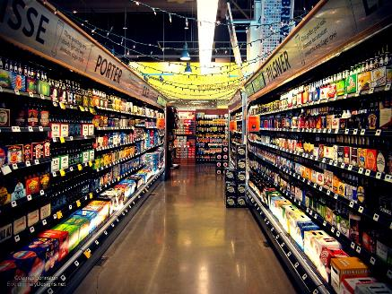
RETAIL sales case study
Large grocery chain: 100 stores, five states
Multiple departments: grocery, frozen, dairy, meat, bakery, etc
60,000 individual products, aka stock keeping units (SKUs)
Sales data collected at point-of-sale (POS) systems – cash registers
Other data: deliveries, inventory, human resources
Price changes (permanent) and promotions (temporary) are used to try to boost profits

Slide 9
The business process: customer purchases at POS system
What business process is most important to business users?
Sales and profits.
What business process is the most feasible?
Sales.
We’ll focus on customer purchases at the POS system as our business process.

Slide 10
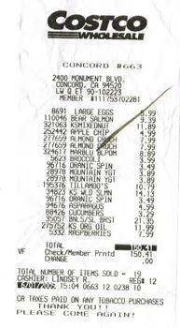
The grain
We could go with an aggregate grain, for example:
one row per product per store per day
However, this violates Kimball’s guideline: “You should develop dimensional models representing the most detailed, atomic information captured by a business process.” We would be throwing away data.
At an “atomic” level, the choice is between the following:
one row per transaction (or “checkout”)
one row per product sold as part of a transaction
The latter would enable us to summarize data by product, and we could derive the transaction-level data from it, so that’s the more “atomic” choice.

Slide 11
The dimensions
Date (part of almost every dimensional model)
Product
Store
Promotion
Cashier
Method of Payment
Transaction Number

Slide 12
The facts
What is (or could be) measured about the sales process?
Quantity sold
Unit price (not additive)
Regular price
Discount
Net price
Sales dollar amount
Discount dollar amount
Net sales dollar amount
Cost + Profit?
If possible. Costs are tricky and may be political (e.g. activity-based-costing). But you could at least get the wholesaler’s unit price.

Slide 13
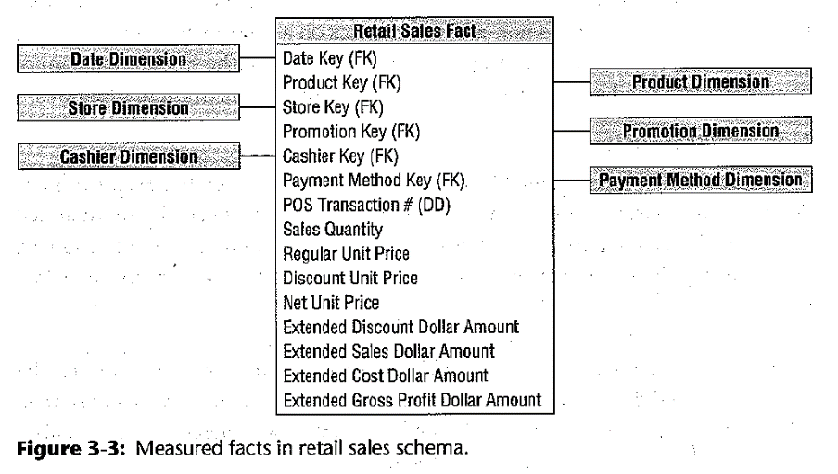
The fact table & Star Schema

Slide 14
Estimate size of fact table
This is a transaction fact table, meaning there’s one row for each “event” (in this case, a line item on a purchase).
Transaction fact tables are “sparsely populated”, that is, there isn’t going to be a row for items which were not included in the purchase.
Rough estimate: if the average line item is $2.00 and the company made $4 billion in revenue last year, there will be approximately 2 billion new rows in the fact table per year.

Slide 15
Closer look at dimensions: date
Fact tables are related to dimension tables by a foreign key / primary key.
The PK of a dimension table should be a surrogate key, that is, an auto-incrementing integer key which has no business meaning. Use of natural keys (which have business meaning) can lead to problems if they change later.
For each row in a dimension table, you can have more than one attribute. In fact you’ll likely have a lot of attributes; each one gives the users a different way to slice and aggregate data.
Size of a date dimension can be calculated easily. One year averages out to about 365¼ days. If you have one row per day, that gives you the number of rows.
For this reason, “time of day” is generally a separate dimension. If it has one row per minute, it would have 1440 rows. But if you did a combined date-time dimension it would have 1440 times 365¼ rows per year – an enormous number of rows.

Slide 16
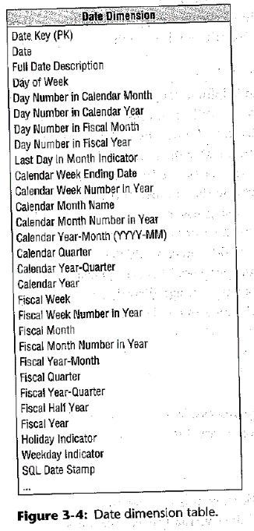
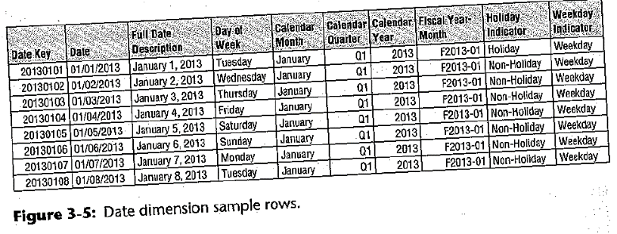
Date dimension
There’s little penalty for having lots of attributes, so add as many as make sense.
Be sure to include “spelled out” attributes instead of “codes”. Remember the design goals are that the data should be understandable by business users and easy to use. We are not worried about trivial “optimizations” for programmers.

Slide 17
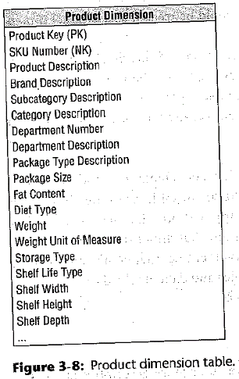
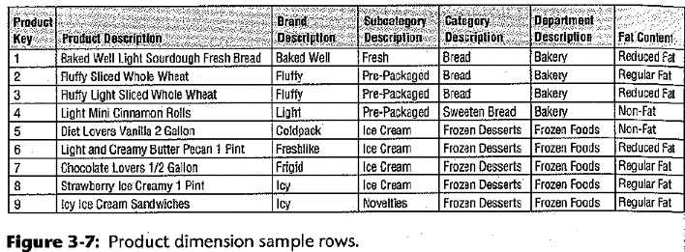
Product Dimension
Notice that the Product dimension includes multiple “hierarchies” (brand, category) and multiple levels of hierarchy (e.g. subcategory, category, department).
This is not a 3NF database. By “flattening” the hierarchies, we make it easier for business users to understand the data, and improve query performance over the alternative which would have many tables.

Slide 18
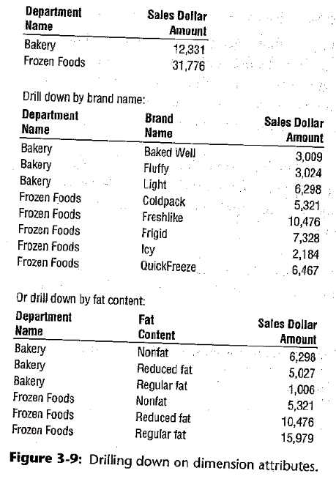
Drill-down
Having multiple attributes in each dimension table enables drill-down. Notice that in a typical query we are probably not looking at the most detailed part of the dimension (e.g. product name.)
You can see why additive facts come in handy. Sales dollar amount (in fig. 3-9) is easily summarized (top) or broken down by any dimensionality the user wants.
You can’t do this with, e.g., unit price or gross margin.

Slide 19
Other dimensions
What would you put in the Store, Promotion, or Cashier dimension?
Consider the transaction number (the receipt number). We want to know this number so we can derive, if needed, a picture of the total sale per “checkout” or receipt. However, there are no unique attributes of the transaction not already covered by date, store, and cashier.
This becomes a degenerate dimension – it’s just a number instead of being a foreign key. We can treat it as a dimension for summarizing data, but it doesn’t point to any other table.

Slide 20
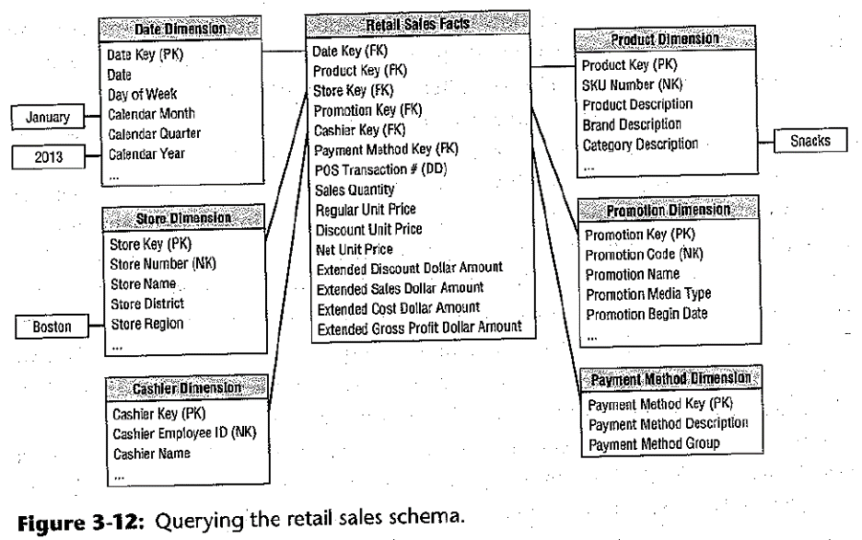
retail sales schema
Also shown: a typical query defined as constraints on dimensions.

Slide 21
Dimensional modeling errors to avoid
Using natural keys for dimension tables instead of meaningless surrogate keys.
These can change, or be different in different source systems.
Creating “snowflake schemas” with normalized dimension tables.
Creating “centipede fact tables” with too many dimensions.

Slide 22
Next time
Next time: bring your laptops. We’ll implement this schema as tables in Postgres.

