Slide 1
Introduction to cis355
CIS 355 ∙ Dr. Joseph Clark

Slide 2
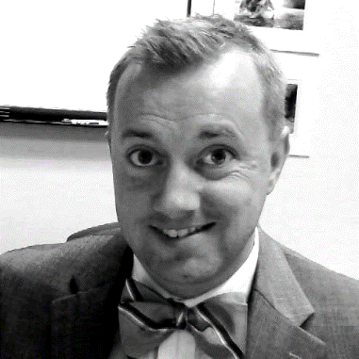
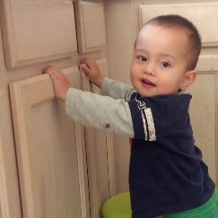
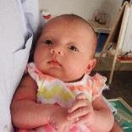
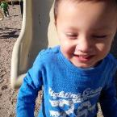
About dr. clark
Web developer in the 56kbps modem era. Best gig ever was for an infomercial company. Also, briefly worked for Mickey Mouse.
Went to business school, then ended up as a business lecturer.
Doctorate in Information Systems from USC in 2012.
Followed by a post-doc at the University of Nebraska at Omaha.
Came to ASU in August 2013. My main teaching is CIS 440, the undergrad IS capstone.
TOPICS TO TALK ABOUT
Doing data science in teams.
DevOps for Big Data?
Agility and Entrepreneurship.
Data Visualization.
NoSQL databases.
PLACES YOU’LL FIND ME
Startup Weekend
Phoenix Scrum Users Group
Pacific Telecoms Council
Chik-fil-A
Buying diapers & beer
ABOUT MY FAMILY
Long line of Maine-iacs
Married 5 years in June
Kermit, 3½ years old
Declan, almost 2
Virginia, 3 months

Slide 3
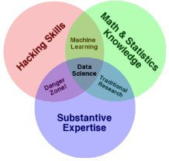

Dr. Clark’s Research Backlog
Project BANDIT
Extends a canonical simulation model of sequential decision-making under uncertainty to show the impacts of fast and accurate feedback loops.
Big idea: demonstrate importance of excellent information systems by showing how business is impacted when they aren’t there.
Looking for a new project to go here….
Project TORCH
Challenge: There’s a lot of hype around the “data scientist” job description, but what it denotes is super-human.
Big idea: Managers in the real world cannot rely on hiring superstars; instead, we need to know how to build data science teams.
How are these teams composed? How many people? What roles?
Bigger idea: Is there a data science DevOps? What new disciplines are needed by those who support and enable data science teams?
Project MAVERICK (with Dr. Read)
Big Idea: adapting the Agile approach to the CIS capstone course to enhance learning and improve project success.
Pedagogical questions:
Do agile practices support the teaching objectives of an IS capstone course? Does Agile enable students to draw on learning from their other courses, and succeed in their projects?
Broader research questions:
What sorts of learning or development occurs in the first few sprints for a new Agile team and for a (new/experienced) Agile project client?
Does our students’ experience give us a window into hidden processes that occur when teams and clients are new to Agile?

Slide 4
More on project torch
This project provides a framework which will help me position CIS 355 in the overall picture of big data, analytics, and data science. Bear with me…

Slide 5
Introducing cis 355
This is the first time we have offered a course on data warehousing and dimensional modeling. This is about the development of analytics applications (such as business intelligence systems) for managers to use. Two sides of this are (a) designing systems for business people to use, and (b) applying your expertise to do the “under the hood” stuff that business users can’t, and automating it for them.
The three main chunks of the course are (1) a primer/refresher on relational databases, (2) dimensional modeling concepts and the design of BI applications, and (3) data wrangling and data engineering with ETL et cetera. Specific topics in all three portions are likely to change.
At the end of this course:
You will be able to query operational databases with SQL.
You will be able to design databases for analytical systems, and know how/why they are different from operational systems.
You will understand the architecture of a complete DW/BI solution.
You will be able to use tools for extracting, transforming, and loading data into a DW/BI solution.

Slide 6
Github and the syllabus
All course materials will be handled on GitHub. We will have a workshop on using GitHub this Wednesday. Follow the links on the course schedule (or the “week01” instructions on GitHub) to get prepared.
https://github.com/asu-cis-355/course-info
Don’t let me leave until your questions are answered!

