Slide 1
Intro to databases
CIS 355 ∙ Dr. Joseph Clark

Slide 2
objectives
Why databases? What problems do they solve?

Slide 3
Data, information, and knowledge
What it’s called | What it is | What it’s for
Data | Stored representations of meaningful objects or facts. Names, places, dates, transactions, quantities, prices, etc. | Answers to questions, filling in gaps to produce information.
Information | Data which has been processed to have meaning and relevancy to people. | Provides the context within which knowledge can be applied.
Knowledge | Know-how or understanding of cause and effect. | Enables people to make right decisions in context.
Example: A doctor knows how to treat different kinds of injuries and diseases (knowledge or know-how); but to use this knowledge, he needs to know what problems a patient is suffering from (information); to get that information, he needs the patient’s history, X-rays, and other kinds of test results (data).

Slide 4
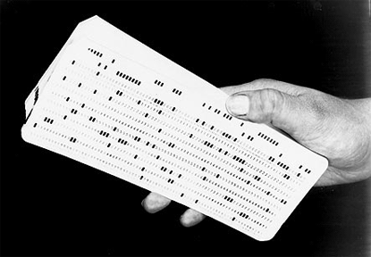

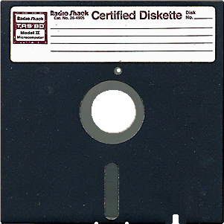




How data is stored
The earliest digital forms of data storage included paper cards where data was manually “punched” in.
We eventually got various kinds of magnetic storage: tapes, floppy disks, and hard disk drives. Computers could read and write data electronically.
Now we have many sophisticated options including optical disks, solid state drives, cloud storage and more.
The typical storage paradigm on all these media is a file, essentially a bounded stream of digits (ones and zeroes) on the storage device.
You know some file types: DOC, PDF, XLS, PNG, and so on.
You can also write programs of your own that store data in formats you define.

Slide 5
The Problem with files: Program-data dependence
The biggest problem with a file processing approach to data storage is that the file is probably only understandable to the program that created it.
A file is produced by, and consumed by, that program.
The program contains logic about what to do with that file.
The file does not contain definitions of the data or the storage format.
So what if you want to build a second program that uses the same data?
Either you have to get the other company to share their secrets, or try to reverse-engineer the data, or you’re stuck.
What if the other company changes their file format in the next version?
You’ll have to update your own program to keep up.
What are the consequences of program-data dependence?
Slower development, repeated work, costly maintenance, and unpredictable outages.

Slide 6
Other Problems with File Storage
Duplication of Data
Often you simply had to re-enter the data for each system to store in its own file format. How much time is wasted? How do you prevent them from becoming inconsistent?
Limited Data Sharing
A file sits on one device (e.g., a hard drive), and sharing it is difficult. How do you prevent two people from making changes at the same time, and getting out of sync?
Lengthy Development Times
For every new application, of course, you have to invent a new file format and spend time establishing data definitions and logic. How much of this is repeated effort?
Excessive Program Maintenance
All the above factors mean much more time is spent maintaining programs and data formats every time new features are added or other programs are changed.

Slide 7
The Database Approach
Some clever people came up with the idea of establishing data storage that contains its own data definitions and logic, and is independent of any individual application, but can be accessed by multiple users and programs.
This is a database.
A database is an “organized collection of logically related data”.
Data is defined and carefully modeled to represent the business situation and its intended uses.
A database contains metadata (“data about data”) so it can describe itself.
E.g., “This is a table of customers. Each customer has a Name, this is a variable-length text field of 0-30 bytes, and a Customer Number, this is an integer of four bytes which must be unique, and…”
A database usually (but not necessarily) sits on a server so that multiple computers can access it through the network.
Databases use standard structures and languages (i.e. SQL) so that application developers can plug into them without knowing the details of their implementation.

Slide 8
Benefits of the Database Approach
Program-Data Independence
Because data model and data definitions are stored with the database, any new application can create or use its data without having to see the code of the other applications that create or use it.
Planned Data Redundancy
No effort or storage space need be wasted. Redundancy, if wanted, may be used strategically to optimize performance or back up the data.
Improved Data Consistency
Centralized servers (and often a central team of database administrators) reduce the likelihood of different systems getting out of sync.
Improved Data Sharing
Databases are built to be accessed by multiple users and applications.
Increased Productivity
No need to invent new data formats or program logic for every project.

Slide 9
Benefits of the Database Approach
Enforcement of Standards
Metadata is transparent, so it’s easier to conform data definitions and formats with other departments, or competitor systems, or global standards.
Improved Data Quality
Modern databases are designed to enforce data integrity in a number of ways that we’ll discuss especially in chapters 4 and 5.
Improved Data Accessibility and Responsiveness
Data can be retrieved by users with little to no programming knowledge, using the SQL query language or other tools.
Reduced Program Maintenance
All of the above benefits reduce the amount of maintenance that needs to be done on existing programs.
Improved Decision Support
As data becomes centralized and knowledge about its meaning becomes more explicit, opportunities are created for data analysis.

Slide 10
Costs Involved with the Database Approach
New, Specialized Personnel
A database isn’t worth much if it’s used like just another file. The database approach requires some discipline and often an expensive professional database administrator (DBA) … or more than one.
Installation & Management Cost and Complexity
The database eliminates the need for application developers to program data models and some logic; the cost is that this must be defined and managed in the database itself.
Conversion Costs
Old software must be updated to work with a new database.
Need for Explicit Backup and Recovery
Because the database is shared, it needs to be available to everyone at all times. This requires a professional approach to managing hardware, backup, security, etc.
Organizational Conflict
Departments can no longer keep using their own separate data definitions. If there are disagreements, something’s got to give!

Slide 11
Key Components of a Database Environment
Database Management System (DBMS) = software for managing the database and metadata
Also usually a database “server” meaning a program that is constantly running in the background, waiting for other applications to make requests.
Database = the actual storage of data on disk(s)
(Metadata) Repository = centralized storage of metadata
Note: the above are typically part of one software system such as PostgreSQL; when we talk about a Postgres or SQL Server “database”, we really mean a DBMS with its own way of storing data and metadata on disk.
(Graphical) User Interface = may or may not be part of the DBMS
We’ll use pgAdmin to interface with PostgreSQL in this class, and may also use the command line interface; other databases have their own tools, and there are some tools that can be used with multiple DBMSs
Application Programs = programs that interact with the database, by inserting, deleting, updating, or requesting data.
These can be standalone applications like Excel, or application servers like websites

Slide 12
Steps in Implementing databases
Conceptual Modeling:
Define the business domain that the data will describe, in terms of “entities”, “attributes”, and “relationships”. This is a way of discovering requirements, and can be done with pen and paper or whiteboard.
Produce ER Diagrams.
Logical Design:
Create the tables, columns, and rows of the database with software code. Design the implementation to match the logical model implicit in the software. For most databases, this will be a relational database logic in 3rd normal form.
Physical Database Design:
Optimize the hardware and software implementation of the database to optimize performance, security, recoverability, and other pragmatic concerns. May involve partitioning, indexing, de-normalizing the neat logical design you previously created.

Slide 13
Steps in implementing databases
The three main steps: conceptual modeling, logical design, physical design, are present no matter what type of database you are building.
They apply to data warehouse (analytical database) design as much as to transactional database design.

Slide 14
What is conceptual modeling?

Slide 15
What is conceptual modeling?
Can be broken down into two phases:
Enterprise data modeling to get a high-level picture of the problem’s scope and content.
Conceptual data modeling to fully understand and specify requirements for the new database.
The task of a database analyst or data modeler.
Translate business users’ understanding of their needs into precise specifications that developers can use.
What conceptual modeling is NOT:
It is NOT the process of translating requirements into data structures on the computer.
It does NOT specify what type of database system will be used: relational, dimensional, etc.

Slide 16
The business rules approach to data modeling
Business users and managers (i.e. your clients) know how the business runs and what their problems or opportunities are. But they need help making this knowledge explicit.
Business rules are these core concepts of the business.
Definition: “…a statement that defines or constrains some aspect of the business. It is intended to assert business structure or to control or influence the behavior of the business… rules prevent, cause, or suggest things to happen.”
Your job is to elicit and clearly articulate all the business rules that impact your database project, NOT to invent or propose new ones!
The business owns the business rules.

Slide 17
Why use this approach?
Business rules express business policy, procedures, events, and functions.
If well structured, they can be stated in natural language and in a data model. They are a kind of rosetta stone for developers to communicate with users/clients.
Business rules can be expressed in terms that are familiar to business users, so these users can help to define and maintain them.

Slide 18
Gathering business rules
Ask questions about the who, what, when, where, why, and how of the organization.
Examine documents, websites, catalogs, processes, organization charts, products, factory or office layout for implicit rules.
Try to identify relevant terms and facts.
Terms are words/phrases with specific meanings for the business, e.g.: course, subject area, professor, grade
Facts are associations between terms. Example: “A course is a module of instruction in a particular subject area.”
Use these to develop two types of business rules:
Data Names
Data Definitions
Those names and definitions lead into your E-R model.

Slide 19
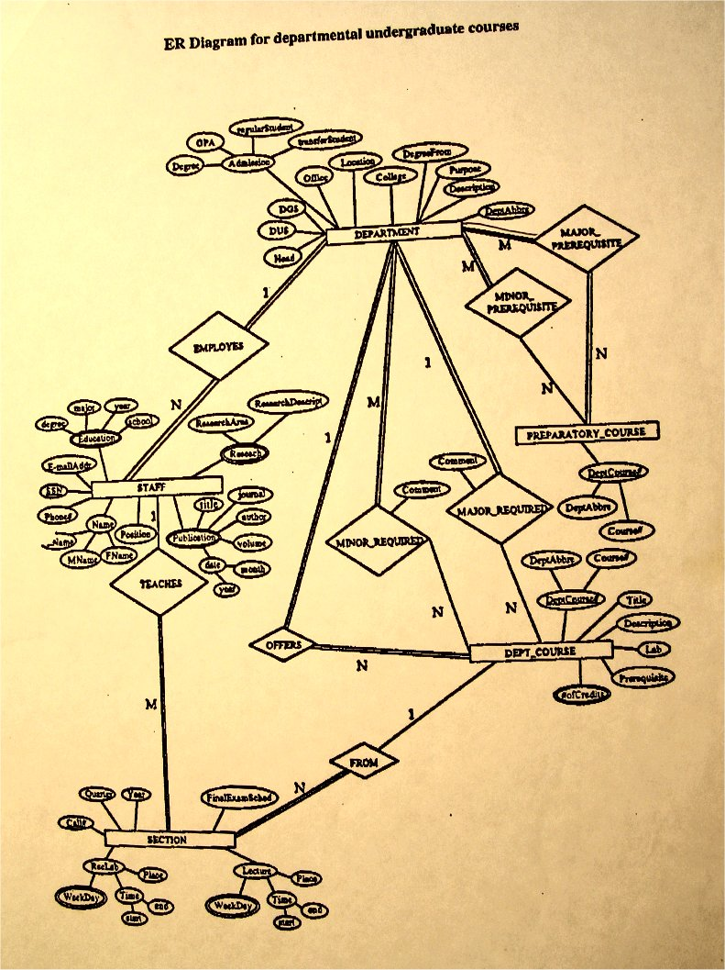
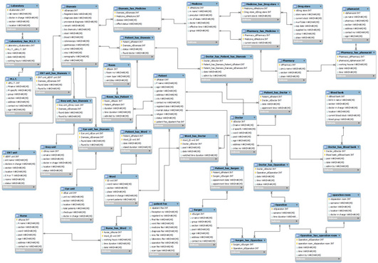
E-R Diagrams

Slide 20
Expressing business rules with the E-R model
The outputs of conceptual modeling are an E-R Diagram (ERD) and the set of data definitions. Not every business rule can be expressed in diagram form.
In other words, an “E-R Model” is more than just an E-R Diagram.
THREE TERMS YOU NEED TO KNOW:
An entity (aka entity type) is a person, place, object, event, or concept (a “noun”) in the business environment that needs to be represented in the database.
An attribute is a property or characteristic of individual instances of an entity type (or relationship type).
A relationship (aka relationship type) is a description of the way entity instances can or must interact.

Slide 21
An entity

Slide 22
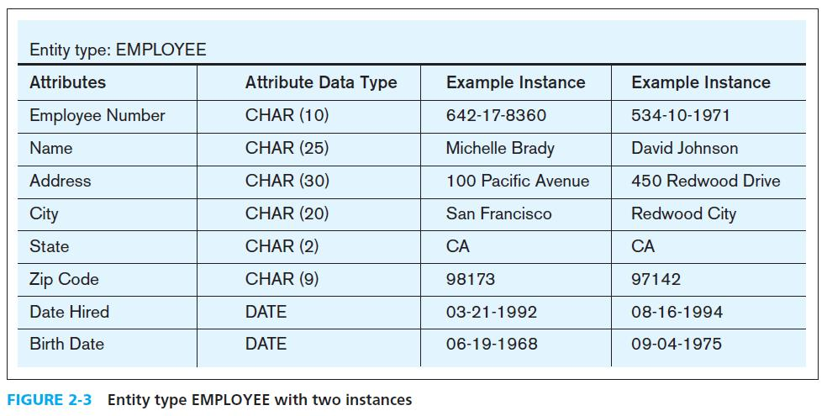
Types vs. Instances
A data model is an abstraction of the types of things, events, situations that might be stored into the database. The data model does not describe the individual cases (instances) of those types.
Example: “PROFESSOR” is an entity type. “Prof. Clark” is an entity instance of that type.
We will often simply say “entity” and you have to use context to know whether we mean types or instances. Sorry.
The same idea applies to relationship types and relationship instances.
How might we diagram relationship types and instances differently?

Slide 23
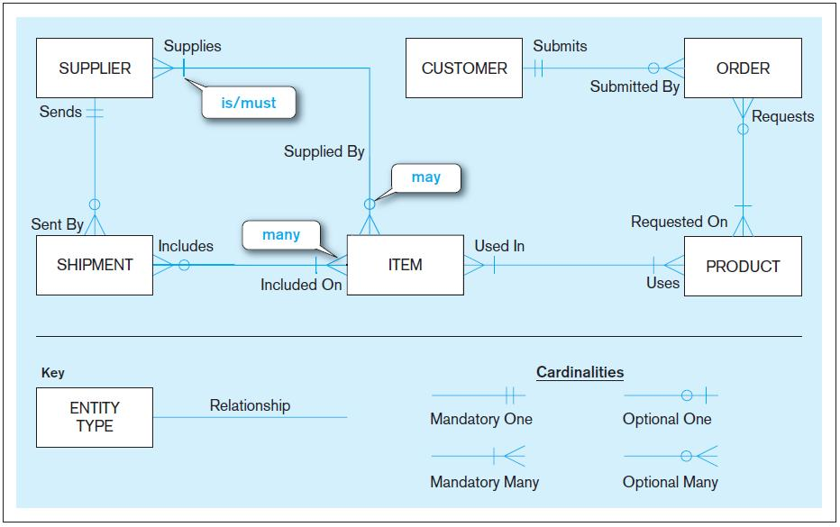
Example E-R diagram (ERD)

Slide 24
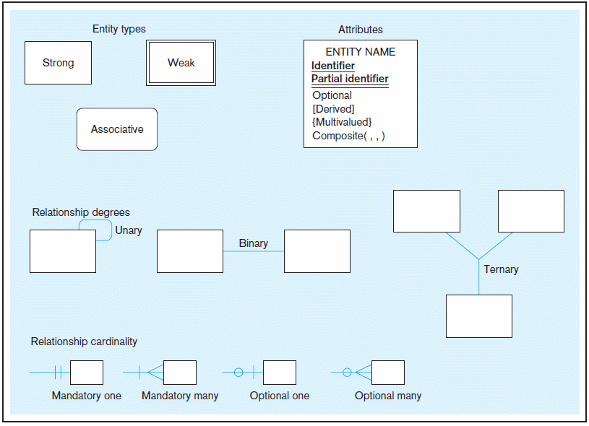
A workable E-R notation Note: there is no one standardized notation
Try
Gliffy.com
for drawing ERDs with this notation!

Slide 25
Entities and their Attributes
Attributes are “variables” that will characterize and distinguish entity instances. Every STUDENT has a Name, but the Name is different for each STUDENT.
You would not create an attribute for something that’s the same in every instance. ASU’s list of students, for example, wouldn’t include an attribute for which university they attend! That’s part of the data definition instead.
Kinds of attributes in a conceptual E-R model:
Required
Optional
Composite
Multivalued
Derived
Identifier attributes (or “keys”; may be composite)

Slide 26
A query

Slide 27
A Relationship

Slide 28
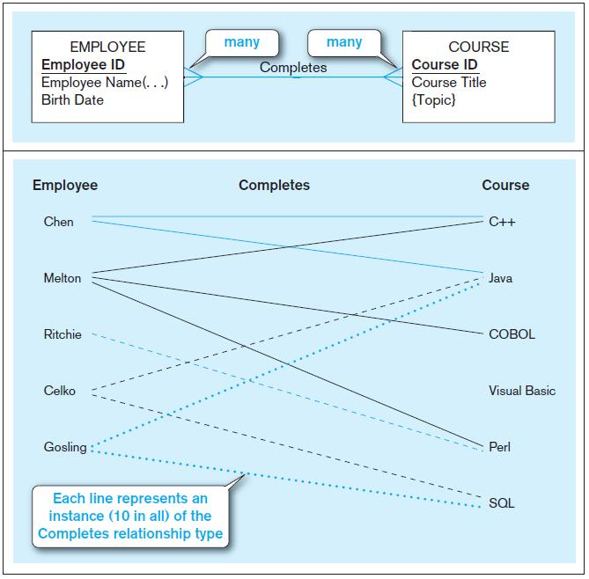
Entities and their Relationships
Relationships also come in “types” and “instances”.
Relationships are simultaneous.
Whenever an EMPLOYEE is linked to a COURSE, the COURSE is also linked to the EMPLOYEE.
Relationships can have attributes.
Example: the link between EMPLOYEE and COURSE may be characterized by Date or Grade.
Sometimes a complicated relationship can be simplified by turning it into an associative entity.

Slide 29
Relationships in Detail
We often describe relationships as “one-to-one”, “one-to-many”, and “many-to-many”. This is useful but real conceptual models make more sophisticated distinctions.
Relationships are defined by degree – the number of entity types that participate in a relationship:
Unary relationship (degree 1)
Binary relationship (degree 2)
Ternary relationship (degree 3)
Relationships are defined by cardinality constraints – the minimum and maximum number of relationships of a given type that the entity instances on each side can participate in.
The issue of one-to-one, one-to-many, many-to-many, etc.

Slide 30
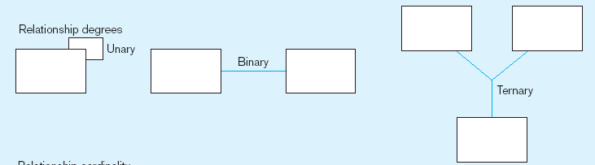
Degree of relationships
Binary relationships are the most common.
Relationships of degrees greater than 3 are possible, though rare.

Slide 31
Cardinality Constraints
Cardinality Constraints—the number of instances of one entity that can or must be associated with each instance of another entity
Minimum Cardinality
If zero, then optional
If one or more, then mandatory
Maximum Cardinality
The maximum number
Often simply “many” but can be precisely specified

Slide 32
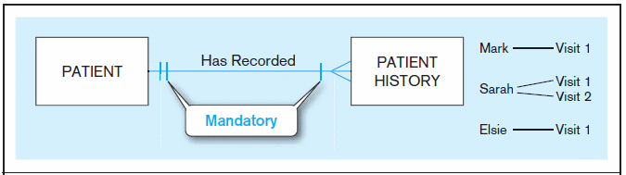
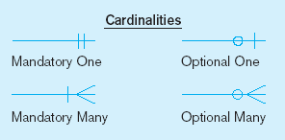
Examples of cardinality constraints
A patient history is recorded for one and only one patient
A patient must have recorded at least one history, and can have many

Slide 33
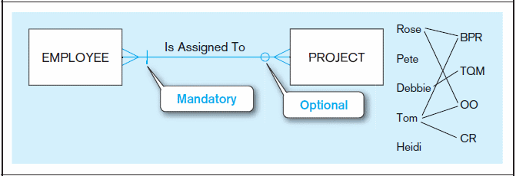
Examples (cont’d)
A project must be assigned to at least one employee, and may be assigned to many
An employee can be assigned to any number of projects, or may not be assigned to any at all

Slide 34
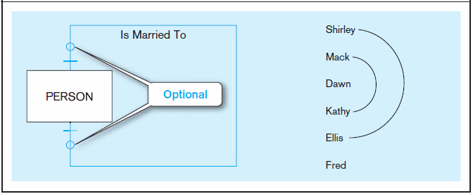
Examples (cont’d)
A person is married to at most one other person, or may not be married at all

Slide 35
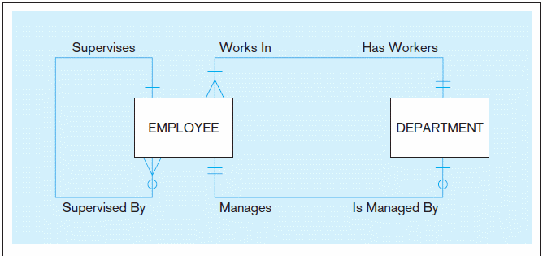
Multiple relationships
Entities can be related to one another in more than one way.

Slide 36
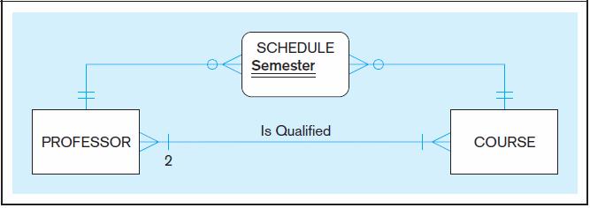
Multiple relationships
Entities can be related to one another in more than one way.

Slide 37
A join

Slide 38
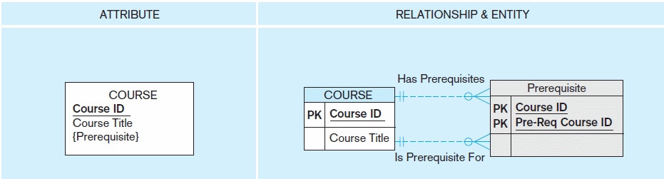
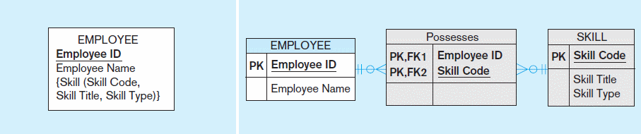
Multivalued Attributes Represented as relationships

Slide 39
Associative Entities
A relationship can have attributes, conceptually.
If it is more intuitive, the relationship can be replaced with an associative entity to hold the attributes.
When should a relationship with attributes instead be an associative entity?
All relationships for the associative entity should be many
The associative entity could have meaning independent of the other entities
The associative entity preferably has a unique identifier, and should also have other attributes
The associative entity may participate in other relationships other than the entities of the associated relationship
Ternary relationships should be converted to associative entities

Slide 40
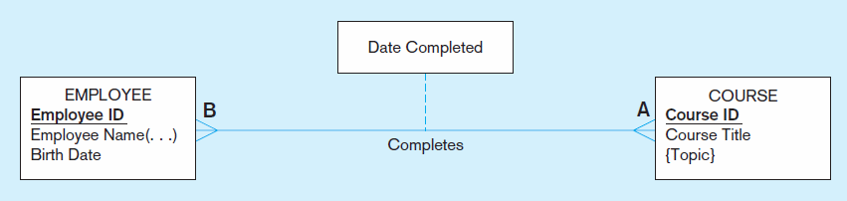
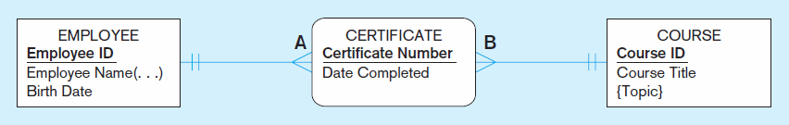
Relationship with Attributes vs. Associative Entity

Slide 41
Multiple joins

Slide 42
Next time
Logical database design and normalization.
The types of anomalies that can be encountered with bad design.
Physical optimization of databases.
WHY transactional and analytical databases are designed differently.

