Slide 1
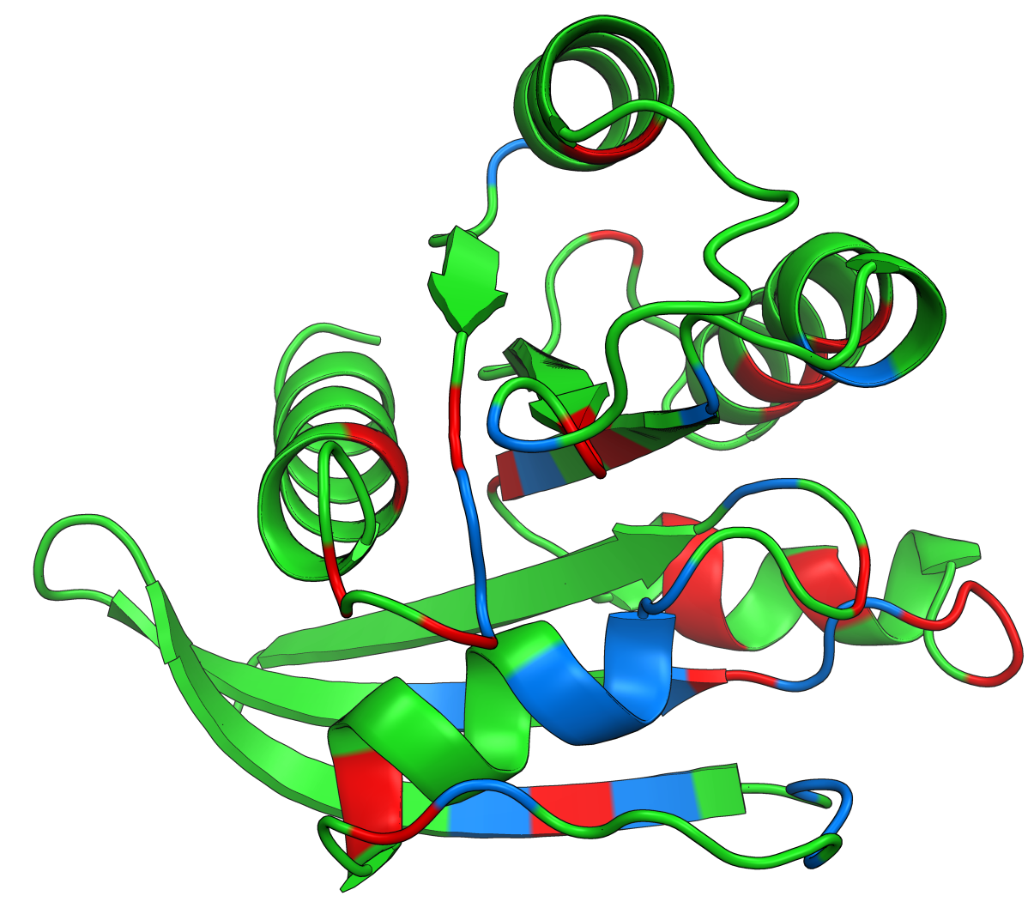
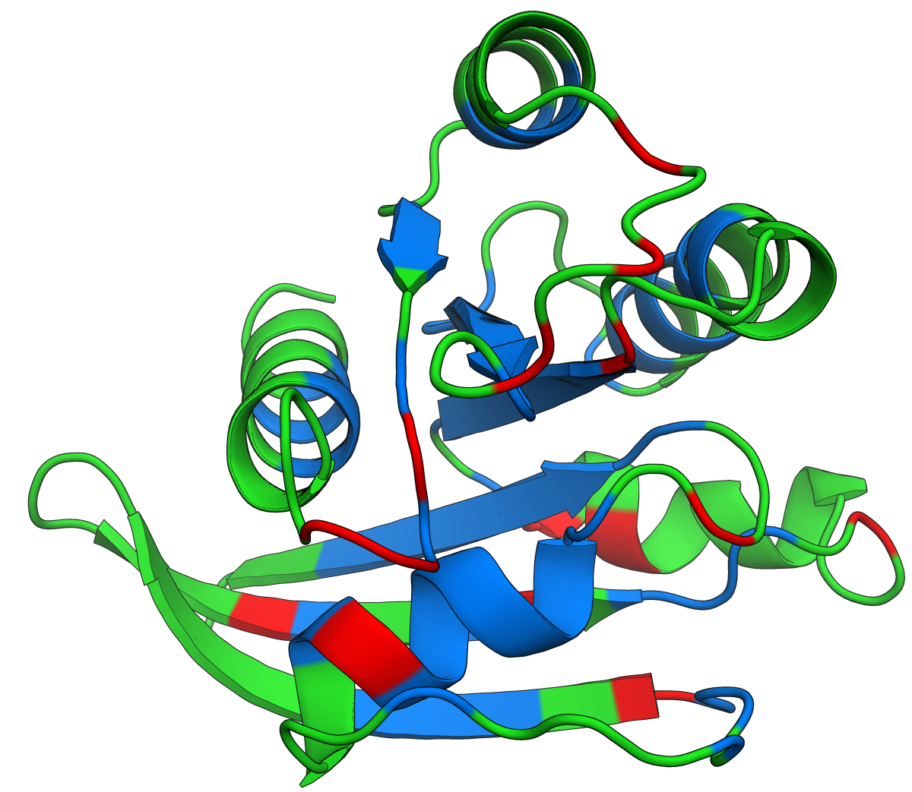
Leucine scan
Aspartate scan

Slide 2
Rank | Variant | Score
0 | R149H | 2.363
1 | R128A | 1.196
2 | L159I | 0.963
3 | V160M | 0.732
4 | Q25G | 0.682

Slide 3
Rank | Variant | Score
0 | R149H | 2.363
1 | R128A | 1.196
2 | L159I | 0.963
3 | V160M | 0.732
4 | Q25G | 0.682

Slide 4
Rank | Combination | R²
0 | DRNTAVWP | 0.778
1 | ERQTAVWP | 0.778
2 | DRQTAVWP | 0.778
3 | ERNTAVWP | 0.778
4 | ERNTGVWP | 0.778

Slide 5
Counts
Codons | T | E | Y | K | L | V
GCC | 1102 | 972 | 1172 | 725 | 577 | 554
GCG | 990 | 788 | 647 | 578 | 401 | 575
TGC | 837 | 612 | 710 | 547 | 508 | 1251
GAC | 799 | 794 | 308 | 381 | 296 | 539
GAG | 970 | 942 | 410 | 897 | 182 | 357
TTC | 788 | 406 | 596 | 421 | 873 | 440
GGC | 1127 | 702 | 800 | 502 | 291 | 663
GGG | 2101 | 1216 | 1228 | 819 | 267 | 885

Slide 6
Codons | T | E | Y | K | L
GCC | 0.05241446 | -0.2333756 | -0.0037015 | 0.03659311 | 0.0284832
GCG | -0.321545 | -0.1932395 | -0.0718173 | -0.090182 | 0.23365943
TGC | -0.0716986 | -0.1797927 | -0.0984878 | 0.12387735 | -0.04149
GAC | 0.16110877 | -0.0595593 | 0.1270668 | 0.08101225 | -0.2555135
GAG | 0.17650634 | 0.10965538 | 0.12123725 | 0.13861135
TTC | -0.0210756 | -0.1650695 | -0.0037015 | -0.1156752 | -0.0753947
GGC | -0.1664288 | -0.1509166 | -0.0931019 | -0.0254207 | -0.2023586
GGG | -0.0594016 | -0.368849 | -0.0759339 | 0.15860149 | 0.08172871
enrichment
Codons | T | E | Y | K | L | V
GCC | 0.052 | -0.233 | -0.004 | 0.037 | 0.028 | -0.198
GCG | -0.322 | -0.193 | -0.072 | -0.090 | 0.234 | -0.119
TGC | -0.072 | -0.180 | -0.098 | 0.124 | -0.041 | -0.191
GAC | 0.161 | -0.060 | 0.127 | 0.081 | -0.256 | -0.239
GAG | 0.177 | 0.110 | 0.121 | 0.139 |  | -0.180
TTC | -0.021 | -0.165 | -0.004 | -0.116 | -0.075 | -0.067
GGC | -0.166 | -0.151 | -0.093 | -0.025 | -0.202 | 0.058
GGG | -0.059 | -0.369 | -0.076 | 0.159 | 0.082 | -0.083

Slide 7
Variant | Score | Conservation
T2A | -0.090 | 0.036
T2C | 0.084 | 0.027
T2D | -0.120 | 0.027
T2E | -0.070 | 0.036
T2F | -0.017 | 0.063
Variant | Score | Conservation
T2A | -0.090926 | 0.036364
T2C | 0.084591 | 0.027273
T2D | -0.120583 | 0.027273
T2E | -0.070526 | 0.036364
T2F | -0.017038 | 0.063636

Slide 8
FP_label | FP_seq | RP_label | RP_seq
fp 0 | CAGTAATACAAGGGGTGTTNNSGAAAAAATTATGCCGG | rp 0 | CCGGCATAATTTTTTCSNNAACACCCCTTGTATTACTG
fp 1 | GTAATACAAGGGGTGTTATGNNSAAAATTATGCCGGAAGA | rp 1 | TCTTCCGGCATAATTTTSNNCATAACACCCCTTGTATTAC
fp 2 | CAAGGGGTGTTATGGAANNSATTATGCCGGAAGA | rp 2 | TCTTCCGGCATAATSNNTTCCATAACACCCCTTG
fp 3 | GGGGTGTTATGGAAAAANNSATGCCGGAAGAAGA | rp 3 | TCTTCTTCCGGCATSNNTTTTTCCATAACACCCC
fp 4 | GGGGTGTTATGGAAAAAATTNNSCCGGAAGAAGAATACAG | rp 4 | CTGTATTCTTCTTCCGGSNNAATTTTTTCCATAACACCCC
fp 5 | GGGTGTTATGGAAAAAATTATGNNSGAAGAAGAATACAGCGAA | rp 5 | ATTCGCTGTATTCTTCTTCSNNCATAATTTTTTCCATAACACCC
fp 6 | GTTATGGAAAAAATTATGCCGNNSGAAGAATACAGCGAATTT | rp 6 | AAATTCGCTGTATTCTTCSNNCGGCATAATTTTTTCCATAAC

Slide 9
>0
ATGGCCGTGGGGTGTTATGGATGTACAGTAATACAAGGGGTGTTATGGAAAAAATTATGCCGGAAGAAGAATACAGCGAATTTAAAG
>1
GCCGCCGTGGGGTGTTATGGATGTACAGTAATACAAGGGGTGTTATGGAAAAAATTATGCCGGAAGAAGAATACAGCGAATTTAAAG
>2
GCGGCCGTGGGGTGTTATGGATGTACAGTAATACAAGGGGTGTTATGGAAAAAATTATGCCGGAAGAAGAATACAGCGAATTTAAAG
>3
TGCGCCGTGGGGTGTTATGGATGTACAGTAATACAAGGGGTGTTATGGAAAAAATTATGCCGGAAGAAGAATACAGCGAATTTAAAG
>4
GACGCCGTGGGGTGTTATGGATGTACAGTAATACAAGGGGTGTTATGGAAAAAATTATGCCGGAAGAAGAATACAGCGAATTTAAAG

