Slide 1


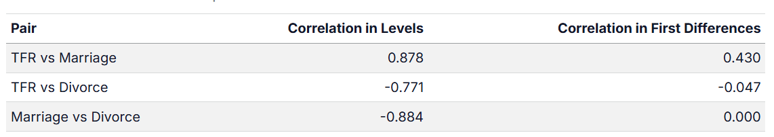
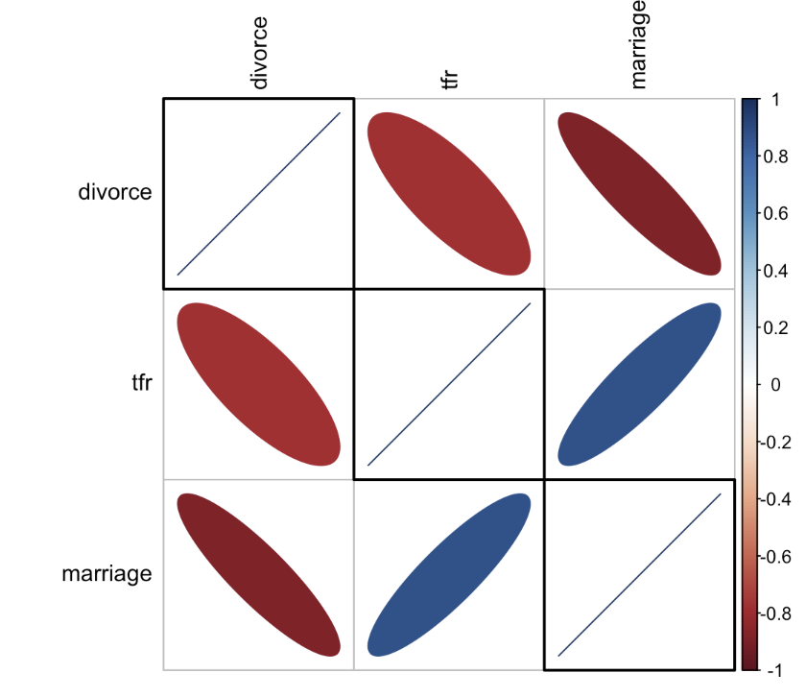


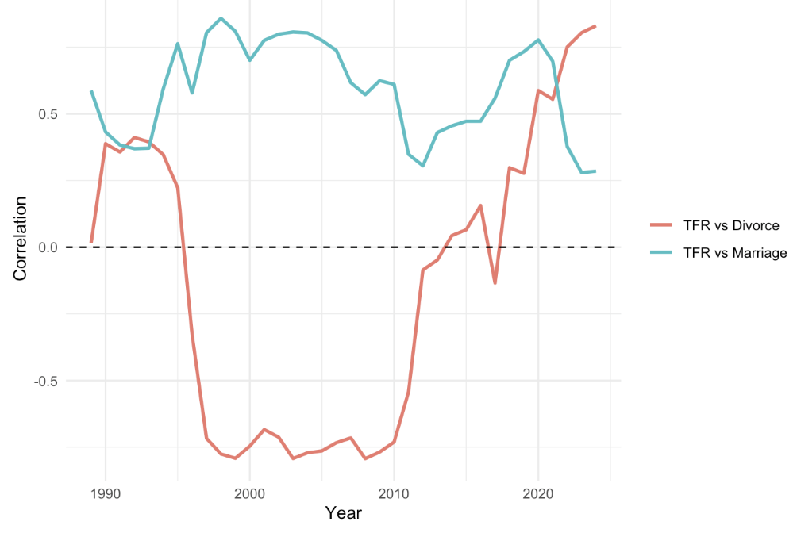
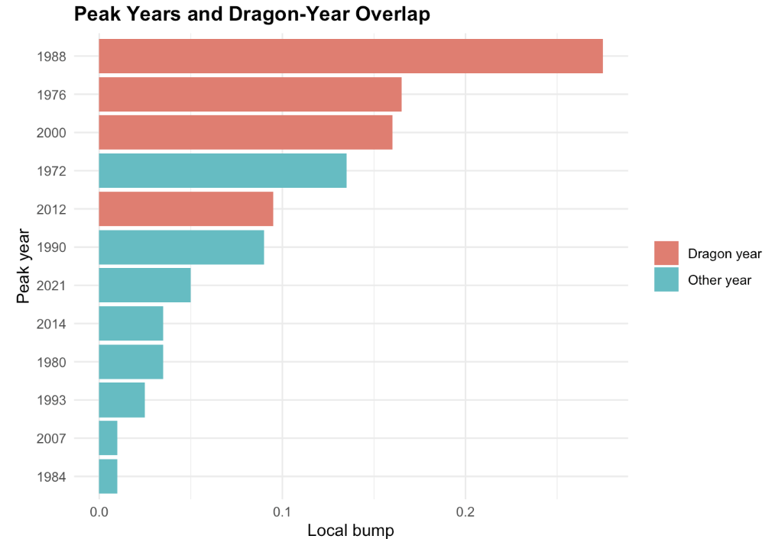
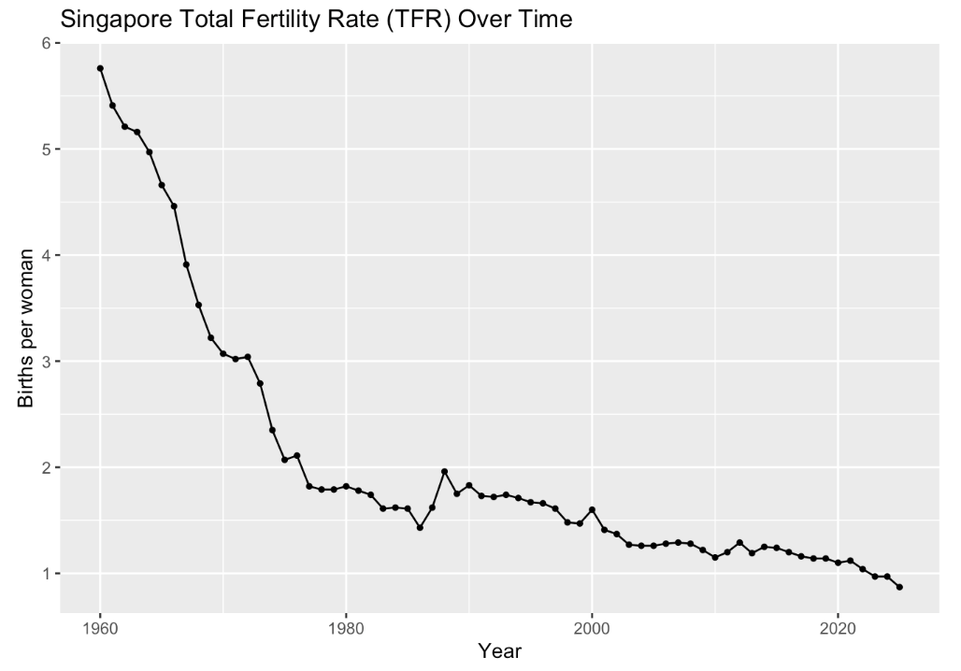
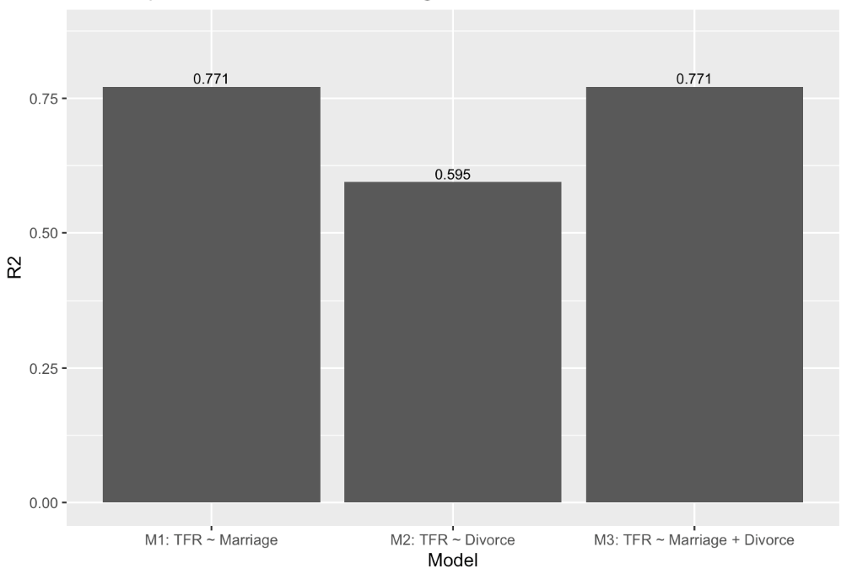
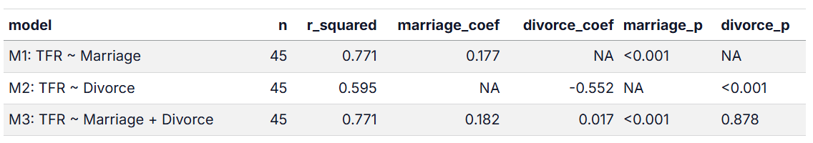
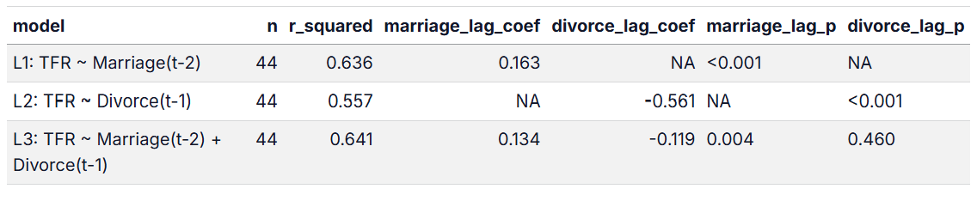
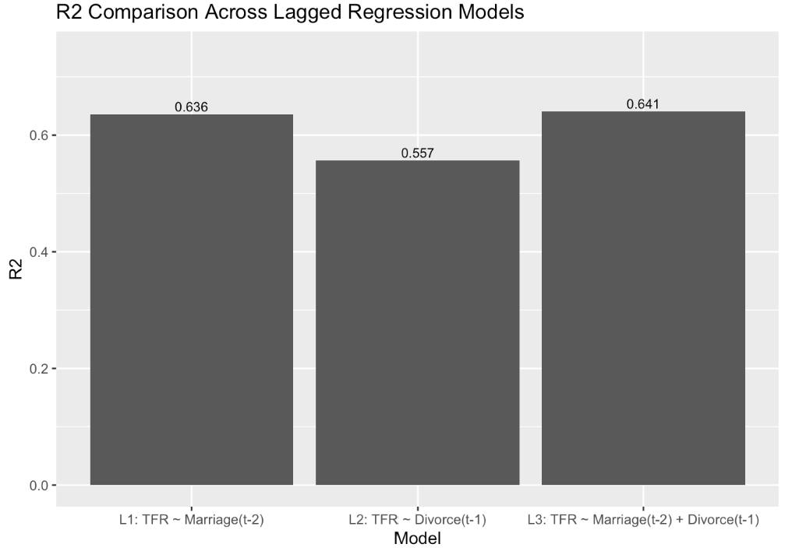
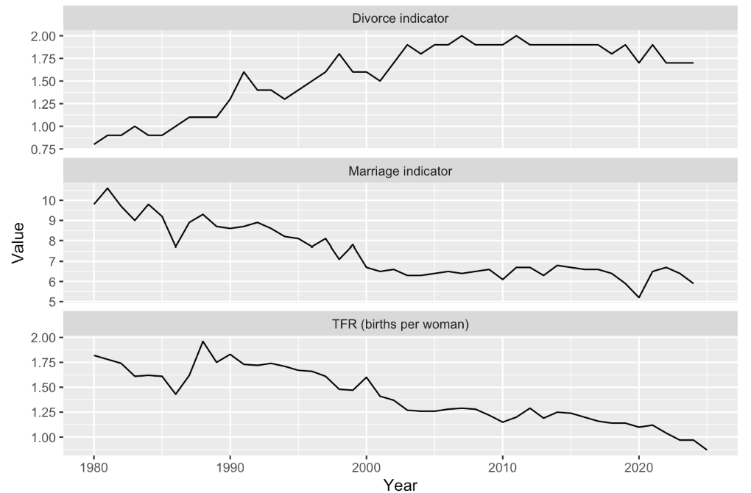

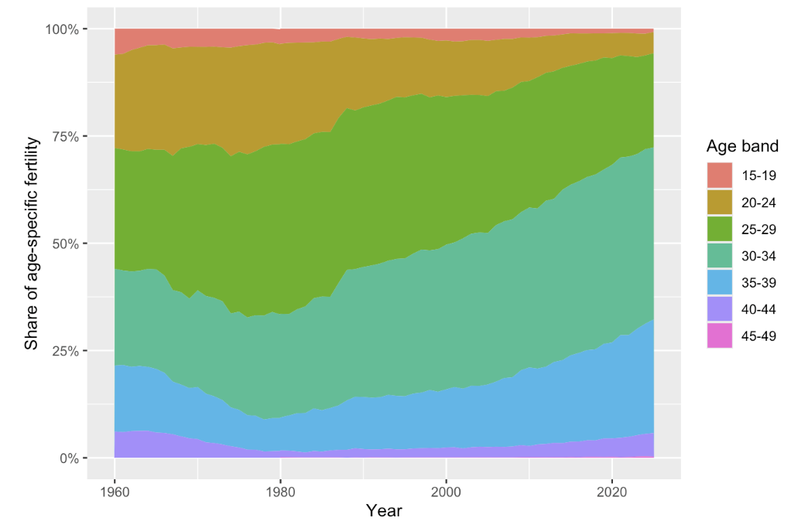

Singapore Fertility Trend:
A Visual Analytics Study
Introduction
Analysis & Results
Background
Singapore’s total fertility rate has fallen to a historic low, raising concerns about population ageing and long-term labor force sustainability.
Fertility trends may be influenced by multiple demographic factors, including marriage, divorce, and birth postponement across age groups
Correlation Analysis
Fertility vs Marriage & Divorce: Correlation Insights
Project Objectives
Explore (i) how fertility has changed over time and (ii) examines whether demographic indicators, including marriage and divorce, are associated with fertility trends, including possible lag effects.
Observation: TFR is strongly positively correlated with marriage and negatively correlated with divorce. However, after removing long-run trends, the TFR–divorce relationship weakens substantially, suggesting it is largely trend-driven.
Data Preparation
Data Source: Excel time series data extracted from CEIC database
Rolling Correlation
Data Cleaning
Observation: Rolling correlations show that the relationship between TFR and marriage remains consistently positive over time. In contrast, the correlation between TFR and divorce varies substantially across periods.
Step | Description
1 | Extract original series labels from first row and convert them into clean, standardized variable names
2 | Transform text values into numeric format and ensure one observation per year per series.
3 | Extract series used in this study – fertility, marriage, divorce rates
4 | Combine selected series into a clean dataset
Exploratory Data Analysis
Correlation conclusion: Marriage shows a more stable association with fertility, while the relationship between fertility and divorce appears less consistent and partly driven by long-run trends.
Singapore Fertility Rate Trend
Regression Analysis
Baseline regression
Observation: Marriage explains more variation in TFR (R² = 0.771) than divorce (R² = 0.595). When both variables are included together, divorce is no longer significant (p = 0.878), indicating that marriage is the stronger statistical indicator of fertility.
Observation: Fertility rate has declined steadily since the 1960s. In 2025, TFR reached a historic low of 0.87, meaning on average woman would have fewer than one child if current rates persisted.
Several fertility peaks coincide with Dragon years (1976, 1988, 2000, 2012) - higher birth rates. However, many peaks occur in non-Dragon years, suggesting that zodiac effects may contribute to some spikes but do not fully explain fertility fluctuations.
Lagged regression
Marriage and Divorce Trend
Observation: Lagged marriage explains more variation in fertility (R² = 0.636) than lagged divorce (R² = 0.557). Including both lagged predictors increases R² only slightly (0.641), with lagged marriage significant (p = 0.004) and lagged divorce insignificant (p = 0.460). Overall, lagged effects are modest and do not improve explanatory power over current-year associations.
Observation: From 1980 onward, fertility and marriage rates generally decline, while divorce rates increase before stabilizing. These patterns suggest that changes in fertility may be linked to broader family-formation trends, although the chart does not imply causality.
Observation: Over time, the share of births shifts from younger women (15–24) to older age groups (30–39). This indicates birth postponement, where childbearing increasingly occurs later in life despite declining overall fertility.
Regression conclusion: Marriage is the strongest and most consistent indicator of fertility, while divorce shows a weaker and less stable association. Year-to-year fertility patterns are largely associated with current-year marriage trends, with only modest evidence of delayed effects.
Fertility Postponement
Future Research
Investigate other social and economic factors influencing fertility, such as housing costs, career patterns, and childcare support.
Extend analysis to forecasting modeling for population policy planning.
Cheok En Qi| Teong Sze Ching
Notes:
Correlation analysis was used to assess the overall strength and direction of association between fertility and demographic indicators such as marriage and divorce. Regression analysis was then used to estimate the size of the relationship, showing how fertility changes with changes in the predictor. Lagged regression was further applied to test whether earlier marriage patterns are associated with fertility in subsequent years, since childbirth may occur some time after marriage.
Correlation = are they related, and how strongly? Regression = how much does fertility change when marriage changes? Lagged regression = does earlier marriage relate to later fertility?
Marriage explains 77.1% of the variation in fertility in the baseline model.
A 1-unit increase in the marriage variable is associated with a 0.177 increase in TFR, based on Model 1.

Slide 2
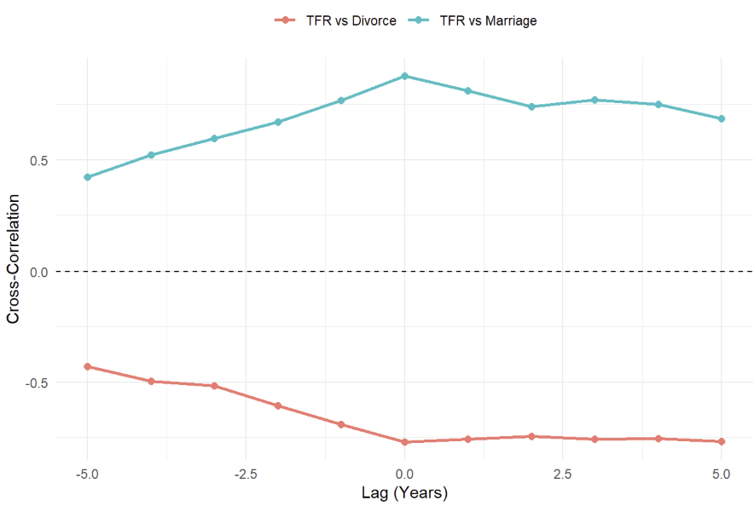
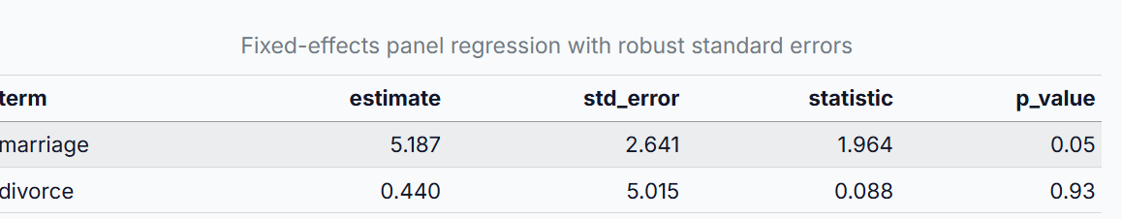
Singapore Fertility Trend:
A Visual Analytics Study
Introduction
Analysis & Results
Background
Singapore’s total fertility rate has fallen to a historic low, raising concerns about population ageing and long-term labor force sustainability.
Fertility rate may be influenced by multiple demographic factors, including marriage, divorce, and birth postponement across age groups
Cross Correlation Analysis
Purpose: Examine the co-movement between TFR and demographic indicators across different lags. This helps identify potentially meaningful lag relationships for further regression analysis.
Cross Correlation Comparison Across Lags
Project Objectives
Explore (i) how fertility has changed over time and (ii) examines whether demographic indicators, including marriage and divorce, are associated with fertility trends, including possible lag effects.
Data Preparation
Data Source: Excel time series data extracted from CEIC database
Observation: Both series show their strongest cross-correlation with TFR at lag 0. Marriage has a positive peak correlation of 0.878, while divorce has a negative peak correlation of -0.771, indicating opposite co-movement patterns with fertility.
Data Cleaning
Step | Description
1 | Extract original series labels from first row and convert them into clean, standardized variable names
2 | Transform text values into numeric format and ensure one observation per year per series.
3 | Extract series used in this study – fertility, marriage, divorce rates
4 | Combine selected series into a clean dataset
Cross correlation conclusion: This analysis highlights the timing and direction of the relationship, but not the size of the fertility effect. It is therefore used as an exploratory step to identify lag patterns before formal regression modelling.
Exploratory Data Analysis
Panel Regression Analysis
Singapore Fertility Rate Trend
Purpose: Because the data vary across both age groups and years, panel regression is more appropriate than simple regression. Using the lag 0 finding from the cross-correlation analysis, this section formally tests the same-year relationship between fertility and the demographic indicators.
2 models performed:
Fixed effect model: Examines whether fertility changes within the same age group over time when marriage or divorce changes.
Random-effects model: Examine overall fertility changes across and within age groups.
Observation: Fertility rate has declined steadily since the 1960s. In 2025, TFR reached a historic low of 0.87, meaning on average woman would have fewer than one child if current rates persisted.
Several fertility peaks coincide with Dragon years (1976, 1988, 2000, 2012) - higher fertility rates. However, many peaks occur in non-Dragon years, suggesting that zodiac effects may contribute to some spikes but do not fully explain fertility fluctuations.
Coefficient comparison across Panel regression models
The Hausman test result suggests that both panel models lead to a similar overall conclusion.
Marriage has a positive coefficient (5.19), suggesting that higher marriage rates are associated with higher fertility, although the evidence is only borderline significant (p = 0.050).
Divorce has a very small and non-significant coefficient (0.44, p = 0.930).
Marriage and Divorce Trend
Observation: From 1980 onward, fertility and marriage rates generally decline, while divorce rates increase before stabilizing.
Regression conclusion: Unlike cross-correlation, panel regression estimates the size and statistical significance of the relationship. The results suggest that marriage is the more consistent demographic indicator of fertility, while divorce shows a weaker and less stable association.
Observation: Over time, the share of births shifts from younger women (15–24) to older age groups (30–39). This indicates birth postponement, where childbearing increasingly occurs later in life despite declining overall fertility.
Fertility Postponement
Future Research
Investigate other social and economic factors influencing fertility, such as housing costs, career patterns, and childcare support.
Extend analysis to forecasting modeling for population policy planning.
Cheok En Qi| Teong Sze Ching
Notes:
This regression analysis uses age-group-by-year fertility data to examine whether fertility is associated with marriage and divorce indicators over time. Panel regression is used because the data vary across both age groups and years. Fixed-effects models help control for differences across age groups, while lagged models check whether these relationships appear with a time delay.

