Slide 1
YouTube Notes
Chrome Extension Development & Publishing

Slide 2
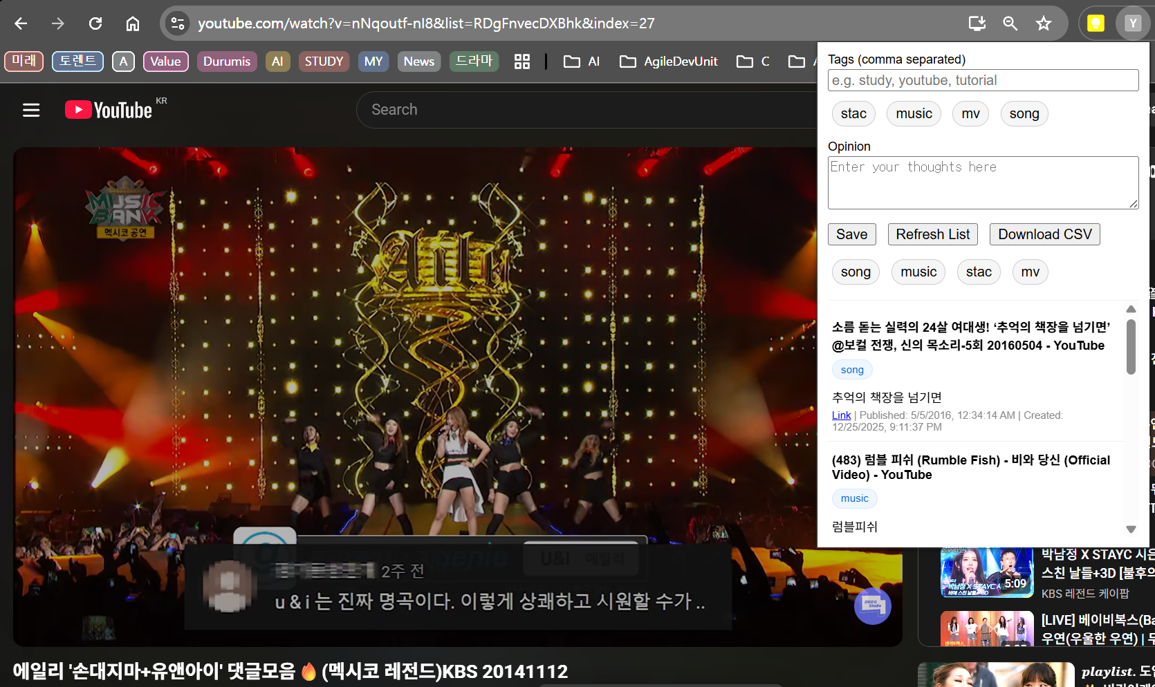

Slide 3
Project Overview
📌 Extension Name: YouTube Notes
✨ Purpose: Save YouTube video info with tags, opinions & export as CSV
🎯 Target Users: Students, researchers, content creators
📊 Key Features: Auto metadata extraction, tag management, CSV export
Youtube Notes extensions are partially paid.
Source code :
https://github.com/cheoljoo/youtube_notes_chrome_extension

Slide 4
Development Phases
Phase 1️⃣: Core Functionality Setup (popup.html, popup.js)
Phase 2️⃣: Storage & Data Management (chrome.storage API)
Phase 3️⃣: YouTube Metadata Extraction (scripting API)
Phase 4️⃣: CSV Export Feature
Phase 5️⃣: UI/UX Enhancement (filtering, tag management)

Slide 5
Key Features Implemented
✅ YouTube Title & Publish Date Extraction
✅ Smart Tag Management (reusable tags with suggestions)
✅ Opinion Notes (multi-line textarea)
✅ Tag-based Filtering (click tag to filter notes)
✅ CSV Download (with all metadata)
✅ Local-only Storage (privacy-first)

Slide 6
Project File Structure
📁 manifest.json - Extension configuration & permissions
📁 popup.html/js - Main UI & user interactions
📁 options.html/js - Settings page
📁 background.js - Service worker
📁 images/ - Icons (16x16, 48x48, 128x128 PNG)
📁 privacy_policy.html - Privacy documentation

Slide 7
Development Tools
💻 Language: JavaScript (ES6+)
🛠️ APIs: Chrome Storage, Chrome Scripting, Chrome Tabs
🎨 UI: HTML5, CSS3
📦 Build: Python (for icon generation)
📊 Data Format: JSON (storage), CSV (export)

Slide 8
Testing & QA Process
1️⃣ Load extension in development mode (chrome://extensions)
2️⃣ Test on real YouTube videos
3️⃣ Verify metadata extraction accuracy
4️⃣ Check tag filtering functionality
5️⃣ Validate CSV export format
6️⃣ Test on multiple YouTube pages

Slide 9
Permission Justification
🔒 storage - Local note storage (no cloud)
📑 activeTab - Current tab URL capture
⚙️ scripting - YouTube metadata extraction
🌐 Host Permission - YouTube.com access only
✨ NO identity/OAuth - Local storage only!

Slide 10
Pre-Submission Checklist
✅ manifest.json properly configured
✅ Icons created (16, 48, 128 PNG)
✅ Privacy policy written (English)
✅ README.md with usage instructions
✅ All files packaged as .zip
✅ No external code/resources

Slide 11

Chrome Web Store - Account Setup
1️⃣ Visit: chrome.google.com/webstore/devconsole
2️⃣ Sign in with Google account
3️⃣ Pay $5 USD developer registration fee
4️⃣ Go to Account tab → Add contact email
5️⃣ Verify email address (check inbox)
6️⃣ Ready for submission!
Not found Korea
Choose any country to pass at once
But, it is make a big issue.
We can not be Trader.
Because not find Korea South.
Actually it is Korea’s SW power.
Notes:
https://chrome.google.com/webstore/devconsole/fe5bd375-f499-4a2a-a6c0-55b54af8bd81/oklpnlmafbbkmpnpgnbgabimkcamlnfo/edit/listing
https://chrome.google.com/webstore/devconsole/fe5bd375-f499-4a2a-a6c0-55b54af8bd81/settings

Slide 12
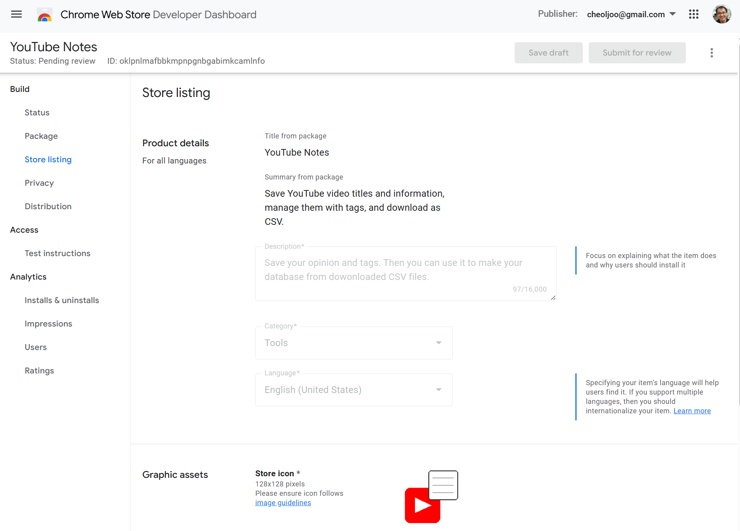

Slide 13
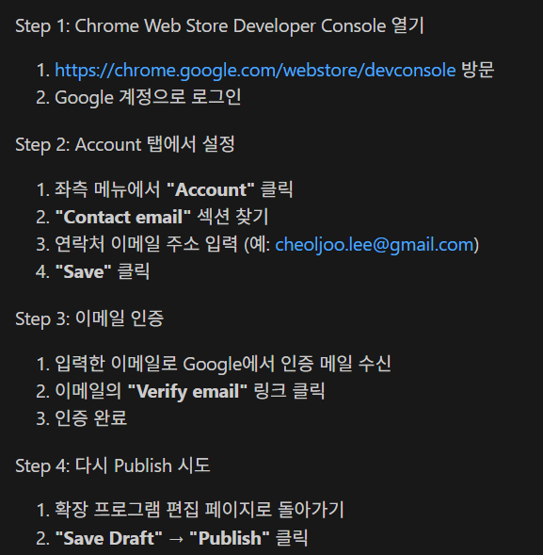
Chrome Web Store – email verification
1️⃣ Visit: chrome.google.com/webstore/devconsole
2️⃣ Sign in with Google account
3️⃣ Pay $5 USD developer registration fee
4️⃣ Go to Account tab → Add contact email
5️⃣ Verify email address (check inbox)
6️⃣ Ready for submission!
Notes:
https://chrome.google.com/webstore/devconsole/fe5bd375-f499-4a2a-a6c0-55b54af8bd81/oklpnlmafbbkmpnpgnbgabimkcamlnfo/edit/listing
https://chrome.google.com/webstore/devconsole/fe5bd375-f499-4a2a-a6c0-55b54af8bd81/settings

Slide 14
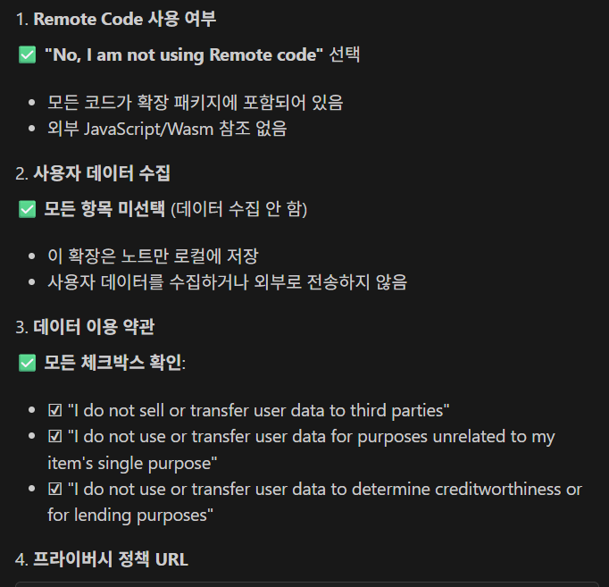
Chrome Web Store – Privacy
Single purpose description
save notes and tags for youtube clips.
storage justification
Local note storage and tag management
activeTab justification
Current tab URL capture for note linking
scripting justification
- YouTube metadata extraction (title, publish date)
identity justification
- identify will be used as local
Host permission justification
YouTube page access for metadata extraction only
https://github.com/cheoljoo/youtube_notes_chrome_extension/blob/main/privacy_policy.html
Notes:
https://chrome.google.com/webstore/devconsole/fe5bd375-f499-4a2a-a6c0-55b54af8bd81/oklpnlmafbbkmpnpgnbgabimkcamlnfo/edit/listing
https://chrome.google.com/webstore/devconsole/fe5bd375-f499-4a2a-a6c0-55b54af8bd81/settings

Slide 15
Submission Process
1️⃣ Create new item → Upload youtube_notes_v1.0.0.zip
2️⃣ Fill basic info: Name, Description, Category
3️⃣ Upload icon (128x128) & promo tiles (440x280)
4️⃣ Add 1-2 screenshots (1280x800 recommended)
5️⃣ Set language (English, Korean, etc)
6️⃣ Save Draft → Click Publish
Register Screenshot
Use only english

Slide 16
Store Listing Details
📝 Title: YouTube Notes
📝 Short Description: Save YouTube info with tags
📝 Detailed Description: Full feature overview
📝 Category: Productivity
📝 Language: English (also Korean for international)
📝 Support email: Your contact email

Slide 17
Privacy & Compliance Declaration
✅ No remote code usage
✅ No user data collection (local only)
✅ No third-party data sharing
✅ Honest permission requests
✅ Clear privacy policy provided
✅ All 3 policy agreements checked

Slide 18
Chrome Web Store Review
⏳ Review Duration: 1-3 days (usually)
🔍 Automated Checks: Malware, code analysis
👥 Manual Review: Functionality & policy compliance
⚠️ Host permission = In-depth review (but approved if justified)
📧 Notification via email when approved/rejected

Slide 19
After Approval ✅
🎉 Extension goes live on Chrome Web Store
🔍 Users can search: 'YouTube Notes'
⭐ Users can rate & review your extension
📊 View analytics: Users, ratings, crashes
🔄 Update extension: Upload new .zip, increase version

Slide 20
Updates & Maintenance
1️⃣ Increase version in manifest.json (e.g., 1.0.1)
2️⃣ Update files (popup.js, etc)
3️⃣ Re-zip and upload to store
4️⃣ Write release notes for update
5️⃣ Monitor user reviews & feedback
6️⃣ Plan next features based on feedback

Slide 21
Best Practices Going Forward
🛡️ Security: Never store sensitive data externally
⚡ Performance: Minimize background processes
👤 UX: Keep interface simple & intuitive
📱 Compatibility: Test on different Chrome versions
📢 Marketing: Promote on GitHub, forums, Twitter
💬 Support: Respond to user issues promptly

Slide 22
Common Issues & Solutions
❌ 'Unable to publish' → Check Account tab email
❌ 'Invalid manifest' → Validate manifest.json syntax
❌ Icon issues → Ensure PNG 16x16, 48x48, 128x128
❌ Rejection → Review error message, re-submit
❌ Slow review → Check for policy violations

Slide 23
Project Success Timeline
📅 Days 1-3: Core development & testing
📅 Days 4-5: Polish UI & documentation
📅 Day 6: Package & prepare submission
📅 Day 7: Submit to Chrome Web Store
📅 Days 8-10: Review & approval
📅 Day 11: Live on Chrome Web Store! 🚀

Slide 24
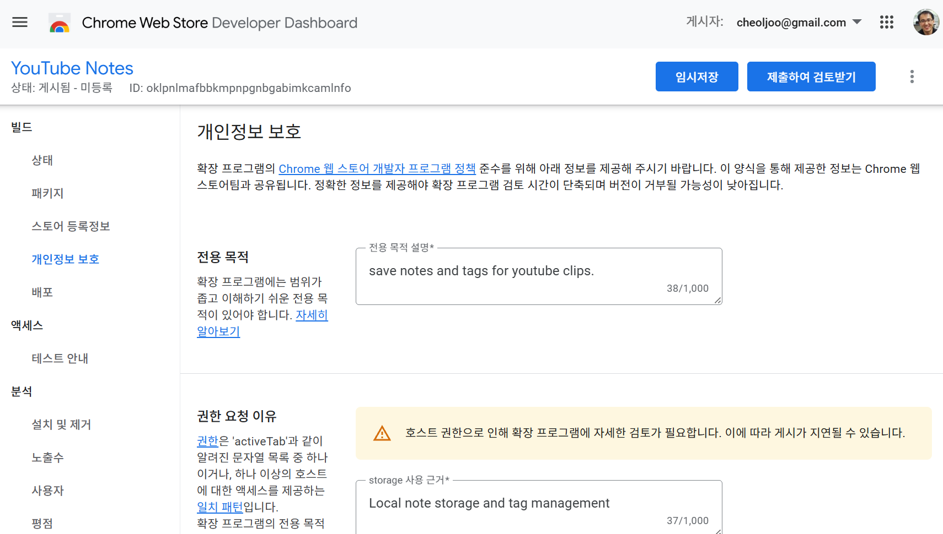
Chrome에 등록

Slide 25
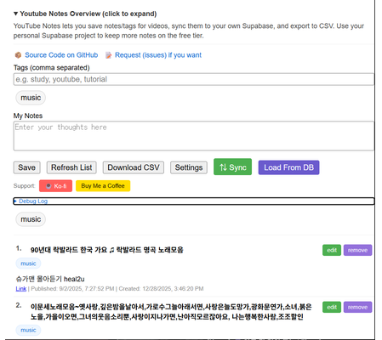
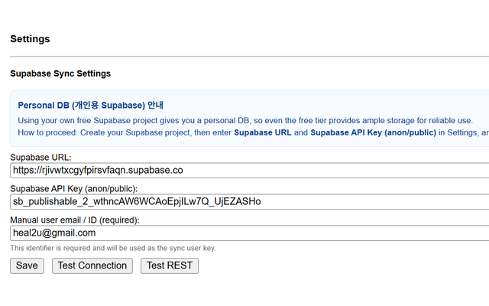
New Function of v1.1.0
Tag Filter
Save to supabase to synchronize

Slide 26
Congratulations!
Your Chrome Extension is Live! 🎉

