Slide 1
System Modeling Runtime Environment (SMRE): SysMPy

Slide 2
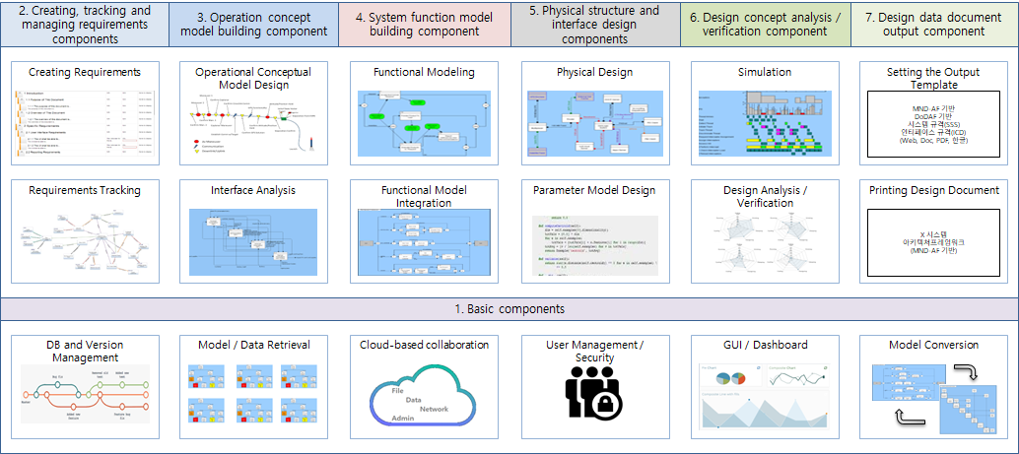
SAI and SysMPy Architecture
SAI
SysMPy
① Requirement Definition
② System Model Definition
③ System Model Simulation
④ System Model & Requirement Verification
Open Source
Unified Code
Python

Slide 3
SAI and SysMPy
Requirement Elicitation and Analysis with GUI
Systems
Modeling with GUI
System Model
Simulation with GUI
System Model Verification & Validation with GUI
SAI Level:
Requirement Definition
System Model
Definition
System Model
Simulation
System Model & Requirement
Verification
SysMPy Level:

Slide 4
SysMPy Operation
Requirement Definition
System Model
Definition
System Model
Simulation
System Model & Requirement
Verification
used for
Step | Example
Requirement Analysis | The system shall produce a steel plate with an error thickness of less than 5 mm using an input slab.
System Modeling | The system is an AGC (Automatic Gauge Control) system. The external system is a rolling machine.
System Simulation
Requirement Evaluation
Simulation Model
Rolling Machine
Simulator
②
AGC
Simulator
③
Simulation Analyzer
①
④
Data
Generation
⑤
Requirement
Evaluation
data flow

Slide 5
Backup

Slide 6
Simulation Type
Time Line Analysis
Resource Analysis
Performance Analysis
Cost Analysis
Physical Shape Analysis
Note that Resource has properties, Time is a property for action.

Slide 7
Paper Goal
How to use the new tool for modeling smart systems characterized by ??

Slide 8
SysMPy Ontology
Relation
Entity
Evaluation
Functional
Domain
Item
Action
Functional
Requirement
Physical
Domain
Conduit
Component
Physical
Requirement

Slide 9
SysMPy Architecture (Old)
① Requirement
② System Modeling
③ Functional Model
Simulation
④ Physical Model
Simulation
⑤ Requirement & System Model
Evaluation
⑥ Documentation
Unified Code
Python

Slide 10
SysMPy Operation (Old)
Functional Requirement
Analysis
Functional Modeling
Functional
Simulation
Functional Req’
Evaluation
Physical Requirement
Analysis
Physical Modeling
Physical
Simulation
Physical Req’
Evaluation
used for
Step | Example
Functional Requirement Analysis | The system shall produce a steel plate with an error thickness of less than 5 mm using an input slab.
Physical Requirement Analysis | The system shall
Functional Modeling
Physical Modeling
Functional Simulation
Physical Simulation
Functional Req’ Evaluation
Physical Req’ Evaluation

Slide 11
Use case
Simulation Model
Rolling Machine
Simulator
②
AGC
Simulator
③
④
Simulation Analyzer
①
Data
Generation
⑤
Requirement
Evaluation
data flow

Slide 12
SysMPy Simulation
Relation
Entity
Evaluation
Simulation
Functional
Item
(Resource)
Action
Functional Property
Operating Time
Input/output Count
F-Sim
Physical
Conduit
Component
Physical Property
Component Cost
Component Size
P-Sim
Functional Model
1
Physical Model
1
F-Sim
1
P-Sim
1
Functional Model 1.1
Physical Model
1.1
F-Sim
1.1
P-Sim
1.1

Slide 13
Types of System Requirement | Description
Functional Requirements | Describe qualitatively the system functions or tasks to be performed in operation.
Performance Requirements | Define quantitatively the extent, or how well, and under what conditions a function or task is to be performed (e.g. rates, velocities). These are quantitative requirements of system performance and are verifiable individually. Note that there may be more than one performance requirement associated with a single function, functional requirement, or task.
Usability Requirements | Define the quality of system use (e.g. measurable effectiveness, efficiency, and satisfaction criteria).
Interface Requirements | Define how the system is required to interact or to exchange material, energy, or information with external systems (external interface), or how system elements within the system, including human elements, interact with each other (internal interface). Interface requirements include physical connections (physical interfaces) with external systems or internal system elements supporting interactions or exchanges.
Operational Requirements | Define the operational conditions or properties that are required for the system to operate or exist. This type of requirement includes: human factors, ergonomics, availability, maintainability, reliability, and security.
Modes and/or States Requirements | Define the various operational modes of the system in use and events conducting to transitions of modes.
Adaptability Requirements | Define potential extension, growth, or scalability during the life of the system.
Physical Constraints | Define constraints on weight, volume, and dimension applicable to the system elements that compose the system.
Design Constraints | Define the limits on the options that are available to a designer of a solution by imposing immovable boundaries and limits (e.g., the system shall incorporate a legacy or provided system element, or certain data shall be maintained in an online repository).
Environmental Conditions | Define the environmental conditions to be encountered by the system in its different operational modes. This should address the natural environment (e.g. wind, rain, temperature, fauna, salt, dust, radiation, etc.), induced and/or self-induced environmental effects (e.g. motion, shock, noise, electromagnetism, thermal, etc.), and threats to societal environment (e.g. legal, political, economic, social, business, etc.).
Logistical Requirements | Define the logistical conditions needed by the continuous utilization of the system. These requirements include sustainment (provision of facilities, level support, support personnel, spare parts, training, technical documentation, etc.), packaging, handling, shipping, transportation.
Policies and Regulations | Define relevant and applicable organizational policies or regulatory requirements that could affect the operation or performance of the system (e.g. labor policies, reports to regulatory agony, health or safety criteria, etc.).
Cost and Schedule Constraints | Define, for example, the cost of a single exemplar of the system, the expected delivery date of the first exemplar, etc.
https://www.sebokwiki.org/wiki/System_Requirements

Slide 14
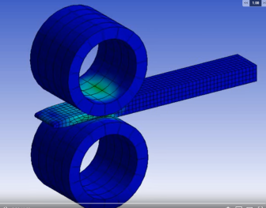
Evaluation of the paper
Use case goal: Modeling AI which can find best control (Best Role Gab)
Matlab(??)
AI Model
(MEBN)
Simulation 결과와
AI 결과를 비교
Requirements
Functional
Modeling
Physical
Modeling
Evaluation

