Slide 1
chRNA / EVIDENCE GALLERY
From published junctions to testable evidence
A reproducible workflow for mouse macrophage chimeric RNA candidates.
01
02
03
04
05
RECONSTRUCT
PRESERVE
MODEL
EVALUATE
EXPLORE
Tables 3 / 4 / 7 / 8
GENCODE M28
Ordered parents
Exact junctions +
reads
RNA features
500-kb Hi-C
context
5 grouped folds
Matched cohorts
Rank + inspect
Trace every claim
NVIDIA · independent evidence
OpenAI · source-grounded explanation
Bounded Parabricks pilot → exact junction matching →
display only
Evidence rows + paper passages → reviewed cached
reports
SOURCE Dataset audit + classifier MODEL_CARD.md + compute pilot_summary.json
01
METHOD / LIMIT Conceptual workflow; arrows describe analysis dependencies, not new experimental validation.
Notes:
From published junctions to testable evidence
SOURCE
Dataset audit + classifier MODEL_CARD.md + compute pilot_summary.json
METHOD
Published tables define the candidate panel and reporting target; gene-disjoint models use only prespecified RNA/spatial features. GPU and language-model outputs remain separate displayed evidence.
INTERPRETATION / CAVEAT
Conceptual workflow; arrows describe analysis dependencies, not new experimental validation.
Generated from the reviewed repository artifacts, not invented measurements. Exact sources and checksums are in gallery/figure_manifest.json.

Slide 2
chRNA / EVIDENCE GALLERY
The evaluation unit is an ordered gene pair
529 probe designs do not mean 529 independently validated chimeras.
probe designs
ordered pairs
eligible pairs
529
527
479
Published design panel
Two repeated-design collapses
48 unresolved pairs excluded
479 eligible pairs: one label per ordered pair
109 reported supported
370 not reported supported
SOURCE dataset_reconstruction/audit.md; probe_panel.tsv; model_input.tsv
02
METHOD / LIMIT NanoString membership is reported support. Unknown testing/QC is not a verified negative.
Notes:
The evaluation unit is an ordered gene pair
SOURCE
dataset_reconstruction/audit.md; probe_panel.tsv; model_input.tsv
METHOD
Sequence-backed pair identity reconciliation; collapse repeated designs to ordered pairs; conservatively exclude unresolved candidate/control identities.
INTERPRETATION / CAVEAT
NanoString membership is reported support. Unknown testing/QC is not a verified negative.
Generated from the reviewed repository artifacts, not invented measurements. Exact sources and checksums are in gallery/figure_manifest.json.

Slide 3
chRNA / EVIDENCE GALLERY
Different evidence answers different questions
Keep read identity, junction identity, pair-level reporting, and protein function separate.
READ / JUNCTION
ORDERED PAIR
FUNCTION
?
A
B
Exact coordinates + read IDs
Reported ≠ every isoform validated
Requires separate experiments
What molecule or breakpoint
was observed?
Was the pair reported
NanoString-supported?
Was a specific biological effect
demonstrated?
Testing/QC unknown • Biological sample count unavailable • Missing contact ≠ zero contact
SOURCE Venezia et al., Nature (2026), doi:10.1038/s41586-026-10982-x; dataset_reconstruction/{junctions,probe_panel}.tsv
03
METHOD / LIMIT Do not promote a pair-level label to isoform validation, translation, function, or authenticity.
Notes:
Different evidence answers different questions
SOURCE
Venezia et al., Nature (2026), doi:10.1038/s41586-026-10982-x; dataset_reconstruction/{junctions,probe_panel}.tsv
METHOD
Separate junction records, probe records, gene-pair target, and paper experiments. Unknown assay/QC and sample identifiers remain explicit.
INTERPRETATION / CAVEAT
Do not promote a pair-level label to isoform validation, translation, function, or authenticity.
Generated from the reviewed repository artifacts, not invented measurements. Exact sources and checksums are in gallery/figure_manifest.json.

Slide 4
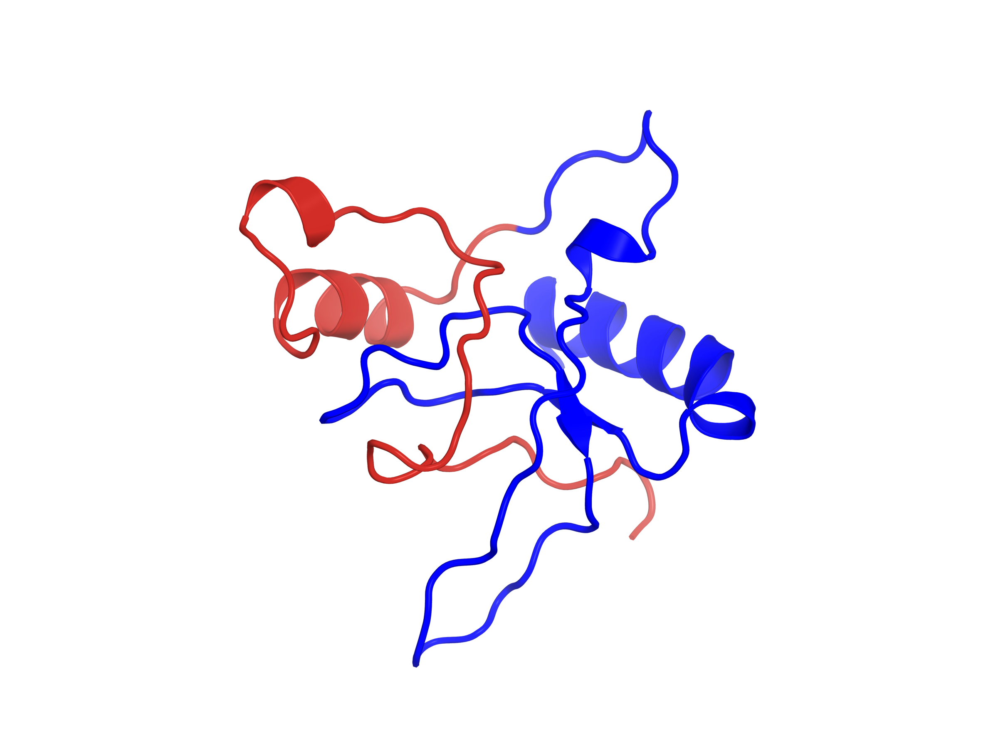
chRNA / EVIDENCE GALLERY
Gsdmd → Tmem106a: RNA architecture and a predicted fold
Reference-reconstructed RNA and protein sequence; the candidate fold remains low confidence.
Gsdmd · exons 1–2
Tmem106a · exons 6–9
Candidate fold · predicted
2 → 6
1
2
6
7
8
9
chr15:75,735,477 (+) → chr11:101,479,679 (+)
ENSMUST00000023238.6 / ENSMUST00000039581.14
118-aa reconstructed protein architecture
1–73 · Gsdmd-derived
74–118 · novel C terminus
Low confidence · mean pLDDT 48.70
Blue: in-frame Gsdmd sequence. Red: novel out-of-frame
Tmem106a-derived C terminus.
Boltz2 · pTM 0.336
SOURCE Venezia et al., Nature (2026), doi:10.1038/s41586-026-10982-x Figs 1 / 3; candidate_examples.json; reference_orf_verification.json; structure manifest
04
METHOD / LIMIT Symbolic exon widths. Retained RNA exons do not imply translation throughout. Boltz2 fold is predicted, not experimental.
Notes:
Gsdmd → Tmem106a: RNA architecture and a predicted fold
SOURCE
Venezia et al., Nature (2026), doi:10.1038/s41586-026-10982-x Figs 1 / 3; candidate_examples.json; reference_orf_verification.json; structure manifest
METHOD
Exact probe halves map to annotated transcripts. Exon numbers are transcript-specific; a lexicographic representative is displayed among exact matches. The 118-aa sequence was independently reference-reconstructed and matches the cached Boltz2 input.
INTERPRETATION / CAVEAT
Symbolic exon widths. Retained RNA exons do not imply translation throughout. Boltz2 fold is predicted, not experimental.
Generated from the reviewed repository artifacts, not invented measurements. Exact sources and checksums are in gallery/figure_manifest.json.

Slide 5
chRNA / EVIDENCE GALLERY
Junction evidence and model score can disagree
Exact exon choices are transcript-specific; a high score does not create biological support.
Cd274 → Lacc1
Cd274
Lacc1
0.227
3 → 6
1
2
3
6
7
8
RNA OOF score
Reported support
chr19:29,351,299 (+) → chr14:77,268,402 (-)
Psap → Lgals3
Psap
Lgals3
0.994
14 → 6
…
11
12
13
14
6
RNA OOF score
Not reported
supported
chr10:60,138,376 (+) → chr14:47,622,982 (+)
SOURCE candidate_examples.json; predictions.tsv; Venezia et al., Nature (2026), doi:10.1038/s41586-026-10982-x Fig. 1 / Extended Data Fig. 2
05
METHOD / LIMIT Representative transcripts are not uniquely validated isoforms. No protein/function claim for Psap:Lgals3.
Notes:
Junction evidence and model score can disagree
SOURCE
candidate_examples.json; predictions.tsv; Venezia et al., Nature (2026), doi:10.1038/s41586-026-10982-x Fig. 1 / Extended Data Fig. 2
METHOD
Two probe-sequence-derived junction diagrams; same preserved parent order and assembly. Full-panel out-of-fold RNA scores shown; no ORF inference for these examples.
INTERPRETATION / CAVEAT
Representative transcripts are not uniquely validated isoforms. No protein/function claim for Psap:Lgals3.
Generated from the reviewed repository artifacts, not invented measurements. Exact sources and checksums are in gallery/figure_manifest.json.

Slide 6
chRNA / EVIDENCE GALLERY
Evaluate new parent-gene groups, not memorized genes
352 parent-gene components are held intact across 5 folds.
Fold 0
Fold 1
Fold 2
Fold 3
Fold 4
Training groups
Training groups
Training groups
Training groups
Held-out groups
Fit on training rows only
Score once
Median imputation
+ missing indicators
Feature scaling
Logistic regression
L2 · C = 1
Out-of-fold
reported-support score
Hi-C ablation: both classifiers use identical contact-observed training and test candidates.
SOURCE classifier/folds.tsv; predictions.tsv; MODEL_CARD.md
06
METHOD / LIMIT Illustrative partition diagram; exact assignments are in folds.tsv. No validation-derived predictor inputs.
Notes:
Evaluate new parent-gene groups, not memorized genes
SOURCE
classifier/folds.tsv; predictions.tsv; MODEL_CARD.md
METHOD
Connected components group every pair sharing either parent gene. Deterministic five-fold predictions (seed 42); fold-local median imputation and scaling; fixed L2 logistic regression C=1.
INTERPRETATION / CAVEAT
Illustrative partition diagram; exact assignments are in folds.tsv. No validation-derived predictor inputs.
Generated from the reviewed repository artifacts, not invented measurements. Exact sources and checksums are in gallery/figure_manifest.json.

Slide 7
chRNA / EVIDENCE GALLERY
A small AP increase; uncertainty includes no benefit
Matched cohort: 401 ordered pairs, 92 reported supported. Identical training rows and fixed folds.
0.4
Hi-C − RNA
0.296
0.300
+0.0036
0.3
0.266
difference in average precision
0.2
0.1
0.0
Read support
RNA
RNA + Hi-C
95% interval [-0.031, 0.047]
SOURCE classifier/metrics.json → matched_hic + comparison; predictions.tsv
07
METHOD / LIMIT RNA AP 0.296 versus RNA+Hi-C AP 0.300 does not establish improvement; bootstrap interval crosses zero.
Notes:
A small AP increase; uncertainty includes no benefit
SOURCE
classifier/metrics.json → matched_hic + comparison; predictions.tsv
METHOD
Average precision of saved out-of-fold predictions. Difference interval from 1,000 bootstrap resamples of parent-gene components, without model refitting.
INTERPRETATION / CAVEAT
RNA AP 0.296 versus RNA+Hi-C AP 0.300 does not establish improvement; bootstrap interval crosses zero.
Generated from the reviewed repository artifacts, not invented measurements. Exact sources and checksums are in gallery/figure_manifest.json.

Slide 8
chRNA / EVIDENCE GALLERY
Top-ranked candidates tell a more cautious story
A small AP change does not guarantee better prioritization at a chosen cutoff.
Read-support
ranking
9 / 20
RNA
10 / 20
RNA + Hi-C
9 / 20
Interchromosomal matched subset: RNA 5 / 20 → RNA + Hi-C 7 / 20 (244 pairs; 58 reported supported)
SOURCE classifier/metrics.json → matched_hic / interchromosomal
08
METHOD / LIMIT Dots represent reporting labels, not verified true/false chimeras. The compared ranked lists need not contain the same pairs.
Notes:
Top-ranked candidates tell a more cautious story
SOURCE
classifier/metrics.json → matched_hic / interchromosomal
METHOD
Counts of reported-supported pairs among the first 20 saved scores, with pair-ID tie-breaking. Interchromosomal comparison restricted to the same 244 observed-contact pairs.
INTERPRETATION / CAVEAT
Dots represent reporting labels, not verified true/false chimeras. The compared ranked lists need not contain the same pairs.
Generated from the reviewed repository artifacts, not invented measurements. Exact sources and checksums are in gallery/figure_manifest.json.

Slide 9
chRNA / EVIDENCE GALLERY
An actual NVIDIA run, with no probe-panel matches
Parabricks on an A100-SXM4-80GB, using a deterministic two-million-pair RNA subsample.
VALIDATED READ PAIRS
ALIGNMENT WALL TIME
MATCHED PROBE PAIRS
2,000,000
85.49 s
0
Deterministic prefix subsample
Reference / setup excluded
Independent GPU evidence only
28,482 raw chimeric records
±10 nt
ordered-junction match
3,275 resolved split-junction
records
25,207 encompassing-mate
records
$1.35 quote-based instance estimate
Instance deleted; watchdog cancelled
SOURCE compute/pilot_summary.json; evidence.tsv; Chimeric.out.junction; independent review
09
METHOD / LIMIT Zero probe matches does not refute candidates. 85.49 s is alignment only; no matched CPU speedup benchmark.
Notes:
An actual NVIDIA run, with no probe-panel matches
SOURCE
compute/pilot_summary.json; evidence.tsv; Chimeric.out.junction; independent review
METHOD
Parabricks 4.7.1-1; paired 151-nt reads from SRR37513722; both ordered breakpoints, strands and chromosomes matched within ±10 nt to probe-derived junctions.
INTERPRETATION / CAVEAT
Zero probe matches does not refute candidates. 85.49 s is alignment only; no matched CPU speedup benchmark.
Generated from the reviewed repository artifacts, not invented measurements. Exact sources and checksums are in gallery/figure_manifest.json.

Slide 10
chRNA / EVIDENCE GALLERY
OpenAI turns cached evidence into traceable explanations
Five Codex-authored reports separate observations, interpretations, and unknowns.
Evidence row
Primary passages
OBSERVATION
Reported NanoString pair support
INTERPRETATION
Paper CTCF perturbation context
Source identity + exact input hash
UNKNOWN
Supported: Gsdmd:Tmem106a, Cd274:Lacc1
Contrast: Psap:Lgals3 is not reported supported
Assay QC; function beyond evidence
Observed evidence stays distinct from biological authenticity, translation, and function.
SOURCE demo/reports/*.json; sources/passages.json; report_review.md; scripts/demo/reports.py
10
METHOD / LIMIT No Responses API call occurred without credentials. The optional strict-schema API adapter is separate; reports are not model features or labels.
Notes:
OpenAI turns cached evidence into traceable explanations
SOURCE
demo/reports/*.json; sources/passages.json; report_review.md; scripts/demo/reports.py
METHOD
The Codex agent authored five reports from actual evidence rows and supplied primary-paper passages. Citation IDs, numerical claims, input snapshots and hashes were reviewed/cached.
INTERPRETATION / CAVEAT
No Responses API call occurred without credentials. The optional strict-schema API adapter is separate; reports are not model features or labels.
Generated from the reviewed repository artifacts, not invented measurements. Exact sources and checksums are in gallery/figure_manifest.json.

Slide 11
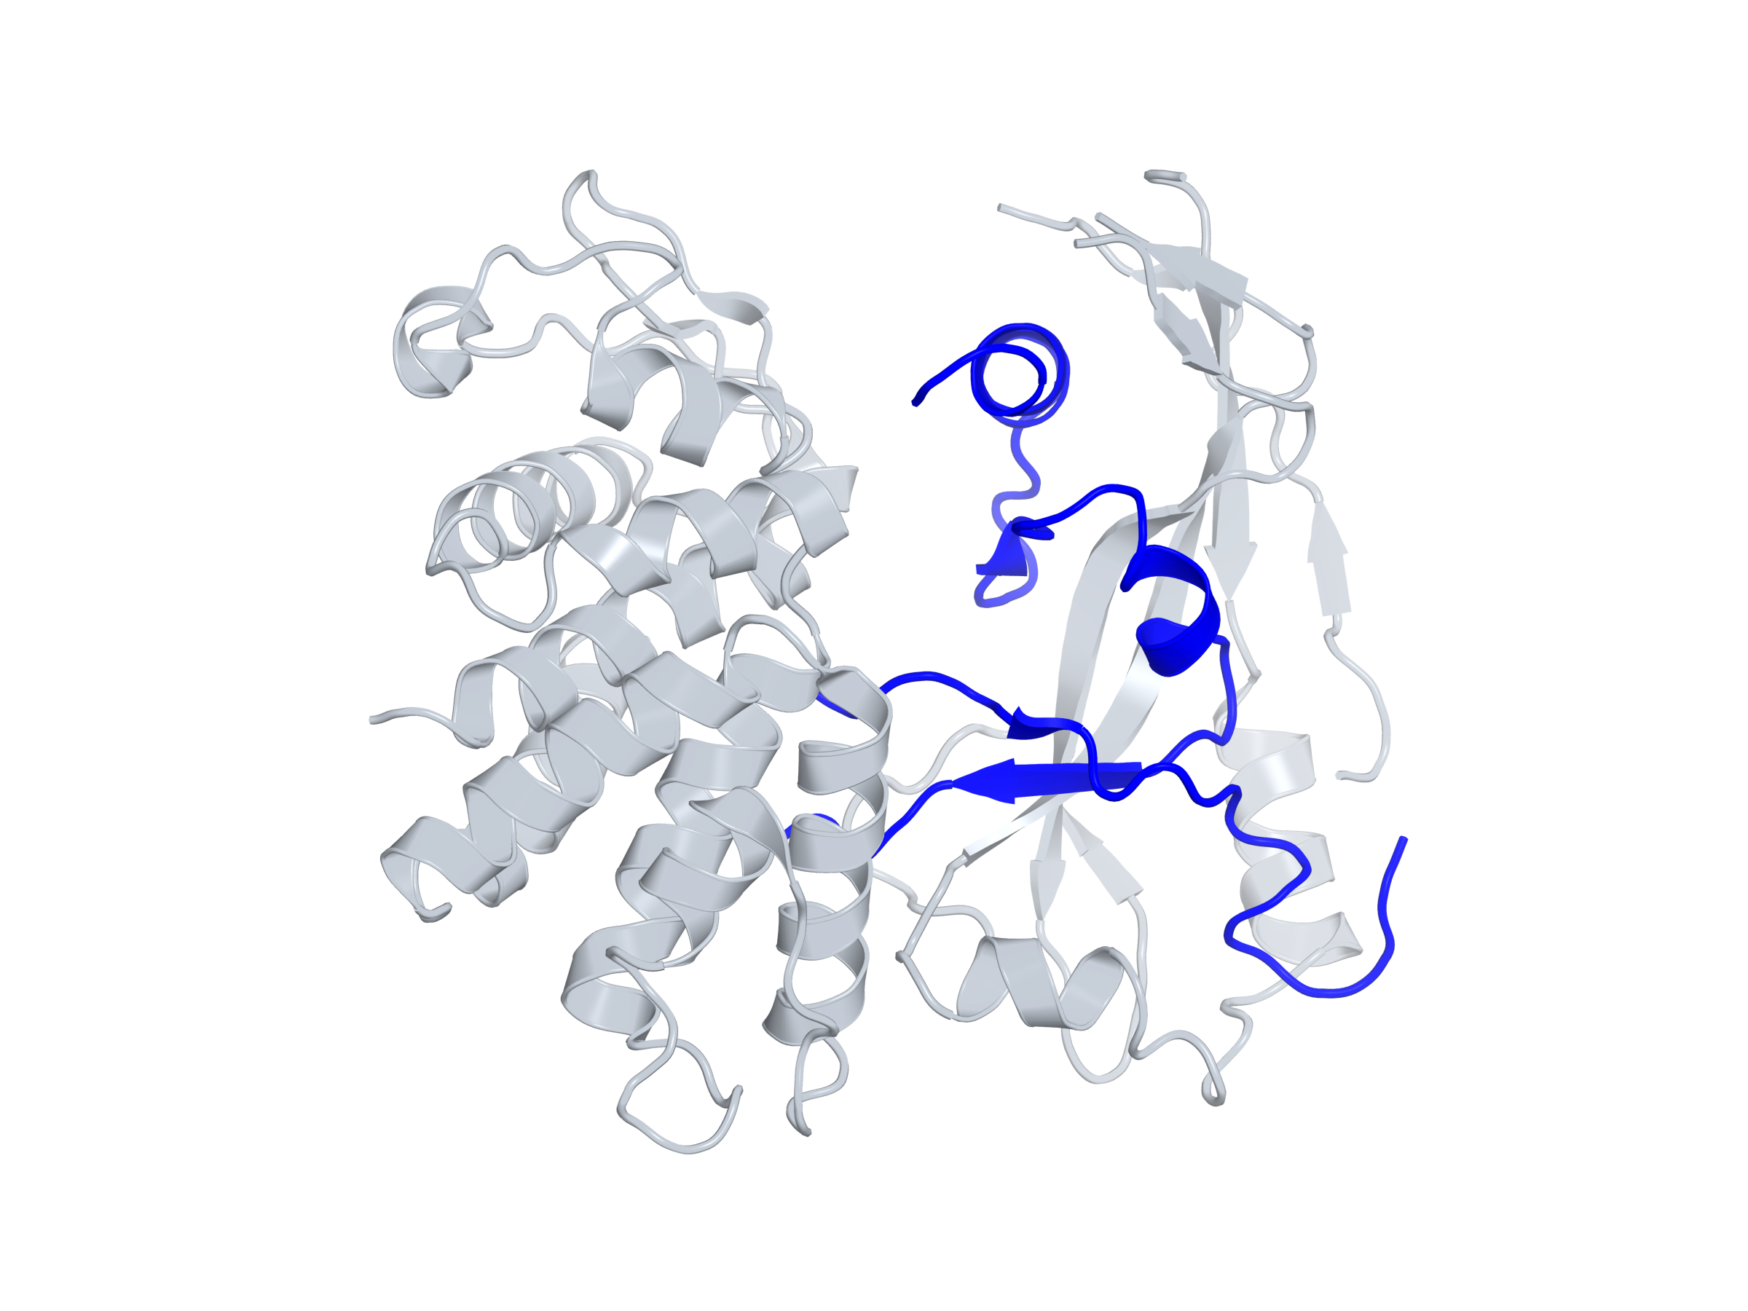
chRNA / EVIDENCE GALLERY
A predicted chimera is not an experimental structure
Protein architecture can be source-grounded while the three-dimensional fold remains uncertain.
Experimental parent · GSDMD
Predicted candidate · 118 residues
PDB 6N9N · experimental mouse parent
3.30 Å crystallographic structure
Boltz2 candidate prediction · mean pLDDT 48.70
pTM 0.336 · low confidence
Blue residues 1–73: Gsdmd-derived. Red residues 74–118: novel out-of-frame C terminus.
SOURCE structures/manifest.json; PDB 6N9N; Venezia et al., Nature (2026), doi:10.1038/s41586-026-10982-x Fig. 3a / Methods
11
METHOD / LIMIT Gsdmd:Tmem106a model is low confidence. Experimental parent GSDMD coordinates do not validate the chimera fold.
Notes:
A predicted chimera is not an experimental structure
SOURCE
structures/manifest.json; PDB 6N9N; Venezia et al., Nature (2026), doi:10.1038/s41586-026-10982-x Fig. 3a / Methods
METHOD
Structure assets are independently supplied with sequence identity, residue-source boundaries, source coordinates, method and confidence. The paper Fig. 3a chimera is also a prediction (AlphaFold3), not an experimental structure.
INTERPRETATION / CAVEAT
Gsdmd:Tmem106a model is low confidence. Experimental parent GSDMD coordinates do not validate the chimera fold.
Generated from the reviewed repository artifacts, not invented measurements. Exact sources and checksums are in gallery/figure_manifest.json.

Slide 12
chRNA / EVIDENCE GALLERY
An auditable result. An independent test comes next.
This gallery demonstrates an auditable experiment and a working evidence product.
Demonstrated
Still unestablished
479 reproducible evaluated pairs
A consistent Hi-C ranking benefit
Gene-disjoint held-out predictions
Candidate recovery in the GPU pilot
Real GPU-generated junction output
Assay QC / biological sample counts
Five reviewed source-grounded reports
A reliable experimental chimera fold
Next test: complete assay/QC records + independent candidates + targeted junction confirmation.
SOURCE All reviewed artifacts; dataset audit; MODEL_CARD.md; compute + demo status records
12
METHOD / LIMIT Probe-panel selection, unknown QC, coarse Hi-C context, small labels and model uncertainty limit generalization.
Notes:
An auditable result. An independent test comes next.
SOURCE
All reviewed artifacts; dataset audit; MODEL_CARD.md; compute + demo status records
METHOD
Summarize the actual retrospective result, independent GPU pilot, cited-report workflow, and remaining experimental needs; no newly discovered chimeras are claimed.
INTERPRETATION / CAVEAT
Probe-panel selection, unknown QC, coarse Hi-C context, small labels and model uncertainty limit generalization.
Generated from the reviewed repository artifacts, not invented measurements. Exact sources and checksums are in gallery/figure_manifest.json.

