Slide 1


2
+
Analysis & Strategy Planning

Slide 2


Objective
2
+
2
+
Use 2018 data as baseline to compare business strategies

Slide 3
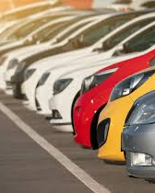
2018 in review
2
+
50 Branches
4000 vehicle fleet
80,000+ rental transactions
$52.8 Million in Revenue
$33 Million in Costs

Slide 4
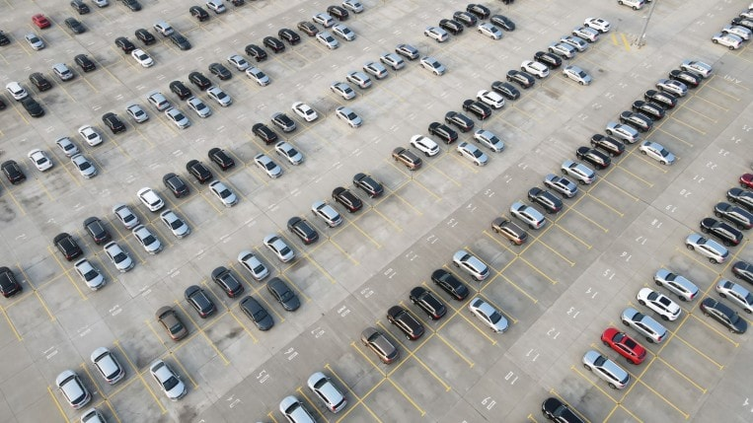
2
+
Strategy 1
Strategy 2
Goal: Increase Revenue
Method: increase fleet size by 500
Assumption: fleet addition keep average revenue and costs
Goal: Reduce Costs
Method: sell 500 lowest profit vehicles
Assumption: not including any revenue from the vehicle sales

Slide 5
Strategy 1
2
+
Goal: Increase Revenue
Total fleet increase from 4000 to 4500
Assuming new vehicles maintain average revenue and costs
Annual Revenue increase by 12.5%

Slide 6
Strategy 2
2
+
Reduce Costs
Total fleet decrease from 4000 to 3500
Annual cost decreased by 13.7%
Even with reduced fleet size, don’t lose out on total Profits

Slide 7
Reccomendation
2
+
Implement Strategy 2
Strategy 1 is projected in increase total annual revenue by 12.5%
Strategy 2 is projected to decrease total annual costs by 13.7%
Therefore Strategy 2 of selling off the 500 least profitable vehicles would have the largest impact.

Slide 8
THANK YOU
2
+

