Slide 1


2019 Race Results Analysis
Capstone III: Analysis with Python
Presenter: Paul Reynolds

Slide 2

The Dataset
The dataset being used contains the results for athletes scheduled to start the full distance Ironman race in Kona, HI.
There were 2435 participants with 15 columns of data including name, country, age group, race time and ranks (finish positions).
Over 7% of the athletes scheduled to race either didn’t start or started but weren’t able to complete the full race.
We’ll be focusing our analysis on the athletes who finished
All data was organized, visualized and tested using Python.

Slide 3
Info on Triathlon
In triathlon there are 3 separate disciplines combined into a single race: Swim, Bike, Run
Triathlon races are classified by their distances, from shortest to longest: Sprint, Olympic, Half Ironman, Ironman
Ironman distances:
Swim: 2.4 miles
Bike: 112 Miles
Run: 26.2 miles

Slide 4
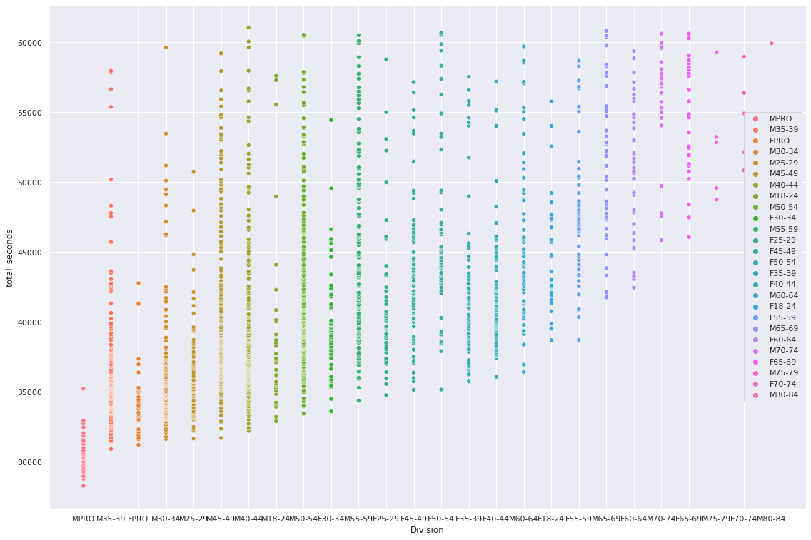
Finishers Visualization
Interesting visualization that plotted all finish times for athletes within each sex and age division.
Notice there were 5 women competing in the 70-74 group and 1 man in the 80-84 group.
The upper limit of 60000 seconds is because the race has a 17 hour cutoff time

Slide 5
Research Questions
Which discipline has the strongest correlation between the overall rank (finish place) and rank for swim, bike or run?
Which discipline will have the largest variance in finish times?

Slide 6
Hypotheses
Hypothesis #1: The bike rank will have the strongest correlation to overall rank.
Hypothesis #2: The bike time will have the largest variance (standard deviation) of finish times.

Slide 7
Methods for Testing
Hypothesis #1
Hypothesis #2
Using the rank data for each individual event (swim, bike, run) and run a correlation test to overall rank.
Convert finish times from HH:MM:SS for each individual event to total seconds and run a descriptive statistical analysis for standard deviation.

Slide 8
Application of Findings
Athletes and sports are driven by data and statistical analysis. Turn on any professional sport and before long the commentators will talk about an athlete or the team’s stats.
Triathletes are some of the most data driven athletes in one of the most expensive-to-participate sports. From wetsuits in the swim, to aerodynamics on the bike and carbon plates in running shoes, these athletes are constantly looking for advantages.
Today’s analysis can help triathletes determine which discipline to invest time and resources in for making the most impact on improving their times and rank.

Slide 9
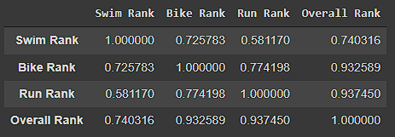
Hypothesis #1
Hypothesis 1: Busted!
I had assumed since the bike on average takes about twice as long as the run to complete, it would be the clear winner.
Analysis:
Even though the Run Rank did have the strongest correlation, it was only by a difference of 0.005

Slide 10
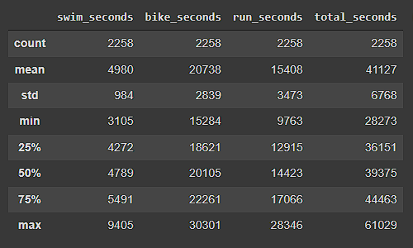
Hypothesis #2
Hypothesis 2: Busted!
Again thinking because bike was the longest overall, it would have the largest standard deviation, proved to be false.
Analysis:
This is where looking at the race as a whole it makes sense that as an average 12 hours of continued effort, towards the end of the race other compounding factors like nutrition and weather begin to cause more variances.

Slide 11
Project Summary
Hypothesis #1
Hypothesis #2
We were able to find that the strongest correlation to overall rank was with both run and bike ranks.
In preparing for an Ironman, you’ll statistically have more impact on improving your overall rank by focusing on trying to make your bike as strong as your run or vice versa
We found that the largest variance of finish times was in the last leg of the race: the run.
We can conclude then that making smaller improvements in training on your run time might not have as much impact on reducing your overall time as it would on the swim or bike portion

Slide 12
Next Level
Difficulties
Expanding
I never realized how difficult it was going to be working with time!
The swim times were stuck in a datetime.object format that I couldn’t figure out how to change to a duration. Even when trying to make those changes directly in the dataset.
In order to run any statistical analysis, I had to find a workaround by subtracting the bike and run times from the overall time.
One key note is that this data set is from the Ironman World Championships; The best of the best.
You have to qualify to be able to race in Kona. So this will never be their first Ironman.
With more time it would be interesting to expand on this analysis to see if there would be any change to the hypotheses results testing data from other race courses with more first time participants.

Slide 13
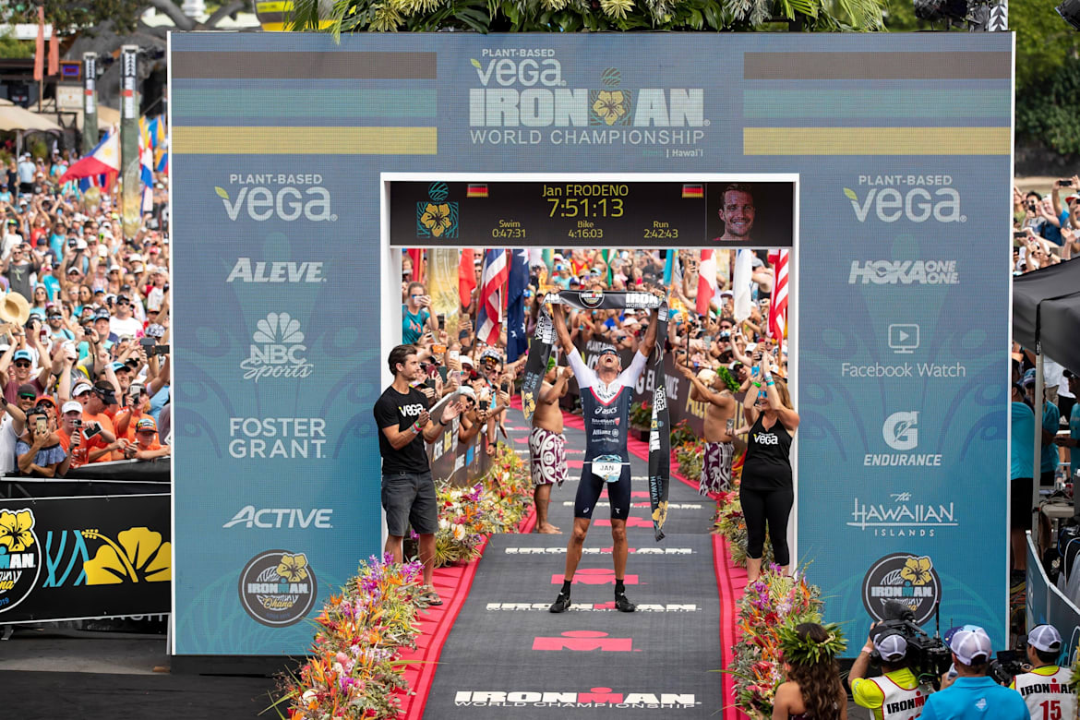
Finish
Thank you for your time!

