Slide 1
Unlearn: Re-learn

Slide 2
Track 1:Scalable Tech Stacks

Slide 3
To (re)introduce a set of technologies that enable the creation of scalable, production ready, cloud native services in record time.

Slide 4
To (re)introduce a set of technologies that enable the creation of scalable, production ready, cloud native services in record time.
an opinionated approach to using these tools professionally.

Slide 5
To (re)introduce a set of technologies that enable the creation of scalable, production ready, cloud native services in record time.
techniques, patterns & best practices.

Slide 6
To (re)introduce a set of technologies that enable the creation of scalable, production ready, cloud native services in record time.
start small, grow BIG.

Slide 7
To (re)introduce a set of technologies that enable the creation of scalable, production ready, cloud native services in record time.
Rely on tested components that rarely change.

Slide 8
To (re)introduce a set of technologies that enable the creation of scalable, production ready, cloud native services in record time.
Scale horizontally. Independently deployable/testable/scalable.

Slide 9
Our toy project:
Distributed TODOs Service

Slide 10
For each technology (or technique), one implementation.
microservices – distributed – REST API– NoSQL – LRUCache
event driven architecture – TDD - CD/CI

Slide 11
Our Tech Stack
Python
Docker
Redis
MongoDB
REST APIs (best practices)
Event Streams (Kafka / Redis Streams)

Slide 12
Day 1: Python + Docker

Slide 13
Environment
Dev environment (Host):
VS Code: https://code.visualstudio.com/Download
Docker (Docker Desktop): https://docs.docker.com/install
PTVSD (Python Visual Studio Debugger): pip install ptvsd
If you don’t have all of these installed, now is a good time to start…

Slide 14
Python 101: Hello, World!

Slide 15
Python 101: Hello, World!
But first, lets address some common myths.

Slide 16
Is it True?
Q: Python is a scripting language, there is no compiler!

Slide 17
Is it True?
Q: Python is a scripting language, there is no compiler!
R: Python is an interpreted language; each script is compiled (and cached) to bytecode during the first run. Execution happens inside a VM.

Slide 18
Is it True?
Q: Python is dynamically typed.

Slide 19
Is it True?
Q: Python is dynamically typed.
R: Objects in python are strongly typed, but names can be reassigned dynamically.
Python typing system is commonly called “Duck Typing” (if it quacks like a duck, walks like a duck and swims like a duck, you can assume it’s a duck). The type of the object is not as important as the methods it defines (__len__, __add__, __gt__, etc.).

Slide 20
Some things to know…
In python everything is a pointer.
One can only interact with an object through its methods.
int, str & float are immutable types (no __set__() method).
Integers can grow indefinitely (if there is memory available).
All objects inherit from <object> and are created through factories (including functions & modules).
Only built-in types have private members. All user class attributes are entirely public.

Slide 21
Is it True?
Q: Python is slow!

Slide 22
Is it True?
Q: Python is slow!
R: Yes.

Slide 23
Is it True?
Q: Python is slow!
R: But also, no:
Usually the ’slow code’ can be profiled and re-implemented more efficiently (built-in tools like cprofile can help).
If the implementation is optimal, there are multiple interpreters & strategies to speed up your code (pypy, numba).
If execution speed is crucial, perhaps that module should be written in a performance-oriented language (C, C++, Rust). Or as an extension with a python API.

Slide 24
Is it True?
Q: Python code can’t be multithreaded, and the GIL is a POS!

Slide 25
Is it True?
Q: Python code can’t be multithreaded, and the GIL is a POS!
R: The Global Interpreter Lock (GIL) can be an obstacle in very specific (CPU-bound) cases, but there are several strategies to follow if you need concurrent or parallel tasks:
Use multiprocessing instead of multithreading.
Use async-await syntax.
Do you really need to use multithreading for this component? Perhaps you could use a task queue (ie. Celery).

Slide 26
Python 101: Hello, World!

Slide 27
Python 101: Hello, World!
But first, some facts about python.

Slide 28
Quick notes about Python
Official stable version is Python 3.8
Python 2.x is officially deprecated.
There are some (major) breaking changes in 3.5-3.6, 3.6-3.7.
The official interpreter is CPython but there are many compliant implementations.
Single source of truth: python.org

Slide 29
Initial goals of Guido Van Rossum (former BDFL*) for Python.
An easy and intuitive language just as powerful as major competitors.
Open source, so anyone can contribute to its development.
Code that is as understandable as plain English.
Suitability for everyday tasks, allowing for short development times.
*no longer BDFL because of the Walrus Operator RFC arguments.

Slide 30
Python 101: Hello, World!

Slide 31
Python 101: Hello, World!
But first, let’s make sure we write ‘good Python’

Slide 32
Good Python? What’s that?
The Zen of Python, by Tim Peters.
PEP8 Style Guide (snake_case for functions & variable names, CamelCase for classes).
What you know from other languages, still apply:
Don’t try to be clever…
Remember: Code is more often READ than WRITTEN.
Follow your principles:
DRY, SOLID
If you’re having this problem in 2020, someone else has already implemented a solution…
Try to apply design patterns & idioms.

Slide 33
Functional, yet Pythonic
Declarative.
Write ‘what’ task to perform, not ‘how’ to do it.
Prefer ‘pure functions’:
No internal state.
Idempotent, with no side effects.
Choose immutable types whenever possible.
Use []/{}/() comprehensions over filter, reduce & map.
Leverage the language built-in types & features.
Prefer dependency injection.

Slide 34
Python 101: Hello, World!

Slide 35
Python 101: Hello, World!
Inside a docker container.

Slide 36
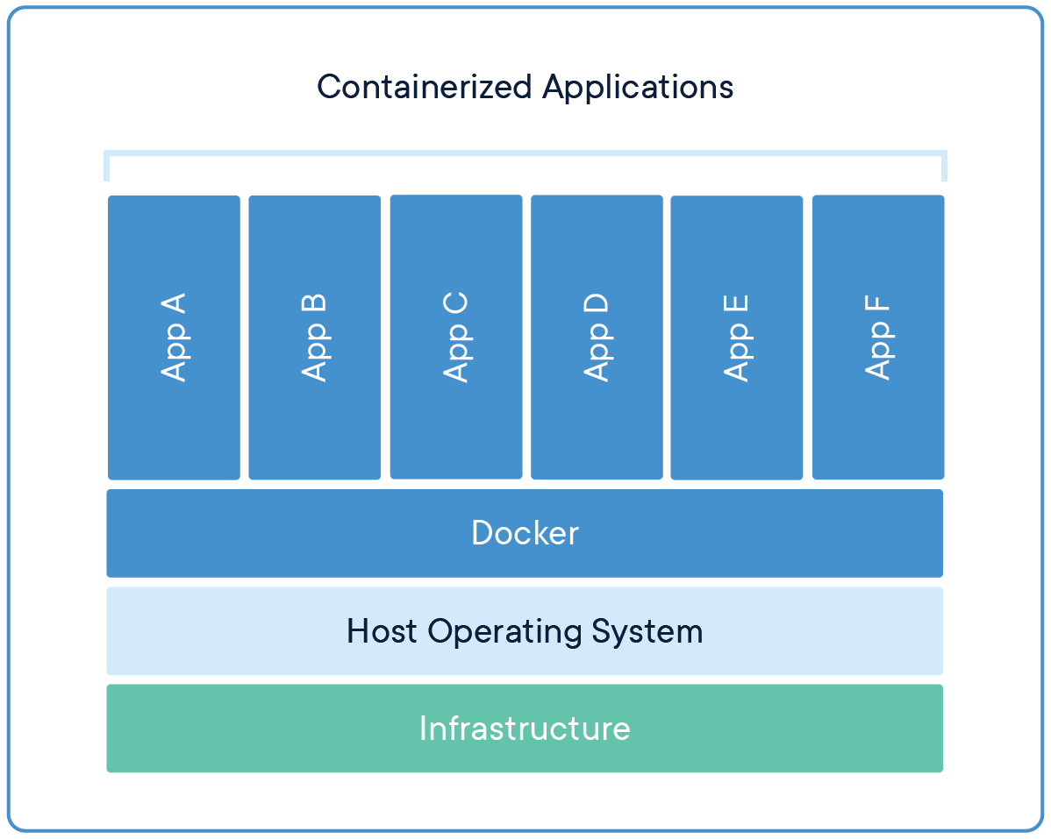
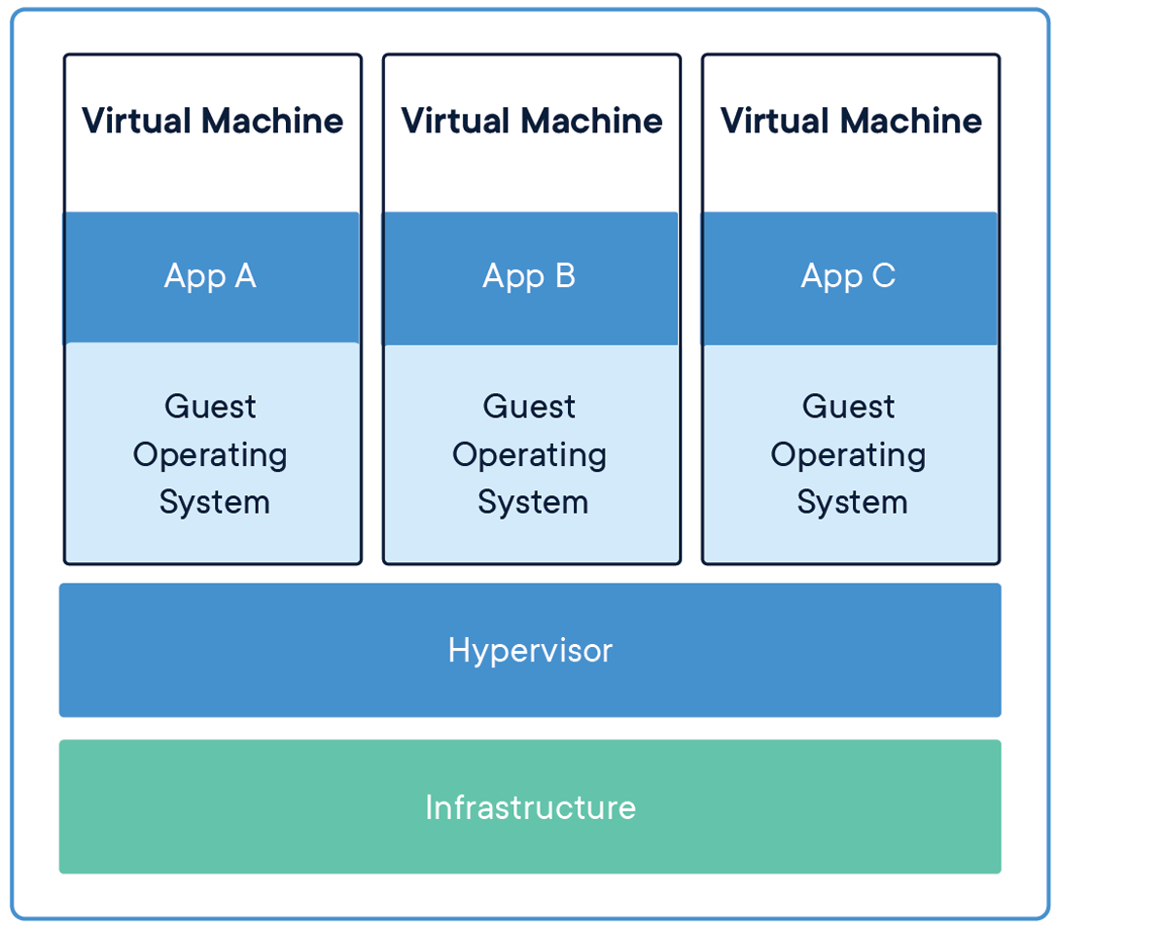
Containers & microservices
What is a container?

Slide 37
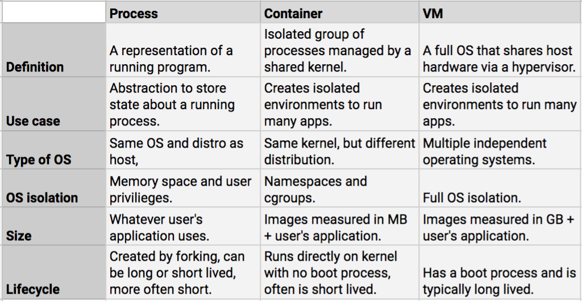
Processes vs containers vs VMs
What is the difference between a process, a container and a VM?

Slide 38
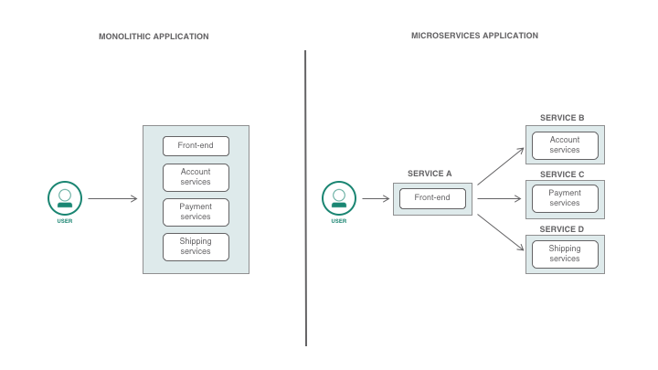
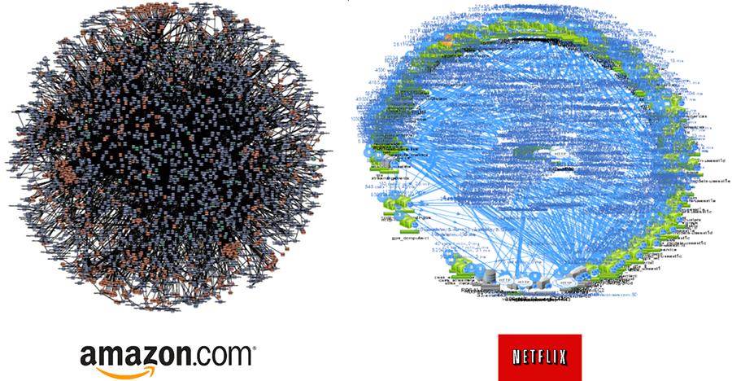
Containers in the cloud
Why should we use microservices & containers?
Amazon & Netflix ”Death Star” architectures.

Slide 39
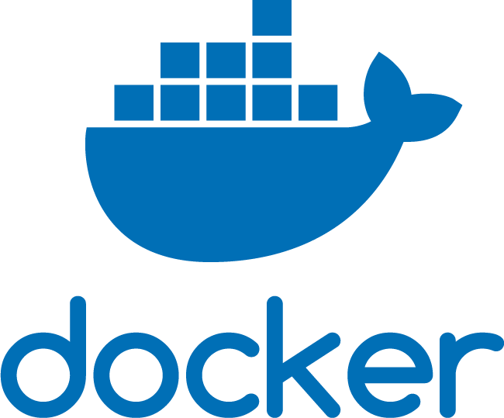
Docker
Widely adopted. Defined OCI.
Multiplatform.
Open source.
You can choose any implementation that fits your needs.
Their logo is a whale. Carrying containers.

Slide 40
Dockerfile
The contents of a dockerfile will allow you to:
Create a new image FROM a previous one (or FROM SCRATCH).
COPY (or ADD) files to the container’s filesystem.
RUN commands to install or configure the container.
Define ENV variables or input ARG to dynamically change the resulting image.
EXPOSE ports to interact with the world.
Set a LABEL for the image.
Define a WORKDIR where your USER starts a process by running a CMD.
Mount a VOLUME to interact with the host’s filesystem.
reference

Slide 41
Off course, everything can be part of the command:
docker run \
--user=root \
--port=8888:8888 \
--volume=/home/$USER/files:/myapp/files \
--volume=/home/$USER/more-files:/myapp/more-files \
bash -x “run_my_app.sh --allow-root --debug=TRUE”

Slide 42
Docker Compose
Compose is a wrapper tool to run multi-container applications:
Define multiple services in a single YAML file (or multiple files).
Build, re-build and monitor the status of multiple containers.
Define the environment for your app, including volumes & networking fibers.
Use environment variables to build & run containers.

Slide 43
Quick notes about…
Storage:
Containers should be stateless to allow for horizontal scaling. If you need persistent storage, you can define volumes for your services.
Networking:
You should define networks to ‘wire’ your containers together. Only expose ports intended to be used by public services.

Slide 44
Environment
At build time (use ARG & ENV).
At testing time.
At deployment time (to enable on-shot procedures).
At runtime.
PRO tip: use .env files to override variables.

Slide 45
Python 101: Hello, World!

Slide 46
print(‘Hello, World!’)

Slide 47
That was lame.
Let’s spice it up :)

Slide 48
Attach a remote debugger
Remember, a container acts as a separate host…
Lets configure the image:
Configure timezone (dinamycally).
Add user.
Copy project resources.
Configure VS CODE.
Refactor code to run inside a function.
Explore…

