Slide 1
Buzzwords: CD

Slide 2
¿What is CD?

Slide 3
Continuous Integration
!=
Continuous Delivery
!=
Continuous Deployment
¿What is CD?

Slide 4
Continuous Integration
!=
Continuous Delivery
!=
Continuous Deployment
¿What is CD?

Slide 5
Continuous Integration
!=
Continuous Delivery
!=
Continuous Deployment
Small merges to master.
¿What is CD?

Slide 6
Continuous Integration
!=
Continuous Delivery
!=
Continuous Deployment
*Small merges to master.
¿What is CD?
*Short-lived feature branches are a requirement.

Slide 7
Continuous Integration
!=
Continuous Delivery
!=
Continuous Deployment
*Small merges to master.
¿What is CD?
As often as possible.
*Short-lived feature branches are a requirement.

Slide 8
Continuous Integration
!=
Continuous Delivery
!=
Continuous Deployment
*Small merges to master.
Avoid the hell of large releases.
¿What is CD?
As often as possible.
*Short-lived feature branches are a requirement.

Slide 9
Continuous Integration
!=
Continuous Delivery
!=
Continuous Deployment
*Small merges to master.
Validated by a build and
Avoid the hell of large releases.
¿What is CD?
As often as possible.
automated testing
*Short-lived feature branches are a requirement.

Slide 10
Continuous Integration
!=
Continuous Delivery
!=
Continuous Deployment
¿What is CD?

Slide 11
Release changes as often as possible.
Continuous Integration
!=
Continuous Delivery
!=
Continuous Deployment
¿What is CD?

Slide 12
Release changes as often as possible.
Continuous Integration
!=
Continuous Delivery
!=
Continuous Deployment
¿What is CD?
Deploy at any time (manually).

Slide 13
Release changes as often as possible.
Plan when to release.
Continuous Integration
!=
Continuous Delivery
!=
Continuous Deployment
¿What is CD?
Deploy at any time (manually).

Slide 14
Release changes as often as possible.
Plan when to release.
Continuous Integration
!=
Continuous Delivery
!=
Continuous Deployment
Automated
release
¿What is CD?
Deploy at any time (manually).

Slide 15
Continuous Integration
!=
Continuous Delivery
!=
Continuous Deployment
¿What is CD?

Slide 16
Continuous Integration
!=
Continuous Delivery
!=
Continuous Deployment
Every change that passes all stages is released.
¿What is CD?

Slide 17
Continuous Integration
!=
Continuous Delivery
!=
Continuous Deployment
No human intervention.
Every change that passes all stages is released.
¿What is CD?

Slide 18
Continuous Integration
!=
Continuous Delivery
!=
Continuous Deployment
No human intervention.
No Release Day!
🎉 🎉 🎉
Every change that passes all stages is released.
¿What is CD?
Or… Every day is release day… 🎉 ? ...

Slide 19
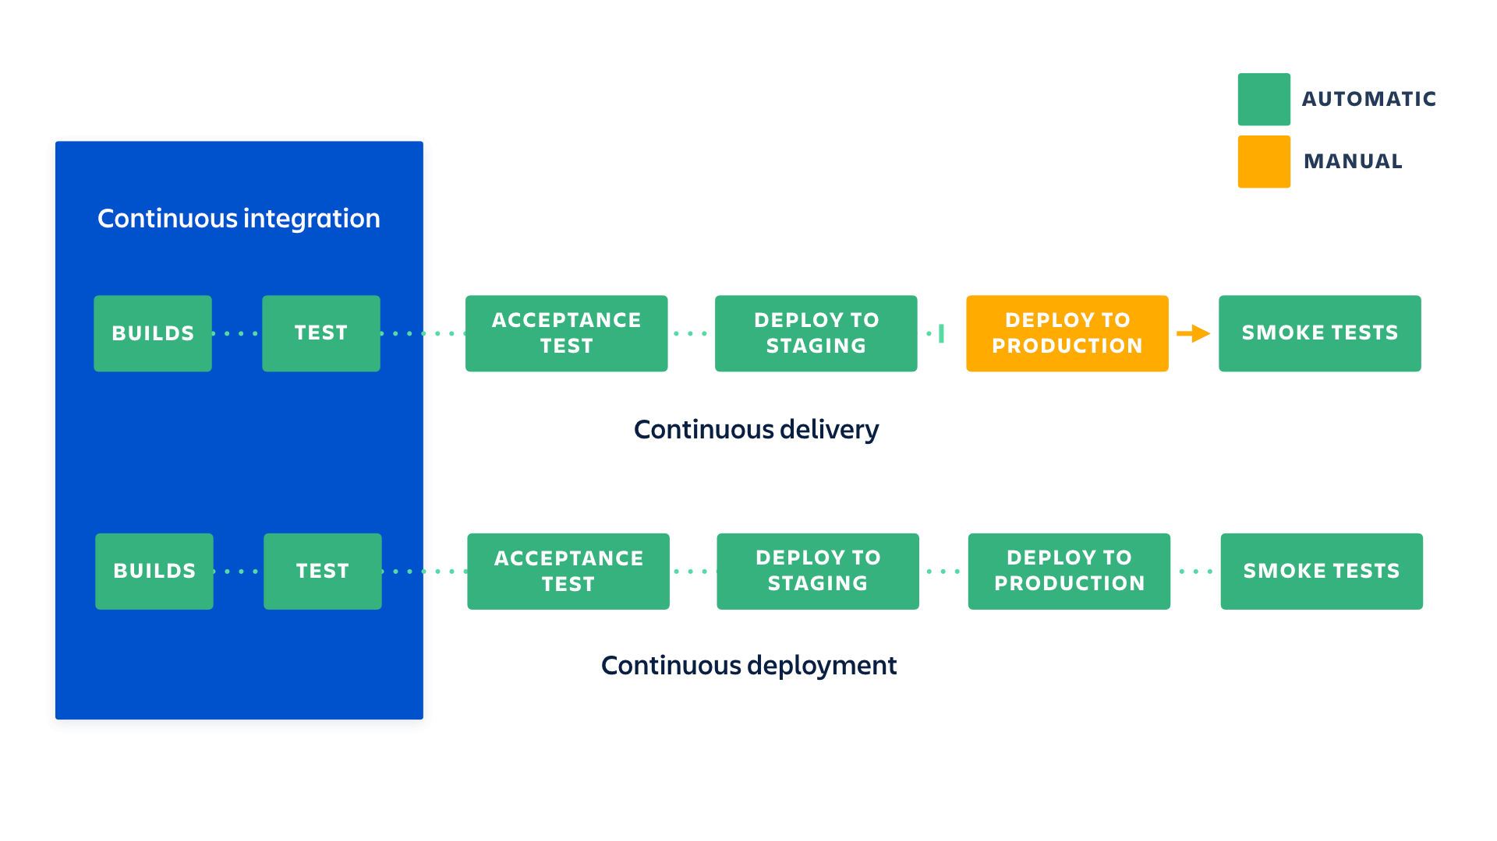

Slide 20






CI/CD Pipeline
Artifact Repository
Source Repo
git push
event
publish
use
version
use
use
build
acceptance test
deploy to staging
deploy to production
unit test
certify version
Deploy manually
on demand
on planned schedule
manually rollback
package
Continuous Delivery
Continuous Integration

Slide 21

The road to happiness
(for an ongoing project)

Slide 22
The road to happiness
(for an ongoing project)
Start by building a Continuous Integration and Continuous delivery pipeline.
Automate the builds.
Create a testing pipeline. → Work on simple tests first.
Automate the deployments.
Try to release as often as possible.

Slide 23
If you want to learn more…
GOTO 2019 – Modern Continuous Delivery – Ken Mugrage https://youtu.be/wjF4X9t3FMk
Continuous integration vs. continuous delivery vs. continuous deployment – Sten Pittet https://www.atlassian.com/continuous-delivery/principles/continuous-integration-vs-delivery-vs-deployment
Deployment Production Line - https://continuousdelivery.com/wp-content/uploads/2011/04/deployment_production_line.pdf

