Slide 1
Unlearn: “The Mighty Database”

Slide 2
Disclaimer: This is an opinionated presentation. It includes MY opinion on how systems should be designed, based on strategies that have worked and have not worked for me in the past. YMMV.

Slide 3
Once upon a time, a brave consultant told an executive:

Slide 4
Once upon a time, a brave consultant told an executive:
C: “You have to protect your data assets”
E: “My data assets? What is that?”

Slide 5
Once upon a time, a brave consultant told an executive:
C: “You have to protect your data assets”
E: “My data assets? What is that?”
C: “Well, it’s the data from your business. That data is valuable!”
E: “You’re right! How do I protect it?”

Slide 6
Once upon a time, a brave consultant told an executive:
C: “Put it in a database. All of it.”

Slide 7
Once upon a time, a brave consultant told an executive:
C: “Put it in a database. All of it.”
And someone made a bunch of money that day.

Slide 8

Once upon a time, a brave consultant told an executive:
C: “Put it in a database. All of it.”
And someone made a bunch of money that day.
( )

Slide 9

Once upon a time, a brave consultant told an executive:
C: “Put it in a database. All of it.”
And someone made a bunch of money that day.
( )
Hurray. .

Slide 10
Once upon a time, a brave consultant told an executive: Other executives realized they had to protect their “data assets” too, so an emerging architecture became popular:

Slide 11
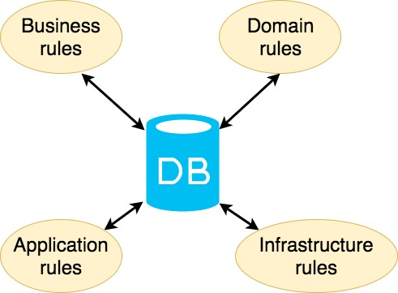
Once upon a time, a brave consultant told an executive: Other executives realized they had to protect their “data assets” too, so an emerging architecture became popular:

Slide 12
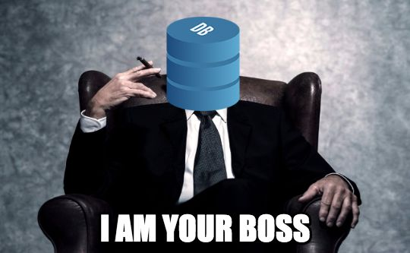
Once upon a time, a brave consultant told an executive: Other executives realized they had to protect their “data assets” too, so an emerging architecture became popular:

Slide 13

And then, some guy appeared:

Slide 14
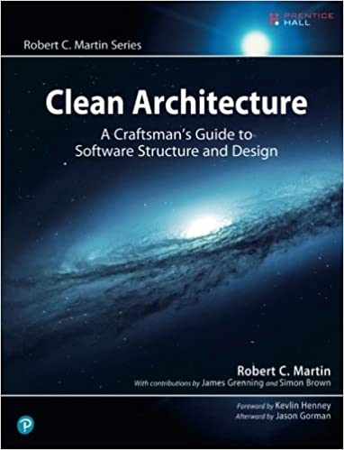
And he wrote a book…

Slide 15
And he wrote a book…
Enter: Uncle Bob and his Clean Architecture

Slide 16
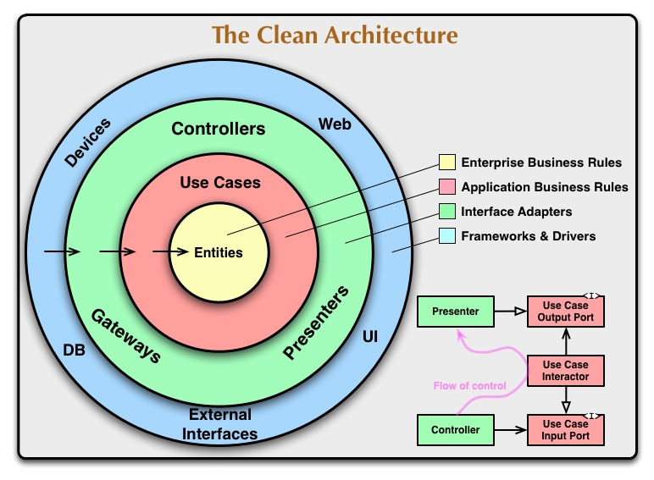

Slide 17
Over the years, Uncle Bob and Michael Feathers have summarized a good Object-Oriented design as:

Slide 18
Over the years, Uncle Bob and Michael Feathers have summarized a good Object-Oriented design as:
SOLID

Slide 19
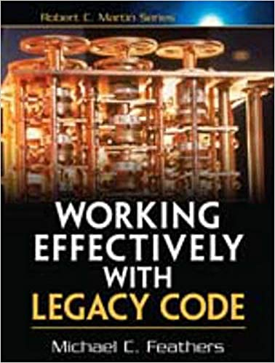
Over the years, Uncle Bob and Michael Feathers have come with an acronym:
Side Note: If you don’t know about him, Michael Feathers wrote this book about applying Design Patterns to an existing codebase:
SOLID

Slide 20
We’ll focus on two principles:
SOLID

Slide 21
We’ll focus on two principles:
Single Responsibility Principle
SOLID
Dependency Inversion
Principle

Slide 22
Single Responsibility Principle
”Do one thing very well.”
Your friend, UNIX

Slide 23
Dependency Inversion Principle
High-level (behavior) modules should not depend on Low-level (implementation details) modules.

Slide 24
Your database is an implementation detail.
Dependency Inversion Principle
High-level (behavior) modules should not depend on Low-level (implementation details) modules.

Slide 25
Your database is an implementation detail.
And so is your framework.
Dependency Inversion Principle
High-level (behavior) modules should not depend on Low-level (implementation details) modules.

Slide 26
Your database is an implementation detail.
And so is your framework.
And the style of your API, and your Message Broker, and your… (this can go on forever)
Dependency Inversion Principle
High-level (behavior) modules should not depend on Low-level (implementation details) modules.

Slide 27
Single Responsibility

Slide 28
Single Responsibility
Plain Objects (POJOs and such)
Business behavior

Slide 29
Single Responsibility
Knowledge about the implementation
Plain Objects (POJOs and such)
Business behavior

Slide 30
Dependency Inversion
(By injecting dependencies)

Slide 31
Dependency Inversion
(By injecting dependencies)
Flow of dependencies inverts
Flow of Control

Slide 32
So…
Let’s talk about persisting objects.

Slide 33
Active Record
It looks something like this:
@Entity
class MyEntity extends Model {
@PrimaryKeyColumn(’id’)
public Int id;
@Column(‘name’)
public String name;
public static findOne(name){
/* … Important database stuff to find ‘e’ */
return e;
}
}

Slide 34
Active Record
Has some ‘magic’ that allows it to access the database.
Has some ‘magic’ that allows it to access the database.
There will be one table for each AR.
It looks something like this:
@Entity(‘MyEntity’)
class MyEntity extends Model {
@PrimaryKeyColumn(’id’)
public Int id;
@Column(‘name’)
public String name;
public static findOne(name){
/* … Important database stuff to find ‘e’ */
return e;
}
}

Slide 35
Active Record
Has some ‘magic’ that allows it to access the database.
Has some ‘magic’ that allows it to access the database.
There will be one table for each AR.
Through annotations, decorators or inheritance
It looks something like this:
@Entity(‘MyEntity’)
class MyEntity extends Model {
@PrimaryKeyColumn(’id’)
public Int id;
@Column(‘name’)
public String name;
public static findOne(name){
/* … Important database stuff to find ‘e’ */
return e;
}
}

Slide 36
Active Record
Has some ‘magic’ that allows it to access the database.
Has some ‘magic’ that allows it to access the database.
There will be one table for each AR.
Through annotations, decorators or inheritance
It looks something like this:
@Entity(‘MyEntity’)
class MyEntity extends Model {
@PrimaryKeyColumn(’id’)
public Int id;
@Column(‘name’)
public String name;
public static findOne(name){
/* … Important database stuff to find ‘e’ */
return e;
}
}
Each member of the class is mapped to a column in the database.

Slide 37
Active Record
Has some ‘magic’ that allows it to access the database.
Has some ‘magic’ that allows it to access the database.
There will be one table for each AR.
Through annotations, decorators or inheritance
It looks something like this:
@Entity(‘MyEntity’)
class MyEntity extends Model {
@PrimaryKeyColumn(’id’)
public Int id;
@Column(‘name’)
public String name;
public static findOne(name){
/* … Important database stuff to find ‘e’ */
return e;
}
}
Each member of the class is mapped to a column in the database.
Includes some class (static) methods to access the

Slide 38
Active Record
It looks something like this:
And lets you do something like this:
@Entity
class MyEntity extends Model {
@PrimaryKeyColumn(’id’)
public Int id;
@Column(‘name’)
public String name;
public static findOne(name){
/* … Important database stuff to find ‘e’ */
return e;
}
}
MyEntity e = MyEntity.findOne(‘Jose Ruiz’);
e.name = ‘Chepe’
e.save()

Slide 39
Active Record
It looks something like this:
And lets you do something like this:
@Entity
class MyEntity extends Model {
@PrimaryKeyColumn(’id’)
public Int id;
@Column(‘name’)
public String name;
public static findOne(name){
/* … Important database stuff to find ‘e’ */
return e;
}
}
MyEntity e = MyEntity.findOne(‘Jose Ruiz’);
e.name = ‘Chepe’
e.save()
That’s great! I can operate on my entity and it knows how to save itself, find itself (and others), etc!

Slide 40
Active Record
It looks something like this:
And lets you do something like this:
@Entity
class MyEntity extends Model {
@PrimaryKeyColumn(’id’)
public Int id;
@Column(‘name’)
public String name;
public static findOne(name){
/* … Important database stuff to find ‘e’ */
return e;
}
}
MyEntity e = MyEntity.findOne(‘Jose Ruiz’);
e.name = ‘Chepe’
e.save()
That’s great! I can operate on my entity and it knows how to save itself, find itself (and others), etc!
Wait…
← read that again

Slide 41
Active Record
It looks something like this:
And lets you do something like this:
@Entity
class MyEntity extends Model {
@PrimaryKeyColumn(’id’)
public Int id;
@Column(‘name’)
public String name;
public static findOne(name){
/* … Important database stuff to find ‘e’ */
return e;
}
}
MyEntity e = MyEntity.findOne(‘Jose Ruiz’);
e.name = ‘Chepe’
e.save()
That’s great! I can operate on my entity and it knows how to save itself, find itself (and others), etc!
Wait…
← read that again

Slide 42
Active Record
It looks something like this:
And lets you do something like this:
@Entity
class MyEntity extends Model {
@PrimaryKeyColumn(’id’)
public Int id;
@Column(‘name’)
public String name;
public static findOne(name){
/* … Important database stuff to find ‘e’ */
return e;
}
}
MyEntity e = MyEntity.findOne(‘Jose Ruiz’);
e.name = ‘Chepe’
e.save()
This violates the SRP.
That’s great! I can operate on my entity and it knows how to save itself, find itself (and others), etc!
Wait…
← read that again

Slide 43
Active Record
MyEntity
It looks something like this:
And lets you do something like this:
@Entity
class MyEntity extends Model {
@PrimaryKeyColumn(’id’)
public Int id;
@Column(‘name’)
public String name;
public static findOne(name){
/* … Important database stuff to find ‘e’ */
return e;
}
}
Int id;
String name;
MyEntity save();
MyEntiy findOne();
MyEntity e = MyEntity.findOne(‘Jose Ruiz’);
e.name = ‘Chepe’
e.save()
This violates the SRP.
That’s great! I can operate on my entity and it knows how to save itself, find itself (and others), etc!
Wait…
← read that again

Slide 44
Active Record
MyEntity
It looks something like this:
And lets you do something like this:
@Entity
class MyEntity extends Model {
@PrimaryKeyColumn(’id’)
public Int id;
@Column(‘name’)
public String name;
public static findOne(name){
/* … Important database stuff to find ‘e’ */
return e;
}
}
Business Data.
Int id;
String name;
MyEntity save();
MyEntiy findOne();
MyEntity e = MyEntity.findOne(‘Jose Ruiz’);
e.name = ‘Chepe’
e.save()
This violates the SRP.
That’s great! I can operate on my entity and it knows how to save itself, find itself (and others), etc!
Database Behavior.
Wait…
← read that again

Slide 45
But if you think about it…
In a database, the data is at rest. It’s not changing.
An Object is supposed to hide data and expose business behavior.

Slide 46
Active Record
MyEntity
It looks something like this:
And lets you do something like this:
@Entity
class MyEntity extends Model {
@PrimaryKeyColumn(’id’)
public Int id;
@Column(‘name’)
public String name;
public static findOne(name){
/* … Important database stuff to find ‘e’ */
return e;
}
}
Business Data.
Now every part of your application that interacts with your object may change the database.
That can be problematic…
Int id;
String name;
MyEntity save();
MyEntiy findOne();
MyEntity e = MyEntity.findOne(‘Jose Ruiz’);
e.name = ‘Chepe’
e.save()
This violates the SRP.
That’s great! I can operate on my entity and it knows how to save itself, find itself (and others), etc!
Database Behavior.
Wait…
← read that again

Slide 47
But if you think about it…
By inverting this principles, the AR pattern forces your business objects to reflect the structure of your database.
And the implementation of your business rules is now bound to what the structure of your objects allow you to.
In a database, the data is at rest. It’s not changing.
An Object is supposed to hide data and expose business behavior.

Slide 48
Does this mean that the Active Record is bad?

Slide 49
Does this mean that the Active Record is bad?
No, just be careful when to use it.
It’s very useful in small, transactional applications.
Where access to the database is sparse. And you don’t care about optimizing that.
If your application grows, it will not be very maintainable. For many reasons.

Slide 50
And if you think about it:
An active record is a DAO.

Slide 51
And if you think about it:
An Active Record is a DAO.
An object that knows how to access the database.

Slide 52
And if you think about it:
And there are other options, like the Data Mapper
An Active Record is a DAO.
An object that knows how to access the database.

Slide 53
Enter: The Repository
Repository
Database
Domain
(Business Behavior)

Slide 54
Enter: The Repository
Repository
Database
Domain
(Business Behavior)
Aggregate
Operates on Aggregate Roots

Slide 55
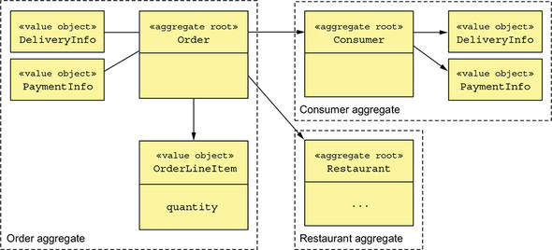
Enter: The Repository
From the Microservices Patterns Book (Chris Richardson):
Aggregates decompose the Domain Model into chunks, which are individually easier to understand.
Repository
Database
Domain
(Business Behavior)
Aggregate
Operates on Aggregate Roots

Slide 56
Enter: The Repository
Repository
Database
Domain
(Business Behavior)
Aggregate
Returns and receives Aggregates.

Slide 57
Enter: The Repository
There should be one repository per type of Aggregate
Repository
Database
Domain
(Business Behavior)
Aggregate
Returns and receives Aggregates.

Slide 58
Enter: The Repository
Doesn’t know about the details of the database. Uses a DAO for that.
There should be one repository per type of Aggregate
Repository
Database
Domain
(Business Behavior)
Aggregate
Data Mapper
Returns and receives Aggregates.

Slide 59
Enter: The Repository
Doesn’t know about the details of the database. Uses a DAO for that.
There should be one repository per type of Aggregate
Repository
Database
Domain
(Business Behavior)
Aggregate
Data Mapper
This is an injected dependency.
Returns and receives Aggregates.

Slide 60
Enter: The Repository
Doesn’t know about the details of the database. Uses a DAO for that.
There should be one repository per type of Aggregate
Repository
Database
Domain
(Business Behavior)
Aggregate
Data Mapper
This is an injected dependency.
Which means that you can change de Database.
Returns and receives Aggregates.

Slide 61
Enter: The Repository
Flow of Control
Repository
Database
Domain
(Business Behavior)
Aggregate
Data Mapper
Flow of Dependencies

Slide 62
Data Mapper:
An active record is a DAO.
Data Mapper
That knows how to talk to the database to persist objects.

Slide 63
Using a repository is Clean.
Remember this?
→

Slide 64
Using a repository is Clean.
Remember this?
→
Repository
Domain
(Business Behavior)
Database
And this?
→
Data Mapper
Aggregate

Slide 65

Using a repository is Clean.
Remember this?
→
Repository
Domain
(Business Behavior)
Database
And this?
→
Data Mapper
Aggregate

Slide 66
Using a repository is Clean.
Aggregate
Database
Domain
Repository

