Slide 1
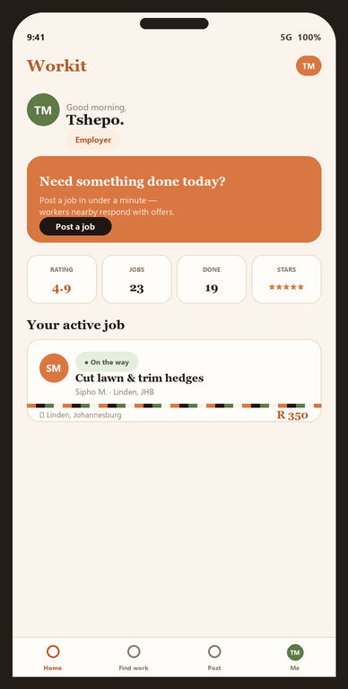
WORKIT
How the system
works.
A guided walk-through of Workit — South Africa's people-first marketplace for everyday work. From sign-up to paid, every step is built trust-first.
A Futhersky Solutions product · workitsa.co.za · Tshepo M

Slide 2
WHAT IS WORKIT
One trusted place for any everyday work.
Employers and households post jobs — gardening, cleaning, trades, deliveries, errands, tutoring and more. Nearby ID-verified workers offer, do the job, and both sides rate each other. If it's a task someone needs done, it can be posted.
🌿
Broad by design
🛡
Trust-first
One marketplace across 11 categories — not a single niche.
Every worker human-verified. Two-way ratings on every job.
📱
Low-data, mobile-first
💵
Cash or EFT
A PWA built for prepaid Android on tight data budgets.
Pay on completion — no card or bank account needed to start.
Live today: workitsa.co.za · ~90 workers already signed up · every worker human-verified · full safety suite shipped.

Slide 3
THE LOOP
Post → offer → hire → do → pay → rate.
🛠
◆
💪
Employer
Workit
Worker
Posts a job + a fair price
Trust, matching, safety
Accepts or counters, does the work
The full loop: Post → workers offer → employer accepts → worker does the job → cash or EFT on completion → both sides rate each other.
Free for users during launch — the agreed price is exactly what the worker earns.

Slide 4
STEP 1 · TRUST FROM DAY ONE
Sign up, then get verified.
📲
Quick sign-up
Phone OTP or email — installable PWA, light on data.
🪪
Human verification
SA ID + selfie video + proof of address, reviewed by a real person.
🏅
Verified & Gold tiers
A police-clearance Gold badge employers can filter for.
👋
Role-aware home
Workers see “find work”; employers see “post a job”.

Slide 5
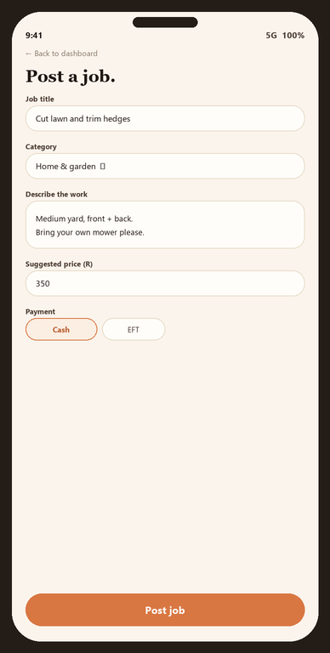
STEP 2 · POST
Post a job in under two minutes.
⚡
Fast posting
Title, category, price, suburb — optional photos + GPS pin.
👥
One worker or a crew
Set a crew size; the post stays open until it's filled.
⏰
Due-by + payment choice
Set a deadline; choose cash or EFT on completion.
🪞
Live preview
See exactly what workers will see as you type.

Slide 6
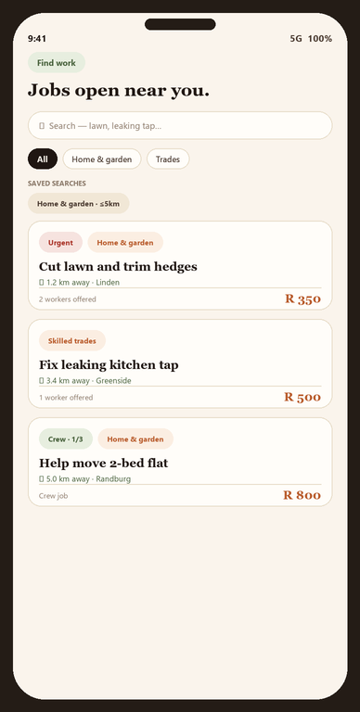
STEP 3 · MATCH
Workers find jobs near them.
📍
Distance-ranked feed
Pin your home once; jobs sort by how close they are.
🔎
Filters + saved alerts
Save a search, get a buzz the moment a match is posted.
🤝
Accept or counter-offer
Take the price in one tap, or send your own with a note.
★
Direct invites
Employers can invite a specific worker to a job.

Slide 7
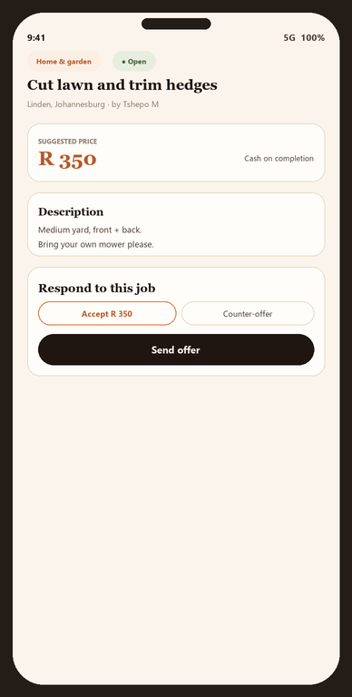
STEP 4 · HIRE
Hire with confidence.
✅
One-tap hire
Accept an offer; chat opens; others are politely declined.
🔑
Doorstep start-code
The worker enters a code you read out — right person, confirmed.
🔄
Clear lifecycle
On-my-way → started → done → confirmed, visible to both.
✓
Verified-only filter
Only take offers from Verified or Gold workers, if you choose.

Slide 8
STEP 5 · ON THE JOB
Safe on every single job.
💬
In-app chat + photos
📍
Live location
Coordinate and share before/after photos — only after someone's hired.
The worker shares live GPS on the day; the employer watches them arrive.
🆘
SOS button
⚖
Disputes, handled
One tap dials SAPS 10111 from inside any active job — logged.
Either side can freeze a job; an admin reviews chat, photos and ratings.

Slide 9
STEP 6 · PROOF OF WORK
Real proof — captured live, not uploaded.
The hardest problem in this market: anyone can post a photo and claim it's their work. Workit closes that gap.
📷
Camera-only capture
🕒
Time-stamped
“After” photos open the camera — no picking an old image from the gallery.
Each photo is watermarked with the date & time it was taken.
🔗
Tied to the real job
⭐
Builds a real portfolio
Evidence is generated on the job — it can't be faked after the fact.
Verified completion photos flow to the worker's public profile.
This also gives disputes a real evidence trail — trust you can verify, not just claim.

Slide 10
STEP 7 · PAID & RATED
Get paid, then build reputation.
💵
Cash or EFT on completion
🤝
Payment handshake
Direct between the parties — no card needed to start earning.
“I've paid” ⇄ “I've been paid” confirms it for both sides.
⭐
Two-way ratings
📈
Levels that compound
Both sides rate every job — reputation is earned, not bought.
Ratings, jobs done and badges unlock trust over time. Workers keep 100% at launch.

Slide 11
DIFFERENTIATOR
Crew jobs: hire a whole team in one post.
Moving day, event staff, a queue-standing team — set how many workers you need and Workit keeps the post open until the crew is full.
①
Set a crew size
②
Per-worker lifecycle
Need 1 or need 20 — the job shows “1 of 3 hired” to everyone.
Each member has their own status and their own agreed price.
③
One group chat
④
Slots auto-reopen
Employer + the whole crew coordinate in a single thread.
If someone drops out, their spot reopens for new offers.

Slide 12
TRUST & SAFETY
Safety isn't a feature. It's the foundation.
🪪
Human verification
⭐
Two-way ratings
📍
Live location
SA ID + selfie + proof of address, reviewed by a person. Verified & Gold tiers.
Both sides rate every job. Reputation badges. Bad actors don't last.
Workers share live GPS on the day; employers watch them arrive.
🆘
Emergency button
⚖
Disputes
🛡
Moderation engine
One tap dials SAPS 10111 from inside any active job — logged.
Either side can freeze a job; an admin reviews chat, photos, ratings.
Auto image scanning, text screening, rate-limits, reports, auto-escalation.

Slide 13
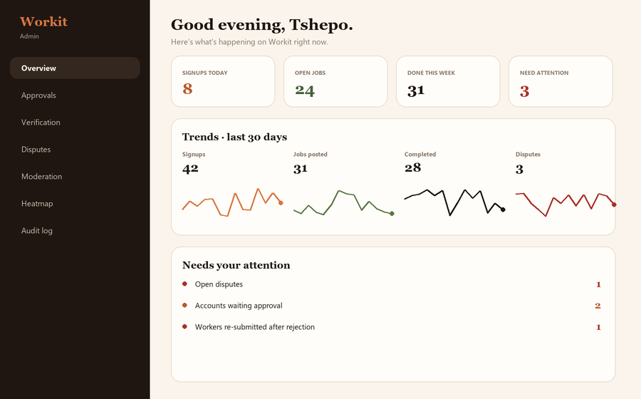
OPERATIONS
A real admin cockpit — not a spreadsheet.
▸
Overview & trends
Live KPIs + 30-day sparklines for signups, jobs, completions.
▸
Moderation queue
Reports + auto-flags in one place; warn / remove / suspend / ban.
▸
Heatmap + suburbs
See where the work is, with a suburb drill-down.
▸
Verification review
Approve IDs, award the Gold badge, re-review re-submissions.
▸
Audit log
Every admin action recorded — accountability built in.

Slide 14
BUILT · LIVE · READY
Dignified work,
one job at a time.
A South African platform that turns the country's biggest problem — joblessness — into its biggest marketplace. Trust-first, mobile-first, built for the people who need it most.
Workit · workitsa.co.za · Tshepo M · Futhersky Solutions

