Slide 1
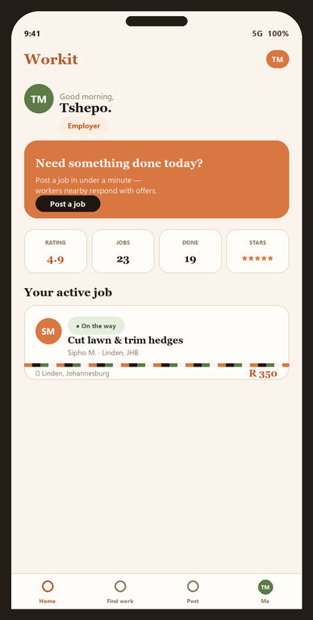
WORKIT
Find work.
Get work done.
South Africa's people-first marketplace for everyday work — connecting people who need a job done with verified workers nearby.
A Furthersky Solutions product · Built by Tshepo M · workitsa.co.za

Slide 2
THE PROBLEM
Joblessness is South Africa's
defining crisis.
42%+
60%+
8M+
expanded unemployment rate — among the highest on earth
youth (15–34) are without work
South Africans actively want a job and can't find one
…and the tools to find work are broken.
✕
Classifieds (Gumtree, Facebook) have zero trust or verification
✕
Existing apps cover narrow niches — cleaning only, one city only
✕
Word-of-mouth doesn't scale and leaves newcomers out
✕
No safety net: no ratings, no IDs, no recourse when things go wrong

Slide 3
THE OPPORTUNITY
One trusted place for
everyday work.
South Africa's informal + gig economy is enormous and almost entirely offline. Smartphones are everywhere; the marketplace to organise this work is not.
Where others are narrow, Workit is the whole market.
🌿
Broad by design
🛡
Trust-first
11 categories from gardening to trades to tutoring — not a single niche.
Every worker reviewed by a human. Two-way ratings on every job.
📱
Low-data, mobile-first
💵
Cash or EFT
Built as a PWA for prepaid Android on tight data budgets.
Pay on completion — no card, no bank account required to start.

Slide 4
WHAT IS WORKIT
A two-sided marketplace for honest work.
🛠
posts
◆
offers
💪
Employer
Workit
Worker
Posts a job + a fair price
Trust, matching, safety, payments-ready
Accepts or counters, does the work
The loop: Post → workers offer → employer accepts → worker does the job → cash or EFT on completion → both sides rate each other.
No middleman fee during launch — the agreed price is exactly what the worker earns.

Slide 5
PRODUCT · HOME
A personalised home the moment you sign in.
👋
Role-aware dashboard
Employers see “post a job”; workers see “find work” + a finish-verification nudge.
📌
Your active job, up top
The in-flight job surfaces with the worker's photo and one-tap message / track.
📊
Reputation at a glance
Rating, jobs done, level and stars — the trust you've built, front and centre.
📲
Installable PWA
Add to home screen; works offline-first and light on data.

Slide 6
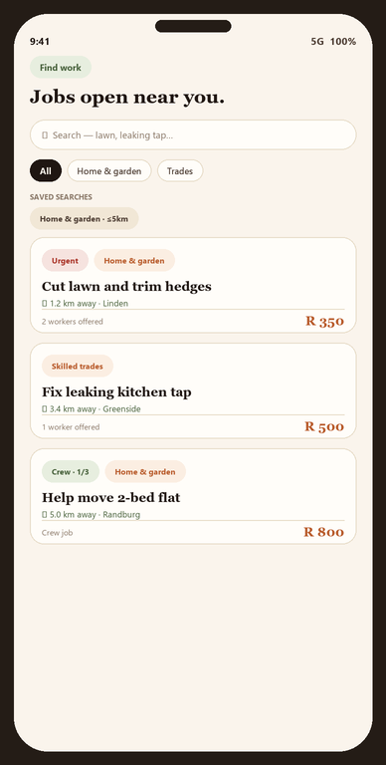
PRODUCT · FIND WORK
Jobs open near you, ranked by distance.
📍
Distance-aware feed
Pin your home once; jobs sort by how close they are to you.
🔎
Filters + saved searches
Category, radius, keyword — save a search and get a buzz when a match is posted.
❤
Save & compare
Bookmark jobs, see who else has offered, send your price in one tap.
★
Direct invites
Employers can invite you to a specific job — it lands with a star badge.

Slide 7
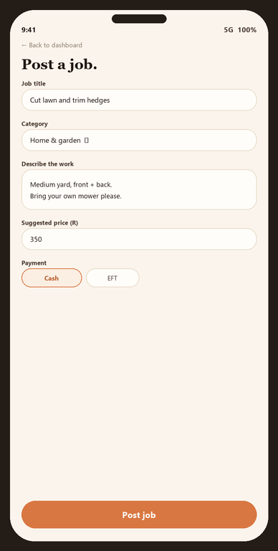
PRODUCT · POST A JOB
Post in under a minute, with a live preview.
⚡
Two-minute posting
Title, category, price, suburb — optional photos, GPS pin, urgency flag.
👥
Single worker or a crew
Need 3 people for a move? Set a crew size; the post stays open until it's filled.
⏰
Due-by + payment choice
Set a deadline; choose cash or EFT on completion. Workers see it upfront.
🪞
Live preview
See exactly what workers will see in their feed as you type.

Slide 8
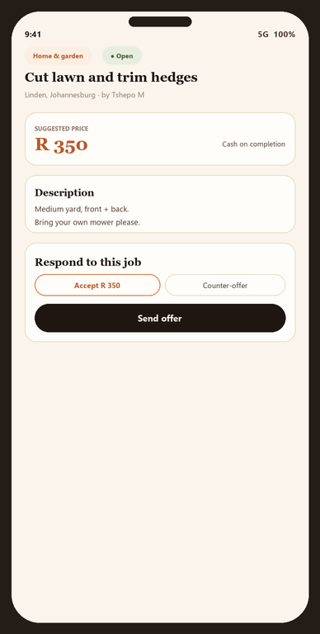
PRODUCT · OFFERS & THE JOB
Accept the price, or let workers counter.
🤝
Accept or counter-offer
Workers accept your price in one tap or send their own with a note.
✓
Verified-only filter
Filter incoming offers to Verified or Gold-badged workers.
🔄
Clear job lifecycle
On-my-way → started → done → confirmed, with status both sides can see.
💬
In-app chat with photos
Message + share before/after photos — only after someone's hired.

Slide 9
WALKTHROUGH · EMPLOYER
From “I need this done” to done — in 5 steps.
1
2
3
4
5
Post the job
Review offers
Accept who you trust
Track the work
Confirm & rate
Describe it, suggest a price, optionally pin the spot and add photos.
Workers nearby respond. See ratings, badges, completed-job counts.
One tap. Other offers are politely declined; chat opens up.
See on-the-way → started, message, live location, SOS if needed.
Pay cash or EFT on completion, confirm, leave an honest rating.

Slide 10
WALKTHROUGH · WORKER
From sign-up to paid — in 5 steps.
1
2
3
4
5
Sign up + verify
Browse work nearby
Send an offer
Do the job
Get paid + rated
SA ID, selfie video, proof of address, skills. Reviewed by a person.
Filter by category + distance. Save searches for instant alerts.
Accept the price or counter with your own + a short pitch.
Tap on-my-way, then started. Share before/after photos in chat.
Mark done, employer confirms, you both rate. Keep 100% at launch.

Slide 11
TRUST & SAFETY
Safety isn't a feature. It's the foundation.
🪪
Human verification
⭐
Two-way ratings
📍
Live location
SA ID + selfie video + proof of address, reviewed by a real person. Verified & Gold (police-cleared) tiers.
Both sides rate every job. Reputation badges. Bad actors don't last.
Workers share live GPS on the day; employers watch them arrive.
🆘
Emergency button
⚖
Disputes
🛡
Moderation engine
One tap dials SAPS 10111 from inside any active job — logged.
Either side can freeze a job; an admin reviews chat, photos, ratings.
Auto image scanning (Vision), text screening, rate-limits, user reports, CSAM auto-escalation.

Slide 12
DIFFERENTIATOR
Crew jobs: hire a whole team in one post.
Moving day, event staff, a queue-standing team — set how many workers you need and Workit keeps the post open until the crew is full.
①
Set a crew size
②
Per-worker lifecycle
Need 1 or need 20. The job shows “1 of 3 hired” to everyone.
Each crew member has their own on-the-way / done / confirmed — and own agreed price.
③
One group chat
④
Slots auto-reopen
Employer + the whole crew coordinate in a single thread.
If someone drops out, their spot reopens for new offers automatically.

Slide 13
ENGAGEMENT
We bring people back — for free.
🔔
Web push (FCM)
💾
Saved-search alerts
Free Firebase push: offers, accepted jobs, confirmations buzz the phone even when Workit is closed.
“Gardening within 5 km of Linden” → instant toast the moment a match is posted.
★
Direct invites
✉
Email fallback
Found a worker you like? Invite them to a job; they get a personal notification.
SendGrid emails for every key event, so nothing important is missed.
Next up: WhatsApp + SMS notifications — the unlock for reaching prepaid users with data off.

Slide 14
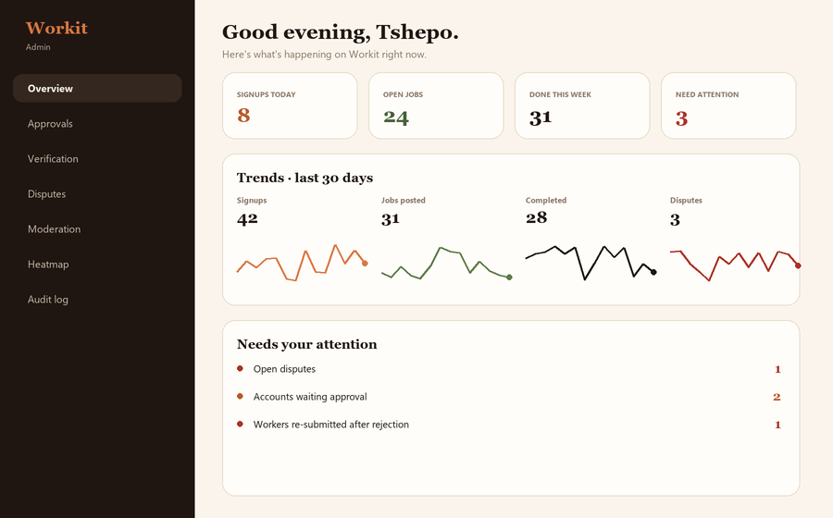
OPERATIONS
A real admin cockpit, not a spreadsheet.
▸
Overview & trends
Live KPIs + 30-day sparklines for signups, jobs, completions, disputes.
▸
Moderation queue
Reports + auto-flags in one place; warn / remove / suspend / ban.
▸
Heatmap + suburbs
Where the work is, with a clickable suburb drill-down.
▸
Verification & re-verify
Approve IDs, award the Gold badge, re-review re-submissions.
▸
Audit log
Every admin action recorded — accountability built in.

Slide 15
UNDER THE HOOD
Built to scale, hosted in South Africa.
CLIENT
Next.js 16 PWA
React, Tailwind v4, offline-first, installable. i18n-ready for all 11 official languages.
AUTH
Firebase Auth
Phone OTP + email/password. Link both to one account.
DATA
Cloud Firestore
Real-time jobs, offers, chat, ratings, disputes. Security rules enforce every access.
LOGIC
13 Cloud Functions
Email, push, ratings, moderation, text screen, rate-limit, verification — all in africa-south1.
STORAGE
Firebase Storage
Photos, videos, CVs, verification docs. Auto image moderation via Google Vision.
africa-south1 (Johannesburg) region · scheduled backups · Sentry-ready error monitoring

Slide 16
STATUS
Not a concept — a working product, live today.
Shipped & live
By the numbers
✓
Two-sided marketplace end-to-end
13
Cloud Functions in production
✓
Phone + email auth, account approval
✓
Worker verification + Gold badge
11
job categories at launch
✓
Crew (multi-worker) jobs
✓
In-app chat with photo sharing
24+
screens / routes shipped
✓
Live location + SAPS emergency
✓
Disputes + full moderation suite
3
verification tiers (None → Verified → Gold)
✓
Web push + saved-search alerts
✓
Admin dashboard, heatmap, audit log
100%
of agreed price kept by workers at launch
✓
Worker portfolios + public profiles

Slide 17
MONETIZATION
Free to grow. Built to earn.
Launch free to win liquidity and trust. Then layer revenue where it adds value — never taxing a worker's first rand.
1
Transaction fee
2
Workit Plus
3
Featured & urgent
A small % service fee on each completed job once liquidity is healthy. Employer-side, so workers keep their rate.
Monthly subscription for power employers: priority placement, scheduled & recurring jobs, team accounts.
Pay to boost a post to the top of the feed or flag it urgent — pay-per-boost, fully optional.
4
Background checks
5
Value-add services
6
B2B / SME plans
Paid police-clearance / ID verification for the Gold badge, in partnership with a screening provider.
Job insurance, instant EFT payouts via a banking partner, materials financing — revenue-share.
Small businesses booking regular labour: dashboards, invoicing, preferred-worker pools.

Slide 18
MONETIZATION · THE MATH
How small fees compound into a real business.
~8%
blended take rate at maturity (employer-side)
R120m
120
R90m
R 260
avg job value (illustrative)
R60m
3–5×
target worker-to-job liquidity per suburb
34
R30m
14
6
0.2
3.1
R0m
R0
CAC at launch — WhatsApp & referral led
Year 1
Year 2
Year 3
GMV (R, millions)
Net revenue (R, millions)
Figures are illustrative planning scenarios, not forecasts — shown to demonstrate the model's shape.

Slide 19
GO TO MARKET
Win one suburb at a time.
Marketplaces live or die on local liquidity. We saturate a handful of Gauteng suburbs before widening — density first, geography second.
🎯
Beachhead
🔁
Built-in growth loops
3–5 Gauteng suburbs. Hit 3–5 workers per open job before expanding the next block.
One-tap WhatsApp job sharing + referral codes turn every user into a recruiter.
🤝
Trust as the wedge
🌍
Then province by province
Verification + ratings make employers comfortable letting strangers into their homes.
Replicate the playbook: KZN, Western Cape, Eastern Cape.

Slide 20
ROADMAP
Where Workit goes next.
NOW — Live
NEXT — 0–6 months
LATER — 6–18 months
•
MVP shipped & in production
•
WhatsApp + SMS notifications
•
Native Android app
•
Full trust + safety suite
•
Payments & escrow (cash → digital)
•
Instant payouts via bank partner
•
Crew jobs, portfolios, push
•
First ops / community hire
•
Job insurance + background checks
•
Gauteng launch-ready
•
Suburb saturation in Gauteng
•
Province-by-province rollout
•
isiZulu / Sesotho translations

Slide 21
THE ASK
What we're raising — and what it unlocks.
The product is built, deployed and live. This is growth capital — to win local liquidity in Gauteng and prove the model. Two scenarios, same playbook:
MINIMUM — LEAN LAUNCH
TARGET — ACCELERATED SCALE
R100,000
R500,000
≈ 6 months runway · founder-led
≈ 12 months runway · first small team
✓
Launch in 3 Gauteng suburbs
✓
10+ suburbs across Gauteng
✓
500–1,000 verified workers onboarded
✓
~5,000 workers · payments + escrow
✓
Prove liquidity: 3–5 offers per job
✓
First hires: 1 dev + 1 ops/community
✓
First paying transactions live
✓
WhatsApp/SMS · positioned for seed round

Slide 22
BUDGET · R100,000
R100,000 — minimum lean-launch budget.
A six-month, founder-led runway to prove liquidity in the first Gauteng suburbs. Every rand goes to demand, supply, and keeping the platform running.
Marketing & user acquisition
R 30,000
30%
Trust & safety / verification ops
R 18,000
18%
Field ops & community ambassadors
R 16,000
16%
Contingency / working capital
R 15,000
15%
Cloud infrastructure & services
R 12,000
12%
Legal & compliance (POPIA, contracts)
R 9,000
9%
TOTAL
R100,000
≈ 6 months · 3 suburbs · 500–1,000 verified workers

Slide 23
BUDGET · R500,000
R500,000 — accelerated-scale budget.
A twelve-month runway with the first small team. Adds engineering capacity, payments and a real growth engine on top of everything the R100k plan already covers.
Engineering (contract dev + tooling)
R 130,000
26%
Marketing & growth
R 130,000
26%
Field ops & community ambassador team
R 65,000
13%
Trust & safety / verification ops
R 60,000
12%
Cloud infrastructure & scaling
R 40,000
8%
Contingency / working capital
R 40,000
8%
Legal, compliance & insurance
R 35,000
7%
TOTAL
R500,000
≈ 12 months · 10+ suburbs · ~5,000 workers · payments live

Slide 24
THE VISION
Dignified work,
one job at a time.
A South African platform that turns the country's biggest problem — joblessness — into its biggest marketplace. Trust-first, mobile-first, built for the people who need it most.
Workit · workitsa.co.za · Tshepo M · tshepowayne2@gmail.com · Furthersky Solutions

