Slide 1
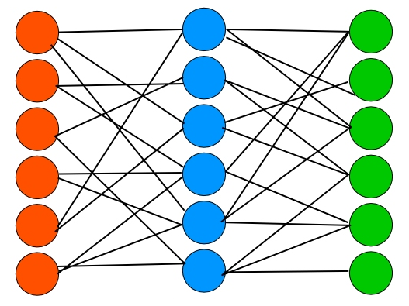


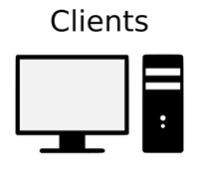

Detect/Recognize
GET/POST
4
Result
JSON Result
5
Model
1
Image reading
Django WS
3
Image saving
6
2

Slide 2
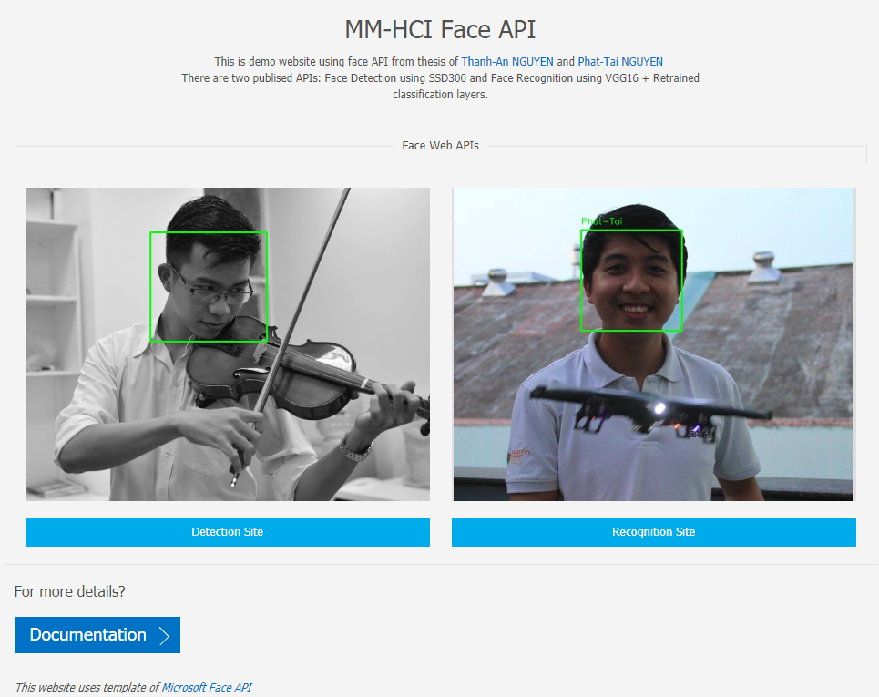
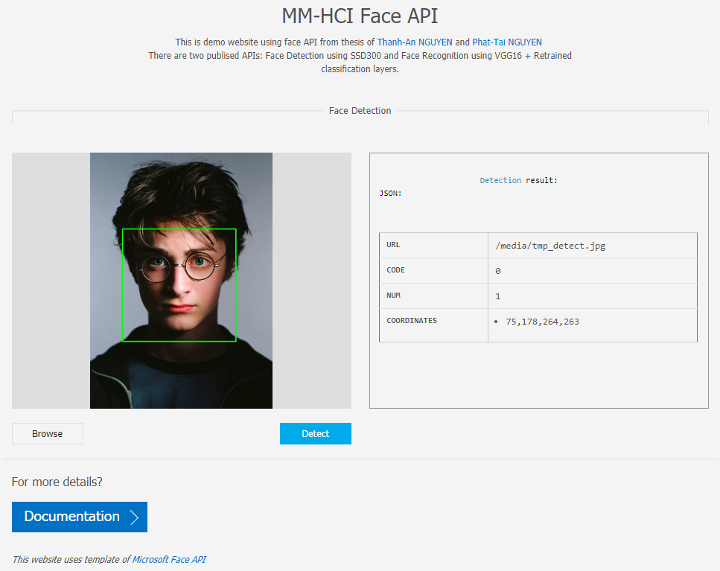
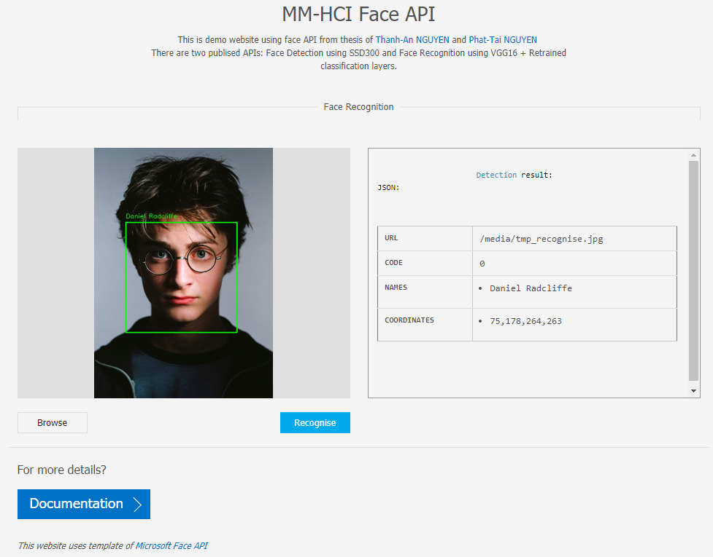
Home Page
Detection Site
Recognition Site

