Slide 1
ANGULAr 2 component advanced: communication & lifecycle

Slide 2
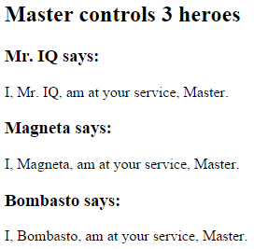
Pass data from parent to child with input binding
@Component({ selector: 'hero-child', template: `
<h3>{{hero.name}} says:</h3> <p>I, {{hero.name}}, am at
your service, {{masterName}}.</p>
` }) export class HeroChildComponent { @Input() hero: Hero; @Input('master') masterName: string; }
@Component({ selector: 'hero-parent', template: `
<hero-child *ngFor="let hero of heroes" [hero]="hero" [master]="master">
</hero-child>`
}) export class HeroParentComponent { heroes = HEROES; master: string = 'Master'; }
HeroParentComponent
HeroChildComponent
hero
master

Slide 3
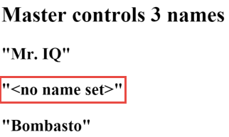
Intercept input property changes with a setter
@Component({ selector: 'name-child', template: '<h3>"{{name}}"</h3>' }) export class NameChildComponent { private _name = ''; @Input() set name(name: string) { this._name = (name && name.trim()) || '<no name set>'; } get name(): string { return this._name; } }

Slide 4
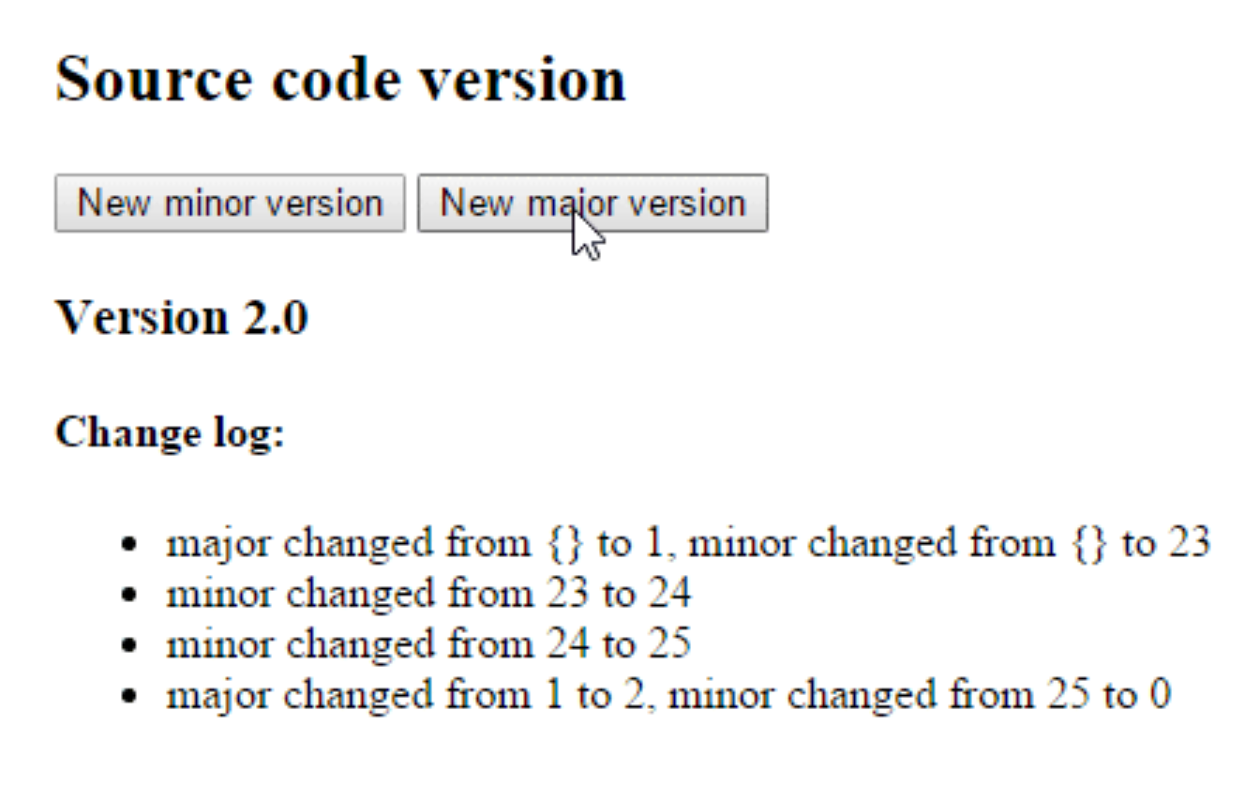
Intercept input property changes with ngOnChanges
@Component({ selector: 'version-parent', template: ` <h2>Source code version</h2> <button (click)="newMinor()"> New minor version </button> <button (click)="newMajor()"> New major version </button> <version-child [major]="major" [minor]="minor"> </version-child>` }) export class VersionParentComponent { major: number = 1; minor: number = 23; newMinor() { this.minor++; } newMajor() { this.major++; this.minor = 0; } }

Slide 5
Intercept input property changes with ngOnChanges
@Component({ selector: 'version-child', template: ` <h3>Version {{major}}.{{minor}}</h3> <h4>Change log:</h4> <ul><li *ngFor="let change of changeLog">{{change}}</li></ul>`}) export class VersionChildComponent implements OnChanges { @Input() major: number; @Input() minor: number; changeLog: string[] = []; ngOnChanges(changes: {[propKey: string]: SimpleChange}) { let log: string[] = []; for (let propName in changes) { let changedProp = changes[propName]; let from = JSON.stringify(changedProp.previousValue); let to = JSON.stringify(changedProp.currentValue); log.push( `${propName} changed from ${from} to ${to}`); } this.changeLog.push(log.join(', ')); } }

Slide 6
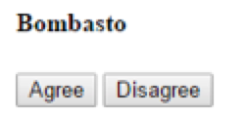
Parent listens for child event
@Component({ selector: 'my-voter', template: ` <h4>{{name}}</h4> <button (click)="vote(true)" [disabled]="voted">Agree</button> <button (click)="vote(false)" [disabled]="voted">Disagree</button> ` }) export class VoterComponent { @Input() name: string; @Output() onVoted = new EventEmitter<boolean>(); voted = false;
vote(agreed: boolean) { this.onVoted.emit(agreed); this.voted = true; } }

Slide 7
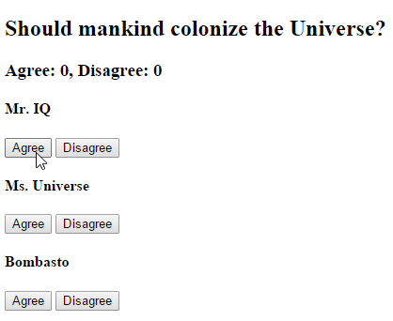
Parent listens for child event
@Component({ selector: 'vote-taker', template: ` <h2>Should mankind colonize the Universe?</h2> <h3>Agree: {{agreed}}, Disagree: {{disagreed}}</h3> <my-voter *ngFor="let voter of voters" [name]="voter" (onVoted)="onVoted($event)"> </my-voter> ` }) export class VoteTakerComponent { agreed = 0; disagreed = 0; voters = ['Mr. IQ', 'Ms. Universe', 'Bombasto']; onVoted(agreed: boolean) { agreed ? this.agreed++ : this.disagreed++; } }

Slide 8
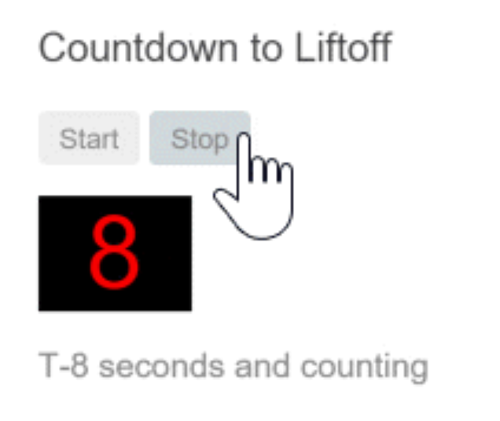
Parent interacts with child via local variable
@Component({ selector: 'countdown-parent-lv', template: ` <h3>Countdown to Liftoff (via local variable)</h3> <button (click)="timer.start()">Start</button> <button (click)="timer.stop()">Stop</button> <div class="seconds">{{timer.seconds}}</div> <countdown-timer #timer></countdown-timer> `, styleUrls: ['demo.css'] }) export class CountdownLocalVarParentComponent { }
We can place a local variable (#timer) on the tag (<countdown-timer>) representing the child component. That gives us a reference to the child component itself and the ability to access any of its properties or methods from within the parent template.
NOTE: The parent component itself has no access to the child.

Slide 9
Parent interacts with child via local variable
@Component({ selector: 'countdown-timer’, template: '<p>{{message}}</p>’}) export class CountdownTimerComponent implements OnInit, OnDestroy { intervalId = 0; message = ''; seconds = 11; clearTimer() { clearInterval(this.intervalId); } ngOnInit() { this.start(); } ngOnDestroy() { this.clearTimer(); } start() { this.countDown(); } stop() { this.clearTimer(); this.message = `Holding at T-${this.seconds} seconds`; } private countDown() { this.clearTimer(); this.intervalId = window.setInterval(() => { this.seconds -= 1; if (this.seconds === 0) { this.message = 'Blast off!'; } else { if (this.seconds < 0) { this.seconds = 10; } // reset this.message = `T-${this.seconds} seconds and counting`; } }, 1000);
} }

Slide 10
Parent calls a ViewChild
We can't use the local variable to access from parent component to child.
In this case we can use @ViewChild
@Component({ selector: 'countdown-parent-vc', template: ` <h3>Countdown to Liftoff (via ViewChild)</h3> <button (click)="start()">Start</button> <button (click)="stop()">Stop</button> <div class="seconds">{{ seconds() }}</div> <countdown-timer></countdown-timer>` }) export class CountdownViewChildParentComponent implements AfterViewInit { @ViewChild(CountdownTimerComponent) private timerComponent: CountdownTimerComponent; seconds() { return 0; } ngAfterViewInit() { setTimeout(() =>
this.seconds = () => this.timerComponent.seconds, 0); } start() { this.timerComponent.start(); } stop() { this.timerComponent.stop(); } }
Notes:
We import references to the ViewChild decorator and the AfterViewInit lifecycle hook.
We inject the child CountdownTimerComponent into the private timerComponent property via the @ViewChild property decoration.
The #timer local variable is gone from the component metadata. Instead we bind the buttons to the parent component's own start and stop methods and present the ticking seconds in an interpolation around the parent component's seconds method.
These methods access the injected timer component directly.
The ngAfterViewInit lifecycle hook is an important wrinkle. The timer component isn't available until after Angular displays the parent view. So we display 0 seconds initially.
Then Angular calls the ngAfterViewInit lifecycle hook at which time it is too late to update the parent view's display of the countdown seconds. Angular's unidirectional data flow rule prevents us from updating the parent view's in the same cycle. We have to wait one turn before we can display the seconds.
We use setTimeout to wait one tick and then revise the seconds method so that it takes future values from the timer component.

Slide 11
Parent and children communicate via a service
@Injectable() export class MissionService { // Observable string sources private missionAnnouncedSource = new Subject<string>(); private missionConfirmedSource = new Subject<string>(); // Observable string streams missionAnnounced$ = this.missionAnnouncedSource.asObservable(); missionConfirmed$ = this.missionConfirmedSource.asObservable(); // Service message commands announceMission(mission: string) { this.missionAnnouncedSource.next(mission); } confirmMission(astronaut: string) { this.missionConfirmedSource.next(astronaut); } }

Slide 12
Parent and children communicate via a service
A parent component and its children share a service whose interface enables bi-directional communication within the family.
@Injectable() export class MissionService { // Observable string sources private missionAnnouncedSource = new Subject<string>(); private missionConfirmedSource = new Subject<string>(); // Observable string streams missionAnnounced$ = this.missionAnnouncedSource.asObservable(); missionConfirmed$ = this.missionConfirmedSource.asObservable(); // Service message commands announceMission(mission: string) { this.missionAnnouncedSource.next(mission); } confirmMission(astronaut: string) { this.missionConfirmedSource.next(astronaut); } }

Slide 13
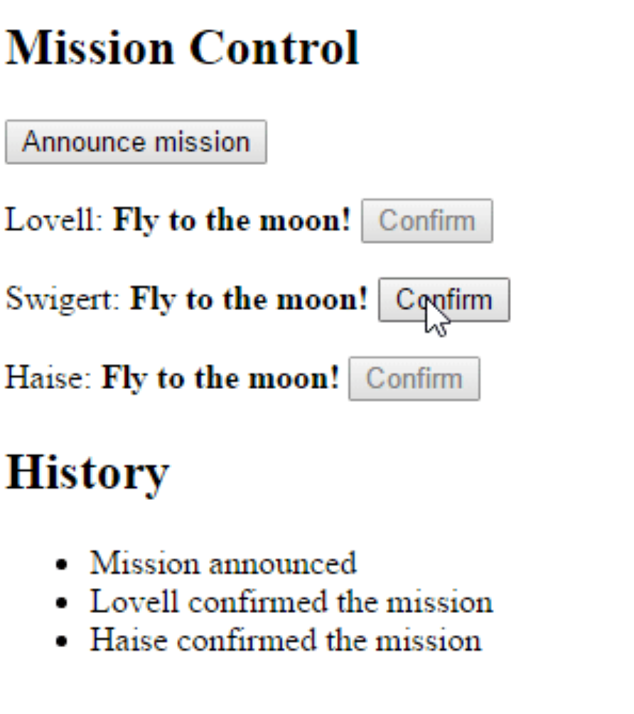
Parent and children communicate via a service
@Component({ selector: 'mission-control', template: `<h2>Mission Control</h2> <button (click)="announce()">Announce mission</button> <my-astronaut *ngFor="let astronaut of astronauts" [astronaut]="astronaut”></my-astronaut> <h3>History</h3> <ul><li *ngFor="let event of history">{{event}}</li></ul>`}) export class MissionControlComponent { astronauts = ['Lovell', 'Swigert', 'Haise']; history: string[] = []; missions = ['Fly to the moon!', 'Fly to mars!', 'Fly to Vegas!']; nextMission = 0; constructor(private missionService: MissionService) { missionService.missionConfirmed$.subscribe( astronaut => { this.history.push(`${astronaut} confirmed the mission`); });} announce() { let mission = this.missions[this.nextMission++]; this.missionService.announceMission(mission); this.history.push(`Mission "${mission}" announced`); if (this.nextMission >= this.missions.length) { this.nextMission = 0; } } }

Slide 14

Parent and children communicate via a service
@Component({ selector: 'my-astronaut', template: `<p> {{astronaut}}: <strong>{{mission}}</strong> <button (click)="confirm()" [disabled]="!announced || confirmed">Confirm</button></p>`}) export class AstronautComponent implements OnDestroy { @Input() astronaut: string; mission = '<no mission announced>'; confirmed = false; announced = false; subscription: Subscription; constructor(private missionService: MissionService) { this.subscription = missionService.missionAnnounced$.subscribe( mission => { this.mission = mission; this.announced = true; this.confirmed = false; }); } confirm() { this.confirmed = true; this.missionService.confirmMission(this.astronaut); } ngOnDestroy() { this.subscription.unsubscribe(); // prevent memory leak when component destroyed } }

Slide 15
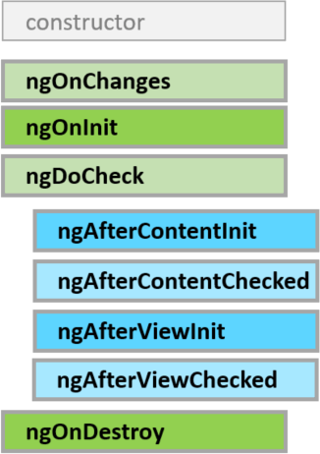
lifecycle
Respond when Angular (re)sets data-bound input properties. The method receives a SimpleChanges object of current and previous property values.
Initialize the directive/component after Angular first displays the data-bound properties and sets the directive/component's input properties.
Called once, after the first ngOnChanges.
Detect and act upon changes that Angular can't or won't detect on its own.
Called during every change detection run, immediately after ngOnChanges and ngOnInit.
Cleanup just before Angular destroys the directive/component. Unsubscribe observables and detach event handlers to avoid memory leaks.
Called just before Angular destroys the directive/component.

Slide 16
OnInit
Use ngOnInit for two main reasons:
1) to perform complex initializations shortly after construction
2) to set up the component after Angular sets the input properties
Don't fetch data in a component constructor. Constructors should do no more than set the initial local variables to simple values.
ngOnInit is a good place for a component to fetch its initial data.
Also directive's data-bound input properties are not set until after construction. That's a problem if you need to initialize the directive based on those properties. They'll have been set when ngOninit runs.

Slide 17
ondestroy
Put cleanup logic in ngOnDestroy, the logic that must run before Angular destroys the directive.
This is the time to notify another part of the application that the component is going away.
This is the place to free resources that won't be garbage collected automatically.
Unsubscribe from observables and DOM events.
Stop interval timers.
Unregister all callbacks that this directive registered with global or application services.
You risk memory leaks if you neglect to do so.

Slide 18
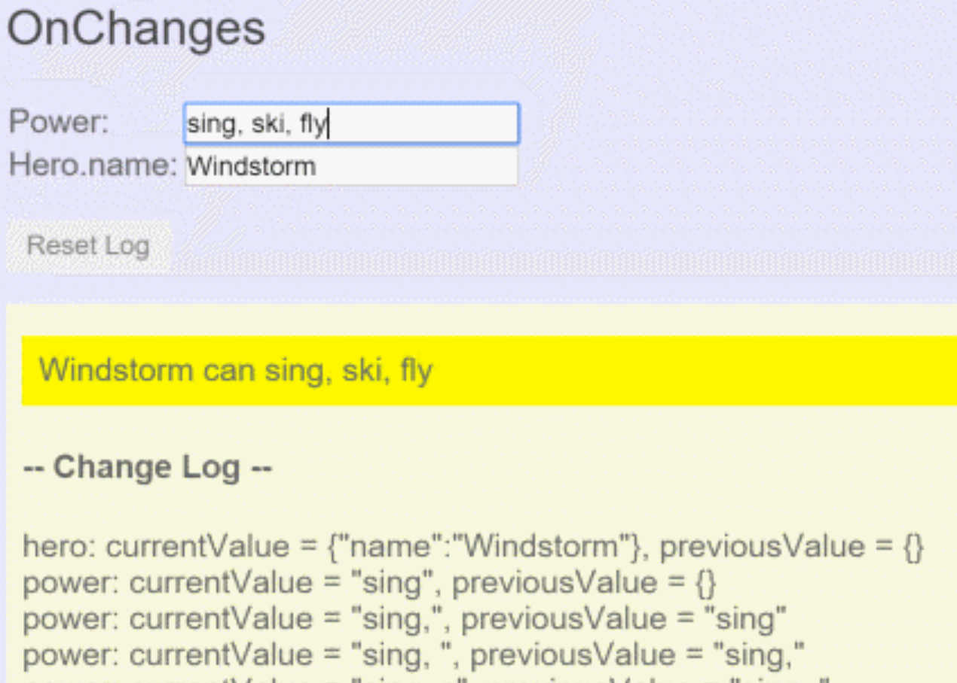
onchanges
Angular calls its ngOnChanges method whenever it detects changes to input properties of the component (or directive). This example monitors the OnChanges hook.
ngOnChanges(changes: SimpleChanges) { for (let propName in changes) { let chng = changes[propName]; let cur = JSON.stringify(chng.currentValue); let prev = JSON.stringify(chng.previousValue); this.changeLog.push(`${propName}:
currentValue = ${cur},
previousValue = ${prev}`); } }
In parent component:
<on-changes [hero]="hero" [power]="power"></on-changes>

Slide 19
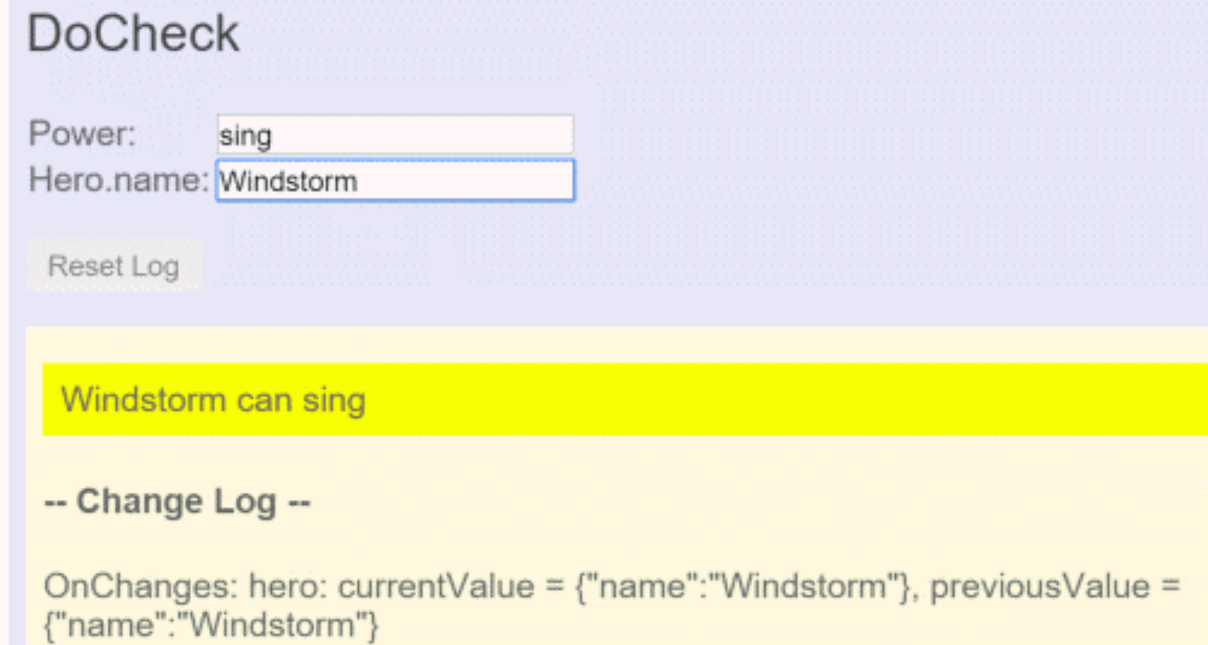
docheck
Use the DoCheck hook to detect and act upon changes that Angular doesn't catch on its own.
ngDoCheck() { if (this.hero.name !== this.oldHeroName) { this.changeDetected = true; this.changeLog.push(`DoCheck: Hero name
changed to "${this.hero.name}"
from "${this.oldHeroName}"`); this.oldHeroName = this.hero.name; } if (this.power !== this.oldPower) { this.changeDetected = true; this.changeLog.push(`DoCheck: Power changed
to "${this.power}" from "${this.oldPower}"`); this.oldPower = this.power; } }
While the ngDoCheck hook can detect when the hero's name has changed, it has a frightful cost. This hook is called with enormous frequency — after every change detection cycle no matter where the change occurred – anywhere on the page(!).

Slide 20
afterview
AfterViewInit and AfterViewChecked hooks that Angular calls after it creates a component's child views.
@Component({ selector: 'my-child-view', template: '<input [(ngModel)]="hero">’}) export class ChildViewComponent { hero = 'Magneta'; }
template: ` <div>-- child view begins --</div> <my-child-view></my-child-view> <div>-- child view ends --</div>`
export class AfterViewComponent implements AfterViewChecked, AfterViewInit { private prevHero = ''; @ViewChild(ChildViewComponent) viewChild: ChildViewComponent; ngAfterViewInit() { this.logIt('AfterViewInit'); } // viewChild is set after view was initialized ngAfterViewChecked() { // viewChild is updated after the view has been checked if (this.prevHero === this.viewChild.hero) { this.logIt('AfterViewChecked (no change)'); } else { this.prevHero = this.viewChild.hero; this.logIt('AfterViewChecked'); } } }

Slide 21

aftercontent
AfterContentInit and AfterContentChecked hooks that Angular calls after Angular projects external content into the component.
Content projection is a way to import HTML content from outside the component and insert that content into the component's template in a designated spot (aka transclusion in Angular 1).
ParentComponent:
`<my-child>
<my-input [value]="Magneta" >
</my-input>
</my-child>`
ChildComponent (selector ‘my-child’):
<div>-- projected content begins --</div> <ng-content></ng-content> <div>-- projected content ends --</div>
InputComponent (selector ‘my-input’):
`<input [value]="value”>`
@ContentChild and @ContentChildren queries will return directives existing inside the <ng-content></ng-content> element of your view, whereas @ViewChild and @ViewChildren only look at elements that are on your view template directly.

Slide 22
aftercontent
export class ParentComponent implements AfterContentChecked, AfterContentInit { @ContentChild(InputComponent) inputComponent: InputComponent;
prevValue: string; // contentChild is set after the content has been initialized
ngAfterContentInit() { this.logIt('AfterContentInit'); }
// contentChild is updated after the content has been checked ngAfterContentChecked() { if (this.prevValue === this.inputComponent.value) { this.logIt('AfterContentChecked (no change)'); } else { this.prevHero = this.inputComponent.value; this.logIt('AfterContentChecked'); } } }
ParentComponent:
`<after-content> <my-child>
<my-input
[value]="Magneta">
</my-input>
</my-child> </after-content>`
InputComponent
(selector ‘my-input’):
`<input [value]="value”>`

