Slide 1
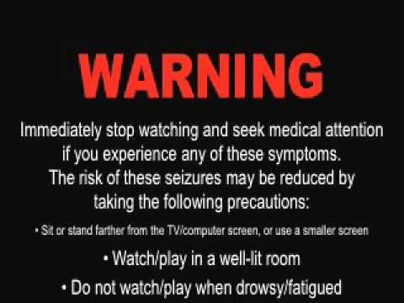

Slide 2
PERSONALITIES & drug use
Finding of our EDA
Ratnakar and Luke

Slide 3

What it’s all about
Our EDA revieled usefull implications of personality as a contributing factor to drug use.
Here we will look at:
The data
Theory
Statistics
Important features and results
And what conclusions we can draw from the EDA

Slide 4

Cleaning the data
Initially the data was converted into a T-Score based on normative data including all categorical variables, but excluding the class values
Categorical values where changed to original values, rather than T values.
Drug-use class was changed to people who had used drugs and those who did not or had not for more than a decade.

Slide 5

Imbalanced data
Of the classes of user, for every one drug a person used, there were 17 that they did not!
1
00000
000000
000000

Slide 6

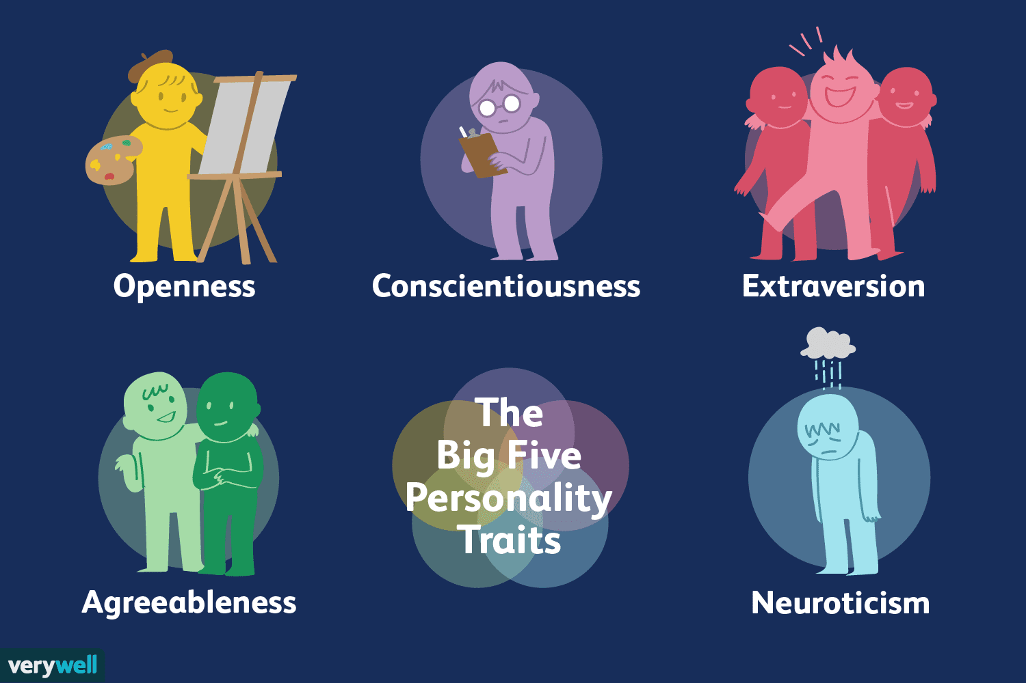
The big 5
From psychology´s trait theory.
Made in the 80´s and shown accurate to present date.
5 long lasting, boiled down traits.

Slide 7


additional mesures
Impulsivity
Sensation seeking

Slide 8
Definition of personality trate
“A relatively stable, consistent, and enduring internal characteristic that is inferred from a pattern of behaviors, attitudes, feelings, and habits in the individual.”
- APA

Slide 9
Hypothesis
At the onset of the project, two hypotheses were posited:
Hypothesis #1
There will be an interaction between personality combinations and particular drug consumption.
Hypothesis #2
Some personality and drug combinations will have stronger effects than others.

Slide 10
Classes of users
Non-using
Using
Never used
Used over a dacade ago
Used in the last day
Used in the last week
Used in the last month
Used in the last year
Used in the last 10 years

Slide 11
Drug types
Alcohol
Amphetamines
Amyl nitrite
Benzodiazepines
Caffeine
Cannabis
Chocolate
Cocaine
Crack
Ecstasy
Heroin
Ketamine
Legal highs
LSD
Methadone
Magic mushrooms
Nicotine
Volatile substance abuse (VSA)
Semeron (Fictisious)
removed from analysis

Slide 12
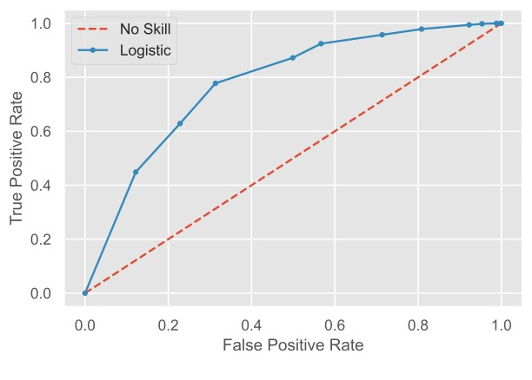
Why logistic regression?
Logistic regression was chosen because of the use of catagorical variables.
We then compared with Random Forest and Adabooster

Slide 13
log regression model
Alcohol = 50.0%
Amphetamines = 69.85%
Amyl nitrite = 56.76%
Benzodiazepines = 66.23%
Caffeine = 66.67%
Cannabis = 76.61%
Chocolate = 71.43%
Cocaine = 67.27%
Crack = 55.84%
Ecstasy = 68.44%
Heroin = 75.29%
Ketamine = 65.71%
Legal highs = 76.07%
LSD = 75.78%
Methadone = 70.66%
Magic mushrooms = 72.66
Nicotine = 62.65%
VSA = 71.74%
Semeron (Fictisious) = 64.89%

Slide 14
log regression model
Alcohol = 50.0%
Amphetamines = 69.85%
Amyl nitrite = 56.76%
Benzodiazepines = 66.23%
Caffeine = 66.67%
Cannabis = 76.61%
Chocolate = 71.43%
Cocaine = 67.27%
Crack = 55.84%
Ecstasy = 68.44%
Heroin = 75.29%
Ketamine = 65.71%
Legal highs = 76.07%
LSD = 75.78%
Methadone = 70.66%
Magic mushrooms = 72.66
Nicotine = 62.65%
VSA = 71.74%
Semeron (Fictisious) = 64.89%

Slide 15
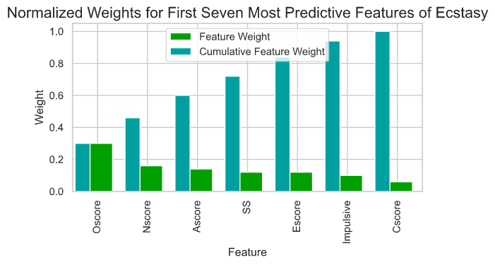
Ecstasy: important features

Slide 16
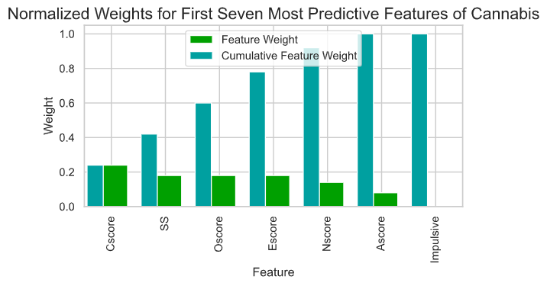
Cannabis: important features

Slide 17
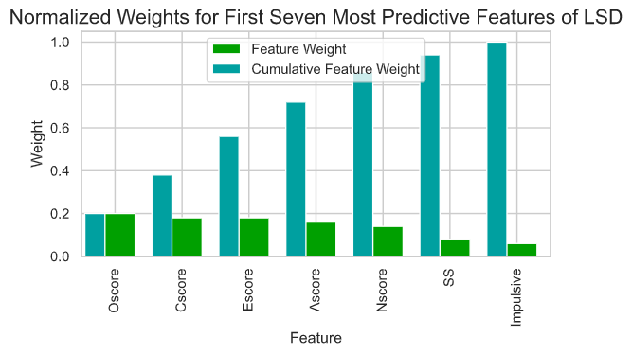
lsd: important features

Slide 18
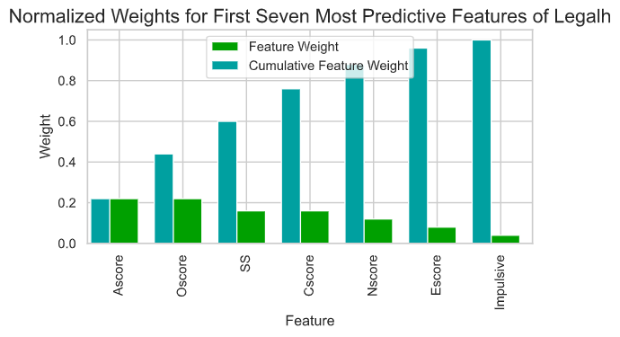
Legal high: important features

Slide 19
Important features
**Based on F1 scores
Ecstasy
Cannabis
LSD
Legal high
+ Openness
+ Nurotic
- Agreeableness
+ Sensation Seeking
- Extraversion
+ Impulsive
- Contientiousness
- Contientiousness
+ Sensation Seeking
+ Openness
- Extraversion
+ Nurotic
- Agreeableness
+ Impulsive
+ Openness
- Contientiousness
+ Extraversion
- Agreeableness
+ Nurotic
+ Sensation Seeking
+ Impulsive
- Agreeableness
+ Openness
+ Sensation Seeking
- Contientiousness
+ Nurotic
- Extraversion
+ Impulsive

Slide 20


example results: Ecstasy
Best model: Logistic regression model
Predicted non-using
Predicted using
97 correctly identified
43 falsly identified
56 falsly identified
105 correctly identified

Slide 21
example results: cannibus
Best model: Logistic regression model
Predicted non-using
Predicted using
95 correctly identified
22 falsly identified
33 falsly identified
98 correctly identified

Slide 22
example results: LSD
Best model: Logistic regression model
Predicted non-using
Predicted using
80 correctly identified
25 falsly identified
35 falsly identified
83 correctly identified

Slide 23
example results: legal high
Best model: Logistic regression model
Predicted non-using
Predicted using
94 correctly identified
28 falsly identified
50 falsly identified
133 correctly identified

Slide 24
Optimized hyperparameters
Ecstasy
AdaBoost Classifier
Decision Tree max depth = 1
Learning rate = 0.1
Cannabis
AdaBoost Classifier
Decision Tree max depth = 3
Min sample split = 6
Learning rate = 0.1
N estimators = 120

Slide 25
Optimized hyperparameters
LSD
AdaBoost Classifier
Decision Tree max depth = 1
Learning rate = 0.1
Legal High
AdaBoost Classifier
Decision Tree max depth = 1
Learning rate = 0.1
N estimators = 120

Slide 26
Final scores
Ecstasy Cannabis
LSD Legal High
Accuracy on testing data: 0.6678
F-score on testing data: 0.6576
Accuracy on testing data: 0.7661
F-score on testing data: 0.7566
Accuracy on testing data: 0.7085
F-score on testing data: 0.6935
Accuracy on testing data: 0.7475
F-score on testing data: 0.7503

Slide 27
Results:
Hypothesis 1: passes
Of the 18 drug catagories (including the one fictional), the model predicted half of the with an accuracy greater that 70%.
Hypothesis 2: passes
It appears that ”openness” is a significant indicator for LSD, Cannabis, Ecstasy, Legal highs, appearing in the top 3 for each drug.

Slide 28
Conclusion:
Although the model shows people with certain personality types are more suseptable to certain drugs, We cannot say for certain that particular drugs are more dependent on personality than on other factors. The findings of our model indicate that there are people who are at higher risk of developing addiction, with particular personality trait combinations.

Slide 29
Conclusion:
It was also shown that there were positive corelations for Opennes, nerotisism, sensation seeking and impulsive personalities, and negative correlations with agreeableness, contientiousnes, and extroversion with the exception of LSD.

Slide 30
Conclusion:
In future, a study could be conducted to identify across drug types, which range of personality types are most suseptable to drug use overall.

Slide 31


Any questions?

Slide 32
Thank you!!!
And you’re welcome…

