Slide 1
ShiVa module
polyglot-visualnode
manual

Slide 2
The purpose of this module is data oriented editing as a property-node graph. By traversing this graph with logic you have the ability to (re-) generate things, like ShiVa-resources for example.
The design of the module adds the possibility to extend it with specific packages to add custom views/handling of nodes, which allows for specific higher level editing.

Slide 3
NODE
LINK
Properties
GRAPH
Key-value
zero or more

Slide 4
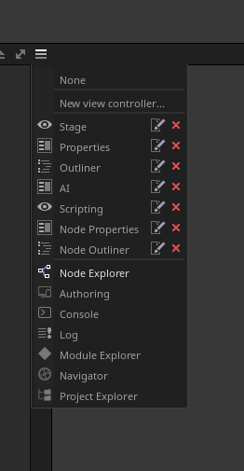
Views
Node Explorer
Node Properties
Node Outliner
Stage

Slide 5
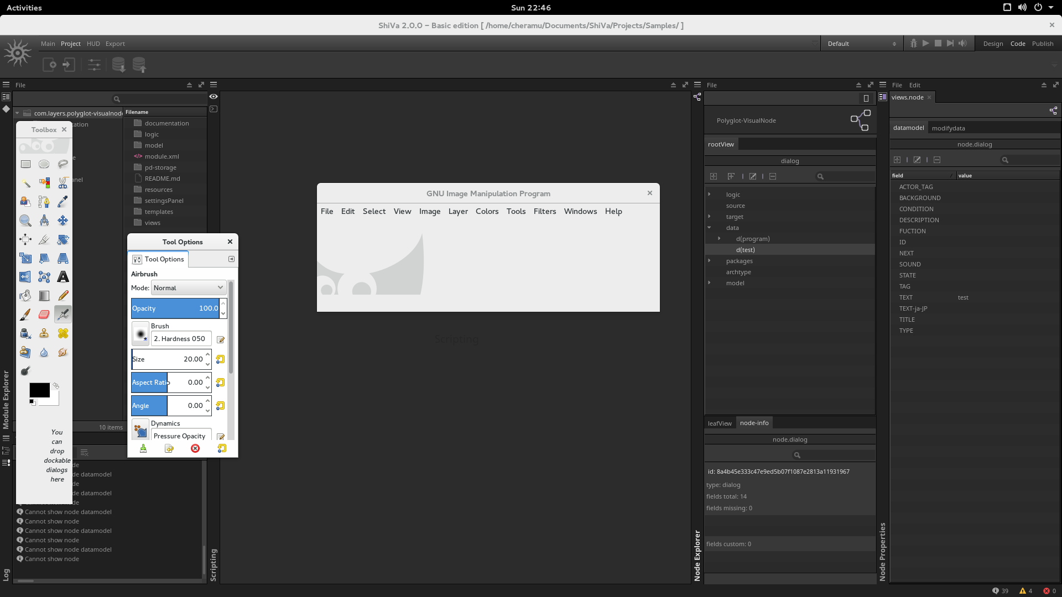
Node Explorer Tree
Logic
  Lua scripts
    traversing nodes tree/linked
Source
  Definition of node types
Target
  Generated output
Data
  Storage for nodes
Packages
  VisualNode extensions
Archtype
  Bundle (of nodes, ..?)
Model
  Definition of nodes

Slide 6
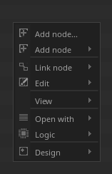
Node Explorer Actions
Add node
  As sibling/child
  Plus treeitem
Link node
  Between 2 selected nodes
Copy & Paste Node
Rename node
  treeitem rename
Delete treeitem
Design
  Node /Filter
  Script /Export
Package
  (De)-Activated
Logic
  Run created lua scripts
Treemenu

Slide 7
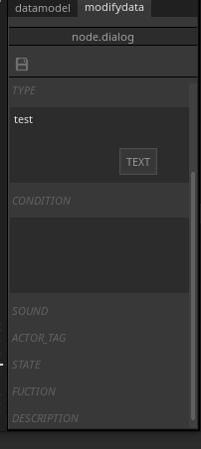
Node Properties
type node is
  e.g “node.dialog”
datamodel
Key value pairs
  Create
  Edit
  Delete
modifydata
  Edit values

Slide 8
ShiVa module
polyglot-visualnode
Package Dialogue
(early stage)

Slide 9
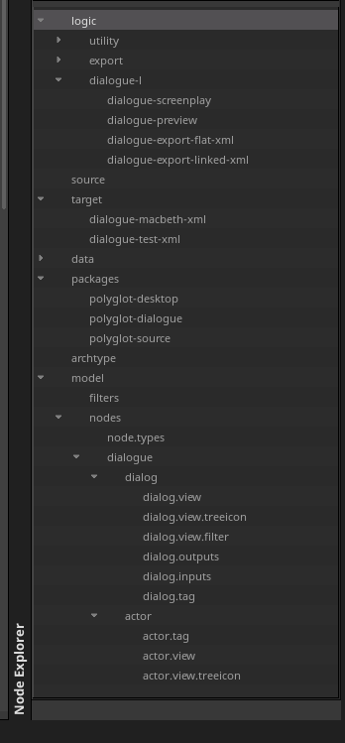
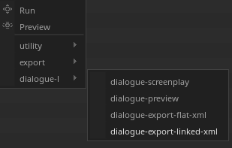
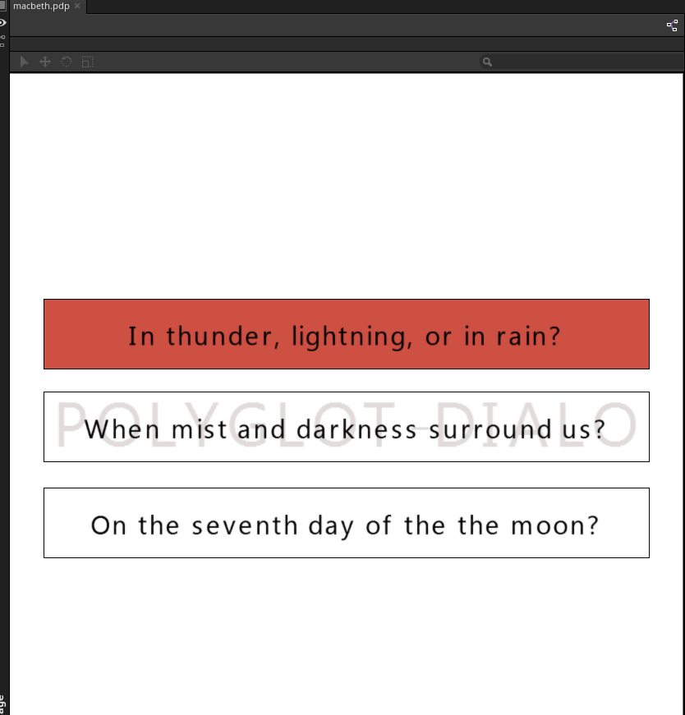
Package Dialogue
Logic To
Export to xml
Preview export
Exported data
Treemenu
this
package
Stage “Preview”
“.pdp extension”
Node definitions
Node definitions
Node definitions
Node definitions

Slide 10
ShiVa module
Polyglot-visualnode
Technical 'lua impl.'

Slide 11
Node
Storage lua table in file
  Node-definitions: have unique path -filename
  Nodes: have content generated-id, same-content == same-id and generated-id == filename. no path
Type def
  Dot separated string: 'node[“x.y.z”]'
Content
  Key value pairs
Content extended functionality
  key value pairs
    e.g. “.link” - <uid> to link 2 nodes
node["dialog"] =
{
["TITLE"] =
""
,
["NEXT"] =
""
,
["DESCRIPTION"] =
""
,
["TEXT"] =
"program"
,
}

Slide 12
Node Api
addNode
snodeId = function CLP_Node.AddNode( self, sNodename, tNode, sNodeId, sRelativePath )
getNode
snodeId = function CLP_Node.GetNode( self, sNodeId, sRelativePath )
getDifferenceFrom
tKeyFields = CLP_Node.getDifferenceFrom(self, sNodeBaseFields, sOtherNodeFields)
isGenNode
bGenNode = function CLP_Node.isGenNode( self, sNodeId, sNodename, tNodeData )
Not yet implemented
function CLP_Node.intersection( self, sNodeId, sOtherNodeId )
function CLP_Node.complement( self, sNodeId, sOtherNodeId )
function CLP_Node.union( self, sNodeId, sOtherNodeId, kOptions )
function CLP_Node.difference( self, sNodeId, sOtherNodeId )

Slide 13
Node Traverse Api
walk( hTreeRoot, call, isRoot ) --tree
  You walk the tree explorer treeitems from the selected or every item
walkLinked( hTreeRoot, call, isRoot ) --node
  You walk nodes connected with each other.
Not yet implemented
  other means of walking the graph
    Visitor
    ..?

Slide 14
Node Model Api
getDatamodel()
  Gets all model definition to create a node from definition
getSharedDatamodel()
  Shared node storage

Slide 15
ShiVa module
polyglot-visualnode
Technical 'module'

Slide 16
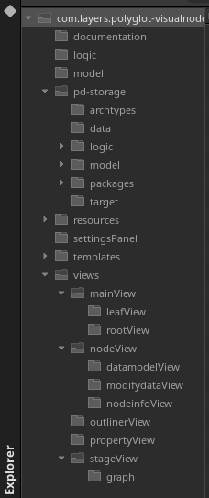
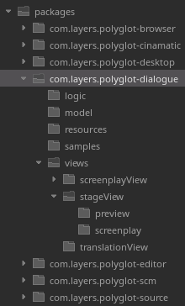
Package structure
Module structure
API' s
Node storage
adds
scripts storage
Node definitions storage
adds
Views

Slide 17
Sources
https://github.com/cheramu/com.layers.polyglot-visualnode
Issues & Taskshttps://github.com/cheramu/com.layers.polyglot-visualnode/issues
Docs & Design
https://github.com/cheramu/com.layers.polyglot-visualnode/tree/master/documentation

