Slide 1
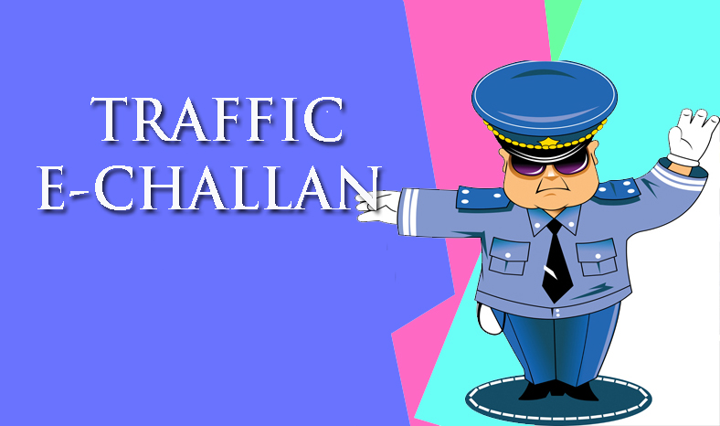
Hackathon Chandigarh
Theme Name : Smart City App with Gamification
Solution Name : Smart Traffic Management System
Location :Chandigarh
Team Name : Chandigarh Rockers
<Manmohan, Kamal, Simarjeet, Manjeet, Sukhvinder>

Slide 2
Problem Statement & Solution Summary
Problem statement
Digitize issuance of Traffic Challan in digital format. Supports addition of unique identification No. (Aadhar card).
Along with Driving license and vehicle registration certificate.
Brief Description
Issuance of Traffic Challan requests is still manual process. And takes a considerable amount of paper work to issue challan to a culprit.
During a challan drive vehicles form long queues, due to Manual Process of filling out Challan forms.
First the police officer spots a possible violator. Asks for various documents like Driving license, Registration certificate. Fills challan form and issues the challan.
Here we are trying to digitize the challan issuance process using Aadhar card.
Gamification implemented on basis of challan count of police officers.
What is unique about our solution?
Solution get its uniqueness from the fact that here the Challaning officer only has to fill certain fields in form of user details and submit it to issue challan.
Some people are also proclaimed offenders. The app keeps the Challan history of a person and displays it after a challan is issued.
The app doesn’t require any extra hardware to be carried except usual smart phone.
Tracks funds collected by traffic police. Also puts trace information on previous offences committed by driver/vehicle.

Slide 3
Solution Summary
Technologies used
Domains that can consume this solution
Java 1.8, Spring boot 1.3.3, Hibernate | Smart City
Swagger, Angular 2, Ionic 2, Node6.5
Cordova1.5, Android sdk 25
Postgresql-9.2.19-1

Slide 4
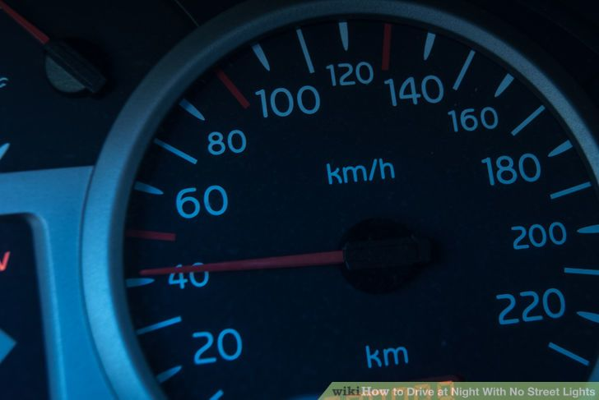
Thank You

