Slide 1
Diving deep into the gamma-ray sky

Slide 2
Diving deep into the gamma-ray sky
Atmospheric Cherenkov Plenoscope

Slide 3

Diving deep into the gamma-ray sky
Atmospheric Cherenkov Plenoscope
Sebastian Achim Mueller,
Max Ludwig Ahnen,
Dominik Neise,
Spiros Daglas,
Axel Arbet Engels,
and Adrian Biland

Slide 4
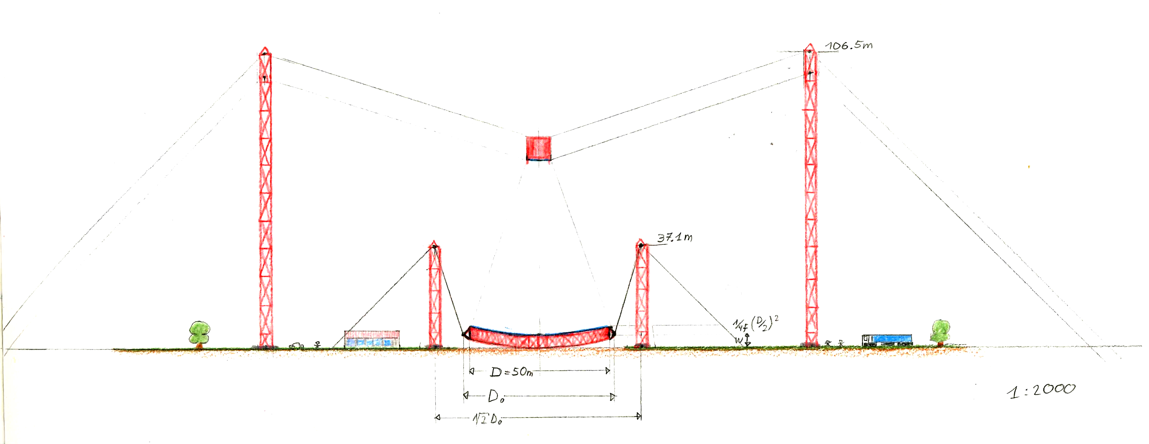
From the first ideas...

Slide 5
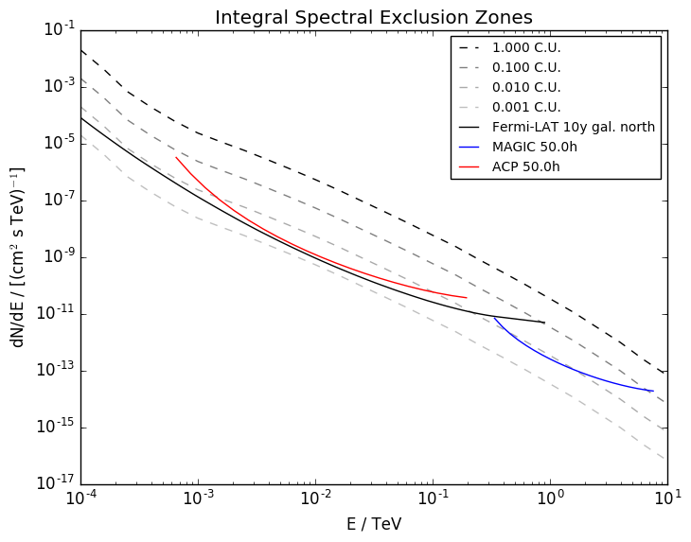
...to a new era in gamma-ray astronomy

