Slide 1
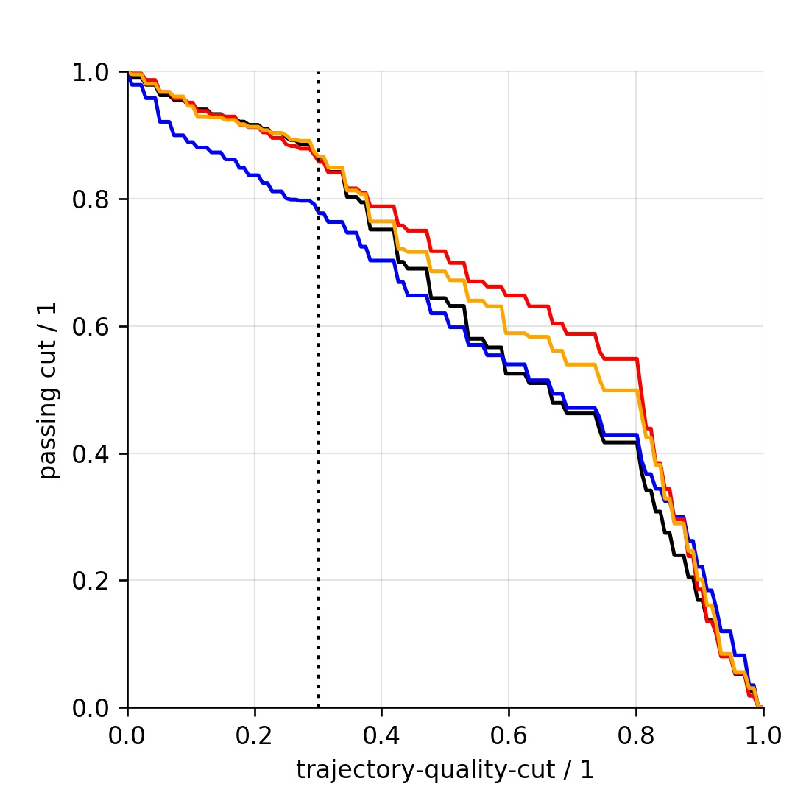
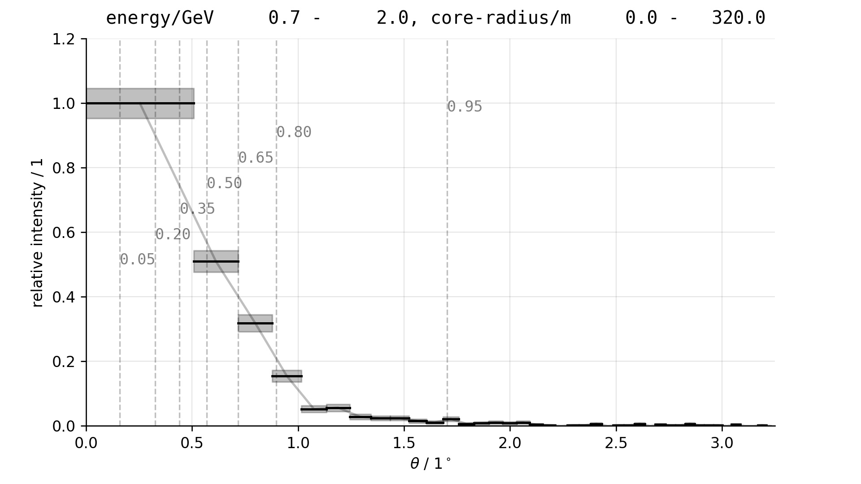
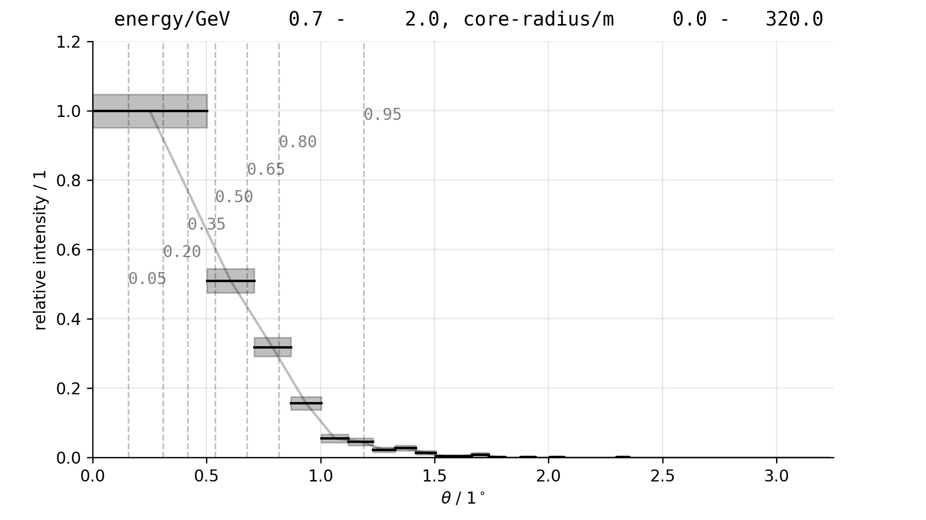
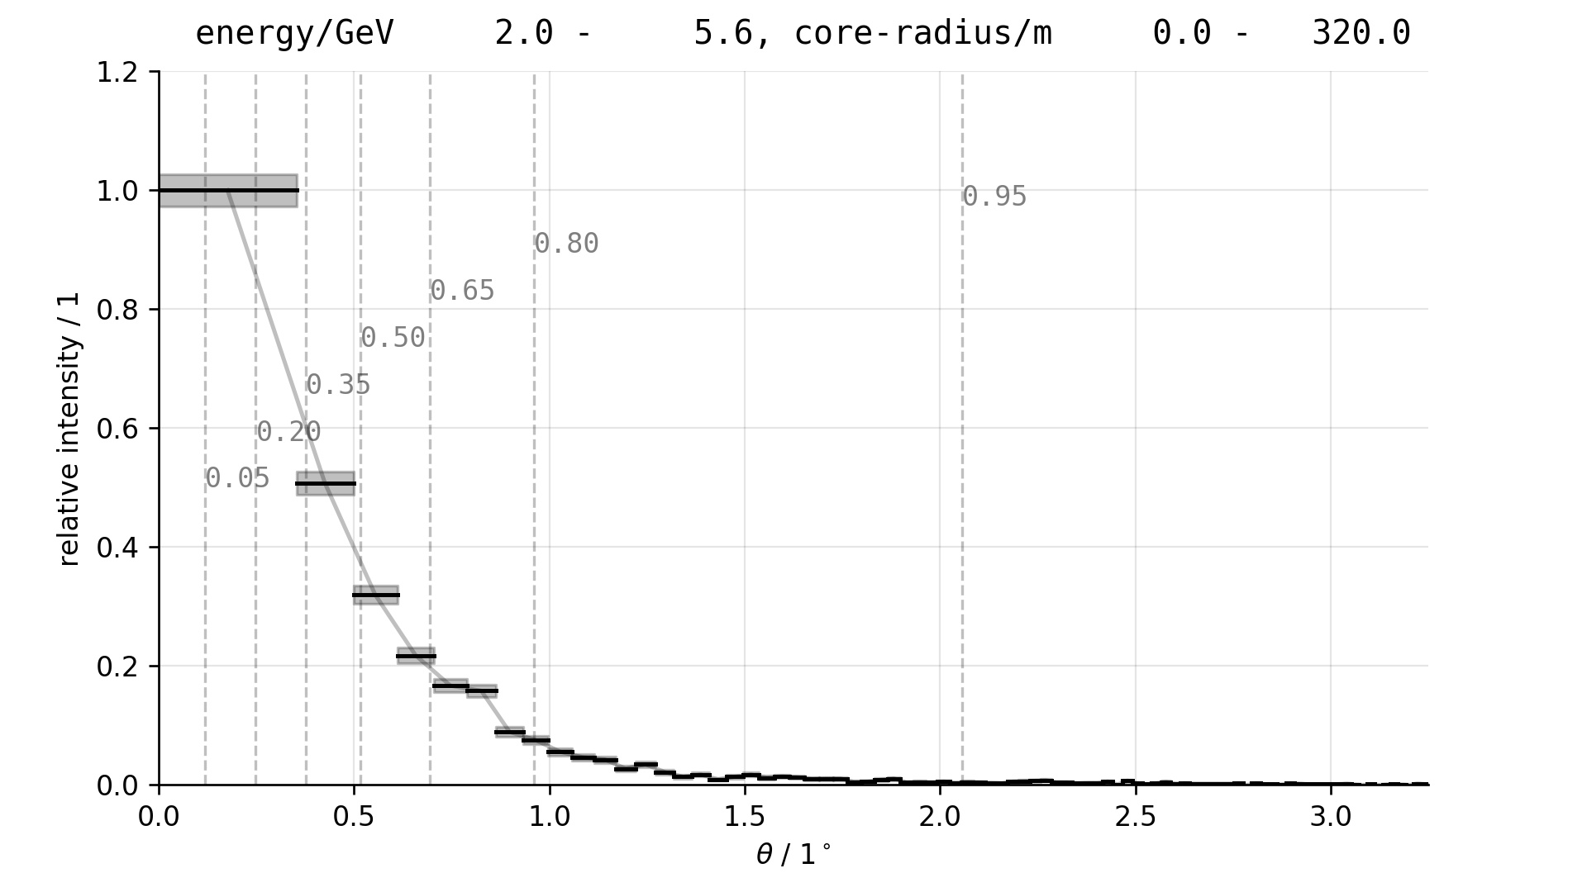
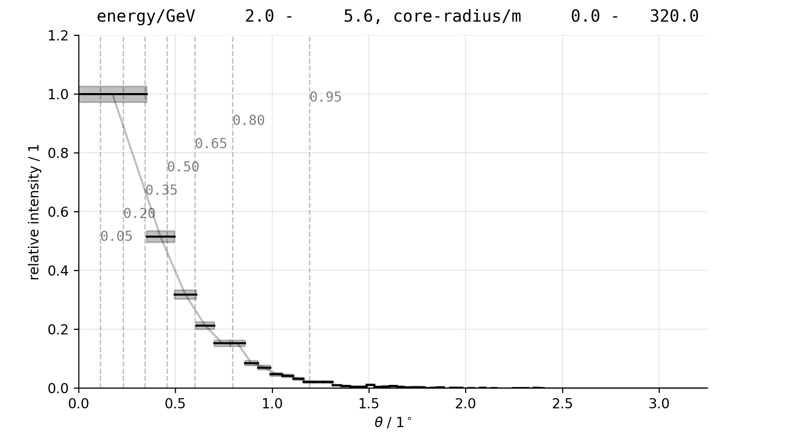
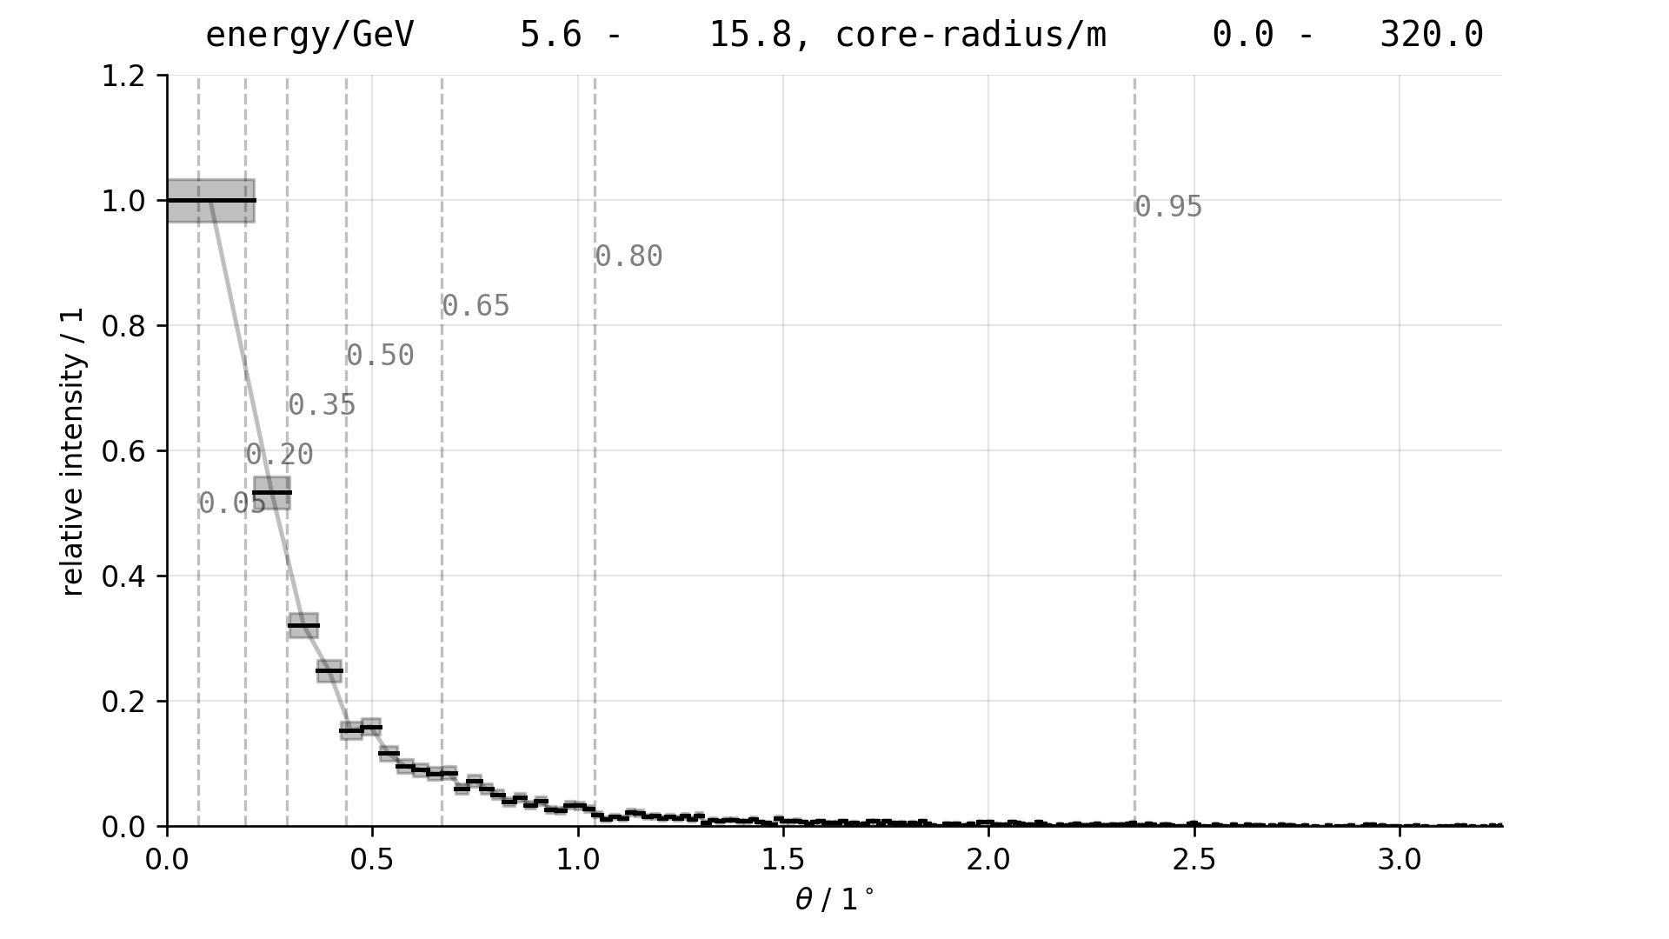
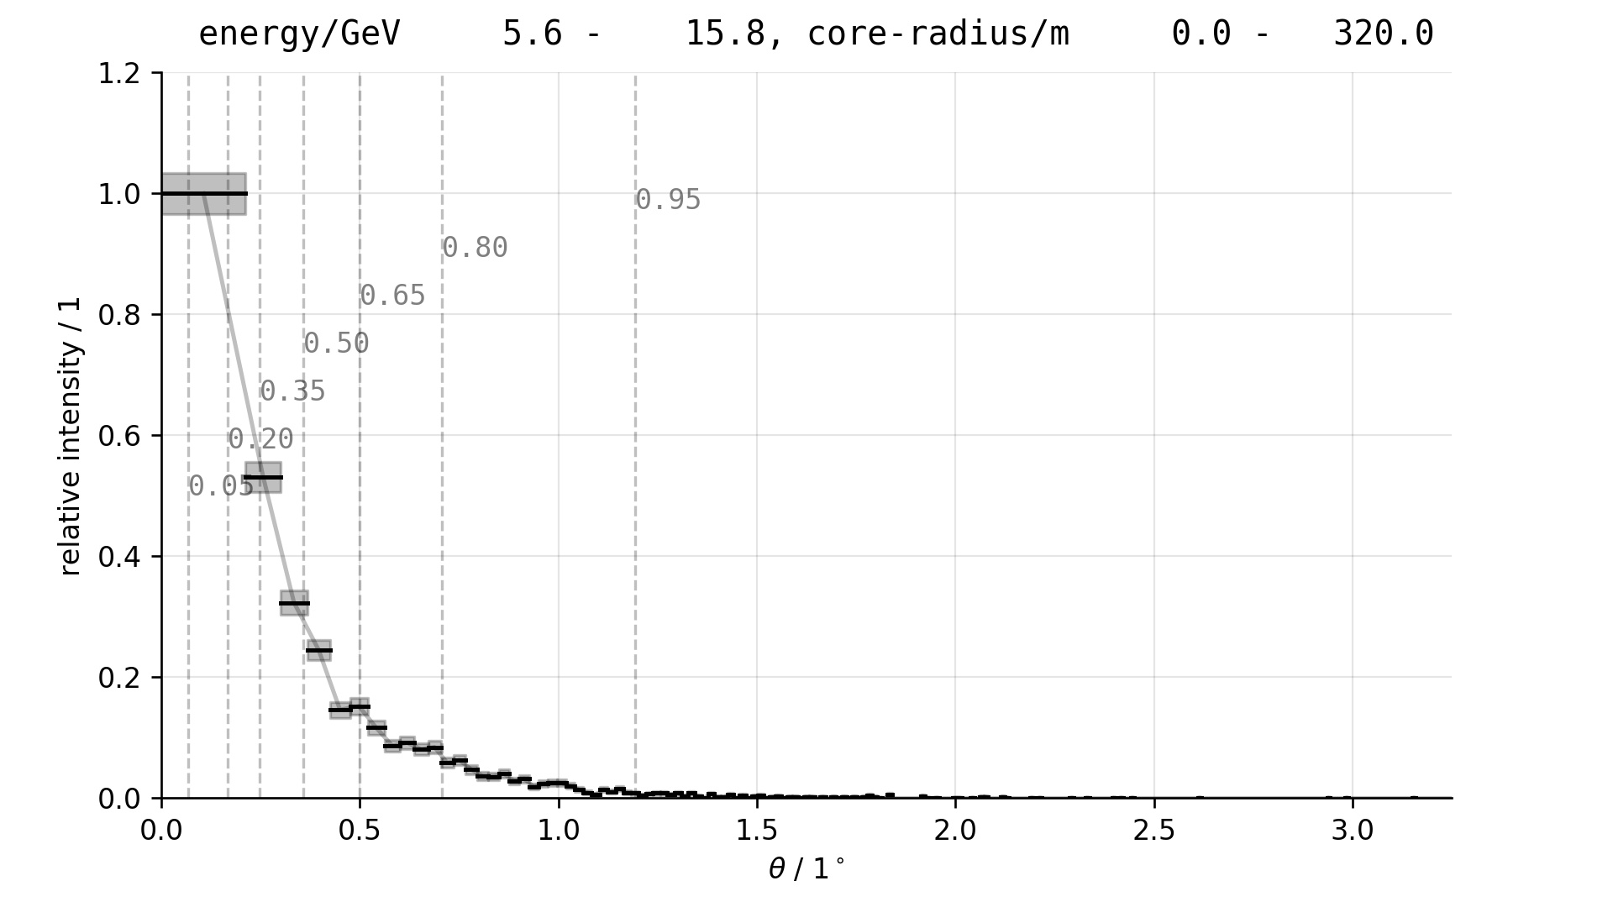
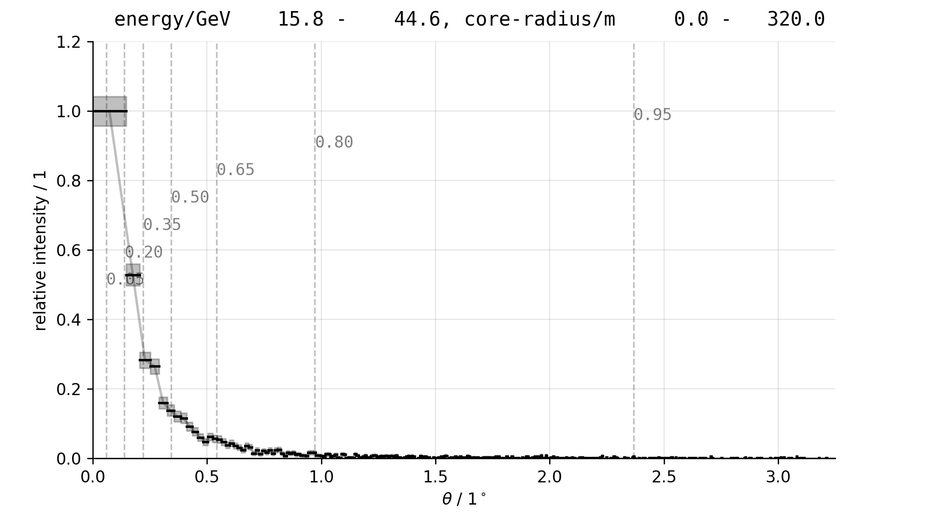
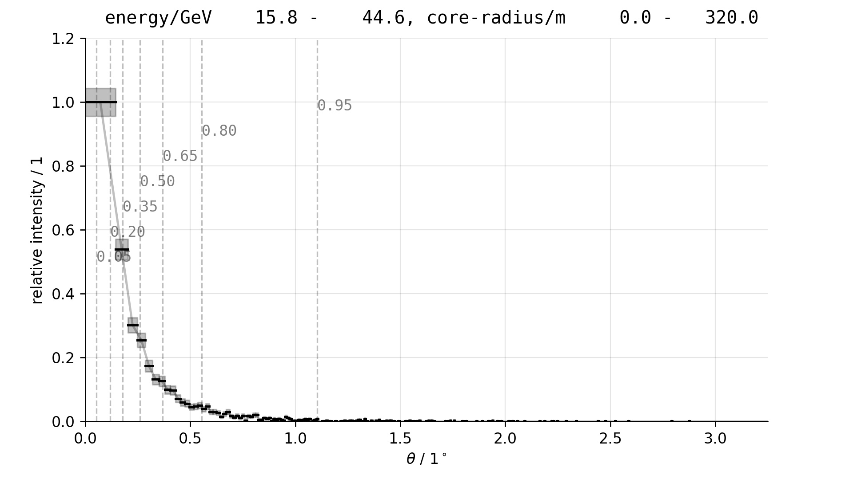
2021 May 27, Sebastian A. Mueller
Reducing tails in theta²-histogram by cutting bad reconstructions
A trajectory-quality is estimated based on the reconstructed core-radius, the reconstructed number of Cherenkov-photons, and others. A gentle cut at 0.3 keeps approx. 90% of the gamma-rays, and reduces the tails in the theta-square-histograms. See especially 65% to 80% containment angles.
Production-run 2021-05-21
71m Plenoscope
Namibia
Gamma
Proton
Electron/Positron
Helium
Quality > 0.0
Quality > 0.3

