Slide 1
Distance Indexing on Road Networks
A summary
Andrew Chiang
CS 4440

Slide 2
Introduction
Geodatabases store geographic data that can be represented on a map
Roads can be stored in a geodatabase or spatial database as polylines
At the very base of MapQuest and Google Maps/Earth is a road network

Slide 3
Road Networks
A network of roads represented by polylines
At each intersection of two roads, a point/vertex is placed
Between any two vertices on the road network, that segment has properties used in calculations (length of segment, time for traveling the segment, etc)

Slide 4
Road Networks VS Normal Space
Normal Euclidean space doesn’t have paths between points, just empty space
With road networks, we connect certain points using edges (roads)
Roads can be given weights (distance, time) that factor into optimization algorithms

Slide 5
Location-Based Services Using Road Networks
Users in a location-based service utilize continuous NN and kNN queries to provide users with information
Shortest path algorithms are commonly used (Dijkstra’s Algorithm) to find the distances between two points on the network
Can find shortest paths on the fly, or pre-compute and store distances and paths in a table

Slide 6
Drawbacks of Current Practices
Dijkstra’s Algorithm is all fine and dandy for short distances, but…
For longer distances, Dijkstra’s Algorithm is very inefficient
We don’t want to have to calculate long distances continuously (terribly inefficient!)
So what do we do? What DO we do?

Slide 7
Distance Signature
To help efficiency in queries, one can use a proposed “distance signature”
Instead of storing a specific distances to objects, we store an approximate distance (distance range)
For each node in the network, we create a signature

Slide 8
What’s in a Distance Signature?
The approximate distance between that node and each other object of interest in the network
The index of the node to go to when traversing the shortest path from this node to the destination node

Slide 9
Some Notation
In a road network N, each node n has a distance signature S(n)
S(n) is composed of components S(n)[0…i], which contains the approximate distance range between the node n and node i
In addition to S(n)[0…i], we store a backtracking link S(n)[0…i].link, which gives us the corresponding index in the adjacency matrix of n of the node to hop to when following the shortest path from n to i

Slide 10
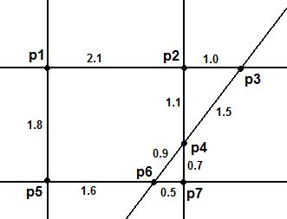
Example of a Distance Signature
Distance Categories
0: < 1 mi
1: 1 mi <= D < 2 mi
2: 2 mi <= D < 3 mi
3: >= 3 mi
S(p6)
p1 | p2 | p3 | p4 | p5 | p6 | p7
3 | 2 | 2 | 0 | 1 | 0 | 0
Units in miles
S(p6).link
Adjacency Matrix for P6
P4 | 0.9
P5 | 1.6
P7 | 0.5
p1 | p2 | p3 | p4 | p5 | p6 | p7
1 | 0 | 0 | 0 | 1 | -- | 2

Slide 11
Operations on S(n)
Find approximate and exact distance between two nodes in the network
Exact distance computation uses backtrack link values to follow shortest path from A to B
Approximate distance comparision, about how far away are points A and B from N?

Slide 12
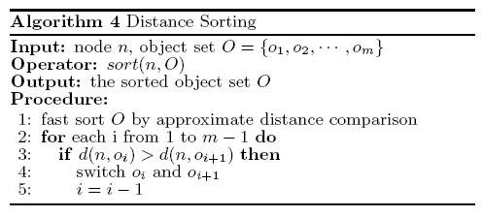
More Operations on S(n)
Distance sorting (ordering of features from closest to farthest or vice versa, kNN queries)

Slide 13
Using S(n) for Range Queries
For range queries, we use distance categories to include or exclude features quickly
If a category is entirely within the query range, we automatically include all features in the category
If a category is entirely outside the query range, we automatically exclude all features in the category
If a category includes the query range distance, we must do distance calculations

Slide 14
Using S(n) for kNN Queries
Find number of feature in each distance category. Keep only the categories that will cover the closest k features
Do distance sort on features categories kept. Keep only top k features

Slide 15
Notice anything?
Operations that return approximate distances VS exact distance?
By using distance signature, we are able to trim down a set of features into a smaller set
This way, we can perform more specific operations on fewer features, rather than on every feature in the network

Slide 16
Other Cool Features of S(n)
S(n) can be compressed, mainly in the backtracking link
  Nodes that share the same link from n
  Commutative property of S(n) (adding two signatures together)
Easy updates to S(n) when a road on the network is changed

Slide 17
Optimization
For best performance, we want to make just the right number of distance categories for a signature
Things to think about
  Density of distance data points
  Query load: how many operations will we need to perform a query?
  Storage space: bits used for storing the signature for each node in the network

Slide 18
Optimization (ctd.)
Since most range and kNN queries are local to the user’s location, we determine our distance categories exponentially
Distance ranges represented as…
T, cT, c²T, …, where c, T are constants

Slide 19
Optimization (ctd.)
After some really ugly math, we determine that the optimal values are…
C = e
T = √(SP / e)
… where SP is the distance of a typical range
query that will be performed on this system. This
is usually defined by the creator of the system
For a full derivation, refer to the paper

Slide 20
A Look at Performance
For purposes of performance comparison, we compare using the distance signature versus using…
  Full indexing: storing the hard distances
  NVD (Network Voronoi Diagram): a commonly-used kNN query algorithm

Slide 21
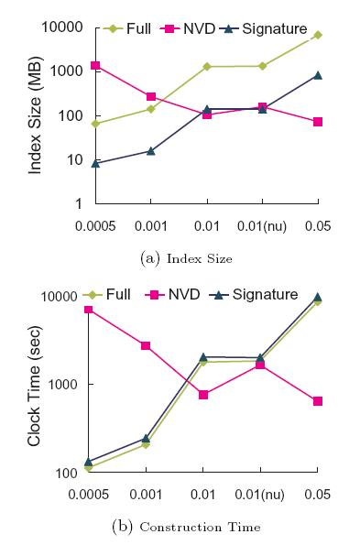
A Look at Performance (ctd.)
Consistently smaller index size than full indexing
Disk size for signature nearly 10% that of full indexing

Slide 22
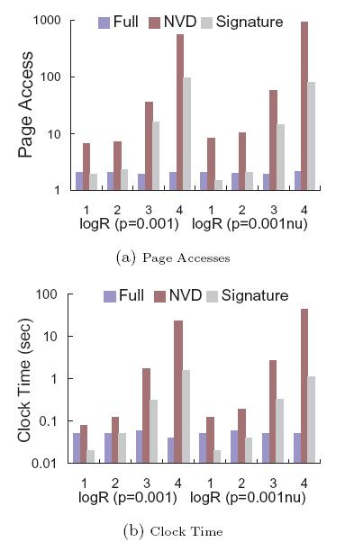
A Look at Performance (ctd.)
For range queries, distance affects performance of signature, but still outperforms NVD
When threshold for query is low, signature is as good as full indexing

Slide 23
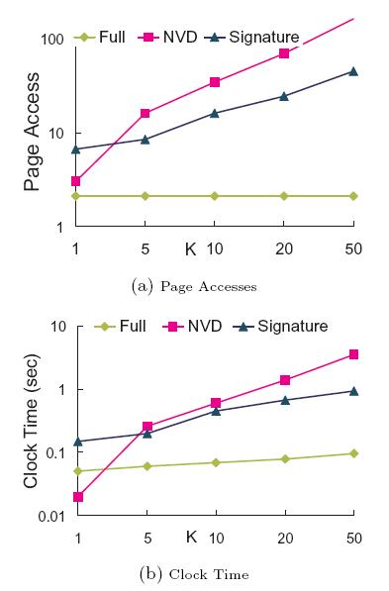
A Look at Performance (ctd.)
For kNN queries with a higher k value, signature outperforms NVD
Signature’s performance doesn’t increase linearly as k increases

Slide 24
Performance Summary
Although full indexing still provides faster query processing time, the disk space used by distance signature is far less
Distance signature performs kNN queries faster than a proven indexing method for kNN queries
Overall performance on all aspects still reasonable for use on both range and kNN queries

Slide 25
Summary
Distance signature is a new indexing method optimized for road networks that can efficiently perform both range and kNN queries
Distances are categorized into exponential ranges, and operations use a general-to-specific approach
Signature itself is smaller in size and is compressible

