Slide 1
1
How beauty pros are getting booked by the right clients
without adding more hours in the chair
Cherie Bowen · Rie Artistry
Notes:
Script slide 1 | Title: narrow topic
How beauty pros are getting booked by the right clients
without adding more hours in the chair
Design: TITLE. Main line 66pt bold, second line 40pt. Small at bottom: "Cherie Bowen · Rie Artistry". No photo, no logo. Have this on screen as people join.

Slide 2
2
I have two agendas tonight.
Notes:
Script slide 2 | Two agendas
I have two agendas tonight.
Design: STATEMENT.

Slide 3
3
#1: Give you the most practical training you've ever had on growing your beauty business.
Notes:
Script slide 3 | Two agendas
#1: Give you the most practical training you've ever had on growing your beauty business.
Design: STATEMENT. "#1" small in accent color above the line.

Slide 4
4
#2: At the end, invite a few of you to work with me personally for 8 weeks.
Notes:
Script slide 4 | Two agendas
#2: At the end, invite a few of you to work with me personally for 8 weeks.
Design: STATEMENT. "#2" small in accent color.

Slide 5
5
If I don't deliver on #1, don't even think about #2.
Notes:
Script slide 5 | Two agendas
If I don't deliver on #1, don't even think about #2.
Design: STATEMENT.

Slide 6
6
Fair deal?
Type DEAL
Notes:
Script slide 6 | Micro-commitment
Fair deal?
Type DEAL in the chat.
Design: CHAT PROMPT. "DEAL" in accent color, 96pt.

Slide 7
7
I believe this will be the most useful hour you've spent on your business this year.
Notes:
Script slide 7 | Frame
I believe this will be the most useful hour you've spent on your business this year.
Design: STATEMENT.

Slide 8
8
You've heard that before.
So don't take my word for it.
Judge me at the end.
Notes:
Script slide 8 | Mind-read the doubt
You've heard that before.
So don't take my word for it.
Judge me at the end.
Design: STATEMENT. Each new line appears on click.

Slide 9
8
You've heard that before.
So don't take my word for it.
Judge me at the end.
Notes:
Script slide 8 | Mind-read the doubt
You've heard that before.
So don't take my word for it.
Judge me at the end.
Design: STATEMENT. Each new line appears on click.

Slide 10
8
You've heard that before.
So don't take my word for it.
Judge me at the end.
Notes:
Script slide 8 | Mind-read the doubt
You've heard that before.
So don't take my word for it.
Judge me at the end.
Design: STATEMENT. Each new line appears on click.

Slide 11
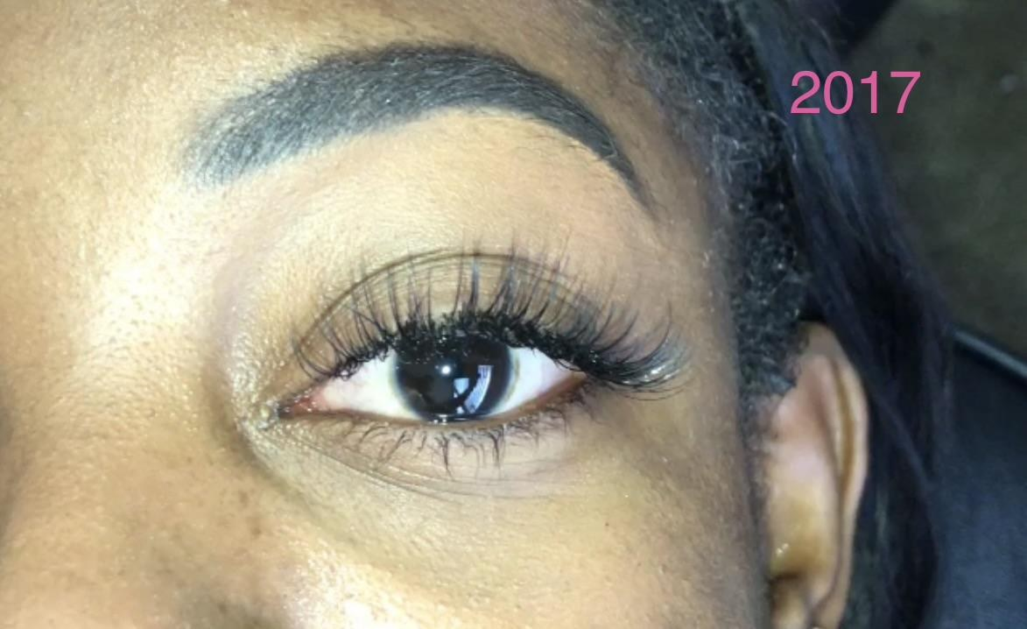
9
2017.
I was one of the only lash artists in my area.
Notes:
Script slide 9 | Founder story (then): where I started
2017.
I was one of the only lash artists in my area.
Design: PHOTO: your 2017 lash photo (file: 2017 lash photo, keep the pink "2017" label). Text on the left third.

Slide 12
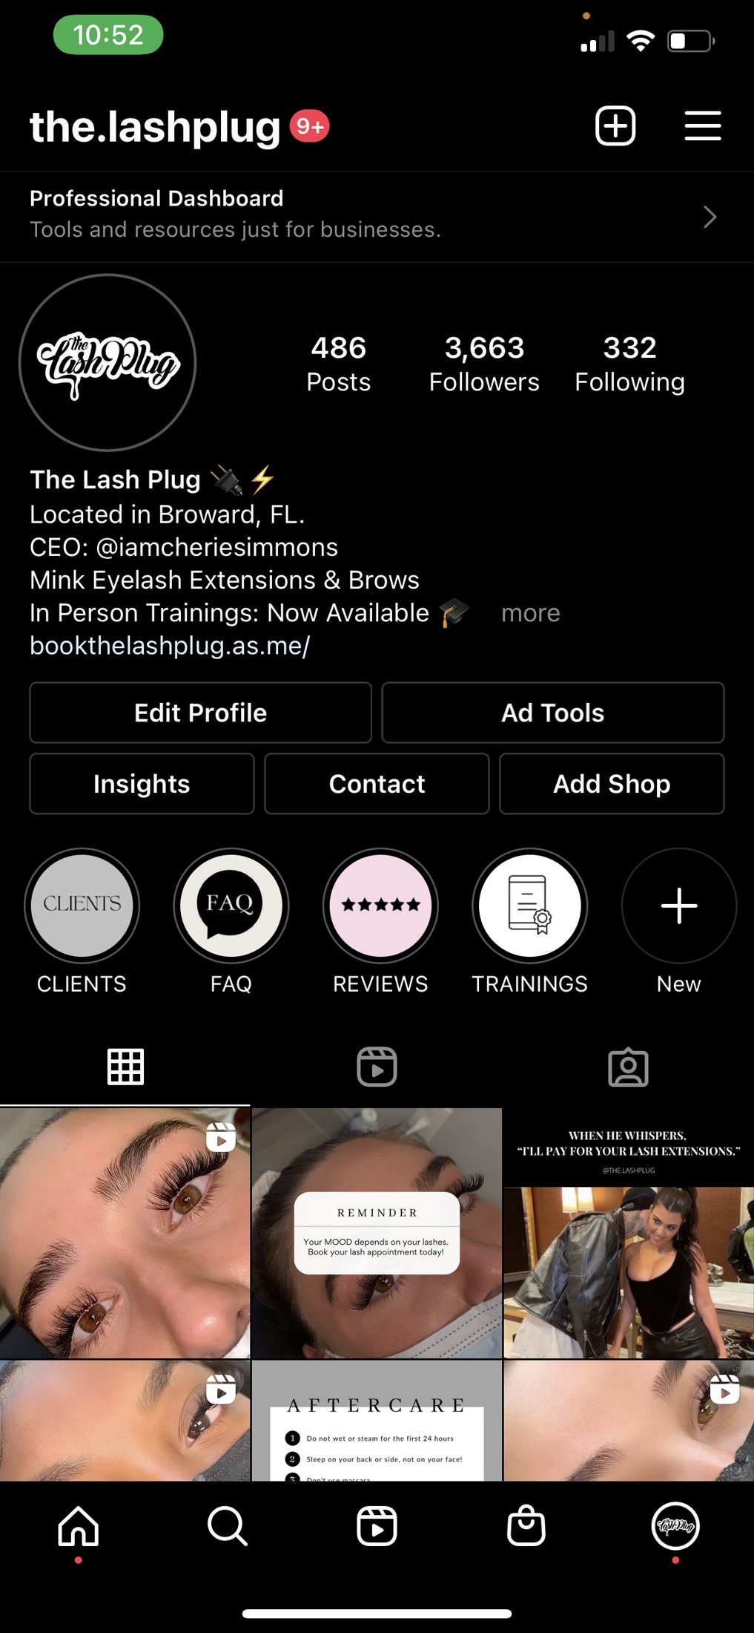
10
I grew it into The Lash Plug.
Notes:
Script slide 10 | Founder story (then): the rise
I grew it into The Lash Plug.
Design: SCREENSHOT: the.lashplug Instagram profile (486 posts, 3,663 followers). Red box on the follower count.

Slide 13

11
I was training other lash artists.
Notes:
Script slide 11 | Founder story (then): the rise
I was training other lash artists.
Design: PHOTO: training class photo (4 students with certificates). Names on certificates blurred.

Slide 14
12
I built it to six figures. From scratch.
Notes:
Script slide 12 | Founder story (then): the pressure
I built it to six figures. From scratch.
Design: SCREENSHOT: both cropped revenue Total rows stacked (revenue-total-194430-compact and revenue-total-142475-compact). Red box on each dollar amount. No year labels. Keep this slide inside The Lash Plug part of the story.

Slide 15
13
And 2,863 hours in the chair in one year.
That's about 55 hours a week.
2,863 hours ÷ 52 weeks
Notes:
Script slide 13 | Founder story (then): the pressure
And 2,863 hours in the chair in one year.
That's about 55 hours a week.
Design: SCREENSHOT: revenue-total-194430-compact. Red box on "2,863.867 hours". MATH. Small under it: 2,863 hours ÷ 52 weeks. Each new line appears on click.

Slide 16
13
And 2,863 hours in the chair in one year.
That's about 55 hours a week.
2,863 hours ÷ 52 weeks
Notes:
Script slide 13 | Founder story (then): the pressure
And 2,863 hours in the chair in one year.
That's about 55 hours a week.
Design: SCREENSHOT: revenue-total-194430-compact. Red box on "2,863.867 hours". MATH. Small under it: 2,863 hours ÷ 52 weeks. Each new line appears on click.

Slide 17
14
I was burnt out.
And I felt God calling me to leave.
Notes:
Script slide 14 | Founder story (then): the decision
I was burnt out.
And I felt God calling me to leave.
Design: STATEMENT. Second line appears on click.

Slide 18
14
I was burnt out.
And I felt God calling me to leave.
Notes:
Script slide 14 | Founder story (then): the decision
I was burnt out.
And I felt God calling me to leave.
Design: STATEMENT. Second line appears on click.

Slide 19
15
March 2023.
I surrendered my life to Christ and walked away from all of it.
Notes:
Script slide 15 | Founder story (then): the decision
March 2023.
I surrendered my life to Christ and walked away from all of it.
Design: STATEMENT.

Slide 20
16
My supplies went into storage. Then to auction.
I deleted my Instagram. Every client. Gone.
Notes:
Script slide 16 | Founder story (then): the fall
My supplies went into storage. Then to auction.
I deleted my Instagram. Every client. Gone.
Design: STATEMENT. Second line appears on click.

Slide 21
16
My supplies went into storage. Then to auction.
I deleted my Instagram. Every client. Gone.
Notes:
Script slide 16 | Founder story (then): the fall
My supplies went into storage. Then to auction.
I deleted my Instagram. Every client. Gone.
Design: STATEMENT. Second line appears on click.

Slide 22
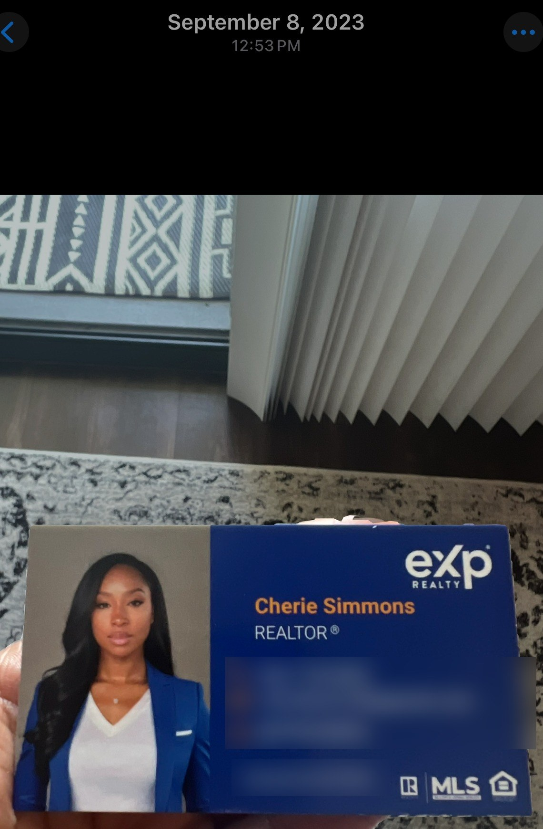
17
I became a Realtor.
It wasn't for me.
Notes:
Script slide 17 | Founder story (then): the detour
I became a Realtor.
It wasn't for me.
Design: PHOTO: your eXp Realty business card (Sept 8, 2023). Phone, email, and license number blurred. Each new line appears on click.

Slide 23
17
I became a Realtor.
It wasn't for me.
Notes:
Script slide 17 | Founder story (then): the detour
I became a Realtor.
It wasn't for me.
Design: PHOTO: your eXp Realty business card (Sept 8, 2023). Phone, email, and license number blurred. Each new line appears on click.

Slide 24
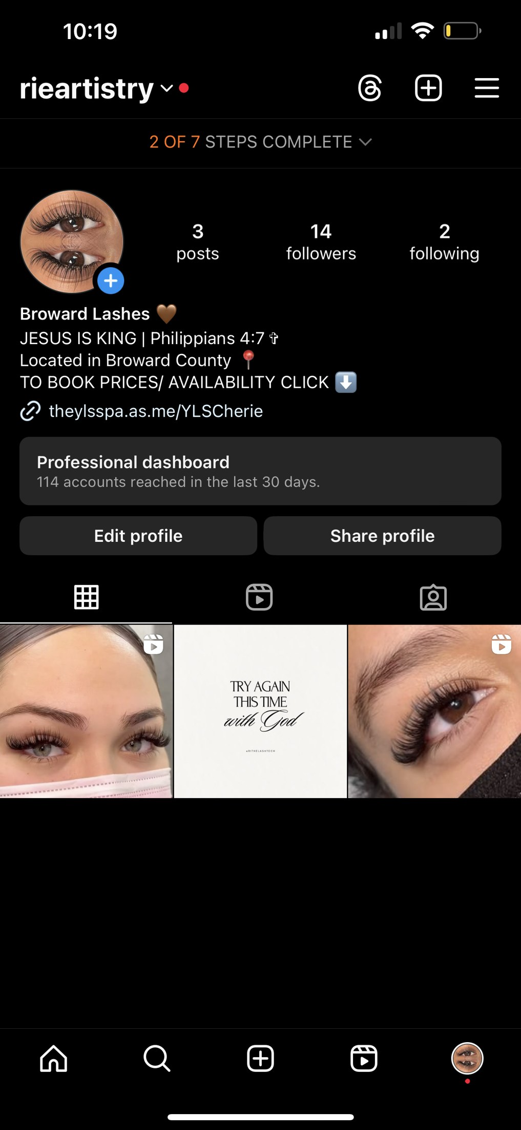
18
August 2024. I came back to lashes.
3 posts. 14 followers.
Notes:
Script slide 18 | Founder story (then): the low point
August 2024. I came back to lashes.
3 posts. 14 followers.
Design: SCREENSHOT: the Rie Artistry restart profile (3 posts, 14 followers, "TRY AGAIN THIS TIME with God"). Red box on "14 followers".

Slide 25
19
I wasn't the "it girl" anymore.
Everything had changed. My methods felt outdated.
I spent months and thousands of dollars on trainings and mentorships.
Notes:
Script slide 19 | Founder story (then): still stuck
I wasn't the "it girl" anymore.
Everything had changed. My methods felt outdated.
I spent months and thousands of dollars on trainings and mentorships.
Design: STATEMENT. Each new line appears on click.

Slide 26
19
I wasn't the "it girl" anymore.
Everything had changed. My methods felt outdated.
I spent months and thousands of dollars on trainings and mentorships.
Notes:
Script slide 19 | Founder story (then): still stuck
I wasn't the "it girl" anymore.
Everything had changed. My methods felt outdated.
I spent months and thousands of dollars on trainings and mentorships.
Design: STATEMENT. Each new line appears on click.

Slide 27
19
I wasn't the "it girl" anymore.
Everything had changed. My methods felt outdated.
I spent months and thousands of dollars on trainings and mentorships.
Notes:
Script slide 19 | Founder story (then): still stuck
I wasn't the "it girl" anymore.
Everything had changed. My methods felt outdated.
I spent months and thousands of dollars on trainings and mentorships.
Design: STATEMENT. Each new line appears on click.

Slide 28
20
Then one moment changed everything.
I'll tell you about it later.
Notes:
Script slide 20 | Open loop
Then one moment changed everything.
I'll tell you about it later.
Design: STATEMENT. Second line appears on click, in accent color.

Slide 29
20
Then one moment changed everything.
I'll tell you about it later.
Notes:
Script slide 20 | Open loop
Then one moment changed everything.
I'll tell you about it later.
Design: STATEMENT. Second line appears on click, in accent color.

Slide 30
21
I've built a six-figure beauty business from scratch.
Twice.
Notes:
Script slide 21 | Now
I've built a six-figure beauty business from scratch.
Twice.
Design: STATEMENT. "Twice." on click, 96pt, accent color. No revenue screenshot on this slide (the totals belong to The Lash Plug beat earlier).

Slide 31
21
I've built a six-figure beauty business from scratch.
Twice.
Notes:
Script slide 21 | Now
I've built a six-figure beauty business from scratch.
Twice.
Design: STATEMENT. "Twice." on click, 96pt, accent color. No revenue screenshot on this slide (the totals belong to The Lash Plug beat earlier).

Slide 32
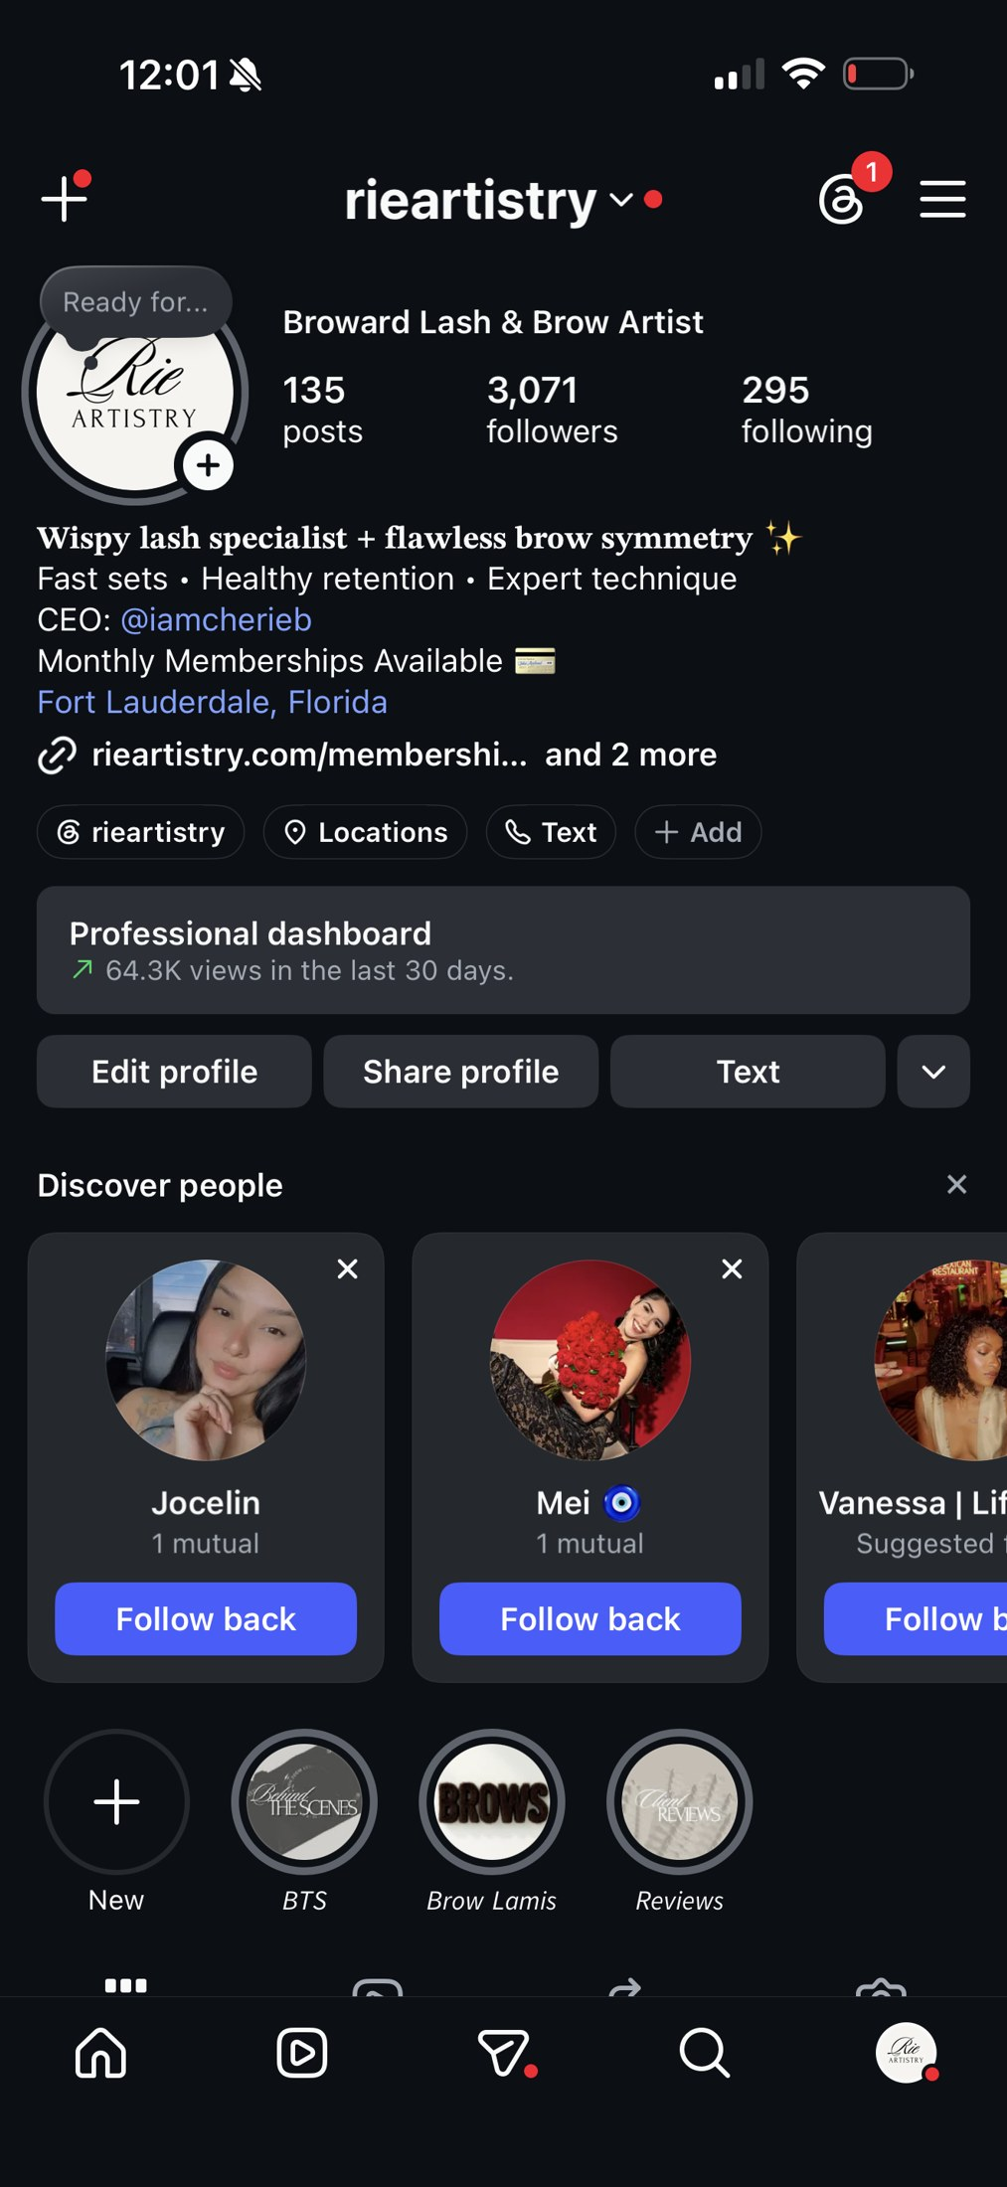
22
Today: Rie Artistry.
Notes:
Script slide 22 | Now
Today: Rie Artistry.
Design: SCREENSHOT: current @rieartistry profile (3,071 followers, 64.3K views in the last 30 days). Red box on the views line.

Slide 33

23
923 appointments last year.
Notes:
Script slide 23 | Proof flash
923 appointments last year.
Design: SCREENSHOT: crop of the 2025 Acuity Total row showing only "923". Do not show the 2025 revenue unless you choose to.

Slide 34
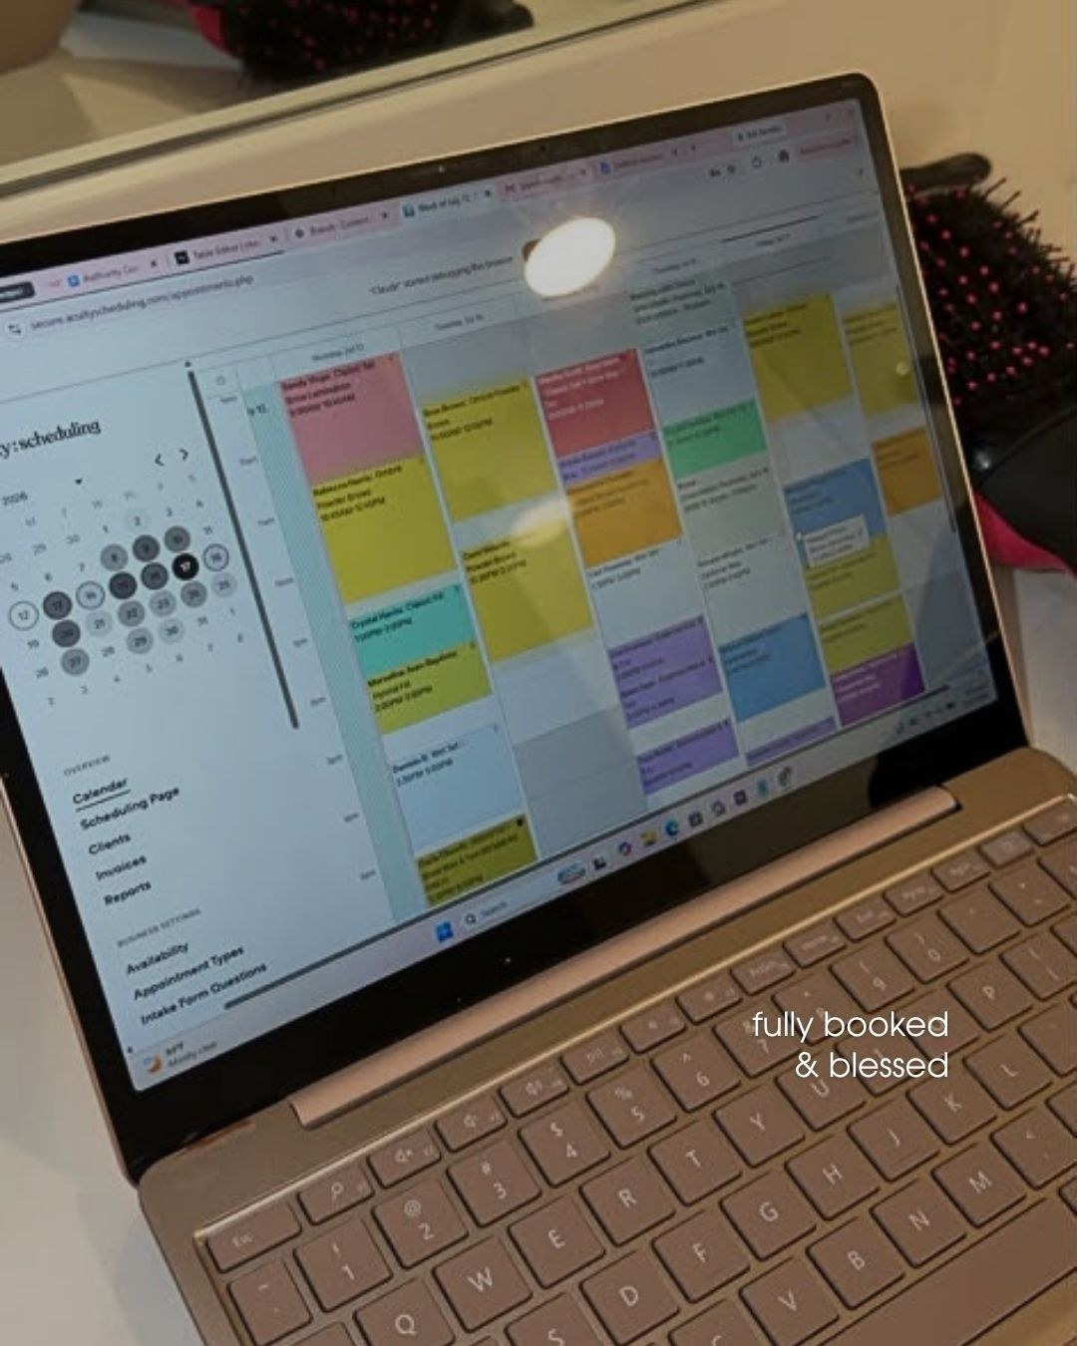
24
Fully booked. So booked I had to limit my calendar.
Notes:
Script slide 24 | Proof flash
Fully booked. So booked I had to limit my calendar.
Design: SCREENSHOT: booked-calendar (your "fully booked & blessed" Acuity week view), as is.

Slide 35
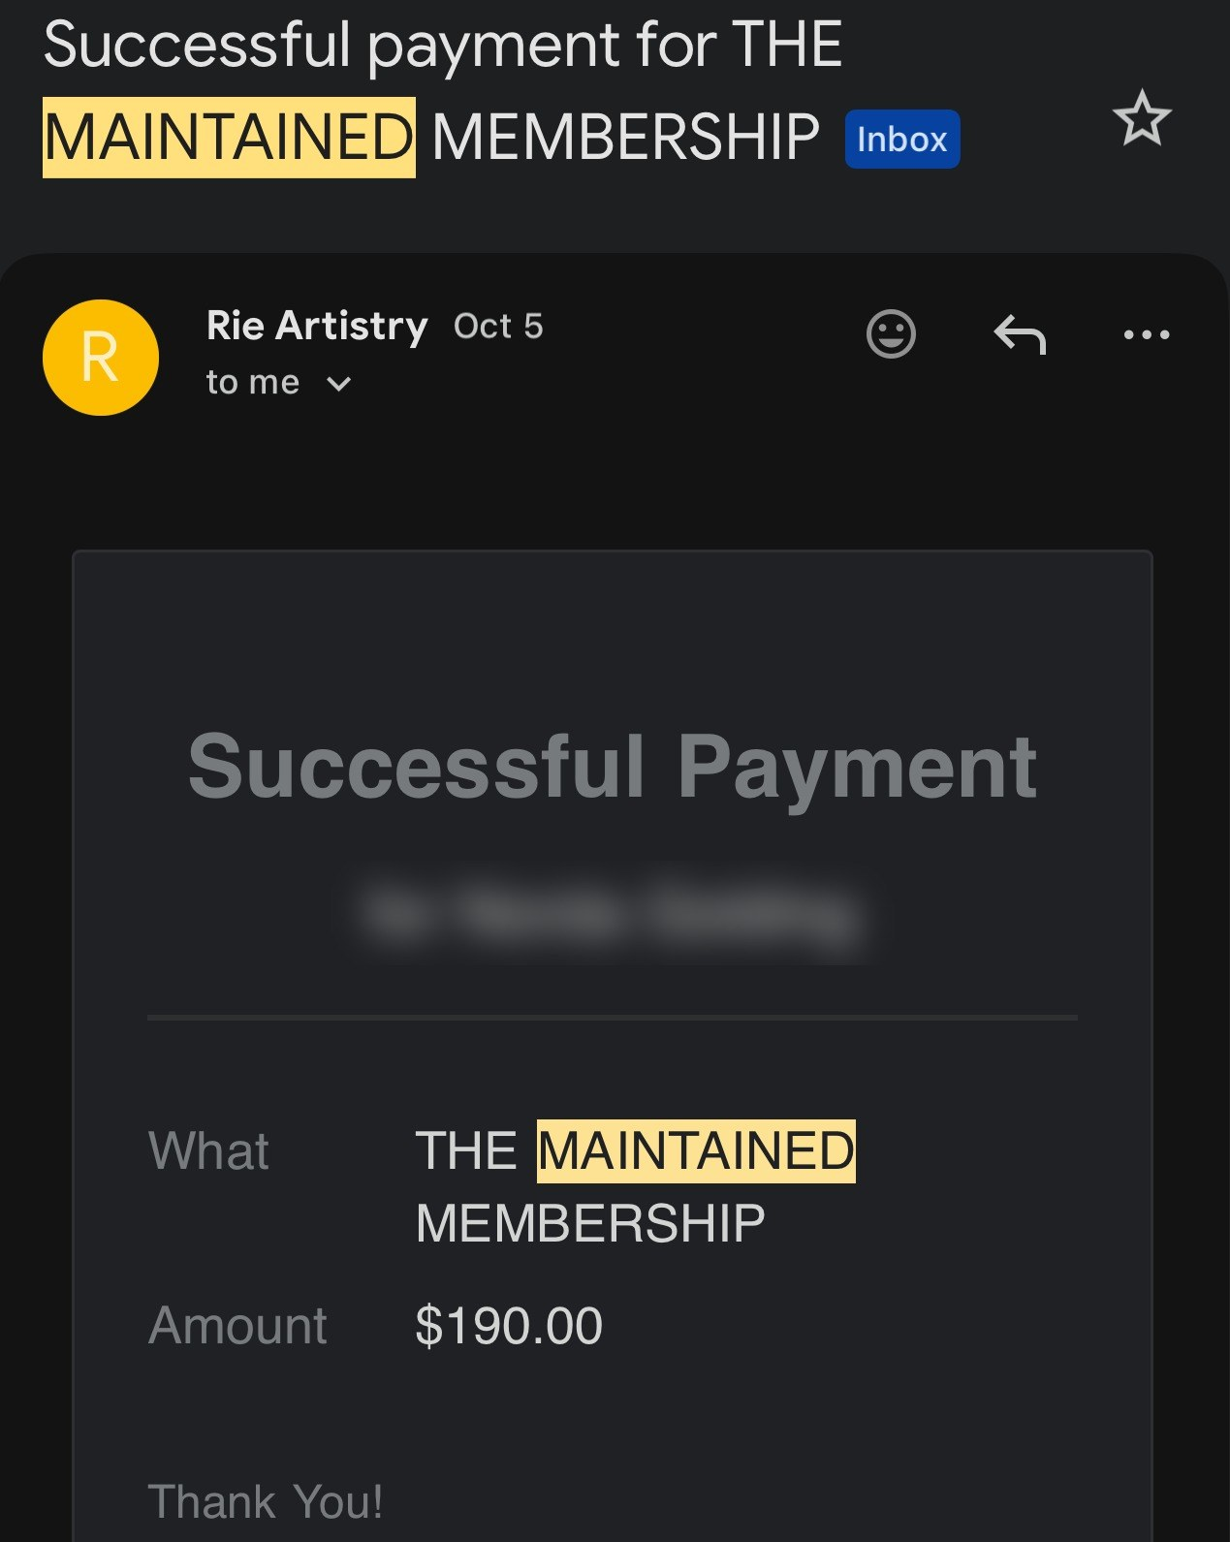

25
11 clients pay me $190 every month.
Before I open my doors.
Notes:
Script slide 25 | Proof flash
11 clients pay me $190 every month.
Before I open my doors.
Design: SCREENSHOT: membership-payment-1 and membership-payment-2 side by side ($190 Maintained Membership receipts, client names blurred). "$190" and "11" large.

Slide 36
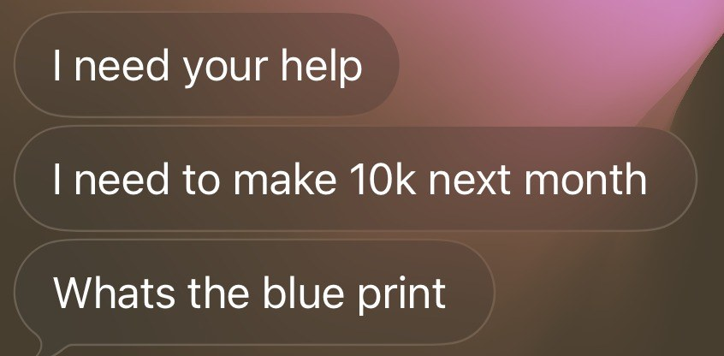
26
And now other pros text me this.
Notes:
Script slide 26 | Proof flash
And now other pros text me this.
Design: SCREENSHOT: the text "I need your help / I need to make 10k next month / Whats the blue print". Crop to those three bubbles. Blur the contact name and photo.

Slide 37
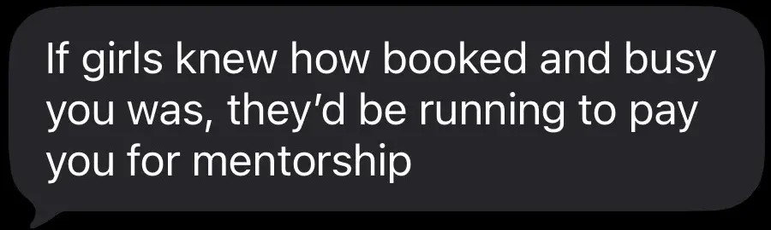
27
"If girls knew how booked and busy you was, they'd be running to pay you for mentorship"
A text I got
Notes:
Script slide 27 | Proof flash
"If girls knew how booked and busy you was, they'd be running to pay you for mentorship"
Design: QUOTE: the screenshot, large. Small label: "A text I got".
[VERIFY: who sent this (client, friend, another pro)? Label it honestly.]

Slide 38
28
Tonight's goal:
Show you the easiest way to get booked by the right clients, without adding more hours in the chair.
Notes:
Script slide 28 | Defined outcome
Tonight's goal:
Show you the easiest way to get booked by the right clients, without adding more hours in the chair.
Design: STATEMENT. Matches title slide wording.

Slide 39
29
This is for you if you're a:
Lash artist
Brow artist
Hairstylist
Makeup artist
Nail tech
Esthetician
PMU artist
And you already have clients. Even a few.
Notes:
Script slide 29 | Who qualifies
This is for you if you're a:
Lash artist
Brow artist
Hairstylist
Makeup artist
Nail tech
Esthetician
PMU artist
And you already have clients. Even a few.
Design: LIST, stacked top to bottom, one per click. Each new line appears on click.

Slide 40
29
This is for you if you're a:
Lash artist
Brow artist
Hairstylist
Makeup artist
Nail tech
Esthetician
PMU artist
And you already have clients. Even a few.
Notes:
Script slide 29 | Who qualifies
This is for you if you're a:
Lash artist
Brow artist
Hairstylist
Makeup artist
Nail tech
Esthetician
PMU artist
And you already have clients. Even a few.
Design: LIST, stacked top to bottom, one per click. Each new line appears on click.

Slide 41
29
This is for you if you're a:
Lash artist
Brow artist
Hairstylist
Makeup artist
Nail tech
Esthetician
PMU artist
And you already have clients. Even a few.
Notes:
Script slide 29 | Who qualifies
This is for you if you're a:
Lash artist
Brow artist
Hairstylist
Makeup artist
Nail tech
Esthetician
PMU artist
And you already have clients. Even a few.
Design: LIST, stacked top to bottom, one per click. Each new line appears on click.

Slide 42
29
This is for you if you're a:
Lash artist
Brow artist
Hairstylist
Makeup artist
Nail tech
Esthetician
PMU artist
And you already have clients. Even a few.
Notes:
Script slide 29 | Who qualifies
This is for you if you're a:
Lash artist
Brow artist
Hairstylist
Makeup artist
Nail tech
Esthetician
PMU artist
And you already have clients. Even a few.
Design: LIST, stacked top to bottom, one per click. Each new line appears on click.

Slide 43
29
This is for you if you're a:
Lash artist
Brow artist
Hairstylist
Makeup artist
Nail tech
Esthetician
PMU artist
And you already have clients. Even a few.
Notes:
Script slide 29 | Who qualifies
This is for you if you're a:
Lash artist
Brow artist
Hairstylist
Makeup artist
Nail tech
Esthetician
PMU artist
And you already have clients. Even a few.
Design: LIST, stacked top to bottom, one per click. Each new line appears on click.

Slide 44
29
This is for you if you're a:
Lash artist
Brow artist
Hairstylist
Makeup artist
Nail tech
Esthetician
PMU artist
And you already have clients. Even a few.
Notes:
Script slide 29 | Who qualifies
This is for you if you're a:
Lash artist
Brow artist
Hairstylist
Makeup artist
Nail tech
Esthetician
PMU artist
And you already have clients. Even a few.
Design: LIST, stacked top to bottom, one per click. Each new line appears on click.

Slide 45
29
This is for you if you're a:
Lash artist
Brow artist
Hairstylist
Makeup artist
Nail tech
Esthetician
PMU artist
And you already have clients. Even a few.
Notes:
Script slide 29 | Who qualifies
This is for you if you're a:
Lash artist
Brow artist
Hairstylist
Makeup artist
Nail tech
Esthetician
PMU artist
And you already have clients. Even a few.
Design: LIST, stacked top to bottom, one per click. Each new line appears on click.

Slide 46
29
This is for you if you're a:
Lash artist
Brow artist
Hairstylist
Makeup artist
Nail tech
Esthetician
PMU artist
And you already have clients. Even a few.
Notes:
Script slide 29 | Who qualifies
This is for you if you're a:
Lash artist
Brow artist
Hairstylist
Makeup artist
Nail tech
Esthetician
PMU artist
And you already have clients. Even a few.
Design: LIST, stacked top to bottom, one per click. Each new line appears on click.

Slide 47
30
I'm giving you my best tonight.
I'm asking for yours.
As I teach each step, picture yourself doing it in your own business.
Notes:
Script slide 30 | Mega-commitment
I'm giving you my best tonight.
I'm asking for yours.
As I teach each step, picture yourself doing it in your own business.
Design: STATEMENT. Each new line appears on click.

Slide 48
30
I'm giving you my best tonight.
I'm asking for yours.
As I teach each step, picture yourself doing it in your own business.
Notes:
Script slide 30 | Mega-commitment
I'm giving you my best tonight.
I'm asking for yours.
As I teach each step, picture yourself doing it in your own business.
Design: STATEMENT. Each new line appears on click.

Slide 49
30
I'm giving you my best tonight.
I'm asking for yours.
As I teach each step, picture yourself doing it in your own business.
Notes:
Script slide 30 | Mega-commitment
I'm giving you my best tonight.
I'm asking for yours.
As I teach each step, picture yourself doing it in your own business.
Design: STATEMENT. Each new line appears on click.

Slide 50
31
Will you do that?
Type YES
Notes:
Script slide 31 | Micro-commitment
Will you do that?
Type YES.
Design: CHAT PROMPT.

Slide 51
32
Say this out loud with me:
"I'm the obvious choice, not the cheaper choice."
Notes:
Script slide 32 | Identity statement
Say this out loud with me:
"I'm the obvious choice, not the cheaper choice."
Design: STATEMENT. Quote line 72pt, accent color.
[VERIFY: this line is mine, built from your "who's cheaper or closest to me" teaching. Change it if it doesn't sound like you.]

Slide 52
33
Now type it in the chat.
Notes:
Script slide 33 | Identity statement
Now type it in the chat.
Design: CHAT PROMPT. Repeat the quote line smaller.

Slide 53
34
How did saying that feel?
Type one word.
Notes:
Script slide 34 | Specific prompt
How did saying that feel?
Type one word.
Design: CHAT PROMPT.

Slide 54
35
Before I teach you anything, let's clear the doubts.
Notes:
Script slide 35 | Clearing the doubts
Before I teach you anything, let's clear the doubts.
Design: STATEMENT.

Slide 55
36
Doubt #1:
"I need to post more to get booked."
It's not how much you post.
It's what you post.
Notes:
Script slide 36 | Doubt #1
Doubt #1:
"I need to post more to get booked."
It's not how much you post.
It's what you post.
Design: STATEMENT. "Doubt #1" small. STATEMENT. Each new line appears on click.

Slide 56
36
Doubt #1:
"I need to post more to get booked."
It's not how much you post.
It's what you post.
Notes:
Script slide 36 | Doubt #1
Doubt #1:
"I need to post more to get booked."
It's not how much you post.
It's what you post.
Design: STATEMENT. "Doubt #1" small. STATEMENT. Each new line appears on click.

Slide 57
36
Doubt #1:
"I need to post more to get booked."
It's not how much you post.
It's what you post.
Notes:
Script slide 36 | Doubt #1
Doubt #1:
"I need to post more to get booked."
It's not how much you post.
It's what you post.
Design: STATEMENT. "Doubt #1" small. STATEMENT. Each new line appears on click.

Slide 58
37
I started over with 14 followers.
And I was fully booked within my first year back.
Notes:
Script slide 37 | Doubt #1: proof
I started over with 14 followers.
And I was fully booked within my first year back.
Design: SCREENSHOT: the 14-follower profile.
[VERIFY: "fully booked within my first year back" (your notebook). A booked calendar screenshot from that time would make this hit.]

Slide 59
38
Doubt #2:
"I have to run specials to stay booked."
When clients can't tell why you're different, price is the only thing left to compare.
Notes:
Script slide 38 | Doubt #2
Doubt #2:
"I have to run specials to stay booked."
When clients can't tell why you're different, price is the only thing left to compare.
Design: STATEMENT. Each new line appears on click.

Slide 60
38
Doubt #2:
"I have to run specials to stay booked."
When clients can't tell why you're different, price is the only thing left to compare.
Notes:
Script slide 38 | Doubt #2
Doubt #2:
"I have to run specials to stay booked."
When clients can't tell why you're different, price is the only thing left to compare.
Design: STATEMENT. Each new line appears on click.

Slide 61
39
I used to run specials to try and get clients in.
Now I have 11 clients paying me every month instead.
Notes:
Script slide 39 | Doubt #2: proof
I used to run specials to try and get clients in.
Now I have 11 clients paying me every month instead.
Design: STATEMENT. "11" in accent color.

Slide 62
40
Doubt #3:
"I've bought courses before. They didn't work."
Me too.
Some of them weren't as valuable as I hoped.
Notes:
Script slide 40 | Doubt #3
Doubt #3:
"I've bought courses before. They didn't work."
Me too.
Some of them weren't as valuable as I hoped.
Design: STATEMENT. Each new line appears on click.

Slide 63
40
Doubt #3:
"I've bought courses before. They didn't work."
Me too.
Some of them weren't as valuable as I hoped.
Notes:
Script slide 40 | Doubt #3
Doubt #3:
"I've bought courses before. They didn't work."
Me too.
Some of them weren't as valuable as I hoped.
Design: STATEMENT. Each new line appears on click.

Slide 64
40
Doubt #3:
"I've bought courses before. They didn't work."
Me too.
Some of them weren't as valuable as I hoped.
Notes:
Script slide 40 | Doubt #3
Doubt #3:
"I've bought courses before. They didn't work."
Me too.
Some of them weren't as valuable as I hoped.
Design: STATEMENT. Each new line appears on click.

Slide 65
41
Information doesn't change your business.
Putting it to work does.
Tonight, you'll put it to work with me. Live.
Notes:
Script slide 41 | Doubt #3: the truth
Information doesn't change your business.
Putting it to work does.
Tonight, you'll put it to work with me. Live.
Design: STATEMENT. Each new line appears on click.

Slide 66
41
Information doesn't change your business.
Putting it to work does.
Tonight, you'll put it to work with me. Live.
Notes:
Script slide 41 | Doubt #3: the truth
Information doesn't change your business.
Putting it to work does.
Tonight, you'll put it to work with me. Live.
Design: STATEMENT. Each new line appears on click.

Slide 67
41
Information doesn't change your business.
Putting it to work does.
Tonight, you'll put it to work with me. Live.
Notes:
Script slide 41 | Doubt #3: the truth
Information doesn't change your business.
Putting it to work does.
Tonight, you'll put it to work with me. Live.
Design: STATEMENT. Each new line appears on click.

Slide 68
42
Type this:
"This time, I'm doing the work."
Notes:
Script slide 42 | Declaration
Type this:
"This time, I'm doing the work."
Design: CHAT PROMPT. Quote line in accent color.

Slide 69
43
I'm going to say two words.
Type the first thing that comes to mind.
Notes:
Script slide 43 | Reaction exercise
I'm going to say two words.
Type the first thing that comes to mind.
Design: STATEMENT.

Slide 70
44
Price increase.
Notes:
Script slide 44 | Reaction exercise: the word
Price increase.
Design: STATEMENT. 120pt. Nothing else on the slide. Let the chat roll for 10 seconds.

Slide 71
45
Whatever you typed, it's not really about the number.
A price increase is scary when clients can't tell why you're worth more.
When they can, it's just the next step.
Notes:
Script slide 45 | Reaction exercise: the response
Whatever you typed, it's not really about the number.
A price increase is scary when clients can't tell why you're worth more.
When they can, it's just the next step.
Design: STATEMENT. Each new line appears on click.

Slide 72
45
Whatever you typed, it's not really about the number.
A price increase is scary when clients can't tell why you're worth more.
When they can, it's just the next step.
Notes:
Script slide 45 | Reaction exercise: the response
Whatever you typed, it's not really about the number.
A price increase is scary when clients can't tell why you're worth more.
When they can, it's just the next step.
Design: STATEMENT. Each new line appears on click.

Slide 73
45
Whatever you typed, it's not really about the number.
A price increase is scary when clients can't tell why you're worth more.
When they can, it's just the next step.
Notes:
Script slide 45 | Reaction exercise: the response
Whatever you typed, it's not really about the number.
A price increase is scary when clients can't tell why you're worth more.
When they can, it's just the next step.
Design: STATEMENT. Each new line appears on click.

Slide 74
46
Let me guess how the next 12 months go if nothing changes.
Stop me if I'm wrong.
Notes:
Script slide 46 | Pain
Let me guess how the next 12 months go if nothing changes.
Stop me if I'm wrong.
Design: STATEMENT.

Slide 75
47
Some weeks you're fully booked and exhausted.
Other weeks you're refreshing your booking app wondering where everybody went.
Notes:
Script slide 47 | Pain prediction
Some weeks you're fully booked and exhausted.
Other weeks you're refreshing your booking app wondering where everybody went.
Design: STATEMENT. Second line on click.

Slide 76
47
Some weeks you're fully booked and exhausted.
Other weeks you're refreshing your booking app wondering where everybody went.
Notes:
Script slide 47 | Pain prediction
Some weeks you're fully booked and exhausted.
Other weeks you're refreshing your booking app wondering where everybody went.
Design: STATEMENT. Second line on click.

Slide 77
48
You know you should raise your prices.
But you keep hearing, "What if they leave?"
Notes:
Script slide 48 | Pain prediction
You know you should raise your prices.
But you keep hearing, "What if they leave?"
Design: STATEMENT.

Slide 78
49
Your back, your neck, your wrists, your eyes start telling on you.
Notes:
Script slide 49 | Pain prediction
Your back, your neck, your wrists, your eyes start telling on you.
Design: STATEMENT.

Slide 79
50
You're the artist, the receptionist, the marketer, and the janitor.
Notes:
Script slide 50 | Pain prediction
You're the artist, the receptionist, the marketer, and the janitor.
Design: STATEMENT.

Slide 80
51
How close was I?
Type 1 to 10
Notes:
Script slide 51 | Rate it
How close was I?
Type 1 to 10.
Design: CHAT PROMPT.

Slide 81
52
Quick math.
Say you run a $20-off special for 5 clients a week.
That's $100 a week.
Notes:
Script slide 52 | Money math
Quick math.
Say you run a $20-off special for 5 clients a week.
That's $100 a week.
Design: MATH. Label "Example" small. Each new line appears on click.
[VERIFY: these example numbers are mine. Swap in a special you see artists run all the time.]

Slide 82
52
Quick math.
Say you run a $20-off special for 5 clients a week.
That's $100 a week.
Notes:
Script slide 52 | Money math
Quick math.
Say you run a $20-off special for 5 clients a week.
That's $100 a week.
Design: MATH. Label "Example" small. Each new line appears on click.
[VERIFY: these example numbers are mine. Swap in a special you see artists run all the time.]

Slide 83
52
Quick math.
Say you run a $20-off special for 5 clients a week.
That's $100 a week.
Notes:
Script slide 52 | Money math
Quick math.
Say you run a $20-off special for 5 clients a week.
That's $100 a week.
Design: MATH. Label "Example" small. Each new line appears on click.
[VERIFY: these example numbers are mine. Swap in a special you see artists run all the time.]

Slide 84
53
That's $5,200 a year you gave away.
And that's just one special.
Notes:
Script slide 53 | Money math
That's $5,200 a year you gave away.
And that's just one special.
Design: MATH. "$5,200" 96pt, accent color. Each new line appears on click.

Slide 85
53
That's $5,200 a year you gave away.
And that's just one special.
Notes:
Script slide 53 | Money math
That's $5,200 a year you gave away.
And that's just one special.
Design: MATH. "$5,200" 96pt, accent color. Each new line appears on click.

Slide 86
54
Now picture this.
A full schedule because the right clients book you, not because you're squeezing them in until 9 at night.
Charging what you're worth.
And not apologizing for it.
Notes:
Script slide 54 | Hope
Now picture this.
A full schedule because the right clients book you, not because you're squeezing them in until 9 at night.
Charging what you're worth.
And not apologizing for it.
Design: STATEMENT. Each new line appears on click.

Slide 87
54
Now picture this.
A full schedule because the right clients book you, not because you're squeezing them in until 9 at night.
Charging what you're worth.
And not apologizing for it.
Notes:
Script slide 54 | Hope
Now picture this.
A full schedule because the right clients book you, not because you're squeezing them in until 9 at night.
Charging what you're worth.
And not apologizing for it.
Design: STATEMENT. Each new line appears on click.

Slide 88
54
Now picture this.
A full schedule because the right clients book you, not because you're squeezing them in until 9 at night.
Charging what you're worth.
And not apologizing for it.
Notes:
Script slide 54 | Hope
Now picture this.
A full schedule because the right clients book you, not because you're squeezing them in until 9 at night.
Charging what you're worth.
And not apologizing for it.
Design: STATEMENT. Each new line appears on click.

Slide 89
54
Now picture this.
A full schedule because the right clients book you, not because you're squeezing them in until 9 at night.
Charging what you're worth.
And not apologizing for it.
Notes:
Script slide 54 | Hope
Now picture this.
A full schedule because the right clients book you, not because you're squeezing them in until 9 at night.
Charging what you're worth.
And not apologizing for it.
Design: STATEMENT. Each new line appears on click.

Slide 90
55
What would that change for you?
Type it in the chat.
Notes:
Script slide 55 | Hope: prompt
What would that change for you?
Type it in the chat.
Design: CHAT PROMPT.

Slide 91
56
Here's what you'll see tonight:
The one sentence that tells clients why to choose you
The 3 posts that turn strangers into bookings
The proof ladder most of us stop at step 1 of
The money already walking out my door, with my real numbers
Notes:
Script slide 56 | Mystery
Here's what you'll see tonight:
The one sentence that tells clients why to choose you
The 3 posts that turn strangers into bookings
The proof ladder most of us stop at step 1 of
The money already walking out my door, with my real numbers
Design: TEASE. Thumbnail of the fill-in-the-blank formula slide (Step 1) on the right. More teasers follow on the next slides. TEASE. Thumbnail of the Found / Trusted / Booked slide. TEASE. Thumbnail of the proof ladder slide. TEASE. Thumbnail of the brow wax and tint Acuity crop. Each new line appears on click.

Slide 92
56
Here's what you'll see tonight:
The one sentence that tells clients why to choose you
The 3 posts that turn strangers into bookings
The proof ladder most of us stop at step 1 of
The money already walking out my door, with my real numbers
Notes:
Script slide 56 | Mystery
Here's what you'll see tonight:
The one sentence that tells clients why to choose you
The 3 posts that turn strangers into bookings
The proof ladder most of us stop at step 1 of
The money already walking out my door, with my real numbers
Design: TEASE. Thumbnail of the fill-in-the-blank formula slide (Step 1) on the right. More teasers follow on the next slides. TEASE. Thumbnail of the Found / Trusted / Booked slide. TEASE. Thumbnail of the proof ladder slide. TEASE. Thumbnail of the brow wax and tint Acuity crop. Each new line appears on click.

Slide 93
56
Here's what you'll see tonight:
The one sentence that tells clients why to choose you
The 3 posts that turn strangers into bookings
The proof ladder most of us stop at step 1 of
The money already walking out my door, with my real numbers
Notes:
Script slide 56 | Mystery
Here's what you'll see tonight:
The one sentence that tells clients why to choose you
The 3 posts that turn strangers into bookings
The proof ladder most of us stop at step 1 of
The money already walking out my door, with my real numbers
Design: TEASE. Thumbnail of the fill-in-the-blank formula slide (Step 1) on the right. More teasers follow on the next slides. TEASE. Thumbnail of the Found / Trusted / Booked slide. TEASE. Thumbnail of the proof ladder slide. TEASE. Thumbnail of the brow wax and tint Acuity crop. Each new line appears on click.

Slide 94
56
Here's what you'll see tonight:
The one sentence that tells clients why to choose you
The 3 posts that turn strangers into bookings
The proof ladder most of us stop at step 1 of
The money already walking out my door, with my real numbers
Notes:
Script slide 56 | Mystery
Here's what you'll see tonight:
The one sentence that tells clients why to choose you
The 3 posts that turn strangers into bookings
The proof ladder most of us stop at step 1 of
The money already walking out my door, with my real numbers
Design: TEASE. Thumbnail of the fill-in-the-blank formula slide (Step 1) on the right. More teasers follow on the next slides. TEASE. Thumbnail of the Found / Trusted / Booked slide. TEASE. Thumbnail of the proof ladder slide. TEASE. Thumbnail of the brow wax and tint Acuity crop. Each new line appears on click.

Slide 95
57
Here are the same 3 steps I walk every mentee through.
1
Step 1: Position yourself so clients know why to choose you
2
Step 2: Post the 3 kinds of content
3
Step 3: Find your next revenue opportunity
Notes:
Script slide 57 | Roadmap intro
Here are the same 3 steps I walk every mentee through.
1. Position yourself
2. Post the 3 kinds of content
3. Find your next revenue opportunity
Design: ROADMAP: all 3 steps visible, same size, appearing one per click:

Slide 96
57
Here are the same 3 steps I walk every mentee through.
1
Step 1: Position yourself so clients know why to choose you
2
Step 2: Post the 3 kinds of content
3
Step 3: Find your next revenue opportunity
Notes:
Script slide 57 | Roadmap intro
Here are the same 3 steps I walk every mentee through.
1. Position yourself
2. Post the 3 kinds of content
3. Find your next revenue opportunity
Design: ROADMAP: all 3 steps visible, same size, appearing one per click:

Slide 97
57
Here are the same 3 steps I walk every mentee through.
1
Step 1: Position yourself so clients know why to choose you
2
Step 2: Post the 3 kinds of content
3
Step 3: Find your next revenue opportunity
Notes:
Script slide 57 | Roadmap intro
Here are the same 3 steps I walk every mentee through.
1. Position yourself
2. Post the 3 kinds of content
3. Find your next revenue opportunity
Design: ROADMAP: all 3 steps visible, same size, appearing one per click:

Slide 98
57
Here are the same 3 steps I walk every mentee through.
1
Step 1: Position yourself so clients know why to choose you
2
Step 2: Post the 3 kinds of content
3
Step 3: Find your next revenue opportunity
Notes:
Script slide 57 | Roadmap intro
Here are the same 3 steps I walk every mentee through.
1. Position yourself
2. Post the 3 kinds of content
3. Find your next revenue opportunity
Design: ROADMAP: all 3 steps visible, same size, appearing one per click:

Slide 99
58
If these make sense, will you actually try them?
Type I'M IN
Notes:
Script slide 58 | Micro-commitment
If these make sense, will you actually try them?
Type I'M IN.
Design: CHAT PROMPT.

Slide 100
59
Step 1: Position yourself so clients know why to choose you
1
2
Step 2: Post the 3 kinds of content
3
Step 3: Find your next revenue opportunity
Notes:
Script slide 59 | Roadmap: Step 1 active
Step 1: Position yourself so clients know why to choose you
Design: ROADMAP: Step 1 large in accent color. Steps 2 and 3 faded.

Slide 101
60
If you've ever said:
"I feel like I have to run specials to get bookings."
"I post my work but it's not turning into appointments."
"I'm good at what I do, but I get overlooked."
Then you probably have a positioning problem.
Notes:
Script slide 60 | Step 1 Context
If you've ever said:
"I feel like I have to run specials to get bookings."
"I post my work but it's not turning into appointments."
"I'm good at what I do, but I get overlooked."
Then you probably have a positioning problem.
Design: LIST, one quote per click. Each new line appears on click.

Slide 102
60
If you've ever said:
"I feel like I have to run specials to get bookings."
"I post my work but it's not turning into appointments."
"I'm good at what I do, but I get overlooked."
Then you probably have a positioning problem.
Notes:
Script slide 60 | Step 1 Context
If you've ever said:
"I feel like I have to run specials to get bookings."
"I post my work but it's not turning into appointments."
"I'm good at what I do, but I get overlooked."
Then you probably have a positioning problem.
Design: LIST, one quote per click. Each new line appears on click.

Slide 103
60
If you've ever said:
"I feel like I have to run specials to get bookings."
"I post my work but it's not turning into appointments."
"I'm good at what I do, but I get overlooked."
Then you probably have a positioning problem.
Notes:
Script slide 60 | Step 1 Context
If you've ever said:
"I feel like I have to run specials to get bookings."
"I post my work but it's not turning into appointments."
"I'm good at what I do, but I get overlooked."
Then you probably have a positioning problem.
Design: LIST, one quote per click. Each new line appears on click.

Slide 104
60
If you've ever said:
"I feel like I have to run specials to get bookings."
"I post my work but it's not turning into appointments."
"I'm good at what I do, but I get overlooked."
Then you probably have a positioning problem.
Notes:
Script slide 60 | Step 1 Context
If you've ever said:
"I feel like I have to run specials to get bookings."
"I post my work but it's not turning into appointments."
"I'm good at what I do, but I get overlooked."
Then you probably have a positioning problem.
Design: LIST, one quote per click. Each new line appears on click.

Slide 105
61
When you only post before-and-afters, people can see you do good work.
But they can see good work on the next person's page too.
Notes:
Script slide 61 | Step 1 Context
When you only post before-and-afters, people can see you do good work.
But they can see good work on the next person's page too.
Design: STATEMENT. Each new line appears on click.

Slide 106
61
When you only post before-and-afters, people can see you do good work.
But they can see good work on the next person's page too.
Notes:
Script slide 61 | Step 1 Context
When you only post before-and-afters, people can see you do good work.
But they can see good work on the next person's page too.
Design: STATEMENT. Each new line appears on click.

Slide 107
62
So the only thing left for them to ask is:
"Well, who's cheaper or closest to me?"
Notes:
Script slide 62 | Step 1 Context
So the only thing left for them to ask is:
"Well, who's cheaper or closest to me?"
Design: STATEMENT. Quote line in accent color.

Slide 108
63
Positioning is what you're known for, and why your ideal client would choose you over someone else.
Notes:
Script slide 63 | Step 1 Context
Positioning is what you're known for, and why your ideal client would choose you over someone else.
Design: STATEMENT. "In simple terms" small above.

Slide 109
64
Good positioning has clients paying the price you set and driving the distance to get to you.
Notes:
Script slide 64 | Step 1 Context
Good positioning has clients paying the price you set and driving the distance to get to you.
Design: STATEMENT.
[VERIFY: your notes say "paying any price you set and driving any distance." I softened "any" so it doesn't sound like a promise. Your call.]

Slide 110
65
Find where these two overlap:
What your audience
desperately wants
What you are
uniquely incredible at
Notes:
Script slide 65 | Step 1 Strategy
Find where these two overlap:
What your audience desperately wants
What you are uniquely incredible at
Design: DIAGRAM: your Venn diagram, redrawn clean. Left circle appears, then right, then the overlap highlights in accent color.

Slide 111
66
That overlap is your unfair advantage.
What your audience
desperately wants
What you are
uniquely incredible at
Your unfair advantage
Notes:
Script slide 66 | Step 1 Strategy
That overlap is your unfair advantage.
Design: DIAGRAM: same Venn, overlap labeled "Your unfair advantage".

Slide 112
67
What my clients desperately want
Lashes that aren't too heavy or dramatic.
What you are
uniquely incredible at
Notes:
Script slide 67 | Step 1 Vision: my example
What my clients desperately want:
Lashes that aren't too heavy or dramatic.
Design: DIAGRAM: left circle highlighted with this text.

Slide 113
68
What I'm uniquely incredible at
Lashes that aren't too heavy or dramatic
Natural, wispy lashes.
Natural, wispy lashes
Notes:
Script slide 68 | Step 1 Vision: my example
What I'm uniquely incredible at:
Natural, wispy lashes.
Design: DIAGRAM: right circle highlighted.

Slide 114
69
So that's what I'm known for.
Notes:
Script slide 69 | Step 1 Vision: my example
So that's what I'm known for.
Design: SCREENSHOT: current @rieartistry bio. Red box on "Wispy lash specialist".

Slide 115
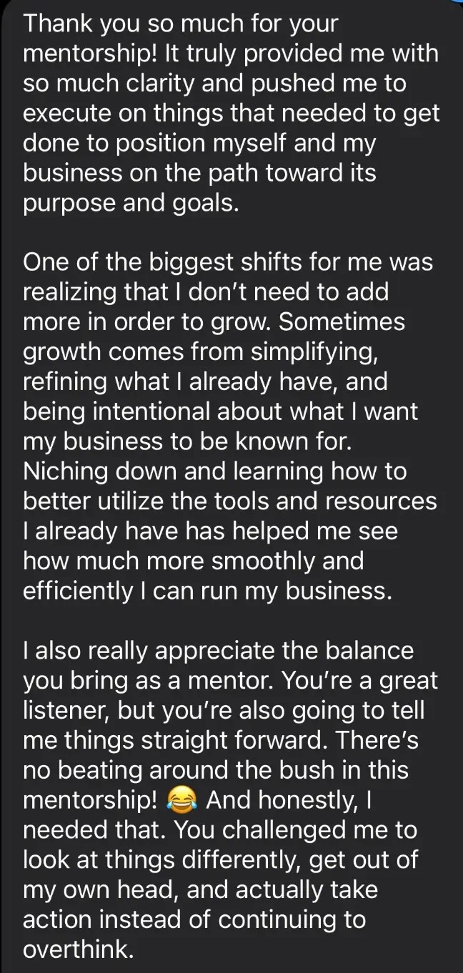
70
"Niching down and learning how to better utilize the tools and resources I already have has helped me see how much more smoothly and efficiently I can run my business."
A beauty pro I mentored
Notes:
Script slide 70 | Step 1 Vision: proof
"Niching down and learning how to better utilize the tools and resources I already have has helped me see how much more smoothly and efficiently I can run my business."
Design: QUOTE: testimonial 1 screenshot with a red box on this sentence. Quote text on screen 40pt. Label "A beauty pro I mentored".

Slide 116
71
Here's what most of us write:
"I offer classic, hybrid, and volume lash extensions. Book now."
That tells them what you do.
It doesn't tell them why to choose you.
Notes:
Script slide 71 | Step 1 Strategy: the before
Here's what most of us write:
"I offer classic, hybrid, and volume lash extensions. Book now."
That tells them what you do.
It doesn't tell them why to choose you.
Design: STATEMENT. Quote in gray, crossed out on the second click. Each new line appears on click.

Slide 117
71
Here's what most of us write:
"I offer classic, hybrid, and volume lash extensions. Book now."
That tells them what you do.
It doesn't tell them why to choose you.
Notes:
Script slide 71 | Step 1 Strategy: the before
Here's what most of us write:
"I offer classic, hybrid, and volume lash extensions. Book now."
That tells them what you do.
It doesn't tell them why to choose you.
Design: STATEMENT. Quote in gray, crossed out on the second click. Each new line appears on click.

Slide 118
71
Here's what most of us write:
"I offer classic, hybrid, and volume lash extensions. Book now."
That tells them what you do.
It doesn't tell them why to choose you.
Notes:
Script slide 71 | Step 1 Strategy: the before
Here's what most of us write:
"I offer classic, hybrid, and volume lash extensions. Book now."
That tells them what you do.
It doesn't tell them why to choose you.
Design: STATEMENT. Quote in gray, crossed out on the second click. Each new line appears on click.

Slide 119
72
Screenshot this next slide.
Notes:
Script slide 72 | Step 1 Strategy
Screenshot this next slide.
Design: STATEMENT.

Slide 120
73
I specialize in [service or result] for [specific client] who wants [benefit], through [what makes my service different].
Notes:
Script slide 73 | Step 1 Strategy: the formula
I specialize in [service or result] for [specific client] who wants [benefit], through [what makes my service different].
Design: FORMULA: brackets in accent color. This is a key visual: same slide is teased in the intro and replayed in the recap.

Slide 121
74
"I specialize in natural, wispy lashes for women who want to look put together without a heavy or dramatic look."
Notes:
Script slide 74 | Step 1 Strategy: my example
"I specialize in natural, wispy lashes for women who want to look put together without a heavy or dramatic look."
Design: STATEMENT.
[VERIFY: your example has no "through" part. Want to add one, like "through fast sets and healthy retention" from your bio?]

Slide 122
75
What I do: Natural, wispy lashes
Who it's for: Women who want to look put together
Why they should care: Their lashes won't be too heavy or dramatic
Notes:
Script slide 75 | Step 1 Strategy: breakdown
What I do: Natural, wispy lashes
Who it's for: Women who want to look put together
Why they should care: Their lashes won't be too heavy or dramatic
Design: LIST, one per click. Labels small, answers large.

Slide 123
75
What I do: Natural, wispy lashes
Who it's for: Women who want to look put together
Why they should care: Their lashes won't be too heavy or dramatic
Notes:
Script slide 75 | Step 1 Strategy: breakdown
What I do: Natural, wispy lashes
Who it's for: Women who want to look put together
Why they should care: Their lashes won't be too heavy or dramatic
Design: LIST, one per click. Labels small, answers large.

Slide 124
75
What I do: Natural, wispy lashes
Who it's for: Women who want to look put together
Why they should care: Their lashes won't be too heavy or dramatic
Notes:
Script slide 75 | Step 1 Strategy: breakdown
What I do: Natural, wispy lashes
Who it's for: Women who want to look put together
Why they should care: Their lashes won't be too heavy or dramatic
Design: LIST, one per click. Labels small, answers large.

Slide 125
76
Take two minutes. Write yours.
It doesn't have to be perfect. It's your starting point.
If you're comfortable, drop yours in the chat.
Notes:
Script slide 76 | Step 1 Strategy: your turn
Take two minutes. Write yours.
It doesn't have to be perfect. It's your starting point.
If you're comfortable, drop yours in the chat.
Design: FORMULA slide repeated small at top, with a 2:00 countdown timer. Each new line appears on click.

Slide 126
76
Take two minutes. Write yours.
It doesn't have to be perfect. It's your starting point.
If you're comfortable, drop yours in the chat.
Notes:
Script slide 76 | Step 1 Strategy: your turn
Take two minutes. Write yours.
It doesn't have to be perfect. It's your starting point.
If you're comfortable, drop yours in the chat.
Design: FORMULA slide repeated small at top, with a 2:00 countdown timer. Each new line appears on click.

Slide 127
76
Take two minutes. Write yours.
It doesn't have to be perfect. It's your starting point.
If you're comfortable, drop yours in the chat.
Notes:
Script slide 76 | Step 1 Strategy: your turn
Take two minutes. Write yours.
It doesn't have to be perfect. It's your starting point.
If you're comfortable, drop yours in the chat.
Design: FORMULA slide repeated small at top, with a 2:00 countdown timer. Each new line appears on click.

Slide 128
77
Let's fix one together, live.
Notes:
Script slide 77 | Step 1 Strategy: live demo
Let's fix one together, live.
Design: STATEMENT. Pick a volunteer's statement from the chat and read it out.

Slide 129
78
I specialize in ______ for ______ who wants ______, through ______.
Notes:
Script slide 78 | Step 1 Strategy: live demo
I specialize in ______ for ______ who wants ______, through ______.
Design: FORMULA, blanks. Talk through filling it in out loud with the volunteer's answers. (No live typing needed.)

Slide 130
79
Imagine someone landing on your page and thinking, "Oh. She's the one for me."
Notes:
Script slide 79 | Step 1 Vision: imagine
Imagine someone landing on your page and thinking, "Oh. She's the one for me."
Design: STATEMENT.
[VERIFY: imagine line is mine.]

Slide 131
80
Will you put your statement in your bio this week?
Type YES.
Type this:
"I know why they should choose me."
Notes:
Script slide 80 | Step 1 Commitment
Will you put your statement in your bio this week?
Type YES.
Type this:
"I know why they should choose me."
Design: CHAT PROMPT. Each new line appears on click.

Slide 132
80
Will you put your statement in your bio this week?
Type YES.
Type this:
"I know why they should choose me."
Notes:
Script slide 80 | Step 1 Commitment
Will you put your statement in your bio this week?
Type YES.
Type this:
"I know why they should choose me."
Design: CHAT PROMPT. Each new line appears on click.

Slide 133
80
Will you put your statement in your bio this week?
Type YES.
Type this:
"I know why they should choose me."
Notes:
Script slide 80 | Step 1 Commitment
Will you put your statement in your bio this week?
Type YES.
Type this:
"I know why they should choose me."
Design: CHAT PROMPT. Each new line appears on click.

Slide 134
80
Will you put your statement in your bio this week?
Type YES.
Type this:
"I know why they should choose me."
Notes:
Script slide 80 | Step 1 Commitment
Will you put your statement in your bio this week?
Type YES.
Type this:
"I know why they should choose me."
Design: CHAT PROMPT. Each new line appears on click.

Slide 135
81
Now that clients know why to choose you, let's make sure they actually see it.
Notes:
Script slide 81 | Transition
Now that clients know why to choose you, let's make sure they actually see it.
Design: STATEMENT.

Slide 136
82
✓
Step 1: Position yourself so clients know why to choose you
Step 2: Post the 3 kinds of content
2
3
Step 3: Find your next revenue opportunity
Notes:
Script slide 82 | Roadmap: Step 1 done
Step 1: Position yourself ✓
Design: ROADMAP: Step 1 small with check. Step 2 large in accent color. Step 3 faded.

Slide 137
83
Quick question.
How many times did you post last week? Drop the number in the chat.
Notes:
Script slide 83 | Step 2 Context
Quick question.
How many times did you post last week? Drop the number in the chat.
Design: CHAT PROMPT.

Slide 138
84
Now be honest.
How many of those posts turned into an actual booking?
Notes:
Script slide 84 | Step 2 Context
Now be honest.
How many of those posts turned into an actual booking?
Design: CHAT PROMPT.

Slide 139
85
That gap is what we're fixing in this section.
Notes:
Script slide 85 | Step 2 Context
That gap is what we're fixing in this section.
Design: STATEMENT.

Slide 140
86
It's usually not that you're not posting enough.
It's that you're posting the same kind of post over and over.
For a lot of us, that's our work, or before-and-afters.
Notes:
Script slide 86 | Step 2 Context
It's usually not that you're not posting enough.
It's that you're posting the same kind of post over and over.
For a lot of us, that's our work, or before-and-afters.
Design: STATEMENT. Each new line appears on click.

Slide 141
86
It's usually not that you're not posting enough.
It's that you're posting the same kind of post over and over.
For a lot of us, that's our work, or before-and-afters.
Notes:
Script slide 86 | Step 2 Context
It's usually not that you're not posting enough.
It's that you're posting the same kind of post over and over.
For a lot of us, that's our work, or before-and-afters.
Design: STATEMENT. Each new line appears on click.

Slide 142
86
It's usually not that you're not posting enough.
It's that you're posting the same kind of post over and over.
For a lot of us, that's our work, or before-and-afters.
Notes:
Script slide 86 | Step 2 Context
It's usually not that you're not posting enough.
It's that you're posting the same kind of post over and over.
For a lot of us, that's our work, or before-and-afters.
Design: STATEMENT. Each new line appears on click.

Slide 143
87
Think about it like dating.
You don't ask someone to marry you the first time you meet.
Someone who's never heard of you isn't booking off one photo.
Notes:
Script slide 87 | Step 2 Context
Think about it like dating.
You don't ask someone to marry you the first time you meet.
Someone who's never heard of you isn't booking off one photo.
Design: STATEMENT. Each new line appears on click.

Slide 144
87
Think about it like dating.
You don't ask someone to marry you the first time you meet.
Someone who's never heard of you isn't booking off one photo.
Notes:
Script slide 87 | Step 2 Context
Think about it like dating.
You don't ask someone to marry you the first time you meet.
Someone who's never heard of you isn't booking off one photo.
Design: STATEMENT. Each new line appears on click.

Slide 145
87
Think about it like dating.
You don't ask someone to marry you the first time you meet.
Someone who's never heard of you isn't booking off one photo.
Notes:
Script slide 87 | Step 2 Context
Think about it like dating.
You don't ask someone to marry you the first time you meet.
Someone who's never heard of you isn't booking off one photo.
Design: STATEMENT. Each new line appears on click.

Slide 146
88
They need to:
Find you
→
Trust you
→
Then book
Notes:
Script slide 88 | Step 2 Context
They need to:
Find you
Trust you
Then book
Design: SEQUENCE: three steps left to right with arrows (true sequence), one per click.

Slide 147
88
They need to:
Find you
→
Trust you
→
Then book
Notes:
Script slide 88 | Step 2 Context
They need to:
Find you
Trust you
Then book
Design: SEQUENCE: three steps left to right with arrows (true sequence), one per click.

Slide 148
88
They need to:
Find you
→
Trust you
→
Then book
Notes:
Script slide 88 | Step 2 Context
They need to:
Find you
Trust you
Then book
Design: SEQUENCE: three steps left to right with arrows (true sequence), one per click.

Slide 149
89
So you don't need more content.
You need 3 kinds:
One that gets you found
One that gets you trusted
One that gets you booked
Notes:
Script slide 89 | Step 2 Strategy
So you don't need more content.
You need 3 kinds:
One that gets you found
One that gets you trusted
One that gets you booked
Design: LIST, one per click. Key visual: teased in intro, replayed in recap.

Slide 150
89
So you don't need more content.
You need 3 kinds:
One that gets you found
One that gets you trusted
One that gets you booked
Notes:
Script slide 89 | Step 2 Strategy
So you don't need more content.
You need 3 kinds:
One that gets you found
One that gets you trusted
One that gets you booked
Design: LIST, one per click. Key visual: teased in intro, replayed in recap.

Slide 151
89
So you don't need more content.
You need 3 kinds:
One that gets you found
One that gets you trusted
One that gets you booked
Notes:
Script slide 89 | Step 2 Strategy
So you don't need more content.
You need 3 kinds:
One that gets you found
One that gets you trusted
One that gets you booked
Design: LIST, one per click. Key visual: teased in intro, replayed in recap.

Slide 152
89
So you don't need more content.
You need 3 kinds:
One that gets you found
One that gets you trusted
One that gets you booked
Notes:
Script slide 89 | Step 2 Strategy
So you don't need more content.
You need 3 kinds:
One that gets you found
One that gets you trusted
One that gets you booked
Design: LIST, one per click. Key visual: teased in intro, replayed in recap.

Slide 153
89
So you don't need more content.
You need 3 kinds:
One that gets you found
One that gets you trusted
One that gets you booked
Notes:
Script slide 89 | Step 2 Strategy
So you don't need more content.
You need 3 kinds:
One that gets you found
One that gets you trusted
One that gets you booked
Design: LIST, one per click. Key visual: teased in intro, replayed in recap.

Slide 154
90
Post #1: Get Found
For people who have no idea who you are yet. Strangers.
This post isn't about you.
It's about what they care about: a trend, a myth, or a question they're already asking.
Notes:
Script slide 90 | Step 2 Strategy: Get Found
Post #1: Get Found
For people who have no idea who you are yet. Strangers.
This post isn't about you.
It's about what they care about: a trend, a myth, or a question they're already asking.
Design: STATEMENT. "Post #1" small. Each new line appears on click.

Slide 155
90
Post #1: Get Found
For people who have no idea who you are yet. Strangers.
This post isn't about you.
It's about what they care about: a trend, a myth, or a question they're already asking.
Notes:
Script slide 90 | Step 2 Strategy: Get Found
Post #1: Get Found
For people who have no idea who you are yet. Strangers.
This post isn't about you.
It's about what they care about: a trend, a myth, or a question they're already asking.
Design: STATEMENT. "Post #1" small. Each new line appears on click.

Slide 156
90
Post #1: Get Found
For people who have no idea who you are yet. Strangers.
This post isn't about you.
It's about what they care about: a trend, a myth, or a question they're already asking.
Notes:
Script slide 90 | Step 2 Strategy: Get Found
Post #1: Get Found
For people who have no idea who you are yet. Strangers.
This post isn't about you.
It's about what they care about: a trend, a myth, or a question they're already asking.
Design: STATEMENT. "Post #1" small. Each new line appears on click.

Slide 157
90
Post #1: Get Found
For people who have no idea who you are yet. Strangers.
This post isn't about you.
It's about what they care about: a trend, a myth, or a question they're already asking.
Notes:
Script slide 90 | Step 2 Strategy: Get Found
Post #1: Get Found
For people who have no idea who you are yet. Strangers.
This post isn't about you.
It's about what they care about: a trend, a myth, or a question they're already asking.
Design: STATEMENT. "Post #1" small. Each new line appears on click.

Slide 158
91
Hair: Is washing your hair every day actually bad for it?
Skin: The skincare trend that's actually ruining your skin barrier
Lashes: Lash extensions don't ruin your natural lashes. Here's what does.
Nails: Why your gel manicure starts lifting after a week
Notes:
Script slide 91 | Step 2 Strategy: Get Found examples
Hair: Is washing your hair every day actually bad for it?
Skin: The skincare trend that's actually ruining your skin barrier
Lashes: Lash extensions don't ruin your natural lashes. Here's what does.
Nails: Why your gel manicure starts lifting after a week
Design: LIST, one per click.

Slide 159
91
Hair: Is washing your hair every day actually bad for it?
Skin: The skincare trend that's actually ruining your skin barrier
Lashes: Lash extensions don't ruin your natural lashes. Here's what does.
Nails: Why your gel manicure starts lifting after a week
Notes:
Script slide 91 | Step 2 Strategy: Get Found examples
Hair: Is washing your hair every day actually bad for it?
Skin: The skincare trend that's actually ruining your skin barrier
Lashes: Lash extensions don't ruin your natural lashes. Here's what does.
Nails: Why your gel manicure starts lifting after a week
Design: LIST, one per click.

Slide 160
91
Hair: Is washing your hair every day actually bad for it?
Skin: The skincare trend that's actually ruining your skin barrier
Lashes: Lash extensions don't ruin your natural lashes. Here's what does.
Nails: Why your gel manicure starts lifting after a week
Notes:
Script slide 91 | Step 2 Strategy: Get Found examples
Hair: Is washing your hair every day actually bad for it?
Skin: The skincare trend that's actually ruining your skin barrier
Lashes: Lash extensions don't ruin your natural lashes. Here's what does.
Nails: Why your gel manicure starts lifting after a week
Design: LIST, one per click.

Slide 161
91
Hair: Is washing your hair every day actually bad for it?
Skin: The skincare trend that's actually ruining your skin barrier
Lashes: Lash extensions don't ruin your natural lashes. Here's what does.
Nails: Why your gel manicure starts lifting after a week
Notes:
Script slide 91 | Step 2 Strategy: Get Found examples
Hair: Is washing your hair every day actually bad for it?
Skin: The skincare trend that's actually ruining your skin barrier
Lashes: Lash extensions don't ruin your natural lashes. Here's what does.
Nails: Why your gel manicure starts lifting after a week
Design: LIST, one per click.

Slide 162
92
Notice what's not in those.
No "book with me." No pitch.
Pitching someone who just met you is like asking a stranger to marry you.
Notes:
Script slide 92 | Step 2 Strategy: Get Found
Notice what's not in those.
No "book with me." No pitch.
Pitching someone who just met you is like asking a stranger to marry you.
Design: STATEMENT. Each new line appears on click.

Slide 163
92
Notice what's not in those.
No "book with me." No pitch.
Pitching someone who just met you is like asking a stranger to marry you.
Notes:
Script slide 92 | Step 2 Strategy: Get Found
Notice what's not in those.
No "book with me." No pitch.
Pitching someone who just met you is like asking a stranger to marry you.
Design: STATEMENT. Each new line appears on click.

Slide 164
92
Notice what's not in those.
No "book with me." No pitch.
Pitching someone who just met you is like asking a stranger to marry you.
Notes:
Script slide 92 | Step 2 Strategy: Get Found
Notice what's not in those.
No "book with me." No pitch.
Pitching someone who just met you is like asking a stranger to marry you.
Design: STATEMENT. Each new line appears on click.

Slide 165
93
This post has one job:
Get the right person to stop scrolling and think, "Oh, she knows what she's talking about."
Notes:
Script slide 93 | Step 2 Strategy: Get Found
This post has one job:
Get the right person to stop scrolling and think, "Oh, she knows what she's talking about."
Design: STATEMENT.

Slide 166
94
Stuck on ideas?
Ask yourself: what question do my clients always ask me?
Notes:
Script slide 94 | Step 2 Strategy: Get Found
Stuck on ideas?
Ask yourself: what question do my clients always ask me?
Design: STATEMENT.

Slide 167
95
Post #2: Get Trusted
They found you. Maybe they followed. They're curious, but they're not ready to book yet.
This post gives them one quick win.
One tip they can use in the next 24 hours that solves a small problem.
Notes:
Script slide 95 | Step 2 Strategy: Get Trusted
Post #2: Get Trusted
They found you. Maybe they followed. They're curious, but they're not ready to book yet.
This post gives them one quick win.
One tip they can use in the next 24 hours that solves a small problem.
Design: STATEMENT. Each new line appears on click.

Slide 168
95
Post #2: Get Trusted
They found you. Maybe they followed. They're curious, but they're not ready to book yet.
This post gives them one quick win.
One tip they can use in the next 24 hours that solves a small problem.
Notes:
Script slide 95 | Step 2 Strategy: Get Trusted
Post #2: Get Trusted
They found you. Maybe they followed. They're curious, but they're not ready to book yet.
This post gives them one quick win.
One tip they can use in the next 24 hours that solves a small problem.
Design: STATEMENT. Each new line appears on click.

Slide 169
95
Post #2: Get Trusted
They found you. Maybe they followed. They're curious, but they're not ready to book yet.
This post gives them one quick win.
One tip they can use in the next 24 hours that solves a small problem.
Notes:
Script slide 95 | Step 2 Strategy: Get Trusted
Post #2: Get Trusted
They found you. Maybe they followed. They're curious, but they're not ready to book yet.
This post gives them one quick win.
One tip they can use in the next 24 hours that solves a small problem.
Design: STATEMENT. Each new line appears on click.

Slide 170
95
Post #2: Get Trusted
They found you. Maybe they followed. They're curious, but they're not ready to book yet.
This post gives them one quick win.
One tip they can use in the next 24 hours that solves a small problem.
Notes:
Script slide 95 | Step 2 Strategy: Get Trusted
Post #2: Get Trusted
They found you. Maybe they followed. They're curious, but they're not ready to book yet.
This post gives them one quick win.
One tip they can use in the next 24 hours that solves a small problem.
Design: STATEMENT. Each new line appears on click.

Slide 171
96
How to make your silk press survive humidity
What to do after a facial so you don't break out
The one thing not to do in the first 24 hours after your lash appointment
How to keep your polish from chipping at the tips
Notes:
Script slide 96 | Step 2 Strategy: Get Trusted examples
How to make your silk press survive humidity
What to do after a facial so you don't break out
The one thing not to do in the first 24 hours after your lash appointment
How to keep your polish from chipping at the tips
Design: LIST, one per click.

Slide 172
96
How to make your silk press survive humidity
What to do after a facial so you don't break out
The one thing not to do in the first 24 hours after your lash appointment
How to keep your polish from chipping at the tips
Notes:
Script slide 96 | Step 2 Strategy: Get Trusted examples
How to make your silk press survive humidity
What to do after a facial so you don't break out
The one thing not to do in the first 24 hours after your lash appointment
How to keep your polish from chipping at the tips
Design: LIST, one per click.

Slide 173
96
How to make your silk press survive humidity
What to do after a facial so you don't break out
The one thing not to do in the first 24 hours after your lash appointment
How to keep your polish from chipping at the tips
Notes:
Script slide 96 | Step 2 Strategy: Get Trusted examples
How to make your silk press survive humidity
What to do after a facial so you don't break out
The one thing not to do in the first 24 hours after your lash appointment
How to keep your polish from chipping at the tips
Design: LIST, one per click.

Slide 174
96
How to make your silk press survive humidity
What to do after a facial so you don't break out
The one thing not to do in the first 24 hours after your lash appointment
How to keep your polish from chipping at the tips
Notes:
Script slide 96 | Step 2 Strategy: Get Trusted examples
How to make your silk press survive humidity
What to do after a facial so you don't break out
The one thing not to do in the first 24 hours after your lash appointment
How to keep your polish from chipping at the tips
Design: LIST, one per click.

Slide 175
97
When they try it and it actually helps, you become the go-to person.
And you've built trust before they ever sit in your chair.
Notes:
Script slide 97 | Step 2 Strategy: Get Trusted
When they try it and it actually helps, you become the go-to person.
And you've built trust before they ever sit in your chair.
Design: STATEMENT.

Slide 176
98
Post #3: Get Booked
Now give them a reason to book. This is your proof post.
Notes:
Script slide 98 | Step 2 Strategy: Get Booked
Post #3: Get Booked
Now give them a reason to book. This is your proof post.
Design: STATEMENT.

Slide 177
99
But proof has levels. Think of it as a ladder:
4 The experience of booking with you
3 Their reaction, in their own words
2 Healed or lasting results
1 The fresh before-and-after
Notes:
Script slide 99 | Step 2 Strategy: the proof ladder
But proof has levels. Think of it as a ladder:
1. The fresh before-and-after
2. Healed or lasting results
3. The client's reaction, in their own words
4. The experience of booking with you
Design: LADDER: 4 levels, bottom to top, one per click. Key visual: teased in intro, replayed in recap.

Slide 178
99
But proof has levels. Think of it as a ladder:
4 The experience of booking with you
3 Their reaction, in their own words
2 Healed or lasting results
1 The fresh before-and-after
Notes:
Script slide 99 | Step 2 Strategy: the proof ladder
But proof has levels. Think of it as a ladder:
1. The fresh before-and-after
2. Healed or lasting results
3. The client's reaction, in their own words
4. The experience of booking with you
Design: LADDER: 4 levels, bottom to top, one per click. Key visual: teased in intro, replayed in recap.

Slide 179
99
But proof has levels. Think of it as a ladder:
4 The experience of booking with you
3 Their reaction, in their own words
2 Healed or lasting results
1 The fresh before-and-after
Notes:
Script slide 99 | Step 2 Strategy: the proof ladder
But proof has levels. Think of it as a ladder:
1. The fresh before-and-after
2. Healed or lasting results
3. The client's reaction, in their own words
4. The experience of booking with you
Design: LADDER: 4 levels, bottom to top, one per click. Key visual: teased in intro, replayed in recap.

Slide 180
99
But proof has levels. Think of it as a ladder:
4 The experience of booking with you
3 Their reaction, in their own words
2 Healed or lasting results
1 The fresh before-and-after
Notes:
Script slide 99 | Step 2 Strategy: the proof ladder
But proof has levels. Think of it as a ladder:
1. The fresh before-and-after
2. Healed or lasting results
3. The client's reaction, in their own words
4. The experience of booking with you
Design: LADDER: 4 levels, bottom to top, one per click. Key visual: teased in intro, replayed in recap.

Slide 181
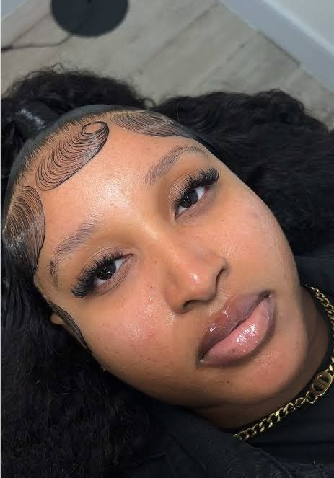
100
1. The fresh before-and-after
This is where most of us stop.
4 The experience of booking with you
3 Their reaction, in their own words
2 Healed or lasting results
1 The fresh before-and-after
Notes:
Script slide 100 | Step 2 Strategy: level 1
1. The fresh before-and-after
This is where most of us stop.
Design: LADDER, level 1 highlighted, with fresh-lash-result photo right next to it.

Slide 182
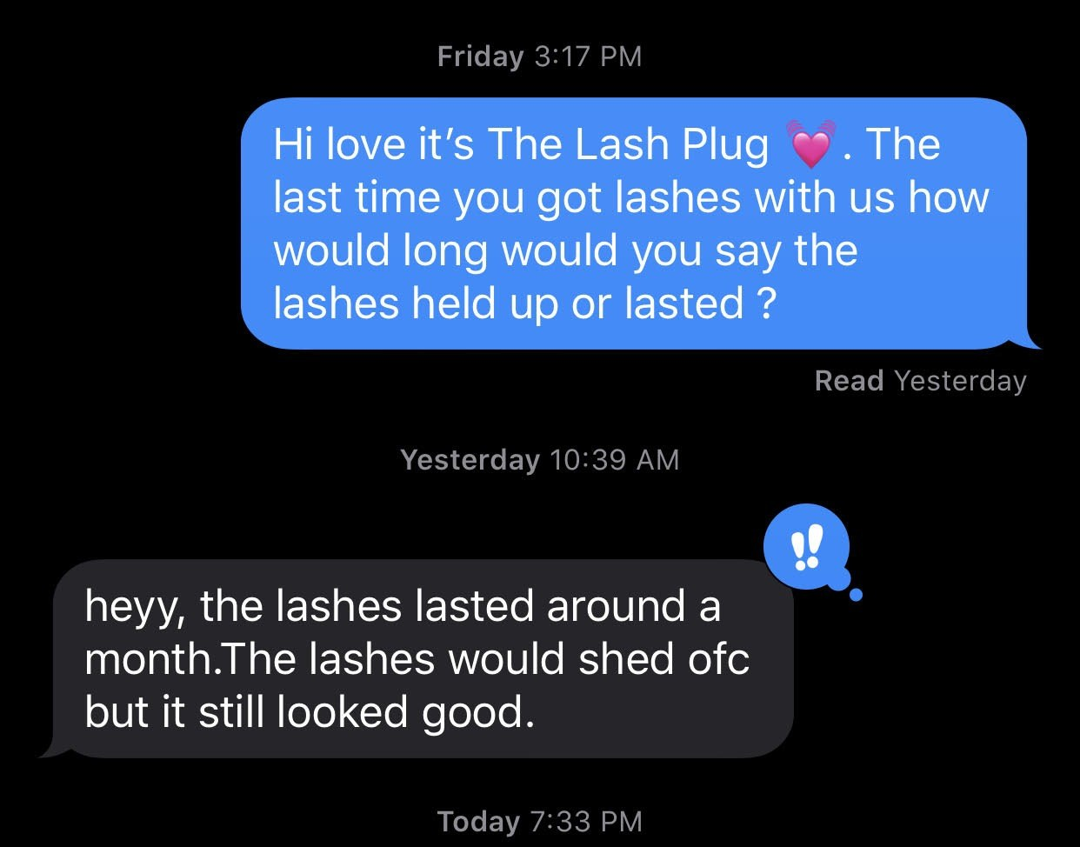
101
2. Healed or lasting results
How the hairstyle looks weeks later. Lash retention at the fill appointment. Skin progress over a few sessions. Healed brows.
4 The experience of booking with you
3 Their reaction, in their own words
2 Healed or lasting results
1 The fresh before-and-after
Notes:
Script slide 101 | Step 2 Strategy: level 2
2. Healed or lasting results
How the hairstyle looks weeks later. Lash retention at the fill appointment. Skin progress over a few sessions. Healed brows.
Design: LADDER, level 2 highlighted, with the client text next to it: "heyy, the lashes lasted around a month.The lashes would shed ofc but it still looked good." Proof sits right next to the level.

Slide 183
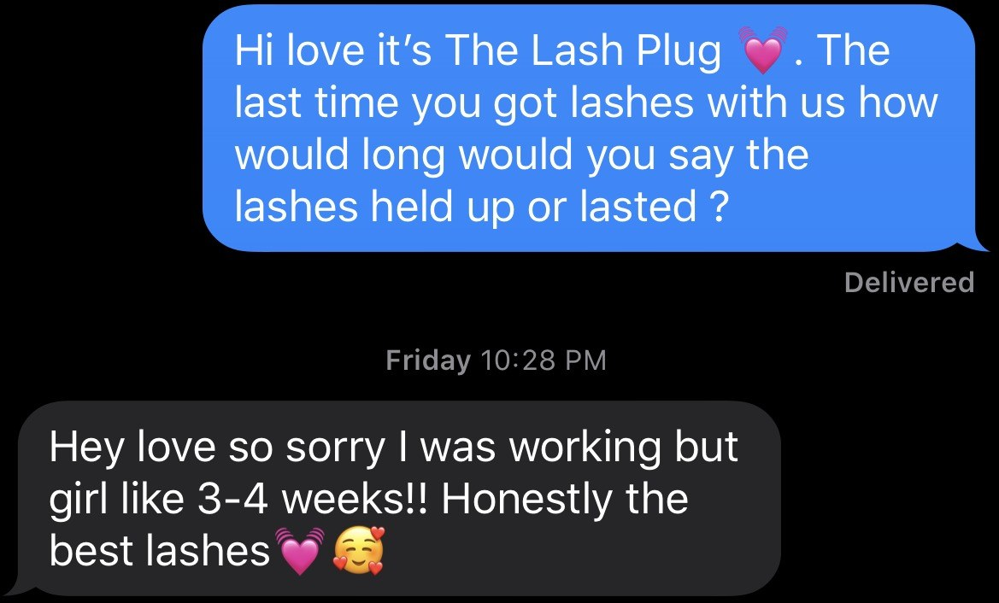
102
3. The client's reaction, in their own words
The mirror moment. The voice note. The text they sent you afterward.
4 The experience of booking with you
3 Their reaction, in their own words
2 Healed or lasting results
1 The fresh before-and-after
Notes:
Script slide 102 | Step 2 Strategy: level 3
3. The client's reaction, in their own words
The mirror moment. The voice note. The text they sent you afterward.
Design: LADDER, level 3 highlighted, with the client text: "girl like 3-4 weeks!! Honestly the best lashes". Crop out the phone number and keyboard.

Slide 184
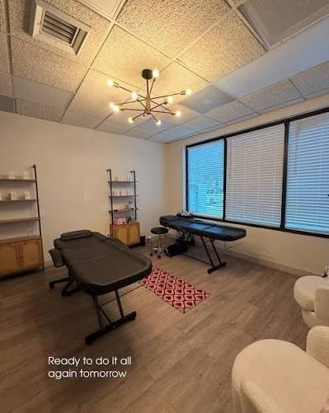
103
4. The experience of booking with you
What it's like from the moment they walk in to the moment they leave.
4 The experience of booking with you
3 Their reaction, in their own words
2 Healed or lasting results
1 The fresh before-and-after
Notes:
Script slide 103 | Step 2 Strategy: level 4
4. The experience of booking with you
What it's like from the moment they walk in to the moment they leave.
Design: LADDER, level 4 highlighted, with the studio photo ("Ready to do it all again tomorrow") right next to it.

Slide 185
104
Look at your page right now.
Which level do you usually stop at? Drop the number in the chat.
4 The experience of booking with you
3 Their reaction, in their own words
2 Healed or lasting results
1 The fresh before-and-after
Notes:
Script slide 104 | Step 2 Strategy
Look at your page right now.
Which level do you usually stop at? Drop the number in the chat.
Design: CHAT PROMPT with the ladder small on the side.

Slide 186
105
Your job: post one level above where you normally stop.
4 The experience of booking with you
3 Their reaction, in their own words
↑ one level up
2 Healed or lasting results
1 The fresh before-and-after
Notes:
Script slide 105 | Step 2 Strategy
Your job: post one level above where you normally stop.
Design: LADDER with an arrow moving up one level.

Slide 187
106
Newer, and don't have client results yet?
Start with a model's result, your process, your training, or a testimonial.
Notes:
Script slide 106 | Step 2 Strategy
Newer, and don't have client results yet?
Start with a model's result, your process, your training, or a testimonial.
Design: STATEMENT.

Slide 188
107
In the caption, don't just say "Book now."
Speak to them. When people feel seen and know you can solve their problem, they book.
Notes:
Script slide 107 | Step 2 Strategy: the caption
In the caption, don't just say "Book now."
Speak to them. When people feel seen and know you can solve their problem, they book.
Design: STATEMENT.

Slide 189
108
My business now brings in consistent clients without me having to constantly post.
Notes:
Script slide 108 | Step 2 Vision
My business now brings in consistent clients without me having to constantly post.
Design: SCREENSHOT: current @rieartistry profile, red box on "64.3K views in the last 30 days".

Slide 190
109
This week: one Get Found, one Get Trusted, one Get Booked.
Will you post all 3? Type 3.
Notes:
Script slide 109 | Step 2 Commitment
This week: one Get Found, one Get Trusted, one Get Booked.
Will you post all 3? Type 3.
Design: CHAT PROMPT.

Slide 191
110
Now the right people are finding you, trusting you, and booking you.
Let's make more from the clients you already have.
Notes:
Script slide 110 | Transition
Now the right people are finding you, trusting you, and booking you.
Let's make more from the clients you already have.
Design: STATEMENT.

Slide 192
111
✓
Step 1: Position yourself so clients know why to choose you
✓
Step 2: Post the 3 kinds of content
Step 3: Find your next revenue opportunity
3
Notes:
Script slide 111 | Roadmap: Step 2 done
Step 2: Post the 3 kinds of content ✓
Design: ROADMAP: Steps 1 and 2 small with checks. Step 3 large in accent color.

Slide 193
112
Let's do some quick math.
Grab your phone calculator.
Notes:
Script slide 112 | Step 3 Context: the ceiling
Let's do some quick math.
Grab your phone calculator.
Design: STATEMENT.

Slide 194
113
Take the most clients you can see in a week.
Multiply it by your average service price.
Multiply that by 4.
Drop that number in the chat.
Notes:
Script slide 113 | Step 3 Context: the ceiling
Take the most clients you can see in a week.
Multiply it by your average service price.
Multiply that by 4.
Drop that number in the chat.
Design: MATH, step 3 of 3. CHAT PROMPT. Each new line appears on click.

Slide 195
113
Take the most clients you can see in a week.
Multiply it by your average service price.
Multiply that by 4.
Drop that number in the chat.
Notes:
Script slide 113 | Step 3 Context: the ceiling
Take the most clients you can see in a week.
Multiply it by your average service price.
Multiply that by 4.
Drop that number in the chat.
Design: MATH, step 3 of 3. CHAT PROMPT. Each new line appears on click.

Slide 196
113
Take the most clients you can see in a week.
Multiply it by your average service price.
Multiply that by 4.
Drop that number in the chat.
Notes:
Script slide 113 | Step 3 Context: the ceiling
Take the most clients you can see in a week.
Multiply it by your average service price.
Multiply that by 4.
Drop that number in the chat.
Design: MATH, step 3 of 3. CHAT PROMPT. Each new line appears on click.

Slide 197
113
Take the most clients you can see in a week.
Multiply it by your average service price.
Multiply that by 4.
Drop that number in the chat.
Notes:
Script slide 113 | Step 3 Context: the ceiling
Take the most clients you can see in a week.
Multiply it by your average service price.
Multiply that by 4.
Drop that number in the chat.
Design: MATH, step 3 of 3. CHAT PROMPT. Each new line appears on click.

Slide 198
114
That's your ceiling.
The most you can make in a month, the way you're working right now.
Notes:
Script slide 114 | Step 3 Context: the ceiling
That's your ceiling.
The most you can make in a month, the way you're working right now.
Design: STATEMENT. "Your ceiling" 96pt.

Slide 199
115
For most of us, the only way we know to raise that number is more hours.
More clients. Later nights. Fewer days off.
And we know where that leads.
Your back, neck, and wrists hurting. Less family time.
Notes:
Script slide 115 | Step 3 Context: the ceiling
For most of us, the only way we know to raise that number is more hours.
More clients. Later nights. Fewer days off.
And we know where that leads.
Your back, neck, and wrists hurting. Less family time.
Design: STATEMENT. Each new line appears on click.

Slide 200
115
For most of us, the only way we know to raise that number is more hours.
More clients. Later nights. Fewer days off.
And we know where that leads.
Your back, neck, and wrists hurting. Less family time.
Notes:
Script slide 115 | Step 3 Context: the ceiling
For most of us, the only way we know to raise that number is more hours.
More clients. Later nights. Fewer days off.
And we know where that leads.
Your back, neck, and wrists hurting. Less family time.
Design: STATEMENT. Each new line appears on click.

Slide 201
115
For most of us, the only way we know to raise that number is more hours.
More clients. Later nights. Fewer days off.
And we know where that leads.
Your back, neck, and wrists hurting. Less family time.
Notes:
Script slide 115 | Step 3 Context: the ceiling
For most of us, the only way we know to raise that number is more hours.
More clients. Later nights. Fewer days off.
And we know where that leads.
Your back, neck, and wrists hurting. Less family time.
Design: STATEMENT. Each new line appears on click.

Slide 202
115
For most of us, the only way we know to raise that number is more hours.
More clients. Later nights. Fewer days off.
And we know where that leads.
Your back, neck, and wrists hurting. Less family time.
Notes:
Script slide 115 | Step 3 Context: the ceiling
For most of us, the only way we know to raise that number is more hours.
More clients. Later nights. Fewer days off.
And we know where that leads.
Your back, neck, and wrists hurting. Less family time.
Design: STATEMENT. Each new line appears on click.

Slide 203
116
So before we talk about adding more hours, I want you to look somewhere else first.
Notes:
Script slide 116 | Step 3 Context: the ceiling
So before we talk about adding more hours, I want you to look somewhere else first.
Design: STATEMENT.

Slide 204
117
Most of us think growth means getting new clients.
But constantly chasing new clients is the most exhausting way to grow.
Notes:
Script slide 117 | Step 3 Strategy: the Invisible Leak
Most of us think growth means getting new clients.
But constantly chasing new clients is the most exhausting way to grow.
Design: STATEMENT. Each new line appears on click.

Slide 205
117
Most of us think growth means getting new clients.
But constantly chasing new clients is the most exhausting way to grow.
Notes:
Script slide 117 | Step 3 Strategy: the Invisible Leak
Most of us think growth means getting new clients.
But constantly chasing new clients is the most exhausting way to grow.
Design: STATEMENT. Each new line appears on click.

Slide 206
118
Meanwhile, there's money sitting right inside the clients you already have.
Let me show you with my own numbers.
Notes:
Script slide 118 | Step 3 Strategy: the Invisible Leak
Meanwhile, there's money sitting right inside the clients you already have.
Let me show you with my own numbers.
Design: STATEMENT. Each new line appears on click.

Slide 207
118
Meanwhile, there's money sitting right inside the clients you already have.
Let me show you with my own numbers.
Notes:
Script slide 118 | Step 3 Strategy: the Invisible Leak
Meanwhile, there's money sitting right inside the clients you already have.
Let me show you with my own numbers.
Design: STATEMENT. Each new line appears on click.

Slide 208
119
A lash client who comes every 3 weeks comes in about 17 times a year.
Notes:
Script slide 119 | Step 3 Strategy: the Invisible Leak
A lash client who comes every 3 weeks comes in about 17 times a year.
Design: MATH. "17" large.

Slide 209
120
At $100 a fill, that's $1,700 a year from one client.
Notes:
Script slide 120 | Step 3 Strategy: the Invisible Leak
At $100 a fill, that's $1,700 a year from one client.
Design: MATH.

Slide 210
121
Now add a $30 brow wax and tint to those appointments.
That's $510 more a year. Same client. Same visit.
I'm helping my client kill two birds with one stone.
Using skills and clients I already have.
17 × $30 = $510
Notes:
Script slide 121 | Step 3 Strategy: the Invisible Leak
Now add a $30 brow wax and tint to those appointments.
That's $510 more a year. Same client. Same visit.
I'm helping my client kill two birds with one stone.
Using skills and clients I already have.
Design: MATH. Small: 17 × $30 = $510. Each new line appears on click.
[VERIFY: your notes used $25 and $425. I switched to your real $30 price.]

Slide 211
121
Now add a $30 brow wax and tint to those appointments.
That's $510 more a year. Same client. Same visit.
I'm helping my client kill two birds with one stone.
Using skills and clients I already have.
17 × $30 = $510
Notes:
Script slide 121 | Step 3 Strategy: the Invisible Leak
Now add a $30 brow wax and tint to those appointments.
That's $510 more a year. Same client. Same visit.
I'm helping my client kill two birds with one stone.
Using skills and clients I already have.
Design: MATH. Small: 17 × $30 = $510. Each new line appears on click.
[VERIFY: your notes used $25 and $425. I switched to your real $30 price.]

Slide 212
121
Now add a $30 brow wax and tint to those appointments.
That's $510 more a year. Same client. Same visit.
I'm helping my client kill two birds with one stone.
Using skills and clients I already have.
17 × $30 = $510
Notes:
Script slide 121 | Step 3 Strategy: the Invisible Leak
Now add a $30 brow wax and tint to those appointments.
That's $510 more a year. Same client. Same visit.
I'm helping my client kill two birds with one stone.
Using skills and clients I already have.
Design: MATH. Small: 17 × $30 = $510. Each new line appears on click.
[VERIFY: your notes used $25 and $425. I switched to your real $30 price.]

Slide 213
121
Now add a $30 brow wax and tint to those appointments.
That's $510 more a year. Same client. Same visit.
I'm helping my client kill two birds with one stone.
Using skills and clients I already have.
17 × $30 = $510
Notes:
Script slide 121 | Step 3 Strategy: the Invisible Leak
Now add a $30 brow wax and tint to those appointments.
That's $510 more a year. Same client. Same visit.
I'm helping my client kill two birds with one stone.
Using skills and clients I already have.
Design: MATH. Small: 17 × $30 = $510. Each new line appears on click.
[VERIFY: your notes used $25 and $425. I switched to your real $30 price.]

Slide 214
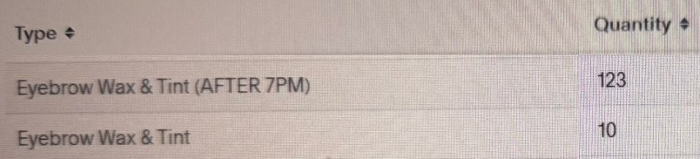
122
Here's what that add-on did in my studio last year:
Notes:
Script slide 122 | Step 3 Vision: the Invisible Leak, my numbers
Here's what that add-on did in my studio last year:
Design: SCREENSHOT: acuity-brow-wax-tint-appointments (Acuity, Type and Quantity columns only). Red box on 123 and 10.

Slide 215
123
123 after-hours wax and tints × $60 = $7,380
Notes:
Script slide 123 | Step 3 Vision: the Invisible Leak, my numbers
123 after-hours wax and tints × $60 = $7,380
Design: MATH. "$7,380" 96pt, accent color. Acuity crop small in the corner.

Slide 216
124
10 regular wax and tints × $30 = $300
Notes:
Script slide 124 | Step 3 Vision: the Invisible Leak, my numbers
10 regular wax and tints × $30 = $300
Design: MATH.

Slide 217
125
$7,680 from one add-on.
Same clients. Skills I already had.
Notes:
Script slide 125 | Step 3 Vision: the Invisible Leak, my numbers
$7,680 from one add-on.
Same clients. Skills I already had.
Design: MATH. "$7,680" 110pt, accent color. Second line on click.

Slide 218
125
$7,680 from one add-on.
Same clients. Skills I already had.
Notes:
Script slide 125 | Step 3 Vision: the Invisible Leak, my numbers
$7,680 from one add-on.
Same clients. Skills I already had.
Design: MATH. "$7,680" 110pt, accent color. Second line on click.

Slide 219
126
And notice: after 7 PM, that same wax and tint is $60.
Getting paid more for your time is a revenue opportunity too.
Notes:
Script slide 126 | Step 3 Strategy: the Invisible Leak
And notice: after 7 PM, that same wax and tint is $60.
Getting paid more for your time is a revenue opportunity too.
Design: STATEMENT. "$60" in accent color. Second line on click.

Slide 220
126
And notice: after 7 PM, that same wax and tint is $60.
Getting paid more for your time is a revenue opportunity too.
Notes:
Script slide 126 | Step 3 Strategy: the Invisible Leak
And notice: after 7 PM, that same wax and tint is $60.
Getting paid more for your time is a revenue opportunity too.
Design: STATEMENT. "$60" in accent color. Second line on click.

Slide 221
127
But I see about 77 clients.
Say only half add it at every visit: 38 clients.
Notes:
Script slide 127 | Step 3 Strategy: the Invisible Leak
But I see about 77 clients.
Say only half add it at every visit: 38 clients.
Design: MATH. Second line on click.

Slide 222
127
But I see about 77 clients.
Say only half add it at every visit: 38 clients.
Notes:
Script slide 127 | Step 3 Strategy: the Invisible Leak
But I see about 77 clients.
Say only half add it at every visit: 38 clients.
Design: MATH. Second line on click.

Slide 223
128
38 × $510 = $19,380 a year.
Notes:
Script slide 128 | Step 3 Strategy: the Invisible Leak
38 × $510 = $19,380 a year.
Design: MATH. "$19,380" 96pt, accent color.

Slide 224
129
$19,380 possible. $7,680 made.
That $11,700 gap is what I call the Invisible Leak.
Notes:
Script slide 129 | Step 3 Strategy: the Invisible Leak
$19,380 possible. $7,680 made.
That $11,700 gap is what I call the Invisible Leak.
Design: MATH. Second line on click. "The Invisible Leak" in accent color.

Slide 225
129
$19,380 possible. $7,680 made.
That $11,700 gap is what I call the Invisible Leak.
Notes:
Script slide 129 | Step 3 Strategy: the Invisible Leak
$19,380 possible. $7,680 made.
That $11,700 gap is what I call the Invisible Leak.
Design: MATH. Second line on click. "The Invisible Leak" in accent color.

Slide 226
130
It's not money you have to find.
It's money already walking out your door.
Notes:
Script slide 130 | Step 3 Strategy: the Invisible Leak
It's not money you have to find.
It's money already walking out your door.
Design: STATEMENT. Second line on click.

Slide 227
130
It's not money you have to find.
It's money already walking out your door.
Notes:
Script slide 130 | Step 3 Strategy: the Invisible Leak
It's not money you have to find.
It's money already walking out your door.
Design: STATEMENT. Second line on click.

Slide 228
131
So how do you find your next revenue opportunity?
There are 3 directions you can grow.
Notes:
Script slide 131 | Step 3 Strategy: the three directions
So how do you find your next revenue opportunity?
There are 3 directions you can grow.
Design: STATEMENT.

Slide 229
132
Direction 1: Go deeper
More value for the clients you already have.
Stop selling just one service. Start solving the whole problem.
Notes:
Script slide 132 | Step 3 Strategy: Direction 1
Direction 1: Go deeper
More value for the clients you already have.
Stop selling just one service. Start solving the whole problem.
Design: STATEMENT.

Slide 230
133
Lash artist: Add a brow service to the same booking
Hairstylist: Packages or a recurring treatment plan for the health of their natural hair
Nail tech: Move basic manicures into structured gel overlays, and send them home with cuticle oil
Esthetician: Turn a one-time facial into a monthly membership with a home-care routine
Notes:
Script slide 133 | Step 3 Strategy: Direction 1 examples
Lash artist: Add a brow service to the same booking
Hairstylist: Packages or a recurring treatment plan for the health of their natural hair
Nail tech: Move basic manicures into structured gel overlays, and send them home with cuticle oil
Esthetician: Turn a one-time facial into a monthly membership with a home-care routine
Design: LIST, one per click.

Slide 231
133
Lash artist: Add a brow service to the same booking
Hairstylist: Packages or a recurring treatment plan for the health of their natural hair
Nail tech: Move basic manicures into structured gel overlays, and send them home with cuticle oil
Esthetician: Turn a one-time facial into a monthly membership with a home-care routine
Notes:
Script slide 133 | Step 3 Strategy: Direction 1 examples
Lash artist: Add a brow service to the same booking
Hairstylist: Packages or a recurring treatment plan for the health of their natural hair
Nail tech: Move basic manicures into structured gel overlays, and send them home with cuticle oil
Esthetician: Turn a one-time facial into a monthly membership with a home-care routine
Design: LIST, one per click.

Slide 232
133
Lash artist: Add a brow service to the same booking
Hairstylist: Packages or a recurring treatment plan for the health of their natural hair
Nail tech: Move basic manicures into structured gel overlays, and send them home with cuticle oil
Esthetician: Turn a one-time facial into a monthly membership with a home-care routine
Notes:
Script slide 133 | Step 3 Strategy: Direction 1 examples
Lash artist: Add a brow service to the same booking
Hairstylist: Packages or a recurring treatment plan for the health of their natural hair
Nail tech: Move basic manicures into structured gel overlays, and send them home with cuticle oil
Esthetician: Turn a one-time facial into a monthly membership with a home-care routine
Design: LIST, one per click.

Slide 233
133
Lash artist: Add a brow service to the same booking
Hairstylist: Packages or a recurring treatment plan for the health of their natural hair
Nail tech: Move basic manicures into structured gel overlays, and send them home with cuticle oil
Esthetician: Turn a one-time facial into a monthly membership with a home-care routine
Notes:
Script slide 133 | Step 3 Strategy: Direction 1 examples
Lash artist: Add a brow service to the same booking
Hairstylist: Packages or a recurring treatment plan for the health of their natural hair
Nail tech: Move basic manicures into structured gel overlays, and send them home with cuticle oil
Esthetician: Turn a one-time facial into a monthly membership with a home-care routine
Design: LIST, one per click.

Slide 234
134
Direction 2: Go wider
The same skills, for a new audience.
When other pros start asking how you do what you do, that's training, mentoring, or teaching classes.
You're not learning a new skill. You're teaching the one you already have.
Notes:
Script slide 134 | Step 3 Strategy: Direction 2
Direction 2: Go wider
The same skills, for a new audience.
When other pros start asking how you do what you do, that's training, mentoring, or teaching classes.
You're not learning a new skill. You're teaching the one you already have.
Design: STATEMENT. Each new line appears on click.

Slide 235
134
Direction 2: Go wider
The same skills, for a new audience.
When other pros start asking how you do what you do, that's training, mentoring, or teaching classes.
You're not learning a new skill. You're teaching the one you already have.
Notes:
Script slide 134 | Step 3 Strategy: Direction 2
Direction 2: Go wider
The same skills, for a new audience.
When other pros start asking how you do what you do, that's training, mentoring, or teaching classes.
You're not learning a new skill. You're teaching the one you already have.
Design: STATEMENT. Each new line appears on click.

Slide 236
134
Direction 2: Go wider
The same skills, for a new audience.
When other pros start asking how you do what you do, that's training, mentoring, or teaching classes.
You're not learning a new skill. You're teaching the one you already have.
Notes:
Script slide 134 | Step 3 Strategy: Direction 2
Direction 2: Go wider
The same skills, for a new audience.
When other pros start asking how you do what you do, that's training, mentoring, or teaching classes.
You're not learning a new skill. You're teaching the one you already have.
Design: STATEMENT. Each new line appears on click.

Slide 237
134
Direction 2: Go wider
The same skills, for a new audience.
When other pros start asking how you do what you do, that's training, mentoring, or teaching classes.
You're not learning a new skill. You're teaching the one you already have.
Notes:
Script slide 134 | Step 3 Strategy: Direction 2
Direction 2: Go wider
The same skills, for a new audience.
When other pros start asking how you do what you do, that's training, mentoring, or teaching classes.
You're not learning a new skill. You're teaching the one you already have.
Design: STATEMENT. Each new line appears on click.

Slide 238

135
I've done this. I've taught classes full of lash artists.
And tonight is me doing it again.
Notes:
Script slide 135 | Step 3 Vision: Direction 2 proof
I've done this. I've taught classes full of lash artists.
And tonight is me doing it again.
Design: PHOTO: training class photo (3 students with certificates). Certificate names blurred. Each new line appears on click.

Slide 239
135
I've done this. I've taught classes full of lash artists.
And tonight is me doing it again.
Notes:
Script slide 135 | Step 3 Vision: Direction 2 proof
I've done this. I've taught classes full of lash artists.
And tonight is me doing it again.
Design: PHOTO: training class photo (3 students with certificates). Certificate names blurred. Each new line appears on click.

Slide 240
136
Direction 3: Go beyond the chair
The same knowledge, without using your hands.
Guides, digital products, and online education.
That's the stuff you explain in your chair over and over.
Or what you're so skilled at that other pros would want to know how to do it.
Notes:
Script slide 136 | Step 3 Strategy: Direction 3
Direction 3: Go beyond the chair
The same knowledge, without using your hands.
Guides, digital products, and online education.
That's the stuff you explain in your chair over and over.
Or what you're so skilled at that other pros would want to know how to do it.
Design: STATEMENT. Each new line appears on click.

Slide 241
136
Direction 3: Go beyond the chair
The same knowledge, without using your hands.
Guides, digital products, and online education.
That's the stuff you explain in your chair over and over.
Or what you're so skilled at that other pros would want to know how to do it.
Notes:
Script slide 136 | Step 3 Strategy: Direction 3
Direction 3: Go beyond the chair
The same knowledge, without using your hands.
Guides, digital products, and online education.
That's the stuff you explain in your chair over and over.
Or what you're so skilled at that other pros would want to know how to do it.
Design: STATEMENT. Each new line appears on click.

Slide 242
136
Direction 3: Go beyond the chair
The same knowledge, without using your hands.
Guides, digital products, and online education.
That's the stuff you explain in your chair over and over.
Or what you're so skilled at that other pros would want to know how to do it.
Notes:
Script slide 136 | Step 3 Strategy: Direction 3
Direction 3: Go beyond the chair
The same knowledge, without using your hands.
Guides, digital products, and online education.
That's the stuff you explain in your chair over and over.
Or what you're so skilled at that other pros would want to know how to do it.
Design: STATEMENT. Each new line appears on click.

Slide 243
136
Direction 3: Go beyond the chair
The same knowledge, without using your hands.
Guides, digital products, and online education.
That's the stuff you explain in your chair over and over.
Or what you're so skilled at that other pros would want to know how to do it.
Notes:
Script slide 136 | Step 3 Strategy: Direction 3
Direction 3: Go beyond the chair
The same knowledge, without using your hands.
Guides, digital products, and online education.
That's the stuff you explain in your chair over and over.
Or what you're so skilled at that other pros would want to know how to do it.
Design: STATEMENT. Each new line appears on click.

Slide 244
136
Direction 3: Go beyond the chair
The same knowledge, without using your hands.
Guides, digital products, and online education.
That's the stuff you explain in your chair over and over.
Or what you're so skilled at that other pros would want to know how to do it.
Notes:
Script slide 136 | Step 3 Strategy: Direction 3
Direction 3: Go beyond the chair
The same knowledge, without using your hands.
Guides, digital products, and online education.
That's the stuff you explain in your chair over and over.
Or what you're so skilled at that other pros would want to know how to do it.
Design: STATEMENT. Each new line appears on click.

Slide 245
137
Answer three questions.
Don't overthink these. Write whatever comes to mind.
1. What do clients ask you for that you don't offer yet?
Notes:
Script slide 137 | Step 3 Strategy: the exercise
Answer three questions.
Don't overthink these. Write whatever comes to mind.
1. What do clients ask you for that you don't offer yet?
Design: STATEMENT. Give them 30 seconds. Each new line appears on click.

Slide 246
137
Answer three questions.
Don't overthink these. Write whatever comes to mind.
1. What do clients ask you for that you don't offer yet?
Notes:
Script slide 137 | Step 3 Strategy: the exercise
Answer three questions.
Don't overthink these. Write whatever comes to mind.
1. What do clients ask you for that you don't offer yet?
Design: STATEMENT. Give them 30 seconds. Each new line appears on click.

Slide 247
137
Answer three questions.
Don't overthink these. Write whatever comes to mind.
1. What do clients ask you for that you don't offer yet?
Notes:
Script slide 137 | Step 3 Strategy: the exercise
Answer three questions.
Don't overthink these. Write whatever comes to mind.
1. What do clients ask you for that you don't offer yet?
Design: STATEMENT. Give them 30 seconds. Each new line appears on click.

Slide 248
138
2. What do other pros ask you how to do?
Notes:
Script slide 138 | Step 3 Strategy: the exercise
2. What do other pros ask you how to do?
Design: STATEMENT.

Slide 249
139
3. What do you find yourself explaining in your chair over and over?
Notes:
Script slide 139 | Step 3 Strategy: the exercise
3. What do you find yourself explaining in your chair over and over?
Design: STATEMENT.

Slide 250
140
Circle the one that came to you easiest.
Notes:
Script slide 140 | Step 3 Strategy: the exercise
Circle the one that came to you easiest.
Design: STATEMENT.
[VERIFY: "circle" comes from your pitch draft ("that next offer you circled today"). It's mine as an instruction.]

Slide 251
141
Now I want to be real with you.
I don't want you leaving here and spending three months building something that doesn't pay you.
Notes:
Script slide 141 | Step 3 Strategy: moment of truth
Now I want to be real with you.
I don't want you leaving here and spending three months building something that doesn't pay you.
Design: STATEMENT. Each new line appears on click.

Slide 252
141
Now I want to be real with you.
I don't want you leaving here and spending three months building something that doesn't pay you.
Notes:
Script slide 141 | Step 3 Strategy: moment of truth
Now I want to be real with you.
I don't want you leaving here and spending three months building something that doesn't pay you.
Design: STATEMENT. Each new line appears on click.

Slide 253
142
Start closest to the chair.
Notes:
Script slide 142 | Step 3 Strategy: moment of truth
Start closest to the chair.
Design: STATEMENT. 96pt.

Slide 254
143
For most of you, Go Deeper is going to be your fastest money.
Those clients already know you, trust you, and pay you.
You're not convincing anybody. You're offering more value to people who already said yes.
Notes:
Script slide 143 | Step 3 Strategy: moment of truth
For most of you, Go Deeper is going to be your fastest money.
Those clients already know you, trust you, and pay you.
You're not convincing anybody. You're offering more value to people who already said yes.
Design: STATEMENT. Each new line appears on click.

Slide 255
143
For most of you, Go Deeper is going to be your fastest money.
Those clients already know you, trust you, and pay you.
You're not convincing anybody. You're offering more value to people who already said yes.
Notes:
Script slide 143 | Step 3 Strategy: moment of truth
For most of you, Go Deeper is going to be your fastest money.
Those clients already know you, trust you, and pay you.
You're not convincing anybody. You're offering more value to people who already said yes.
Design: STATEMENT. Each new line appears on click.

Slide 256
143
For most of you, Go Deeper is going to be your fastest money.
Those clients already know you, trust you, and pay you.
You're not convincing anybody. You're offering more value to people who already said yes.
Notes:
Script slide 143 | Step 3 Strategy: moment of truth
For most of you, Go Deeper is going to be your fastest money.
Those clients already know you, trust you, and pay you.
You're not convincing anybody. You're offering more value to people who already said yes.
Design: STATEMENT. Each new line appears on click.

Slide 257
144
A digital product sounds exciting, and it is.
But it's usually the slowest to make money, because you have to build an audience for it first.
Notes:
Script slide 144 | Step 3 Strategy: moment of truth
A digital product sounds exciting, and it is.
But it's usually the slowest to make money, because you have to build an audience for it first.
Design: STATEMENT.

Slide 258
145
Not sure where to start?
Start with the person already sitting in front of you.
Notes:
Script slide 145 | Step 3 Strategy: moment of truth
Not sure where to start?
Start with the person already sitting in front of you.
Design: STATEMENT.

Slide 259
146
Imagine it's the 1st of the month.
You haven't opened your doors yet. You haven't done a single appointment.
And a chunk of your income is already in the bank.
Notes:
Script slide 146 | Step 3 Vision
Imagine it's the 1st of the month.
You haven't opened your doors yet. You haven't done a single appointment.
And a chunk of your income is already in the bank.
Design: STATEMENT. Each new line appears on click.

Slide 260
146
Imagine it's the 1st of the month.
You haven't opened your doors yet. You haven't done a single appointment.
And a chunk of your income is already in the bank.
Notes:
Script slide 146 | Step 3 Vision
Imagine it's the 1st of the month.
You haven't opened your doors yet. You haven't done a single appointment.
And a chunk of your income is already in the bank.
Design: STATEMENT. Each new line appears on click.

Slide 261
146
Imagine it's the 1st of the month.
You haven't opened your doors yet. You haven't done a single appointment.
And a chunk of your income is already in the bank.
Notes:
Script slide 146 | Step 3 Vision
Imagine it's the 1st of the month.
You haven't opened your doors yet. You haven't done a single appointment.
And a chunk of your income is already in the bank.
Design: STATEMENT. Each new line appears on click.

Slide 262
147
That's what recurring revenue does.
Memberships, packages, and plans.
It's not passive. You're still doing the work.
But it's predictable. You know what's coming before the month even starts.
Notes:
Script slide 147 | Step 3 Vision
That's what recurring revenue does.
Memberships, packages, and plans.
It's not passive. You're still doing the work.
But it's predictable. You know what's coming before the month even starts.
Design: STATEMENT. Each new line appears on click.

Slide 263
147
That's what recurring revenue does.
Memberships, packages, and plans.
It's not passive. You're still doing the work.
But it's predictable. You know what's coming before the month even starts.
Notes:
Script slide 147 | Step 3 Vision
That's what recurring revenue does.
Memberships, packages, and plans.
It's not passive. You're still doing the work.
But it's predictable. You know what's coming before the month even starts.
Design: STATEMENT. Each new line appears on click.

Slide 264
147
That's what recurring revenue does.
Memberships, packages, and plans.
It's not passive. You're still doing the work.
But it's predictable. You know what's coming before the month even starts.
Notes:
Script slide 147 | Step 3 Vision
That's what recurring revenue does.
Memberships, packages, and plans.
It's not passive. You're still doing the work.
But it's predictable. You know what's coming before the month even starts.
Design: STATEMENT. Each new line appears on click.

Slide 265
147
That's what recurring revenue does.
Memberships, packages, and plans.
It's not passive. You're still doing the work.
But it's predictable. You know what's coming before the month even starts.
Notes:
Script slide 147 | Step 3 Vision
That's what recurring revenue does.
Memberships, packages, and plans.
It's not passive. You're still doing the work.
But it's predictable. You know what's coming before the month even starts.
Design: STATEMENT. Each new line appears on click.

Slide 266
148
In my studio, I have a Maintained Membership at $190 a month.
11 clients are on it.
Notes:
Script slide 148 | Step 3 Vision: my numbers
In my studio, I have a Maintained Membership at $190 a month.
11 clients are on it.
Design: MATH.

Slide 267
149
That's $2,090 before the month even starts.
11 × $190
Notes:
Script slide 149 | Step 3 Vision: my numbers
That's $2,090 before the month even starts.
Design: MATH. "$2,090" 96pt, accent color. Small: 11 × $190.

Slide 268
150
That's the shift.
From hoping clients book to knowing what's coming in.
Notes:
Script slide 150 | Step 3 Vision
That's the shift.
From hoping clients book to knowing what's coming in.
Design: STATEMENT.

Slide 269
151
"One of the biggest shifts for me was realizing that I don't need to add more in order to grow. Sometimes growth comes from simplifying, refining what I already have, and being intentional about what I want my business to be known for."
A beauty pro I mentored
Notes:
Script slide 151 | Step 3 Vision: proof
"One of the biggest shifts for me was realizing that I don't need to add more in order to grow. Sometimes growth comes from simplifying, refining what I already have, and being intentional about what I want my business to be known for."
Design: QUOTE: testimonial 1 screenshot, red box on these two sentences. Label "A beauty pro I mentored".

Slide 270
152
Type the one opportunity you circled.
Notes:
Script slide 152 | Step 3 Commitment
Type the one opportunity you circled.
Design: CHAT PROMPT.

Slide 271
153
You now know where your next dollar is coming from.
And it's already sitting in your chair.
Notes:
Script slide 153 | Transition
You now know where your next dollar is coming from.
And it's already sitting in your chair.
Design: STATEMENT.

Slide 272
154
✓
Step 1: Position yourself so clients know why to choose you
✓
Step 2: Post the 3 kinds of content
✓
Step 3: Find your next revenue opportunity
Notes:
Script slide 154 | Roadmap: all done
Step 1: Position yourself ✓
Step 2: Post the 3 kinds of content ✓
Step 3: Find your next revenue opportunity ✓
Design: ROADMAP: all three small with checks.

Slide 273
155
Don't aim for a whole new business by January.
Notes:
Script slide 155 | Big Shift
Don't aim for a whole new business by January.
Design: STATEMENT.

Slide 274
156
Aim for one add-on.
Notes:
Script slide 156 | Big Shift
Aim for one add-on.
Design: STATEMENT. 96pt.

Slide 275
157
One $30 add-on. 5 clients a week.
That's $150 a week.
Notes:
Script slide 157 | Big Shift: math
One $30 add-on. 5 clients a week.
That's $150 a week.
Design: MATH.
[VERIFY: example numbers are mine, using your $30 price.]

Slide 276
158
That's about $600 a month.
From people already in your chair.
Notes:
Script slide 158 | Big Shift: math
That's about $600 a month.
From people already in your chair.
Design: MATH. "$600" accent color.

Slide 277
159
If we stopped right now, would you feel you got more than any webinar you've been on?
Type YES or NO
Notes:
Script slide 159 | Big Shift: check-in
If we stopped right now, would you feel you got more than any webinar you've been on?
Type YES or NO.
Design: CHAT PROMPT.

Slide 278
160
Remember the moment I said changed everything?
Notes:
Script slide 160 | Loop close
Remember the moment I said changed everything?
Design: STATEMENT.

Slide 279
161
I had spent months and thousands of dollars on trainings, mentorships, and consultation calls.
They weren't scams. But some weren't as valuable as I hoped.
I took one or two things from each one.
And some really showed me the power of investing in yourself with the right people, and how you can avoid years of stress.
Notes:
Script slide 161 | Loop close: where I was
I had spent months and thousands of dollars on trainings, mentorships, and consultation calls.
They weren't scams. But some weren't as valuable as I hoped.
I took one or two things from each one.
And some really showed me the power of investing in yourself with the right people, and how you can avoid years of stress.
Design: STATEMENT. Each new line appears on click.

Slide 280
161
I had spent months and thousands of dollars on trainings, mentorships, and consultation calls.
They weren't scams. But some weren't as valuable as I hoped.
I took one or two things from each one.
And some really showed me the power of investing in yourself with the right people, and how you can avoid years of stress.
Notes:
Script slide 161 | Loop close: where I was
I had spent months and thousands of dollars on trainings, mentorships, and consultation calls.
They weren't scams. But some weren't as valuable as I hoped.
I took one or two things from each one.
And some really showed me the power of investing in yourself with the right people, and how you can avoid years of stress.
Design: STATEMENT. Each new line appears on click.

Slide 281
161
I had spent months and thousands of dollars on trainings, mentorships, and consultation calls.
They weren't scams. But some weren't as valuable as I hoped.
I took one or two things from each one.
And some really showed me the power of investing in yourself with the right people, and how you can avoid years of stress.
Notes:
Script slide 161 | Loop close: where I was
I had spent months and thousands of dollars on trainings, mentorships, and consultation calls.
They weren't scams. But some weren't as valuable as I hoped.
I took one or two things from each one.
And some really showed me the power of investing in yourself with the right people, and how you can avoid years of stress.
Design: STATEMENT. Each new line appears on click.

Slide 282
161
I had spent months and thousands of dollars on trainings, mentorships, and consultation calls.
They weren't scams. But some weren't as valuable as I hoped.
I took one or two things from each one.
And some really showed me the power of investing in yourself with the right people, and how you can avoid years of stress.
Notes:
Script slide 161 | Loop close: where I was
I had spent months and thousands of dollars on trainings, mentorships, and consultation calls.
They weren't scams. But some weren't as valuable as I hoped.
I took one or two things from each one.
And some really showed me the power of investing in yourself with the right people, and how you can avoid years of stress.
Design: STATEMENT. Each new line appears on click.

Slide 283
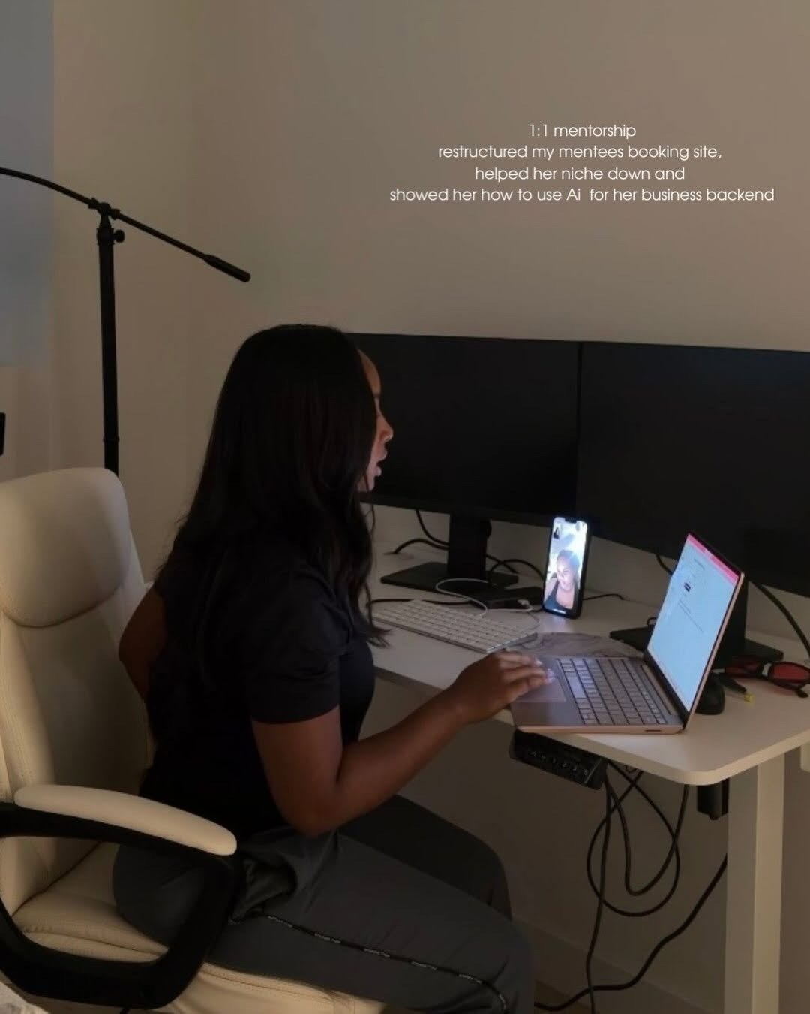
162
Then I mixed those pieces with my own research, learning, and experience.
And everything clicked.
Notes:
Script slide 162 | Loop close: the moment
Then I mixed those pieces with my own research, learning, and experience.
And everything clicked.
Design: PHOTO: cherie-mentoring-at-desk. "Everything clicked" in accent color. Each new line appears on click.

Slide 284
162
Then I mixed those pieces with my own research, learning, and experience.
And everything clicked.
Notes:
Script slide 162 | Loop close: the moment
Then I mixed those pieces with my own research, learning, and experience.
And everything clicked.
Design: PHOTO: cherie-mentoring-at-desk. "Everything clicked" in accent color. Each new line appears on click.

Slide 285
163
I got so booked I had to restructure my hours, limit my appointments, and turn away clients I couldn't take.
Notes:
Script slide 163 | Loop close: what happened
I got so booked I had to restructure my hours, limit my appointments, and turn away clients I couldn't take.
Design: SCREENSHOT: booked-calendar (same image as the proof flash, shown again).

Slide 286
164
Working wasn't a survival need anymore.
It became a choice.
Notes:
Script slide 164 | Loop close: the realization
Working wasn't a survival need anymore.
It became a choice.
Design: STATEMENT.

Slide 287
165
Then other pros started asking me how.
Notes:
Script slide 165 | Loop close: what happened next
Then other pros started asking me how.
Design: SCREENSHOT: the "Whats the blue print" text again.

Slide 288
166
I know what it's like to struggle, try different things, and get generic information that doesn't change your business.
Notes:
Script slide 166 | Loop close: the promise
I know what it's like to struggle, try different things, and get generic information that doesn't change your business.
Design: STATEMENT.

Slide 289
167
So I promised myself I'd share the information and resources I wish I had when I was figuring it out alone.
Notes:
Script slide 167 | Loop close: the promise
So I promised myself I'd share the information and resources I wish I had when I was figuring it out alone.
Design: STATEMENT.

Slide 290
168
Tonight, I want to be that for you.
Notes:
Script slide 168 | Loop close
Tonight, I want to be that for you.
Design: STATEMENT. Photo of you on the right (your landing page headshot).

Slide 291
169
So far tonight...
Notes:
Script slide 169 | Recap
So far tonight...
Design: STATEMENT.

Slide 292
170
You found your positioning.
Notes:
Script slide 170 | Recap: Step 1
You found your positioning.
Design: RECAP: thumbnail of the formula slide.

Slide 293
171
You learned the 3 kinds of posts and the proof ladder.
Notes:
Script slide 171 | Recap: Step 2
You learned the 3 kinds of posts and the proof ladder.
Design: RECAP: thumbnails of the Found / Trusted / Booked slide and the ladder.

Slide 294
172
You found the money already sitting in your chair.
Notes:
Script slide 172 | Recap: Step 3
You found the money already sitting in your chair.
Design: RECAP: thumbnail of the Invisible Leak math.

Slide 295
173
Do you see why clients need a reason to choose you, not just good work?
Type YES
Notes:
Script slide 173 | Yes #1
Do you see why clients need a reason to choose you, not just good work?
Type YES.
Design: CHAT PROMPT.

Slide 296
174
Do you see how 3 kinds of posts move a stranger to a booking?
Notes:
Script slide 174 | Yes #2
Do you see how 3 kinds of posts move a stranger to a booking?
Design: CHAT PROMPT.

Slide 297
175
Do you believe there's money sitting in the clients you already have?
Notes:
Script slide 175 | Yes #3
Do you believe there's money sitting in the clients you already have?
Design: CHAT PROMPT.

Slide 298
176
Do you want a business that pays more and costs your body less?
Notes:
Script slide 176 | Yes #4
Do you want a business that pays more and costs your body less?
Design: CHAT PROMPT.

Slide 299
177
Would it help to have someone look at your business and tell you exactly what to fix first?
Notes:
Script slide 177 | Yes #5
Would it help to have someone look at your business and tell you exactly what to fix first?
Design: CHAT PROMPT.

Slide 300
178
If we could package everything you learned tonight, with me building it with you week by week, would you want to move forward?
Notes:
Script slide 178 | Yes #6
If we could package everything you learned tonight, with me building it with you week by week, would you want to move forward?
Design: CHAT PROMPT.

Slide 301
179
Remember my two agendas?
#1: The best training you've had on growing your beauty business.
Notes:
Script slide 179 | Two-agendas callback
Remember my two agendas?
#1: The best training you've had on growing your beauty business.
Design: STATEMENT.

Slide 302
180
If I delivered on #1, let's talk about #2.
Notes:
Script slide 180 | Two-agendas callback
If I delivered on #1, let's talk about #2.
Design: STATEMENT.

Slide 303
181
You have two choices.
Notes:
Script slide 181 | Two choices
You have two choices.
Design: STATEMENT.

Slide 304
182
Choice 1: Take what you learned tonight and do it on your own.
I'll be cheering for you.
Notes:
Script slide 182 | Two choices
Choice 1: Take what you learned tonight and do it on your own.
I'll be cheering for you.
Design: STATEMENT.

Slide 305
183
Choice 2: Build it with me, for 8 weeks, with a small group of pros who get it.
Notes:
Script slide 183 | Two choices
Choice 2: Build it with me, for 8 weeks, with a small group of pros who get it.
Design: STATEMENT.

Slide 306
184
So I built something for exactly this.
Notes:
Script slide 184 | Introduce the program
So I built something for exactly this.
Design: STATEMENT.

Slide 307
185
Remember this?
Notes:
Script slide 185 | Introduce the program
Remember this?
Design: SCREENSHOT: the "Whats the blue print" text, red box on "Whats the blue print".

Slide 308
186
The Beauty Business Blueprint
Notes:
Script slide 186 | Name alone
The Beauty Business Blueprint
Design: TITLE. Name only, 80pt.

Slide 309
187
An 8-week group mentorship where you build a beauty business that pays more and costs your body less.
Notes:
Script slide 187 | One sentence
An 8-week group mentorship where you build a beauty business that pays more and costs your body less.
Design: STATEMENT.

Slide 310
188
It's not another course you buy and never finish.
It's 8 weeks of building your business, live, with me and a small group of pros who get it.
Notes:
Script slide 188 | What it's not
It's not another course you buy and never finish.
It's 8 weeks of building your business, live, with me and a small group of pros who get it.
Design: STATEMENT. Each new line appears on click.

Slide 311
188
It's not another course you buy and never finish.
It's 8 weeks of building your business, live, with me and a small group of pros who get it.
Notes:
Script slide 188 | What it's not
It's not another course you buy and never finish.
It's 8 weeks of building your business, live, with me and a small group of pros who get it.
Design: STATEMENT. Each new line appears on click.

Slide 312
189
What I do:
What you do:
Teach you live every week.
Give you feedback.
Hold you accountable.
Show up, live or on replay.
Do the weekly homework.
Put it into your business.
Notes:
Script slide 189 | I do / you do
What I do: Teach you live every week. Give you feedback. Hold you accountable.
What you do: Show up, live or on replay. Do the weekly homework. Put it into your business.
Design: SPLIT: two columns side by side, "What I do" left, "What you do" right.

Slide 313
190
Founding cohort is open.
The link is in the chat.
Link in the chat · Founding price ends Oct 30
training.rieartistry.com/mentorship-page
Notes:
Script slide 190 | First CTA
Founding cohort is open.
The link is in the chat.
Design: CTA. Rose bar at bottom: "Link in the chat · training.rieartistry.com/mentorship-page · Founding price ends Oct 30". CTA bar: ON from here, on about 2 of every 3 slides.
[REMINDER: paste and pin training.rieartistry.com/mentorship-page in the Zoom chat right before this slide.]

Slide 314
191
Part 1: Fix the foundation
Weeks 1 and 2
Link in the chat · Founding price ends Oct 30
training.rieartistry.com/mentorship-page
Notes:
Script slide 191 | Component 1
Part 1: Fix the foundation
Weeks 1 and 2
Design: COMPONENT header. CTA bar: ON.

Slide 315
192
Audit your revenue, pricing, schedule, and bottlenecks, so you know exactly what to fix first.
A 60-day action plan, so you're not guessing what to do next.
Streamline your service from setup to cleanup, so it takes less time and less out of your body.
Link in the chat · Founding price ends Oct 30
training.rieartistry.com/mentorship-page
Notes:
Script slide 192 | Component 1
Audit your revenue, pricing, schedule, and bottlenecks, so you know exactly what to fix first.
A 60-day action plan, so you're not guessing what to do next.
Streamline your service from setup to cleanup, so it takes less time and less out of your body.
Design: LIST. Each new line appears on click. CTA bar: ON.

Slide 316
192
Audit your revenue, pricing, schedule, and bottlenecks, so you know exactly what to fix first.
A 60-day action plan, so you're not guessing what to do next.
Streamline your service from setup to cleanup, so it takes less time and less out of your body.
Link in the chat · Founding price ends Oct 30
training.rieartistry.com/mentorship-page
Notes:
Script slide 192 | Component 1
Audit your revenue, pricing, schedule, and bottlenecks, so you know exactly what to fix first.
A 60-day action plan, so you're not guessing what to do next.
Streamline your service from setup to cleanup, so it takes less time and less out of your body.
Design: LIST. Each new line appears on click. CTA bar: ON.

Slide 317
192
Audit your revenue, pricing, schedule, and bottlenecks, so you know exactly what to fix first.
A 60-day action plan, so you're not guessing what to do next.
Streamline your service from setup to cleanup, so it takes less time and less out of your body.
Link in the chat · Founding price ends Oct 30
training.rieartistry.com/mentorship-page
Notes:
Script slide 192 | Component 1
Audit your revenue, pricing, schedule, and bottlenecks, so you know exactly what to fix first.
A 60-day action plan, so you're not guessing what to do next.
Streamline your service from setup to cleanup, so it takes less time and less out of your body.
Design: LIST. Each new line appears on click. CTA bar: ON.

Slide 318
193
Picture finishing your last client and still having energy left for your life.
Notes:
Script slide 193 | Component 1: picture it
Picture finishing your last client and still having energy left for your life.
Design: STATEMENT. CTA bar: OFF.
[VERIFY: picture-it line is mine.]

Slide 319
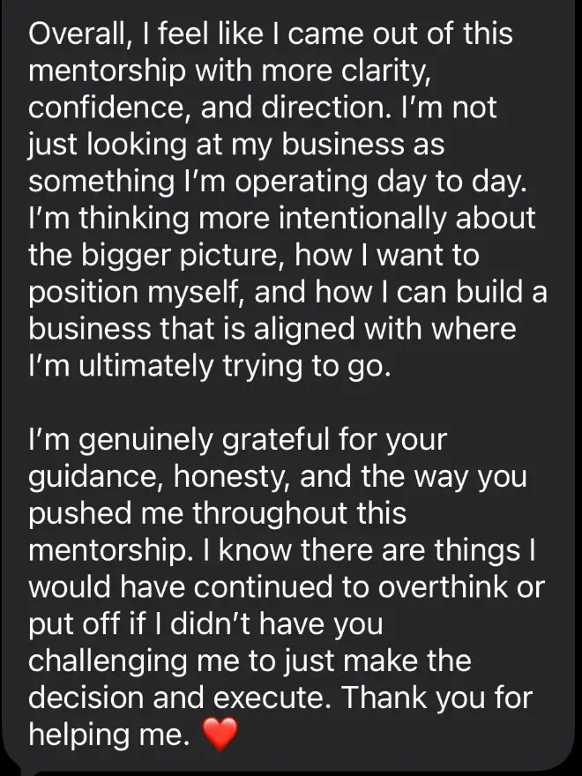
194
"I'm not just looking at my business as something I'm operating day to day. I'm thinking more intentionally about the bigger picture, how I want to position myself, and how I can build a business that is aligned with where I'm ultimately trying to go."
A beauty pro I mentored
Link in the chat · Founding price ends Oct 30
training.rieartistry.com/mentorship-page
Notes:
Script slide 194 | Component 1: proof
"I'm not just looking at my business as something I'm operating day to day. I'm thinking more intentionally about the bigger picture, how I want to position myself, and how I can build a business that is aligned with where I'm ultimately trying to go."
Design: QUOTE: testimonial 3 screenshot, red box on these lines. Label "A beauty pro I mentored". CTA bar: ON.

Slide 320
195
Part 2: Become the obvious choice
Weeks 3 and 4
Link in the chat · Founding price ends Oct 30
training.rieartistry.com/mentorship-page
Notes:
Script slide 195 | Component 2
Part 2: Become the obvious choice
Weeks 3 and 4
Design: COMPONENT header. CTA bar: ON.

Slide 321
196
Nail your positioning, ideal client, signature service, and pricing, so the right people choose you on purpose.
An Instagram audit and content strategy, so your posts turn into bookings.
A booking path that turns followers into clients.
Link in the chat · Founding price ends Oct 30
training.rieartistry.com/mentorship-page
Notes:
Script slide 196 | Component 2
Nail your positioning, ideal client, signature service, and pricing, so the right people choose you on purpose.
An Instagram audit and content strategy, so your posts turn into bookings.
A booking path that turns followers into clients.
Design: LIST. Each new line appears on click. CTA bar: ON.

Slide 322
196
Nail your positioning, ideal client, signature service, and pricing, so the right people choose you on purpose.
An Instagram audit and content strategy, so your posts turn into bookings.
A booking path that turns followers into clients.
Link in the chat · Founding price ends Oct 30
training.rieartistry.com/mentorship-page
Notes:
Script slide 196 | Component 2
Nail your positioning, ideal client, signature service, and pricing, so the right people choose you on purpose.
An Instagram audit and content strategy, so your posts turn into bookings.
A booking path that turns followers into clients.
Design: LIST. Each new line appears on click. CTA bar: ON.

Slide 323
196
Nail your positioning, ideal client, signature service, and pricing, so the right people choose you on purpose.
An Instagram audit and content strategy, so your posts turn into bookings.
A booking path that turns followers into clients.
Link in the chat · Founding price ends Oct 30
training.rieartistry.com/mentorship-page
Notes:
Script slide 196 | Component 2
Nail your positioning, ideal client, signature service, and pricing, so the right people choose you on purpose.
An Instagram audit and content strategy, so your posts turn into bookings.
A booking path that turns followers into clients.
Design: LIST. Each new line appears on click. CTA bar: ON.

Slide 324
197
Picture raising your prices and watching your best clients stay.
Notes:
Script slide 197 | Component 2: picture it
Picture raising your prices and watching your best clients stay.
Design: STATEMENT. CTA bar: OFF.
[VERIFY: picture-it line is mine.]

Slide 325
198
"It truly provided me with so much clarity and pushed me to execute on things that needed to get done to position myself and my business on the path toward its purpose and goals."
A beauty pro I mentored
Link in the chat · Founding price ends Oct 30
training.rieartistry.com/mentorship-page
Notes:
Script slide 198 | Component 2: proof
"It truly provided me with so much clarity and pushed me to execute on things that needed to get done to position myself and my business on the path toward its purpose and goals."
Design: QUOTE: testimonial 1 screenshot, red box on this sentence. CTA bar: ON.

Slide 326
199
Part 3: Build income beyond your hours
Weeks 5 to 8
Link in the chat · Founding price ends Oct 30
training.rieartistry.com/mentorship-page
Notes:
Script slide 199 | Component 3
Part 3: Build income beyond your hours
Weeks 5 to 8
Design: COMPONENT header. CTA bar: ON.

Slide 327
200
Systems: Acuity, rebooking, policies, and paying yourself, so your business runs smoother.
Revenue expansion: brows, retail, memberships, trainings, and digital products.
You'll build your first additional offer.
The CEO mindset: confidence, boundaries, and premium pricing.
Plus a 90-day growth plan, so you keep growing after we're done.
Link in the chat · Founding price ends Oct 30
training.rieartistry.com/mentorship-page
Notes:
Script slide 200 | Component 3
Systems: Acuity, rebooking, policies, and paying yourself, so your business runs smoother.
Revenue expansion: brows, retail, memberships, trainings, and digital products.
You'll build your first additional offer.
The CEO mindset: confidence, boundaries, and premium pricing.
Plus a 90-day growth plan, so you keep growing after we're done.
Design: LIST. Each new line appears on click. CTA bar: ON.

Slide 328
200
Systems: Acuity, rebooking, policies, and paying yourself, so your business runs smoother.
Revenue expansion: brows, retail, memberships, trainings, and digital products.
You'll build your first additional offer.
The CEO mindset: confidence, boundaries, and premium pricing.
Plus a 90-day growth plan, so you keep growing after we're done.
Link in the chat · Founding price ends Oct 30
training.rieartistry.com/mentorship-page
Notes:
Script slide 200 | Component 3
Systems: Acuity, rebooking, policies, and paying yourself, so your business runs smoother.
Revenue expansion: brows, retail, memberships, trainings, and digital products.
You'll build your first additional offer.
The CEO mindset: confidence, boundaries, and premium pricing.
Plus a 90-day growth plan, so you keep growing after we're done.
Design: LIST. Each new line appears on click. CTA bar: ON.

Slide 329
200
Systems: Acuity, rebooking, policies, and paying yourself, so your business runs smoother.
Revenue expansion: brows, retail, memberships, trainings, and digital products.
You'll build your first additional offer.
The CEO mindset: confidence, boundaries, and premium pricing.
Plus a 90-day growth plan, so you keep growing after we're done.
Link in the chat · Founding price ends Oct 30
training.rieartistry.com/mentorship-page
Notes:
Script slide 200 | Component 3
Systems: Acuity, rebooking, policies, and paying yourself, so your business runs smoother.
Revenue expansion: brows, retail, memberships, trainings, and digital products.
You'll build your first additional offer.
The CEO mindset: confidence, boundaries, and premium pricing.
Plus a 90-day growth plan, so you keep growing after we're done.
Design: LIST. Each new line appears on click. CTA bar: ON.

Slide 330
200
Systems: Acuity, rebooking, policies, and paying yourself, so your business runs smoother.
Revenue expansion: brows, retail, memberships, trainings, and digital products.
You'll build your first additional offer.
The CEO mindset: confidence, boundaries, and premium pricing.
Plus a 90-day growth plan, so you keep growing after we're done.
Link in the chat · Founding price ends Oct 30
training.rieartistry.com/mentorship-page
Notes:
Script slide 200 | Component 3
Systems: Acuity, rebooking, policies, and paying yourself, so your business runs smoother.
Revenue expansion: brows, retail, memberships, trainings, and digital products.
You'll build your first additional offer.
The CEO mindset: confidence, boundaries, and premium pricing.
Plus a 90-day growth plan, so you keep growing after we're done.
Design: LIST. Each new line appears on click. CTA bar: ON.

Slide 331
200
Systems: Acuity, rebooking, policies, and paying yourself, so your business runs smoother.
Revenue expansion: brows, retail, memberships, trainings, and digital products.
You'll build your first additional offer.
The CEO mindset: confidence, boundaries, and premium pricing.
Plus a 90-day growth plan, so you keep growing after we're done.
Link in the chat · Founding price ends Oct 30
training.rieartistry.com/mentorship-page
Notes:
Script slide 200 | Component 3
Systems: Acuity, rebooking, policies, and paying yourself, so your business runs smoother.
Revenue expansion: brows, retail, memberships, trainings, and digital products.
You'll build your first additional offer.
The CEO mindset: confidence, boundaries, and premium pricing.
Plus a 90-day growth plan, so you keep growing after we're done.
Design: LIST. Each new line appears on click. CTA bar: ON.

Slide 332
201
Picture the 1st of the month, with part of your income already in.
Notes:
Script slide 201 | Component 3: picture it
Picture the 1st of the month, with part of your income already in.
Design: STATEMENT. CTA bar: OFF.

Slide 333
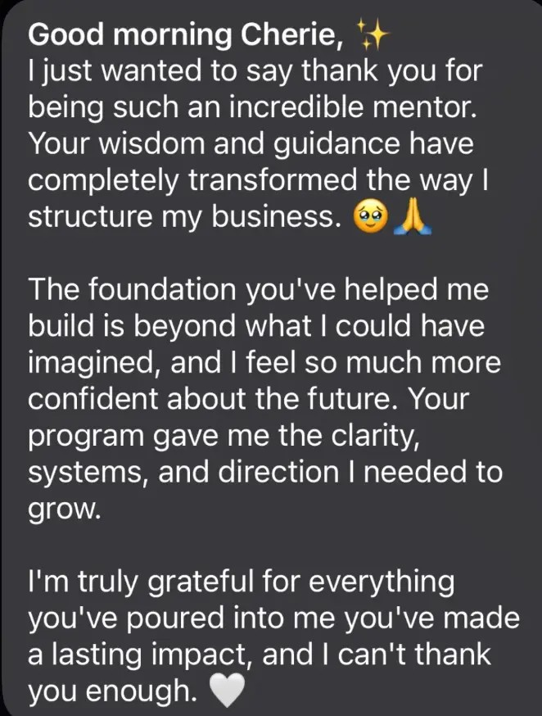
202
"Your wisdom and guidance have completely transformed the way I structure my business."
"Your program gave me the clarity, systems, and direction I needed to grow."
A beauty pro I mentored
Link in the chat · Founding price ends Oct 30
training.rieartistry.com/mentorship-page
Notes:
Script slide 202 | Component 3: proof
"Your wisdom and guidance have completely transformed the way I structure my business."
"Your program gave me the clarity, systems, and direction I needed to grow."
Design: QUOTE: testimonial 2 screenshot, red box on these two lines. CTA bar: ON.

Slide 334
203
8 live calls, 90 minutes each.
Mondays at 7:30 PM Eastern, starting November 2.
Can't make it live? Every call is recorded.
Link in the chat · Founding price ends Oct 30
training.rieartistry.com/mentorship-page
Notes:
Script slide 203 | How it works
8 live calls, 90 minutes each.
Mondays at 7:30 PM Eastern, starting November 2.
Can't make it live? Every call is recorded.
Design: STATEMENT. Each new line appears on click. CTA bar: ON.
[VERIFY: are you meeting Nov 23 (Thanksgiving week) and Dec 21 (Christmas week)?]

Slide 335
203
8 live calls, 90 minutes each.
Mondays at 7:30 PM Eastern, starting November 2.
Can't make it live? Every call is recorded.
Link in the chat · Founding price ends Oct 30
training.rieartistry.com/mentorship-page
Notes:
Script slide 203 | How it works
8 live calls, 90 minutes each.
Mondays at 7:30 PM Eastern, starting November 2.
Can't make it live? Every call is recorded.
Design: STATEMENT. Each new line appears on click. CTA bar: ON.
[VERIFY: are you meeting Nov 23 (Thanksgiving week) and Dec 21 (Christmas week)?]

Slide 336
203
8 live calls, 90 minutes each.
Mondays at 7:30 PM Eastern, starting November 2.
Can't make it live? Every call is recorded.
Link in the chat · Founding price ends Oct 30
training.rieartistry.com/mentorship-page
Notes:
Script slide 203 | How it works
8 live calls, 90 minutes each.
Mondays at 7:30 PM Eastern, starting November 2.
Can't make it live? Every call is recorded.
Design: STATEMENT. Each new line appears on click. CTA bar: ON.
[VERIFY: are you meeting Nov 23 (Thanksgiving week) and Dec 21 (Christmas week)?]

Slide 337
204
Plus a private Telegram group for support between calls.
Link in the chat · Founding price ends Oct 30
training.rieartistry.com/mentorship-page
Notes:
Script slide 204 | How it works
Plus a private Telegram group for support between calls.
Design: STATEMENT. CTA bar: ON.

Slide 338
205
Want me looking directly at your business?
Link in the chat · Founding price ends Oct 30
training.rieartistry.com/mentorship-page
Notes:
Script slide 205 | VIP
Want me looking directly at your business?
Design: STATEMENT. CTA bar: ON.

Slide 339
206
VIP: Everything in the cohort, plus 3 private 1:1 sessions with me.
Notes:
Script slide 206 | VIP
VIP: Everything in the cohort, plus 3 private 1:1 sessions with me.
Design: STATEMENT. CTA bar: OFF.

Slide 340
207
Week 1: Private business diagnostic
I look at your business, Instagram, offers, pricing, positioning, and schedule, and tell you what needs to change.
Week 4: Private check-in
What's working? Where are you stuck? What needs adjusting?
Week 8: Your personal growth plan
Your customized strategy for the next 90 days.
Link in the chat · Founding price ends Oct 30
training.rieartistry.com/mentorship-page
Notes:
Script slide 207 | VIP
Week 1: Private business diagnostic
I look at your business, Instagram, offers, pricing, positioning, and schedule, and tell you what needs to change.
Week 4: Private check-in
What's working? Where are you stuck? What needs adjusting?
Week 8: Your personal growth plan
Your customized strategy for the next 90 days.
Design: LIST. Each new line appears on click. CTA bar: ON.

Slide 341
207
Week 1: Private business diagnostic
I look at your business, Instagram, offers, pricing, positioning, and schedule, and tell you what needs to change.
Week 4: Private check-in
What's working? Where are you stuck? What needs adjusting?
Week 8: Your personal growth plan
Your customized strategy for the next 90 days.
Link in the chat · Founding price ends Oct 30
training.rieartistry.com/mentorship-page
Notes:
Script slide 207 | VIP
Week 1: Private business diagnostic
I look at your business, Instagram, offers, pricing, positioning, and schedule, and tell you what needs to change.
Week 4: Private check-in
What's working? Where are you stuck? What needs adjusting?
Week 8: Your personal growth plan
Your customized strategy for the next 90 days.
Design: LIST. Each new line appears on click. CTA bar: ON.

Slide 342
207
Week 1: Private business diagnostic
I look at your business, Instagram, offers, pricing, positioning, and schedule, and tell you what needs to change.
Week 4: Private check-in
What's working? Where are you stuck? What needs adjusting?
Week 8: Your personal growth plan
Your customized strategy for the next 90 days.
Link in the chat · Founding price ends Oct 30
training.rieartistry.com/mentorship-page
Notes:
Script slide 207 | VIP
Week 1: Private business diagnostic
I look at your business, Instagram, offers, pricing, positioning, and schedule, and tell you what needs to change.
Week 4: Private check-in
What's working? Where are you stuck? What needs adjusting?
Week 8: Your personal growth plan
Your customized strategy for the next 90 days.
Design: LIST. Each new line appears on click. CTA bar: ON.

Slide 343
207
Week 1: Private business diagnostic
I look at your business, Instagram, offers, pricing, positioning, and schedule, and tell you what needs to change.
Week 4: Private check-in
What's working? Where are you stuck? What needs adjusting?
Week 8: Your personal growth plan
Your customized strategy for the next 90 days.
Link in the chat · Founding price ends Oct 30
training.rieartistry.com/mentorship-page
Notes:
Script slide 207 | VIP
Week 1: Private business diagnostic
I look at your business, Instagram, offers, pricing, positioning, and schedule, and tell you what needs to change.
Week 4: Private check-in
What's working? Where are you stuck? What needs adjusting?
Week 8: Your personal growth plan
Your customized strategy for the next 90 days.
Design: LIST. Each new line appears on click. CTA bar: ON.

Slide 344
207
Week 1: Private business diagnostic
I look at your business, Instagram, offers, pricing, positioning, and schedule, and tell you what needs to change.
Week 4: Private check-in
What's working? Where are you stuck? What needs adjusting?
Week 8: Your personal growth plan
Your customized strategy for the next 90 days.
Link in the chat · Founding price ends Oct 30
training.rieartistry.com/mentorship-page
Notes:
Script slide 207 | VIP
Week 1: Private business diagnostic
I look at your business, Instagram, offers, pricing, positioning, and schedule, and tell you what needs to change.
Week 4: Private check-in
What's working? Where are you stuck? What needs adjusting?
Week 8: Your personal growth plan
Your customized strategy for the next 90 days.
Design: LIST. Each new line appears on click. CTA bar: ON.

Slide 345
207
Week 1: Private business diagnostic
I look at your business, Instagram, offers, pricing, positioning, and schedule, and tell you what needs to change.
Week 4: Private check-in
What's working? Where are you stuck? What needs adjusting?
Week 8: Your personal growth plan
Your customized strategy for the next 90 days.
Link in the chat · Founding price ends Oct 30
training.rieartistry.com/mentorship-page
Notes:
Script slide 207 | VIP
Week 1: Private business diagnostic
I look at your business, Instagram, offers, pricing, positioning, and schedule, and tell you what needs to change.
Week 4: Private check-in
What's working? Where are you stuck? What needs adjusting?
Week 8: Your personal growth plan
Your customized strategy for the next 90 days.
Design: LIST. Each new line appears on click. CTA bar: ON.

Slide 346
208
"You're a great listener, but you're also going to tell me things straight forward. There's no beating around the bush in this mentorship! 😂 And honestly, I needed that."
A beauty pro I mentored
Link in the chat · Founding price ends Oct 30
training.rieartistry.com/mentorship-page
Notes:
Script slide 208 | VIP: proof
"You're a great listener, but you're also going to tell me things straight forward. There's no beating around the bush in this mentorship! 😂 And honestly, I needed that."
Design: QUOTE: testimonial 1 screenshot, red box on these lines. CTA bar: ON.

Slide 347
209
Only 5 VIP seats.
Link in the chat · Founding price ends Oct 30
training.rieartistry.com/mentorship-page
Notes:
Script slide 209 | VIP
Only 5 VIP seats.
Design: STATEMENT. CTA bar: ON.

Slide 348
210
Let's talk about what this is worth.
Notes:
Script slide 210 | Value anchor
Let's talk about what this is worth.
Design: STATEMENT. CTA bar: OFF.

Slide 349
211
Go back to your ceiling number.
If nothing changes, that's your income a year from now.
Same hours. Same body aches. Same slow weeks.
Link in the chat · Founding price ends Oct 30
training.rieartistry.com/mentorship-page
Notes:
Script slide 211 | Value anchor: cost of inaction
Go back to your ceiling number.
If nothing changes, that's your income a year from now.
Same hours. Same body aches. Same slow weeks.
Design: STATEMENT. Each new line appears on click. CTA bar: ON.

Slide 350
211
Go back to your ceiling number.
If nothing changes, that's your income a year from now.
Same hours. Same body aches. Same slow weeks.
Link in the chat · Founding price ends Oct 30
training.rieartistry.com/mentorship-page
Notes:
Script slide 211 | Value anchor: cost of inaction
Go back to your ceiling number.
If nothing changes, that's your income a year from now.
Same hours. Same body aches. Same slow weeks.
Design: STATEMENT. Each new line appears on click. CTA bar: ON.

Slide 351
211
Go back to your ceiling number.
If nothing changes, that's your income a year from now.
Same hours. Same body aches. Same slow weeks.
Link in the chat · Founding price ends Oct 30
training.rieartistry.com/mentorship-page
Notes:
Script slide 211 | Value anchor: cost of inaction
Go back to your ceiling number.
If nothing changes, that's your income a year from now.
Same hours. Same body aches. Same slow weeks.
Design: STATEMENT. Each new line appears on click. CTA bar: ON.

Slide 352
212
Now look at the Invisible Leak.
In my own studio, if half my clients added it, the gap was over $11,000 a year.
$19,380 possible minus $7,680 made = $11,700
Notes:
Script slide 212 | Value anchor: one good result
Now look at the Invisible Leak.
In my own studio, if half my clients added it, the gap was over $11,000 a year.
Design: MATH. Small: $19,380 possible minus $7,680 made = $11,700. CTA bar: OFF.

Slide 353
213
I can't promise you a specific number. Your results depend on what you put in.
But staying where you are has a cost too.
You're already paying it, in your body and in your time.
Link in the chat · Founding price ends Oct 30
training.rieartistry.com/mentorship-page
Notes:
Script slide 213 | Value anchor: honest
I can't promise you a specific number. Your results depend on what you put in.
But staying where you are has a cost too.
You're already paying it, in your body and in your time.
Design: STATEMENT. Each new line appears on click. CTA bar: ON.

Slide 354
213
I can't promise you a specific number. Your results depend on what you put in.
But staying where you are has a cost too.
You're already paying it, in your body and in your time.
Link in the chat · Founding price ends Oct 30
training.rieartistry.com/mentorship-page
Notes:
Script slide 213 | Value anchor: honest
I can't promise you a specific number. Your results depend on what you put in.
But staying where you are has a cost too.
You're already paying it, in your body and in your time.
Design: STATEMENT. Each new line appears on click. CTA bar: ON.

Slide 355
213
I can't promise you a specific number. Your results depend on what you put in.
But staying where you are has a cost too.
You're already paying it, in your body and in your time.
Link in the chat · Founding price ends Oct 30
training.rieartistry.com/mentorship-page
Notes:
Script slide 213 | Value anchor: honest
I can't promise you a specific number. Your results depend on what you put in.
But staying where you are has a cost too.
You're already paying it, in your body and in your time.
Design: STATEMENT. Each new line appears on click. CTA bar: ON.

Slide 356
214
After this founding cohort, the Blueprint will be $1,497.
Notes:
Script slide 214 | Price reveal
After this founding cohort, the Blueprint will be $1,497.
Design: PRICE. "$1,497" large. CTA bar: OFF.

Slide 357
215
$1,497
Standard, founding price tonight
$997
Link in the chat · Founding price ends Oct 30
training.rieartistry.com/mentorship-page
Notes:
Script slide 215 | Price reveal
Standard, founding price tonight: $997
Design: PRICE. "$997" 96pt in accent color. "$1,497" above it, smaller, struck through. CTA bar: ON.

Slide 358
216
VIP after this cohort: $1,997
VIP, founding price tonight
$1,497
That means VIP tonight costs what Standard costs next time.
Link in the chat · Founding price ends Oct 30
training.rieartistry.com/mentorship-page
Notes:
Script slide 216 | Price reveal: VIP
VIP after this cohort: $1,997
VIP, founding price tonight: $1,497
That means VIP tonight costs what Standard costs next time.
Design: PRICE. Same layout. Each new line appears on click. CTA bar: ON.

Slide 359
216
VIP after this cohort: $1,997
VIP, founding price tonight
$1,497
That means VIP tonight costs what Standard costs next time.
Link in the chat · Founding price ends Oct 30
training.rieartistry.com/mentorship-page
Notes:
Script slide 216 | Price reveal: VIP
VIP after this cohort: $1,997
VIP, founding price tonight: $1,497
That means VIP tonight costs what Standard costs next time.
Design: PRICE. Same layout. Each new line appears on click. CTA bar: ON.

Slide 360
216
VIP after this cohort: $1,997
VIP, founding price tonight
$1,497
That means VIP tonight costs what Standard costs next time.
Link in the chat · Founding price ends Oct 30
training.rieartistry.com/mentorship-page
Notes:
Script slide 216 | Price reveal: VIP
VIP after this cohort: $1,997
VIP, founding price tonight: $1,497
That means VIP tonight costs what Standard costs next time.
Design: PRICE. Same layout. Each new line appears on click. CTA bar: ON.

Slide 361
217
Want to split it up? Klarna and Afterpay are available at checkout.
Just tap "More payment options."
Link in the chat · Founding price ends Oct 30
training.rieartistry.com/mentorship-page
Notes:
Script slide 217 | Payment
Want to split it up? Klarna and Afterpay are available at checkout.
Just tap "More payment options."
Design: STATEMENT. CTA bar: ON.

Slide 362
218
Join the founding cohort.
The link is in the chat.
Link in the chat · Founding price ends Oct 30
training.rieartistry.com/mentorship-page
Notes:
Script slide 218 | CTA
Join the founding cohort.
The link is in the chat.
Design: CTA. CTA bar: ON.

Slide 363
219
When you join, you also get 3 bonuses.
Notes:
Script slide 219 | Bonuses intro
When you join, you also get 3 bonuses.
Design: STATEMENT. CTA bar: OFF.

Slide 364
220
Worried you won't know what to post once we're done?
Link in the chat · Founding price ends Oct 30
training.rieartistry.com/mentorship-page
Notes:
Script slide 220 | Bonus #1: objection
Worried you won't know what to post once we're done?
Design: STATEMENT. CTA bar: ON.

Slide 365
221
Bonus #1: 30-Day Content Starter Kit
Content prompts for showing your expertise, building trust, and inviting bookings. Plus a simple planning template.
Mockup of the 30-Day Content Starter Kit goes here
Link in the chat · Founding price ends Oct 30
training.rieartistry.com/mentorship-page
Notes:
Script slide 221 | Bonus #1
Bonus #1: 30-Day Content Starter Kit
Content prompts for showing your expertise, building trust, and inviting bookings. Plus a simple planning template.
Design: BONUS: name large, description 32pt, mockup image of the kit on the right. CTA bar: ON.
[NEED: one page or mockup of the kit.]

Slide 366
222
So far:
The Beauty Business Blueprint
Bonus #1: 30-Day Content Starter Kit
Notes:
Script slide 222 | Stack recap
So far:
The Beauty Business Blueprint
Bonus #1: 30-Day Content Starter Kit
Design: STACK. CTA bar: OFF.

Slide 367
222
So far:
The Beauty Business Blueprint
Bonus #1: 30-Day Content Starter Kit
Notes:
Script slide 222 | Stack recap
So far:
The Beauty Business Blueprint
Bonus #1: 30-Day Content Starter Kit
Design: STACK. CTA bar: OFF.

Slide 368
223
Worried you'll feel salesy asking clients to book, rebook, or come back?
Link in the chat · Founding price ends Oct 30
training.rieartistry.com/mentorship-page
Notes:
Script slide 223 | Bonus #2: objection
Worried you'll feel salesy asking clients to book, rebook, or come back?
Design: STATEMENT. CTA bar: ON.

Slide 369
224
Bonus #2: Client Booking + Rebooking Script Pack
Copy-and-paste messages for inquiries, booking follow-ups, rebooking, and reconnecting with past clients.
Mockup of one booking/rebooking script goes here
Link in the chat · Founding price ends Oct 30
training.rieartistry.com/mentorship-page
Notes:
Script slide 224 | Bonus #2
Bonus #2: Client Booking + Rebooking Script Pack
Copy-and-paste messages for inquiries, booking follow-ups, rebooking, and reconnecting with past clients.
Design: BONUS: mockup of one script on the right. CTA bar: ON.
[NEED: one sample script page.]

Slide 370
225
So far:
The Beauty Business Blueprint
Bonus #1: 30-Day Content Starter Kit
Bonus #2: Client Booking + Rebooking Script Pack
Notes:
Script slide 225 | Stack recap
So far:
The Beauty Business Blueprint
Bonus #1: 30-Day Content Starter Kit
Bonus #2: Client Booking + Rebooking Script Pack
Design: STACK. CTA bar: OFF.

Slide 371
225
So far:
The Beauty Business Blueprint
Bonus #1: 30-Day Content Starter Kit
Bonus #2: Client Booking + Rebooking Script Pack
Notes:
Script slide 225 | Stack recap
So far:
The Beauty Business Blueprint
Bonus #1: 30-Day Content Starter Kit
Bonus #2: Client Booking + Rebooking Script Pack
Design: STACK. CTA bar: OFF.

Slide 372
225
So far:
The Beauty Business Blueprint
Bonus #1: 30-Day Content Starter Kit
Bonus #2: Client Booking + Rebooking Script Pack
Notes:
Script slide 225 | Stack recap
So far:
The Beauty Business Blueprint
Bonus #1: 30-Day Content Starter Kit
Bonus #2: Client Booking + Rebooking Script Pack
Design: STACK. CTA bar: OFF.

Slide 373
226
Worried your page doesn't look like someone worth premium prices?
Link in the chat · Founding price ends Oct 30
training.rieartistry.com/mentorship-page
Notes:
Script slide 226 | Bonus #3: objection
Worried your page doesn't look like someone worth premium prices?
Design: STATEMENT. CTA bar: ON.

Slide 374

227
Bonus #3: 5 Instagram Reel Covers, customized to your business
A mini revamp for your page. Editable in Canva, so you can reuse them.
Link in the chat · Founding price ends Oct 30
training.rieartistry.com/mentorship-page
Notes:
Script slide 227 | Bonus #3
Bonus #3: 5 Instagram Reel Covers, customized to your business
A mini revamp for your page. Editable in Canva, so you can reuse them.
Design: BONUS: before and after, side by side (true sequence): reel-cover-before-after-highlights (plain photo, then your finished cover). Label "Before" and "After" small. CTA bar: ON.

Slide 375
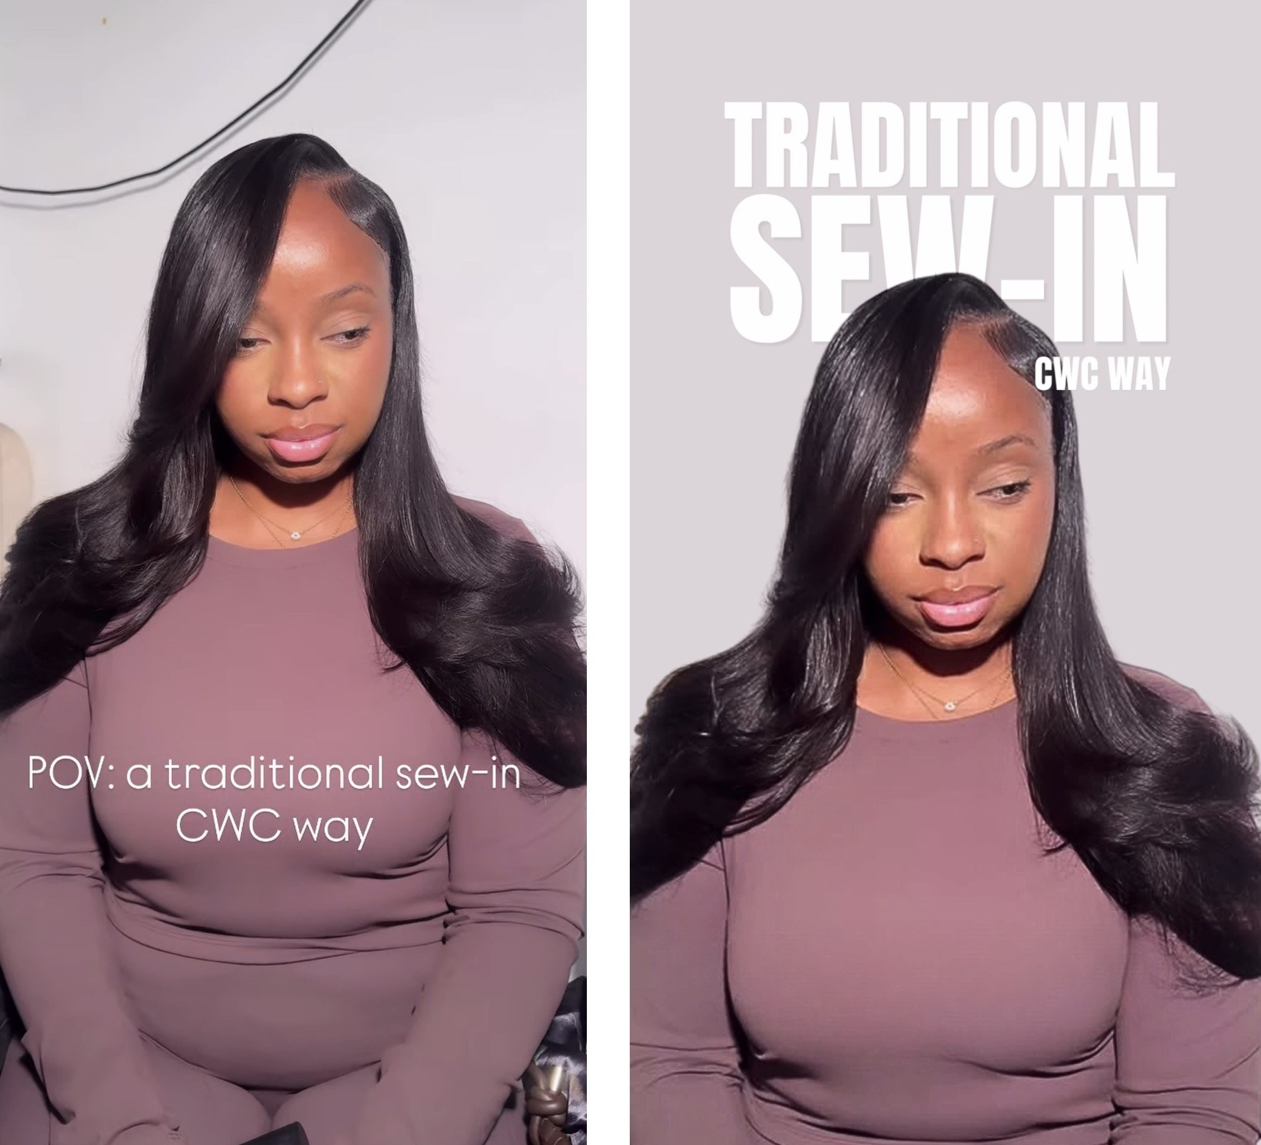
228
Same photo. Now it stops the scroll.
Notes:
Script slide 228 | Bonus #3: proof
Same photo. Now it stops the scroll.
Design: BONUS: reel-cover-before-after-sew-in, side by side, "Before" and "After" small. CTA bar: OFF.

Slide 376
229
Everything you get:
8 live 90-minute calls with me
Every call recorded
Private Telegram group
Your 60-day action plan
Your 90-day growth plan
Bonus #1: 30-Day Content Starter Kit
Bonus #2: Client Booking + Rebooking Script Pack
Bonus #3: 5 customized Instagram Reel Covers
$1,497 after this cohort. Standard tonight: $997.
Link in the chat · Founding price ends Oct 30
training.rieartistry.com/mentorship-page
Notes:
Script slide 229 | Full stack
Everything you get:
8 live 90-minute calls with me
Every call recorded
Private Telegram group
Your 60-day action plan
Your 90-day growth plan
Bonus #1: 30-Day Content Starter Kit
Bonus #2: Client Booking + Rebooking Script Pack
Bonus #3: 5 customized Instagram Reel Covers
Design: FULL STACK: stacked list, one per click. Price at bottom: "$1,497 after this cohort. Standard tonight: $997." CTA bar: ON.

Slide 377
229
Everything you get:
8 live 90-minute calls with me
Every call recorded
Private Telegram group
Your 60-day action plan
Your 90-day growth plan
Bonus #1: 30-Day Content Starter Kit
Bonus #2: Client Booking + Rebooking Script Pack
Bonus #3: 5 customized Instagram Reel Covers
$1,497 after this cohort. Standard tonight: $997.
Link in the chat · Founding price ends Oct 30
training.rieartistry.com/mentorship-page
Notes:
Script slide 229 | Full stack
Everything you get:
8 live 90-minute calls with me
Every call recorded
Private Telegram group
Your 60-day action plan
Your 90-day growth plan
Bonus #1: 30-Day Content Starter Kit
Bonus #2: Client Booking + Rebooking Script Pack
Bonus #3: 5 customized Instagram Reel Covers
Design: FULL STACK: stacked list, one per click. Price at bottom: "$1,497 after this cohort. Standard tonight: $997." CTA bar: ON.

Slide 378
229
Everything you get:
8 live 90-minute calls with me
Every call recorded
Private Telegram group
Your 60-day action plan
Your 90-day growth plan
Bonus #1: 30-Day Content Starter Kit
Bonus #2: Client Booking + Rebooking Script Pack
Bonus #3: 5 customized Instagram Reel Covers
$1,497 after this cohort. Standard tonight: $997.
Link in the chat · Founding price ends Oct 30
training.rieartistry.com/mentorship-page
Notes:
Script slide 229 | Full stack
Everything you get:
8 live 90-minute calls with me
Every call recorded
Private Telegram group
Your 60-day action plan
Your 90-day growth plan
Bonus #1: 30-Day Content Starter Kit
Bonus #2: Client Booking + Rebooking Script Pack
Bonus #3: 5 customized Instagram Reel Covers
Design: FULL STACK: stacked list, one per click. Price at bottom: "$1,497 after this cohort. Standard tonight: $997." CTA bar: ON.

Slide 379
229
Everything you get:
8 live 90-minute calls with me
Every call recorded
Private Telegram group
Your 60-day action plan
Your 90-day growth plan
Bonus #1: 30-Day Content Starter Kit
Bonus #2: Client Booking + Rebooking Script Pack
Bonus #3: 5 customized Instagram Reel Covers
$1,497 after this cohort. Standard tonight: $997.
Link in the chat · Founding price ends Oct 30
training.rieartistry.com/mentorship-page
Notes:
Script slide 229 | Full stack
Everything you get:
8 live 90-minute calls with me
Every call recorded
Private Telegram group
Your 60-day action plan
Your 90-day growth plan
Bonus #1: 30-Day Content Starter Kit
Bonus #2: Client Booking + Rebooking Script Pack
Bonus #3: 5 customized Instagram Reel Covers
Design: FULL STACK: stacked list, one per click. Price at bottom: "$1,497 after this cohort. Standard tonight: $997." CTA bar: ON.

Slide 380
229
Everything you get:
8 live 90-minute calls with me
Every call recorded
Private Telegram group
Your 60-day action plan
Your 90-day growth plan
Bonus #1: 30-Day Content Starter Kit
Bonus #2: Client Booking + Rebooking Script Pack
Bonus #3: 5 customized Instagram Reel Covers
$1,497 after this cohort. Standard tonight: $997.
Link in the chat · Founding price ends Oct 30
training.rieartistry.com/mentorship-page
Notes:
Script slide 229 | Full stack
Everything you get:
8 live 90-minute calls with me
Every call recorded
Private Telegram group
Your 60-day action plan
Your 90-day growth plan
Bonus #1: 30-Day Content Starter Kit
Bonus #2: Client Booking + Rebooking Script Pack
Bonus #3: 5 customized Instagram Reel Covers
Design: FULL STACK: stacked list, one per click. Price at bottom: "$1,497 after this cohort. Standard tonight: $997." CTA bar: ON.

Slide 381
229
Everything you get:
8 live 90-minute calls with me
Every call recorded
Private Telegram group
Your 60-day action plan
Your 90-day growth plan
Bonus #1: 30-Day Content Starter Kit
Bonus #2: Client Booking + Rebooking Script Pack
Bonus #3: 5 customized Instagram Reel Covers
$1,497 after this cohort. Standard tonight: $997.
Link in the chat · Founding price ends Oct 30
training.rieartistry.com/mentorship-page
Notes:
Script slide 229 | Full stack
Everything you get:
8 live 90-minute calls with me
Every call recorded
Private Telegram group
Your 60-day action plan
Your 90-day growth plan
Bonus #1: 30-Day Content Starter Kit
Bonus #2: Client Booking + Rebooking Script Pack
Bonus #3: 5 customized Instagram Reel Covers
Design: FULL STACK: stacked list, one per click. Price at bottom: "$1,497 after this cohort. Standard tonight: $997." CTA bar: ON.

Slide 382
229
Everything you get:
8 live 90-minute calls with me
Every call recorded
Private Telegram group
Your 60-day action plan
Your 90-day growth plan
Bonus #1: 30-Day Content Starter Kit
Bonus #2: Client Booking + Rebooking Script Pack
Bonus #3: 5 customized Instagram Reel Covers
$1,497 after this cohort. Standard tonight: $997.
Link in the chat · Founding price ends Oct 30
training.rieartistry.com/mentorship-page
Notes:
Script slide 229 | Full stack
Everything you get:
8 live 90-minute calls with me
Every call recorded
Private Telegram group
Your 60-day action plan
Your 90-day growth plan
Bonus #1: 30-Day Content Starter Kit
Bonus #2: Client Booking + Rebooking Script Pack
Bonus #3: 5 customized Instagram Reel Covers
Design: FULL STACK: stacked list, one per click. Price at bottom: "$1,497 after this cohort. Standard tonight: $997." CTA bar: ON.

Slide 383
229
Everything you get:
8 live 90-minute calls with me
Every call recorded
Private Telegram group
Your 60-day action plan
Your 90-day growth plan
Bonus #1: 30-Day Content Starter Kit
Bonus #2: Client Booking + Rebooking Script Pack
Bonus #3: 5 customized Instagram Reel Covers
$1,497 after this cohort. Standard tonight: $997.
Link in the chat · Founding price ends Oct 30
training.rieartistry.com/mentorship-page
Notes:
Script slide 229 | Full stack
Everything you get:
8 live 90-minute calls with me
Every call recorded
Private Telegram group
Your 60-day action plan
Your 90-day growth plan
Bonus #1: 30-Day Content Starter Kit
Bonus #2: Client Booking + Rebooking Script Pack
Bonus #3: 5 customized Instagram Reel Covers
Design: FULL STACK: stacked list, one per click. Price at bottom: "$1,497 after this cohort. Standard tonight: $997." CTA bar: ON.

Slide 384
230
VIP adds:
3 private 1:1 sessions with me
Your personal business and Instagram audit
Your customized 90-day growth plan
$1,997 after this cohort. VIP tonight: $1,497.
Link in the chat · Founding price ends Oct 30
training.rieartistry.com/mentorship-page
Notes:
Script slide 230 | Full stack: VIP
VIP adds:
3 private 1:1 sessions with me
Your personal business and Instagram audit
Your customized 90-day growth plan
Design: FULL STACK. Price: "$1,997 after this cohort. VIP tonight: $1,497." CTA bar: ON.

Slide 385
230
VIP adds:
3 private 1:1 sessions with me
Your personal business and Instagram audit
Your customized 90-day growth plan
$1,997 after this cohort. VIP tonight: $1,497.
Link in the chat · Founding price ends Oct 30
training.rieartistry.com/mentorship-page
Notes:
Script slide 230 | Full stack: VIP
VIP adds:
3 private 1:1 sessions with me
Your personal business and Instagram audit
Your customized 90-day growth plan
Design: FULL STACK. Price: "$1,997 after this cohort. VIP tonight: $1,497." CTA bar: ON.

Slide 386
230
VIP adds:
3 private 1:1 sessions with me
Your personal business and Instagram audit
Your customized 90-day growth plan
$1,997 after this cohort. VIP tonight: $1,497.
Link in the chat · Founding price ends Oct 30
training.rieartistry.com/mentorship-page
Notes:
Script slide 230 | Full stack: VIP
VIP adds:
3 private 1:1 sessions with me
Your personal business and Instagram audit
Your customized 90-day growth plan
Design: FULL STACK. Price: "$1,997 after this cohort. VIP tonight: $1,497." CTA bar: ON.

Slide 387
231
Standard: $997
VIP: $1,497
The link is in the chat.
Founding prices. 15 seats. 5 VIP. Ends Oct 30.
Link in the chat · Founding price ends Oct 30
training.rieartistry.com/mentorship-page
Notes:
Script slide 231 | Major CTA
Standard: $997
VIP: $1,497
The link is in the chat.
Design: CTA. Large. Under the prices: "Founding prices. 15 seats. 5 VIP. Ends Oct 30." Small: training.rieartistry.com/mentorship-page. CTA bar: ON.

Slide 388
232
Here's exactly how to join.
Link in the chat · Founding price ends Oct 30
training.rieartistry.com/mentorship-page
Notes:
Script slide 232 | Hand-hold
Here's exactly how to join.
Design: STATEMENT. CTA bar: ON.

Slide 389
233
Step 1: Click the link in the chat.
Or use the link at the bottom of the screen.
Checkout screenshot goes here
top of your mentorship page
Notes:
Script slide 233 | Hand-hold: step 1
Step 1: Click the link in the chat.
Or use the link at the bottom of the screen.
Design: CHECKOUT SCREENSHOT: top of your mentorship page. Red box on "Choose Your Option". CTA bar: OFF.
[NEED: screenshot of the top of the mentorship page.]

Slide 390
234
Step 2: Scroll to the pricing and click Join Standard or Join VIP.
Checkout screenshot goes here
pricing section with both buttons
Link in the chat · Founding price ends Oct 30
training.rieartistry.com/mentorship-page
Notes:
Script slide 234 | Hand-hold: step 2
Step 2: Scroll to the pricing and click Join Standard or Join VIP.
Design: CHECKOUT SCREENSHOT: pricing section with both buttons. Red box on the two buttons. CTA bar: ON.
[NEED: screenshot of the pricing section.]

Slide 391
235
Step 3: Enter your info and payment on the secure checkout.
Want to split it? Tap "More payment options" for Klarna or Afterpay.
Checkout screenshot goes here
payment page
Link in the chat · Founding price ends Oct 30
training.rieartistry.com/mentorship-page
Notes:
Script slide 235 | Hand-hold: step 3
Step 3: Enter your info and payment on the secure checkout.
Want to split it? Tap "More payment options" for Klarna or Afterpay.
Design: CHECKOUT SCREENSHOT: payment page. Red box on "More payment options". CTA bar: ON.
[NEED: screenshot of the payment page.]

Slide 392
236
Step 4: You'll see a confirmation page and get an email with next steps.
Checkout screenshot goes here
thank-you page
Notes:
Script slide 236 | Hand-hold: step 4
Step 4: You'll see a confirmation page and get an email with next steps.
Design: CHECKOUT SCREENSHOT: thank-you page. CTA bar: OFF.
[NEED: screenshot of the confirmation page or email. What does the email include (Telegram invite, calendar link)?]

Slide 393
237
That's it. The link is in the chat.
Link in the chat · Founding price ends Oct 30
training.rieartistry.com/mentorship-page
Notes:
Script slide 237 | CTA
That's it. The link is in the chat.
Design: CTA. CTA bar: ON.

Slide 394
238
I'm only taking 15 people.
I'd rather give your money back than have you in a seat that isn't right for you.
Link in the chat · Founding price ends Oct 30
training.rieartistry.com/mentorship-page
Notes:
Script slide 238 | Guarantee: the reason
I'm only taking 15 people.
I'd rather give your money back than have you in a seat that isn't right for you.
Design: STATEMENT. CTA bar: ON.

Slide 395
239
So here's my Two-Week Clarity Guarantee.
Come to the first 2 calls, live or on replay.
Do the Week 1 audit and the Week 2 homework.
Link in the chat · Founding price ends Oct 30
training.rieartistry.com/mentorship-page
Notes:
Script slide 239 | Guarantee: the promise
So here's my Two-Week Clarity Guarantee.
Come to the first 2 calls, live or on replay.
Do the Week 1 audit and the Week 2 homework.
Design: TITLE. Each new line appears on click. CTA bar: ON.

Slide 396
239
So here's my Two-Week Clarity Guarantee.
Come to the first 2 calls, live or on replay.
Do the Week 1 audit and the Week 2 homework.
Link in the chat · Founding price ends Oct 30
training.rieartistry.com/mentorship-page
Notes:
Script slide 239 | Guarantee: the promise
So here's my Two-Week Clarity Guarantee.
Come to the first 2 calls, live or on replay.
Do the Week 1 audit and the Week 2 homework.
Design: TITLE. Each new line appears on click. CTA bar: ON.

Slide 397
239
So here's my Two-Week Clarity Guarantee.
Come to the first 2 calls, live or on replay.
Do the Week 1 audit and the Week 2 homework.
Link in the chat · Founding price ends Oct 30
training.rieartistry.com/mentorship-page
Notes:
Script slide 239 | Guarantee: the promise
So here's my Two-Week Clarity Guarantee.
Come to the first 2 calls, live or on replay.
Do the Week 1 audit and the Week 2 homework.
Design: TITLE. Each new line appears on click. CTA bar: ON.

Slide 398
240
If you don't feel it was worth it, message me before the Week 3 call on November 16.
I'll refund every dollar.
Link in the chat · Founding price ends Oct 30
training.rieartistry.com/mentorship-page
Notes:
Script slide 240 | Guarantee: the promise
If you don't feel it was worth it, message me before the Week 3 call on November 16.
I'll refund every dollar.
Design: STATEMENT. "Every dollar" in accent color. CTA bar: ON.
[VERIFY: your Terms of Service page should match this guarantee.]

Slide 399
241
Your part:
My part:
show up and do the work.
make it worth it.
Notes:
Script slide 241 | Guarantee
Your part: show up and do the work.
My part: make it worth it.
Design: SPLIT. CTA bar: OFF.

Slide 400
242
I'm not asking you to decide tonight.
I'm asking you to make a fully informed decision.
Link in the chat · Founding price ends Oct 30
training.rieartistry.com/mentorship-page
Notes:
Script slide 242 | Informed decision
I'm not asking you to decide tonight.
I'm asking you to make a fully informed decision.
Design: STATEMENT. CTA bar: ON.

Slide 401
243
15 seats total.
5 of them are VIP.
Why so small?
So I can actually understand each person's business and give you real help.
Link in the chat · Founding price ends Oct 30
training.rieartistry.com/mentorship-page
Notes:
Script slide 243 | Scarcity
15 seats total.
5 of them are VIP.
Why so small?
So I can actually understand each person's business and give you real help.
Design: STATEMENT. Each new line appears on click. CTA bar: ON.

Slide 402
243
15 seats total.
5 of them are VIP.
Why so small?
So I can actually understand each person's business and give you real help.
Link in the chat · Founding price ends Oct 30
training.rieartistry.com/mentorship-page
Notes:
Script slide 243 | Scarcity
15 seats total.
5 of them are VIP.
Why so small?
So I can actually understand each person's business and give you real help.
Design: STATEMENT. Each new line appears on click. CTA bar: ON.

Slide 403
243
15 seats total.
5 of them are VIP.
Why so small?
So I can actually understand each person's business and give you real help.
Link in the chat · Founding price ends Oct 30
training.rieartistry.com/mentorship-page
Notes:
Script slide 243 | Scarcity
15 seats total.
5 of them are VIP.
Why so small?
So I can actually understand each person's business and give you real help.
Design: STATEMENT. Each new line appears on click. CTA bar: ON.

Slide 404
243
15 seats total.
5 of them are VIP.
Why so small?
So I can actually understand each person's business and give you real help.
Link in the chat · Founding price ends Oct 30
training.rieartistry.com/mentorship-page
Notes:
Script slide 243 | Scarcity
15 seats total.
5 of them are VIP.
Why so small?
So I can actually understand each person's business and give you real help.
Design: STATEMENT. Each new line appears on click. CTA bar: ON.

Slide 405
244
Founding pricing ends Friday, October 30 at 11:59 PM Eastern.
Or when the seats fill.
Link in the chat · Founding price ends Oct 30
training.rieartistry.com/mentorship-page
Notes:
Script slide 244 | Scarcity: deadline
Founding pricing ends Friday, October 30 at 11:59 PM Eastern.
Or when the seats fill.
Design: STATEMENT. CTA bar: ON.
[VERIFY: 11:59 PM Eastern is my placeholder. Confirm the exact time.]

Slide 406
245
After that, it's $1,497 for the cohort and $1,997 for VIP.
Link in the chat · Founding price ends Oct 30
training.rieartistry.com/mentorship-page
Notes:
Script slide 245 | Scarcity
After that, it's $1,497 for the cohort and $1,997 for VIP.
Design: STATEMENT. CTA bar: ON.

Slide 407
246
Grab your seat. The link is in the chat.
Link in the chat · Founding price ends Oct 30
training.rieartistry.com/mentorship-page
Notes:
Script slide 246 | CTA
Grab your seat. The link is in the chat.
Design: CTA. CTA bar: ON.

Slide 408
247
Let's answer the questions you might be asking.
Notes:
Script slide 247 | FAQ intro
Let's answer the questions you might be asking.
Design: STATEMENT. CTA bar: OFF.

Slide 409
248
"I can't afford it right now."
Look at what you're already losing.
The specials. The slow weeks. The money walking out your door.
Link in the chat · Founding price ends Oct 30
training.rieartistry.com/mentorship-page
Notes:
Script slide 248 | FAQ: money
"I can't afford it right now."
Look at what you're already losing.
The specials. The slow weeks. The money walking out your door.
Design: STATEMENT. Each new line appears on click. CTA bar: ON.

Slide 410
248
"I can't afford it right now."
Look at what you're already losing.
The specials. The slow weeks. The money walking out your door.
Link in the chat · Founding price ends Oct 30
training.rieartistry.com/mentorship-page
Notes:
Script slide 248 | FAQ: money
"I can't afford it right now."
Look at what you're already losing.
The specials. The slow weeks. The money walking out your door.
Design: STATEMENT. Each new line appears on click. CTA bar: ON.

Slide 411
248
"I can't afford it right now."
Look at what you're already losing.
The specials. The slow weeks. The money walking out your door.
Link in the chat · Founding price ends Oct 30
training.rieartistry.com/mentorship-page
Notes:
Script slide 248 | FAQ: money
"I can't afford it right now."
Look at what you're already losing.
The specials. The slow weeks. The money walking out your door.
Design: STATEMENT. Each new line appears on click. CTA bar: ON.

Slide 412
249
Klarna and Afterpay let you split it into smaller payments.
And the Two-Week Clarity Guarantee means you'll know it's worth it before Week 3.
Notes:
Script slide 249 | FAQ: money
Klarna and Afterpay let you split it into smaller payments.
And the Two-Week Clarity Guarantee means you'll know it's worth it before Week 3.
Design: STATEMENT. CTA bar: OFF.

Slide 413
250
The question isn't whether you can afford this.
It's whether you can afford another year of the same hours, the same slow weeks, and the same body aches.
Link in the chat · Founding price ends Oct 30
training.rieartistry.com/mentorship-page
Notes:
Script slide 250 | FAQ: money
The question isn't whether you can afford this.
It's whether you can afford another year of the same hours, the same slow weeks, and the same body aches.
Design: STATEMENT. CTA bar: ON.

Slide 414
251
"I don't have time."
It's one 90-minute call a week, on Monday evenings.
Can't make it? Watch the replay.
Link in the chat · Founding price ends Oct 30
training.rieartistry.com/mentorship-page
Notes:
Script slide 251 | FAQ: time
"I don't have time."
It's one 90-minute call a week, on Monday evenings.
Can't make it? Watch the replay.
Design: STATEMENT. Each new line appears on click. CTA bar: ON.

Slide 415
251
"I don't have time."
It's one 90-minute call a week, on Monday evenings.
Can't make it? Watch the replay.
Link in the chat · Founding price ends Oct 30
training.rieartistry.com/mentorship-page
Notes:
Script slide 251 | FAQ: time
"I don't have time."
It's one 90-minute call a week, on Monday evenings.
Can't make it? Watch the replay.
Design: STATEMENT. Each new line appears on click. CTA bar: ON.

Slide 416
251
"I don't have time."
It's one 90-minute call a week, on Monday evenings.
Can't make it? Watch the replay.
Link in the chat · Founding price ends Oct 30
training.rieartistry.com/mentorship-page
Notes:
Script slide 251 | FAQ: time
"I don't have time."
It's one 90-minute call a week, on Monday evenings.
Can't make it? Watch the replay.
Design: STATEMENT. Each new line appears on click. CTA bar: ON.

Slide 417
252
And Week 2 is all about getting time back: a faster workflow from setup to cleanup.
Link in the chat · Founding price ends Oct 30
training.rieartistry.com/mentorship-page
Notes:
Script slide 252 | FAQ: time
And Week 2 is all about getting time back: a faster workflow from setup to cleanup.
Design: STATEMENT. CTA bar: ON.

Slide 418
253
"I'm not a lash artist. Will this work for me?"
Yes. Positioning, content, pricing, and systems work the same for hair, nails, skin, brows, makeup, and PMU.
Link in the chat · Founding price ends Oct 30
training.rieartistry.com/mentorship-page
Notes:
Script slide 253 | FAQ
"I'm not a lash artist. Will this work for me?"
Yes. Positioning, content, pricing, and systems work the same for hair, nails, skin, brows, makeup, and PMU.
Design: STATEMENT. Each new line appears on click. CTA bar: ON.

Slide 419
253
"I'm not a lash artist. Will this work for me?"
Yes. Positioning, content, pricing, and systems work the same for hair, nails, skin, brows, makeup, and PMU.
Link in the chat · Founding price ends Oct 30
training.rieartistry.com/mentorship-page
Notes:
Script slide 253 | FAQ
"I'm not a lash artist. Will this work for me?"
Yes. Positioning, content, pricing, and systems work the same for hair, nails, skin, brows, makeup, and PMU.
Design: STATEMENT. Each new line appears on click. CTA bar: ON.

Slide 420
254
"I'm still pretty new."
If you already have clients, even a few, this is for you.
If you don't have any clients yet, this isn't the right fit yet.
Link in the chat · Founding price ends Oct 30
training.rieartistry.com/mentorship-page
Notes:
Script slide 254 | FAQ
"I'm still pretty new."
If you already have clients, even a few, this is for you.
If you don't have any clients yet, this isn't the right fit yet.
Design: STATEMENT. Each new line appears on click. CTA bar: ON.

Slide 421
254
"I'm still pretty new."
If you already have clients, even a few, this is for you.
If you don't have any clients yet, this isn't the right fit yet.
Link in the chat · Founding price ends Oct 30
training.rieartistry.com/mentorship-page
Notes:
Script slide 254 | FAQ
"I'm still pretty new."
If you already have clients, even a few, this is for you.
If you don't have any clients yet, this isn't the right fit yet.
Design: STATEMENT. Each new line appears on click. CTA bar: ON.

Slide 422
254
"I'm still pretty new."
If you already have clients, even a few, this is for you.
If you don't have any clients yet, this isn't the right fit yet.
Link in the chat · Founding price ends Oct 30
training.rieartistry.com/mentorship-page
Notes:
Script slide 254 | FAQ
"I'm still pretty new."
If you already have clients, even a few, this is for you.
If you don't have any clients yet, this isn't the right fit yet.
Design: STATEMENT. Each new line appears on click. CTA bar: ON.

Slide 423
255
"Is this another course I'll buy and never finish?"
No. It's live, with weekly homework and me holding you accountable.
Link in the chat · Founding price ends Oct 30
training.rieartistry.com/mentorship-page
Notes:
Script slide 255 | FAQ
"Is this another course I'll buy and never finish?"
No. It's live, with weekly homework and me holding you accountable.
Design: STATEMENT. Each new line appears on click. CTA bar: ON.

Slide 424
255
"Is this another course I'll buy and never finish?"
No. It's live, with weekly homework and me holding you accountable.
Link in the chat · Founding price ends Oct 30
training.rieartistry.com/mentorship-page
Notes:
Script slide 255 | FAQ
"Is this another course I'll buy and never finish?"
No. It's live, with weekly homework and me holding you accountable.
Design: STATEMENT. Each new line appears on click. CTA bar: ON.

Slide 425
256
"I know there are things I would have continued to overthink or put off if I didn't have you challenging me to just make the decision and execute."
A beauty pro I mentored
Link in the chat · Founding price ends Oct 30
training.rieartistry.com/mentorship-page
Notes:
Script slide 256 | FAQ: proof
"I know there are things I would have continued to overthink or put off if I didn't have you challenging me to just make the decision and execute."
Design: QUOTE: testimonial 3 screenshot, red box on this line. CTA bar: ON.

Slide 426
257
"What's the difference between Standard and VIP?"
VIP adds 3 private 1:1 sessions with me and a personal audit of your business and Instagram.
Notes:
Script slide 257 | FAQ
"What's the difference between Standard and VIP?"
VIP adds 3 private 1:1 sessions with me and a personal audit of your business and Instagram.
Design: STATEMENT. CTA bar: OFF.

Slide 427
258
"When does it start?"
Monday, November 2 at 7:30 PM Eastern.
Link in the chat · Founding price ends Oct 30
training.rieartistry.com/mentorship-page
Notes:
Script slide 258 | FAQ
"When does it start?"
Monday, November 2 at 7:30 PM Eastern.
Design: STATEMENT. CTA bar: ON.

Slide 428
259
"Can I just wait for the next one?"
You can. It'll be $1,497.
And you'll have spent a few more months working the same hours for the same money.
Link in the chat · Founding price ends Oct 30
training.rieartistry.com/mentorship-page
Notes:
Script slide 259 | FAQ: money and time, again
"Can I just wait for the next one?"
You can. It'll be $1,497.
And you'll have spent a few more months working the same hours for the same money.
Design: STATEMENT. Each new line appears on click. CTA bar: ON.

Slide 429
259
"Can I just wait for the next one?"
You can. It'll be $1,497.
And you'll have spent a few more months working the same hours for the same money.
Link in the chat · Founding price ends Oct 30
training.rieartistry.com/mentorship-page
Notes:
Script slide 259 | FAQ: money and time, again
"Can I just wait for the next one?"
You can. It'll be $1,497.
And you'll have spent a few more months working the same hours for the same money.
Design: STATEMENT. Each new line appears on click. CTA bar: ON.

Slide 430
259
"Can I just wait for the next one?"
You can. It'll be $1,497.
And you'll have spent a few more months working the same hours for the same money.
Link in the chat · Founding price ends Oct 30
training.rieartistry.com/mentorship-page
Notes:
Script slide 259 | FAQ: money and time, again
"Can I just wait for the next one?"
You can. It'll be $1,497.
And you'll have spent a few more months working the same hours for the same money.
Design: STATEMENT. Each new line appears on click. CTA bar: ON.

Slide 431
260
You have two choices.
Do it on your own. Or build it with me.
Link in the chat · Founding price ends Oct 30
training.rieartistry.com/mentorship-page
Notes:
Script slide 260 | Final close
You have two choices.
Do it on your own. Or build it with me.
Design: STATEMENT. CTA bar: ON.

Slide 432
261
If you're ready to stop guessing and start building, the link is in the chat.
Link in the chat · Founding price ends Oct 30
training.rieartistry.com/mentorship-page
Notes:
Script slide 261 | Final close
If you're ready to stop guessing and start building, the link is in the chat.
Design: CTA. CTA bar: ON.

Slide 433
262
I'll see you Monday, November 2.
Link in the chat · Founding price ends Oct 30
training.rieartistry.com/mentorship-page
Notes:
Script slide 262 | Final close
I'll see you Monday, November 2.
Design: STATEMENT. Photo of you. CTA bar: ON.

Slide 434
263
Questions? Ask away.
Link in the chat · Founding price ends Oct 30
training.rieartistry.com/mentorship-page
Notes:
Script slide 263 | Q&A
Questions? Ask away.
Design: Q&A. CTA bar ON and stays on screen for the rest of the call: prices, "Ends Oct 30", "Link in the chat", and training.rieartistry.com/mentorship-page.

