Slide 1


Q: Why don’t aliens visit our planet?
A: Terrible rating… Only one star…
But with our travel experts, everyone will have a five star experience!

Slide 2

Group
5/5
Alex
James D
Salah
Raman

Slide 3
Bring Your Solutions to Life with our fantastic Webservices
Full Stack Services
Specialist in Webservice Solutions
James : Product Manager
Raman: Android developer
Alex: Java (and Coffee) Developer
Salah: Back End Developer

Slide 4
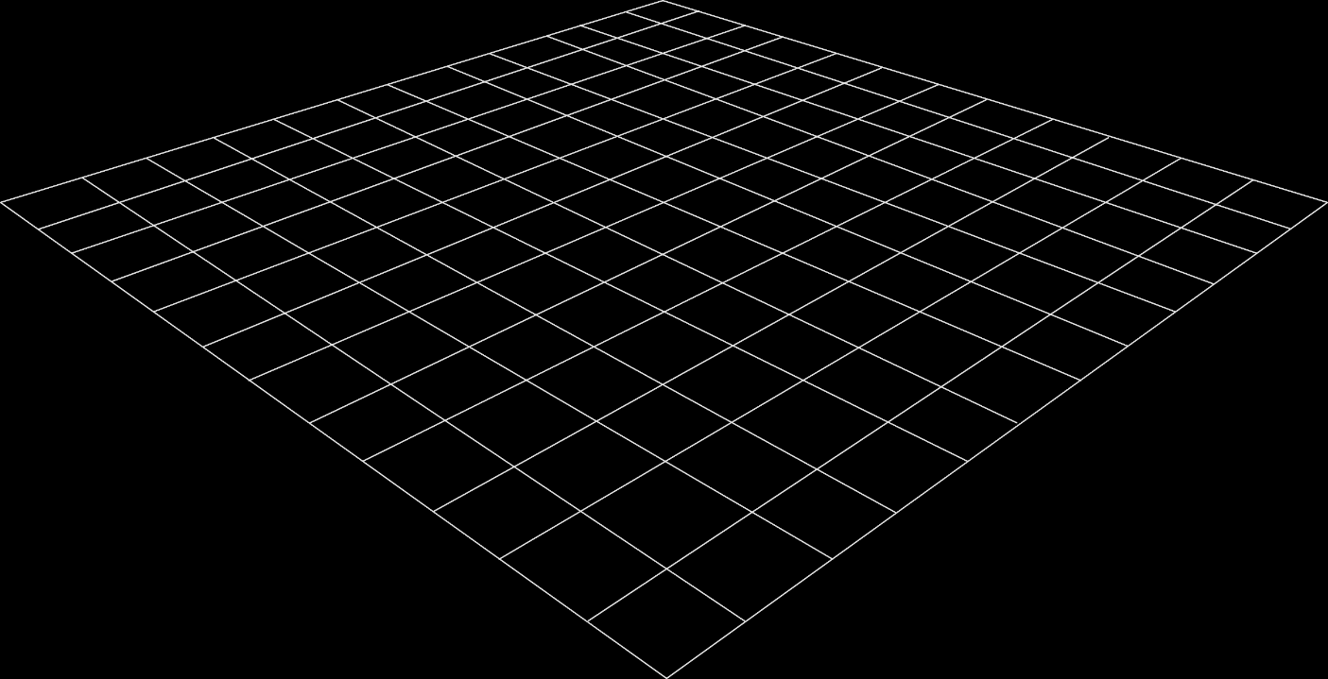
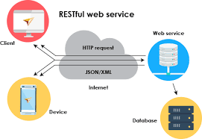
Why Use Web Services?
Old Model
New Model
A 2 layer solution
-Data base layer
-A website (Asp. Net) and an application (C#) connected directly to the Db layer
A 3 Layer Solution
-Data base layer
-A webservice : connect the Db layer with all the applications working on Travel Experts Db
-An android app, A java app, A website interacting with a webservice
No interaction with other Solutions
Applications available to others as a web service.
Take advantage of services offered by other web service

Slide 5





The Problem
DB Maintenance
Travel Expert Website
Android application
Webservice
Adaptable and Easy to maintain
Create an Application that will provide a graphical user interface for viewing and modifying data using Java
Customer will be able to set up an account and login.
Customer can view
History of past bookings
Both agent and customer can login and manipulate their data
A rest web service
Serving both applications and website
Any future features can be added as per user requirements

Slide 6
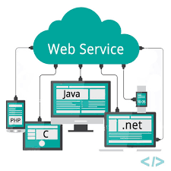



Solution
Strong Point of our solution:
A web service
A rest service that englobe all the business logic
A Java Application
An interface for agents to maintain the Database
An Android Application
More sales channels
Travel Expert Website
Customer can Register/Login/Display & Edit
Profile & View Details of Past Booking
Data and Service are protected and available to other Solution to use
Complete solution in 1 month
Always Refund If not satisfied
Will give a 1 month free trial on applications
Version 1.0 with all requirements needed

Slide 7


Company benefit – Our vision explained
Agent Productivity will go up by 80%
Increase Company profits by more than 50%
More free time for vacations!
Our vision
Web service is a must technology to have
Customer can choose which version of application to use (C#, Java)

Slide 8
What Makes An Android Special
Open Source – Free Development Platform
Built in components can be improved
Management of process life cycle
High Quality Graphics and Sounds
Multi Layer isolation of programs
Portability across current and future hardware
Built in Services like SQL Database,map,GPS

Slide 9
Where Is Android Going
Android is biggest selling OS in the world on mobile computing
Android , by increasing the user base , might hasten the integration of mobile technology
The android OS may accelerate the diffusion of smart phones by providing a free OS
In future more number of applications will continue to swell as professional developers provide new offerings.
Transforming them from consumers of existing applications to creators of app designed to meet their needs.

Slide 10

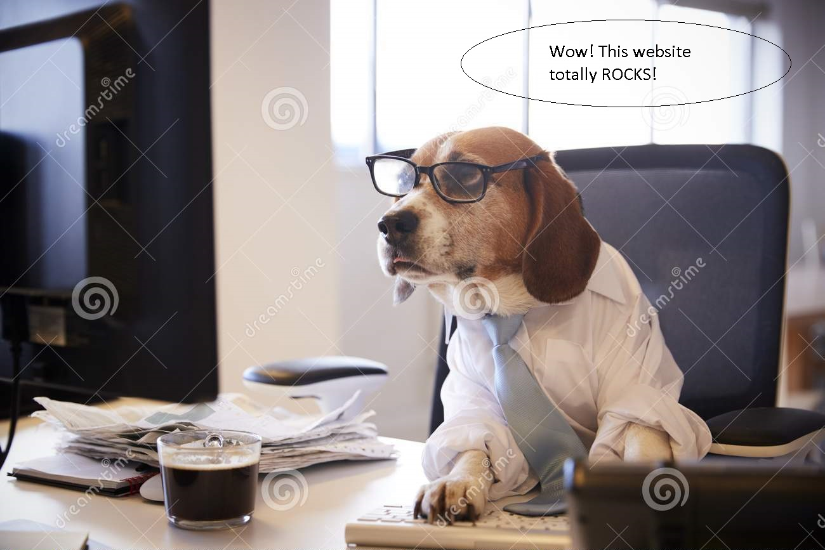
Just look how easy our program is…
Even my Grandma could do it
If she had better glasses coz
mobile phone is soo small !!!
With OUR Desktop product, however, everybody is an expert.

Slide 11

Happy Travelling, you’ll have lots of time with us on your team.
Thank you for
not choosing our competitors!

Slide 12

Thank you !

