Slide 1
Restaurant Food Waste Analysis
GA Data science 2017
Cheri Hung

Slide 2
Problem Statement
Food cost overage is an indication of waste or mismanagement.
Goal is to determine factors that can cause such overage

Slide 3
hypothesis
The factors may include:
gross sales as a proxy for demand,
type of menu items used for the food item,
inventory order pattern
Current focus because it’s more actionable.
This is a tricky area of analysis in the restaurant industry. As there are many covariates unaccounted for in the data.

Slide 4
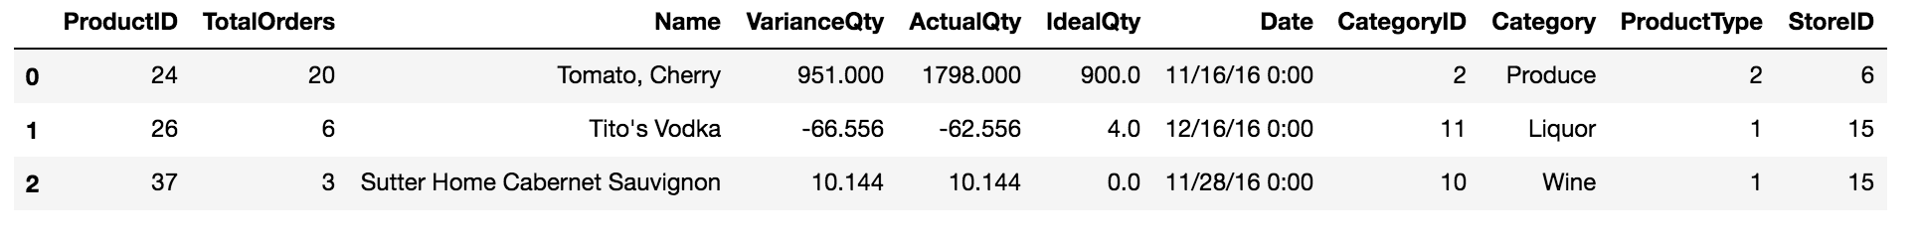
Dataset For inventory pattern
Raw datasets of a single chain of restaurants are pulled from SQL database. They are then joined and modified to this view:
VarianceQty is the target variable or what we are predicting for.
TotalOrders is the predictor or what we use to make the prediction. (This is a proxy based on frequency of orders)

Slide 5
Data exploratory some caveats
VarianceQty values aren’t entirely ‘clean’ (i.e. negative values)
8 months of data available
After rolling up individual inventory item, we only have 49 usable data points.
Found no substantial benefit for splitting out Food sub-categories (e.g. Poultry, Seafood)
Small sample size
Number of items somewhat even between sub-categories
Wide range of values

Slide 6
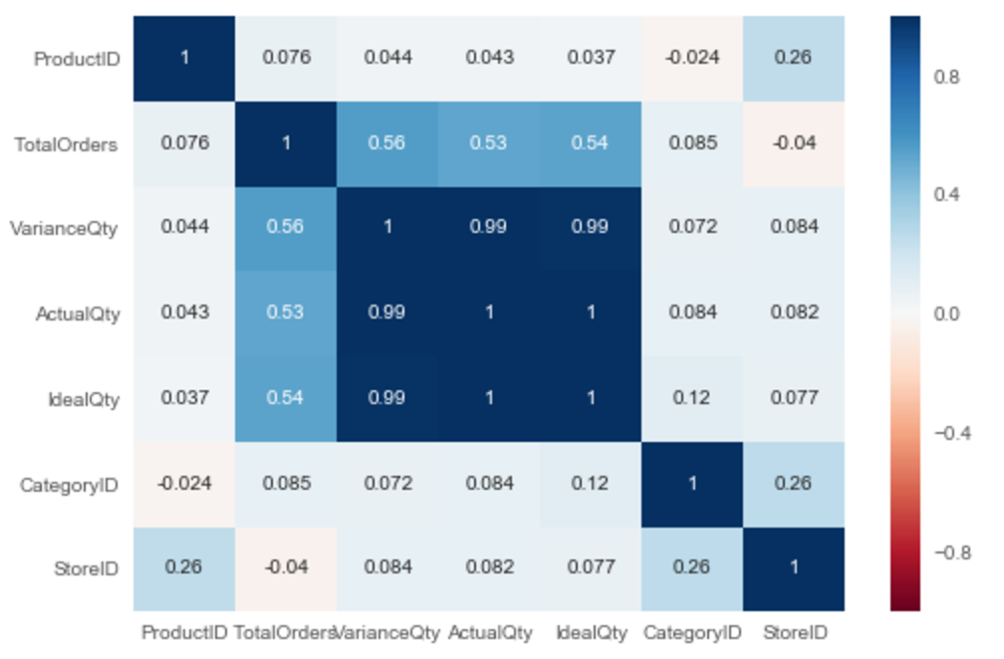
Data exploratory variable relationships

Slide 7
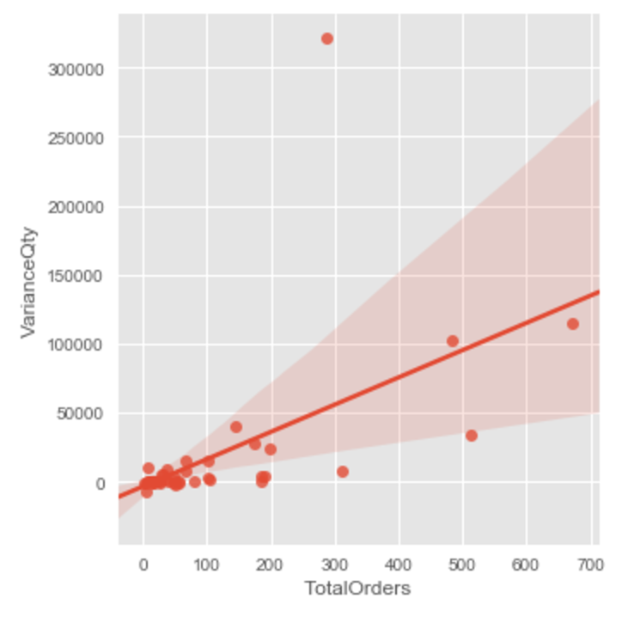
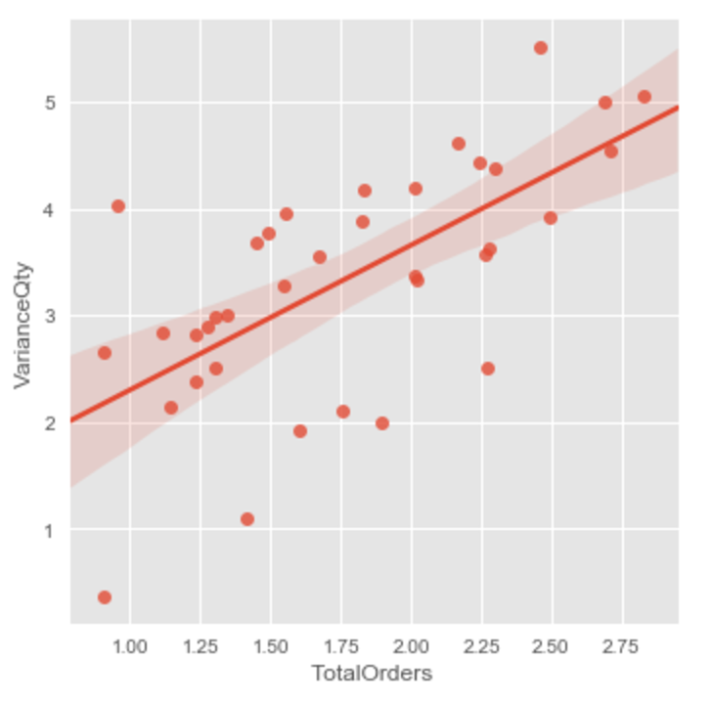
Data exploratory target and predictor
Raw Data
After normalization

Slide 8
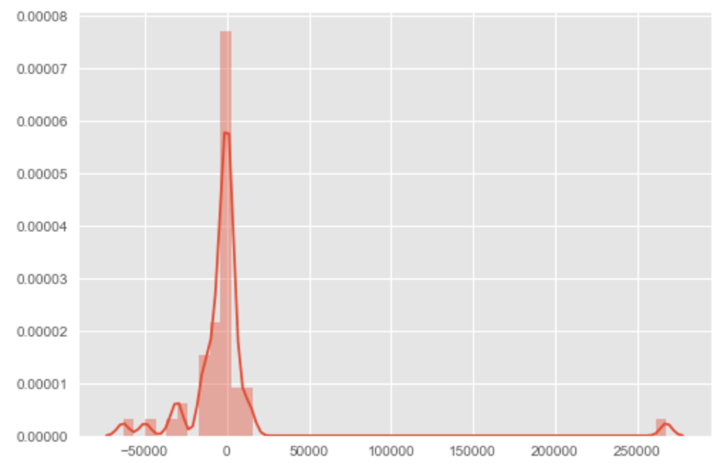
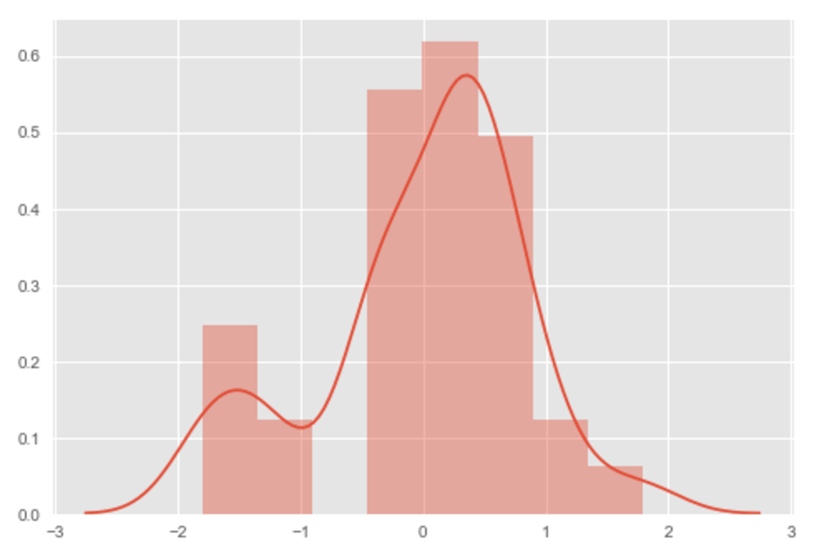
Data modeling linear regression model
Raw Data
R-2: 0.31
MSE: 1690378600
RMSE: 41114
Normalized Data
R-2: 0.46
MSE: 0.68
RMSE: 0.83

Slide 9
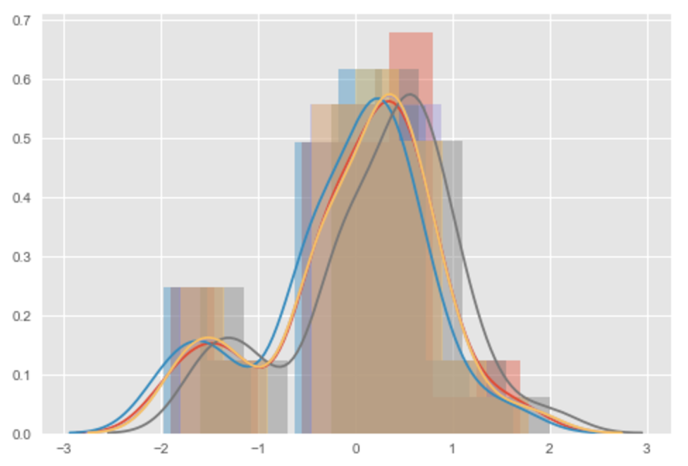
Data modeling refining the regression model
Models tested
LinearRegression
Ridge
HuberRegressor
SGDRegressor

Slide 10
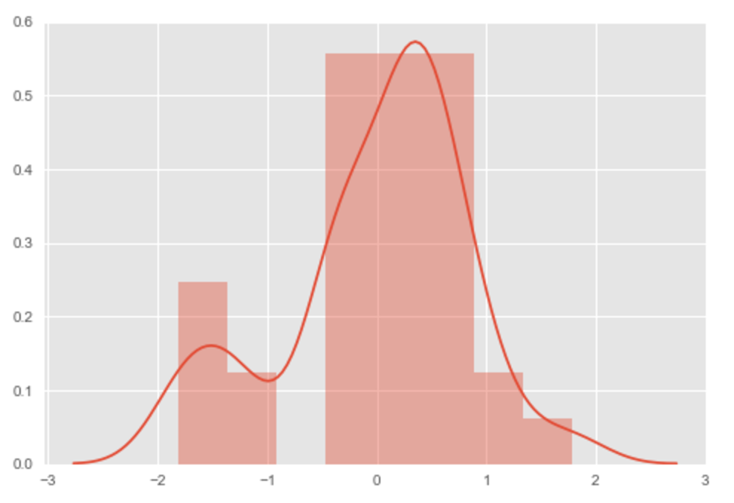
Data modeling fitting the regression model – ridge()
Ridge Model after Tuning
R-2: 0.44
MSE: 0.684
RMSE: 0.827
Cross-validation pointed to
variance problem.

Slide 11
Next step
Get more data to cover at least a whole year.
Could enable us to account for seasonality better
Could also let us break down store by store
Perhaps different approach to inventory pattern:
classify inventory pattern
focus on high-volume items’ pattern. So we can fine-tune the rate of order instead of a simple frequency count
Shift focus to the other two potential predictors – menu items and demand

