Slide 1

React JS
By Cherita Lashley
JAVA Bootcamp
2/14/17

Slide 2
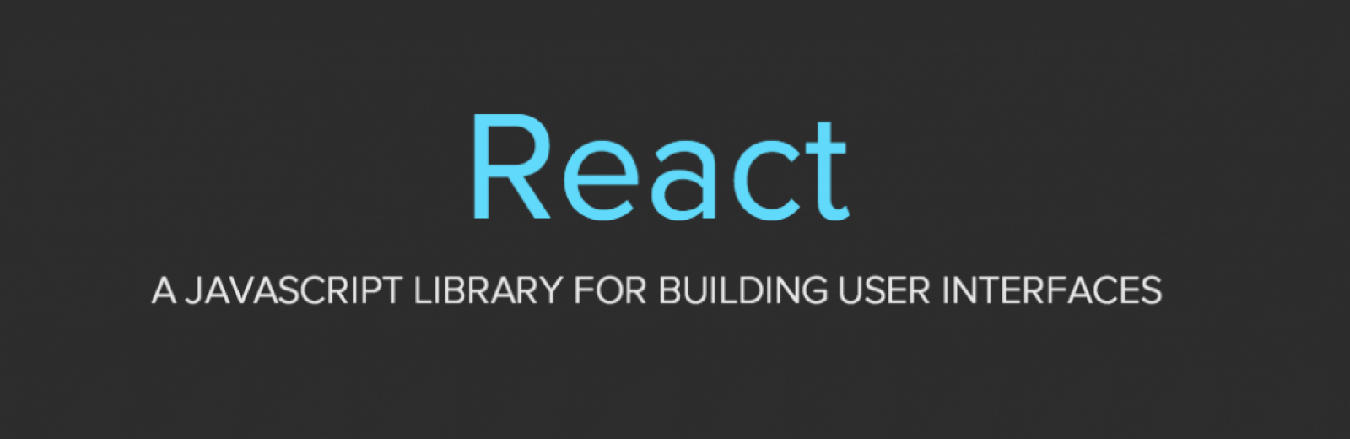
What Is React JS?
One of the latest markup languages for building user interfaces using a markup java-scripting type of language.
Notes:
It makes writing JavaScript easier, uses a special syntax called JSX, which allows you to mix HTML with JavaScript
You can create your own components that you can later reuse, combine, and nest
React is extremely efficient, creates its own virtual DOM (Document Object Model) where your components actually live
Searchable - you can run React on the server, and the virtual DOM will be rendered and returned to the browser as a regular web page
The brains behind Facebook are maintaining this project

Slide 3




WHO USE REACT JS?

Slide 4
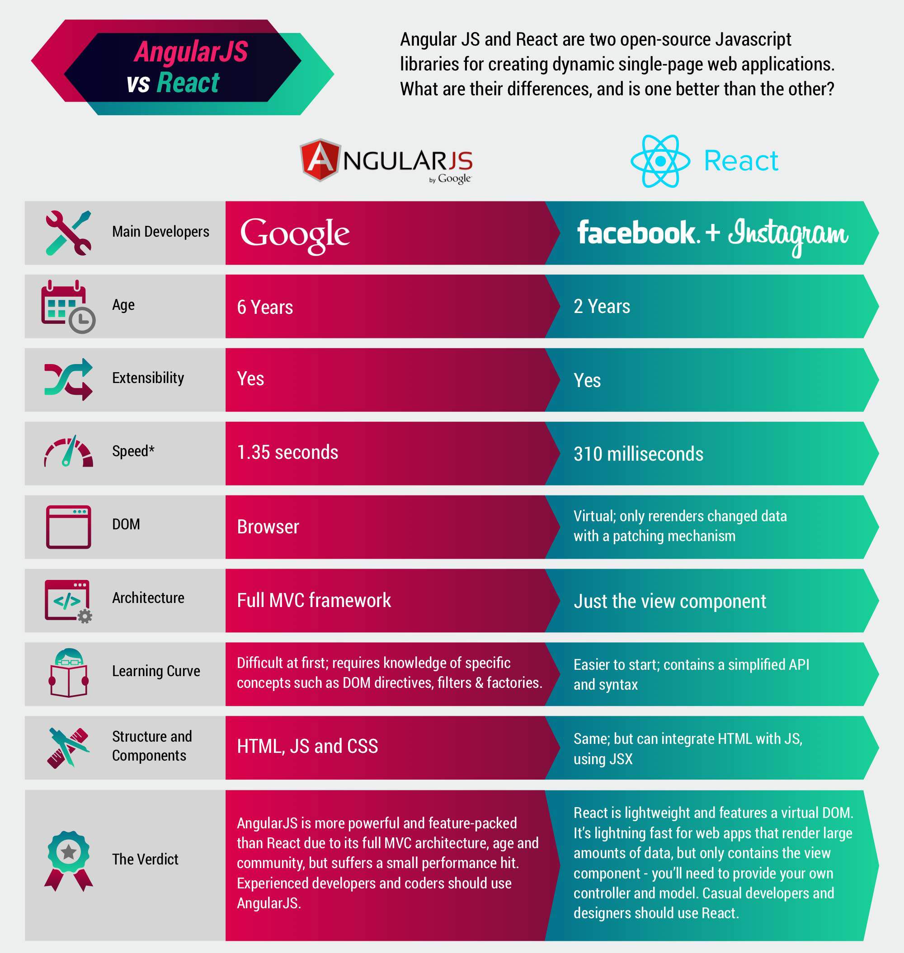
WHY DID THEY MAKE REACT JS?

Slide 5

HOW DO YOU USE REACT JS?
Tutorial by Dev Coffee by Chris on YouTube called React in 15 minutes
https://youtu.be/PGUMRVowdv8

Slide 6
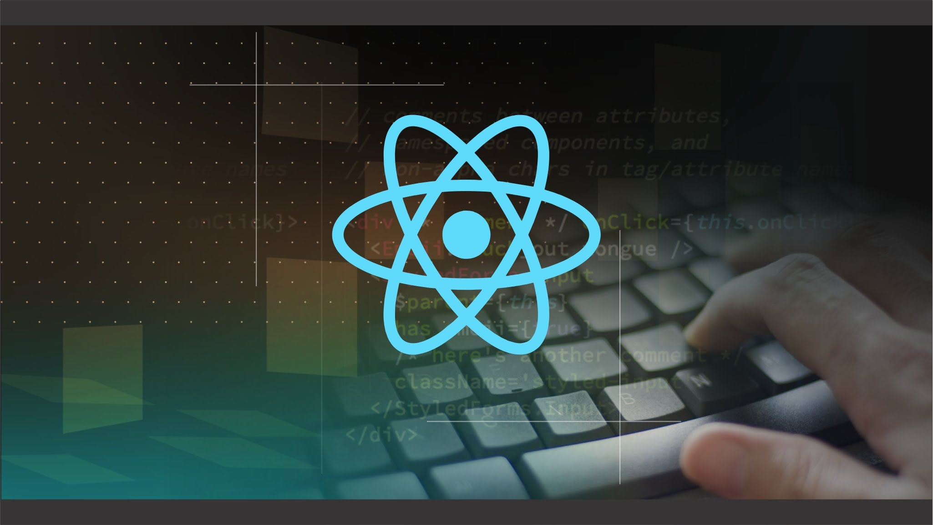
CONCLUSIONS?
Notes:
Some people really like React.js and some really don’t. But according to many it will be around for a long time so it would be one of the great ones to learn.

Slide 7


Slide 8


