Slide 1
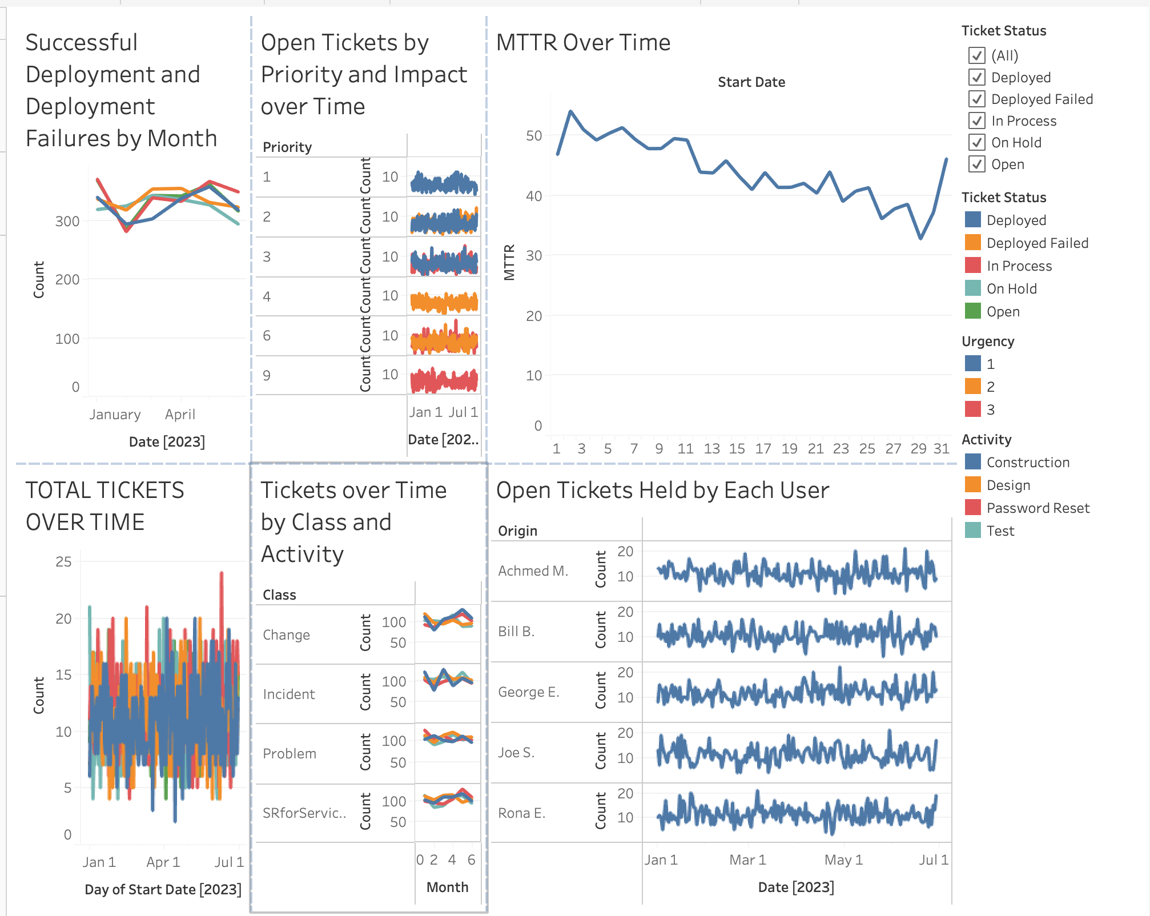
Overall Dashboard

Slide 2
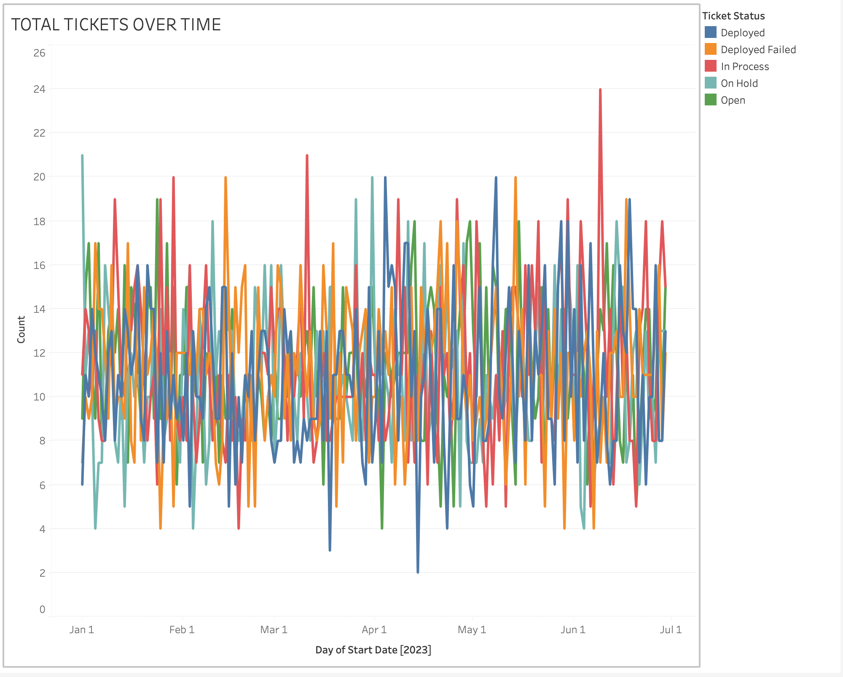
Total Tickets Over Time by Class

Slide 3
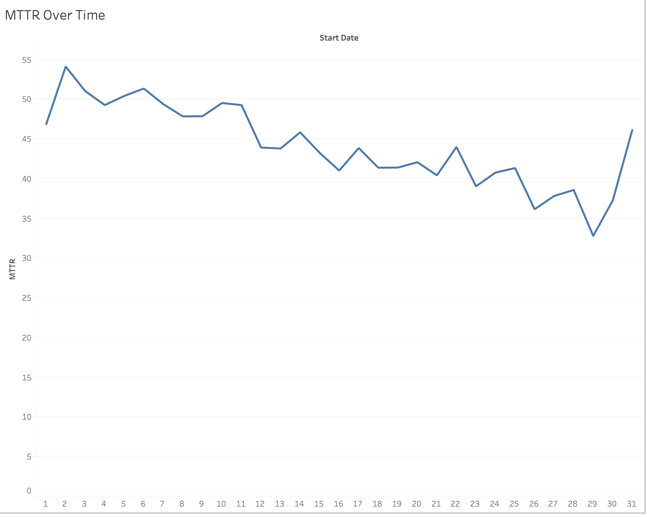
MTTR Over Time

Slide 4
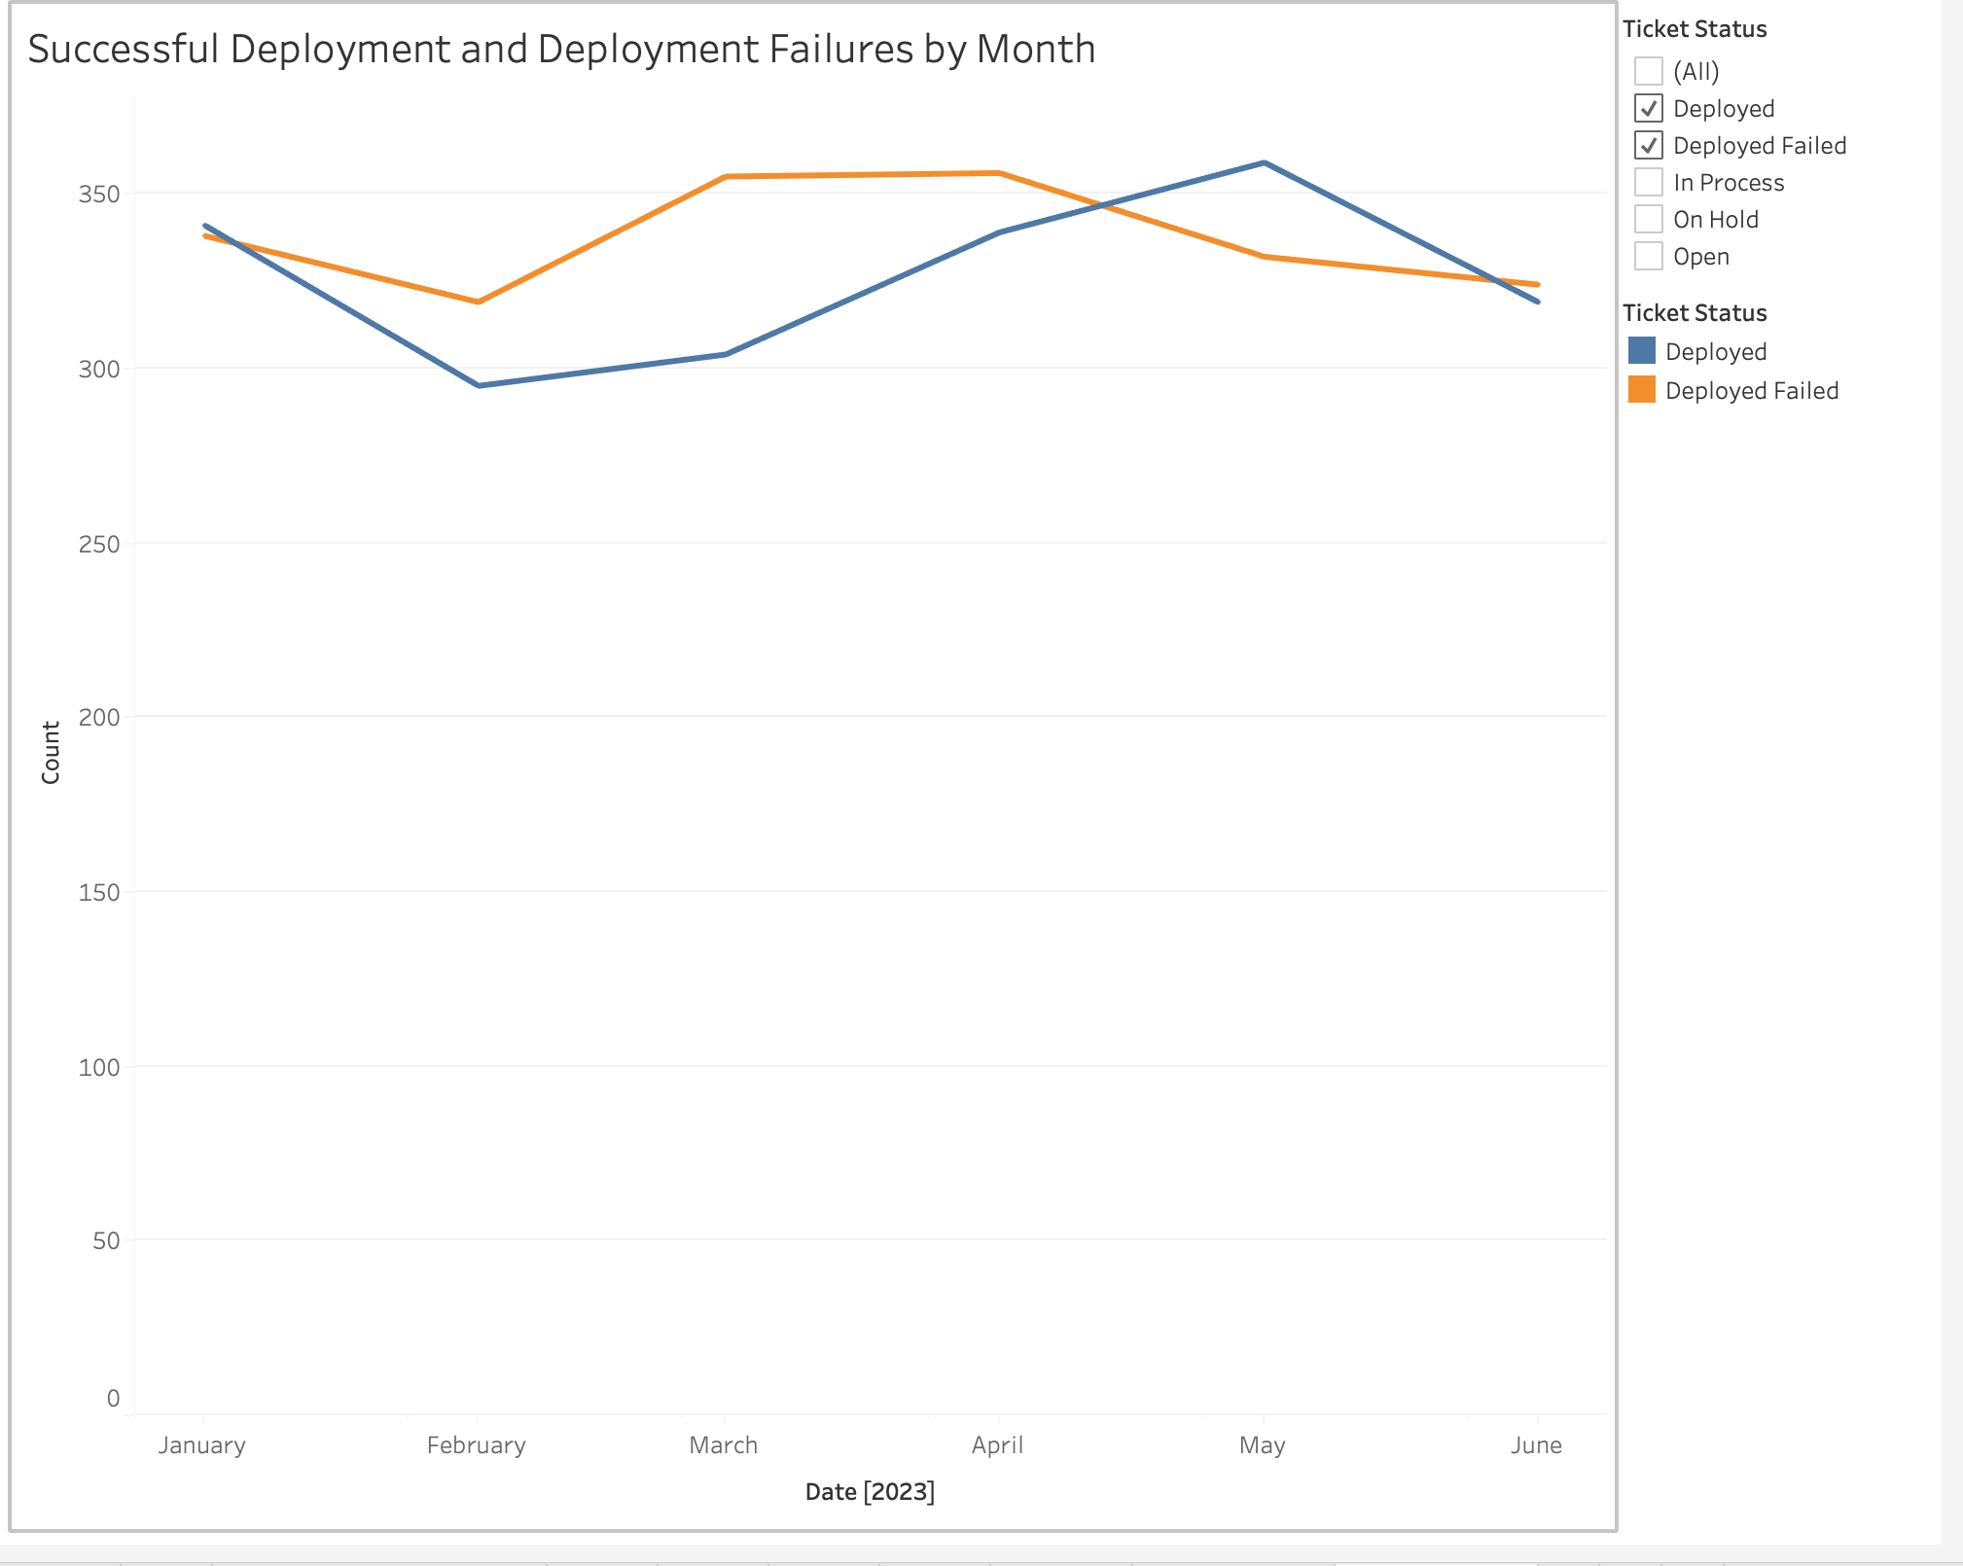
Successful Deployments and Failures Over Time

Slide 5
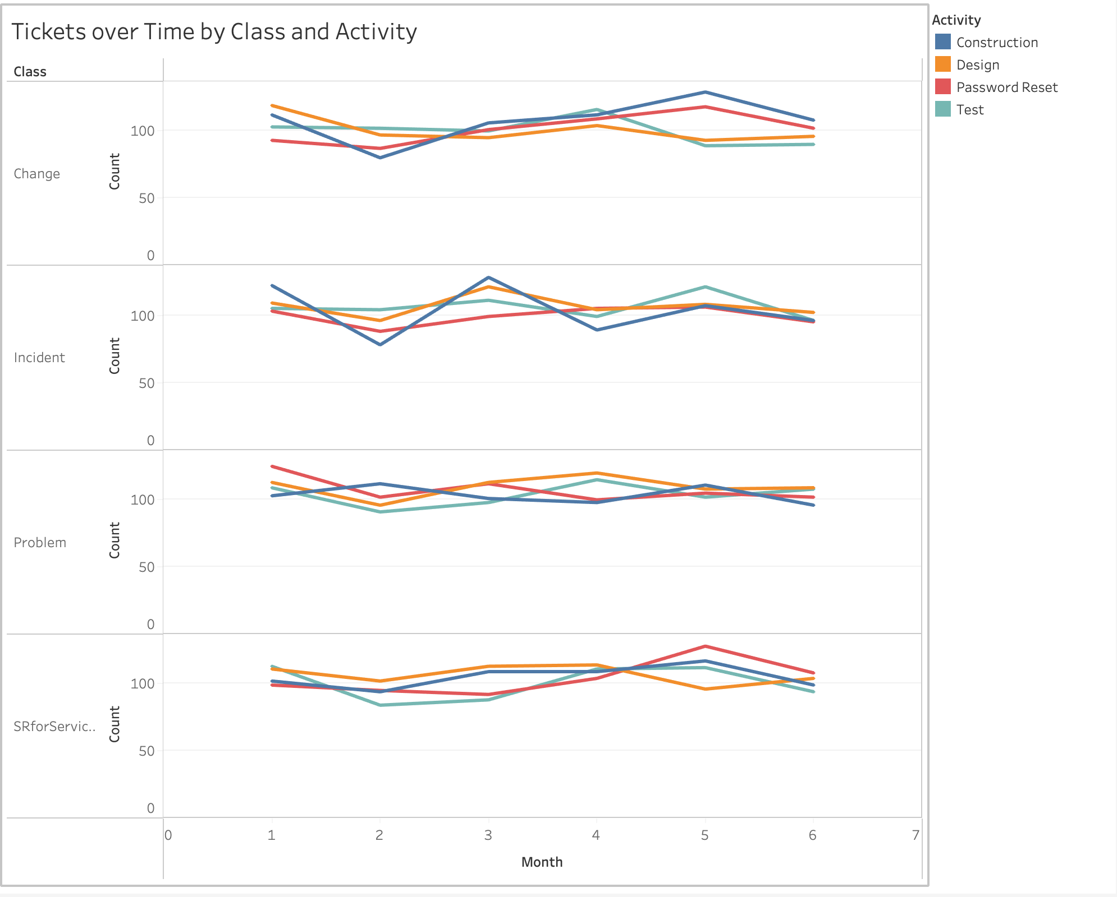
Tickets over Time by Class and Activity

Slide 6
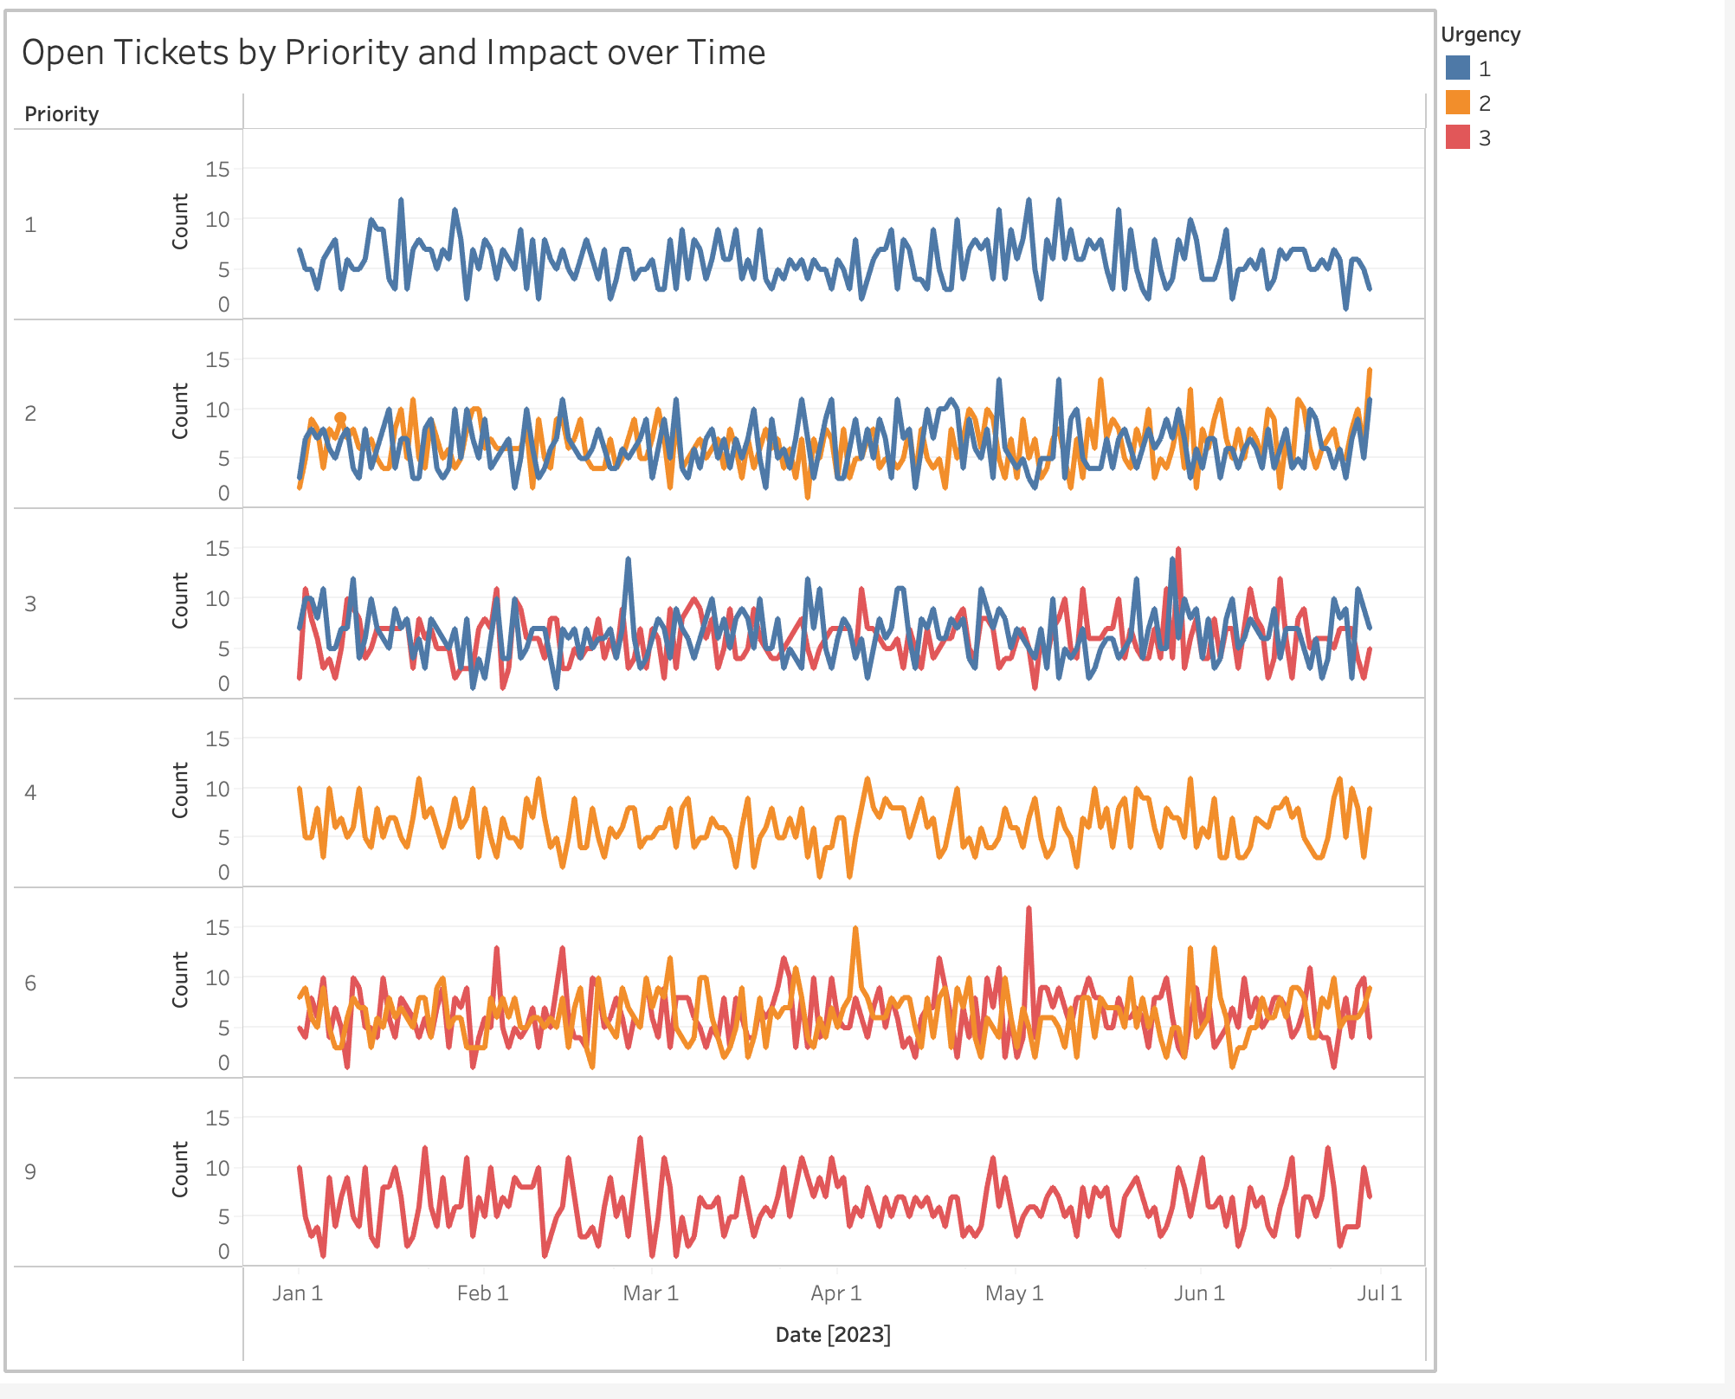
Open Tickets by Priority and Urgency over Time

Slide 7
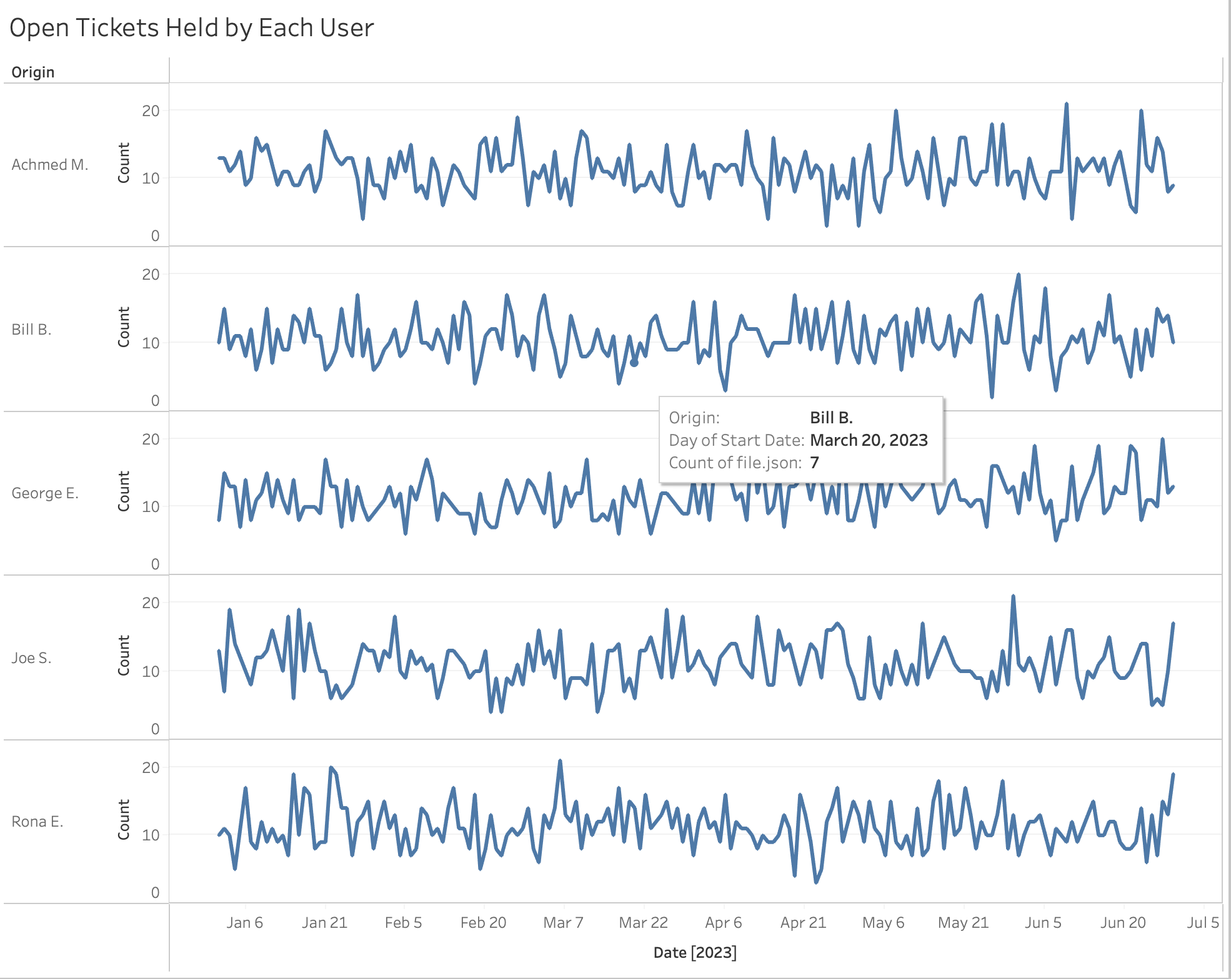
Open Tickets Held by Each User

