Slide 1


Samples
Experiment
Data
Analysis
master
devel1
devel2
devel3
Figures
Article
Notes:
Skull: Miltiadis, CC0, via Wikimedia Commons
Celebration: Chanut is Industries, TH, CC BY 3.0 <https://creativecommons.org/licenses/by/3.0>, via Wikimedia Commons
https://twitter.com/redpenblackpen/status/875100791165648898

Slide 2

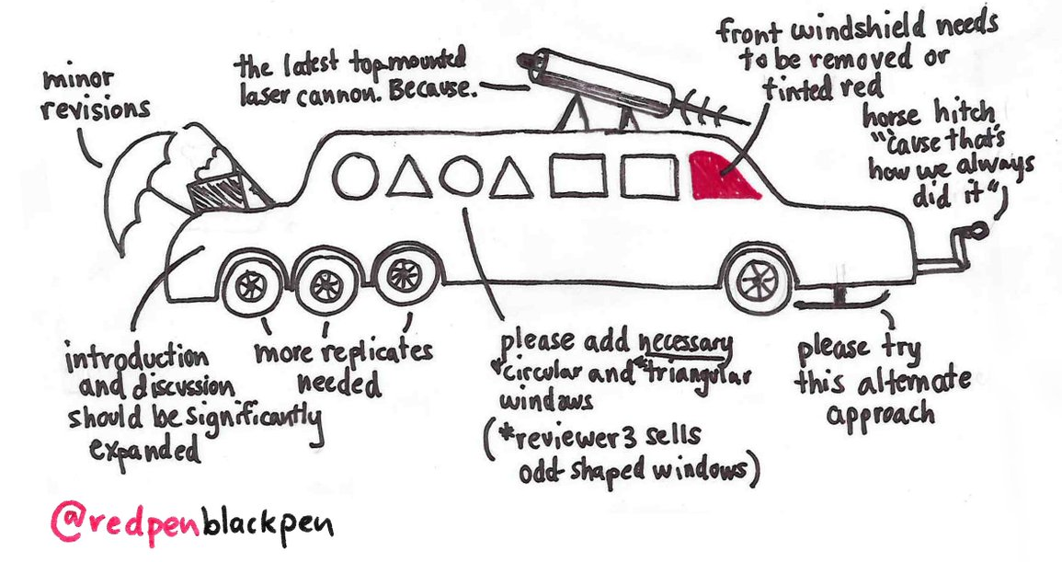

Samples
Submit to a journal
Experiment
Reviewer 1
Data
Analysis
master
devel1
devel2
devel3
Reviewer 2
Reviewer 3
Figures
Article
Notes:
Skull: Miltiadis, CC0, via Wikimedia Commons
Celebration: Chanut is Industries, TH, CC BY 3.0 <https://creativecommons.org/licenses/by/3.0>, via Wikimedia Commons
https://twitter.com/redpenblackpen/status/875100791165648898

Slide 3


Samples
Submit to a journal
Samples
Experiment
Experiment
Reviewer 1
Data
Data
Analysis
Analysis
master
devel1
devel2
devel3
master
devel1
devel2
devel3
Reviewer 2
Reviewer 3
Figures
Article
Notes:
Skull: Miltiadis, CC0, via Wikimedia Commons
Celebration: Chanut is Industries, TH, CC BY 3.0 <https://creativecommons.org/licenses/by/3.0>, via Wikimedia Commons
https://twitter.com/redpenblackpen/status/875100791165648898

