Slide 1
Hero’s Gambit
Justin Berman, Class of 2021

Slide 2
Game Background
Not as much dungeon crawling
Your nation is at war
King has sent the hero (you) to preemptively strike the opposing nation’s army
You must kill as many enemies as possible before his own army's country arrives.

Slide 3
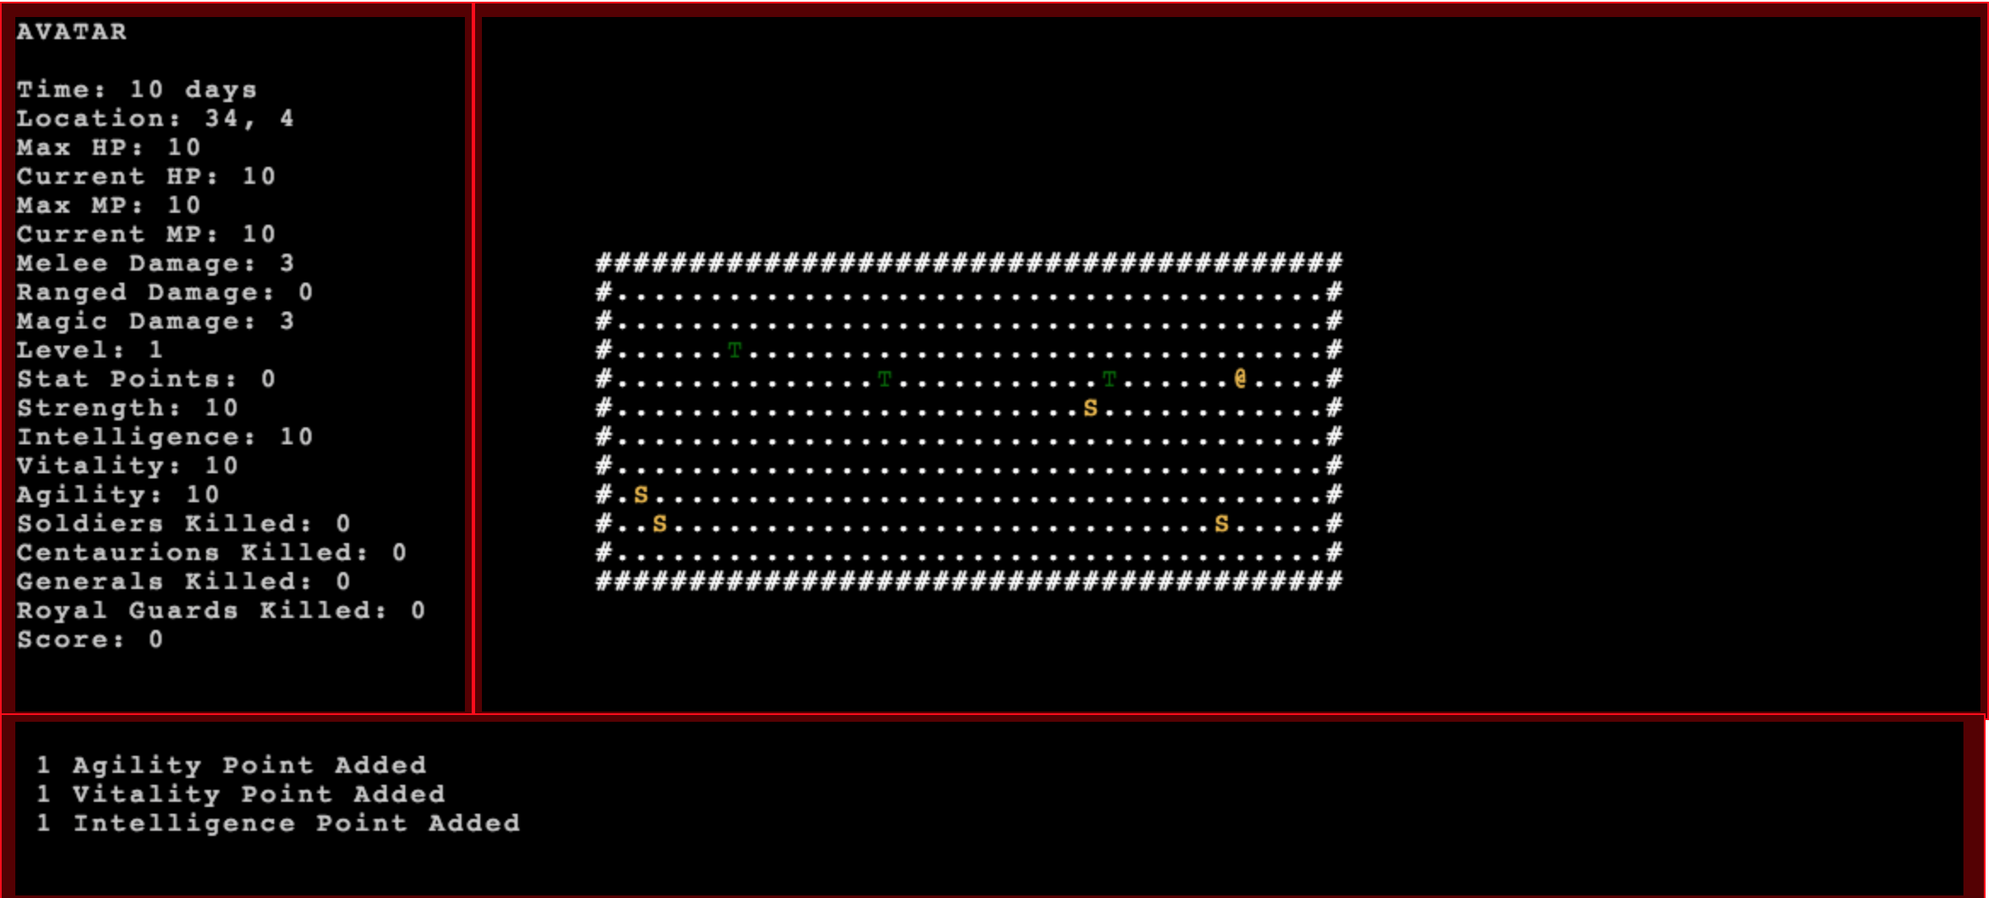
Overview of Hero’s Gambit
Level based kill a bunch of enemies
Increasing difficulty and ability
Player levels and stats
Timing system
Ranged attacks

Slide 4
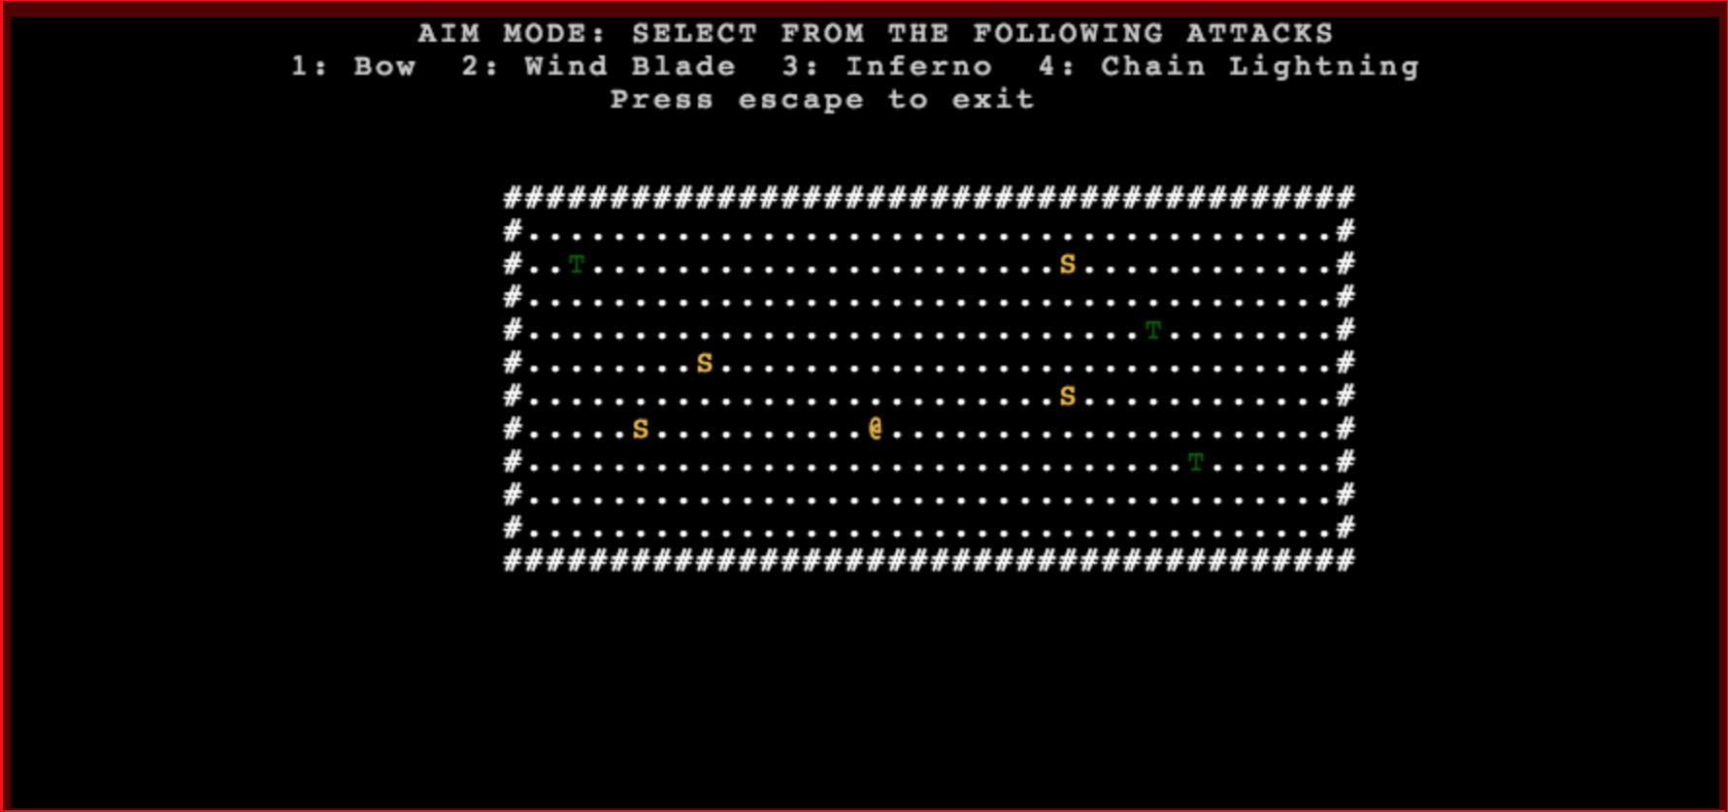
Player Perspective
Aim mode: extra mode attached to play mode
Allows player to choose between 4 different ranged attacks
Aim attacks in a straight line starting from the avatar

Slide 5
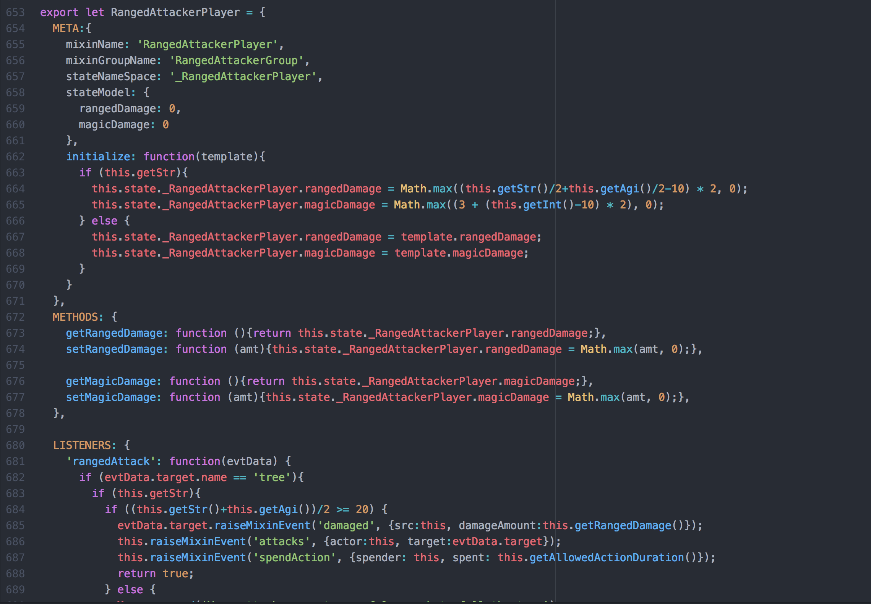
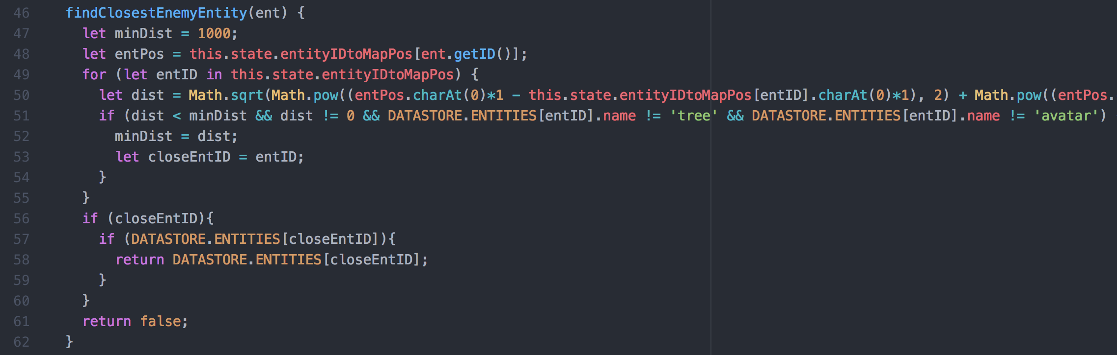
Implementation
Extra aim mode
Ranged attack mixin
Extra functions to find entities
Finding non self entities

Slide 6
Future
Improving Scheduler/Turn system
More enemy types
Making boss enemies
Items?
More dungeon crawling?

