Slide 1
Hero’s Gambit
Justin Berman, Class of 2021

Slide 2
Roguelike Games
Generally, fantastical, dungeon crawling, role player games
Hero’s Gambit specific
Not quite dungeon crawling, more level based
Basic storyline

Slide 3
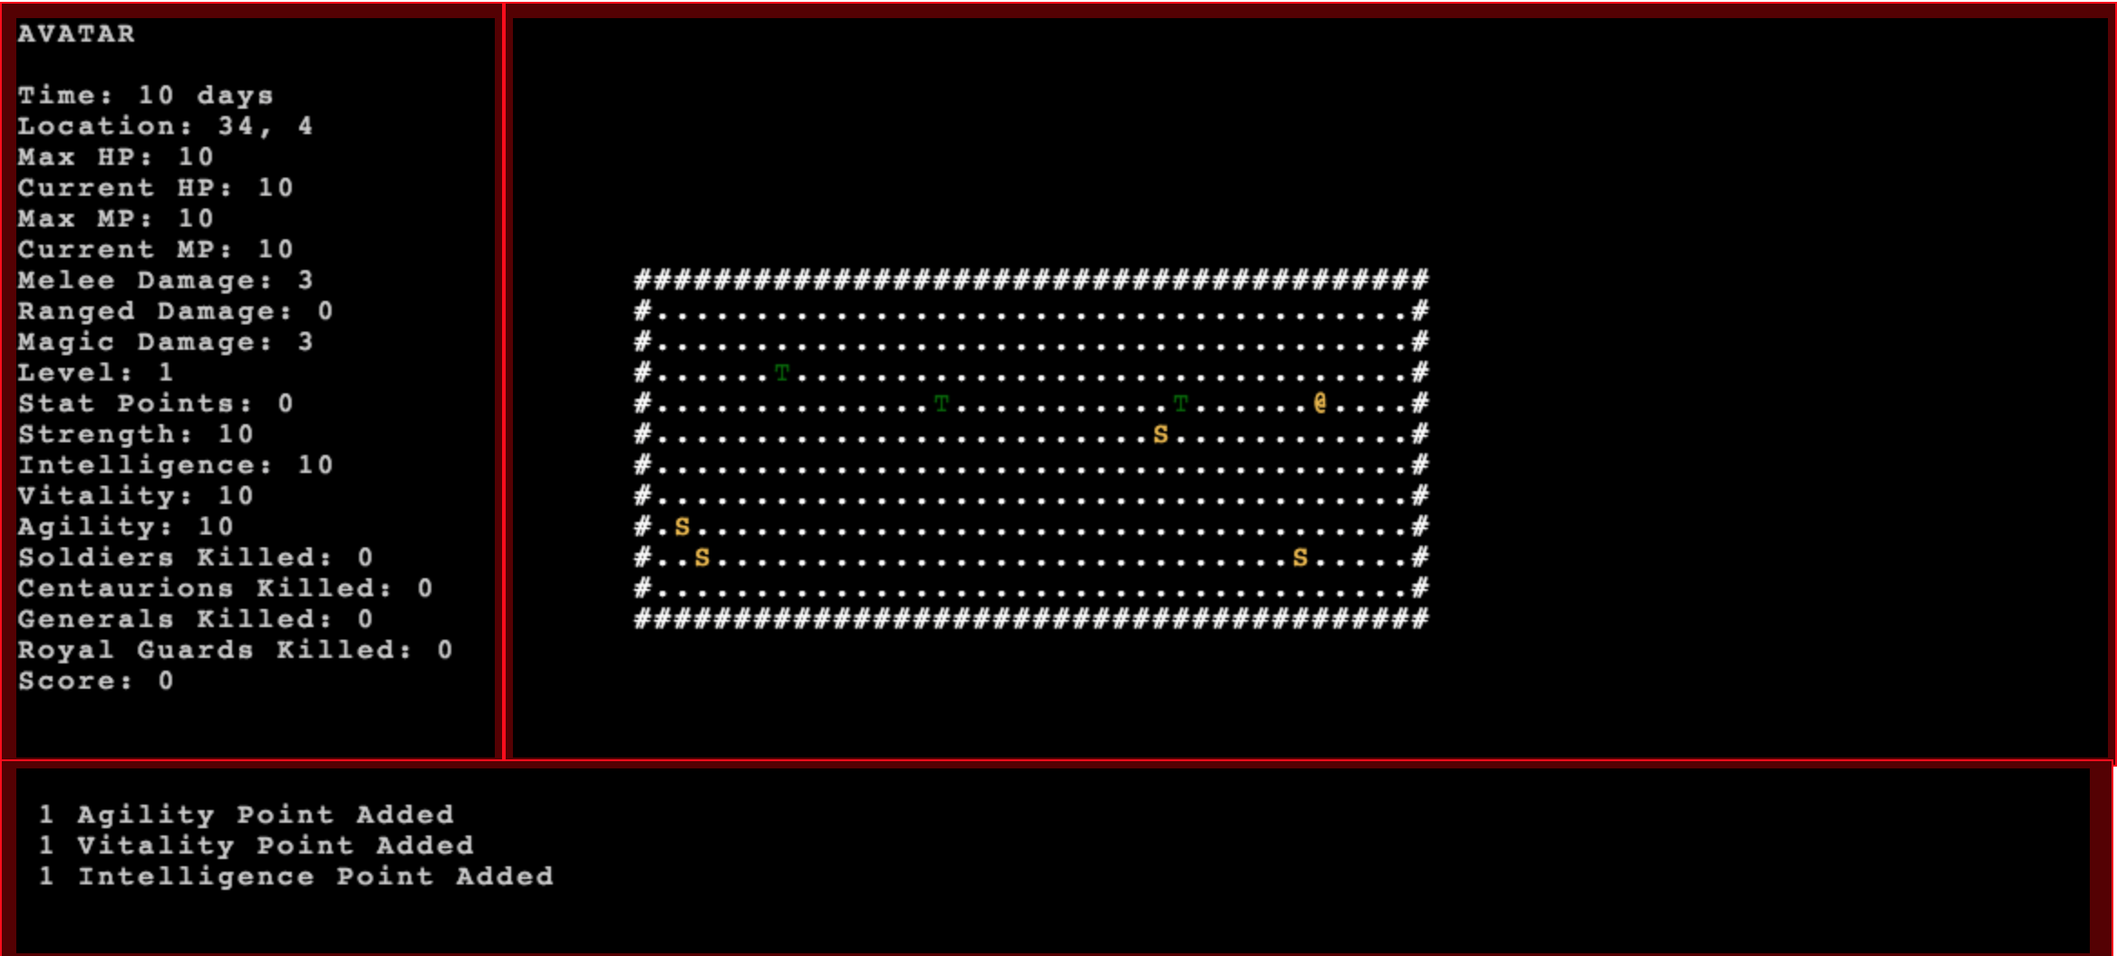
Overview of Hero’s Gambit
Level based kill a bunch of enemies
Increasing difficulty and ability
Player levels and stats
Timing system
Ranged attacks

Slide 4
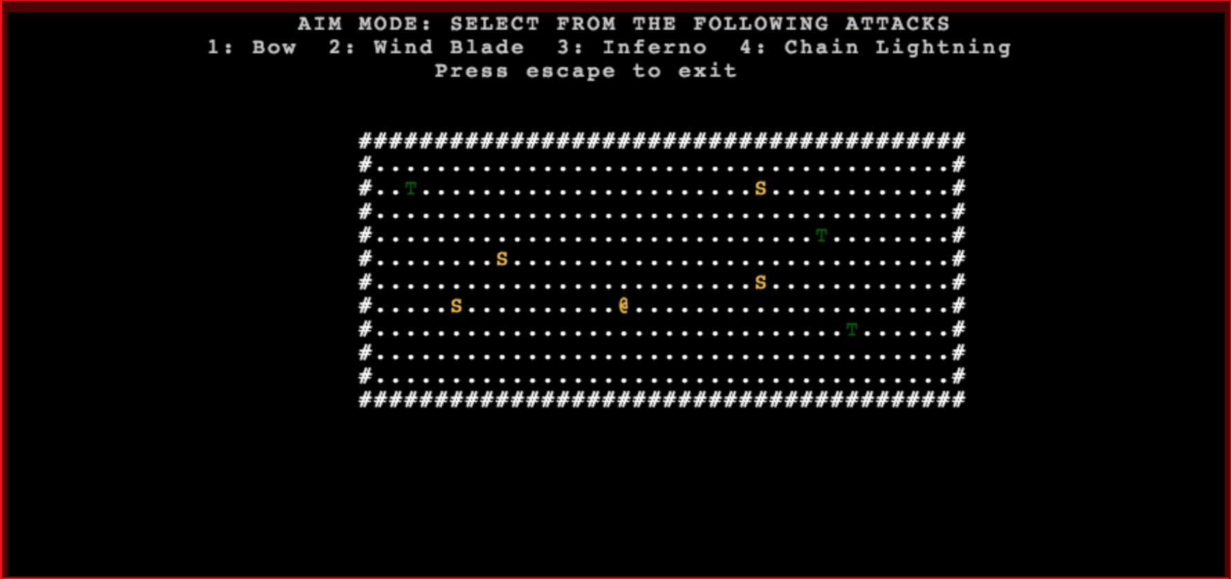
Player Perspective
Aim mode: extra mode attached to play mode
Allows player to choose between 4 different ranged attacks
Aim attacks in a straight line starting from the avatar

Slide 5
Implementation
Extra aim mode
Ranged attack mixin
Extra functions to find entities
Finding non self entities

Slide 6
Future
Improving Scheduler/Turn system
More enemy types
Making boss enemies
Items?
More dungeon crawling?

