Slide 1
Life-stage Prediction for Product Recommendation in E-commerce
Team No: 4
Team member:
Xubin Zhuge, Yuqi Zhang, Rui Chang

Slide 2
Outline
Motivation
Feature processing
Life-stage prediction
Recommendation
Our Result

Slide 3
Motivation
Although marketing researchers and sociologists have recognized the large impact of life stage on consumer's purchasing behaviors, existing recommender systems have not taken this impact into consideration.
Motivated by this, we introduce the conception of life stage into recommender systems and propose to predict a user's current life-stage and recommend products correspondingly.

Slide 4
Defination
Life-stage: a predefined set of phases in life, and each life stage spans a period of time.

Slide 5
Mum-baby Domain
Label | Baby Age Category(life stage)
0 | Pregnant
1 | New born-6 months
2 | 6 months – 1 year
3 | 1-3 years
4 | 3-6 years
Find baby's birthday
Set label for user
Life-stage labels for Mom-baby domain
In training process

Slide 6
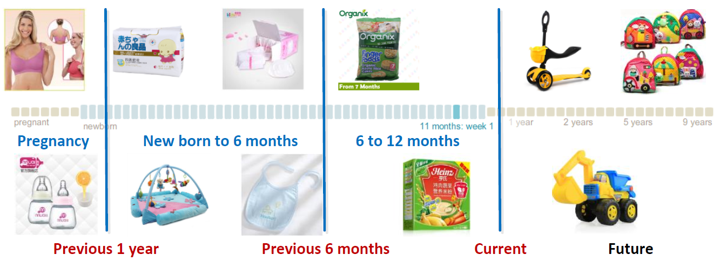
Our tasks
Set label for each user's behavior sequences so that we can tell a user's current life stage.
Generate recommendations based on the predicted life-stage

Slide 7
Features for the Classifier
Category features: all items are mapped to a category hierarchy.
Queries: user product search activities.
Product property features: meta data of the product. Eg. ’Size’ as “M” or “L” or label ’Age’ as “newborn” or “1-3 years”.
Product title features: created by sellers
Other features

Slide 8
Features Processing
Preprocessing
Generating Feature vector
Feature Matrix
Preprocessing:
To reduce the influence of popular categories and properties.
Set feature weight based on TF-IDF equation
User → Document ; Feature → term

Slide 9
TF-IDF weighting
Define:
t: feature( category or property)
d: user
For each feature, we can calculate the weight W_{t,d} based on the following formula:
This weight will be used to construct the Feature Vector.

Slide 10
Construction of Feature Vector
One feature Vector for one user
1) Counting
Time window → purchasing sequence
Count the times of each feature appearing in a user‘s time window
2)Calculate weight
3) Normalization
Normalize each user's purchasing sequence in a certain period of timeline
Feature for a certain user with feature (f1, f2, ..., fn)
tf1 tf2 ...... tfn
n1 n2 ...... n_{n}
tf1*idf tf2*idf ...... tfn*idf

Slide 11
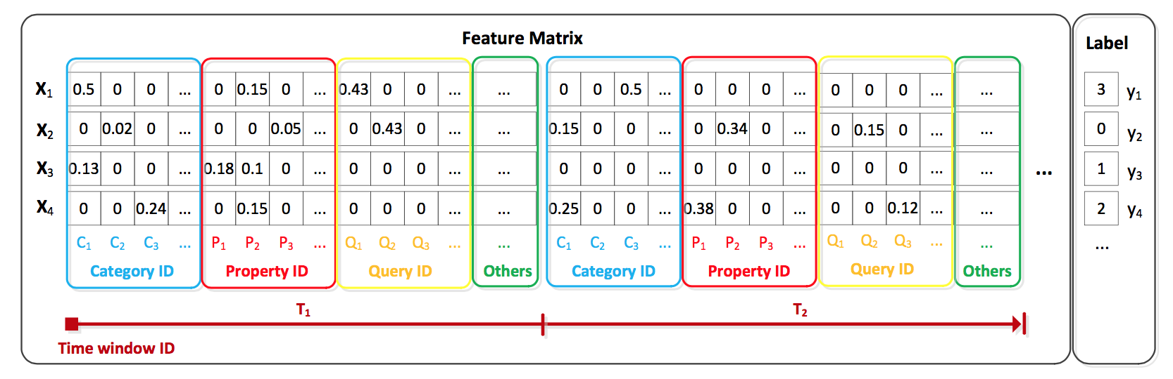
Feature Matrix

Slide 12
Bayesian Classification
Age Label Recognition
Classifier
test data
output label

Slide 13
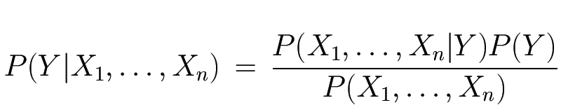
The Bayes Classifier
Use Bayes Rule!
Conditional probability
Prior Lable Likelihood
Normalization Constant

Slide 14
The Bayes Classifier
How to calculate each part of the expression
For all the lable ,P(X1,X2…Xn) is same,so we can view it as a constant number.
P(Y=y) = Count(Y=y) / TotalCount(Sample)
For conditional probability P(X1,…,Xn| Y),we have 2 solution:
Using similarity
Using Naïve Bayes

Slide 15
By Using Similarity
Step 1: Set the one threshold t1;
Step2: For P(X1,X2,…,Xn|Y=yj) , we calculate cosine similarity between test feature and all sample feature with label equal yj and count the number that bigger than t1,saying count(yj).
Step3: Estimate P(X1,X2,…,Xn|Y=yj) using count(yj)/total(yj),which total(yj) is the count number of entry with the lable = yj.
Step4:predict the lable with the yj which meet the
MAX (P(X1,X2,…,Xn|Y=yj)*P(Y=yj) )

Slide 16
By Using Similarity
result using different threshold
Threshold | 0.55 | 0.6 | 0.65 | 0.7 | 0.75 | 0.8 | 0.85 | 0.9 | 0.95
Accuracy | 0.34 | 0.37 | 0.40 | 0.56 | 0.70 | 0.77 | 0.83 | 0.81 | 0.72

Slide 17
By Using Similarity
Pros and Cons
Pros:
Transform the multi variable conditional probability to the cosine similarity between 2 vector, it is easy to calculate and do not need to fancy with small decimal and the influence of zero probability.
Cons:
To every test data we need to train again, cannot store the previous tranning result.If test sample input in a batch mode,it will cost a lot of time compute the cosine similarity.

Slide 18
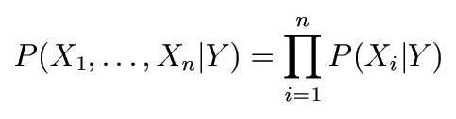
The Naïve Bayes Model
The Naïve Bayes Assumption: Assume that all features are independent given the class label Y
Equationally speaking:

Slide 19
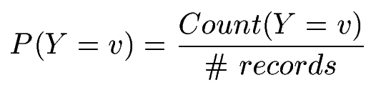

Naïve Bayes Training
Training in Naïve Bayes is easy:
Estimate P(Y=v) as the fraction of records with Y=v
Estimate P(Xi=u|Y=v) as the fraction of records with Y=v for which Xi=u
(This corresponds to Maximum Likelihood estimation of model parameters)

Slide 20
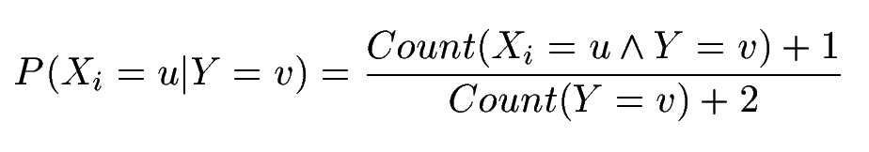
Naïve Bayes Training
In practice, some of these counts can be zero
Fix this by adding “virtual” counts:
This is called Smoothing

Slide 21
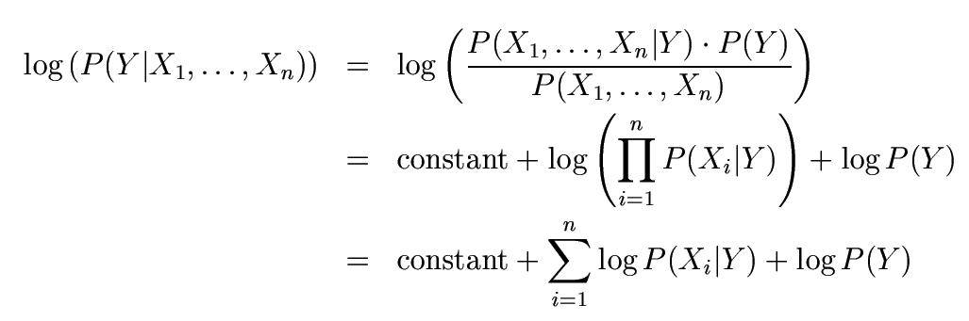
Numerical Stability
Instead of comparing P(Y=1|X₁,…,X_{n}) with P(Y=2|X₁,…,X_{n}),
Compare their logarithms

Slide 22
Naïve Bayes Assumption
Recall the Naïve Bayes assumption:
that all features are independent given the class label Y
Actually, the Naïve Bayes assumption is almost never true.
The accuracy of the assumption depends on Feature Selection
Select the features that are independent as much as possible
Still… Naïve Bayes often performs surprisingly well even when its assumptions do not hold

Slide 23
Performance Comparison
Bayes | Naïve Bayes | Similarity (T=0.8)
Trainning Time(s) | 1.5 | 1.4
Test Time(s) | 1.7 | 12572
Accuracy | 0.86 | 0.83

Slide 24
Recommendation Systems
Two major recommendation systems:
Content-based systems: recommend based on properties of the items
Callaborative filtering systems: recommend based on similarity measures between users and/or items. The items recommended to a user are those preferred by similar users.

Slide 25
Recommendation Based on Life-stage
To make product recommendation, we propose a model to estimate the probability of a user purchasing a product at a specific age a
P(p_product_{j}, a) = P(a | p_product_{j})*P(p_product_{j})
Rank all candidate products
Choose the products with highest probabiliy to recommend

Slide 26
Our Result
Table: Effects of features for child life-stage prediction
Features & Approach | Accuracy
Basic(category) | 74.3%
Basic+Property | 87.6%

Slide 27
Analysis of Temporal Effect
The effect of window size to accuracy

Slide 28
Analysis of Temporal Effect
The effect of window number to accuracy, window size = 60

Slide 29
Future Work
Train our model with a larger dataset
Establish Mixture Model For Multi-kids senario
Apply the model to other categories such as wedding and home remodeling

Slide 30
Quesions ?

