Slide 1
Linear Programming: Data Fitting
Steve Gu
Mar 21, 2008

Slide 2
Outline
Data fitting (Ref: pp 250)
Data fitting using LP

Slide 3
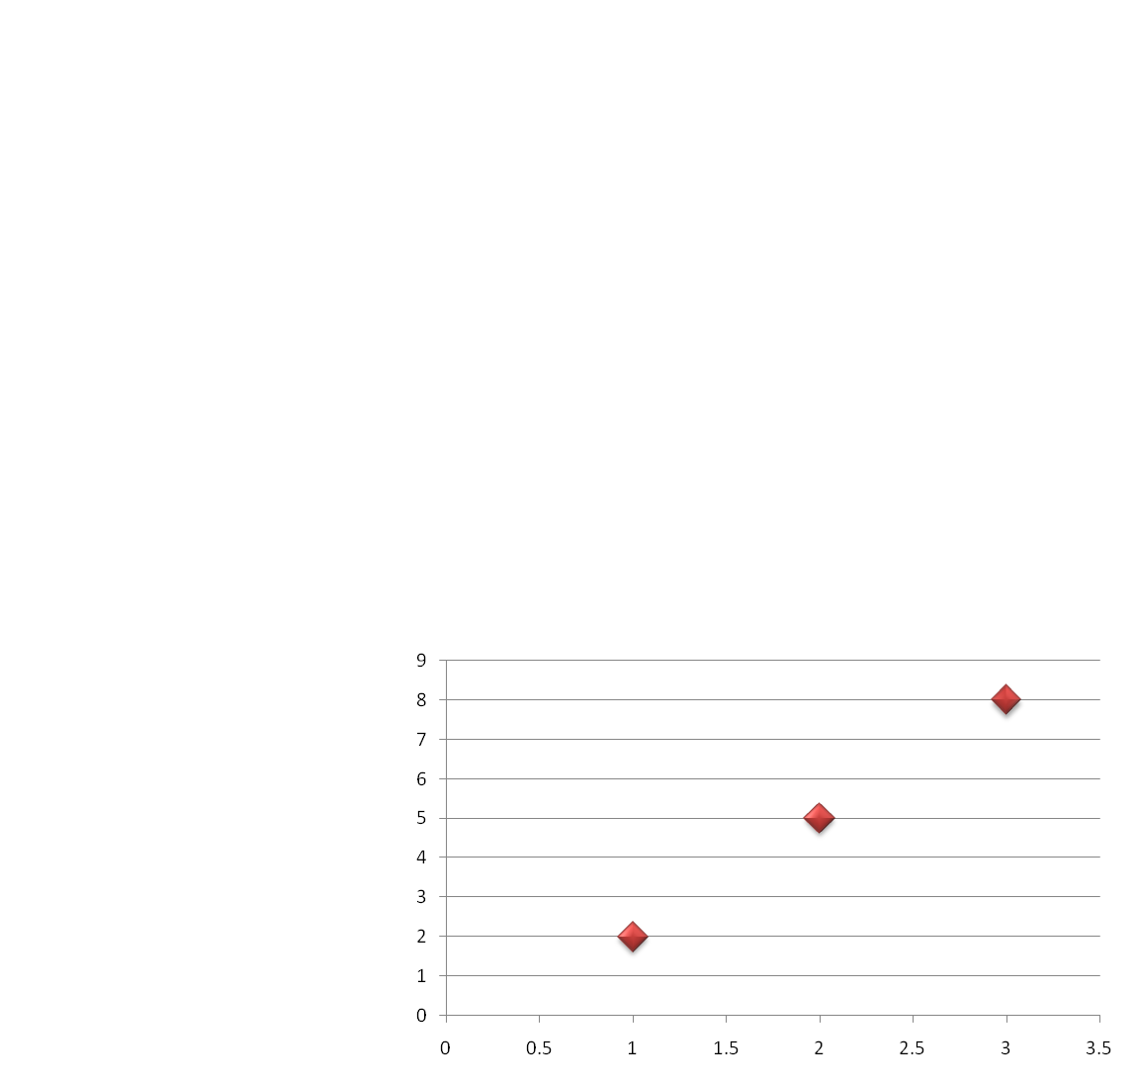
Data fitting
X | 1 | 2 | 3
Y | 2 | 5 | 8
Y
X

Slide 4
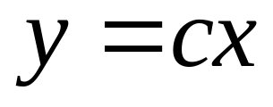
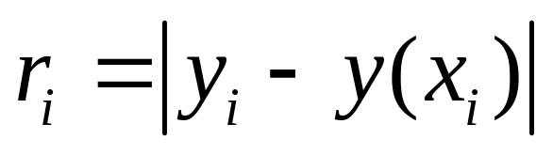
Data fitting
How to fit the model to the following data set using Chebyshev criterion?
Chebyshev’s criterion: minimize the largest absolute deviation:
X | 1 | 2 | 3
Y | 2 | 5 | 8

Slide 5
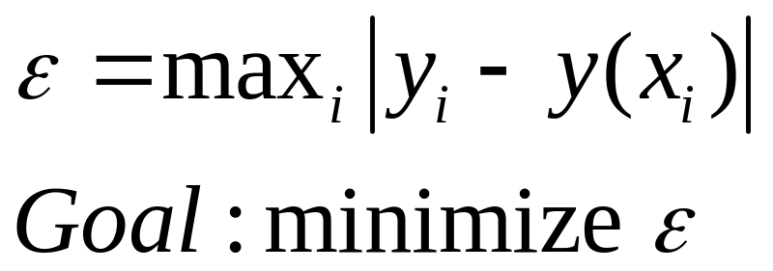
Chebyshev Criterion
A min max problem!

Slide 6
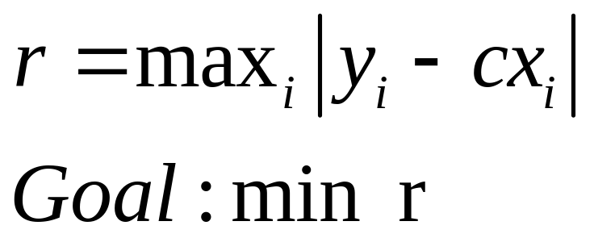
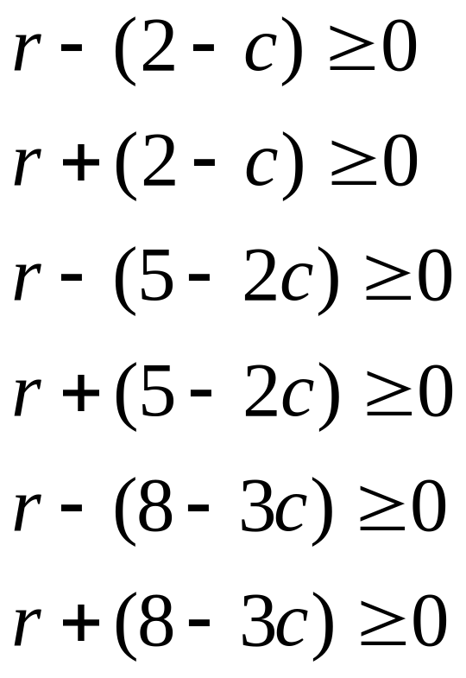
More Formal Statement
X | 1 | 2 | 3
Y | 2 | 5 | 8
subject to:

Slide 7
Interpret Geometrically
r
8
6
Feasible region
4
2
c
1
2
3
4
5

Slide 8
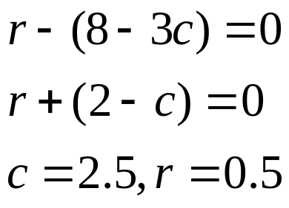
Interpret Geometrically
Therefore, 2.5 is the optimal value of c and the residual error is 0.5
r
8
6
Feasible region
4
2
Optimal solution
c
1
2
3
4
5

Slide 9
More general problem
Given N points (X₁,Y₁),(X₂,Y₂),…,(X_{N},Y_{N}), How to fit the model y=cx using Chebyshev criterion?

Slide 10
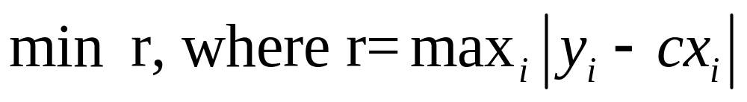
Data fitting using Linear Programming
What’s the Goal?
What are the Unknowns?
  r and c
What are the constraints?
  Compare to 3-points case:

Slide 11
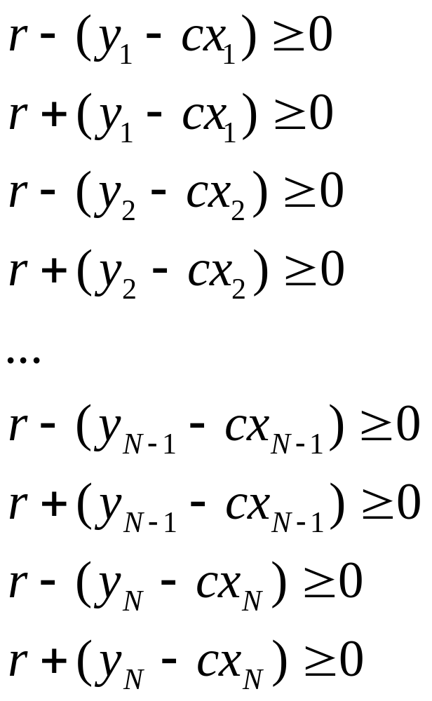
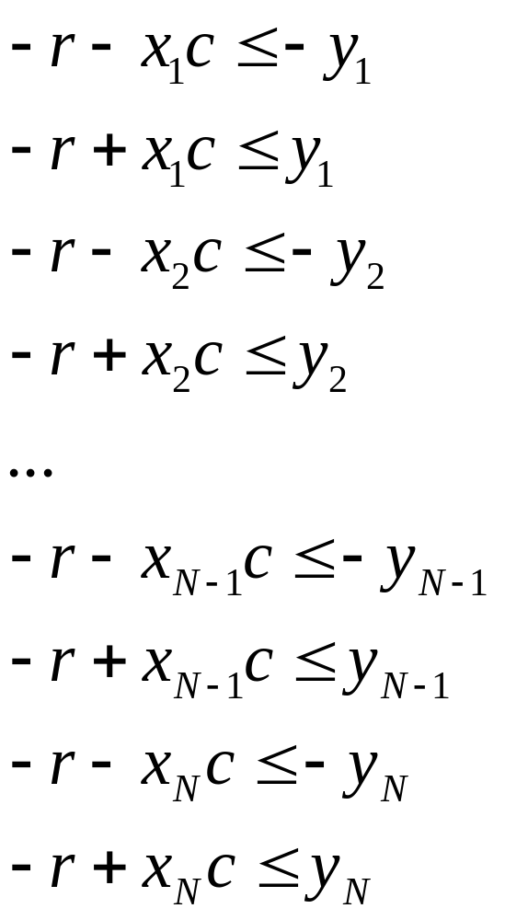
Data fitting using Linear Programming

Slide 12
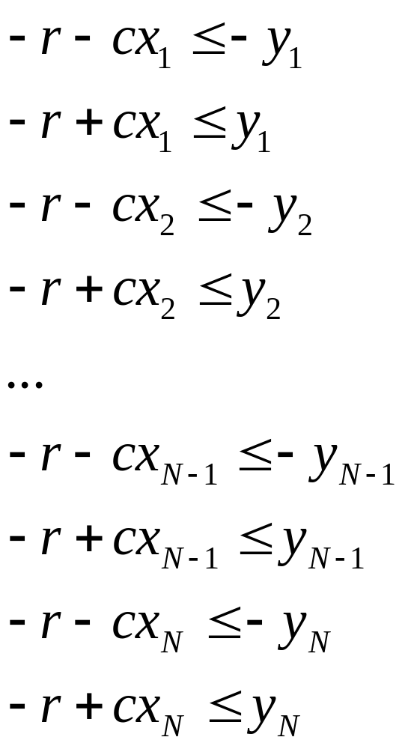
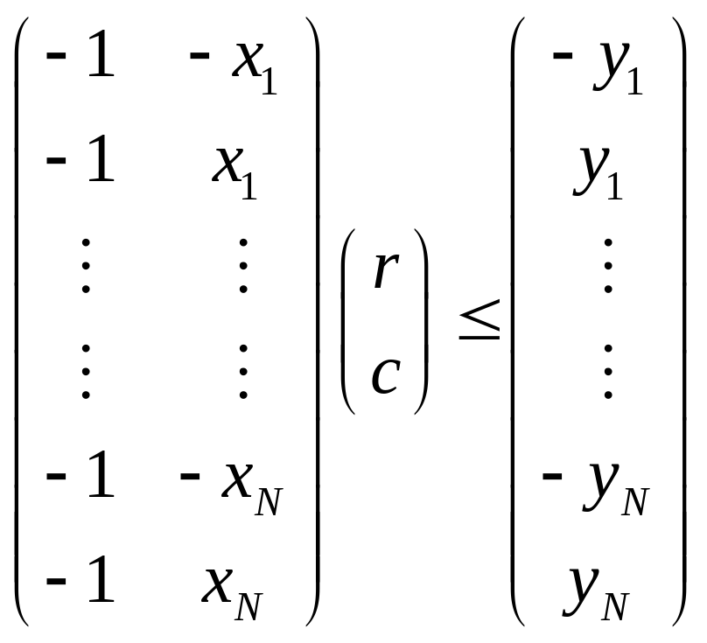
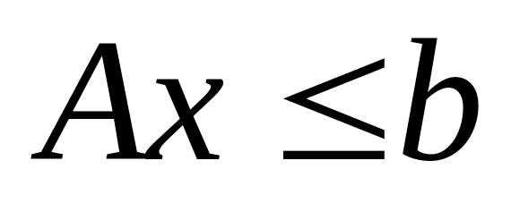
Data fitting using Linear Programming

Slide 13
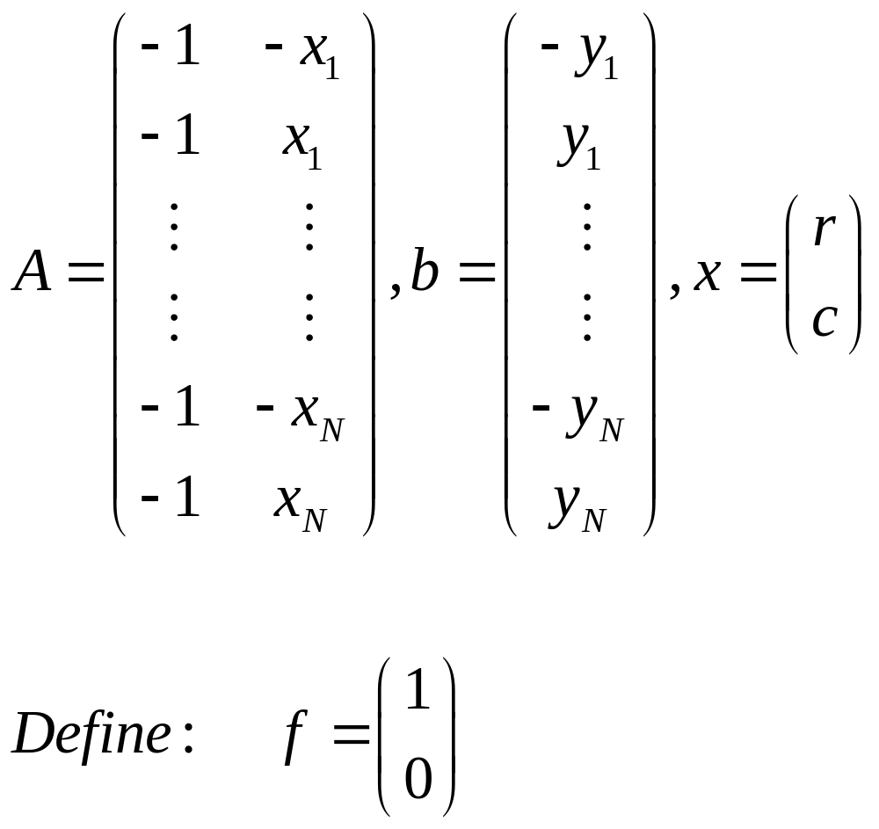
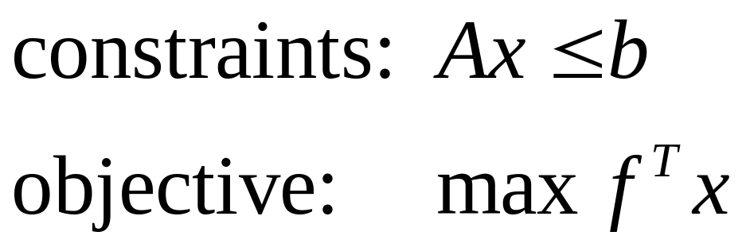
Data fitting using Linear Programming

Slide 14
LP in MATLAB
Use command:
  linprog
  Do type “help linprog” !
Example:
  X=linprog(f,A,b) solves the linear programming problem: min f'*x subject to: A*x <= b

Slide 15
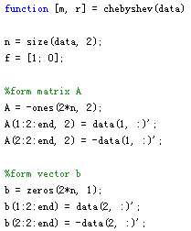
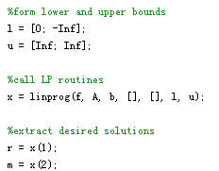
LP in MATLAB

Slide 16
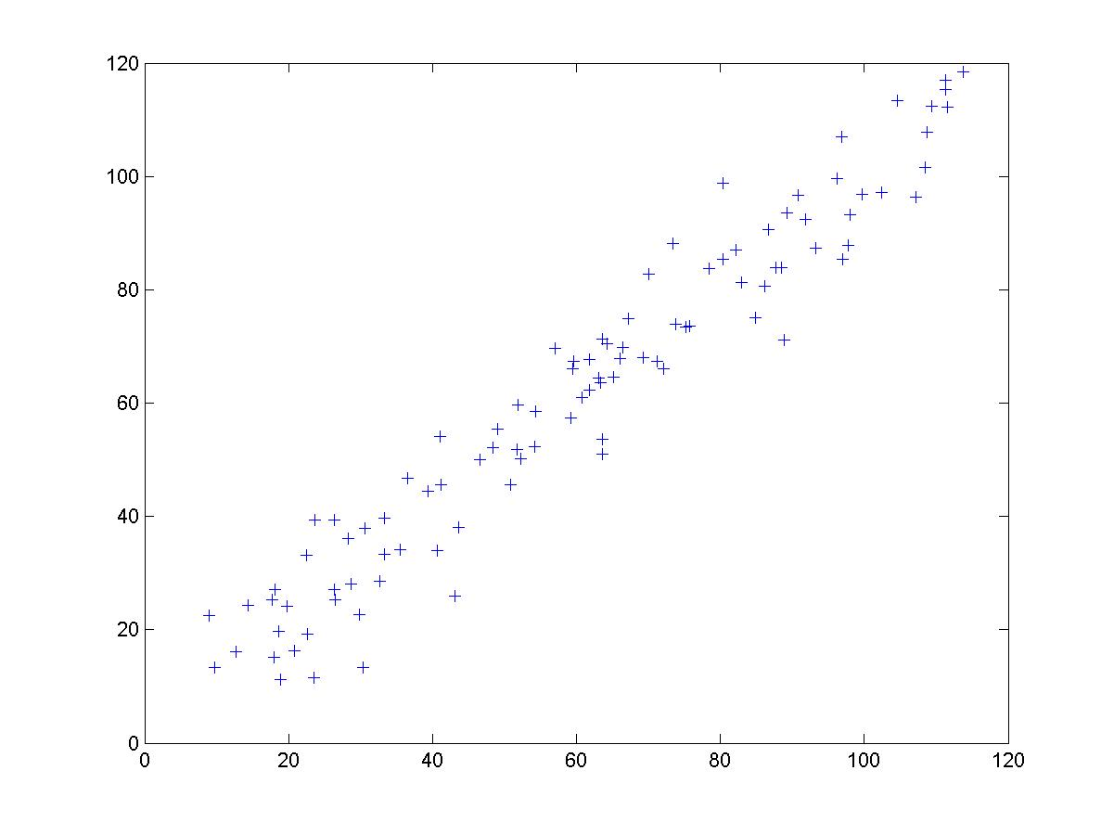
Results: Fitting data using LP

Slide 17
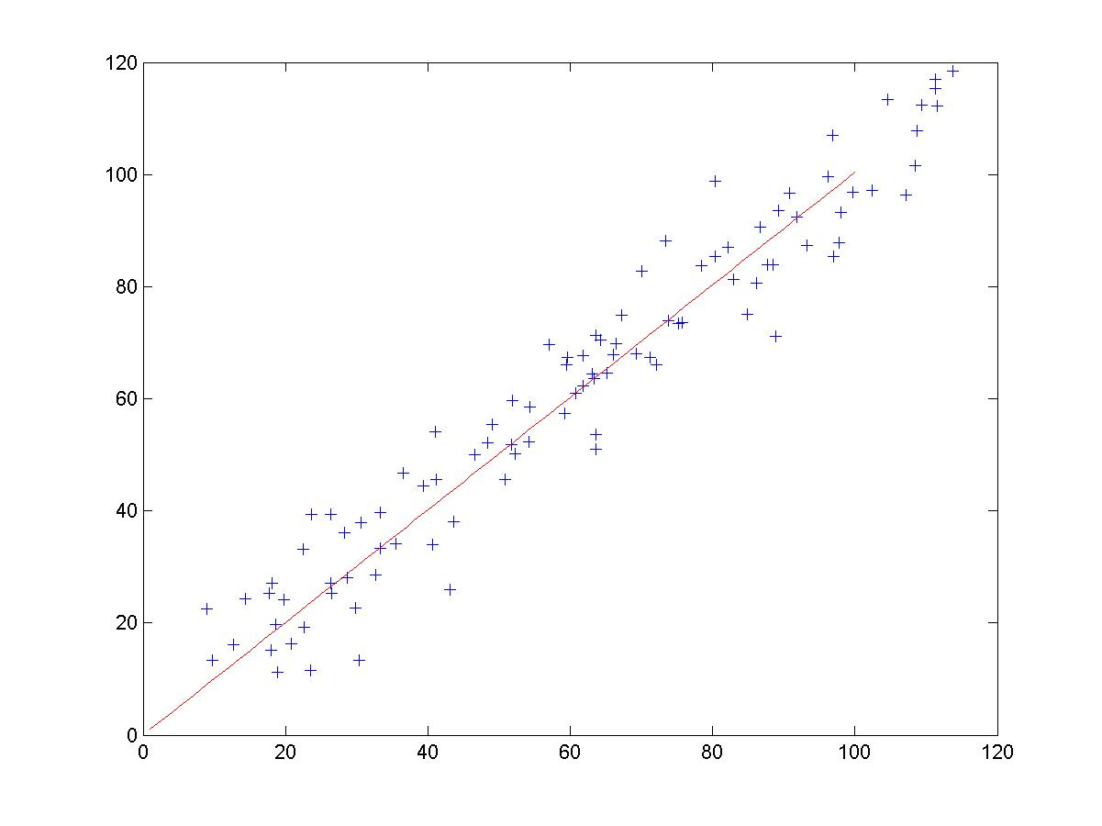
Results: Fitting data using LP
c=1.0039
r=18.1304

Slide 18
End: Q&A
Thanks

