Slide 1

Introduction of USB subsystem in Linux
Neusoft Corporate
2011年09月16日
yu.ht@neusoft.com

Slide 2
Agenda
1
Brief Introduction of USB Bus Spec
2
The Core of USB Subsystem in Linux
3
USB Host Controller Driver in Linux
4
USB Device Driver in Linux as a Host
5
USB Gadget Driver in Linux
6
USB Device Controller Driver in Linux
7
Miscellaneous

Slide 3
1. Brief Introduction of USB Bus Spec -- I
USB Bus Specification:
USB 2.0: Low Speed -- 1.5Mbps, derived from USB1.0
Full Speed -- 12Mbps, derived from USB1.1
High Speed -- 480Mbps
Wireless USB -- 2005.
USB 3.0: Super Speed -- 5Gbps, 2008.
USB Bus Cable and Connector:
4 or 8(USB3.0)signal wires usually.
-- Power, Ground, 2 differential D+/- data wires.
Standard/Micro A/B type, Power-B type, Micro-AB(5 pins).
Bus Topology: Tree, Host <--> Hub <--> Device.
The maximum number of tiers of BUS: 7
The maximum number of devices on BUS: 128.
Device’s bus address range: 0 to 127,
Address ‘0’ is used for the newly-attached device.

Slide 4
1. Brief Introduction of USB Bus Spec -- II
Host polls all the active devices on bus. That is, device
can NOT send data to host and other devices on bus
spontaneously. There is only one host in one bus except
for OTG (dual roles, as embedded limited-functional host).
USB Bus Architecture: defined by USB Specification.
Physical Layer: signaling, transceiver, clock,
8b/10b encode/decoding.
Link Layer: Link management and flow control, Power-On
and in-band reset, link error recovery, link-
status state machine, packet framing.
Protocol Layer: Bit/Byte Order – LSb/LSB first.
SYNC Field, PID, Packet format.
Token packet(IN, OUT, SOF, Setup), Data packet,
Handshake packet(ACK, NAK, STALL), Special packet.

Slide 5
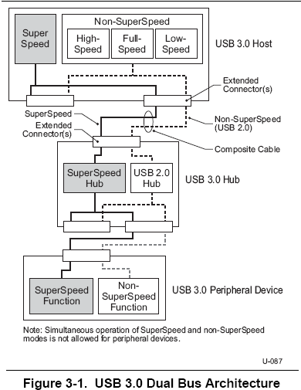
1. Brief Introduction of USB Bus Spec -- III

Slide 6
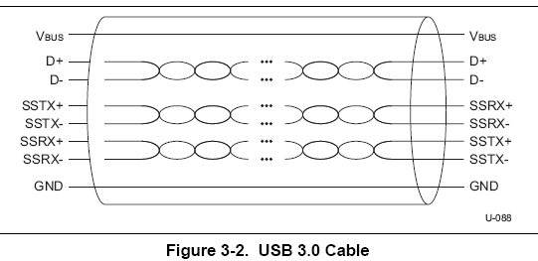
1. Brief Introduction of USB Bus Spec -- IV
USB3.0: Dual Bus, down compatible with USB2.0
Transfer type: Control Transfer,
Interrupt Transfer,
Bulk Transfer,
Isochronous Transfer.

Slide 7
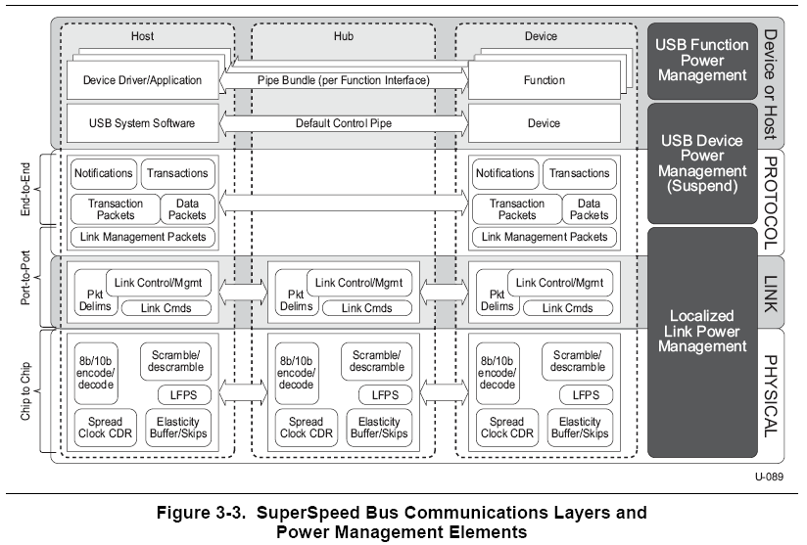
1. Brief Introduction of USB Bus Spec -- V

Slide 8
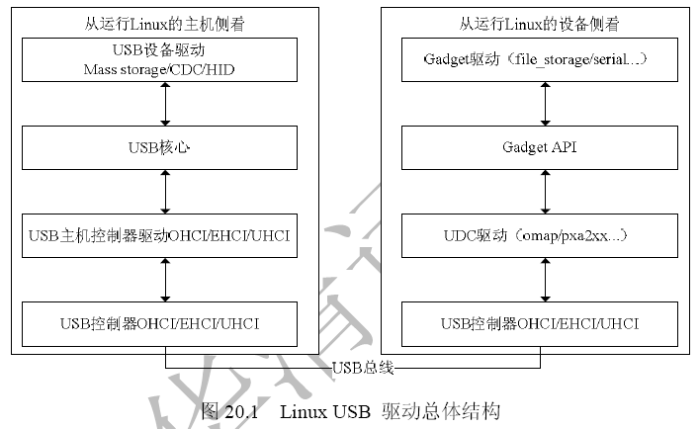
2. The Core of USB Subsystem in Linux -- I

Slide 9
2. The Core of USB Subsystem in Linux -- II
Source and header files:
in drivers/usb/core/ and drivers/usb/wusbcore/
hcd.c, hcd-pci.c, urb.c, hub.c, usb.c …
struct usb_hcd;
struct hc_driver;
struct urb;
include/linux/usb/
Ch9.h -- USB Device Framework in USB Bus Spec.
struct usb_ctrlrequest;
struct usb_device_descriptor;
struct usb_descriptor_header;
struct usb_config_descriptor;
struct usb_interface_descriptor;
struct usb_endpoint_descriptor;
struct usb_string_descriptor;

Slide 10
2. The Core of USB Subsystem in Linux -- III
Only one Host controller driver can be enabled in Linux USB sub-system. -- ehci-hcd.c
#ifdef CONFIG_USB_EHCI_FSL
#include "ehci-fsl.c"
#define PLATFORM_DRIVER ehci_fsl_driver
#endif
#ifdef CONFIG_USB_EHCI_MXC
#include "ehci-mxc.c"
#define PLATFORM_DRIVER ehci_mxc_driver
#endif
Only one Device controller driver can be enabled in
Linux USB sub-system. -- xxx_udc.c

Slide 11
3. USB Host Controller Driver in Linux -- I
Host Controller Spec: not only for USB.
OHCI -- Open Host Controller Interface.
UHCI -- Universal Host Controller Interface.
EHCI -- Enhanced Host Controller Interface.
Source and header files:
in drivers/usb/host/
ehci-atmel.c, ehci-fsl.c, ehci-mxc.c, ehci-omap.c,
ehci-hcd.c, ehci-pci.c, ohci-at91.c, ohci-hcd.c,
ohci-pci.c …
Register hc_driver and usb_hcd to Linux USB sub-
system by using usb_create_hcd() and usb_add_hcd().
to analyze ehci-mxc.c …

Slide 12
4. USB Device Driver in Linux as a Host -- I
Device/Interface Class type:
USB_CLASS_AUDIO,
USB_CLASS_COMM,
USB_CLASS_HID,
USB_CLASS_PRINTER,
USB_CLASS_MASS_STORAGE,
USB_CLASS_WIRELESS_CONTROLLER,
…
USB_CLASS_VENDOR_SPEC,
One device may has more than one interface with
different class types.
Different Device Classes have their own related
Specs.
Example: MSC -- CB, CBI, Bulk-Only, UFI.

Slide 13
4. USB Device Driver in Linux as a Host -- II
Related files:
drivers/usb/class/
drivers/net/usb/
drivers/sound/usb/
drivers/usb/serial/
drivers/usb/storage/
drivers/block/ub.c -- usb block device, but obsolete.
struct usb_driver;
struct usb_device;
struct usb_interface;
struct usb_host_interface;
to analyzing ub.c …

Slide 14
5. USB Gadget Driver in Linux -- I
Act as different kinds of USB devices:
drivers/usb/gadget/file_storage.c
drivers/usb/gadget/mass_storage.c -- after 2.6.29.
drivers/usb/gadget/serial.c
drivers/usb/gadget/ether.c
drivers/usb/gadget/audio.c
drivers/usb/gadget/webcam.c
drivers/usb/gadget/hid.c
drivers/usb/gadget/printer.c
use UDC driver to communicate with USB
host.

Slide 15
5. USB Gadget Driver in Linux -- II
struct usb_gadget_driver;
struct usb_gadget;
usb_gadget_probe_driver();
usb_gadget_unregister_driver();
to analyze file_storage.c …
mount -t vfat -o winnt=shortname /dev/sxs_blk0 /usr/sxs/
umount /usr/sxs/
insmod /usr/g_file_storage.ko file=/dev/sxs_blk0 stall=0 removable=1
mount …. again…

Slide 16
6. USB Device Controller Driver in Linux -- I
USB Device Controller -- UDC driver:
drivers/usb/gadget/s3c2410_udc.c
drivers/usb/gadget/fsl_mxc_udc.c
drivers/usb/gadget/at91_udc.c
drivers/usb/gadget/omap_udc.c
…
provides interfaces for USB Gadget driver to communicate with USB host.

Slide 17
6. USB Device Controller Driver in Linux -- II
struct usb_gadget_ops;
struct usb_ep_ops;
to analyze s3c2410_udc.c …
Control ep in/out -- setup packet
get-descriptor: device-descriptor,
config-descriptor,
interface-descriptor,
endpoint-descriptor,
string-descriptor,
set config, set interface,
Bulk-ep in/out handling

Slide 18
7. Miscellaneous
……

Slide 19

Copyright © 2008 版权所有 东软集团

