Slide 1

Data Driven Decisions
On Opening a Restaurant
GROUP 4 :
Emily Buzzelli
Cherry Agarwal

Slide 2

Objective
Determine the ideal type of restaurant the team could open in order to maximize customer ratings
What area/locality should the restaurant be open in?
Which cuisine restaurant should we open?
What extra features should be added to the restaurant to improve ratings?

Slide 3

Dataset & Limitations
The team started with a dataset from Kaggle called “Zomato-restaurants”. This data set contained:
restaurant name/address information
details on the average cost/price range
whether the restaurant had online delivery or took reservations
the cuisine type and details on customer ratings (aggregate score & level)
the number of total votes used to calculate those ratings
More data would have been helpful
Evenly distributed across all countries and cities
More details on reviews
Financial data on how well the restaurant was doing

Slide 4
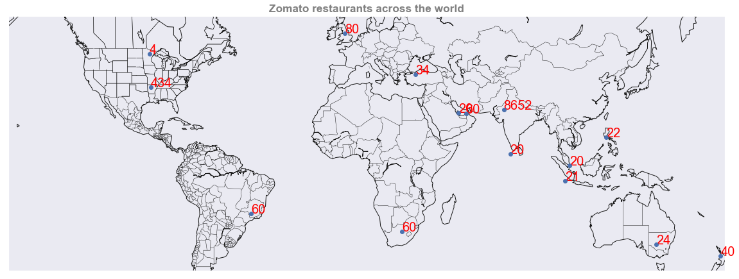
Data Overview
The data set contains information for ~9k restaurants across the world, around 8600 (>90%) of which are in India. For the purpose of further analysis we will restrict our analysis to Indian Restaurants.

Slide 5
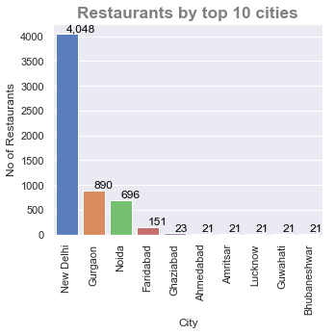
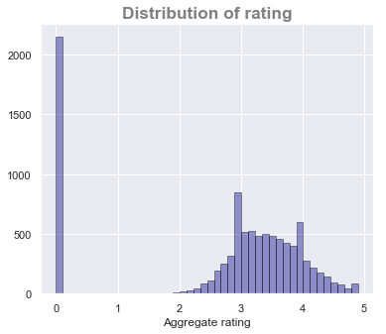
Data Cleaning
New Delhi has most number of restaurants followed by Gurgaon, Noida, Faridabad & Ghaziabad
Ratings are normally distributed between 2 and 5 barring a few spikes which can be seen at 3 & 4
A lot of restaurants are not rated – these have been removed from the data for further analysis
Notes:
New Delhi has most number of restaurants followed by Gurgaon, Noida, Faridabad & Ghazibad. All these 5 cities constitute the greater NCR (National Capital Region ). This could be due to the fact that Zomato, in its initial days started operations in NCR.
A lot of restaurants have no rating. This could be due to the fact that:
They have recently registered on Zomato
No ratings given by customers - so far
These records will be removed from the analysis from here onwards.
Ratings are normally distributed between 2 and 5 barring a few spikes which can be seen at 3 & 4. This tells us that, people in general, rate restaurants either 3 or 4

Slide 6
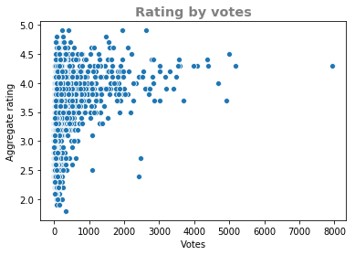
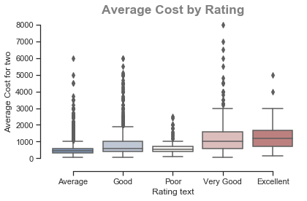
Understanding data by Rating
A majority of restaurants have votes <1500 and a rating between 3 and 4.5
Restaurants with votes >1500 have a rating between 3.5 and 4.3
Restaurants with higher price ranges tend to get better ratings on average
Notes:
A majority of restaurants have votes <1500 and a rating between 3 and 4.5
Restaurants with votes >1500 have a rating between 3.5 and 4.3
Additionally, it could be seen that restaurants with higher price ranges tend to get better ratings on average – though this could be a correlation between better food being more expensive and not an increase in price causing better ratings.

Slide 7
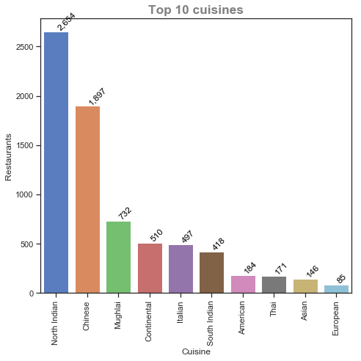
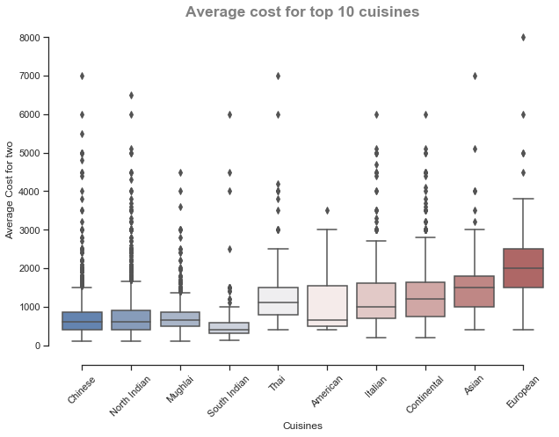
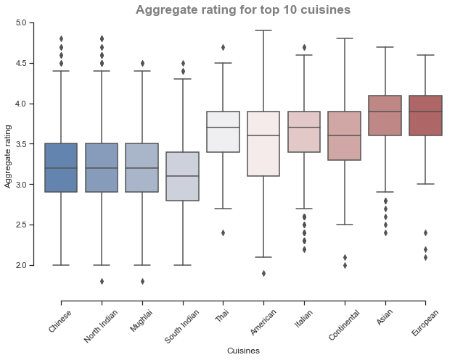
Identifying the Cuisine
Chinese and North Indian are the two main served cuisines
Italian and continental are highly priced and have fewer outlets have high rating
Asian and European are more general cuisines and don’t seem to have much dominance
Notes:
Chinese and North Indian are the two main served cuisines across the restaurants
They are low – mid price range and are rated in same low – mid range
Italian and continental are the two niche cuisines which despite of being highly priced and fewer outlets have high rating
Asian and European are more general cuisines and don’t seem to have much dominance

Slide 8
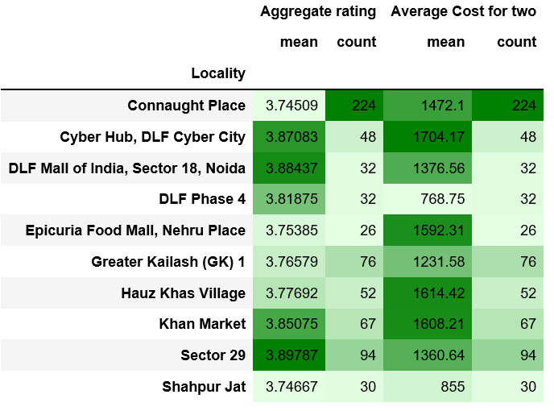
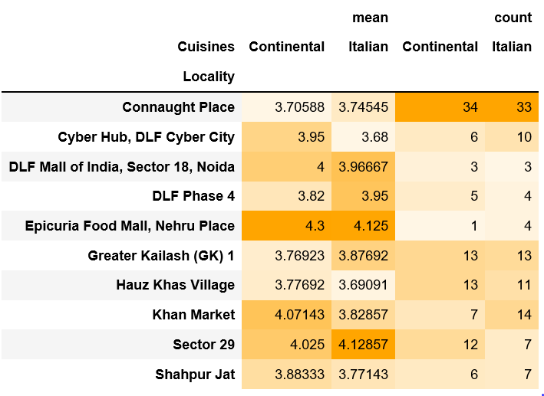
Choosing the Locality
We want to open Italian and Continental restaurants in a locality where:
Average cost across restaurants is high – to make profit
Restaurants are highly rated
Few Italian and Continental restaurants with high rating

Slide 9
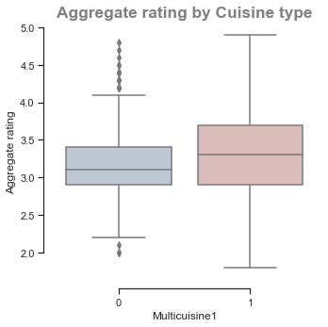
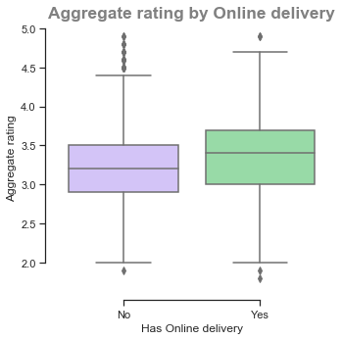
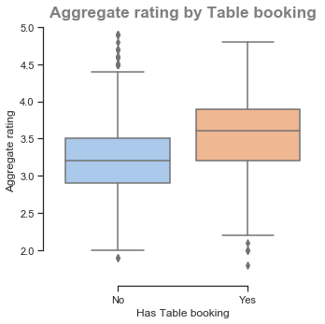
Other features
Restaurants offering Multicuisine, Online delivery and Table booking are rated slightly better over the ones which do not offer

Slide 10
Model Selection
From our model, we identified that
Italian and Continental restaurants have positive impact on rating
Multicuisine and Table booking(Yes) showed positive impact too
Online Delivery (Yes) showed less of a negative impact than Online Delivery (No)
Model Built | Accuracy on Train data | Accuracy on Test data
Logistic Regression | 90.21% | 90.17% (Baseline accuracy = 90.43%)
Decision Tree | 100% | 93%
KNN Classifier | 93% | 91%
LDA | 89% | 89%
Naïve Bayes | 86% | 86%
But we would still not use any model here….

Slide 11
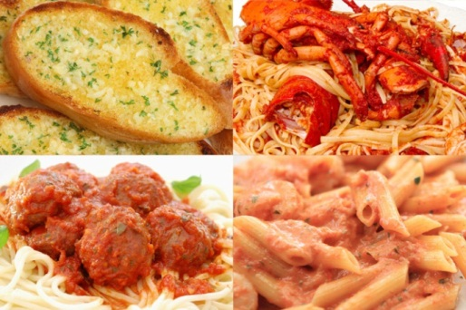



Recommendation
Cuisine : Italian or continental
(Can be a combination - multicuisine)
Locality: Epicura Food Mall, Nehru Place & Sector 29
Other features: Online delivery, Table booking

Slide 12

Takeaways/Next Steps
Takeaways
It’s pretty hard to get a Very Good or Excellent rating
However, we were able to take advantage of the data we had to direct us
Next Steps
Need some way to validate that good ratings actually translate to making money
Importance of “good” food

