Slide 1
SITUATION
$30–50M+
NFL teams bet their
franchises on
quarterback picks
Guaranteed on a top-5 QB rookie contract —
before a single NFL snap
40 QBs
The draft is the single most consequential roster decision in professional football — and the quarterback pick defines a franchise's direction for years.
Teams evaluate QB prospects using a wide array of information; such as college film, efficiency stats, advanced metrics (PPA, usage), and their high school recruiting profile — then commit to a selection with no performance guarantees.
This analysis covers the 2017–2023 draft classes — the era of Mahomes, Burrow, Hurts, and a long list of costly misses.
Received a real chance to start
(2018–2024, ≥16 games played)
7 Classes
Draft years studied (2017–2023),
last 2 seasons of college data used

Slide 2
COMPLICATION
QB outcomes diverge wildly, and teams can't always explain why
68 pts
No proven College-to-NFL translator
01
Efficiency stats, PPA, and usage metrics are all used differently by different front offices. There is no consensus on which signals actually matter.
Recruiting rankings may bias decisions
Gap between the best and worst
composite NFL score in our cohort
02
High composite ratings influence draft positioning — but do they reflect NFL potential or simply prior hype? Systematic bias may be baked into current evaluation.
Despite comparable draft investment,
outcomes vary enormously — something
current evaluation frameworks fail to predict.
Draft round is no guarantee
03
Round 1 QBs appear at both extremes of our NFL composite scores — 5 of 40 scored below 45. There is no consistent framework for identifying which prospects will succeed.

Slide 3
QUESTION
What Actually Predicts Early NFL Success?
Which college QB characteristics — efficiency metrics, PPA, usage, mobility, and recruiting profile — best predict early NFL success, and do recruiting rankings introduce a systematic bias?
Sub-Q A
Can we cluster college QB profiles into meaningful archetypes based on production patterns?
Sub-Q B
Do certain archetypes consistently outperform or underperform expectations in the NFL?
Sub-Q C
Does a QB's recruiting rank predict NFL success better, worse, or independently of college production?

Slide 4
ANSWER PREVIEW
Four Key Findings
01
02
Recruit Ratings Are Noise
Completion % Is Signal
r = −0.10 between 247Sports recruit rating and NFL composite score. Teams pay a premium for the wrong signal.
College completion % has r = +0.33 with NFL success (p < 0.10). Accuracy in college transfers to the NFL.
03
04
Recruiting Bias Is Costly
Late Rounds Can Win
Top-5 most overvalued QBs by recruit prestige averaged a composite score of 32.3 — vs. cohort mean of 57.8.
Brock Purdy (Rd 7, score 87.9) and Gardner Minshew (Rd 6, 67.3) outperformed most Round 1 picks.

Slide 5
METHOD
Data & Sample
Sample: 40 QBs drafted 2017–2024 | ≥16 NFL games played | ≥8 starts in first two seasons | Advanced stats available
Source
What We Used
Coverage
Pro-Football-Reference
NFL passing stats (standard + advanced), rushing stats, draft records
40/40 QBs
Sportradar NCAAFB v7
College sack data (supplemental)
40/40 QBs
College Football Data API
College passing, rushing, PPA, usage, team win %
39/40 QBs
247Sports (via CFBD)
Recruiting composite rating and star rankings
34/40 QBs
40
7
48
5
QBs in cohort
draft classes
(2017–2024)
columns in
model table
data sources
combined

Slide 6
METHOD
Scoring, Clustering & SQL
COMPOSITE NFL SCORE (0–100)
PCA + K-MEANS CLUSTERING
WEIGHT
METRIC COMPONENT
Applied to 40-QB college feature matrix
PCA: 3 components explain 78.7% of variance
PC1 (50%): Passing efficiency — PPA, Yds/Att, usage
PC2 (18%): Volume/usage — INT rate, pass usage
PC3 (11%): Mobility — sack rate, rush yards/att
K-Means k=4 (elbow method): 4 archetype clusters
2×
On-Target Throw %
2×
Bad Throw % (inverted)
1.5×
Completion %
1×
ANY/A, Passer Rating, QBR
1×
TD%, INT% (inverted)
1×
Pressure Rate (inverted)
1×
Rush Yards / Attempt
SQL DATABASE
SQL database (qb_analysis.db) — 5 tables, 10 analytical queries
Examples: avg score by draft round · recruit bias by conference · top college predictors

Slide 7
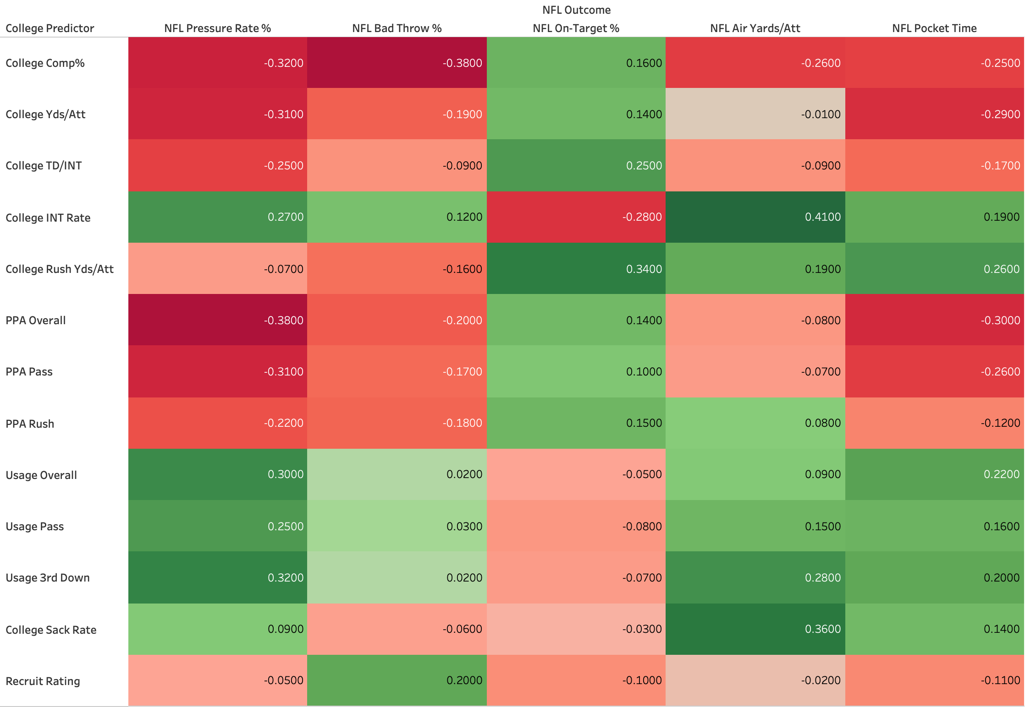
CORRELATIONS
College Traits vs. Early NFL Outcomes
−0.45
PPA Overall → Pressure Rate
Strongest signal: elite college efficiency = less NFL pressure
−0.41
College Yds/Att → Pressure Rate
Deep-ball college passers handle the NFL pass rush better
+0.39
Usage Overall → Pressure Rate
High-volume college QBs may face tougher scheme transitions

Slide 8
RESULTS
Composite NFL Score Rankings
57.8
16.9
20–88
Round 1 picks appear at both extremes — draft round alone is a poor predictor of outcomes.
Cohort mean
Std deviation
Score range
TOP 7
BOTTOM 7
QB
Yr
Rd
Score
QB
Yr
Rd
Score
Brock Purdy
2022
7
87.9
Dwayne Haskins
2019
1
42.8
Drake Maye
2024
1
84.9
J.J. McCarthy
2024
1
35.6
Joe Burrow
2020
1
84.1
Zach Wilson
2021
1
33.6
Jayden Daniels
2024
1
81.0
D.Thompson-Robinson
2023
5
29.5
Justin Herbert
2020
1
80.2
Josh Rosen
2018
1
29.4
Lamar Jackson
2018
1
79.2
Anthony Richardson
2023
1
24.1
Bo Nix
2024
1
76.2
Ryan Finley
2019
4
20.0

Slide 9
RESULTS
Recruiting Bias Analysis
r = −0.10
r = +0.33
r = +0.18
Recruit Rating vs. NFL Score
College Cmp% vs. NFL Score
College PPA vs. NFL Score
MOST OVERVALUED (high recruit prestige, low NFL output)
MOST UNDERVALUED (lower prestige, high NFL output)
QB
Recruit Rtg
NFL Score
Bias
QB
Recruit Rtg
NFL Score
Bias
Josh Rosen
99.3
29.4
+69.9
Brock Purdy
85.9
87.9
−2.0
D.Thompson-Robinson
98.1
29.5
+68.7
Joe Burrow
90.0
84.1
+5.9
Anthony Richardson
92.0
24.1
+67.9
Justin Herbert
86.1
80.2
+5.9
J.J. McCarthy
98.7
35.6
+63.1
Lamar Jackson
88.2
79.2
+9.0
Dwayne Haskins
95.6
42.8
+52.8
Drake Maye
97.2
84.9
+12.3

Slide 10
RESULTS
QB Archetypes: PCA + K-Means (k=4)
PCA: 3 components explain 78.7% of variance · PC1 (50%) = passing efficiency · PC2 (18%) = volume/usage · PC3 (11%) = mobility
Efficient Passers
n=5 avg 63.5
Elite Multi-Dimensional
n=10 avg 61.9
Cmp% 71.6% · PPA 0.616
Cmp% 69.5% · Recruit Rtg avg 98.1
Kyler Murray, Tua Tagovailoa, Mac Jones, Jalen Hurts, Dwayne Haskins
Burrow, Stroud, Daniels, Williams, Lawrence, Nix, Bryce Young, Fields, Mayfield, McCarthy
Highest-floor college profiles. Haskins (42.8) shows efficiency ≠ guaranteed NFL success.
Highest upside but widest bust risk. Young (49.5) & McCarthy (35.6) drag average down.
Raw Dual-Threats
n=7 avg 55.2
Pure Pocket Passers
n=18 avg 54.9
Rush Y/A 3.73 · Cmp% 61.0% · Highest INT rate
Rush Y/A 1.84 · Largest cluster (45% of cohort)
Lamar Jackson, Josh Allen, Anthony Richardson, Sam Howell, Daniel Jones, Will Levis, Spencer Rattler
Herbert, Purdy, Drake Maye, Minshew, Pickett, Darnold, Wilson, Rosen + 10 more
Most volatile cluster: two generational talents (Jackson 79.2, Rattler 63.8) alongside Richardson (24.1).
Widest outcome range (score 20–88). Cluster label alone is not predictive.

Slide 11
CONCLUSIONS
Recommendations & Limitations
For NFL Front Offices
Limitations
Stop over-indexing on recruiting rankings — r = −0.10 is statistically indistinguishable from zero
Prioritize college completion % and PPA — directionally consistent signals (r = +0.33 / +0.18)
5 of 40 Round 1 QBs scored below 45 (Rosen, Wilson, Richardson, McCarthy, Haskins) — draft round ≠ outcome
Late rounds can produce elite performers: Purdy (Rd 7, 87.9) and Minshew (Rd 6, 67.3) outperformed most Rd 1 picks
Sample: n=40, draft years 2018–2024 only (advanced stats era)
NFL outcomes limited to first two seasons — careers evolve significantly after
Recruit ratings missing for 6 QBs (small-school players not tracked by 247Sports)
College stats reflect team context — SOS controls limited by free API tier
Bottom line: College efficiency (completion %, PPA) should be weighted significantly more than recruiting prestige in NFL draft evaluation models.

