Slide 1
Lagrangians in Earnix
Annalee Wiswell
August 2022

Slide 2





What are Lagrange Multipliers?
The method of Lagrange Multipliers is a technique for solving constrained optimization problems
It costs $1 per square inch for the materials to make the bottom and sides of a box.
The box’s lid costs $2 per square inch to make.
What are the dimensions of the largest volume box you can make for $36?
e.g.
maximize the function
$$f(l, w, h) = lwh$$
subject to
$$g(l, w, h) = 1(2lh + 2wh + lw) + 2(lw) = 36$$
$$h$$
$$l$$
$$w$$
Notes:
solution: l = 2”, w = 2”, h = 3”

Slide 3
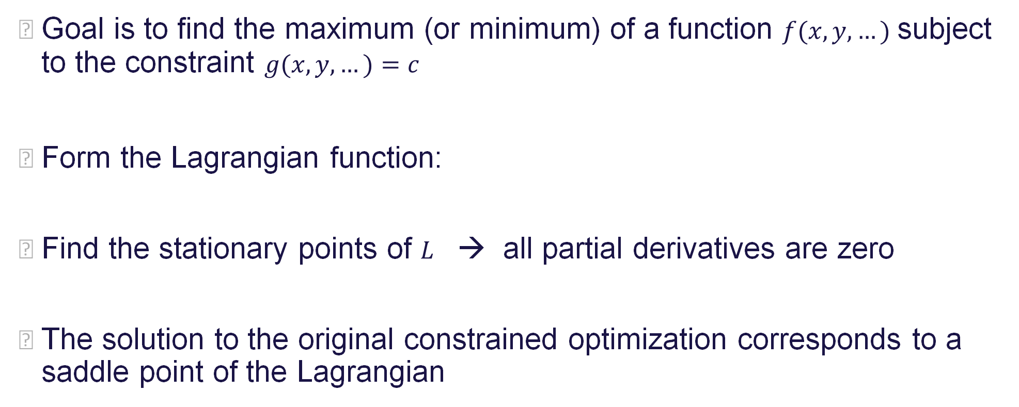
Lagrange Multipliers Overview
Goal is to find the maximum (or minimum) of a function $f(x, y, …)$ subject to the constraint $g(x, y, …)=c$
Form the Lagrangian function:
Find the stationary points of $L$ → all partial derivatives are zero
The solution to the original constrained optimization corresponds to a saddle point of the Lagrangian
$$L\left(x, y, …,λ\right)= f\left(x, y,…\right)− λ(g\left(x, y,…\right)−c)$$

Slide 4
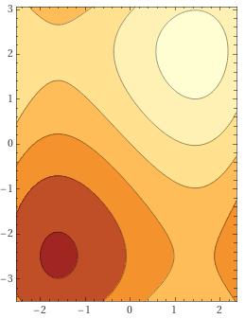
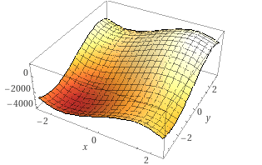
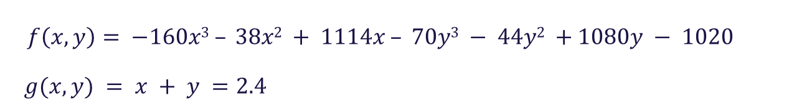

Why do Lagrange Multipliers Work?
Optimal points occur where the contour lines of $f$ and $g$ are tangent
$f\left(x, y\right)= −160x3 – 38x2 + 1114x – 70y3 − 44y2 +1080y − 1020$
$g(x, y) = x + y =2.4$
e.g.

Slide 5
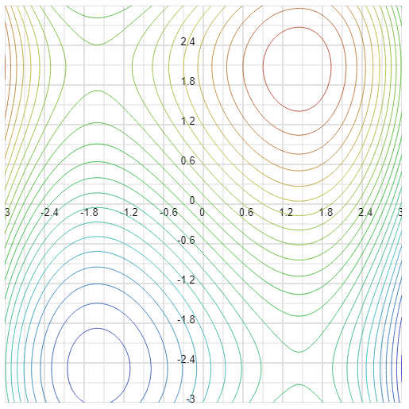
Why do Lagrange Multipliers Work?

Slide 6
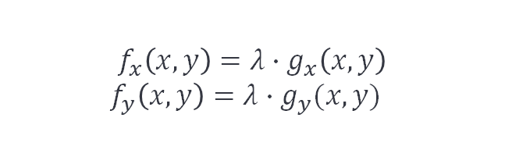





Why do Lagrange Multipliers Work?
Optimal points occur where the contour lines of $f$ and $g$ are tangent
In other words: the gradient vectors of $f$ and $g$ are parallel to each other
Check this out:
$$f_{x}\left(x,y\right)={λ∙g}_{x}\left(x,y\right)$$
$$f_{y}\left(x,y\right)={λ∙g}_{y}(x,y)$$
$$∇f=λ∙∇g$$
$$L\left(x, y, λ\right)= f\left(x, y\right)− λ(g\left(x, y\right)−c)$$
$$L_{x}\left(x,y, λ\right)=f_{x}\left(x,y\right)−{λ∙g}_{x}\left(x,y\right)=0$$
$$L_{y}\left(x,y, λ\right)=f_{y}\left(x,y\right)−{λ∙g}_{y}\left(x,y\right)=0$$
$$L_{λ}\left(x,y, λ\right)=−g\left(x,y\right)+c=0$$
These are exactly the conditions we are after!
$$∇L=0$$

Slide 7

Price Optimization with 2 Policies
Imagine there are only 2 policies up for renewal
For each policy:
renewal premium is $1000∙(\text{price} \text{change} \text{factor})$
probability of retention is a function of the price change factor
expected profit is $(1000∙\left(\text{price} \text{change} \text{factor}\right)−\left(\text{loss} \text{cost}\right))∙(\text{retention})$
Policy | Expiring Premium | Estimated Loss Cost | Price Change Factor | Renewal Premium | Retention
1 | $1000 | $200 | x | 1000x | -0.16x² – 0.07x + 1.1
2 | $1000 | $300 | y | 1000y | -0.07y² – 0.10y + 1.0

Slide 8
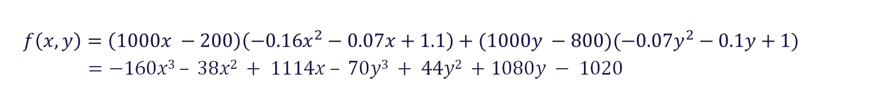
Price Optimization with 2 Policies
Policy | Expiring Premium | Estimated Loss Cost | Price Change Factor | Renewal Premium | Retention
1 | $1000 | $200 | x | 1000x | -0.16x² – 0.07x + 1.1
2 | $1000 | $800 | y | 1000y | -0.07y² – 0.1y + 1
$f\left(x, y\right)=\left(1000x −200\right)\left(−0.16x^{2}−0.07x+1.1\right)+(1000y −800)(−0.07y^{2}−0.1y+1)$
$$=−160x3 – 38x2 + 1114x – 70y3 + 44y2 +1080y − 1020$$
profit

Slide 9
Price Optimization with 2 Policies

Slide 10
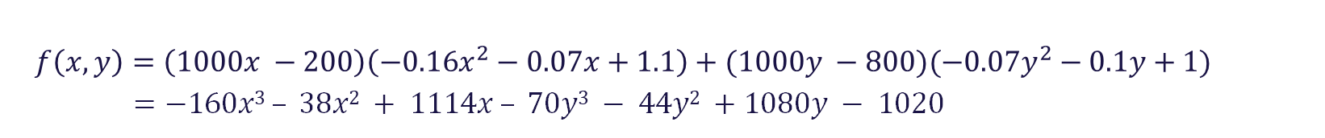
Price Optimization with 2 Policies
Policy | Expiring Premium | Estimated Loss Cost | Price Change Factor | Renewal Premium | Retention
1 | $1000 | $200 | x | 1000x | -0.16x² – 0.07x + 1.1
2 | $1000 | $800 | y | 1000y | -0.07y² – 0.1y + 1
$f\left(x, y\right)=\left(1000x −200\right)\left(−0.16x^{2}−0.07x+1.1\right)+(1000y −800)(−0.07y^{2}−0.1y+1)$
$$=−160x3 – 38x2 + 1114x – 70y3 − 44y2 +1080y − 1020$$
profit
maximum profit of $1454 when x = 1.446 and y = 2.068

Slide 11
Why Constrain Profit?
other business goals, such as growth
retention models only accurate in a small window of price change factors

Slide 12
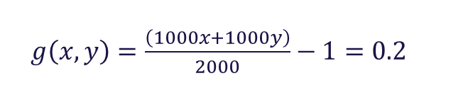

Constrained Optimization with 2 Policies
Policy | Expiring Premium | Estimated Loss Cost | Price Change Factor | Renewal Premium | Retention
1 | $1000 | $200 | x | 1000x | -0.16x² – 0.07x + 1.1
2 | $1000 | $800 | y | 1000y | -0.07y² – 0.1y + 1
$f\left(x, y\right)=\left(1000x −200\right)\left(−0.16x^{2}−0.07x+1.1\right)+(1000y −800)(−0.07y^{2}−0.1y+1)$
$$=−160x3 – 38x2 + 1114x – 70y3 − 44y2 +1080y − 1020$$
profit
$g\left(x, y\right)=\frac{\left(1000x+1000y\right)}{2000}−1=0.2$
额外限制：该业务下的本年车均报价保费较上年上升20%
“rate”
$$g\left(x,y\right)=x+y=2.4$$
change in average offered premium

Slide 13
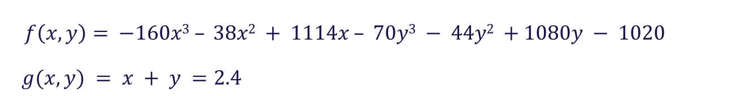
Constrained Optimization with 2 Policies
Policy | Expiring Premium | Estimated Loss Cost | Price Change Factor | Renewal Premium | Retention
1 | $1000 | $200 | x | 1000x | -0.16x² – 0.07x + 1.1
2 | $1000 | $800 | y | 1000y | -0.07y² – 0.1y + 1
$f\left(x, y\right)= −160x3 – 38x2 + 1114x – 70y3 − 44y2 +1080y − 1020$
$g(x, y) = x + y =2.4$
$$L\left(x, y, λ\right)=−160x3 – 38x2 + 1114x – 70y3 − 44y2 +1080y − 1020−λ(x+y−2.4)$$

Slide 14
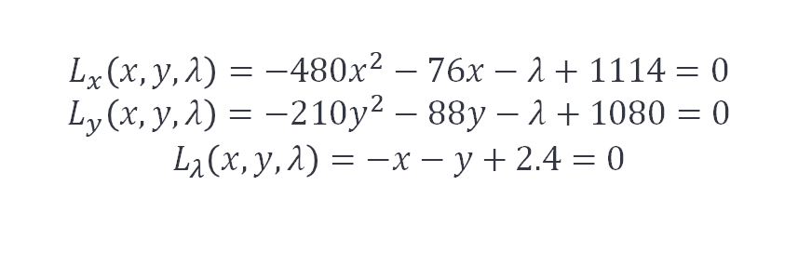
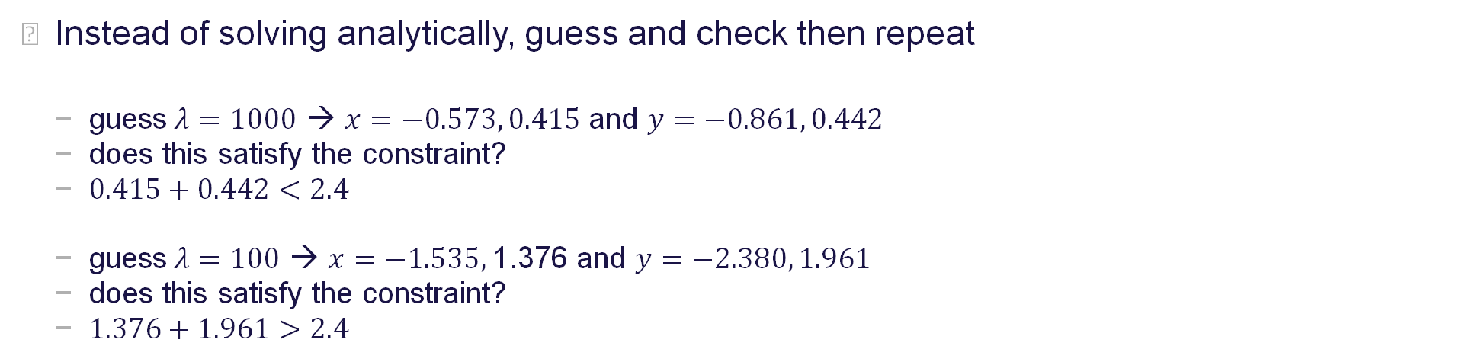

Constrained Optimization with 2 Policies
$$L\left(x, y, λ\right)=−160x3 – 38x2 + 1114x – 70y3 − 44y2 +1080y − 1020−λ(x+y−2.4)$$
$$L_{x}\left(x,y, λ\right)=−480x^{2}−76x−λ+1114=0$$
$$L_{y}\left(x,y, λ\right)=−210y^{2}−88y−λ+1080=0$$
$$L_{λ}\left(x,y, λ\right)=−x−y+2.4=0$$
$$∇L=0$$
Instead of solving analytically, guess and check then repeat
guess$λ=1000$ → $x=−0.573, 0.415$ and $y=−0.861, 0.442$
does this satisfy the constraint?
$0.415+0.442<2.4$
guess$λ=100$ → $x=−1.535,$1.376 and $y=−2.380, 1.961$
does this satisfy the constraint?
$1.376+1.961>2.4$

Slide 15
Constrained Optimization with 2 Policies
Policy | Expiring Premium | Estimated Loss Cost | Price Change Factor | Renewal Premium | Retention
1 | $1000 | $200 | x | 1000x | -0.16x² – 0.07x + 1.1
2 | $1000 | $800 | y | 1000y | -0.07y² – 0.1y + 1
$f\left(x, y\right)= −160x3 – 38x2 + 1114x – 70y3 − 44y2 +1080y − 1020$
$g(x, y) = x + y =2.4$
maximum profit of $1130 when $x = 1.008$and $y = 1.393$
note: $λ=550$

Slide 16
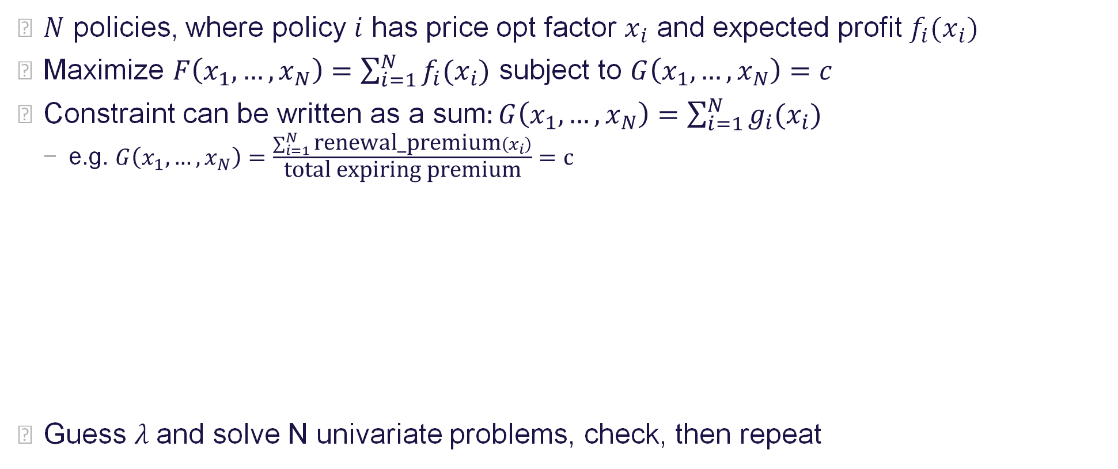

Now Generalize to MANY Policies
$N$ policies, where policy $i$ has price opt factor $x_{i}$ and expected profit $f_{i}(x_{i})$
Maximize $F\left(x_{1},…,x_{N}\right)=\sum_{i=1}^{N}{f_{i}(x_{i})}$ subject to $G\left(x_{1},…,x_{N}\right)=c$
Constraint can be written as a sum$:G\left(x_{1},…,x_{N}\right)=\sum_{i=1}^{N}{g_{i}(x_{i})}$
e.g. $G\left(x_{1},…,x_{N}\right)=\frac{\sum_{i=1}^{N}{\text{renewal}\text{_}\text{premium}\left(x_{i}\right)}}{\text{total} \text{expiring} \text{premium}}=c$
Guess $λ$and solve N univariate problems, check, then repeat
$$\frac{∂L}{∂x_{1}}\left(x_{1},{…,x}_{N}, λ\right)=\frac{∂f_{1}}{∂x_{1}}\left(x_{1}\right)−λ∙\frac{∂g_{1}}{∂x_{1}}\left(x_{1}\right)=0$$
$$…$$
$$\frac{∂L}{∂x_{N}}\left(x_{1},{…,x}_{N}, λ\right)=\frac{∂f_{N}}{∂x_{N}}\left(x_{N}\right)−λ∙\frac{∂g_{N}}{∂x_{N}}\left(x_{N}\right)=0$$
$$\frac{∂L}{∂λ}{(x}_{1},{…,x}_{N})=−G\left(x_{1},{…,x}_{N}\right)+c=0$$
$$∇L=0$$
Notes:
$F$ and $G$ are each sums over all policies, where terms of the sum are independent

Slide 17
How Does Earnix Solve the Univariate Problems?
Default: use an analytical approach
If the function to be optimized is troublesome (e.g. non-continuous), Earnix can perform a grid search

Slide 18
What is λ?
λ measures the increase in the objective obtained through a marginal relaxation in the constraint
Be careful of units in this interpretation
If we are maximizing profit subject to 80% retention, λ tells us the (approximate) additional profit if we decrease the required retention to 79%
e.g.

Slide 19


How Does Earnix Price a New Sample?
To price subsequent policies in real time, use the previously found value for $λ$
Allows pricing one policy at a time and still satisfy aggregate constraints
Solve the univariate problems, but don’t check actual constraint satisfaction
The result will be an approximation, not exact
$$\frac{∂L}{∂x_{1}}\left(x_{1},{…,x}_{N}, λ\right)=\frac{∂f_{1}}{∂x_{1}}\left(x_{1}\right)−λ∙\frac{∂g_{1}}{∂x_{1}}\left(x_{1}\right)=0$$
$$…$$
$$\frac{∂L}{∂x_{N}}\left(x_{1},{…,x}_{N}, λ\right)=\frac{∂f_{N}}{∂x_{N}}\left(x_{N}\right)−λ∙\frac{∂g_{N}}{∂x_{N}}\left(x_{N}\right)=0$$
$$\frac{∂L}{∂λ}{(x}_{1},{…,x}_{N})=−G\left(x_{1},{…,x}_{N}\right)+c=0$$
$$∇L=0$$

