Slide 1
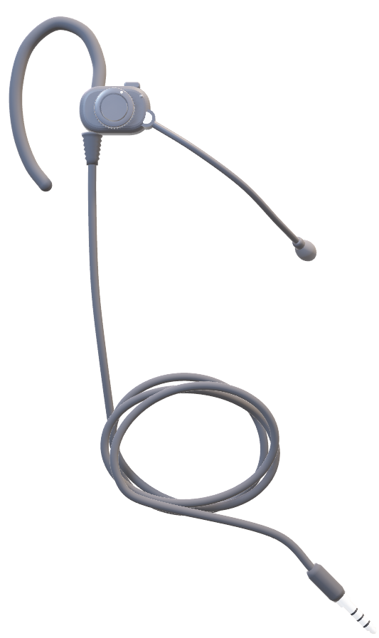
Atelier, by Joule
PROTOTYPE
Introducing

Slide 2
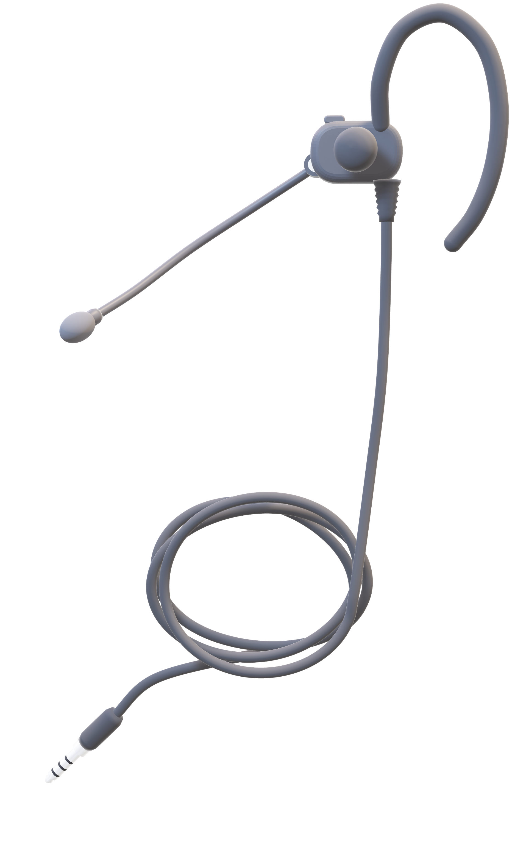
PROTOTYPE
Turn on the earpiece.
On/off button
Everything begins when you turn on the earpiece.
Nothing is recorded if you have the earpiece turned off.

Slide 3
PROTOTYPE
Turn on the earpiece.
On/off button
Everything begins when you turn on the earpiece.
Nothing is recorded if you have the earpiece turned off.

Slide 4

PROTOTYPE
Turn on the earpiece.
On/off button
Everything begins when you turn on the earpiece.
✦ Powered on.
Nothing is recorded if you have the earpiece turned off.

Slide 5
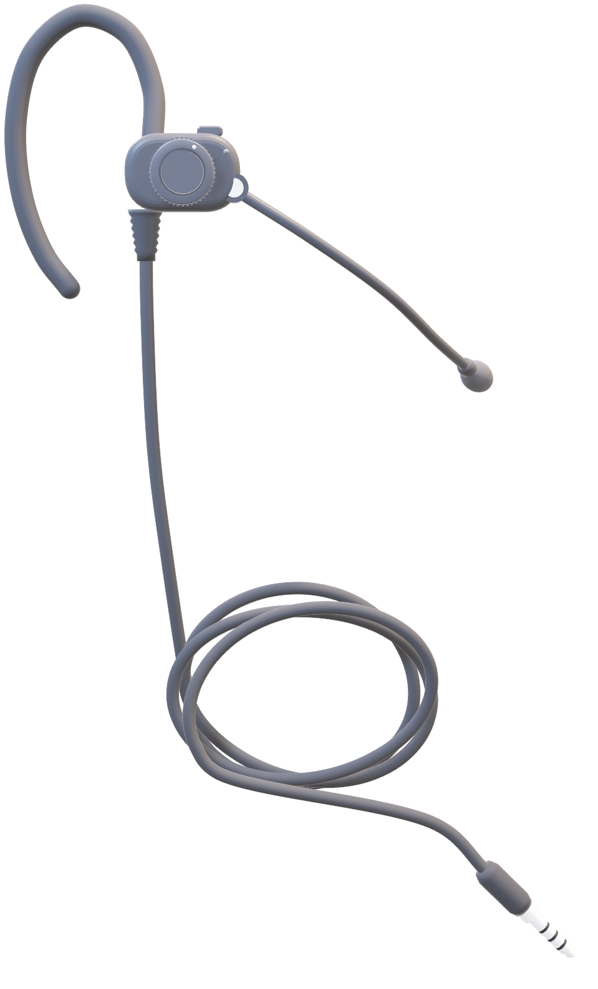
PROTOTYPE
Talk to exactly who you need.
“Hey Joule, connect me to a boutique associate.”
Voice-commands activate specific voice channels.
Use voice-activated commands to talk to the specific person you need

Slide 6

PROTOTYPE
Talk to exactly who you need.
“Hey Joule, connect me to a boutique associate.”
Voice-commands activate specific voice channels.
✦ You’re connected to Josh.
Use voice-activated commands to talk to the specific person you need

Slide 7
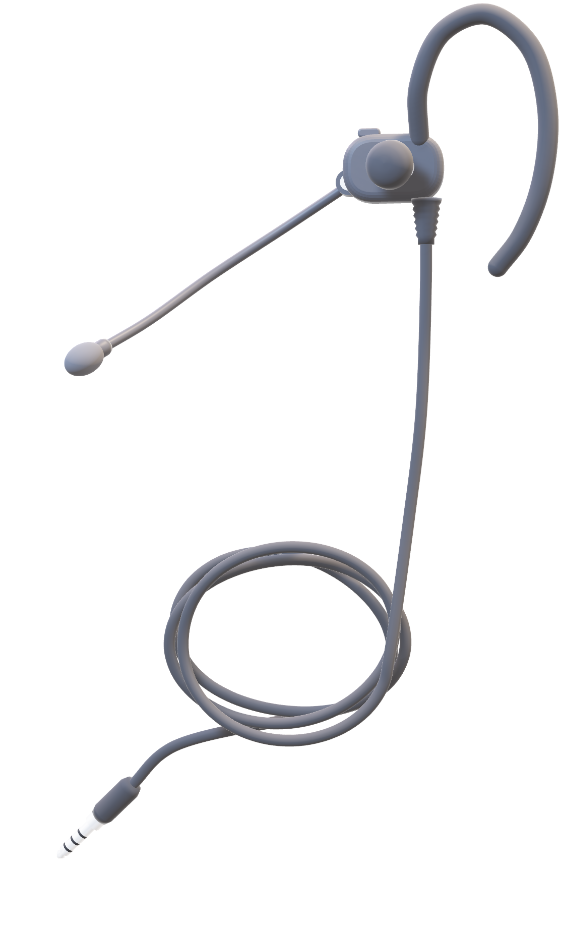
PROTOTYPE
Checking inventory? Just ask.
“Hey Joule, do we have Effortless Pants in Black, size 4?”
Instant inventory checks through the earpiece.
Check stock on floor, in back, nearby stores and online through a voice command.

Slide 8
PROTOTYPE
Checking inventory? Just ask.
“Hey Joule, do we have Effortless Pants in Black, size 4?”
Instant inventory checks through the earpiece.
✦ Yes, six pairs at Metrotown.
Check stock on floor, in back, nearby stores and online through a voice command.

Slide 9
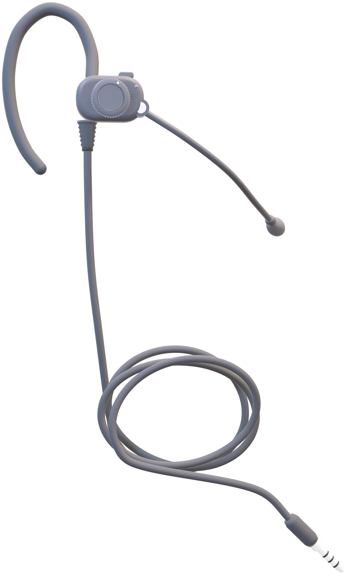
PROTOTYPE
Extract product data from conversations.
✦ “Six people tried on the Effortless Pants today, but no one bought a pair.”
More access to in-depth product and user insights.
Earpieces collect anonymized product data that sync with SAP Business Data Cloud (visualized in Analytics Cloud).

Slide 10
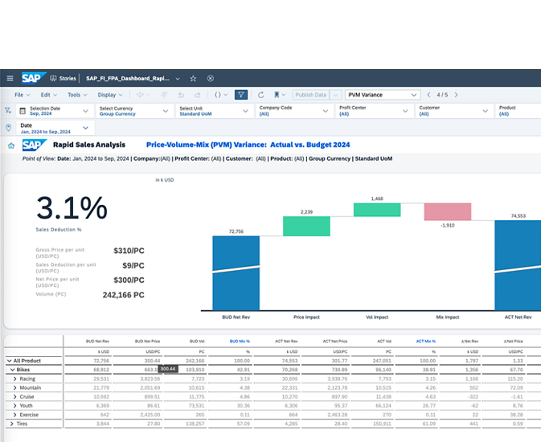

PROTOTYPE
✦ “Synced to Analytics Cloud.

Slide 11
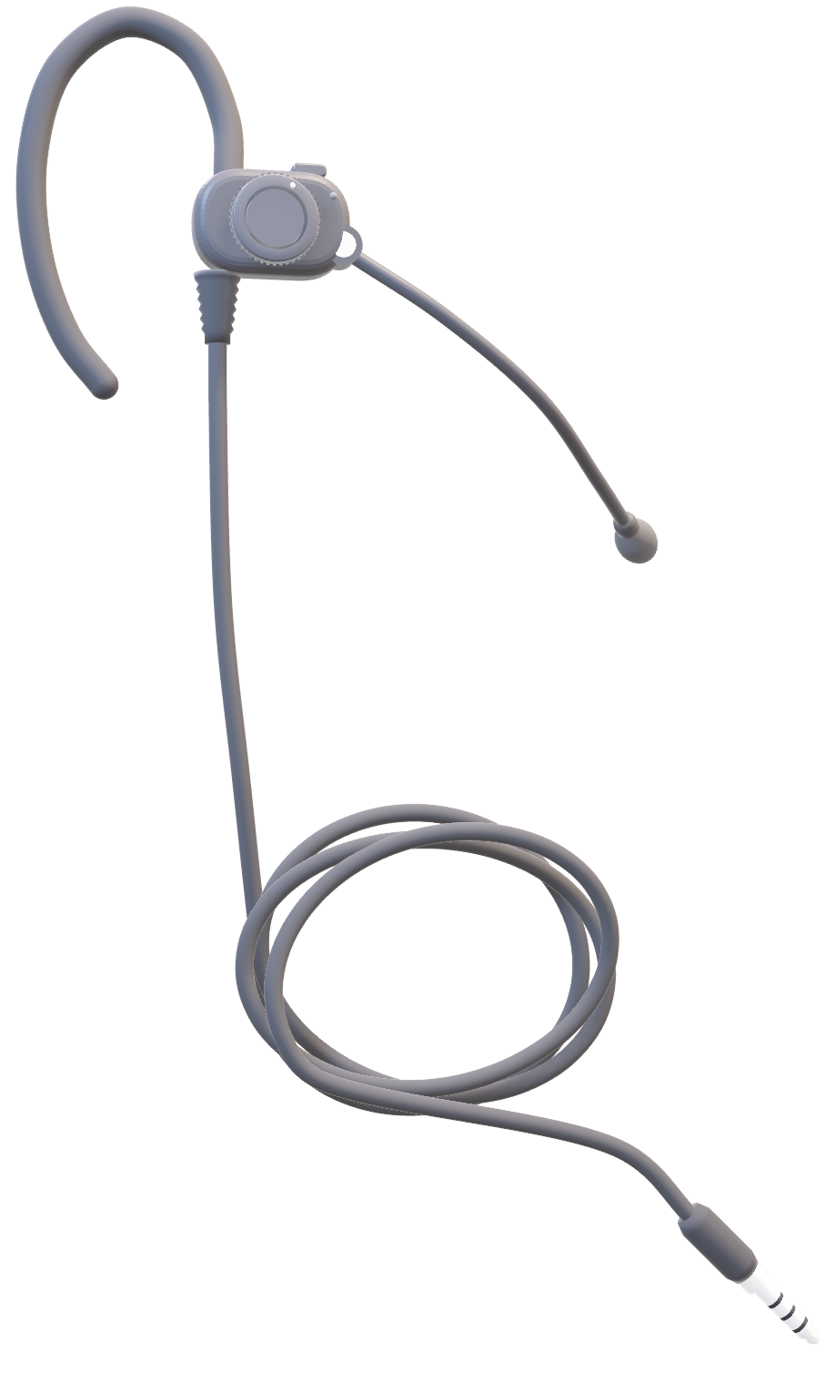
PROTOTYPE

Slide 12
PROTOTYPE
On/off switch
Microphone, flip up to mute
Plugs into work phone. Also available as USB-C.
Volume dial
Adjustable earpiece

