Slide 1

Analysis of Amcat Data
Priya Kumari
IN1240159

Slide 2
About me
My name is Priya Kumari. I'm currently pursuing a degree in computer science and possess strong skills in Python and problem-solving. My academic journey has ignited a profound interest in data science, machine learning, AI, and technology innovation. I'm driven by the potential of these fields to revolutionize industries and improve lives, and I'm eager to contribute to cutting-edge projects in these domains.
Why I want to learn Data Science: Data science represents the perfect amalgamation of my skills and interests. I see it as a powerful tool to leverage my Python expertise and problem-solving abilities to tackle real-world challenges. The prospect of uncovering insights from data and utilizing them to drive informed decisions excites me. I'm particularly drawn to the interdisciplinary nature of data science, which allows me to explore diverse domains and make meaningful contributions.
Linkedin: https://www.linkedin.com/in/connectwithpriyak
Github: https://github.com/cherrywine-04

Slide 3
Introduction
Business Problem and Use case domain understanding :
The Aspiring Mind Employment Outcome 2015 (AMEO) dataset, curated by Aspiring Minds, is a comprehensive repository that sheds light on the employment trajectories of engineering graduates. Boasting around 4000 data points and approximately 40 independent variables, this dataset delves deep into various facets, including demographic attributes, standardized scores capturing cognitive, technical, and personality proficiencies, alongside employment-centric variables such as salary, job designations, and geographic placements. By encapsulating such a broad spectrum of information, the AMEO dataset provides invaluable insights into the multifaceted factors that shape the career paths of engineering graduates.
Objective:
The primary aim of this research is to examine the factors that impact the employment outcomes of engineering graduates. This involves investigating the relationships between demographic characteristics, standardized skill assessments, and employment indicators such as salary, job roles, and geographic locations. Through comprehensive data analysis and statistical modeling, the goal is to pinpoint key predictors of employment success among engineering graduates.

Slide 4
Web Scrapping Details
Web Site Scrapped :
data provided by Innomatics Research labs
Data Collection : data provided by innomatics research labs
Data Cleaning : Pandas , numpy
Data Visualization: Matplotlib, Seaborn

Slide 5
Data Cleaning
Step 1: Check for Duplicates:
Find the Duplicates and drop them, keep preference as first.
Step 2: Identify the Corrupted Data:
Remove the Corrupted values, symbols or text etc..,
Step 3 : Handling missing values:
Identify missing values using `isna()` or `isnull()` View the missing values
Replace the missing values after changing the dtypes of the columns with respective Mean(), Median(),
Step 4 : Handling Outliers:
Find the skewness for each column and based on the value move forward. Identify the Outliers using IQR method or Z-score method and view them.
Step 5: Treating Outliers:
Either Drop the Outliers if they have no effect on your Data Frame.
Do the 4 Transformation techniques that are available to reduce the outliers to use it as a new column for better visualization.

Slide 6
Data Manipulation
Data Manipulation contains the following steps:
Type Casting of Data Frame columns to the respective dtypes.
Filtering the Dataset according to the need for better understanding.
Data Frame operations like `Column Renaming`, `Dropping rows and columns`, `Resettingndex` etc..,
Sorting the data in a data frame.
pplying string operations, Array operations , list operations etc.., on the data.

Slide 7
UNIVARIATE ANAYLYSIS:
Univariate data consists of only one variable. The analysis of univariate data is thus the simplest form of analysis since the information deals with only one quantity that changes.
Categorical
Countplot used
Numerical
Bar plot, box plot

Slide 8
BIVARIATE ANALYSIS:
Bivariate data involves two different variables. The analysis of this type of data deals with causes and relationships and the analysis is done to find out the relationship among the two variables.
Categorical and Categorical:
Stacked bar plot
Categorical and Numerical
Box plot
Numerical and Numerical
Scatter plot

Slide 9
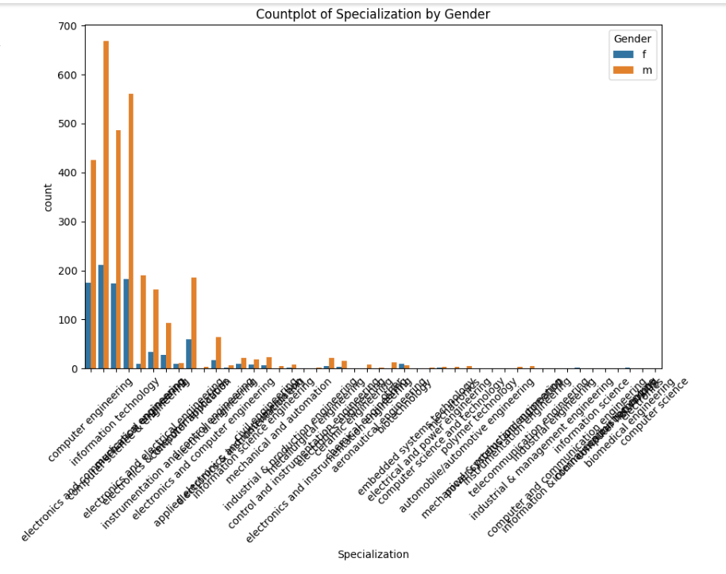
Who is more interested in Specialization ?

Slide 10
Conclusion:
Skill Proficiency and Employment Success:
The dataset highlights the importance of cognitive, technical, and personality skills in determining employment outcomes. Higher standardized scores in these areas correlate with better job prospects and potentially higher salaries for engineering graduates.
Demographic Influences:
Demographic features such as gender, age, and educational background also play a role in shaping employment outcomes. Gender disparities may exist in terms of job opportunities, salary offers, and specialization preferences, warranting further investigation and potential interventions to promote gender equity in the engineering workforce.
Salary Expectations and Job Roles:
The analysis supports the claim that certain job roles, such as Programming Analyst, Software Engineer, Hardware Engineer, and Associate Engineer, offer competitive salary prospects for fresh graduates with a Computer Science Engineering background. However, further analysis may be needed to assess the variability in salary offers across different job titles and locations.

Slide 11

THANK YOU

