Slide 1
Cyberphysical Systems: Invariants
Sayan Mitra
Verifying cyberphysical systems
mitras@illinois.edu

Slide 2

How to prove invariants of hybrid automata
Theorem 7.1. Given an HIOA $𝒜=⟨X,Θ, A,D, T⟩$, if a set of states $I⊆val\left(X\right)$ satisfies the following:
(Start condition) For any starting state $x∈Θ, x∈I$ and
(Transition closure) For any action $a∈A$, if and $x→_{a}x^{′}$and $x∈I$ then $x^{′}∈I$, and
(Trajectory closure) For any trajectory $τ∈T$ if $τ.fstate∈I$ then $τ.lstate∈I$
Then $I$ is an inductive invariant of $𝒜$.

Slide 3
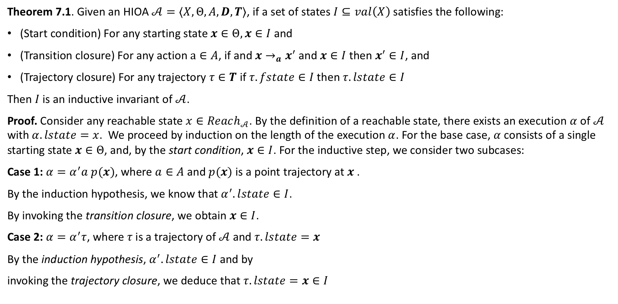
How to prove invariants of hybrid automata
Theorem 7.1. Given an HIOA $𝒜=⟨X,Θ, A,D, T⟩$, if a set of states $I⊆val\left(X\right)$ satisfies the following:
(Start condition) For any starting state $x∈Θ, x∈I$ and
(Transition closure) For any action $a∈A$, if and $x→_{a}x^{′}$and $x∈I$ then $x^{′}∈I$, and
(Trajectory closure) For any trajectory $τ∈T$ if $τ.fstate∈I$ then $τ.lstate∈I$
Then $I$ is an inductive invariant of $𝒜$.
Proof. Consider any reachable state $x∈Reach_{𝒜}$. By the definition of a reachable state, there exists an execution $α$ of $𝒜$ with $α.lstate=x$. We proceed by induction on the length of the execution $α$. For the base case, $α$consists of a single starting state $x∈Θ$, and, by the start condition, $x∈I$. For the inductive step, we consider two subcases:
Case 1: $α=α^{′}a p(x)$, where $a∈A$ and $p(x)$ is a point trajectory at $x$ .
By the induction hypothesis, we know that $α^{′}.lstate∈I$.
By invoking the transition closure, we obtain $x∈I$.
Case 2: $α=α^{′}τ$, where $τ$is a trajectory of $𝒜$ and $τ.lstate=x$
By the induction hypothesis, $α^{′}.lstate∈I$ and by
invoking the trajectory closure, we deduce that $τ.lstate=x∈I$

Slide 4
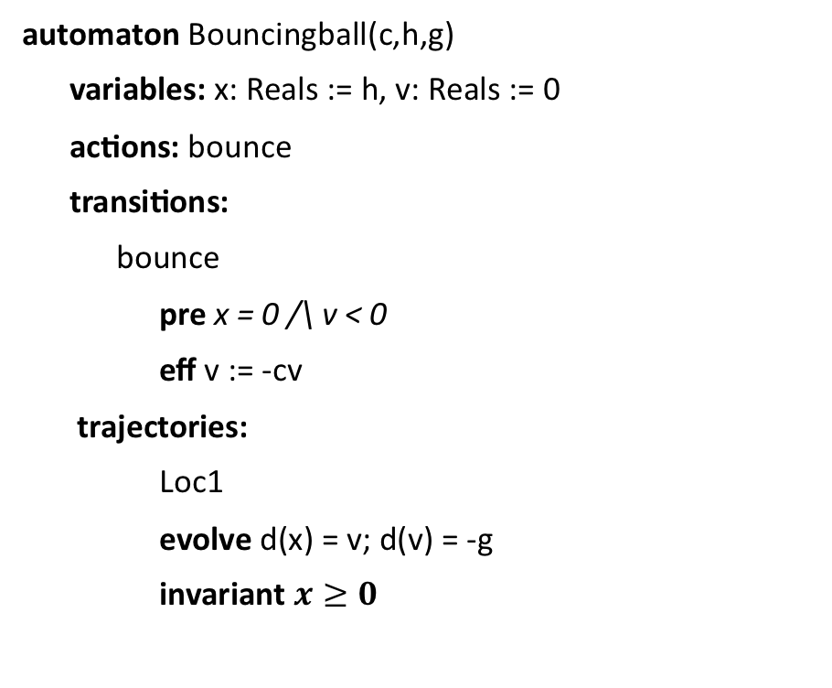
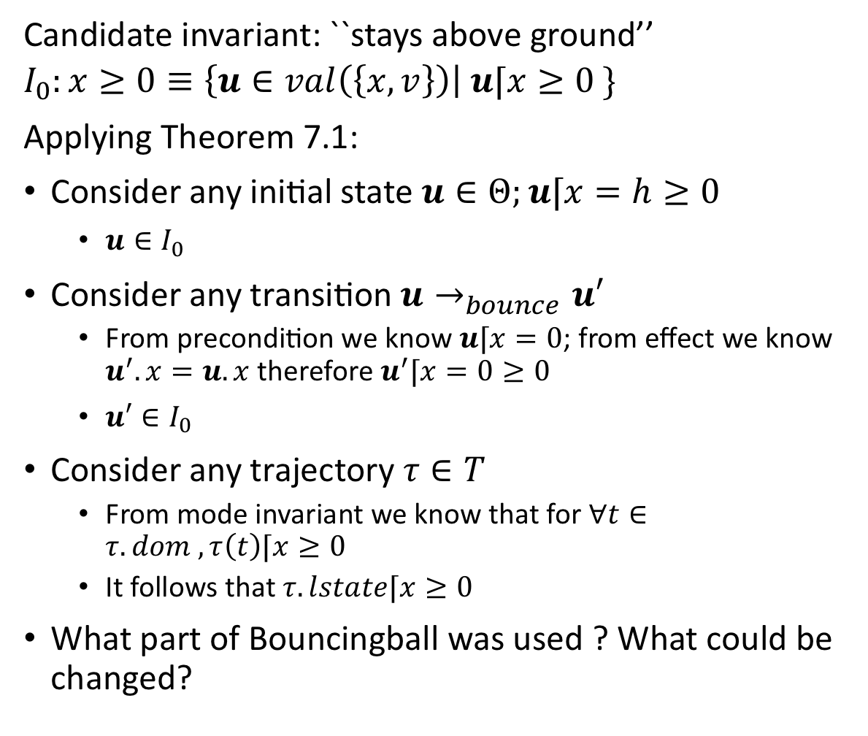
An application
Candidate invariant: ``stays above ground’’
$$I_{0}:x≥0≡\left\{u∈val\left(\left\{x,v\right\}\right)\right| u⌈x≥0 \}$$
Applying Theorem 7.1:
Consider any initial state $u∈Θ;u⌈x=h≥0$
$u∈I_{0}$
Consider any transition $u→_{bounce}u′$
From precondition we know $u⌈x=0$; from effect we know $u^{′}.x=u.x$ therefore $u^{′}⌈x=0≥0$
$u′∈I_{0}$
Consider any trajectory $τ∈T$
From mode invariant we know that for $∀t∈τ. dom , τ\left(t\right)⌈x≥0$
It follows that $τ.lstate⌈x≥0$
What part of Bouncingball was used ? What could be changed?
automaton Bouncingball(c,h,g)
variables: x: Reals := h, v: Reals := 0
actions: bounce
transitions:
bounce
pre x = 0 /\ v < 0
eff v := -cv
trajectories:
Loc1
evolve d(x) = v; d(v) = -g
invariant $x≥0$

Slide 5
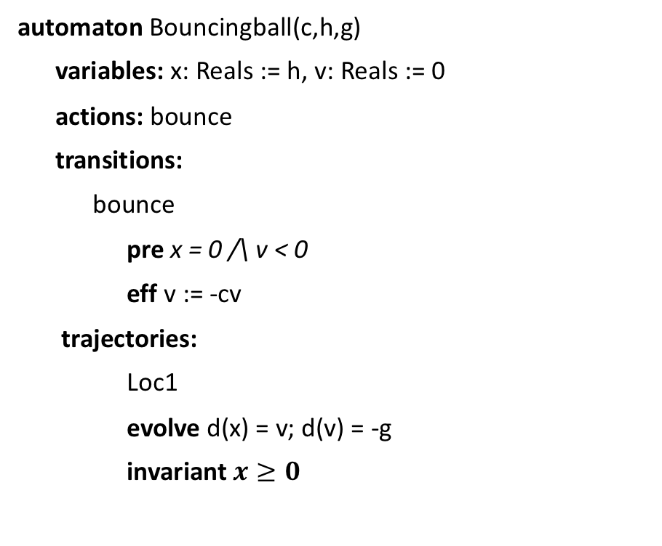
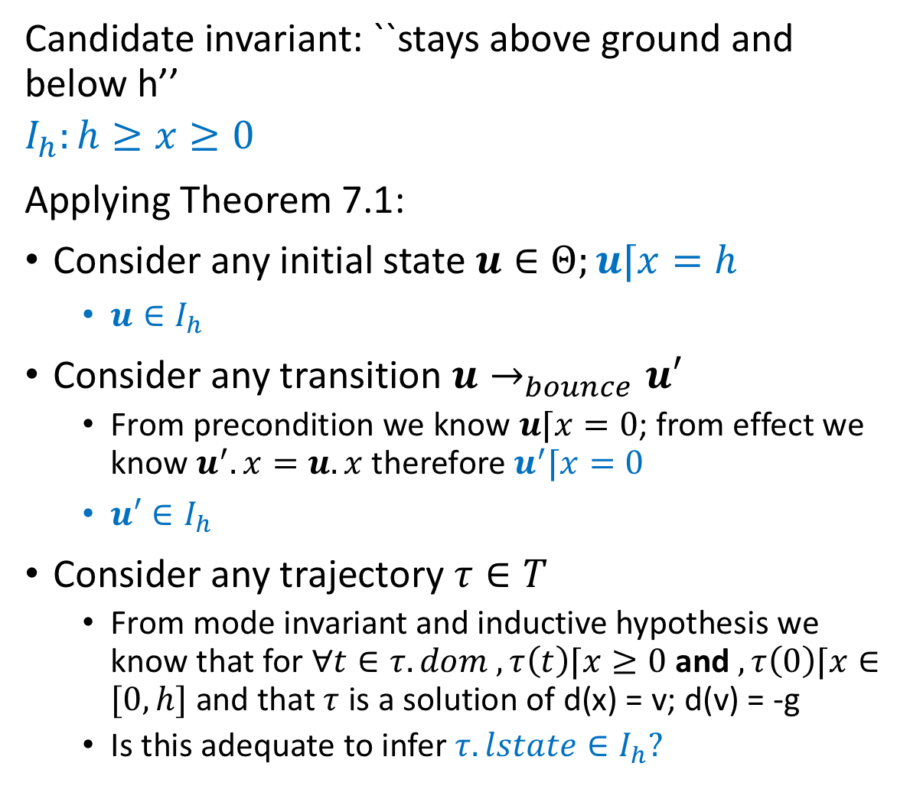
An application
Candidate invariant: ``stays above ground and below h’’
$$I_{h}:h≥x≥0$$
Applying Theorem 7.1:
Consider any initial state $u∈Θ;u⌈x=h$
$u∈I_{h}$
Consider any transition $u→_{bounce}u′$
From precondition we know $u⌈x=0$; from effect we know $u^{′}.x=u.x$ therefore $u^{′}⌈x=0$
$u′∈I_{h}$
Consider any trajectory $τ∈T$
From mode invariant and inductive hypothesis we know that for $∀t∈τ. dom , τ\left(t\right)⌈x≥0$ and $, τ\left(0\right)⌈x∈[0,h]$ and that $τ$ is a solution of d(x) = v; d(v) = -g
Is this adequate to infer $τ. lstate∈I_{h}?$
automaton Bouncingball(c,h,g)
variables: x: Reals := h, v: Reals := 0
actions: bounce
transitions:
bounce
pre x = 0 /\ v < 0
eff v := -cv
trajectories:
Loc1
evolve d(x) = v; d(v) = -g
invariant $x≥0$

Slide 6
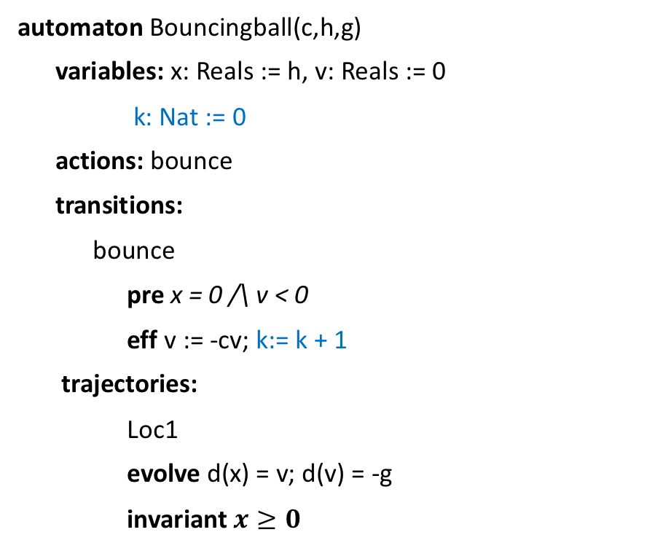

Strengthened invariant
Candidate invariant: ``stays above ground and below h’’
$$I_{v}:v^{2}−2g\left(hc^{2k}−x\right)=0$$
Applying Theorem 7.1:
Consider any initial state $u∈Θ;u⌈x=h$; $u⌈k=0$
$u∈I_{v}$
Exercise: Finish the rest
automaton Bouncingball(c,h,g)
variables: x: Reals := h, v: Reals := 0
k: Nat := 0
actions: bounce
transitions:
bounce
pre x = 0 /\ v < 0
eff v := -cv; k:= k + 1
trajectories:
Loc1
evolve d(x) = v; d(v) = -g
invariant $x≥0$

Slide 7
Summary
Theorem 7.1 gives a sufficient condition for proving inductive invariants
Not all invariants are inductive
We often have to strengthen invariants to make them inductive
Read examples in Chapter 7

Slide 8
Floyd-Hoare Proofs
The core idea of inductive invariants dates back to the classical program analysis technique called Floyd-Hoare logic
The logic provides a set of rules for deducing correctness of automata, programs
The logic is built on Hoare triples, which describes how the execution of a statement (or line of code) changes the state of the automaton:
P c Q where
P and Q are predicates on the program variables and are called the precondition and postcondition
c is a statement describing program variable change
The triple implies that when the precondition P is met, execution of c establishes the postcondition Q

Slide 9
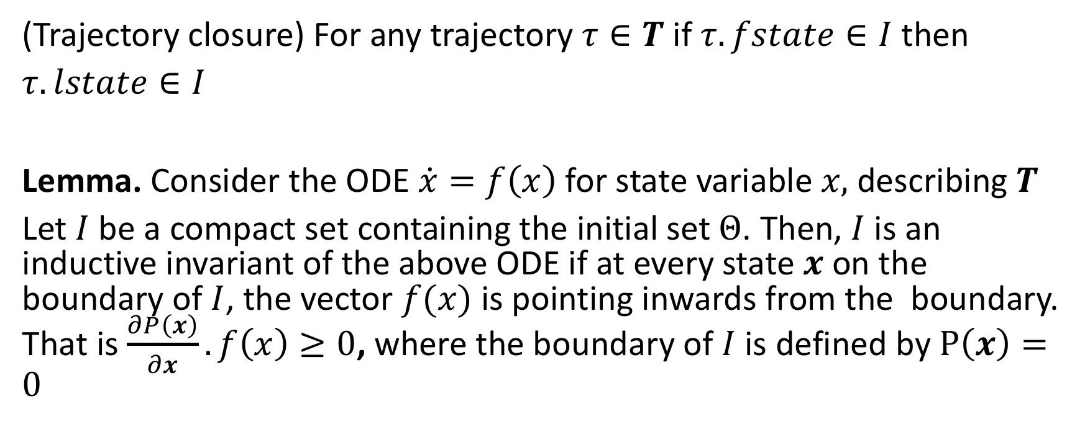
Sub-tangential conditions. Checking trajectory conditions without solving ODEs
(Trajectory closure) For any trajectory $τ∈T$ if $τ.fstate∈I$ then $τ.lstate∈I$
Lemma. Consider the ODE $\dot{x}=f\left(x\right)$ for state variable $x,$ describing $T$
Let $I$ be a compact set containing the initial set $Θ$. Then, $I$ is an inductive invariant of the above ODE if at every state $x$ on the boundary of $I$, the vector $f(x)$ is pointing inwards from the boundary. That is $\frac{∂P\left(x\right)}{∂x}.f\left(x\right)≥0$, where the boundary of $I$ is defined by $P\left(x\right)=0$

Slide 10
Checking sub-tangential condition

Slide 11
Assignments
Chapter 7
Examples: Mutual exclusion, helicopter model
Barrier certificates
Project proposals due thursday

