Slide 1
CTL Model Checking
Sayan Mitra
Verifying cyberphysical systems
mitras@illinois.edu

Slide 2
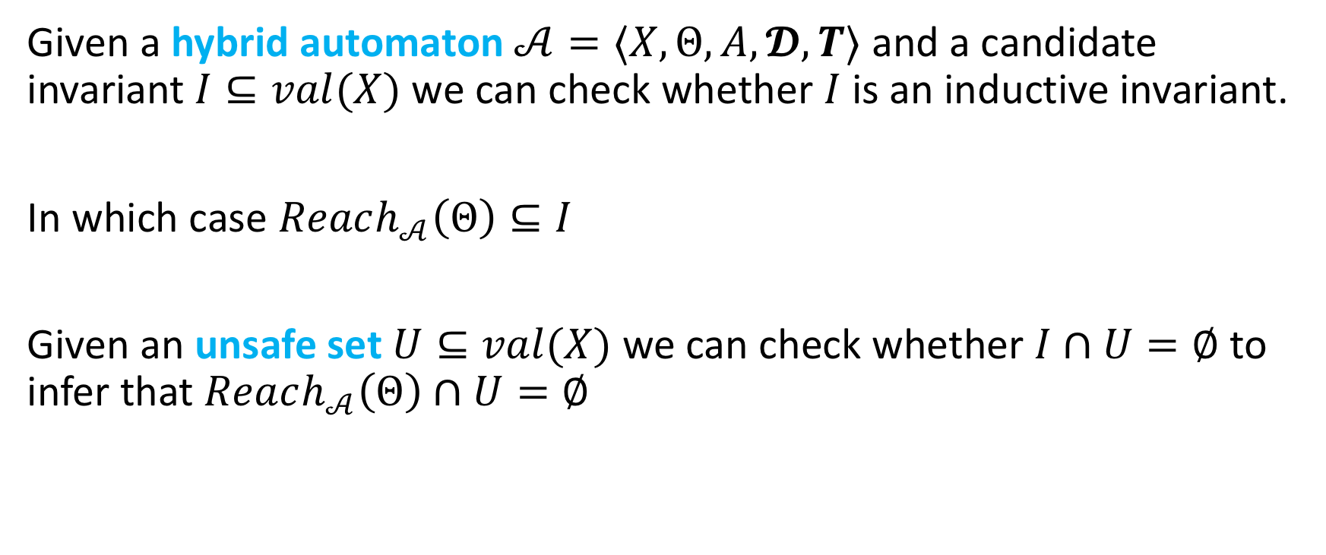
Verification thus far: Invariants and safety
Given a hybrid automaton $𝒜=〈X,Θ, A, 𝓓,T〉$ and a candidate invariant $I⊆val(X)$ we can check whether $I$ is an inductive invariant.
In which case $Reach_{𝒜}\left(Θ\right)⊆I$
Given an unsafe set $U⊆val(X)$ we can check whether $I∩U=∅$ to infer that $Reach_{𝒜}\left(Θ\right)∩U=∅$

Slide 3
What about more general types of requirements, e.g.,
“Eventually the light turns red and prior to that the orange light blinks”
“After failures, eventually there is just one token in the system”
How to express and verify such properties?

Slide 4
Outline
Temporal logics
Computational Tree Logic (CTL)
CTL model checking
Setup
CTL syntax and semantics
Model checking algorithms
Example
References: Model Checking, Second Edition, by Edmund M. Clarke, Jr., Orna Grumberg, Daniel Kroening, Doron Peled and Helmut Veith
Principles of Model Checking, by Christel Baier and Joost-Pieter Katoen

Slide 5
Introduction to temporal logics
Temporal logics give a formal language for representing, and reasoning about, propositions qualified in terms of time or in a sequence
Amir Pnueli received the ACM Turing Award (1996) for seminal work introducing temporal logic into computer science and for outstanding contributions to program and systems verification.
Large follow-up literature, e.g., different temporal logics MTL, MITL, PCTL, ACTL, STL, applications in synthesis and monitoring
Notes:
Bachelor's degree in mathematics from the Technion in Haifa, and Ph.D. in applied mathematics from the Weizmann Institute of Science. His thesis was on the topic of "Calculation of Tides in the Ocean".

Slide 6
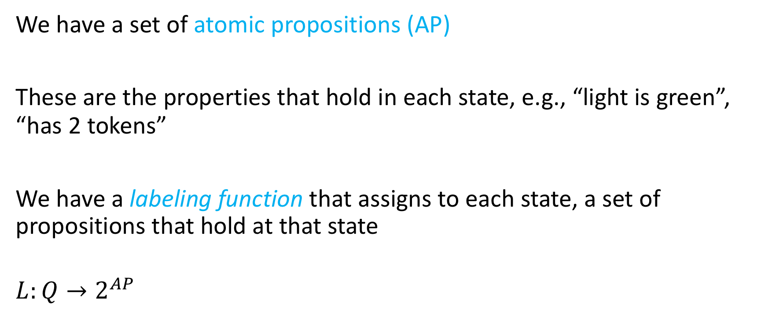
Setup: States are labeled
We have a set of atomic propositions (AP)
These are the properties that hold in each state, e.g., “light is green”, “has 2 tokens”
We have a labeling function that assigns to each state, a set of propositions that hold at that state
$$L:Q→2^{AP}$$

Slide 7

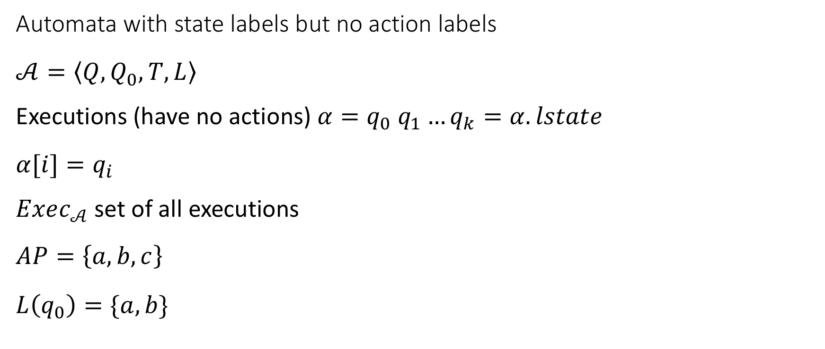


Notations
Automata with state labels but no action labels
$$𝒜=\left\langle Q,Q_{0},T,L\right\rangle$$
Executions (have no actions) $α=q_{0} q_{1}…q_{k}=α.lstate$
$$α[i]=q_{i}$$
$Exec_{𝒜}$ set of all executions
$$AP=\left\{a,b,c\right\}$$
$$L\left(q_{0}\right)=\{a,b\}$$
$$q_{0}$$
$$\{a,b\}$$
$$q_{1}$$
$$\{b,c\}$$
$$q_{2}$$
$$\{c\}$$

Slide 8
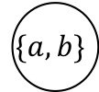

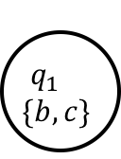


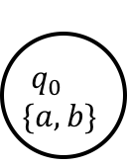
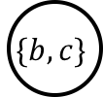
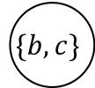


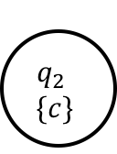


Computational tree logic (CTL)
Unfolding the automaton
We get a tree
A CTL formula allows us to specify subsets of paths in this tree
$$q_{0}$$
$$\{a,b\}$$
$$q_{1}$$
$$\{b,c\}$$
$$q_{2}$$
$$\{c\}$$
$$\{a,b\}$$
$$\{b,c\}$$
$$\{c\}$$
$$\{a,b\}$$
$$\{c\}$$
$$\{c\}$$
$$\{b,c\}$$
$$\{c\}$$
$$\{c\}$$
$$\{c\}$$

Slide 9
CTL quantifiers
Path quantifiers
E: Exists some path
A: All paths
Temporal operators
X: Next state
U: Until
F: Eventually
G: Globally (Always)

Slide 10
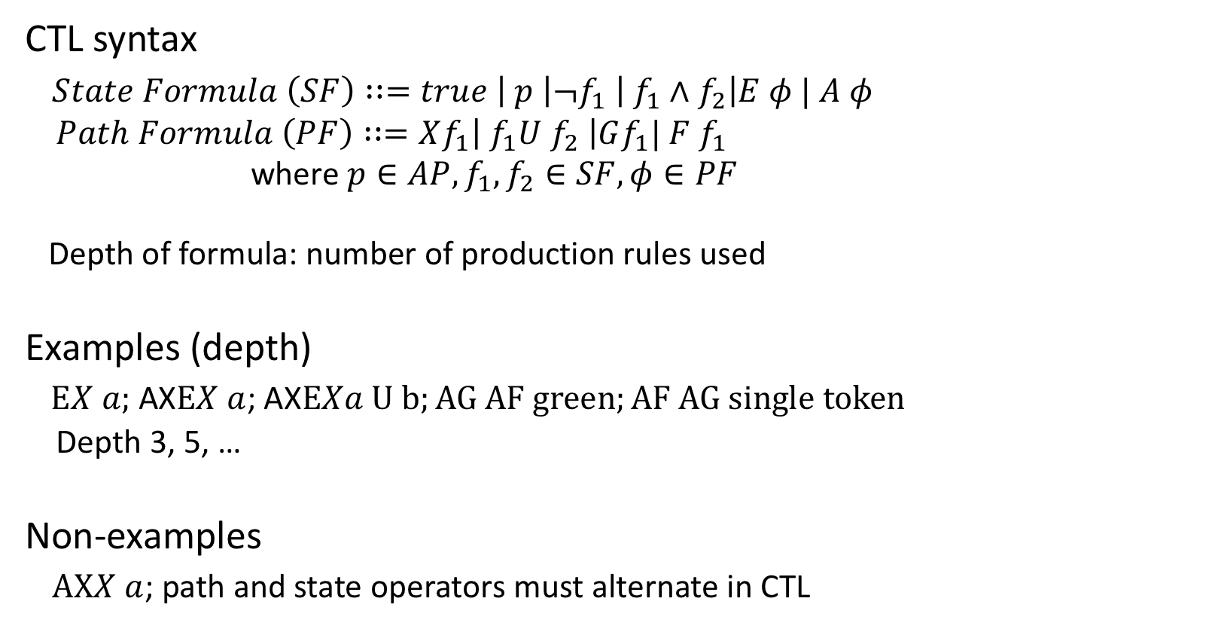
CTL syntax
CTL syntax
$State Formula \left(SF\right)∷=true \left| p \right|¬f_{1} \left| f_{1}∧f_{2}\right|E φ | A φ$
$Path Formula \left(PF\right)∷=Xf_{1}\left| f_{1}U f_{2} \right|Gf_{1}| F f_{1}$
where $p∈AP, f_{1},f_{2}∈SF, φ∈PF$
Depth of formula: number of production rules used
Examples (depth)
$EX a;$ AX$EX a$; AX$EXa U b;AG AF green;AF AG single token$
Depth 3, 5, …
Non-examples
$AXX a$; path and state operators must alternate in CTL

Slide 11
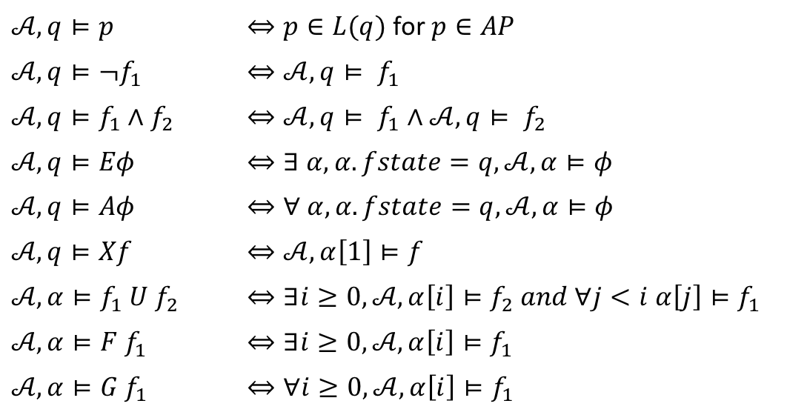

CTL semantics
Given automaton $𝒜=〈Q,Q_{0}, T,L〉, q∈Q$ and a CTL formula $φ, q⊨φ$ denotes that $q$ satisfies $φ;$ $α⊨φ$ denotes that path (execution) $α$ satisfies $φ.$ The relation $⊨$ is defined inductively as:
$𝒜,q⊨p$ | $⇔p∈L(q)$ for $p∈AP$
$𝒜,q⊨¬f_{1}$ | $$⇔𝒜,q⊨ f_{1}$$
$𝒜,q⊨f_{1}∧f_{2}$ | $$⇔𝒜,q⊨ f_{1}∧𝒜,q⊨ f_{2}$$
$$𝒜,q⊨Eφ$$ | $$⇔∃ α, α.fstate=q, 𝒜,α⊨φ$$
$$𝒜,q⊨Aφ$$ | $$⇔∀ α, α.fstate=q, 𝒜,α⊨φ$$
$$𝒜,q⊨Xf$$ | $$⇔𝒜,α\left[1\right]⊨f$$
$$𝒜,α⊨f_{1} U f_{2}$$ | $⇔∃i≥0, 𝒜,α\left[i\right]⊨f_{2} and ∀j<i α\left[j\right]⊨f_{1}$
$$𝒜,α⊨F f_{1}$$ | $$⇔∃i≥0, 𝒜,α\left[i\right]⊨f_{1}$$
$$𝒜,α⊨G f_{1}$$ | $$⇔∀i≥0, 𝒜,α\left[i\right]⊨f_{1}$$
Automaton satisfies property: $𝒜⊨f$ iff $∀q∈Q_{0},𝒜, q⊨f$

Slide 12
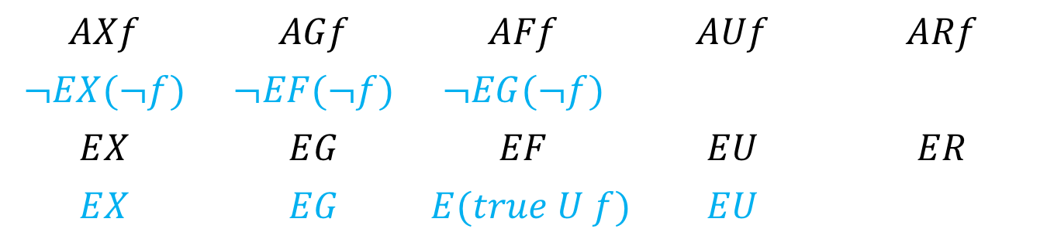
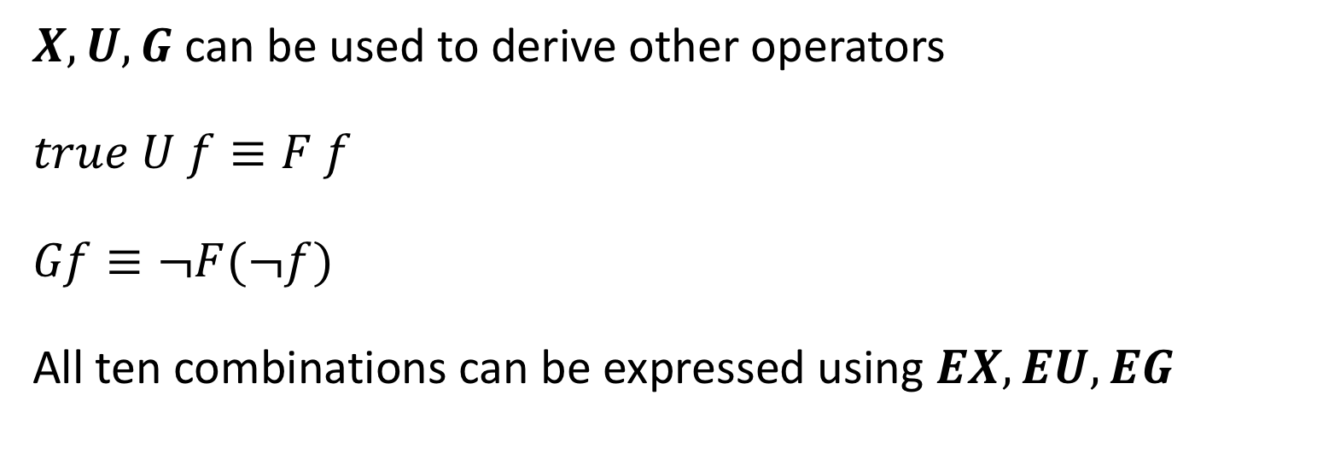
Universal CTL operators
$X,U, G$ can be used to derive other operators
$$true U f≡F f$$
$$Gf≡¬F(¬f)$$
All ten combinations can be expressed using $EX, EU, EG$
$$AXf$$ | $$AGf$$ | $$AFf$$ | $$AUf$$ | $$ARf$$
$$¬EX(¬f)$$ | $$¬EF(¬f)$$ | $$¬EG(¬f)$$
$$EX$$ | $$EG$$ | $$EF$$ | $$EU$$ | $$ER$$
$$EX$$ | $$EG$$ | $$E(true U f)$$ | $$EU$$

Slide 13








Visualizing semantics
$$q$$
$$q$$
$$q⊨EF red$$
$$q⊨EG red$$
$$q$$
$$q$$
$$q⊨AF red$$
$$q⊨AG red$$

Slide 14
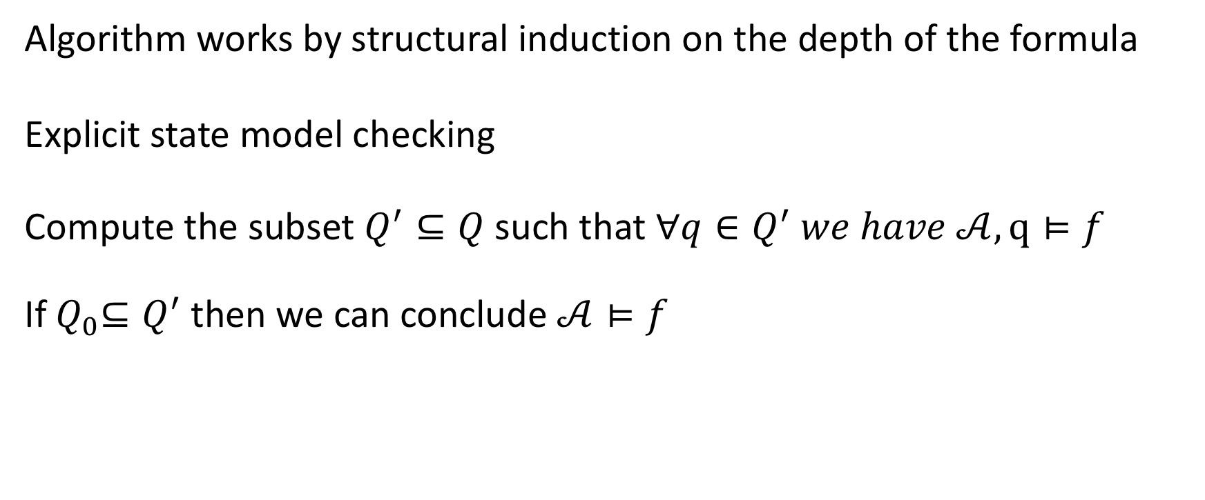

Algorithm for deciding $𝒜⊨f$
Algorithm works by structural induction on the depth of the formula
Explicit state model checking
Compute the subset $Q^{′}⊆Q$ such that $∀q∈Q^{′} we have 𝒜,q⊨f$
If${ Q}_{0}⊆Q^{′}$then we can conclude $𝒜⊨f$

Slide 15
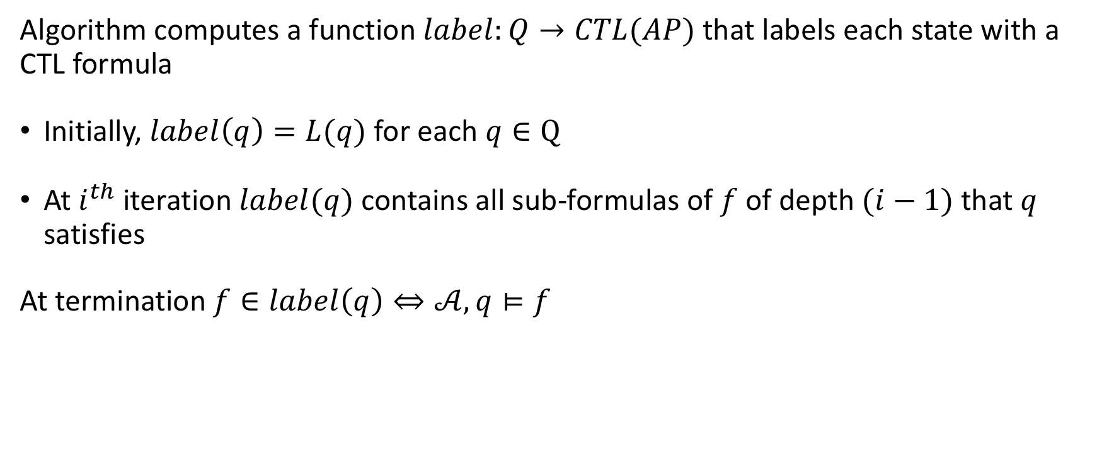
Induction on depth of formula
Algorithm computes a function $label:Q→CTL(AP)$ that labels each state with a CTL formula
Initially, $label\left(q\right)=L(q)$ for each $q∈Q$
At $i^{th}$ iteration $label(q)$ contains all sub-formulas of $f$ of depth $(i−1)$ that $q$ satisfies
At termination $f∈label\left(q\right)⇔𝒜,q⊨f$

Slide 16
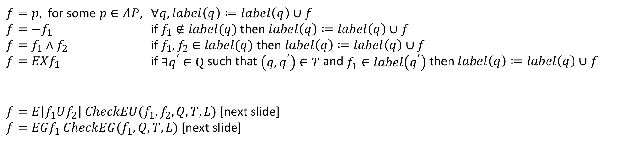
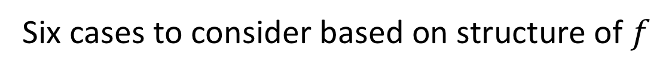
Structural induction on formula
Six cases to consider based on structure of $f$
$f=p,$ for some $p∈AP,$ $∀q, label\left(q\right)≔label\left(q\right)∪f$
$f=¬f_{1}$ if $f_{1}∉label(q)$ then $label\left(q\right)≔label\left(q\right)∪f$
$f=f_{1}∧f_{2}$ if $f_{1}, f_{2}∈label(q)$ then $label\left(q\right)≔label\left(q\right)∪f$
$f=EXf_{1}$ if$∃q^{′}∈Q$ such that $\left(q,q^{′}\right)∈T$ and $f_{1}∈label\left(q^{′}\right)$ then $label\left(q\right)≔label\left(q\right)∪f$
$f=E\left[f_{1}Uf_{2}\right] CheckEU(f_{1},f_{2},Q,T,L)$ [next slide]
$f=EGf_{1} CheckEG(f_{1}, Q,T,L)$ [next slide]

Slide 17


$CheckEU(f_{1},f_{2},Q,T,L)$
Let $S=\left\{q∈Q \right| f_{2}∈label(q)\}$
for each $q∈S$
$label\left(q\right)≔label\left(q\right)∪\{E[f_{1}Uf_{2}]\}$
while $S≠∅$
for each $q′∈S$
$S≔S∖\left\{q^{′}\right\}$
for each $q∈T^{−1}(q^{′})$
if $f_{1}∈label(q)$ then
$label\left(q\right)≔label\left(q\right)∪\{E[f_{1}Uf_{2}]\}$
$S≔S∪\{q\}$
Proposition. For any state $label\left(q\right)∋E[f_{1}Uf_{2}]$ iff $q⊨E[f_{1}Uf_{2}]$.
Proposition. Finite $Q$ therefore terminates and in $O\left(\left|Q\right|+\left|T\right|\right)$ steps.

Slide 18
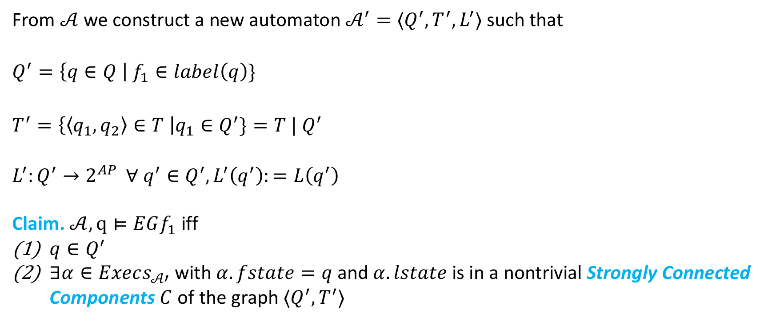

$CheckEG(f_{1}, Q,T,L)$
From $𝒜$ we construct a new automaton $𝒜^{′}=⟨Q^{′},T^{′},L^{′}⟩$ such that
$$Q^{′}=\left\{q∈Q \right| f_{1}∈label\left(q\right)\}$$
$$T^{′}=\left\{\left\langle q_{1},q_{2}\right\rangle ∈T \right|q_{1}∈Q^{′}\}=T | Q^{′}$$
$L^{′}:Q^{′}→2^{AP }$ $∀ q^{′}∈Q^{′}, L^{′}\left(q^{′}\right):=L\left(q^{′}\right)$
Claim. $𝒜,q⊨EGf_{1}$ iff
$q∈Q^{′}$
$∃α∈Execs_{𝒜′}$ with $α.fstate=q$and $α.lstate$ is in a nontrivial Strongly Connected Components $C$ of the graph $⟨Q^{′},T^{′}⟩$

Slide 19
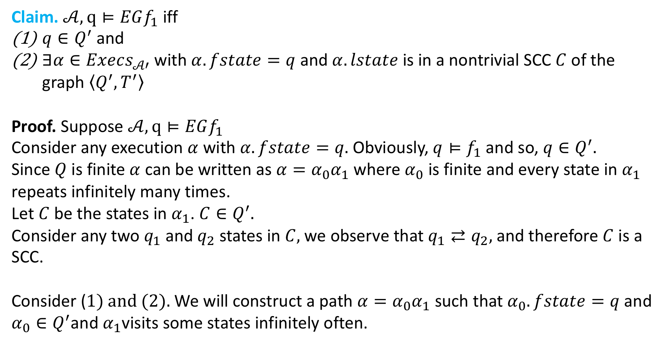
Claim. $𝒜,q⊨EGf_{1}$ iff
$q∈Q^{′}$ and
$∃α∈Execs_{𝒜′}$ with $α.fstate=q$and $α.lstate$ is in a nontrivial SCC $C$ of the graph $\left\langle Q^{′},T^{′}\right\rangle$
Proof. Suppose $𝒜,q⊨EGf_{1}$
Consider any execution $α$ with $α.fstate=q.$ Obviously, $q⊨f_{1}$ and so, $q∈Q^{′}.$
Since $Q$ is finite $α$ can be written as $α=α_{0}α_{1}$ where $α_{0}$ is finite and every state in $α_{1}$ repeats infinitely many times.
Let $C$ be the states in $α_{1}$. $C∈Q^{′}.$
Consider any two $q_{1}$ and $q_{2}$ states in $C,$we observe that $q_{1}⇄q_{2},$and therefore $C$is a SCC.
Consider ($1) and (2).$ We will construct a path $α=α_{0}α_{1}$ such that $α_{0}.fstate=q$and $α_{0}∈Q^{′}$and $α_{1}$visits some states infinitely often.

Slide 20
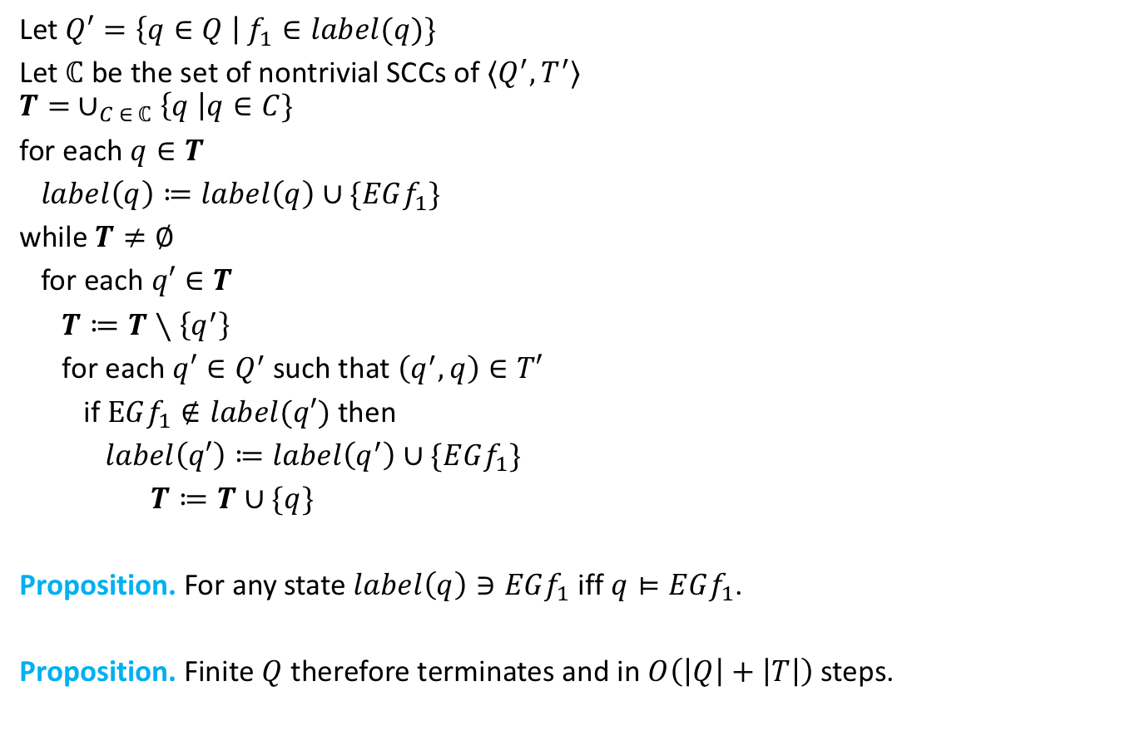
$CheckEG(f_{1}, Q,T,L)$
Let $Q′=\left\{q∈Q \right| f_{1}∈label(q)\}$
Let $ℂ$ be the set of nontrivial SCCs of $⟨Q^{′},T^{′}⟩$
$$T= ∪_{C ∈ ℂ}\left\{q \right|q∈C\}$$
for each $q∈T$
$label\left(q\right)≔label\left(q\right)∪\{EGf_{1}\}$
while $T≠∅$
for each $q′∈T$
$T≔T∖\left\{q^{′}\right\}$
for each $q′∈Q^{′}$ such that $\left(q^{′},q\right)∈T′$
if $EGf_{1}∉label(q′)$ then
$label\left(q′\right)≔label\left(q^{′}\right)∪\{EGf_{1}\}$
$T≔T∪\{q\}$
Proposition. For any state $label\left(q\right)∋EGf_{1}$ iff $q⊨EGf_{1}$.
Proposition. Finite $Q$ therefore terminates and in $O\left(\left|Q\right|+\left|T\right|\right)$ steps.

Slide 21
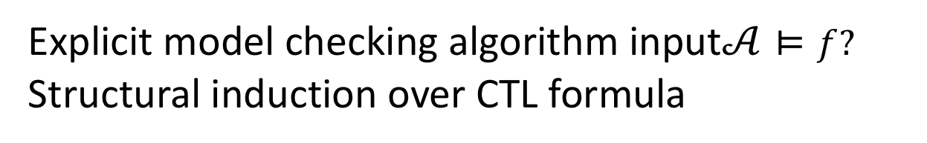
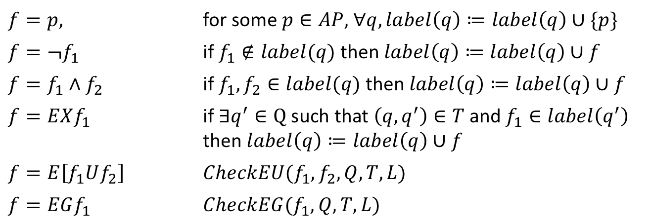

Summary
Explicit model checking algorithm input$𝒜⊨f?$
Structural induction over CTL formula
$f=p,$ | for some $p∈AP,$ $∀q, label\left(q\right)≔label\left(q\right)∪\{p\}$
$$f=¬f_{1}$$ | if $f_{1}∉label(q)$ then $label\left(q\right)≔label\left(q\right)∪f$
$$f=f_{1}∧f_{2}$$ | if $f_{1}, f_{2}∈label(q)$ then $label\left(q\right)≔label\left(q\right)∪f$
$$f=EXf_{1}$$ | if$∃q^{′}∈Q$ such that $\left(q,q^{′}\right)∈T$ and $f_{1}∈label\left(q^{′}\right)$ then $label\left(q\right)≔label\left(q\right)∪f$
$$f=E\left[f_{1}Uf_{2}\right]$$ | $$CheckEU(f_{1},f_{2},Q,T,L)$$
$$f=EGf_{1}$$ | $$CheckEG(f_{1}, Q,T,L)$$
Proposition. Overall complexity of CTL model checkign $O(\left|f\right|\left(\left|Q\right|+\left|T\right|\right))$ steps.

Slide 22
1
!Start
!Close
!Heat
!Error
Start oven
Open door
Open door
Close door
2
Start
!Close
!Heat
Error
3
! Start
Close
!Heat
!Error
4
!Start
Close
Heat
!Error
Close door
Open door
Start oven
Start cooking
Reset
5
Start
Close
!Heat
Error
6
Start
Close
!Heat
!Error
7
Start
Close
Heat
!Error
Warmup

Slide 23
AG (Start -> AF Heat)
1
!Start
!Close
!Heat
!Error
Start oven
Open door
Open door
Close door
2
Start
!Close
!Heat
Error
3
! Start
Close
!Heat
!Error
4
!Start
Close
Heat
!Error
Close door
Open door
Start oven
Start cooking
Reset
5
Start
Close
!Heat
Error
6
Start
Close
!Heat
!Error
7
Start
Close
Heat
!Error
Warmup

Slide 24



! EF (Start $∧$EG ! Heat)
1
!Start
!Close
!Heat
!Error
! [True EU (Start $∧$EG ! Heat)]
Start oven
Open door
Open door
Close door
2
Start
!Close
!Heat
Error
3
! Start
Close
!Heat
!Error
4
!Start
Close
Heat
!Error
Close door
Open door
Start oven
Start cooking
Reset
5
Start
Close
!Heat
Error
6
Start
Close
!Heat
!Error
7
Start
Close
Heat
!Error
Warmup

Slide 25

! EF (Start $∧$EG ! Heat)
1
!Start
!Close
!Heat
!Error
! [True EU (Start $∧$EG ! Heat)]
Start oven
Open door
Open door
Close door
2
Start
!Close
!Heat
Error
3
! Start
Close
!Heat
!Error
4
!Start
Close
Heat
!Error
Close door
Open door
Start oven
Start cooking
Reset
5
Start
Close
!Heat
Error
6
Start
Close
!Heat
!Error
7
Start
Close
Heat
!Error
Warmup

Slide 26

! EF (Start $∧$ EG ! Heat)
Nontrivial SCC of ! Heat
Start, ! Heat
EG ! Heat
1
!Start
!Close
!Heat
!Error
Start oven
Open door
Open door
Close door
2
Start
!Close
!Heat
Error
3
! Start
Close
!Heat
!Error
4
!Start
Close
Heat
!Error
Close door
Open door
Start oven
Start cooking
Reset
5
Start
Close
!Heat
Error
6
Start
Close
!Heat
!Error
7
Start
Close
Heat
!Error
Warmup

Slide 27

! EF (Start $∧$ EG ! Heat)
EG ! Heat
Set of states that can reach n
nontrivial SCC of ! Heat
Start, ! Heat
EG ! Heat
1
!Start
!Close
!Heat
!Error
Start $∧$ EG ! Heat
Start oven
Open door
Open door
Close door
EG ! Heat
2
Start
!Close
!Heat
Error
EG ! Heat
3
! Start
Close
!Heat
!Error
4
!Start
Close
Heat
!Error
Close door
Open door
Start oven
Start cooking
Reset
5
Start
Close
!Heat
Error
6
Start
Close
!Heat
!Error
7
Start
Close
Heat
!Error
Warmup
EG ! Heat

Slide 28


! EF (Start $∧$ EG ! Heat)
EG ! Heat
Start, ! Heat
EG ! Heat
1
!Start
!Close
!Heat
!Error
Start $∧$ EG ! Heat
Start oven
Open door
Start $∧$ EG ! Heat
Open door
Close door
EG ! Heat
2
Start
!Close
!Heat
Error
EG ! Heat
3
! Start
Close
!Heat
!Error
4
!Start
Close
Heat
!Error
Close door
Open door
Start oven
Start cooking
Reset
5
Start
Close
!Heat
Error
6
Start
Close
!Heat
!Error
7
Start
Close
Heat
!Error
Warmup
EG ! Heat
Start $∧$ EG ! Heat

Slide 29


! EF (Start $∧$ EG ! Heat)
EG ! Heat
Start, ! Heat
EG ! Heat
1
!Start
!Close
!Heat
!Error
Start $∧$ EG ! Heat
EF (Start $∧$ EG ! Heat)
Open door
Start oven
Start $∧$ EG ! Heat
Open door
Close door
EG ! Heat
2
Start
!Close
!Heat
Error
EG ! Heat
3
! Start
Close
!Heat
!Error
4
!Start
Close
Heat
!Error
Close door
Open door
Start oven
Start cooking
Reset
5
Start
Close
!Heat
Error
6
Start
Close
!Heat
!Error
7
Start
Close
Heat
!Error
Warmup
EG ! Heat
Start $∧$ EG ! Heat

Slide 30
! EF (Start $∧$ EG ! Heat)
EG ! Heat
Start, ! Heat
EG ! Heat
1
!Start
!Close
!Heat
!Error
Start $∧$ EG ! Heat
EF (Start $∧$ EG ! Heat)
Open door
Start oven
Start $∧$ EG ! Heat
Open door
Close door
EG ! Heat
2
Start
!Close
!Heat
Error
EG ! Heat
3
! Start
Close
!Heat
!Error
4
!Start
Close
Heat
!Error
Close door
Open door
Start oven
Start cooking
Reset
5
Start
Close
!Heat
Error
6
Start
Close
!Heat
!Error
7
Start
Close
Heat
!Error
Warmup
EG ! Heat
Start $∧$ EG ! Heat

Slide 31








! EF (Start $∧$ EG ! Heat)
EG ! Heat
EF (Start $∧$ EG ! Heat)
Set of states that can reach
Start $∧$ EG ! Heat
Start, ! Heat
EG ! Heat
1
!Start
!Close
!Heat
!Error
Start $∧$ EG ! Heat
EF (Start $∧$ EG ! Heat)
Open door
Start oven
EF (Start $∧$ EG ! Heat)
Open door
Close door
Start $∧$ EG ! Heat
EG ! Heat
EF (Start $∧$ EG ! Heat)
2
Start
!Close
!Heat
Error
EF (Start $∧$ EG ! Heat)
3
! Start
Close
!Heat
!Error
4
!Start
Close
Heat
!Error
EG ! Heat
Close door
Open door
Start oven
Start cooking
Reset
5
Start
Close
!Heat
Error
6
Start
Close
!Heat
!Error
7
Start
Close
Heat
!Error
Warmup
EG ! Heat
Start $∧$ EG ! Heat
EF (Start $∧$ EG ! Heat)
EF (Start $∧$ EG ! Heat)
EF (Start $∧$ EG ! Heat)

Slide 32

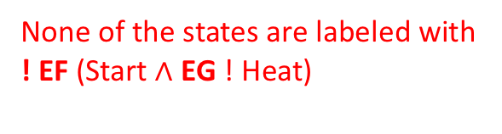
! EF (Start $∧$ EG ! Heat)
EG ! Heat
EF (Start $∧$ EG ! Heat)
None of the states are labeled with
! EF (Start $∧$ EG ! Heat)
Start, ! Heat
EG ! Heat
1
!Start
!Close
!Heat
!Error
Start $∧$ EG ! Heat
EF (Start $∧$ EG ! Heat)
Open door
Start oven
EF (Start $∧$ EG ! Heat)
Open door
Close door
Start $∧$ EG ! Heat
EG ! Heat
EF (Start $∧$ EG ! Heat)
2
Start
!Close
!Heat
Error
EF (Start $∧$ EG ! Heat)
3
! Start
Close
!Heat
!Error
4
!Start
Close
Heat
!Error
EG ! Heat
Close door
Open door
Start oven
Start cooking
Reset
5
Start
Close
!Heat
Error
6
Start
Close
!Heat
!Error
7
Start
Close
Heat
!Error
Warmup
EG ! Heat
Start $∧$ EG ! Heat
EF (Start $∧$ EG ! Heat)
EF (Start $∧$ EG ! Heat)
EF (Start $∧$ EG ! Heat)

