Slide 1
Satisfiability modulo theories
Verifying cyberphysical systems
Sayan Mitra
mitras@illinois.edu
Some of the slides and examples for this lecture are from Clark Barrett

Slide 2
Today
Satisfiability modulo theories (SMT)
Theories, models, decision procedures
Examples
Brief z3 tutorial (see notebook)

Slide 3
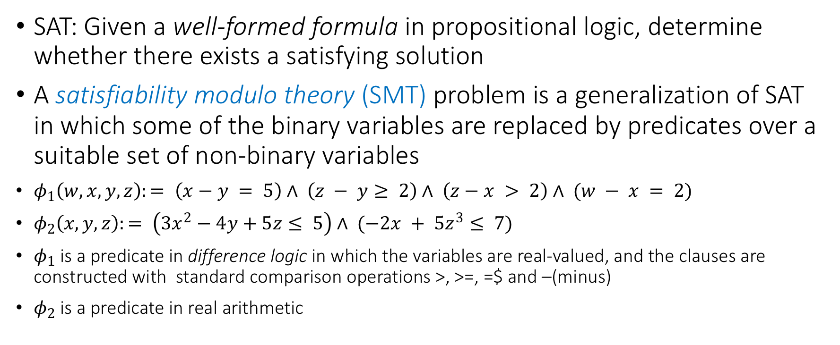
Satisfiability modulo theories
SAT: Given a well-formed formula in propositional logic, determine whether there exists a satisfying solution
A satisfiability modulo theory (SMT) problem is a generalization of SAT in which some of the binary variables are replaced by predicates over a suitable set of non-binary variables
$φ_{1}\left(w,x,y,z\right):= \left(x−y = 5\right)∧ \left(z − y≥ 2\right)∧ \left(z−x > 2\right)∧ (w − x = 2)$
$φ_{2}\left(x,y,z\right):= \left(3x^{2}−4y+5z≤ 5\right)∧ (−2x + 5z^{3}≤ 7)$
$φ_{1}$ is a predicate in difference logic in which the variables are real-valued, and the clauses are constructed with standard comparison operations >, >=, =$ and –(minus)
$φ_{2}$ is a predicate in real arithmetic

Slide 4
Architecture of an SMT solver
Theory solvers/decision procedures
CNF formula in
real arithmetic
boolean skeleton of problem
Arithmetic
Bitvectors
Core
DPLL
Difference logic
…
Uninterpreted functions
assertions
solution or
counterexample

Slide 5
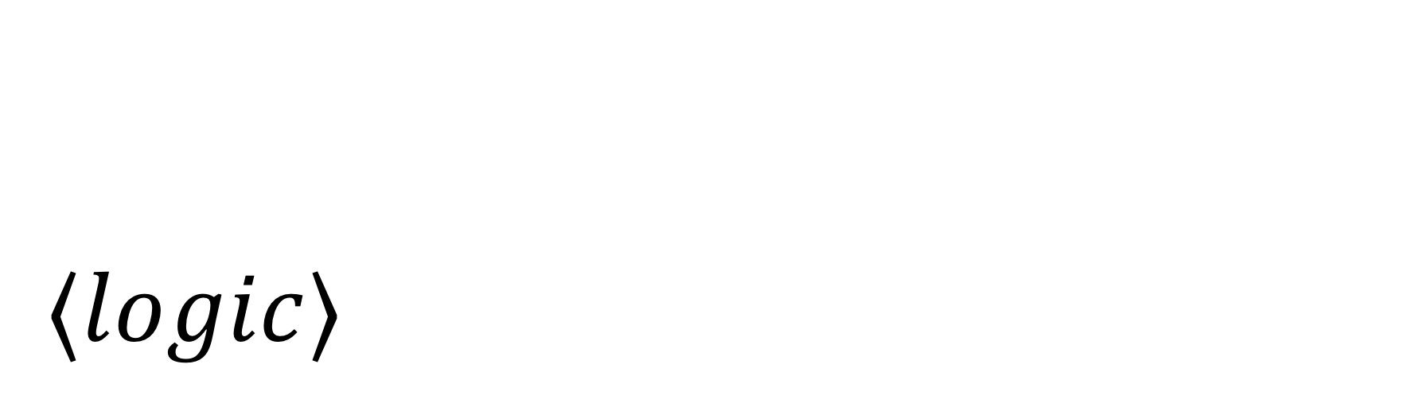
$$⟨logic⟩$$
A short overview of theories, models, decision procedures

Slide 6
What is a theory in mathematical logic?
When we talk about well-formed formulas with non-binary variables, we have to say exactly what type of formulas are allowed
and, what it means for assignments to satisfy such formulas
This brings us to the notions theory and models in mathematical logic

Slide 7
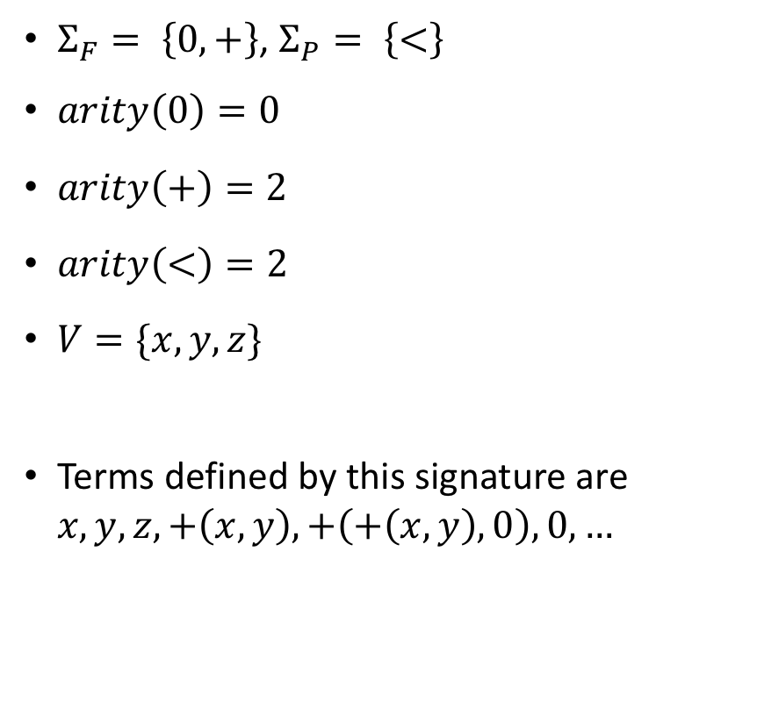
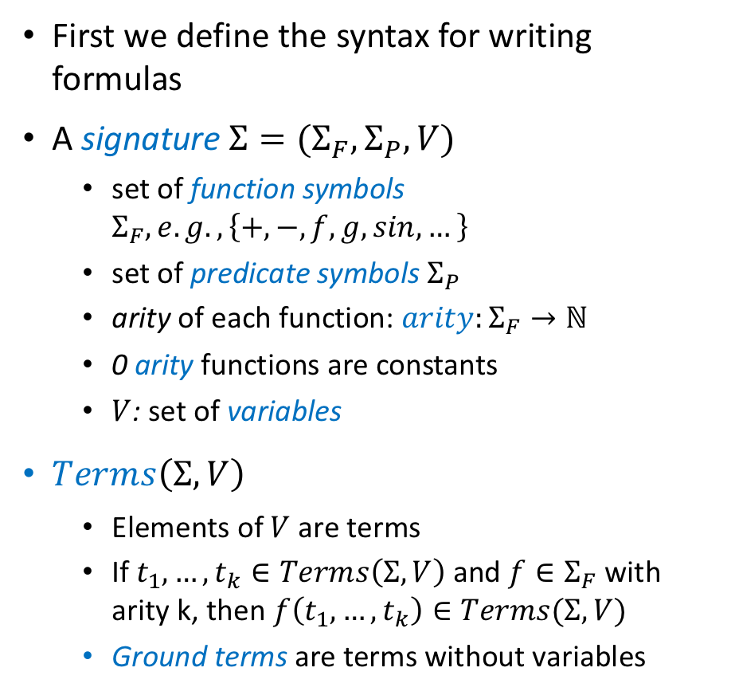
Building up a theory
First we define the syntax for writing formulas
A signature $Σ=(Σ_{F},Σ_{P},V)$
set of function symbols $Σ_{F}, e.g., \left\{+,−,f,g,sin,…\right\}$
set of predicate symbols $Σ_{P}$
arity of each function: $arity:Σ_{F}→ℕ$
0 arity functions are constants
$V$: set of variables
$Terms\left(Σ,V\right)$
Elements of $V$ are terms
If $t_{1},…,t_{k}∈Terms\left(Σ,V\right)$ and $f∈Σ_{F}$ with arity k, then $f\left(t_{1},…,t_{k}\right)∈Terms(Σ,V)$
Ground terms are terms without variables
$Σ_{F}= \left\{0,+\right\}$, $Σ_{P}= \left\{<\right\}$
$arity\left(0\right)=0$
$arity\left(+\right)=2$
$arity\left(<\right)=2$
$V=\{x,y,z\}$
Terms defined by this signature are $x,y,z, +\left(x,y\right), +\left(+\left(x,y\right),0\right),0,…$

Slide 8
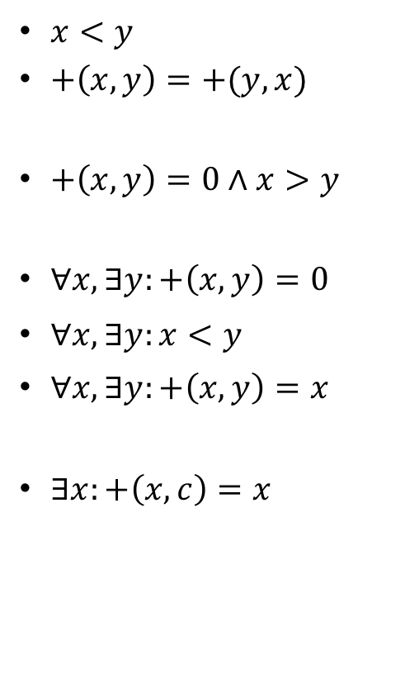
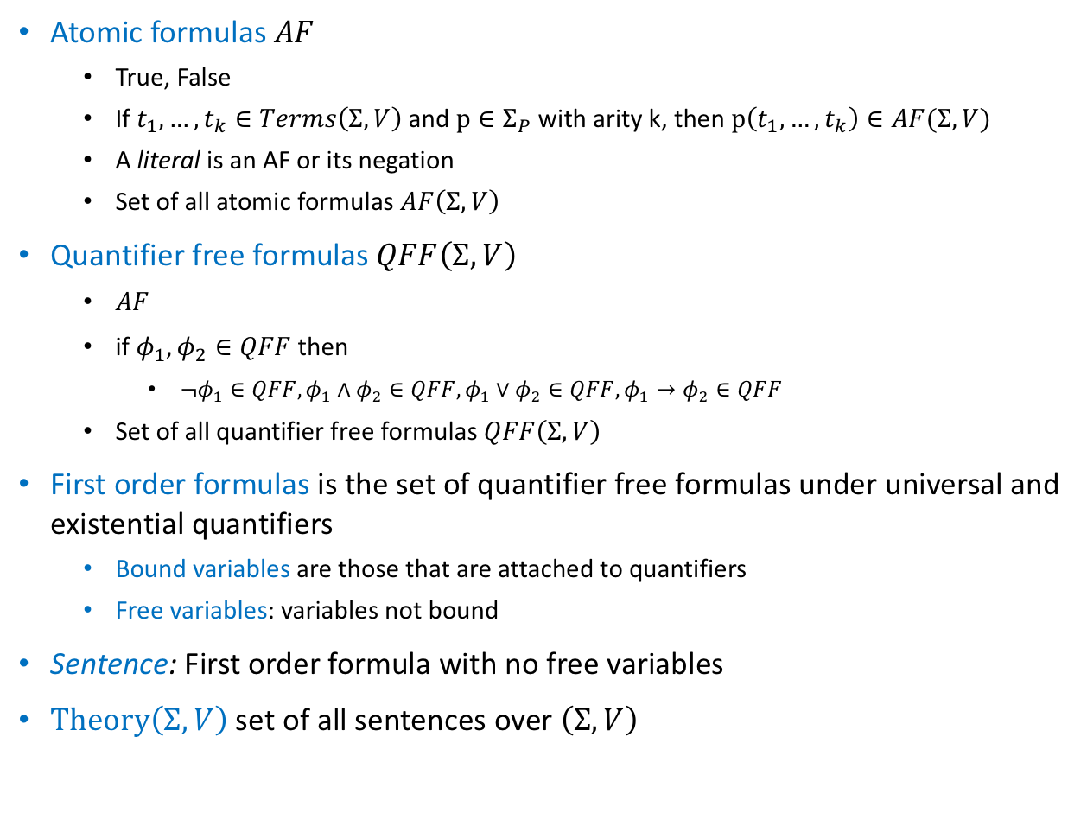
Terms to Formulas
Atomic formulas $AF$
True, False
If $t_{1},…,t_{k}∈Terms\left(Σ,V\right)$ and $p∈Σ_{P}$ with arity k, then $p\left(t_{1},…,t_{k}\right)∈AF(Σ,V)$
A literal is an AF or its negation
Set of all atomic formulas $AF\left(Σ,V\right)$
Quantifier free formulas $QFF\left(Σ,V\right)$
$AF$
if $φ_{1}, φ_{2}∈QFF$ then
$¬φ_{1}∈QFF, φ_{1}∧φ_{2}∈QFF,φ_{1}∨φ_{2}∈QFF, φ_{1}→φ_{2}∈QFF$
Set of all quantifier free formulas $QFF\left(Σ,V\right)$
First order formulas is the set of quantifier free formulas under universal and existential quantifiers
Bound variables are those that are attached to quantifiers
Free variables: variables not bound
Sentence: First order formula with no free variables
$Theory\left(Σ,V\right)$ set of all sentences over $\left(Σ,V\right)$
$x<y$
$+\left(x,y\right)=+(y,x)$
$+\left(x,y\right)=0∧x>y$
$∀x, ∃y:+\left(x,y\right)=0$
$∀x, ∃y:x<y$
$∀x, ∃y:+\left(x,y\right)=x$
$∃x:+\left(x,c\right)=x$

Slide 9
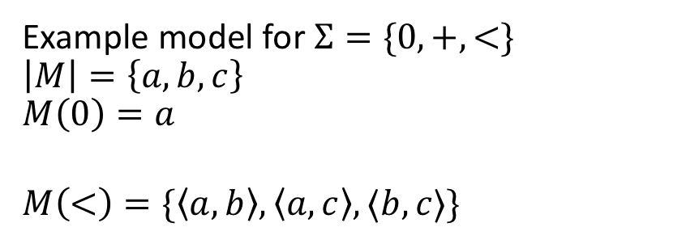
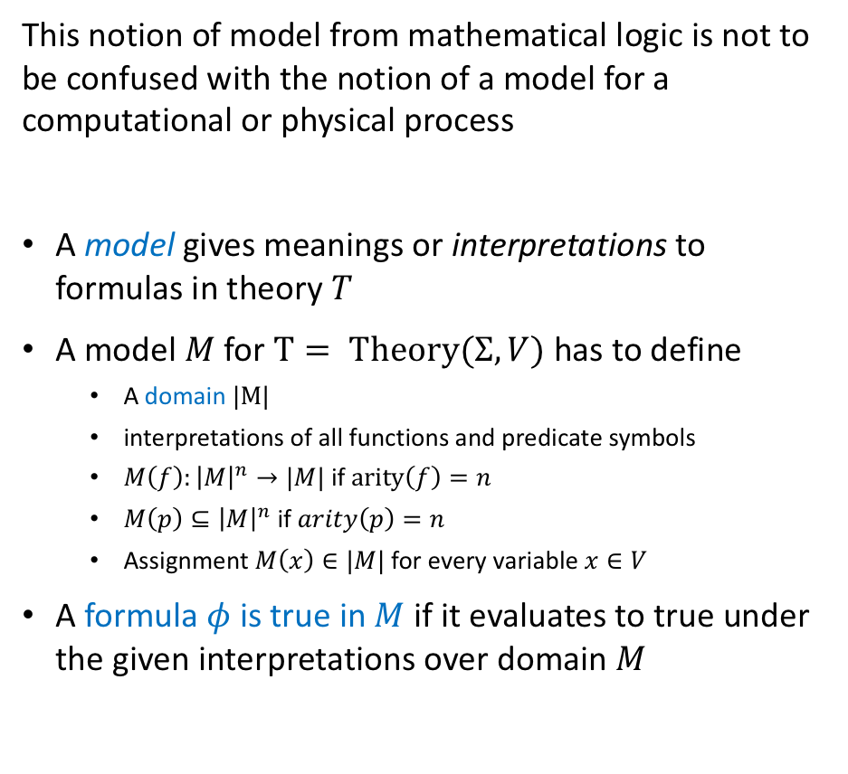
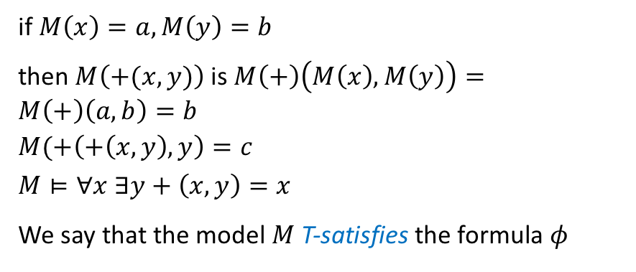
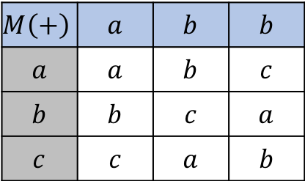
Models for theories
Example model for $Σ=\{0,+,<\}$
$$\left|M\right|=\left\{a,b,c\right\}$$
$$M\left(0\right)=a$$
$$M\left(<\right)=\{\left\langle a,b\right\rangle ,\left\langle a,c\right\rangle ,⟨b,c⟩\}$$
This notion of model from mathematical logic is not to be confused with the notion of a model for a computational or physical process
A model gives meanings or interpretations to formulas in theory $T$
A model $M$ for $T= Theory(Σ,V)$ has to define
A domain $|M|$
interpretations of all functions and predicate symbols
$M\left(f\right):{\left|M\right|}^{n}→|M|$ if $arity\left(f\right)=n$
$M\left(p\right)⊆{\left|M\right|}^{n}$ if $arity\left(p\right)=n$
Assignment $M\left(x\right)∈|M|$ for every variable $x∈V$
A formula $φ$ is true in $M$ if it evaluates to true under the given interpretations over domain $M$
$$M\left(+\right)$$ | $$a$$ | $$b$$ | $$b$$
$$a$$ | $$a$$ | $$b$$ | $$c$$
$$b$$ | $$b$$ | $$c$$ | $$a$$
$$c$$ | $$c$$ | $$a$$ | $$b$$
if $M\left(x\right)=a, M\left(y\right)=b$
then $M\left(+(x,y)\right)$ is $M\left(+\right)\left(M\left(x\right),M\left(y\right)\right)=M\left(+\right)\left(a,b\right)=b$
$$M(+\left(+\left(x,y\right),y\right)=c$$
$$M⊨∀x ∃y+\left(x,y\right)=x$$
We say that the model $M$ T-satisfies the formula $φ$

Slide 10

Decision procedures
Given a theory $T$ a theory solver or a decision procedure for $T$ takes as input a set of literals $φ$ (atomic propositions) and determines whether $φ$ is $T$-satisfiable, that is,
$∃$ a model $M$ such that $M⊨φ?$

Slide 11

$$⟨\backslash logic⟩$$
A short overview of theories and models in mathematical logic

Slide 12
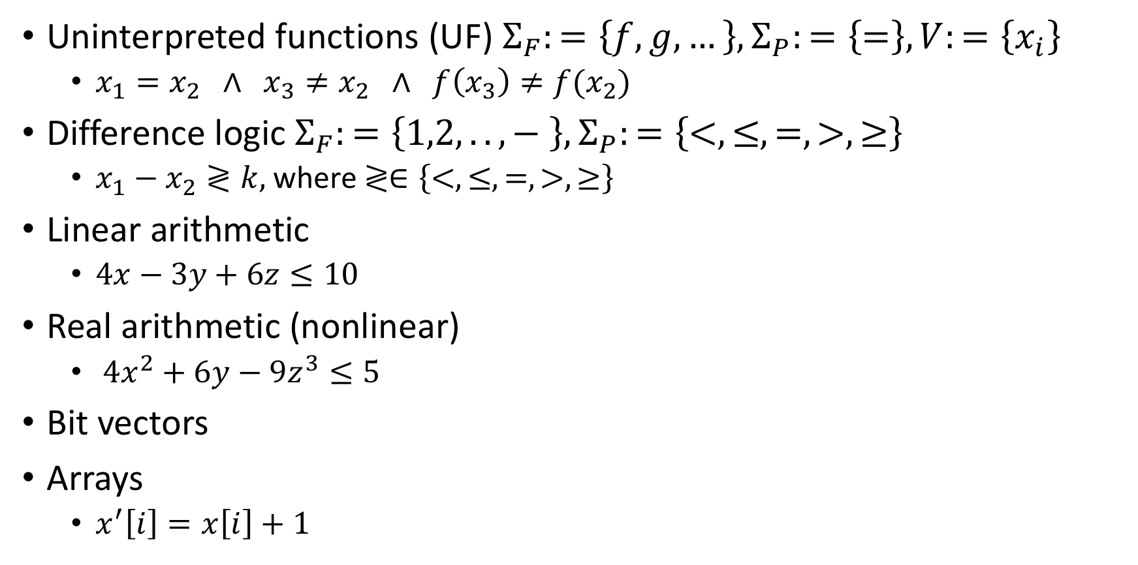
Example theories
Uninterpreted functions (UF) $Σ_{F}:=\left\{f,g,…\right\}, Σ_{P}:=\left\{=\right\}, V:=\left\{x_{i}\right\}$
$x_{1}=x_{2} ∧ x_{3}≠x_{2} ∧ f\left(x_{3}\right)≠f(x_{2})$
Difference logic $Σ_{F}:=\left\{1,2,..,− \right\},Σ_{P}:=\left\{<,≤, =,>,≥\right\}$
$x_{1}−x_{2}≷k,$ where $≷∈\left\{<,≤, =,>,≥\right\}$
Linear arithmetic
$4x−3y+6z≤10$
Real arithmetic (nonlinear)
$4x^{2}+6y−9z^{3}≤5$
Bit vectors
Arrays
$x^{′}\left[i\right]=x\left[i\right]+1$

Slide 13
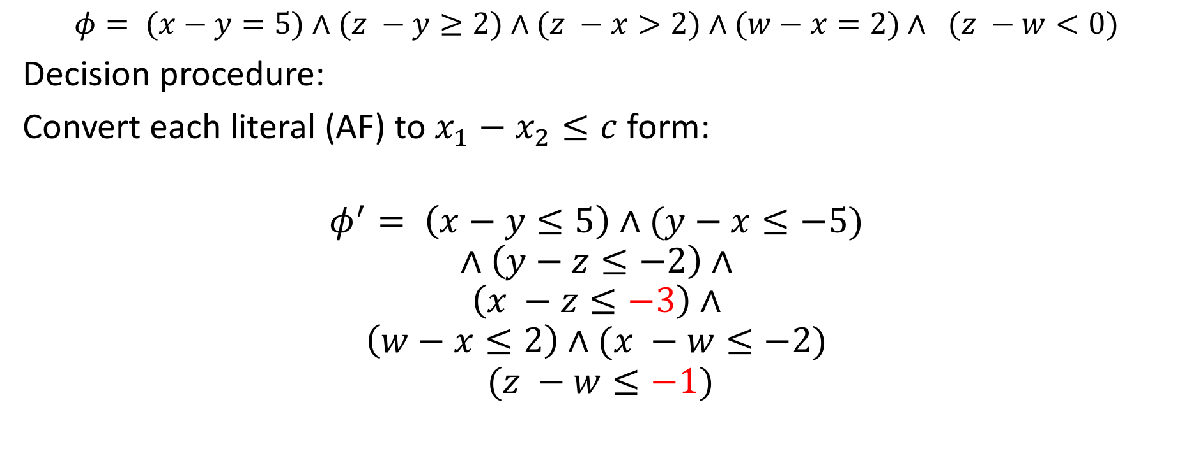
Example decision procedure 1: Difference logic
$$φ= (x−y=5)∧(z −y≥2)∧(z −x>2)∧(w−x=2)∧ (z −w<0)$$
Decision procedure:
Convert each literal (AF) to $x_{1}−x_{2}≤c$ form:
$$φ^{′}= \left(x−y≤5\right)∧(y−x≤−5)$$
$$∧\left(y−z≤−2\right)∧$$
$$\left(x −z≤−3\right)∧$$
$$\left(w−x≤2\right)∧(x −w≤−2)$$
$$(z −w≤−1)$$

Slide 14







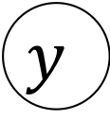




$$φ^{′}= \left(x−y≤5\right)∧(y−x≤−5)$$
$$∧\left(y−z≤−2\right)∧$$
$$\left(x −z≤−3\right)∧$$
$$\left(w−x≤2\right)∧(x −w≤−2)$$
$$(z −w≤−1)$$
Construct a graph with edge from $x→^{c}y$ for each literal $φ′$
$$y$$
$$5$$
$$−2$$
$$x$$
$$−5$$
$$z$$
$$−3$$
$$−2$$
$$2$$
$$w$$
$$−1$$

Slide 15
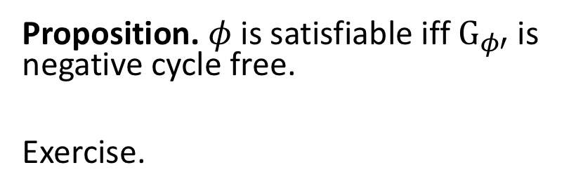
$$φ^{′}= \left(x−y≤5\right)∧(y−x≤−5)$$
$$∧\left(y−z≤−2\right)∧$$
$$\left(x −z≤−3\right)∧$$
$$\left(w−x≤2\right)∧(x −w≤−2)$$
$$(z −w≤−1)$$
Construct a graph $G_{φ′}$ with edge from $x→^{c}y$ for each literal $φ′$
$$y$$
$$5$$
$$−2$$
Proposition. $φ$ is satisfiable iff $G_{φ′}$is negative cycle free.
Exercise.
$$x$$
$$−5$$
$$z$$
$$−3$$
$$−2$$
$$2$$
$$w$$
$$−1$$

Slide 16
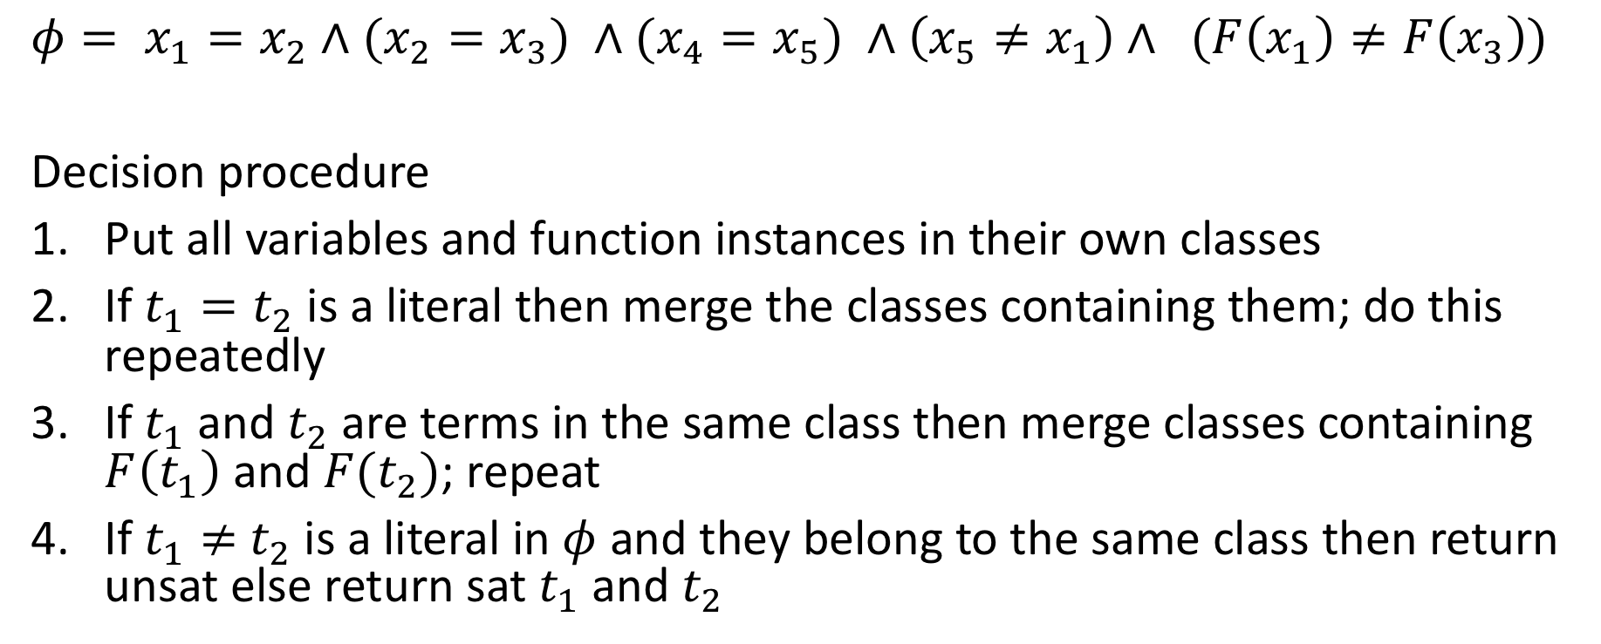
Example decision procedure 2: Uninterpreted functions (UF)
$$φ= x_{1}=x_{2}∧(x_{2}=x_{3}) ∧(x_{4}=x_{5}) ∧\left(x_{5}≠x_{1}\right)∧ (F\left(x_{1}\right)≠F\left(x_{3}\right))$$
Decision procedure
Put all variables and function instances in their own classes
If $t_{1}=t_{2}$ is a literal then merge the classes containing them; do this repeatedly
If $t_{1}$ and $t_{2}$ are terms in the same class then merge classes containing $F\left(t_{1}\right)$ and $F(t_{2})$; repeat
If $t_{1}≠$ $t_{2}$ is a literal in $φ$ and they belong to the same class then return unsat else return sat $t_{1}$ and $t_{2}$

Slide 17
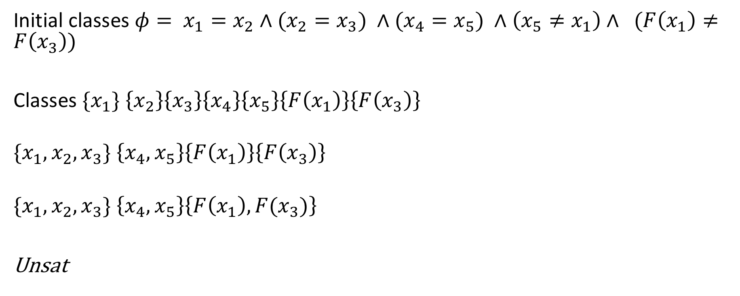
Example decision procedure 2: Uninterpreted functions (UF)
Initial classes $φ= x_{1}=x_{2}∧(x_{2}=x_{3}) ∧(x_{4}=x_{5}) ∧\left(x_{5}≠x_{1}\right)∧ (F\left(x_{1}\right)≠F\left(x_{3}\right))$
Classes ${\{x}_{1}\} \left\{x_{2}\right\}\left\{x_{3}\right\}\left\{x_{4}\right\}\left\{x_{5}\right\}\left\{F\left(x_{1}\right)\right\}\left\{F\left(x_{3}\right)\right\}$
$${\{x}_{1},x_{2},x_{3}\} \left\{x_{4},x_{5}\right\}\left\{F\left(x_{1}\right)\right\}\left\{F\left(x_{3}\right)\right\}$$
$${\{x}_{1},x_{2},x_{3}\} \left\{x_{4},x_{5}\right\}\left\{F\left(x_{1}\right),F(x_{3})\right\}$$
Unsat

Slide 18
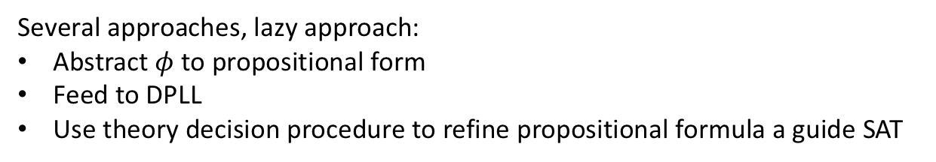
Return to SMT
$$φ≡g\left(a\right)=c∧f\left(g\left(a\right)\right)≠f\left(c\right)∨g\left(a\right)=d∧c≠d$$
Several approaches, lazy approach:
Abstract $φ$ to propositional form
Feed to DPLL
Use theory decision procedure to refine propositional formula a guide SAT
Theory solvers/decision procedures
literals/formula in
real arithmetic
boolean skeleton of problem
Arithmetic
Bitvectors
Core
DPLL
Difference logic
…
Uninterpreted functions
assertions
solution or
counterexample

Slide 19
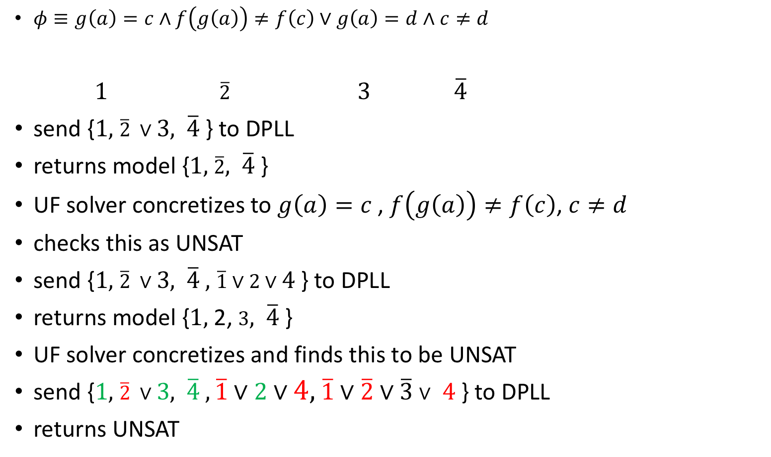
Theory solvers/decision procedures
literals/formula in
real arithmetic
boolean skeleton of problem
Arithmetic
Bitvectors
Core
DPLL
Difference logic
$φ≡g\left(a\right)=c∧f\left(g\left(a\right)\right)≠f\left(c\right)∨g\left(a\right)=d∧c≠d$
$1$ $\overline{2}$ $3$ $\overline{4}$
send {$1,$ $\overline{2} ∨3,$ $\overline{4}$} to DPLL
returns model {$1,$ $\overline{2},$ $\overline{4}$}
UF solver concretizes to $g\left(a\right)=c$, $f\left(g\left(a\right)\right)≠f\left(c\right)$, $c≠d$
checks this as UNSAT
send {$1,$ $\overline{2} ∨3,$ $\overline{4} ,$ $\overline{1}∨2∨4$} to DPLL
returns model {$1,$ 2, $3,$ $\overline{4}$}
UF solver concretizes and finds this to be UNSAT
send {$1,$ $\overline{2} ∨3,$ $\overline{4} ,\overline{1}∨2∨4,$ $\overline{1}∨\overline{2}∨\overline{3}∨$ $4$ } to DPLL
returns UNSAT
…
Uninterpreted functions
assertions
solution or
counterexample

Slide 20
Assignments
HW1
Learn z3
https://ericpony.github.io/z3py-tutorial/guide-examples.htm
Readings
Chapter 7.5.3 of CPSBook on using SAT/SMT for verification
Read chapter 4 for next week
Reading more about decision procedures

