Slide 1
Abstractions Part II
Sayan Mitra
Verifying cyberphysical systems
mitras@illinois.edu

Slide 2
Outline
Abstractions
Simulation relations
Back to rational timed automata

Slide 3
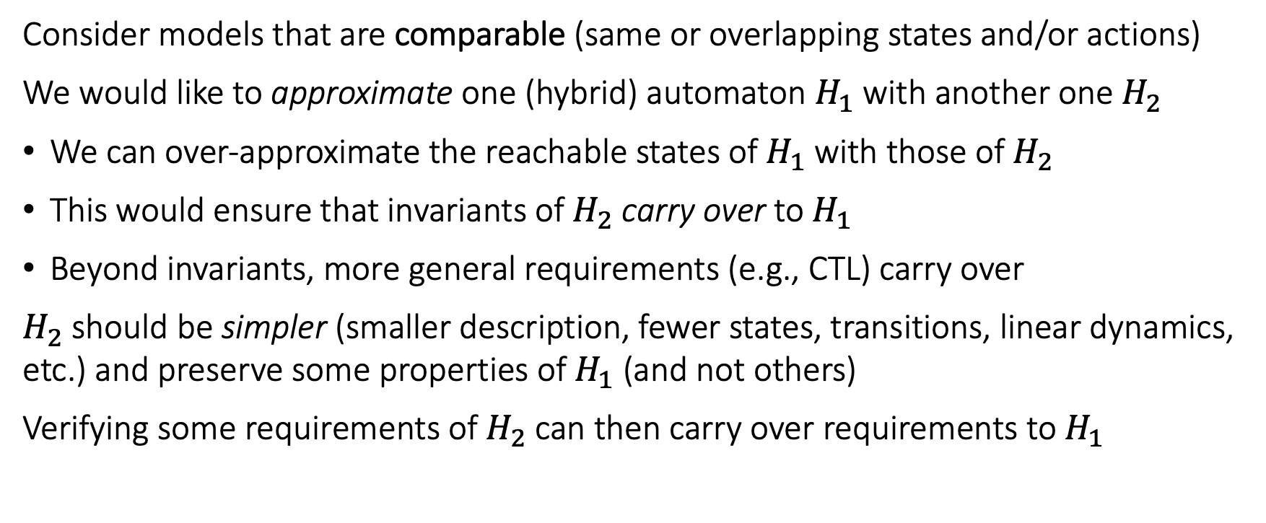
Abstractions and Simulations
Consider models that are comparable (same or overlapping states and/or actions)
We would like to approximate one (hybrid) automaton $H_{1}$ with another one $H_{2}$
We can over-approximate the reachable states of $H_{1}$ with those of $H_{2}$
This would ensure that invariants of $H_{2}$ carry over to $H_{1}$
Beyond invariants, more general requirements (e.g., CTL) carry over
$H_{2}$ should be simpler (smaller description, fewer states, transitions, linear dynamics, etc.) and preserve some properties of $H_{1}$ (and not others)
Verifying some requirements of $H_{2}$ can then carry over requirements to $H_{1}$

Slide 4

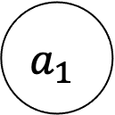
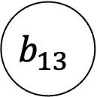
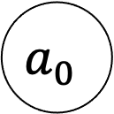
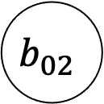
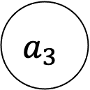
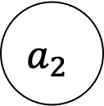
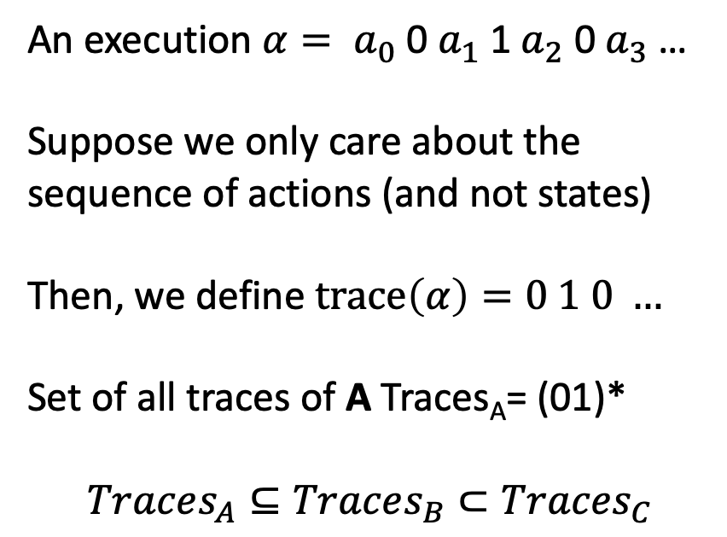
Finite state examples
0
1
0
$$a_{0}$$
$$a_{1}$$
$$a_{2}$$
$$a_{3}$$
An execution $α= a_{0}$ 0 $a_{1}$ 1 $a_{2}$ 0 $a_{3}$ …
Suppose we only care about the sequence of actions (and not states)
Then, we define $trace\left(α\right)=0 1 0 …$
Set of all traces of A Traces_{A}= (01)*
$$Traces_{A}⊆Traces_{B}⊂Traces_{C}$$
A
1
0
1
0
$$b_{02}$$
$$b_{13}$$
B
Traces_{B}= (01)*
1
$$c_{0}$$
Traces_{C}= {0,1}*
C
0,1

Slide 5
Finite state examples
0
1
0
$$a_{0}$$
$$a_{1}$$
$$a_{2}$$
$$a_{3}$$
B simulates A and vice versa.
A and B are bisimilar
C simulates both A and B.
C is an abstraction of both A and B.
A
1
0
1
0
$$b_{02}$$
$$b_{13}$$
B
Traces_{B}= (01)*
1
$$c_{0}$$
Traces_{C}= {0,1}*
C
0,1

Slide 6
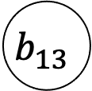


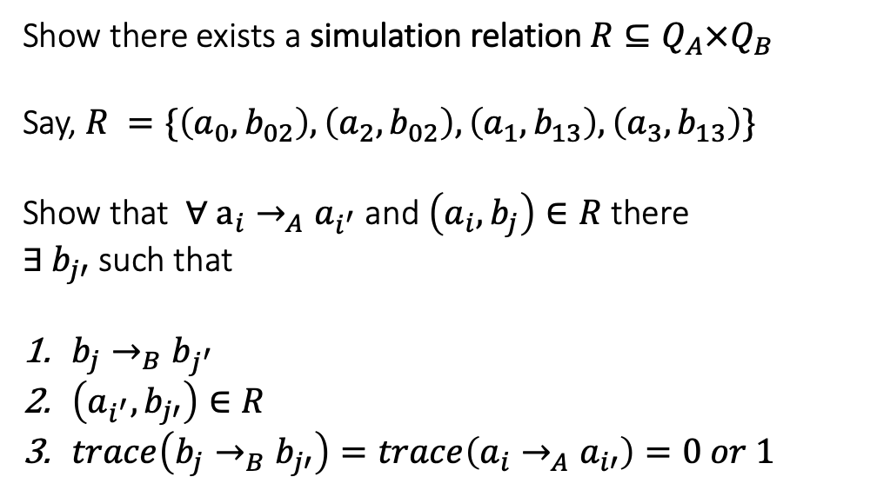
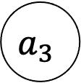
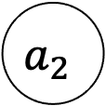
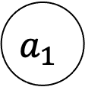
How to prove B simulates A?
0
1
0
Show there exists a simulation relation $R⊆Q_{A}×Q_{B}$
Say, $R =\{\left(a_{0},b_{02}\right), \left(a_{2},b_{02}\right), \left(a_{1}, b_{13}\right), \left(a_{3}, b_{13}\right)\}$
Show that $∀ a_{i}→_{A}a_{i^{′}}$ and $\left(a_{i},b_{j}\right)∈R$ there
$∃ b_{j′}$ such that
$b_{j}→_{B}b_{j^{′}}$
$\left(a_{i^{′}},b_{j′}\right)∈R$
$trace\left(b_{j}→_{B}b_{j′}\right)=trace\left(a_{i}→_{A}a_{i′}\right)=0 or 1$
$$a_{0}$$
$$a_{1}$$
$$a_{2}$$
$$a_{3}$$
A
1
0
1
0
$$b_{02}$$
$$b_{13}$$
B
1

Slide 7
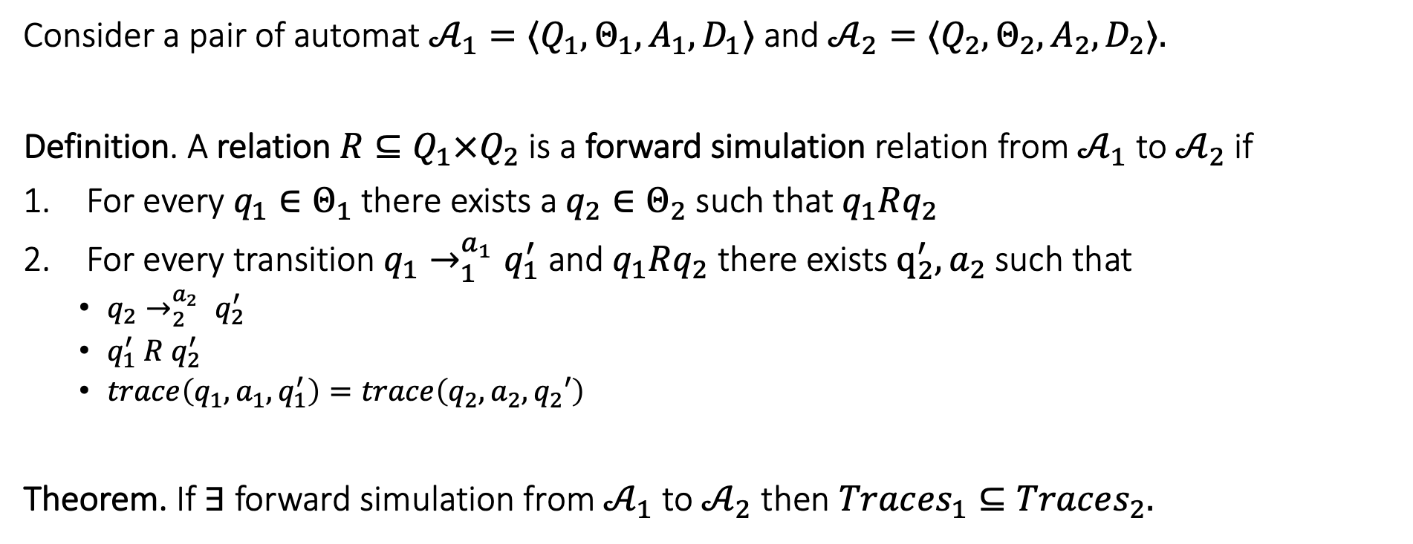
Forward simulation relation
Consider a pair of automat ${𝒜_{1}=⟨Q}_{1}, Θ_{1},A_{1},D_{1}⟩$and ${𝒜_{2}=⟨Q}_{2}, Θ_{2},A_{2},D_{2}⟩.$
Definition. A relation $R⊆Q_{1}×Q_{2}$ is a forward simulation relation from $𝒜_{1}$to $𝒜_{2}$if
For every $q_{1}∈Θ_{1}$there exists a $q_{2}∈Θ_{2}$ such that $q_{1}Rq_{2}$
For every transition $q_{1}→_{1}^{a_{1}}q_{1}^{′}$ and $q_{1}Rq_{2}$ there exists $q_{2}^{′},a_{2}$ such that
$q_{2}→_{2}^{a_{2}} q_{2}^{′}$
$q_{1}^{′} R q_{2}^{′}$
$trace\left(q_{1},a_{1},q_{1}^{′}\right)=trace\left(q_{2},a_{2},q_{2}′\right)$
Theorem. If $∃$ forward simulation from $𝒜_{1}$ to $𝒜_{2}$ then $Trac{es}_{1}⊆Traces_{2}.$

Slide 8
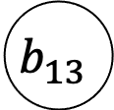

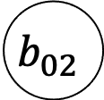
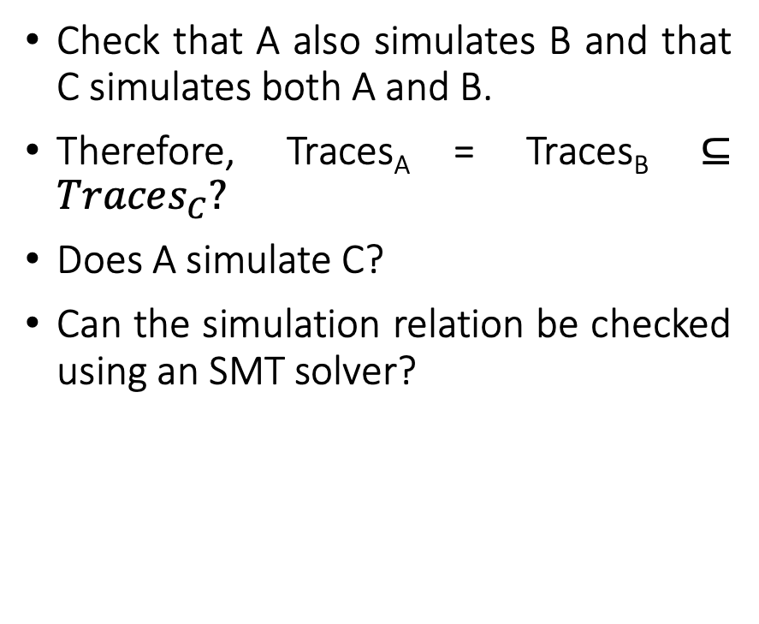
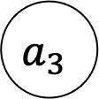
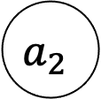

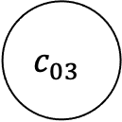
Simulation example continued
Check that A also simulates B and that C simulates both A and B.
Therefore, Traces_{A} = Traces_{B} $⊆Traces_{C}?$
Does A simulate C?
Can the simulation relation be checked using an SMT solver?
0
1
0
$$a_{0}$$
$$a_{1}$$
$$a_{2}$$
$$a_{3}$$
A
1
0
1
0
$$b_{02}$$
$$b_{13}$$
B
1
0
$$c_{03}$$
1

Slide 9
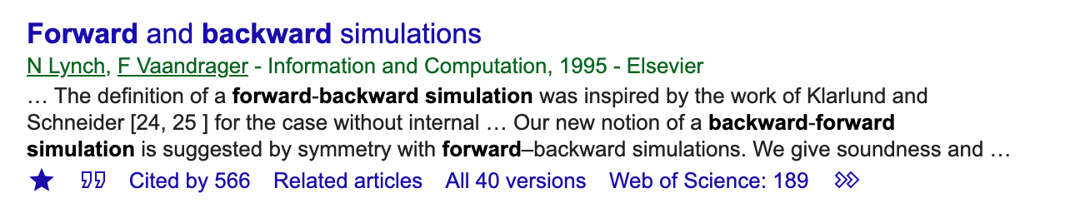

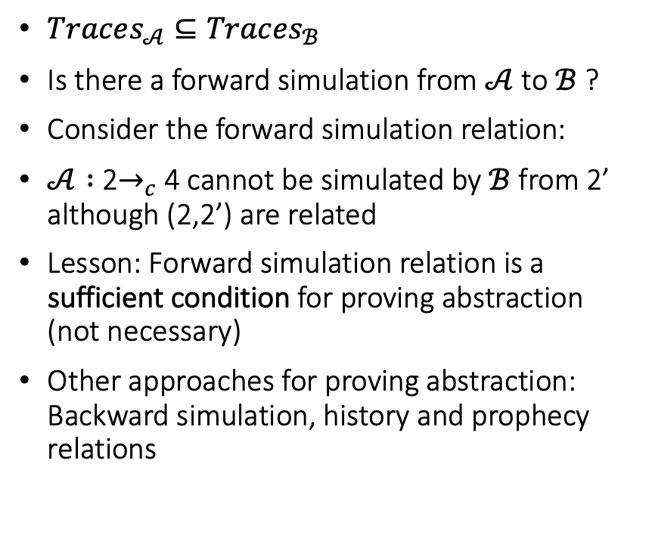

A Simulation Example
$$ℬ$$
a
3
2’
b
1
a
c
$Traces_{𝒜}⊆Traces_{ℬ}$
Is there a forward simulation from $𝒜$ to $ℬ$ ?
Consider the forward simulation relation:
$𝒜 :$ 2$→_{c}$4 cannot be simulated by $ℬ$ from 2’ although (2,2’) are related
Lesson: Forward simulation relation is a sufficient condition for proving abstraction (not necessary)
Other approaches for proving abstraction: Backward simulation, history and prophecy relations
2
4
$$𝒜$$
3
b
a
1
2
c
4

Slide 10
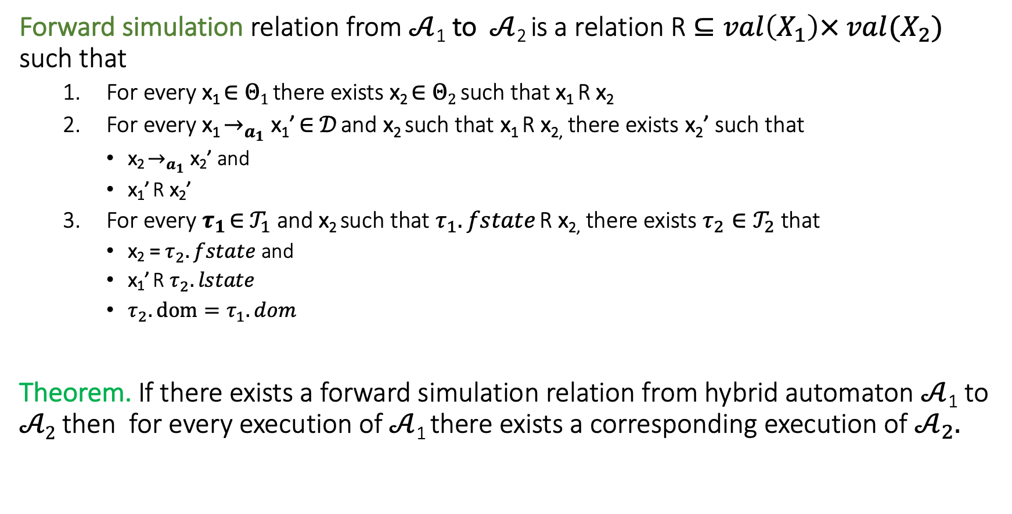
Recall simulations for hybrid systems
Forward simulation relation from $𝒜$₁ to $𝒜$₂ is a relation R $⊆val\left(X_{1}\right)× {val(X_{2})}_{}$ such that
For every x₁ ∈ $Θ1$ there exists x₂ ∈ $Θ2$ such that x₁ R x₂
For every x₁ $→_{a_{1}}$ x₁’ ∈ $𝒟$ and x₂ such that x₁ R x_{2,} there exists x₂’ such that
x₂ $→_{a_{1}}$ x₂’ and
x₁’ R x₂’
For every $τ_{1}$ ∈ $𝒯_{1}$ and x₂ such that $τ_{1}.fstate$ R x_{2,} there exists $τ_{2}∈𝒯_{2}$ that
x₂ = $τ_{2}.fstate$ and
x₁’ R $τ_{2}.lstate$
$τ_{2}.dom=τ_{1}.dom$
Theorem. If there exists a forward simulation relation from hybrid automaton $𝒜$₁ to $𝒜2$ then for every execution of $𝒜$₁ there exists a corresponding execution of $𝒜_{2}.$

Slide 11
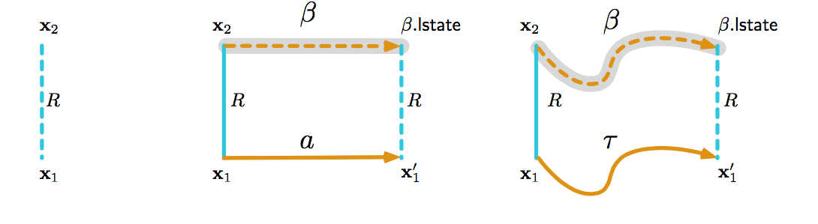
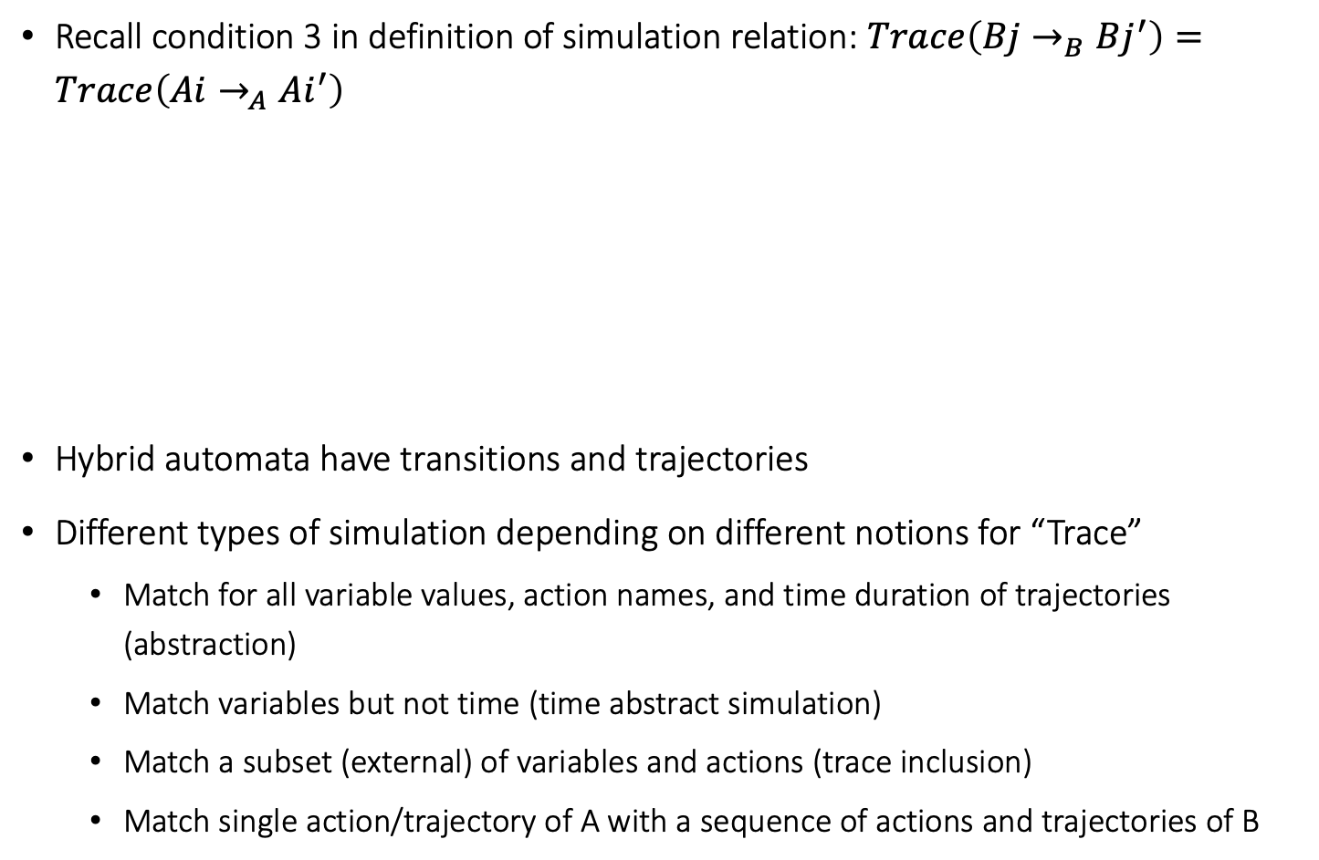
Simulation relations for hybrid automata
Recall condition 3 in definition of simulation relation: $Trace\left(Bj→_{B}Bj^{′}\right)=Trace\left(Ai→_{A}Ai^{′}\right)$
Hybrid automata have transitions and trajectories
Different types of simulation depending on different notions for “Trace”
Match for all variable values, action names, and time duration of trajectories (abstraction)
Match variables but not time (time abstract simulation)
Match a subset (external) of variables and actions (trace inclusion)
Match single action/trajectory of A with a sequence of actions and trajectories of B

Slide 12
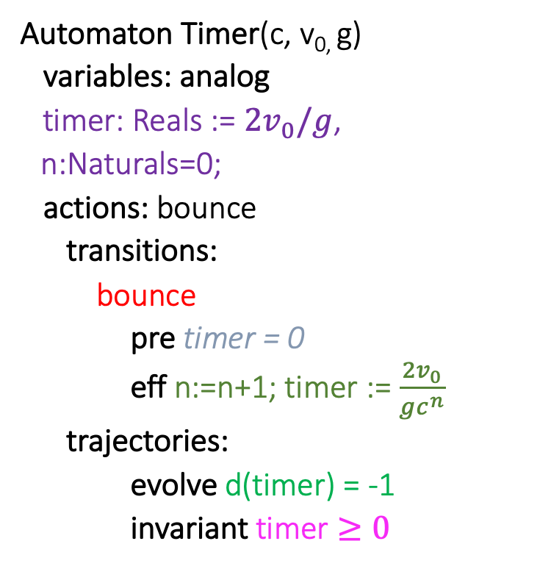

Timer simulates Ball (w.r.t. timing of bounce actions)
Automaton Timer(c, v_{0,} g)
variables: analog
timer: Reals := $2v_{0}/g$,
n:Naturals=0;
actions: bounce
transitions:
bounce
pre timer = 0
eff n:=n+1; timer := $\frac{2v_{0}}{gc^{n}}$
trajectories:
evolve d(timer) = -1
invariant timer $≥0$
Automaton Ball(c,v₀,g)
variables:
x: Reals := 0
v: Reals := v₀
actions: bounce
transitions:
bounce
pre x = 0 /\ v < 0
eff v := -cv
trajectories:
evolve d(x) = v; d(v) = -g
invariant $x≥0$

Slide 13
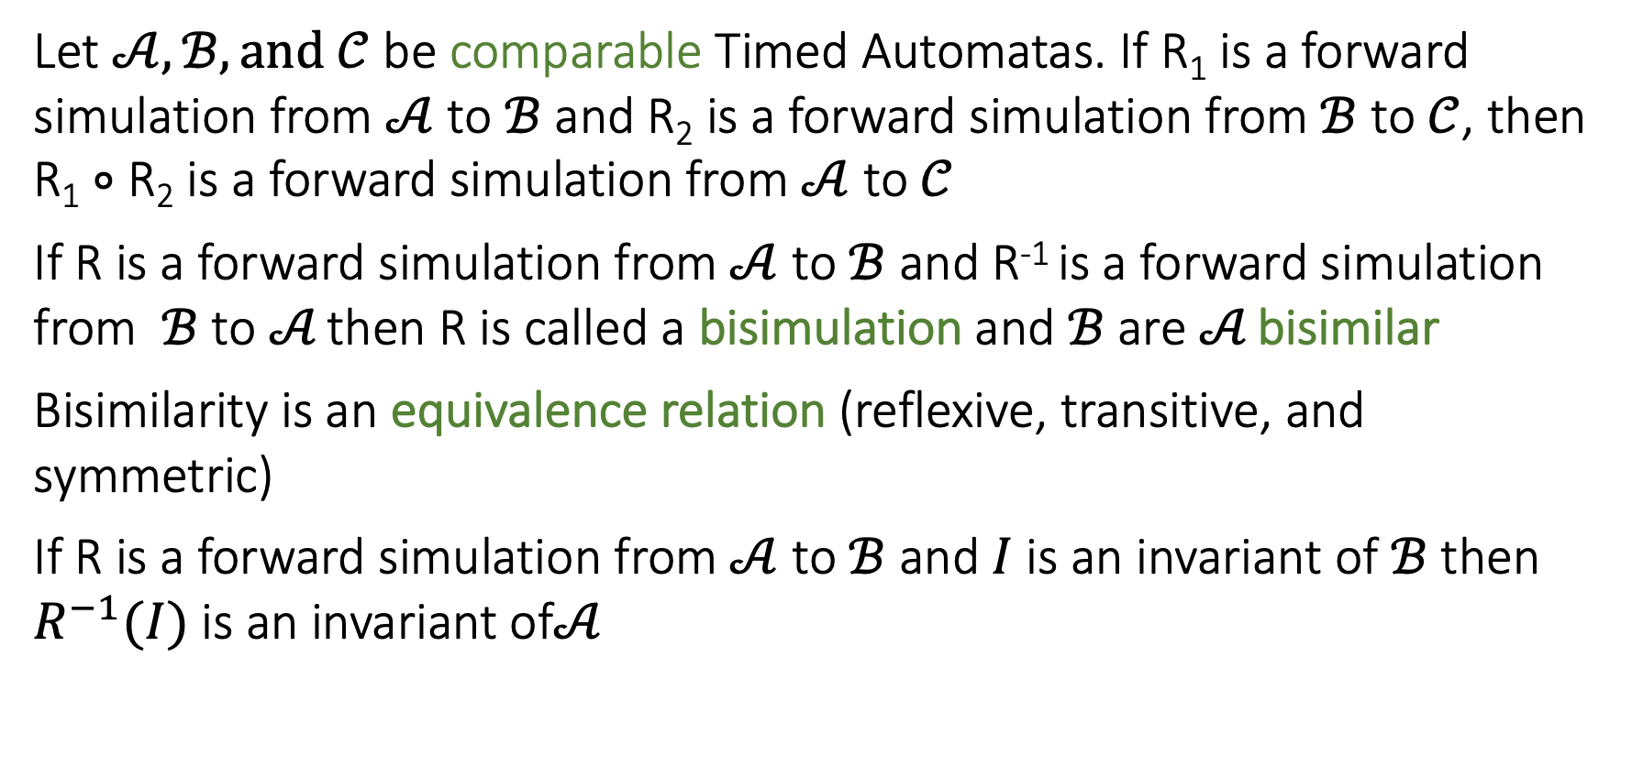
Some nice properties of Forward Simulation
Let $𝒜, ℬ, and 𝒞$ be comparable Timed Automatas. If R₁ is a forward simulation from $𝒜$ to $ℬ$ and R₂ is a forward simulation from $ℬ$ to $𝒞$, then R₁ $∘$ R₂ is a forward simulation from $𝒜$ to $𝒞$
If R is a forward simulation from $𝒜$ to $ℬ$ and R⁻¹ is a forward simulation from $ℬ$ to $𝒜$ then R is called a bisimulation and $ℬ$ are $𝒜$ bisimilar
Bisimilarity is an equivalence relation (reflexive, transitive, and symmetric)
If R is a forward simulation from $𝒜$ to $ℬ$ and $I$ is an invariant of $ℬ$ then $R^{−1}(I)$ is an invariant of$𝒜$
Notes:
Relational composition

Slide 14
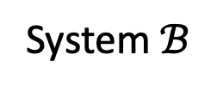
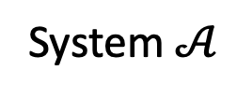
Simulations and Stability
But, stability not preserved by ordinary simulations and bisimulations [Prabhakar, et. al 15]
System $𝒜$
System $ℬ$
time
time
Stability Preserving Simulations and Bisimulations for Hybrid Systems, Prabhakar, Dullerud, Viswanathan IEEE Trans. Automatic Control 2015

Slide 15
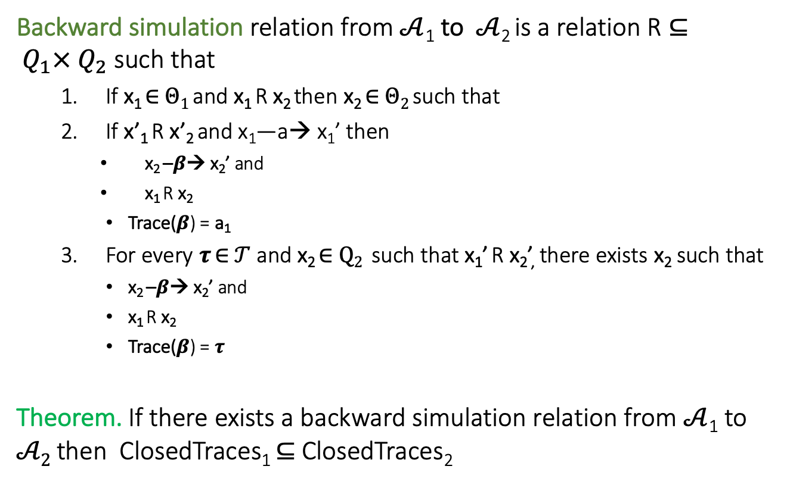
Backward Simulations
Backward simulation relation from $𝒜$₁ to $𝒜$₂ is a relation R $⊆ Q_{1}× Q_{2}$ such that
If x₁ ∈ $Θ1$ and x₁ R x₂ then x₂ ∈ $Θ2$ such that
If x’₁ R x’₂ and x₁—a→ x₁’ then
x₂ –$β$→ x₂’ and
x₁ R x₂
Trace($β$) = a₁
For every $τ$ ∈ $𝒯$ and x₂ ∈ $Q2$ such that x₁’ R x₂’, there exists x₂ such that
x₂ –$β$→ x₂’ and
x₁ R x₂
Trace($β$) = $τ$
Theorem. If there exists a backward simulation relation from $𝒜$₁ to $𝒜2$ then ClosedTraces₁ $⊆$ ClosedTraces₂
Notes:
skip this maybe

Slide 16
Special Classes of Hybrid Automata
Finite Automata
Integral Timed Automata ←
Rational time automata
Multirate automata
Rectangular Initialized HA
Rectangular HA
Linear HA
Nonlinear HA

Slide 17
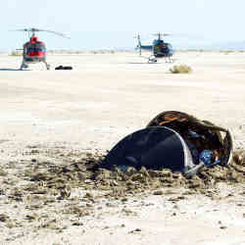
ACM NEWS: In Space, No One Can Fix Your Sign Errors--- Paul Cheng & Peter Carian
15,000 satellite launches planned for the decade
5.3% satellites are lost in the first year, 42% of those in first 2 months
Most common cause sign errors: SW/HW parameter used the wrong way
fitting acceleration sensors the wrong way
wrong usage of negative instead of positive parameters
switching current in wrong direction in a circuit
inverting the orientation of the electromagnets used for positioning
Genesis (2001) for capturing particles from the solar wind, pounded into the Utah desert unbraked because a pencil-eraser-sized deceleration sensor was mounted upside-down.

Slide 18
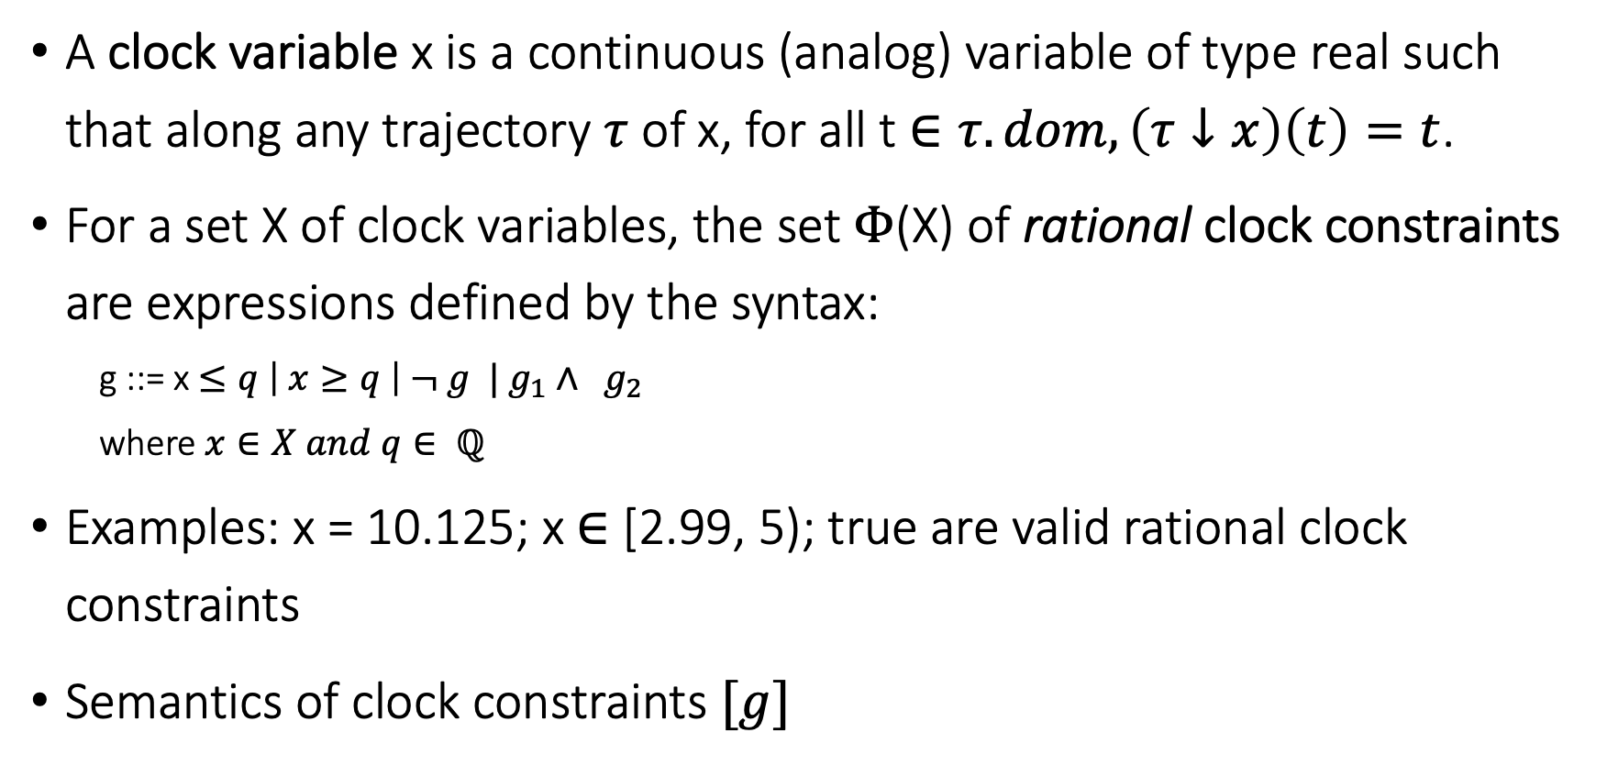
Clocks and Rational Clock Constraints
A clock variable x is a continuous (analog) variable of type real such that along any trajectory $τ$ of x, for all t $∈τ.dom, \left(τ↓x\right)\left(t\right)=t$.
For a set X of clock variables, the set $Φ$(X) of rational clock constraints are expressions defined by the syntax:
g ::= x $≤q \left| x≥q \right| ¬ g | g_{1}∧ g_{2}$
where $x∈X and q∈ ℚ$
Examples: x = 10.125; x $∈$ [2.99, 5); true are valid rational clock constraints
Semantics of clock constraints $[g]$

Slide 19
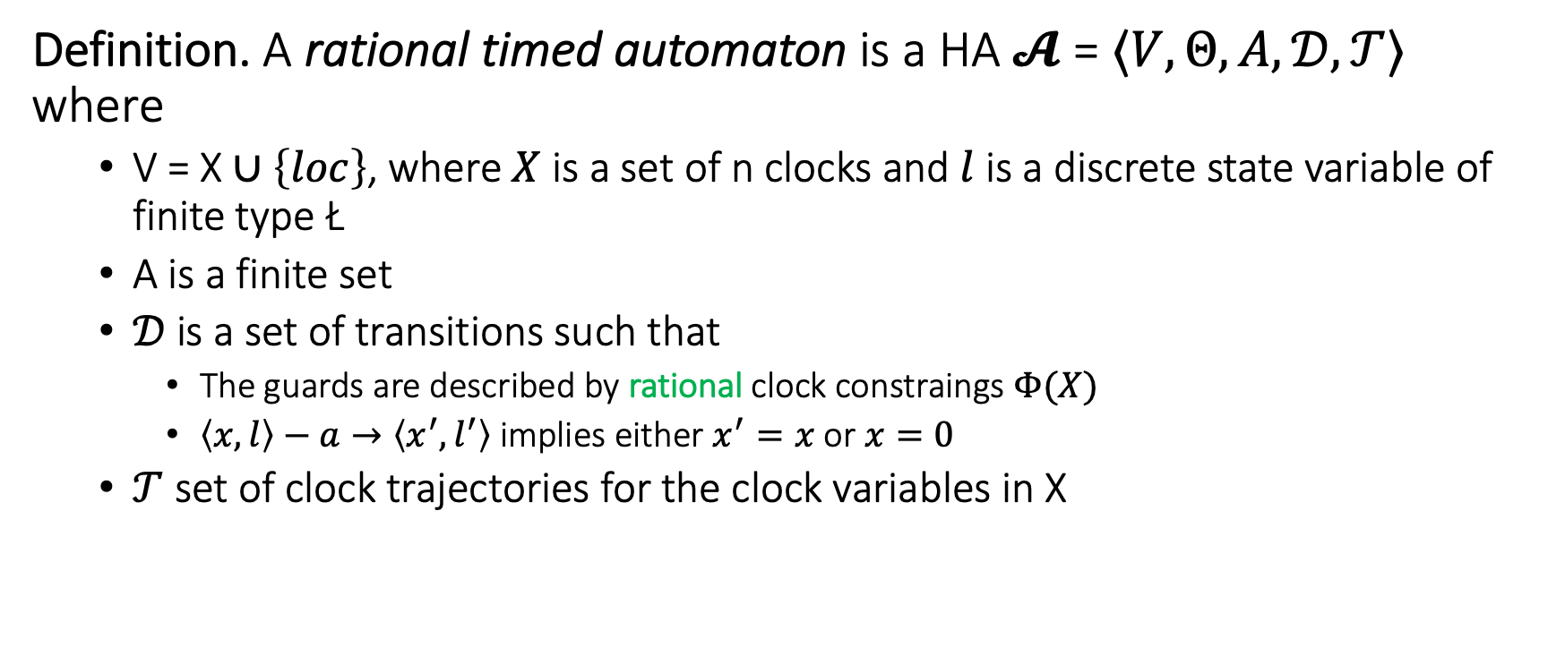
Step 1. Rational Timed Automata
Definition. A rational timed automaton is a HA $𝓐$ = $〈V, Θ, A, 𝒟, 𝒯〉$ where
V = X $∪\left\{loc\right\}$, where $X$ is a set of n clocks and $l$ is a discrete state variable of finite type Ł
A is a finite set
$𝒟$is a set of transitions such that
The guards are described by rational clock constraings $Φ(X)$
$〈x,l〉−a→〈x^{′},l^{′}〉$ implies either $x^{′}=x$ or $x=0$
$𝒯$ set of clock trajectories for the clock variables in X

Slide 20
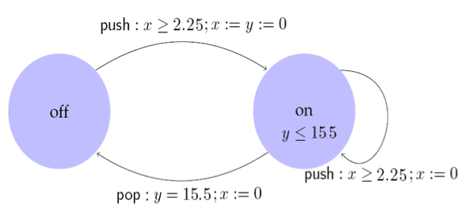
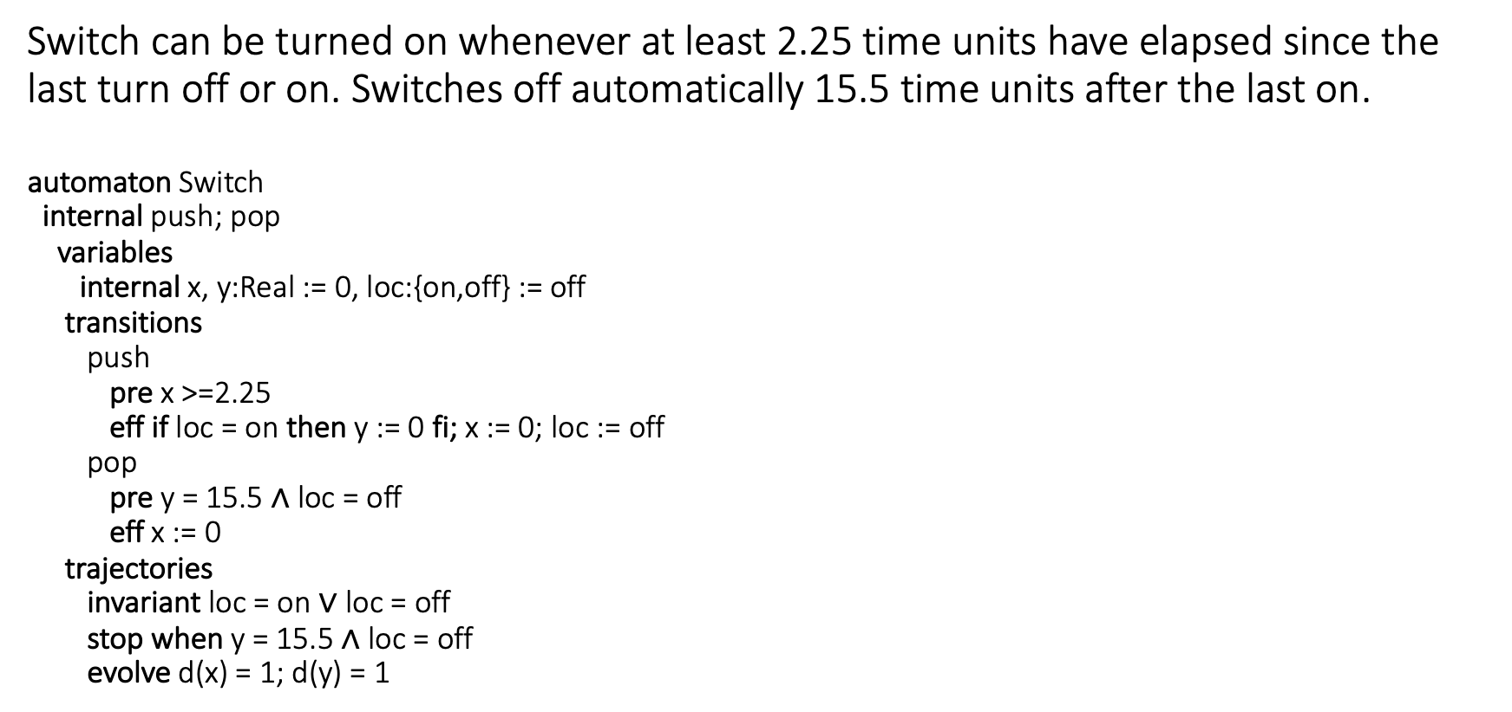
Example: Rational Light switch
Switch can be turned on whenever at least 2.25 time units have elapsed since the last turn off or on. Switches off automatically 15.5 time units after the last on.
automaton Switch
internal push; pop
variables
internal x, y:Real := 0, loc:{on,off} := off
transitions
push
pre x >=2.25
eff if loc = on then y := 0 fi; x := 0; loc := off
pop
pre y = 15.5 $∧$ loc = off
eff x := 0
trajectories
invariant loc = on $∨$ loc = off
stop when y = 15.5 $∧$ loc = off
evolve d(x) = 1; d(y) = 1

Slide 21
Control State (Location) Reachability Problem
Given an RTA, check if a particular mode is reachable from the initial states
Is problem decidable?
Yes
Key idea:
Construct a ITA that has exactly same mode reachability behavior as the given RTA (timing behavior may be different)
Check mode reachability for ITA

Slide 22
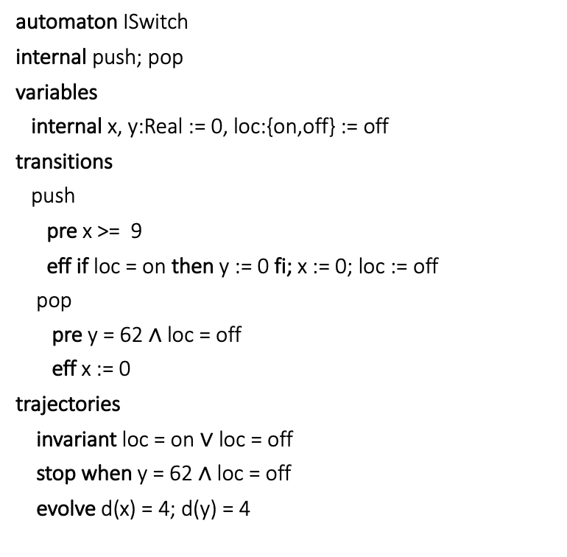
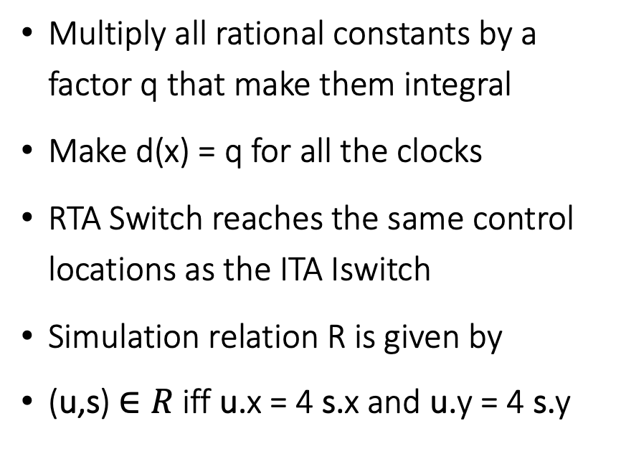
Construction of ITA from RTA
automaton ISwitch
internal push; pop
variables
internal x, y:Real := 0, loc:{on,off} := off
transitions
push
pre x >= 9
eff if loc = on then y := 0 fi; x := 0; loc := off
pop
pre y = 62 $∧$ loc = off
eff x := 0
trajectories
invariant loc = on $∨$ loc = off
stop when y = 62 $∧$ loc = off
evolve d(x) = 4; d(y) = 4
Multiply all rational constants by a factor q that make them integral
Make d(x) = q for all the clocks
RTA Switch reaches the same control locations as the ITA Iswitch
Simulation relation R is given by
(u,s) $∈R$iff u.x = 4 s.x and u.y = 4 s.y

Slide 23
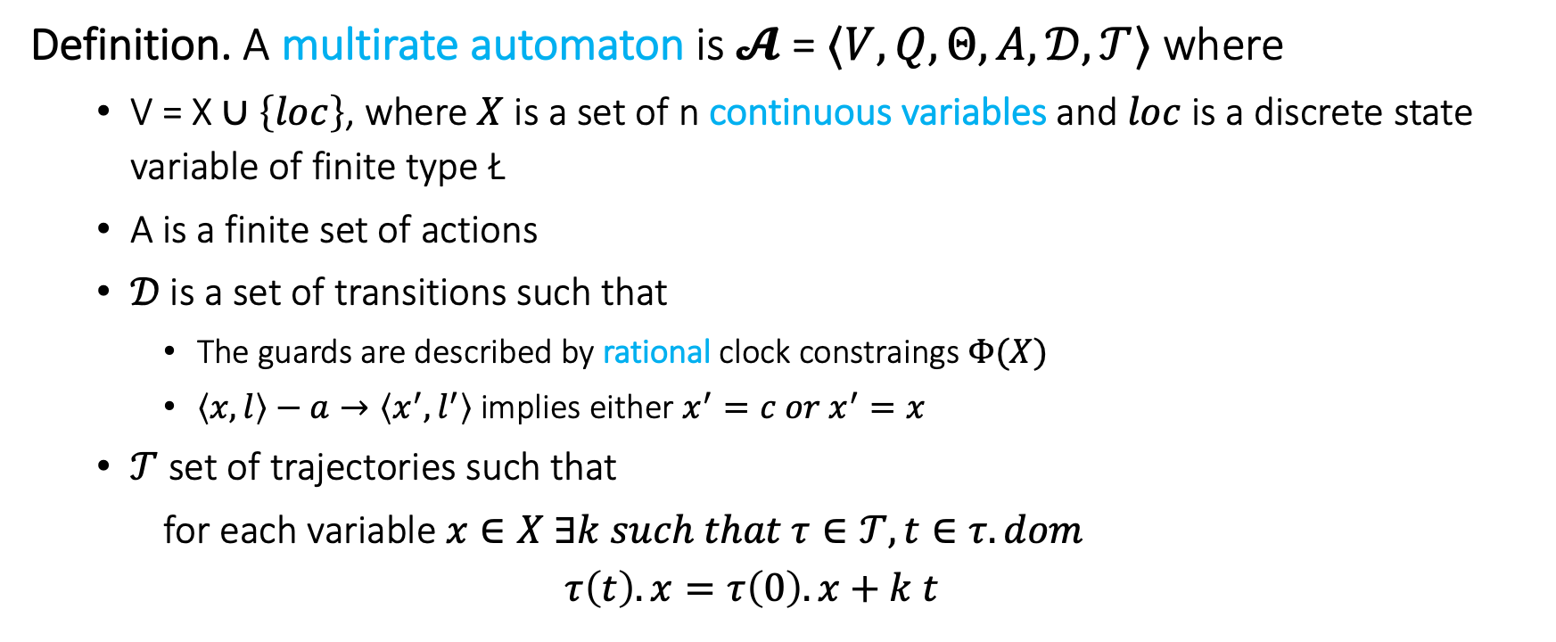
Step 2. Multi-Rate Automaton
Definition. A multirate automaton is $𝓐$ = $〈V, Q, Θ, A, 𝒟, 𝒯〉$ where
V = X $∪\left\{loc\right\}$, where $X$ is a set of n continuous variables and $loc$ is a discrete state variable of finite type Ł
A is a finite set of actions
$𝒟$is a set of transitions such that
The guards are described by rational clock constraings $Φ(X)$
$〈x,l〉−a→〈x^{′},l^{′}〉$ implies either $x^{′}=c{ or x}^{′}=x$
$𝒯$ set of trajectories such that
for each variable $x∈X ∃k such that τ∈𝒯, t∈τ.dom$
$$τ\left(t\right).x=τ\left(0\right).x+k t$$

Slide 24
Control State (Location) Reachability Problem
Given an MRA, check if a particular location is reachable from the initial states
Is problem is decidable?
Yes
Key idea:
Construct a RTA that is bisimilar to the given MRA

Slide 25
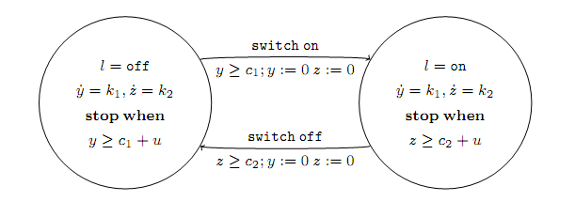
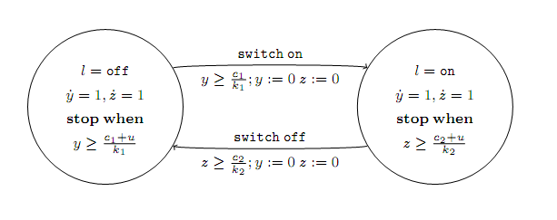
Example: Multi-rate to rational TA
Multirate automaton
Rational timed automaton

Slide 26
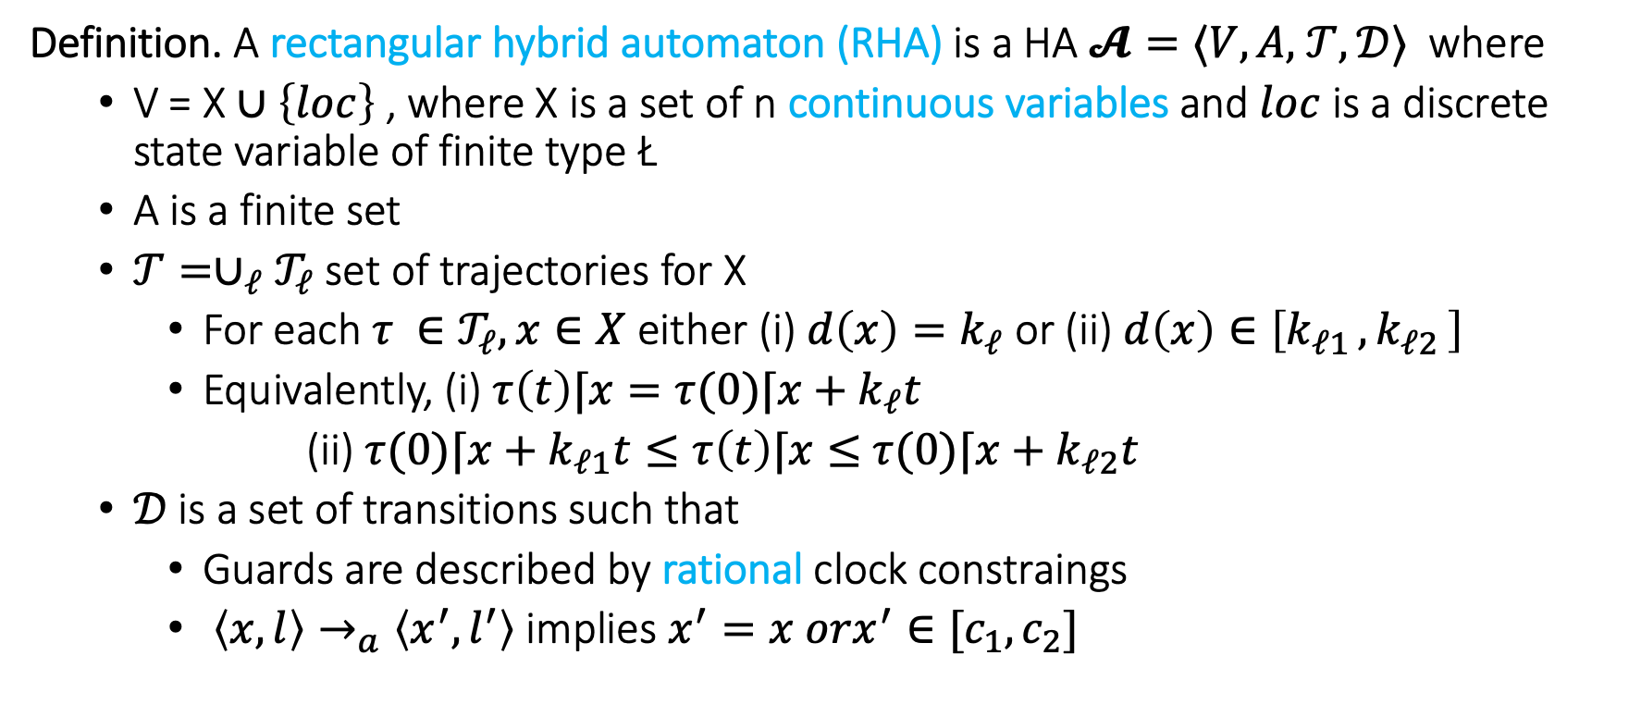
Step 3. Rectangular HA
Definition. A rectangular hybrid automaton (RHA) is a HA $𝓐=⟨V,A,$ $𝒯,𝒟⟩$ where
V = X $∪\left\{loc\right\}$ , where X is a set of n continuous variables and $loc$ is a discrete state variable of finite type Ł
A is a finite set
$𝒯={∪_{ℓ}𝒯}_{ℓ}$ set of trajectories for X
For each $τ ∈𝒯_{ℓ}, x∈X$ either (i) $d\left(x\right)=k_{ℓ}$ or (ii) $d\left(x\right)∈\left[k_{ℓ1 },k_{ℓ2 }\right]$
Equivalently, (i) $τ\left(t\right)⌈x=τ(0)⌈x+k_{ℓ}t$
(ii) $τ(0)⌈x+k_{ℓ1}t≤τ\left(t\right)⌈x≤$ $τ(0)⌈x+k_{ℓ2}t$
$𝒟$is a set of transitions such that
Guards are described by rational clock constraings
$〈x,l〉→_{a}〈x^{′},l^{′}〉$ implies $x^{′}=x orx^{′}∈[c_{1},c_{2}]$

Slide 27
CSR Decidable for RHA?
Given an RHA, check if a particular location is reachable from the initial states?
Is this problem decidable? No
[Henz95] Thomas Henzinger, Peter Kopke, Anuj Puri, and Pravin Varaiya. What's Decidable About Hybrid Automata?. Journal of Computer and System Sciences, pages 373–382. ACM Press, 1995.
CSR for RHA reduction to Halting problem for 2 counter machines
Halting problem for 2CM known to be undecidable
Reduction in next lecture

Slide 28
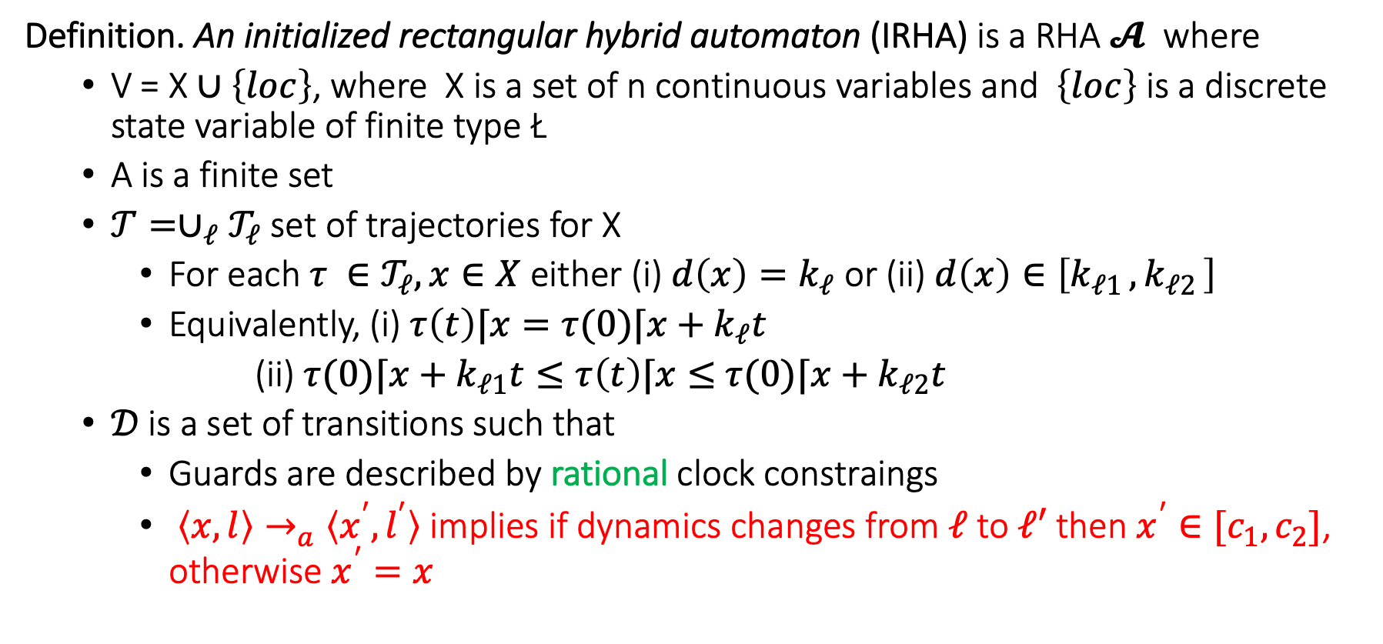
Step 4. Initialized Rectangular HA
Definition. An initialized rectangular hybrid automaton (IRHA) is a RHA $𝓐$ where
V = X $∪\left\{loc\right\}$, where X is a set of n continuous variables and $\left\{loc\right\}$ is a discrete state variable of finite type Ł
A is a finite set
$𝒯={∪_{ℓ}𝒯}_{ℓ}$ set of trajectories for X
For each $τ ∈𝒯_{ℓ}, x∈X$ either (i) $d\left(x\right)=k_{ℓ}$ or (ii) $d\left(x\right)∈\left[k_{ℓ1 },k_{ℓ2 }\right]$
Equivalently, (i) $τ\left(t\right)⌈x=τ(0)⌈x+k_{ℓ}t$
(ii) $τ(0)⌈x+k_{ℓ1}t≤τ\left(t\right)⌈x≤$ $τ(0)⌈x+k_{ℓ2}t$
$𝒟$is a set of transitions such that
Guards are described by rational clock constraings
$〈x,l〉→_{a}〈x^{′},l^{′}〉$ implies if dynamics changes from $ℓ$ to $ℓ′$ then $x^{′}∈[c_{1},c_{2}]$, otherwise $x^{′}=x$

Slide 29
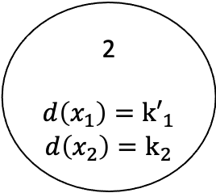

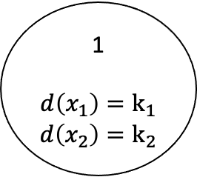
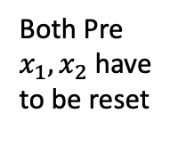
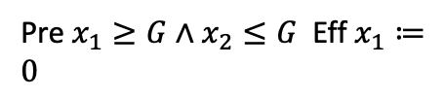
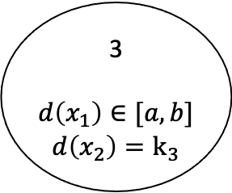
Example: Rectangular Initialized HA
Pre $x_{1}≥G∧x_{2}≤G$ Eff $x_{1}≔0$
1
$$d\left(x_{1}\right)=k_{1}$$
$$d\left(x_{2}\right)=k_{2}$$
2
$$d\left(x_{1}\right)={k′}_{1}$$
$$d\left(x_{2}\right)=k_{2}$$
Both Pre $x_{1}, x_{2}$ have to be reset
3
$$d\left(x_{1}\right)∈[a,b]$$
$$d\left(x_{2}\right)=k_{3}$$
Eff $x_{1}, x_{2}∈[c,d]$

Slide 30
CSR Decidable for IRHA?
Given an IRHA, check if a particular location is reachable from the initial states
Is this problem decidable? Yes
Key idea:
Construct a 2n-dimensional initialized multi-rate automaton that is bisimilar to the given IRHA
Construct a ITA that is bisimilar to the Singular TA

Slide 31
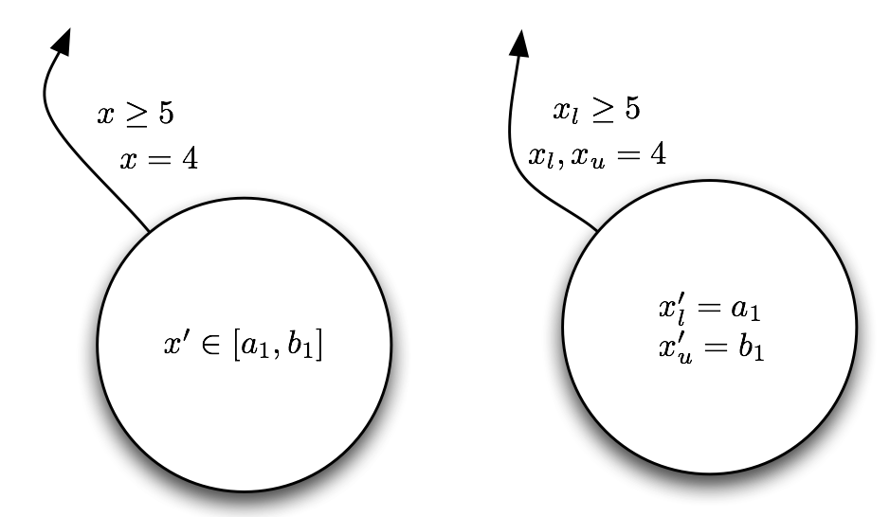
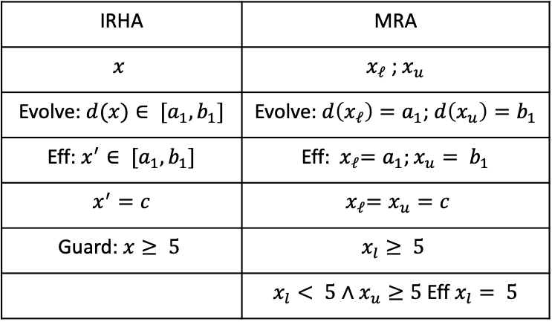
From IRHA to Singular HA conversion
For every variable create two variables---tracking the upper and lower bounds
IRHA | MRA
$$x$$ | $x_{ℓ}$ ; $x_{u}$
Evolve: $d(x)∈ [a_{1},b_{1}]$ | Evolve: $d\left(x_{ℓ}\right)=a_{1}$; $d\left(x_{u}\right)=b_{1}$
Eff: $x^{′}∈ [a_{1},b_{1}]$ | Eff:${ x}_{ℓ}=a_{1};x_{u}= b_{1}$
$x^{′}=c$ | $${ x}_{ℓ}=x_{u}=c$$
Guard: $x≥ 5$ | $$x_{l}≥ 5$$
 | $x_{l}< 5∧x_{u}≥5$ Eff $x_{l}= 5$

Slide 32
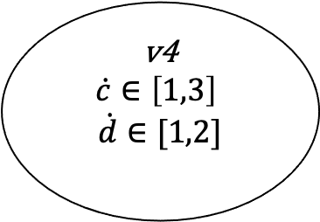








Example IRHA
$$c≔0;d≔1$$
v1
$$\dot{c}∈\left[1,3\right]$$
$$\dot{d}∈[−3,−2]$$
$c≥0∧d≤$2
$$d≔1$$
v4
$$\dot{c}∈\left[1,3\right]$$
$$\dot{d}∈[1,2]$$
$$c≤5∧d≤−3$$
$$c≔4$$
$c≥−3∧d≤−$2
$$c∈[−1,−2]$$
v2
$$\dot{c}∈\left[−4,−2\right]$$
$$\dot{d}∈[−3,−2]$$
$$d≤−5$$
$$d≔−4$$
v3
$$\dot{c}∈\left[−4,−2\right]$$
$$\dot{d}∈[1,2]$$

Slide 33





Initialized Singular HA
$$c_{l},c_{u}≔0;d_{l}, d_{u}≔1$$
v1
$$\dot{c_{l}}=1$$
$$\dot{c_{u}}=3$$
$$\dot{d_{l}}=−3$$
$$\dot{d_{u}}=−2$$
v4
$\dot{\begin{aligned}\dot{c_{l}}=1 \\ \dot{c_{u}}=3 \\ \begin{aligned} \dot{d_{l}}=1 \\ \dot{d_{u}}=2 \end{aligned}\end{aligned}}$
v2
$$\dot{\begin{aligned}\dot{c_{l}}=−4 \\ \dot{c_{u}}=−2 \\ \begin{aligned} \dot{d_{l}}=−3 \\ \dot{d_{u}}=−2 \end{aligned}\end{aligned}}$$
v3
$$\dot{\begin{aligned}\dot{c_{l}}=−4 \\ \dot{c_{u}}=−2 \\ \begin{aligned} \dot{d_{l}}=1 \\ \dot{d_{u}}=2 \end{aligned}\end{aligned}}$$

Slide 34






Transitions
v1
$$\dot{c_{l}}=1$$
$$\dot{c_{u}}=3$$
$$\dot{d_{l}}=−3$$
$$\dot{d_{u}}=−2$$
5
$$c_{u}$$
$$c_{l}$$
$$c_{l}≤5$$
$$c_{l}, c_{u}≔4$$
$d_{u}≤−3$ no reset
$d_{u}>−3∧d_{l}≤−3 d_{u}≔$-3
$${d_{u}}_{ }$$
-3
$$d_{l}$$

Slide 35





Initialized Singular HA
$$c_{l},c_{u}≔0;d_{l}, d_{u}≔1$$
v1
$$\dot{c_{l}}=1$$
$$\dot{c_{u}}=3$$
$$\dot{d_{l}}=−3$$
$$\dot{d_{u}}=−2$$
$c_{l}≥0∧d_{l}≤$2
$$d_{l}, d_{u}≔1$$
v4
$\dot{\begin{aligned}\dot{c_{l}}=1 \\ \dot{c_{u}}=3 \\ \begin{aligned} \dot{d_{l}}=1 \\ \dot{d_{u}}=2 \end{aligned}\end{aligned}}$
$c_{l}<0∧c_{u}≥0∧d_{l}≤$2
$$c_{l}≔0d_{l}, d_{u}≔1$$
$$c_{l}≤5∧d_{u}≤−3$$
$$c_{l}, c_{u}≔4$$
$$c_{l}≤5∧d_{l}≤−3∧d_{u}>−3$$
$$c_{l}, c_{u}≔4 d_{u}≔−3$$
$c_{u}≥−3∧d_{u}≤−$2
$$c_{l}≔−2c_{u}≔−1$$
$c_{u}≥−3∧d_{l}≤−2 ∧d_{u}>−2$
$$c_{l}≔−2c_{u}≔−1 d_{u}−2$$
v2
$$\dot{\begin{aligned}\dot{c_{l}}=−4 \\ \dot{c_{u}}=−2 \\ \begin{aligned} \dot{d_{l}}=−3 \\ \dot{d_{u}}=−2 \end{aligned}\end{aligned}}$$
$$d_{l}≤−5$$
$$d_{l}d_{u}≔−4$$
v3
$$\dot{\begin{aligned}\dot{c_{l}}=−4 \\ \dot{c_{u}}=−2 \\ \begin{aligned} \dot{d_{l}}=1 \\ \dot{d_{u}}=2 \end{aligned}\end{aligned}}$$

Slide 36
Can this be further generalized ?
For initialized Rectangular HA, control state reachability is decidable
Can we drop the initialization restriction?
No, problem becomes undecidable (next time)
Can we drop the rectangular restriction?
No, problem becomes undecidable

Slide 37


Verification in tools

Slide 38

Data structures make reachability go around
Hyperrectangles
$\left[\left[g_{1};g_{2}\right]\right]=\left\{x∈R^{n} \right|{ \left|\left|x−g_{1}\right|\right|}_{ _{∞}}≤{\left|\left|g_{2}−g_{1}\right|\right|}_{ _{∞}}\}=Π_{i}[g_{1i},g_{2i}]$
Polyhedra
Zonotopes [Girard 2005]
Ellipsoids [Kurzhanskiy 2001]
Support functions [Guernic et al. 2009]
Generalized star set [Duggirala and Viswanathan 2018]

Slide 39
Data structures: rectangles and ellipsoids

Slide 40
Zonotopes and polytopes

Slide 41
Summary
ITA: Restricted class of hybrid automata
Clocks, integer constraints
No clock comparison, linear
Control state reachability with Alur-Dill’s algorithm (region automaton construction)
Rational coefficients; multirate Automata
Initialized Rectangular Hybrid Automata
HyTech, PHAVer use polyhedral reachability computations
Notes:
fix-point implementation in tools
We can remove the init. set. Hytech will accept the automaton, but there is no guarantee on termination

