Slide 1
Modeling Computation
Sayan Mitra
Verifying cyberphysical systems
mitras@illinois.edu

Slide 2
Outline
Read Chapter 2
Today
Dijkstra’s mutual exclusion algorithm
Specification language
Semantics: executions, reachable states
Invariant proof
Ponder
Assumptions

Slide 3
Automata or discrete transition systems
The “state” of a system captures all the information needed to predict the system’s future behavior
Behavior of a system is a sequence of states
Our ultimate goal: write programs that prove properties about all behaviors of a system
“Transitions” capture how the state can change

Slide 4
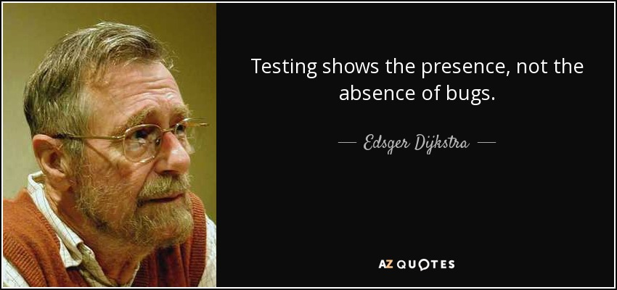

Slide 5
Example: Dijkstra’s mutual exclusion algorithm
Informal Description A token-based mutual exclusion algorithm on a ring network
Collection of processes that send and receive bits over a ring network so that only one of them has a “token” to access a critical resource (e.g., a shared calendar)
Discrete model
Each process has variables that take only discrete values
Time elapses in discrete steps
﻿Self-stabilizing Systems in Spite of Distributed Control, CACM, 1974.

Slide 6
Token-based mutual exclusion in unidirectional ring
Legal configuration
Illegal
N processes with ids 0, 1, …, N-1
Unidirectional means: each i>0 process P_{i} reads the state of only the predecessor P_{i-1;} P₀ reads only P_{N-1}
Legal configuration = exactly one “token” in the ring
Single token circulates in the ring
Even if multiple tokens arise because of faults, if the algorithm continues to work correctly, then eventually there is a single token; this is the self stabilizing property

Slide 7
Dijkstra’s Algorithm [‘74]
N processes: 0, 1, …, N-1
state of each process j is a single integer variable x[j] ∈ {0, 1, 2, K-1}, where K > N
P₀ if x[0] = x[N-1] then x[0] := x[0] + 1 mod K
P_{j} j > 0 if x[j] ≠ x[j -1] then x[j] := x[j-1]
(p_{i} has TOKEN if and only if the blue conditional is true)

Slide 8

Sample executions: from a legal state (single token)
…
…
…
…

Slide 9

Execution from an illegal state
Legal in single “step”
Legal in two steps

Slide 10
A language for specifying automata
automaton DijkstraTR(N:Nat, K:Nat), where K > N
type ID: enumeration [0,...,N-1]
type Val: enumeration [0,...,K]
actions
update(i:ID)
variables
x:[ID -> K]
transitions
update(i:ID)
pre i = 0 /\ x[i] = x[(i-1)]
eff x[i] := (x[i] + 1) % K
update(i:ID)
pre i >0 /\ x[i] ~= x[i-1]
eff x[i] := x[i-1]

Slide 11
A language for specifying automata
automaton DijkstraTR(N:Nat, K:Nat), where K > N
type ID: enumeration [0,...,N-1]
type Val: enumeration [0,...,K]
actions
update(i:ID)
variables
x:[ID -> K]
transitions
update(i:ID) where i = 0
pre i = 0 /\ x[i] = x[N-1]
eff x[i] := (x[i] + 1) % K
update(i:ID)$ where
pre i >0 /\ x[i] ~= x[i-1]
eff x[i] := x[i-1]
Name of automaton and formal parameters
symbols -> maps, /\ and, \/ or, ~= not equal, % mod

Slide 12
A language for specifying automata
automaton DijkstraTR(N:Nat, K:Nat), where K > N
type ID: enumeration [0,...,N-1]
type Val: enumeration [0,...,K]
actions
update(i:ID)
variables
x:[ID -> Val]
transitions
update(i:ID)
pre i = 0 /\ x[i] = x[N-1]
eff x[i] := (x[i] + 1) % K
update(i:ID)
pre i >0 /\ x[i] ~= x[i-1]
eff x[i] := x[i-1]
user defined type declarations
symbols -> maps, /\ and, \/ or, ~= not equal, % mod

Slide 13
A language for specifying automata
automaton DijkstraTR(N:Nat, K:Nat), where K > N
type ID: enumeration [0,...,N-1]
type Val: enumeration [0,...,K]
actions
update(i:ID)
variables
x:[ID -> Val]
transitions
update(i:ID)
pre i = 0 /\ x[i] = x[N-1]
eff x[i] := (x[i] + 1) % K
update(i:ID)
pre i >0 /\ x[i] ~= x[i-1]
eff x[i] := x[i-1]
declaration of “actions” or transition labels; actions can have parameter; this declares the actions update(0), update(1), …, update(N-1)
symbols -> maps, /\ and, \/ or, ~= not equal, % mod

Slide 14
A language for specifying automata
automaton DijkstraTR(N:Nat, K:Nat), where K > N
type ID: enumeration [0,...,N-1]
type Val: enumeration [0,...,K]
actions
update(i:ID)
variables
x:[ID -> Val]
transitions
update(i:ID)
pre i = 0 /\ x[i] = x[N-1]
eff x[i] := (x[i] + 1) % K
update(i:ID)
pre i >0 /\ x[i] ~= x[i-1]
eff x[i] := x[i-1]
declaration of state variables or variables; this declares an array x[0], x[1], …, x[N-1] of Val’s
symbols -> maps, /\ and, \/ or, ~= not equal, % mod

Slide 15
A language for specifying automata
automaton DijkstraTR(N:Nat, K:Nat), where K > N
type ID: enumeration [0,...,N-1]
type Val: enumeration [0,...,K]
actions
update(i:ID)
variables
x:[ID -> Val]
transitions
update(i:ID)
pre i = 0 /\ x[i] = x[N-1]
eff x[i] := (x[i] + 1) % K
update(i:ID)
pre i >0 /\ x[i] ~= x[i-1]
eff x[i] := x[i-1]
declaration of transitions: for each action this defines when the action can occur (pre) and how the state is updated when the action does occur (eff)
symbols -> maps, /\ and, \/ or, ~= not equal, % mod

Slide 16
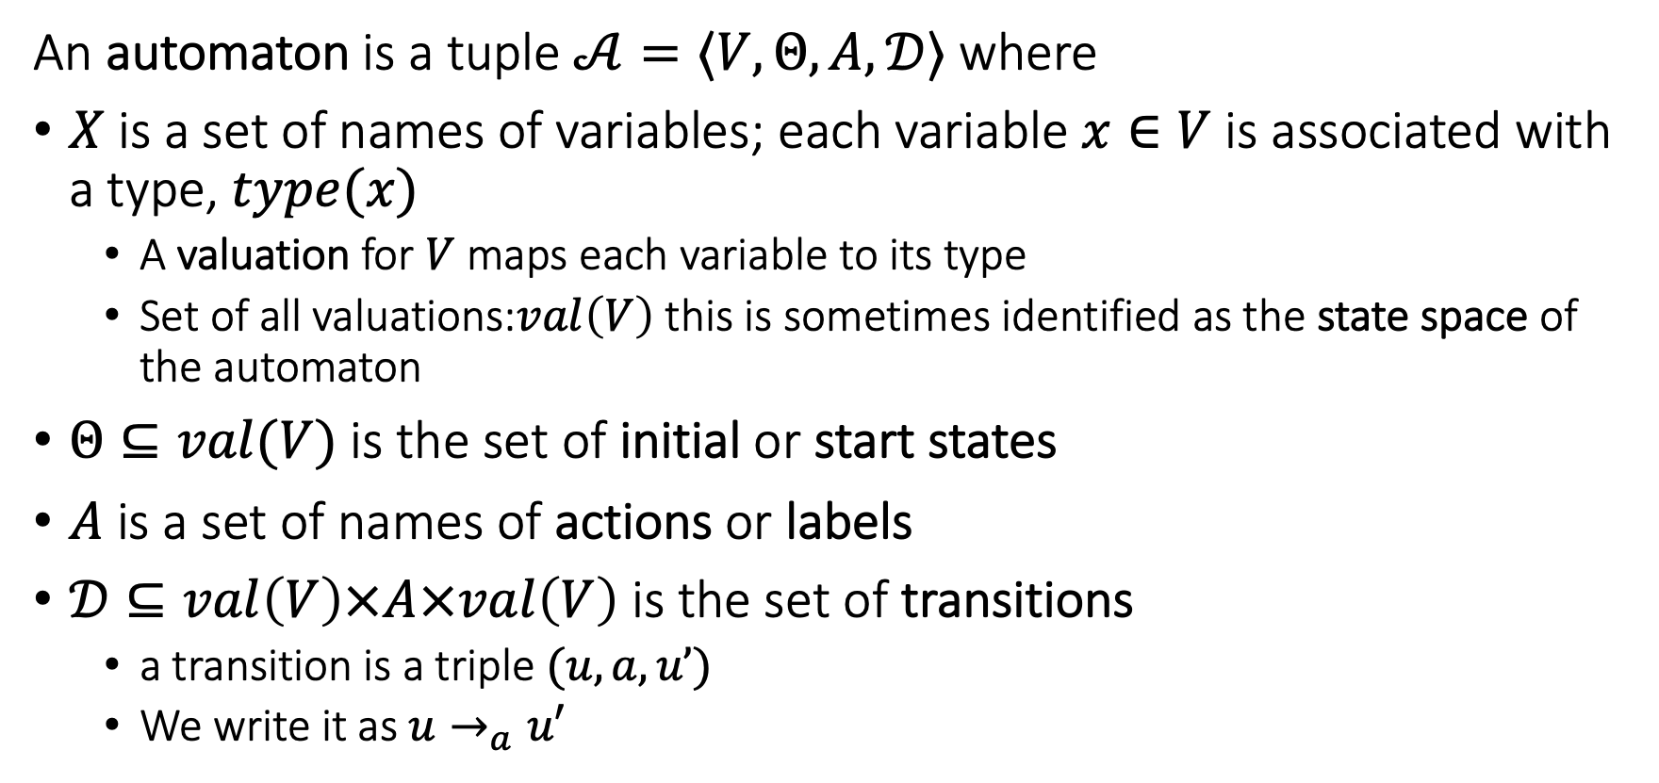
The language defines an automaton
An automaton is a tuple $𝒜=〈V,Θ, A, 𝒟〉$ where
$X$ is a set of names of variables; each variable $x∈V$is associated with a type, $type(x)$
A valuation for $V$ maps each variable to its type
Set of all valuations:$val\left(V\right)$ this is sometimes identified as the state space of the automaton
$Θ⊆val(V)$ is the set of initial or start states
$A$ is a set of names of actions or labels
$𝒟⊆val\left(V\right)×A×val\left(V\right)$ is the set of transitions
a transition is a triple $(u,a,u’)$
We write it as $u→_{a}u′$

Slide 17
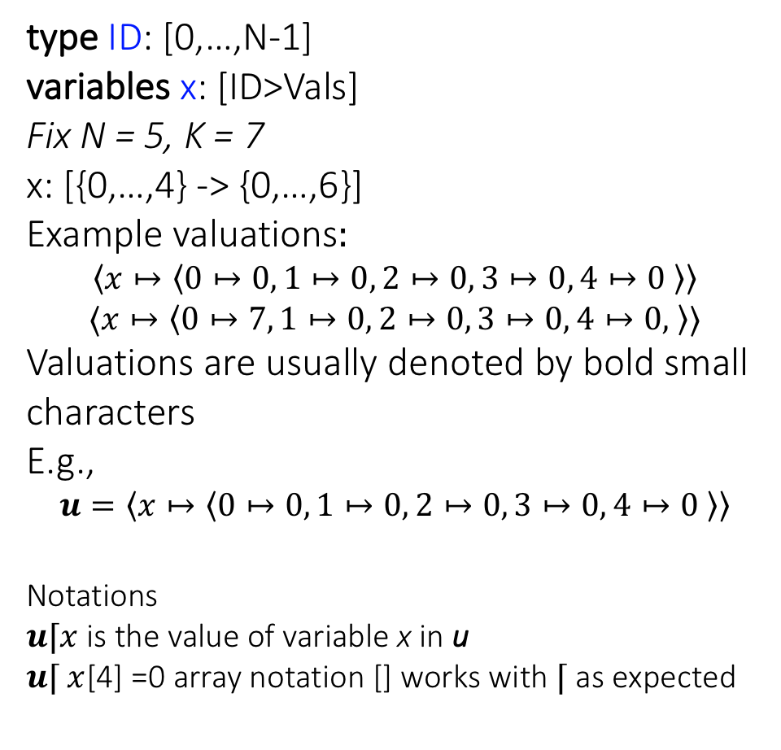
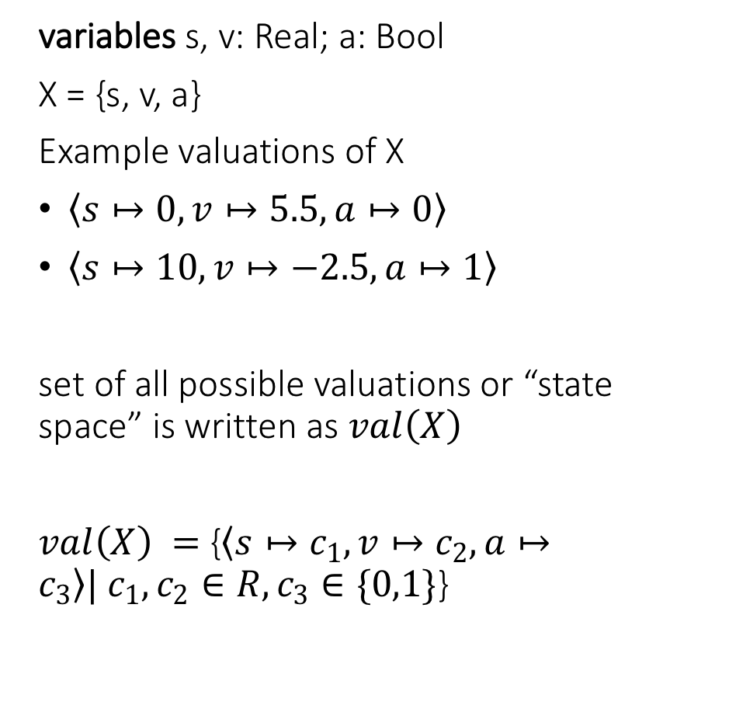
Well formed specifications in IOA Language define automata variables and valuations
type ID: [0,…,N-1]
variables x: [ID>Vals]
Fix N = 5, K = 7
x: [{0,…,4} -> {0,…,6}]
Example valuations$:$
$$〈x↦〈0↦0, 1↦0, 2↦0, 3↦0, 4↦0 〉〉$$
$$〈x↦〈0↦7, 1↦0, 2↦0, 3↦0, 4↦0, 〉〉$$
Valuations are usually denoted by bold small characters
E.g.,
$$u=〈x↦〈0↦0, 1↦0, 2↦0, 3↦0, 4↦0 〉〉$$
Notations
$u⌈x$ is the value of variable x in u
$u⌈ x$[4] =0 array notation [] works with $⌈$ as expected
variables s, v: Real; a: Bool
X = {s, v, a}
Example valuations of X
$〈s↦0, v↦5.5, a↦0〉$
$〈s↦10, v↦−2.5, a↦1〉$
set of all possible valuations or “state space” is written as $val\left(X\right)$
$val\left(X\right) =${$〈s↦c_{1}, v↦c_{2}, a↦c_{3}〉| c_{1},c_{2}∈R, c_{3}∈\{0,1\}$}

Slide 18
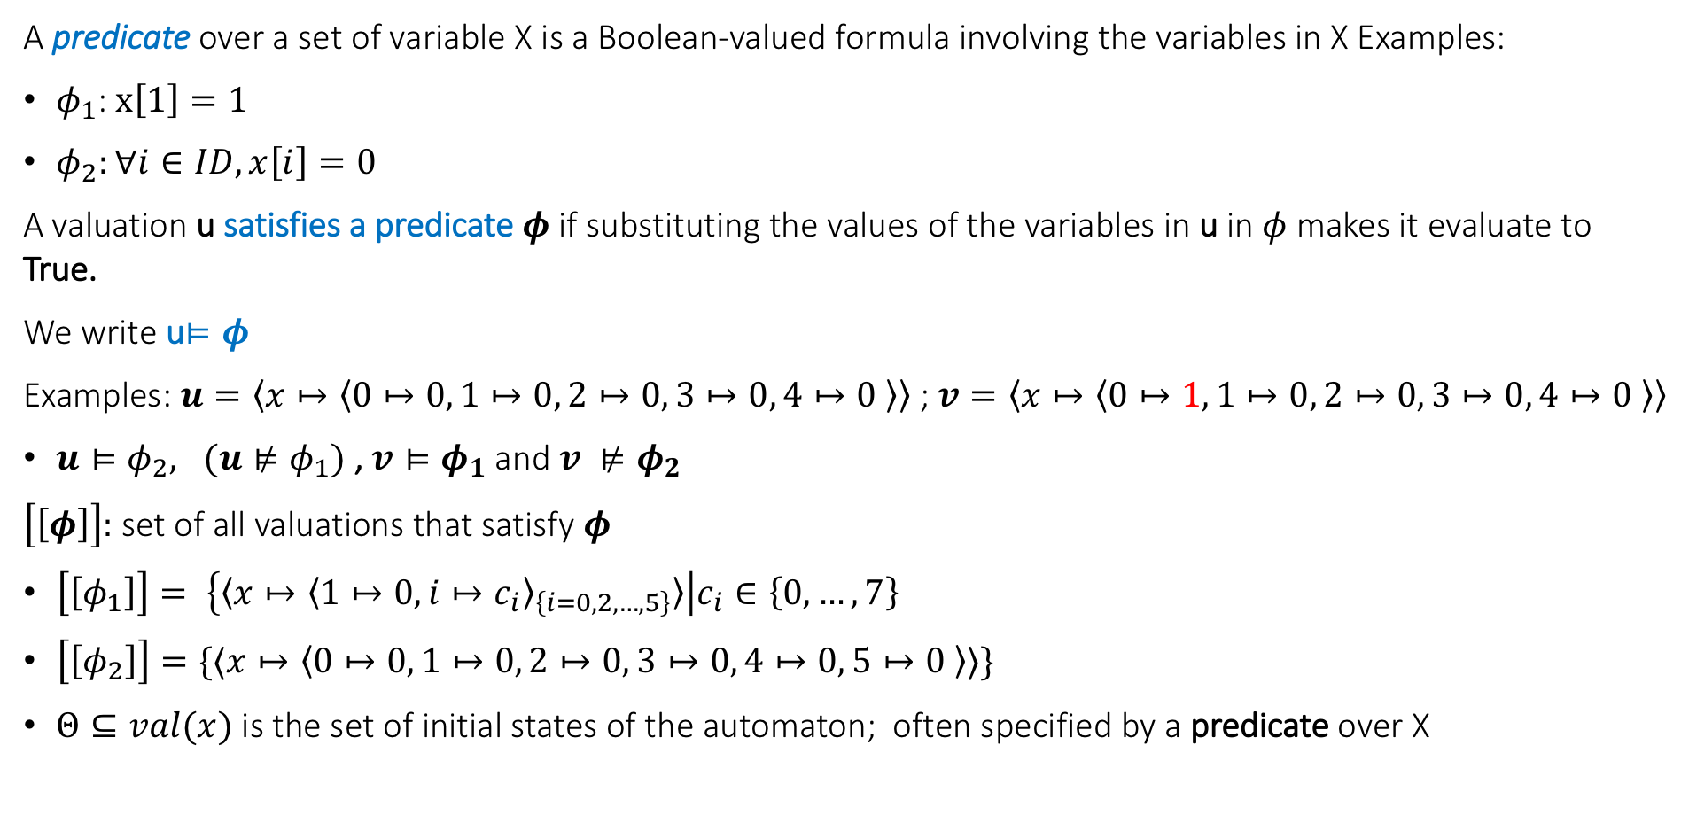
States and predicates
A predicate over a set of variable X is a Boolean-valued formula involving the variables in X Examples:
$φ_{1}$: $x\left[1\right]=1$
$φ_{2}:∀i∈ID, x\left[i\right]=0$
A valuation u satisfies a predicate $φ$ if substituting the values of the variables in u in $φ$ makes it evaluate to True.
We write u$⊨φ$
Examples: $u=〈x↦〈0↦0, 1↦0, 2↦0, 3↦0, 4↦0 〉〉$ ; $v=〈x↦〈0↦1, 1↦0, 2↦0, 3↦0, 4↦0 〉〉$
$u⊨φ_{2}, (u⊭φ_{1})$, $v⊨φ_{1}$ and $v ⊭φ_{2}$
$\left[\left[φ\right]\right]:$ set of all valuations that satisfy $φ$
$\left[\left[φ_{1}\right]\right]= \left\{〈x↦{〈1↦0, i↦c_{i}〉}_{\left\{i=0,2,…,5\right\}}〉\right|c_{i}∈\left\{0,…,7\right\}$
$\left[\left[φ_{2}\right]\right]=\{〈x↦〈0↦0, 1↦0, 2↦0, 3↦0, 4↦0, 5↦0 〉〉\}$
$Θ⊆val(x)$ is the set of initial states of the automaton; often specified by a predicate over X

Slide 19
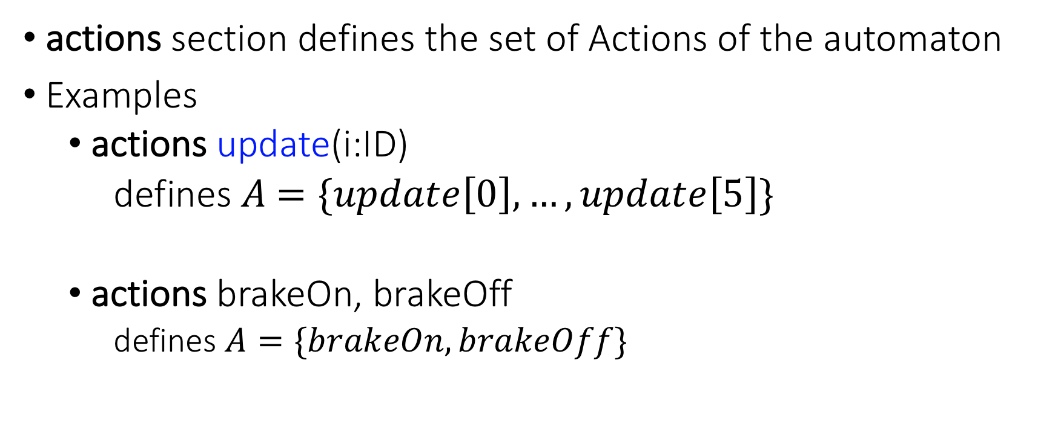
Actions
actions section defines the set of Actions of the automaton
Examples
actions update(i:ID)
defines $A$ $=\{update\left[0\right],…,update\left[5\right]\}$
actions brakeOn, brakeOff
defines $A=\{brakeOn,brakeOff\}$

Slide 20

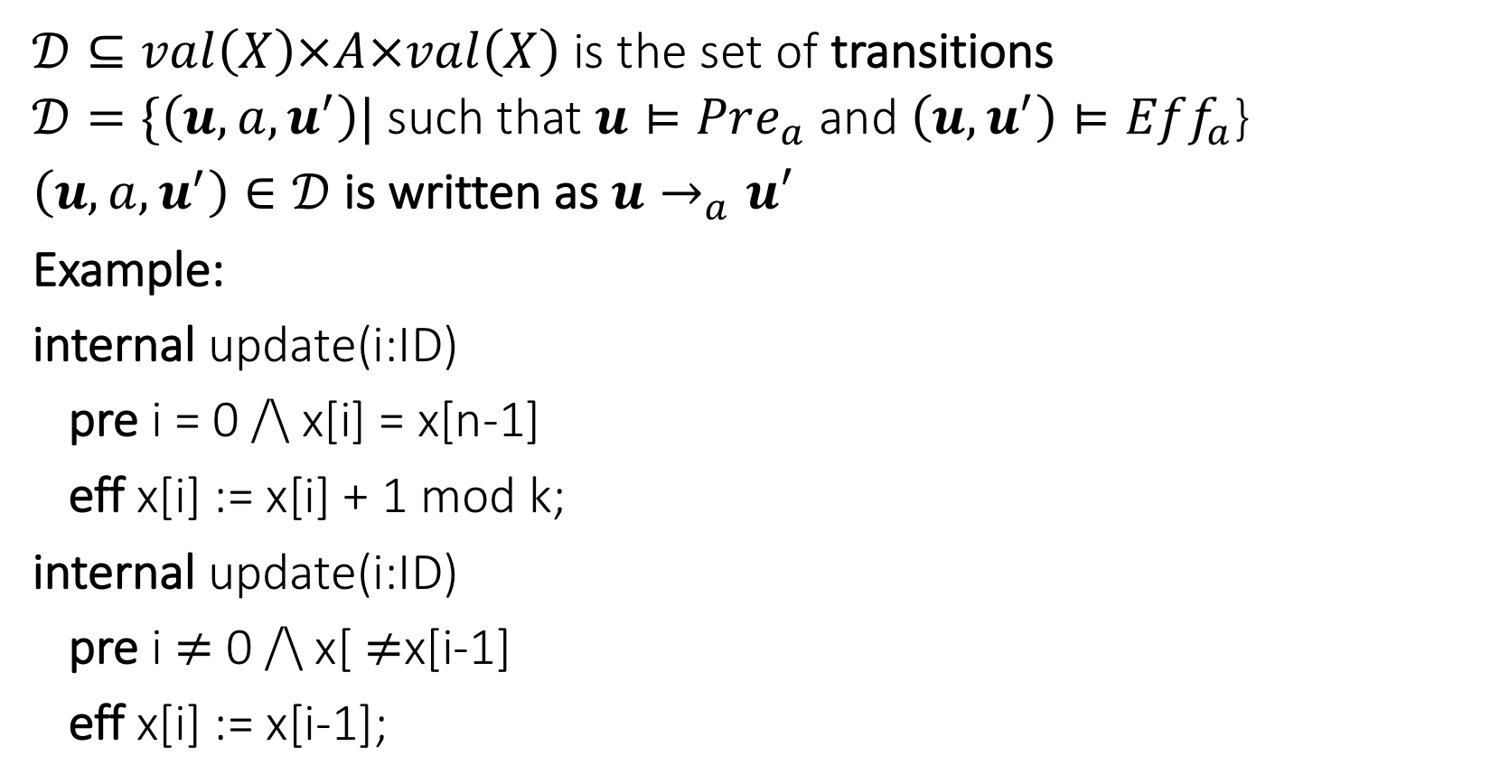
Transitions defined by preconditions and effects
$𝒟⊆val\left(X\right)×A×val\left(X\right)$ is the set of transitions
$𝒟=\{\left(u,a,u^{′}\right)|$such that $u⊨Pre_{a}$ and $\left(u,u^{′}\right)⊨Eff_{a}$}
$\left(u,a,u^{′}\right)∈𝒟$is written as $u→_{a}u′$
Example:
internal update(i:ID)
pre i = 0 /\ x[i] = x[n-1]
eff x[i] := x[i] + 1 mod k;
internal update(i:ID)
pre i $≠$ 0 /\ x[ $≠$x[i-1]
eff x[i] := x[i-1];
$\left(u,update\left(i\right),u^{′}\right)∈𝒟$ iff
(a) $(i=0∧u⌈ x\left[0\right]=u⌈x\left[5\right]$
$∧u^{′}⌈x\left[0\right]=u ⌈x[0]+1 mod K$) $∨$
(b) ($i≠0∧u ⌈x\left[i\right]≠u ⌈x\left[i−1\right]$
$∧u^{′} ⌈x\left[i\right]=u⌈x[i−1]$)

Slide 21
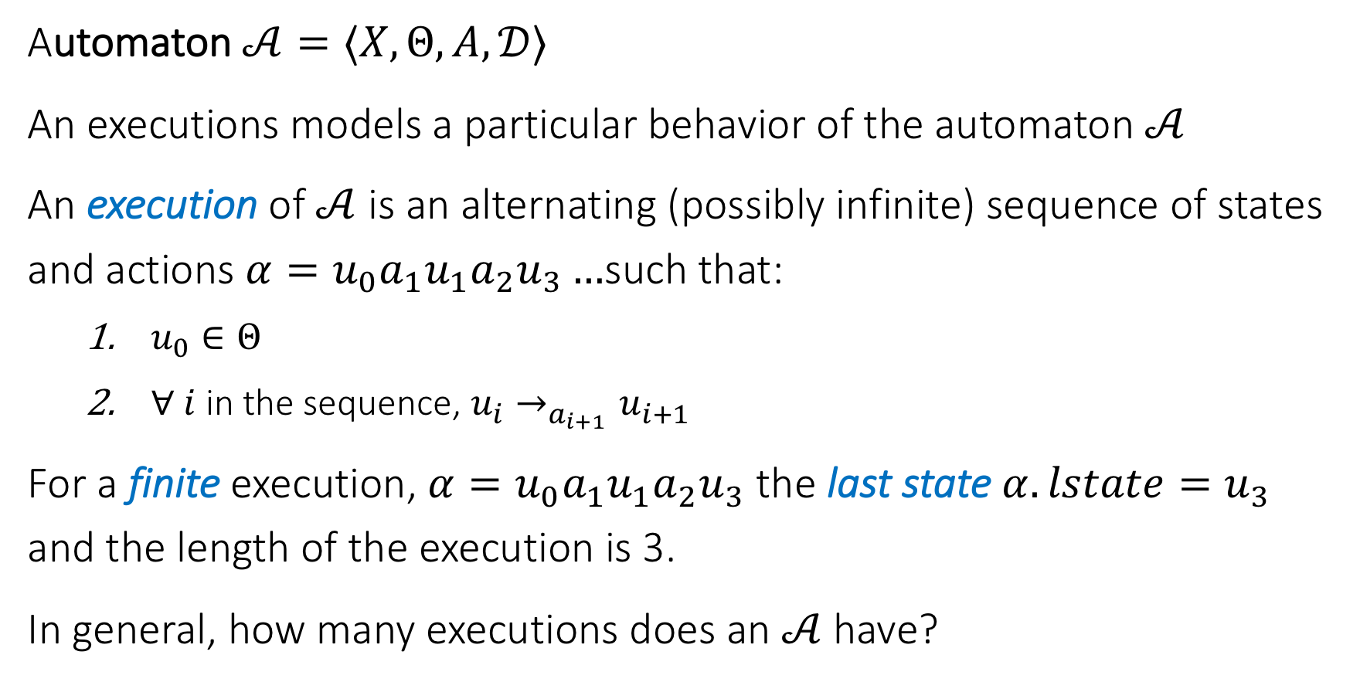
Executions, Reachability, and Invariants
Automaton $𝒜=〈X,Θ, A, 𝒟〉$
An executions models a particular behavior of the automaton $𝒜$
An execution of $𝒜$ is an alternating (possibly infinite) sequence of states and actions $α=u_{0}a_{1}u_{1}a_{2}u_{3}…$such that:
$u_{0}∈Θ$
$∀ i$in the sequence, $u_{i}→_{a_{i+1}}u_{i+1}$
For a finite execution, $α=u_{0}a_{1}u_{1}a_{2}u_{3}$ the last state $α.lstate=u_{3}$ and the length of the execution is 3.
In general, how many executions does an $𝒜$have?

Slide 22
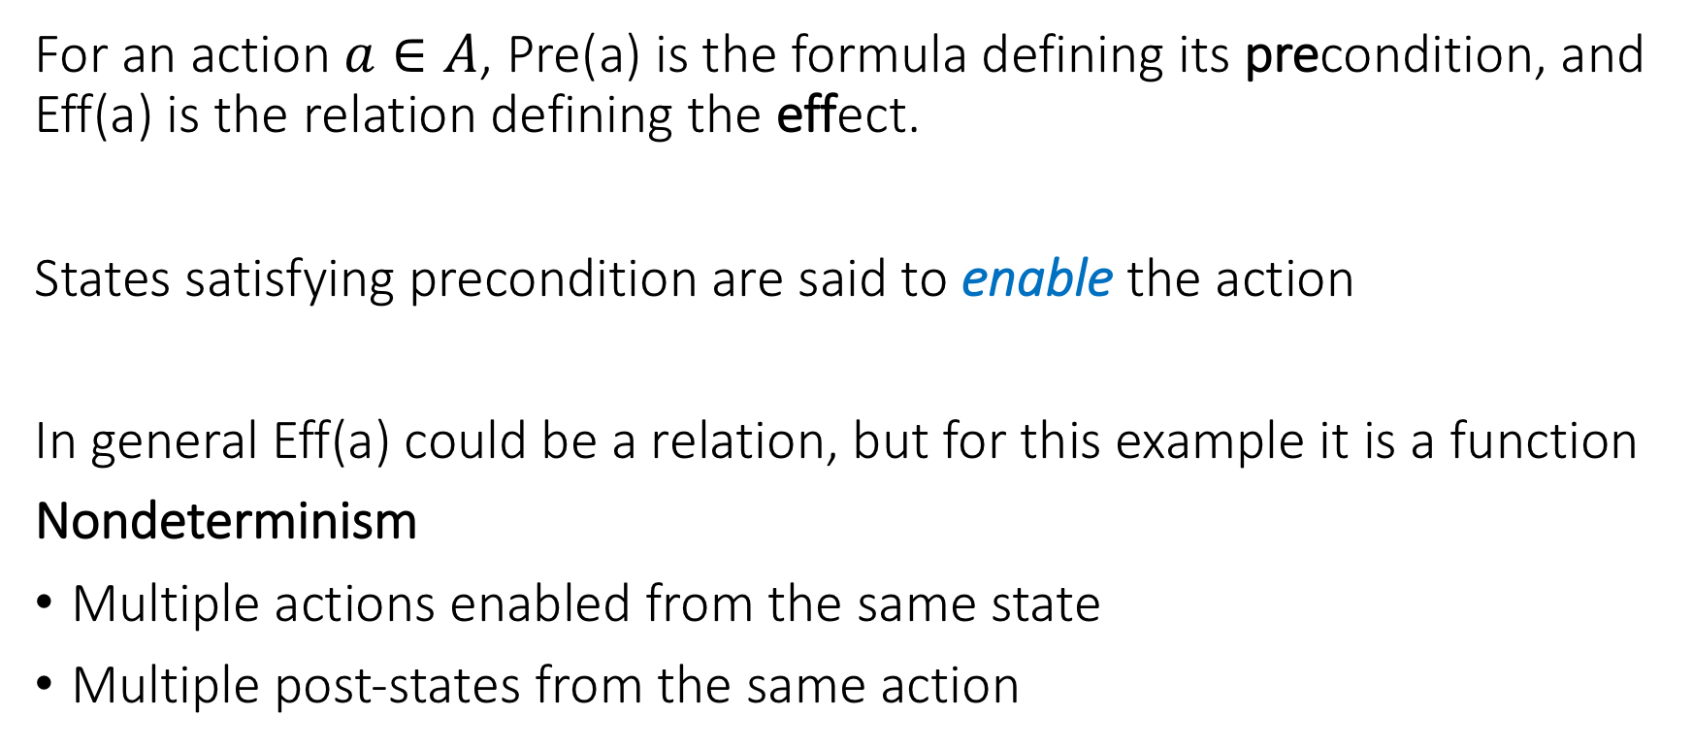
Nondeterminism
For an action $a∈A$, Pre(a) is the formula defining its precondition, and Eff(a) is the relation defining the effect.
States satisfying precondition are said to enable the action
In general Eff(a) could be a relation, but for this example it is a function
Nondeterminism
Multiple actions enabled from the same state
Multiple post-states from the same action

Slide 23
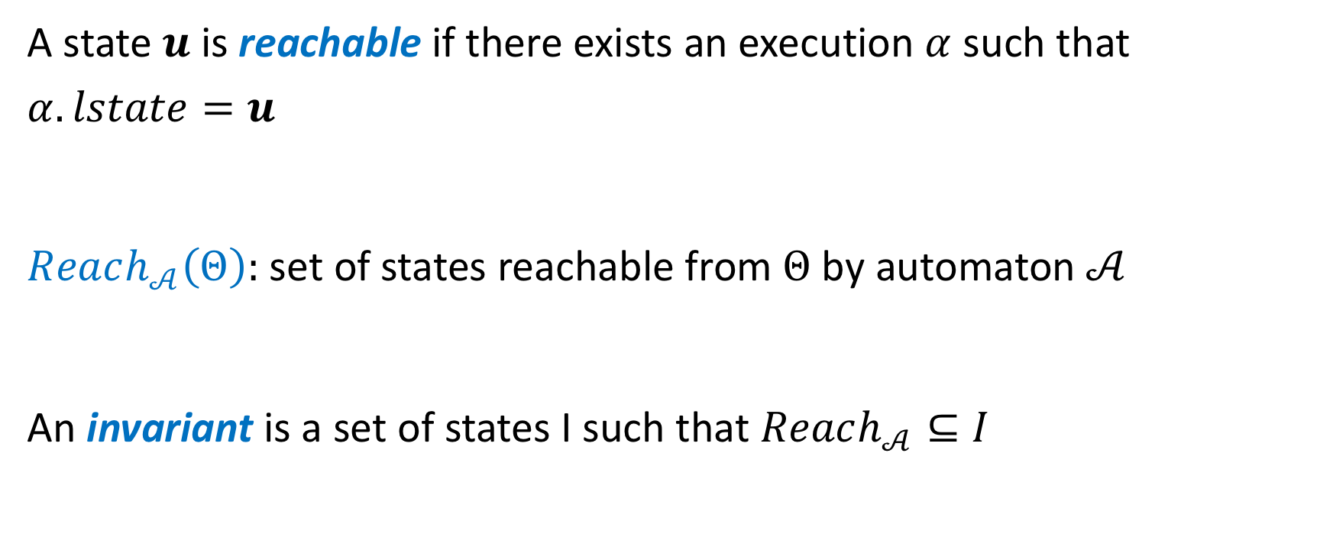
Reachable states and invariants
A state $u$ is reachable if there exists an execution $α$ such that $α.lstate=u$
$Reach_{𝒜}\left(Θ\right):$ set of states reachable from $Θ$ by automaton $𝒜$
An invariant is a set of states I such that $Reach_{𝒜}⊆I$

Slide 24





Candidate invariants for token Ring
For any automaton
val(X): All states e.g. $I_{3}$
$I_{1}$: “Exactly one process has the token”.
$I_{≥1}$: “At least one process has a token”.
$I_{3}$: “All processes have values at most K-1”.
Invariant e.g. $I_{1}$
$${Reach}_{𝒜}(u_{0})$$
$$u_{0}$$

Slide 25
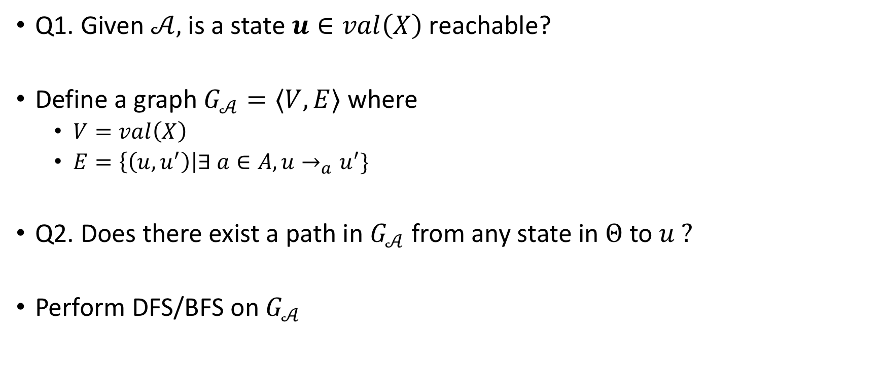
Reachability as graph search
Q1. Given $𝒜,$is a state $u∈val\left(X\right)$ reachable?
Define a graph $G_{𝒜}=〈V,E〉$ where
$V=val\left(X\right)$
$E=\left\{\left(u,u^{′}\right)\right|∃ a∈A, u→_{a}u^{′}\}$
Q2. Does there exist a path in $G_{𝒜}$ from any state in $Θ$ to $u ?$
Perform DFS/BFS on $G_{𝒜}$

Slide 26
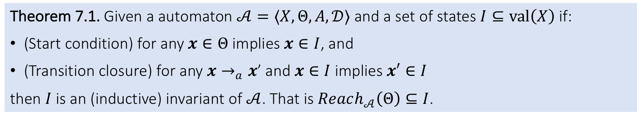
Proving invariants by induction (Chapter 7)
Theorem 7.1. Given a automaton $𝒜=〈X,Θ, A, 𝒟〉$ and a set of states $I⊆val\left(X\right)$if:
(Start condition) for any $x∈Θ$ implies $x∈I$, and
(Transition closure) for any $x→_{a}x$’ and $x∈I$ implies $x′∈I$
then $I$ is an (inductive) invariant of $𝒜$. That is $Reach_{𝒜}\left(Θ\right)⊆I$.

Slide 27

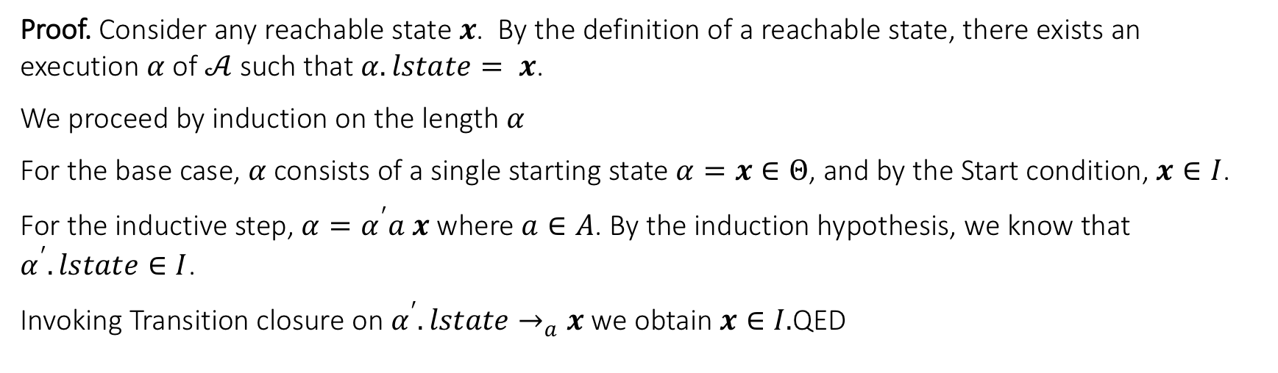
Proving invariants by induction (Chapter 7)
Theorem 7.1. Given a automaton $𝒜=〈X,Θ, A, 𝒟〉$ and a set of states $I⊆val\left(X\right)$if:
(Start condition) for any $x∈Θ$ implies $x∈I$, and
(Transition closure) for any $x→_{a}x′$ and $x∈I$ implies $x′∈I$
then $I$ is an (inductive) invariant of $𝒜$. That is $Reach_{𝒜}\left(Θ\right)⊆I$.
Proof. Consider any reachable state $x$. By the definition of a reachable state, there exists an execution $α$of $𝒜$such that $α.lstate= x$.
We proceed by induction on the length $α$
For the base case, $α$consists of a single starting state $α=x∈Θ$, and by the Start condition, $x∈I$.
For the inductive step, $α=α^{′}a x$ where $a∈A$. By the induction hypothesis, we know that $α^{′}.lstate∈I$.
Invoking Transition closure on $α^{′}.lstate→_{a}x$we obtain $x∈I.$ QED

Slide 28
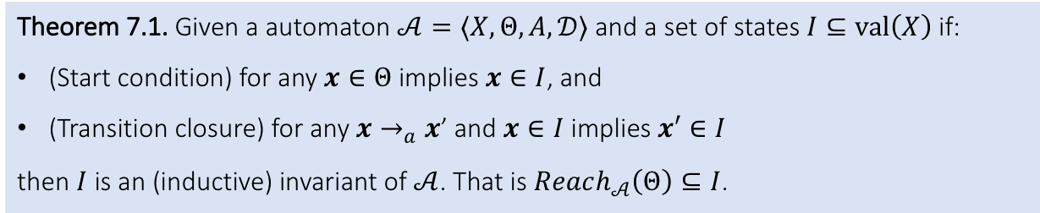
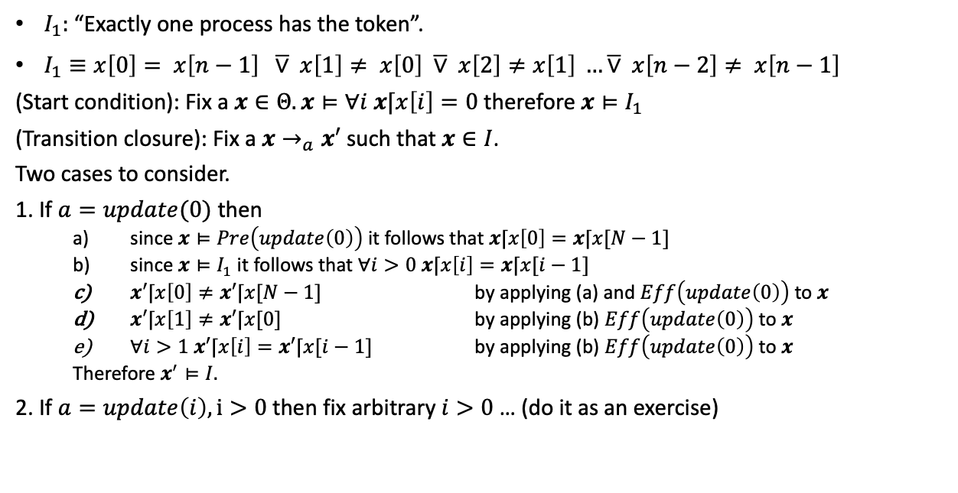
Proving invariants by induction for Dijkstra
Theorem 7.1. Given a automaton $𝒜=〈X,Θ, A, 𝒟〉$ and a set of states $I⊆val\left(X\right)$if:
(Start condition) for any $x∈Θ$ implies $x∈I$, and
(Transition closure) for any $x→_{a}x$’ and $x∈I$ implies $x′∈I$
then $I$ is an (inductive) invariant of $𝒜$. That is $Reach_{𝒜}\left(Θ\right)⊆I$.
automaton DijkstraTR(N:Nat, K:Nat), where K > N
type ID: enumeration [0,...,N-1]
type Val: enumeration [0,...,K]
actions
update(i:ID)
variables
x:[ID -> Val] initially forall i:ID x[i] = 0
transitions
update(i:ID)
pre i = 0 /\ x[i] = x[(N-1)]
eff x[i] := (x[i] + 1) % K
update(i:ID)
pre i >0 /\ x[i] ~= x[i-1]
eff x[i] := x[i-1]
$I_{1}:$“Exactly one process has the token”.
$I_{1}≡x\left[0\right]= x\left[n−1\right] \overline{∨} x\left[1\right]≠ x\left[0\right] \overline{∨} x\left[2\right]≠x\left[1\right] …\overline{∨} x\left[n−2\right]≠ x\left[n−1\right]$
(Start condition): Fix a $x∈Θ. x⊨∀i x⌈x\left[i\right]=0$ therefore $x⊨I_{1}$
(Transition closure): Fix a $x→_{a}x′$ such that $x∈I$.
Two cases to consider.
1. If $a=update(0)$ then
since $x⊨Pre\left(update\left(0\right)\right)$ it follows that $x⌈x\left[0\right]=x⌈x[N−1]$
since $x⊨I_{1}$ it follows that $∀i>0 x⌈x\left[i\right]=x⌈x[i−1]$
$x′⌈x\left[0\right]≠x′⌈x[N−1]$ by applying (a) and $Eff\left(update\left(0\right)\right)$ to $x$
$x′⌈x\left[1\right]≠x′⌈x[0]$ by applying (b) $Eff\left(update\left(0\right)\right)$ to $x$
$∀i>1 x′⌈x\left[i\right]=x′⌈x[i−1]$ by applying (b) $Eff\left(update\left(0\right)\right)$ to $x$
Therefore $x^{′}⊨I.$
2. If $a=update\left(i\right), i>0$then fix arbitrary $i>0$ … (do it as an exercise)
From above Theorem it follows that $I_{1}$ is an invariant of DijkstraTR

Slide 29
Discussion
What did we assume in arriving at the above conclusion?
What would we need to prove that statement automatically?

Slide 30
Reach as fixpoint of Post

Slide 31
Assignments
Read. Modeling computation: Chapter 2 of CPSBook, first part of Chapter 7, and section on SAT/SMT
Specification language: Appendix C of CPSBook
Narrow down project choices to 2 options
Next: Satisfiability

